Slide 1
Advancing LGBTQ+ Justice

Slide 2
Feedback

Slide 3

COMMUNITY AGREEMENTS
Awareness and Self-Knowledge
Listen for Understanding
Be Gracious
Stay Engaged
Be Open and Suspend Judgment
Say “I”- tell your truth
Seek Discomfort
Reach for Empathy
Expect non- Resolution and non-Closure

Slide 4

TODAY’S AGENDA
8:30 – 8:40 Morning Routine
8:40- 8:55 -- Shared Identity
8:55-9:35 – Workplace Issues
9:35- 10:00- Building Campaigns
10:00-10:40 -- Problems and Issues
10:40-10:55 - Break
10:55-11:30- Targets and Tactics
11:30-12:10pm – Group Work Time
12:10 -12:40 -- Presentation
12:40-1:00 – Goodbyes
1:00 -- Lunch - grab and go

Slide 5

Barb

Slide 6

SHARED IDENTITY
Gather around an identity of your choosing
Answer the following discussion questions:
Why did you select this piece of your identity?
What are some challenges of this identity?
Notes:
Ben 10:00-10:15
Post the following identities around the room:
High risk (day 3) – religious, spiritual, agnostic, survivor, immigrant, LGBTQ+, middle class
Participants will get up and gather around an identity of their choosing (2 min instructions), then they will answer the following discussion questions (8 min):
Why did you select this piece of your identity?
What are some challenges you face with this identity?
Share out/debrief (5 min)
What was something you learned about someone else
What was easy/hard about this activity?

Slide 7

More from our members!

Slide 8

SHARED IDENTITY
Debrief-
What was something you learned about someone else?
What was easy/hard about this activity?
How safe did you feel sharing in this activity?
Which of these identities are internal vs external?
Notes:
Ben 10:00-10:15

Slide 9
Bekah

Slide 10
SCENARIO: Supporting a Trans Educator
You are a Uniserv Director in a medium-sized conservative school district. A member reaches out to you and asks for your help. She explains to you that she is a returning employee who is transgender and began transitioning over the summer break. She is nervous about coming back in the fall and is asking for your help in navigating her return.
•What additional information would you need? How would you go about finding that information? What resources would you use or seek out?
•What would be your first steps?
•Knowing what we know now about transitioning and gender, what would you avoid doing?
15 minutes to answer the questions at your table.
One person from each group will report out on the questions.
10

Slide 11
DEBRIEF pg 37
What additional information would you need? How would you go about finding that information? What resources would you use or seek out?
What would be your first steps?
Knowing what we know now about transitioning and gender, what would you avoid doing?

Slide 12

KEY IDEAS
We don’t have to have all the answers immediately, but we have to know enough to find the information we need.
We need to follow the lead of the trans individual however, it would be best to have some ideas of steps that can be taken.
NEVER try to talk someone out of transitioning or question their decisions around their identity.

Slide 13
Michelle

Slide 14
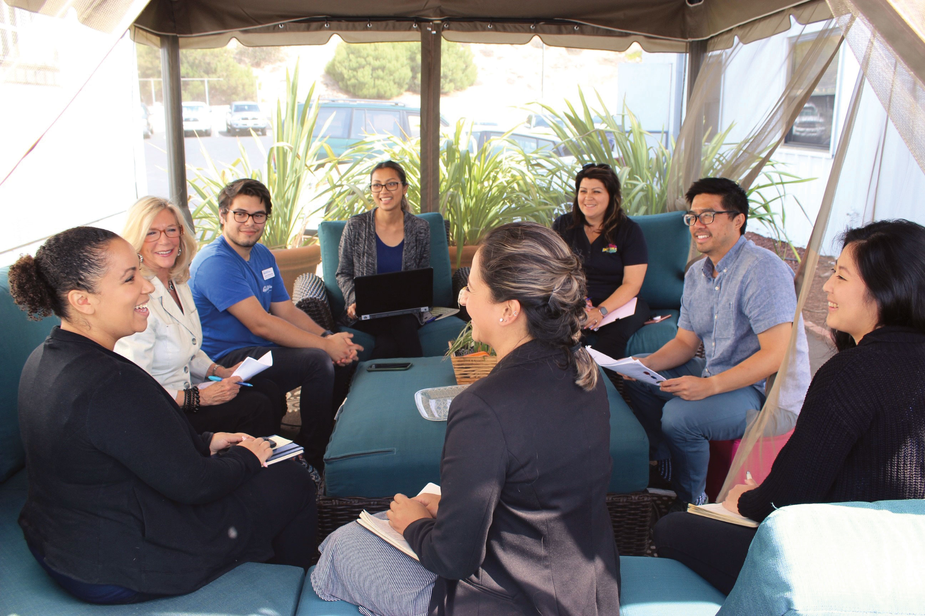
Pg 36-49 Building an equitable workplace
Family Meeting Time
Topic: Just how LGBTQ inclusive (or toxic?) is your workplace?

Slide 15

Content Warning
Content warning :
The next section discusses microaggressions commonly found in the workplace.

Slide 16


Building an equitable workplace
Microaggressions. They aren’t just about race.
Notes:
https://www.youtube.com/watch?v=Lh0Qw0THHAE

Slide 17
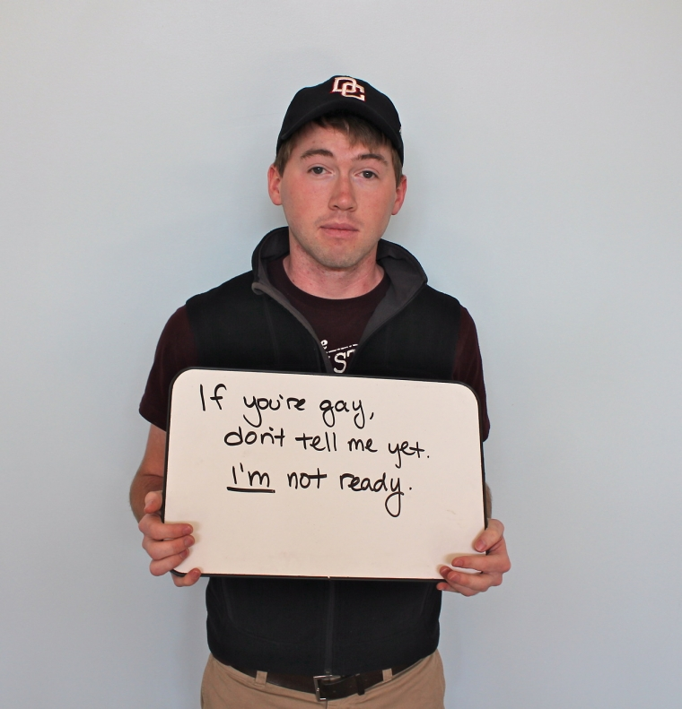
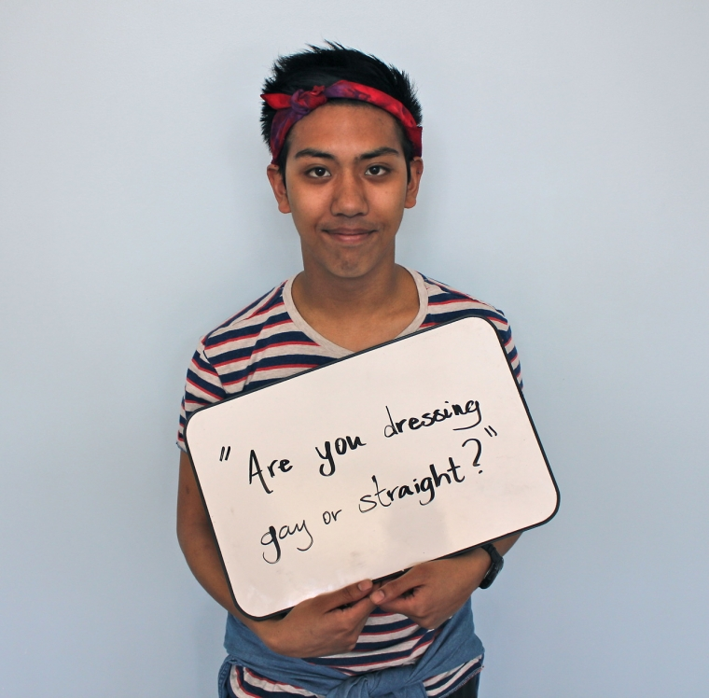
Building an equitable workplace
Microaggressions. They aren’t just about race.

Slide 18
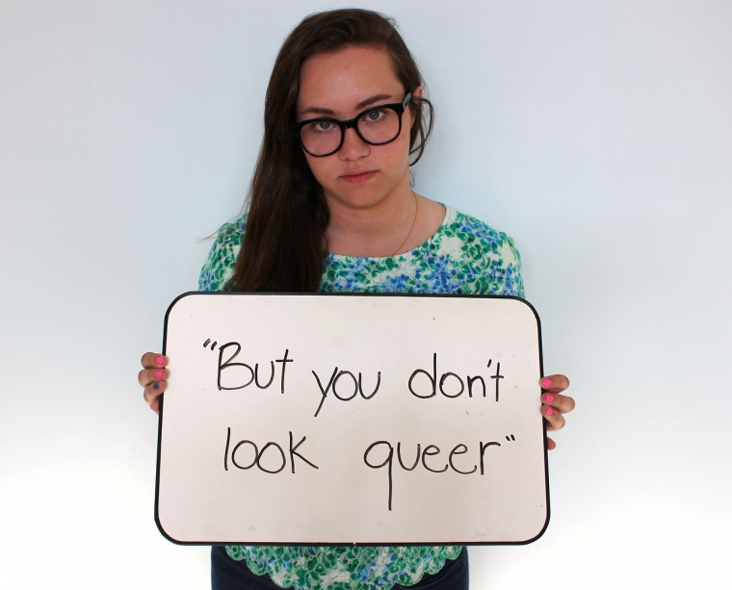
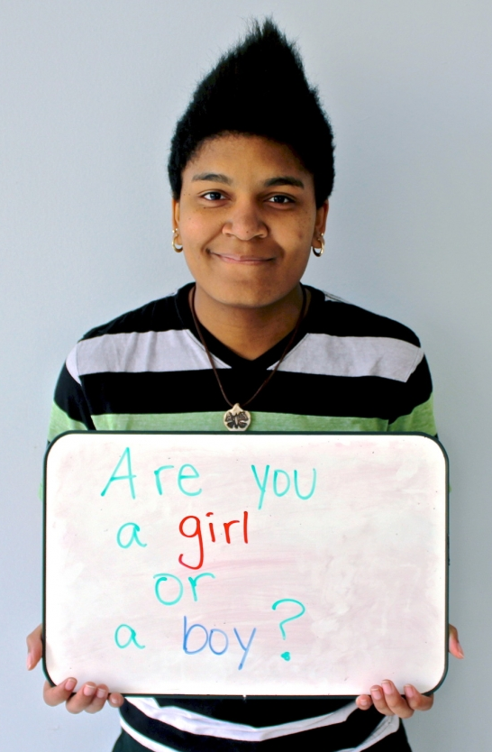
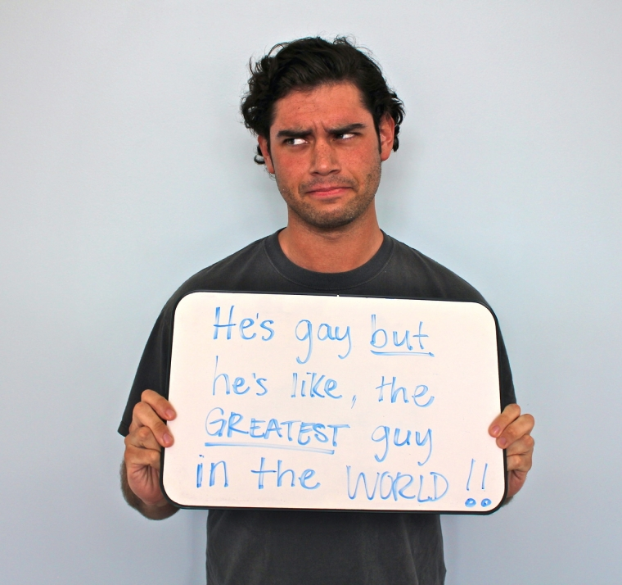
Building an equitable workplace
Microaggressions. They aren’t just about race.

Slide 19

Turn and Talk

Slide 20
Building an equitable workplace
TYPES OF
MICROAGRESSIONS

Slide 21

Building an equitable workplace
TYPES OF
MICROAGRESSIONS
"You don't look ________"
Assuming "man"/"woman" roles in queer relationships
excluding family members
"It's a lifestyle"
"No homo"
speaking for instead
of letting speak
Thinking you can
"turn" someone
Invasive body part(s) questions
"I don't use singular 'they'"

Slide 22
Building an equitable workplace
WHAT to do when you witness a microaggression:
Assess the situation: are you able to respond
  Environment
  Physical/Employment Safety
  Your own mental/emotional status
PAUSE. Breathe.
Ask the person to repeat what was said
  “I don’t understand the joke. Can you please repeat it so I can get what was funny?
  “Did you just say______?”

Slide 23
Building an equitable workplace
WHAT to do when you witness a microaggression:
4. Take control of the situation.
a. “I don’t find that funny.”
b. “That type of language/question makes me uncomfortable, particularly in the workplace.”
5. Offer a way to learn/grow (if you are in a place to do so with generosity, not passive aggressively).
6. Reflect: What information did you need to help educate the person OR to better understand the microaggression yourself?

Slide 24
Building an equitable workplace
Be aware of:
Context
Environment
Assessing whether or not the person directly affected wants the help or not.

Slide 25
Allyship means
Allyship is the use of personal PRIVILEGE and
proximity-to -power to advocate for change
Allyship is a verb not a self-proclaimed identity
Allyship is continuous
Allyship means checking in not saving the day
How do you incorporate allyship into your collegial and professional relationships?

Slide 26
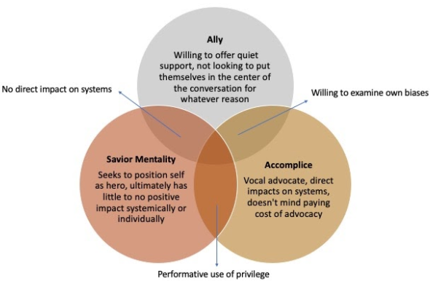
From Savior to Ally to Accomplice

Slide 27
Building an equitable workplace
Turn and Talk:
Describe a time when you witnessed a microaggression against the LGBTQ+ community at work.
How did you respond?
Do you wish you could have handled it differently?
What roadblocks exist to your most complete response?

Slide 28

Building an equitable workplace
What to do when YOU are called out ?

Slide 29
Building an equitable workplace
What to do when YOU are called out for a microaggression?
Apologize
  Without “if” or “but”
  context and excuse does not matter here
Make a commitment to be better in the future
Don’t expect forgiveness without earning it
Don’t apologize ad nauseum (it’s just weird).
Don't expect the person to let you out of it.

Slide 30

Building an equitable workplace
Brainstorm: How to deal with the religiously grounded aggression?
Take a few minutes with your table to discuss how to respond when the microaggression is vocally rooted in faith or religion.
Be prepared to share your table’s thinking.

Slide 31
Key Ideas
Everyone deserves to work in an environment that is free of vocal indignities.
We each have a role in responding to microaggressions when we witness them, if we are in a place to do so safely and responsibly.
If we are responsible for the microaggression, an apology combined with a commitment to be better is essential for moving forward.

Slide 32
Ben
Notes:
Likely to get cut out due to community groups coming to attend a panel discussion

Slide 33
BUILDING AN ORGANIZING CAMPAIGN

Slide 34
Selecting a Scenario
Take 2 minutes to review the Scenarios from the pre-attendance packet on pg 28.
Pick the scenario you want to work on!
Move to the table that corresponds to that scenario

Slide 35
Consider...
For the following scenarios, imagine you are in a state that has recently banned conversations about LBGTQ+ topics. What would you do?

Slide 36

BREAKOUT SESSION
What Would You Do?
Scenario #1: Member disciplined for student’s “about me” project which included pride flags
Scenario #2: Board policy issue and community outcry regarding treatment of transgender students
Scenario #3: Member disciplined for drag show on campus
36
Notes:
In small groups, invite participants to discuss what they would do in one of the following scenarios:
For the following scenarios, imagine you’re in a state that has recently banned conversation about LGBTQ+ topics. What would you do?
Scenario #1: In a US government class students begin discussing local elections. One student mentions a popular candidate’s LGBTQ+ status and other students began to chime in for a discussion. What would you do?
Scenario #2: During a group activity a kindergartner tells their peer a “secret” about their identity: they may look like a boy, but they’re really a girl.
Scenario #3: It’s bring your favorite book to school day, and a first-grader brings And Tango Makes Three, the true life story of a same-sex penguin couple who reside at the Central Park Zoo, to share with the class.

Slide 37
Why do you think that it is important that we address concerns around LGBTQ+ equity through an organizing model ?
(as opposed to relying solely on lawsuits and grievances?)

Slide 38
Why an Organizing Approach
Well-organized worksites and locals have a positive, visible presences
Members feel that they have the collective power to solve their problems and see themselves as responsible for the win – not a third party (UD, Lawyer, Lobbyist).
Builds power by continually increasing the amount of member leadership and ownership for the actions.
We cannot assume that the law/policy will always be on the side of LGBTQ+ equity!!!

Slide 39
What is an Organizing Campaign?
An action plan with a beginning, middle, and end, working towards a specific demand
•Involves a series of escalating actions (or tactics)
•Increases pressure on decision-makers
•Builds power by increasing engagement, developing leaders, and building capacity.
•Throughout the campaign we identify milestones that indicate we have enough power to try something more and something bigger and win!

Slide 40
Key Parts of an Organizing Campaign
•Issue
•Demand
•Target
•Tactics
•Escalation

Slide 41

Structure of a Campaign pg. 51

Slide 42
Bekah

Slide 43
STEP 1:
Issue

Slide 44
PROBLEM vs. ISSUE
Campaigns start with issues members care about.
An issue is a slice of a workplace problem.
Often a problem can have different issues depending on the perspective of the people we are working with.
It is KEY to get enough input on what the issues are that make up the problem so that YOU do not drive the solution.

Slide 45

PROBLEM vs. ISSUE

Slide 46
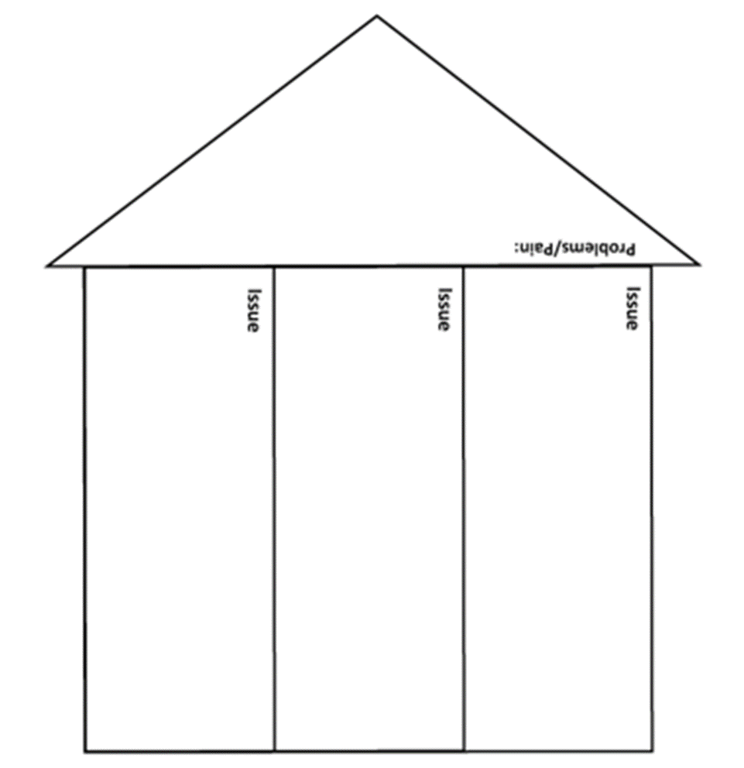
Issues are the small(er) actionable pieces that contribute to the larger problem
(Pg. 53)

Slide 47
EXAMPLE- Problem and Issue
PROBLEM -Our school is hostile to LGBTQ+ staff and students
◦ Issue – There are no gender inclusive bathrooms and/or transgender students are forced to use the wrong restroom
◦ Issue – Our healthcare and leave benefits do not cover non-“traditional” family structures or are not fully accessible to people with same-gender partners.
◦ Issue – Our administration forces us to “out” trans and queer students to their families.

Slide 48

SCENARIO WORK!
In your group, spend time identifying the potential “Issues” in your scenario.

Slide 49
Assessing our Issues pg 54
What makes a good issue:
It is widely felt and/or deeply felt.
It is winnable.
It builds the union and builds leaders.
It has a connection to students and the public.

Slide 50

Assessing our Issues Pg 54
Sample chart that can be used to assess our issues

Slide 51
SCENARIO WORK!
In your group, spend time evaluating your issue using the chart in the handouts.

Slide 52

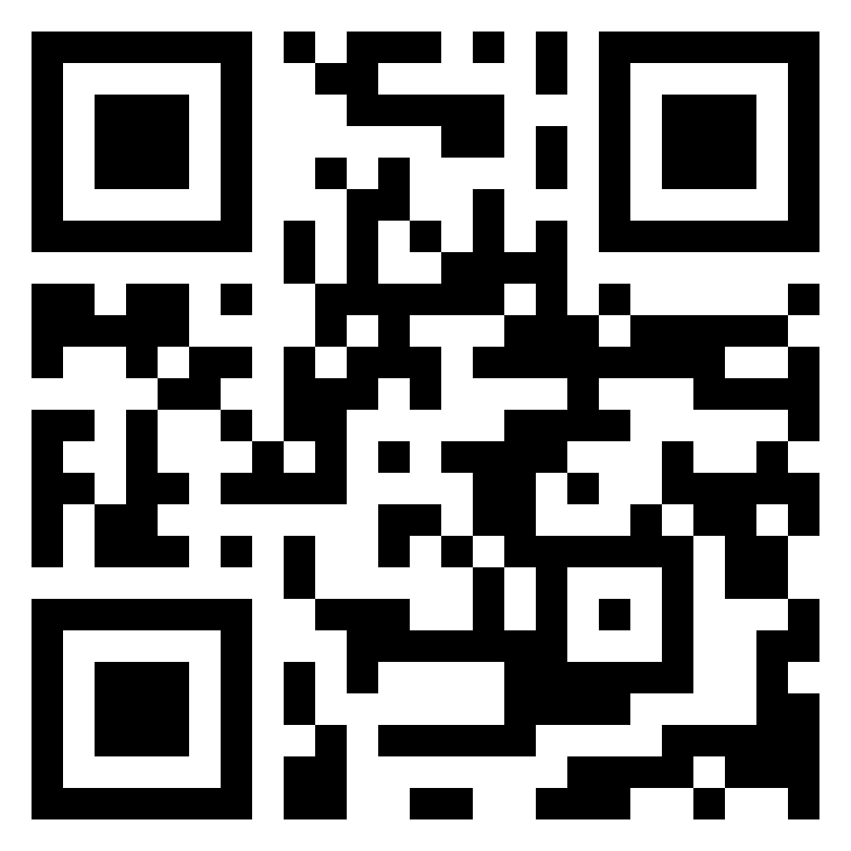
15 Minute Break!
During the break, continue our earlier conversation about intersectionality.
Check out the Human Rights Campaigns report
“Black and African American LGBTQ Youth Report” for more information about the challenges experienced by youth navigating multiple identities.

Slide 53
Grat & Ellen

Slide 54
STEP 2:
Demand

Slide 55
Demand:
A demand is the outcome that addresses the issue that you are making of a target.
Measurable
Achievable
“We demand gender affirming bathrooms in every school because all students need to feel safe and included in our schools. ”

Slide 56
STEP 3:
Target

Slide 57
Targets:
Is the person with the power to give you what you are demanding.
A single person:
a name, face, & address
“ Hey Superintendent Sam - We demand gender affirming bathrooms in every school because all our students need to feel safe and included in our schools ”

Slide 58
SCENARIO WORK!
In your group, decide the following:
• Issue
Revisit to make sure it's the one you want!
• Demand
What do you want to win (and why) to solve your issue?
• Target
Who has the power to give you your demand?
(feel free to make up names and titles if your scenario doesn’t have one!)

Slide 59
STEP 4:
Tactics

Slide 60
Tactics
Tactic: Actions you to take as a part of an escalation plan that increases pressure on your target to try to win your demand.

Slide 61
A Tactic Should
Puts pressure on your Target
(puts them out of their comfort zone)
Builds your Power
(develops leaders, brings more people in, etc.)
Is Strategic

Slide 62
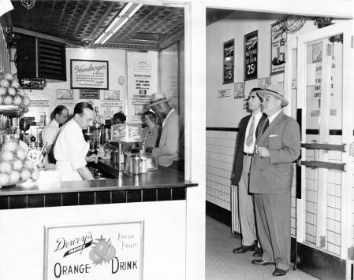
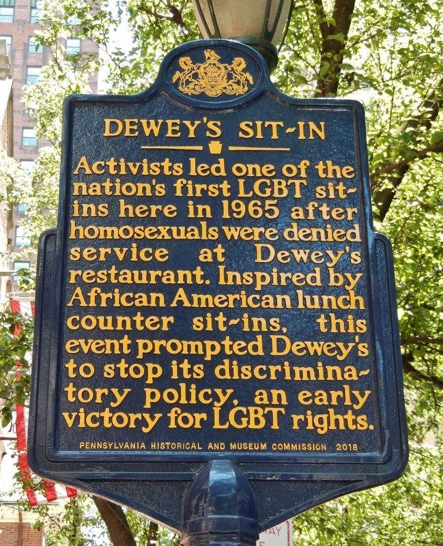
Historic LGBTQ+ Tactics

Slide 63
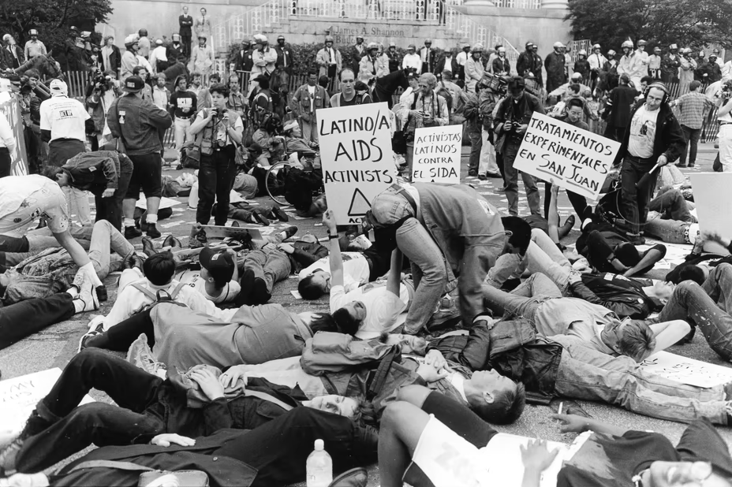

Historic LGBTQ+ Tactics
ACT UP!

Slide 64
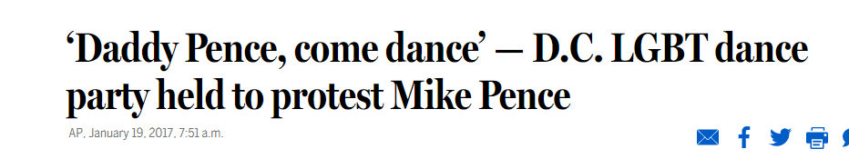

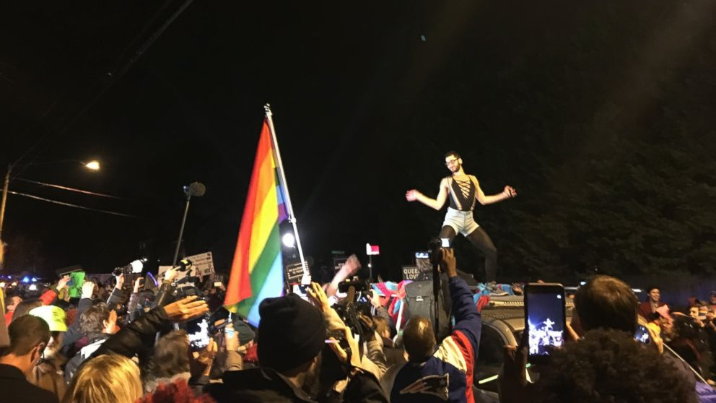
Historic LGBTQ+ Tactics

Slide 65
SCENARIO WORK!
TIME: 5 Minutes
TACTICS BRAINSTORM!
+++YOU HAVE 5 MINUTES!+++
Brainstorm AS MANY tactics as you can on 1 chart.
•Be creative!
•You are NOT evaluating right now! Everything goes on the board!

Slide 66
Evaluating Tactics
Does the action relate to your issue?
Will it increase the pressure on the decision-maker?
Is it visible?
Is it timed for effect?
Is it new and different—or tried and true?
Are enough people ready to do it?​
Will it unify people?​
How will management react?​
Does it violate the law? (If so, are we prepared for the consequences?)​
Will it be fun?

Slide 67
STEP 5:
Compression Points and
Escalation

Slide 68
Compression Points
Points on the calendar where you celebrate short term wins or escalate your tactics.
◦Naturally occurring deadlines- Breaks, Board Meetings
◦Artificial deadlines-target has till day X to act
◦Help us build urgency and crisis

Slide 69

Why do you think tactics escalate gradually?

Slide 70
Less escalated actions prepare our people for more escalated actions
Give the target the chance to do the right thing before things escalate
Use the threat of escalation

Slide 71
Ben

Slide 72
Group Work
TIME: 30 minutes
Build your campaign!
You have 30 minutes to build your campaign and be ready to present out! Make sure that you include at least…
Issue
Demand
Target
Tactics + Compression points in a campaign mountain!
Extra points if you include some messaging, graphics, hashtags, etc.

Slide 73
Jeny

Slide 74

Campaign Presentations!
Each group will have ____ to present their solution to their scenario.
Notes:
10:30-11:00

Slide 75
Ellen

Slide 76

LINGERING QUESTIONS
Anything you NEED to ask before leaving?
What feels VERY unsettled or confusing?
Notes:
11:00-11:30

