Slide 1
LGBT+ Infographics
Here is where this template begins

Slide 2
LGTB+ infographics
Venus
Venus is the second planet from the Sun
Mercury
The closest planet to the Sun and the smallest
Saturn
It’s composed mostly of hydrogen and helium
Mars
Despite being red, Mars is actually a cold place
Jupiter
It’s the biggest planet in the Solar System
Earth
Earth is the planet where we all live on

Slide 3
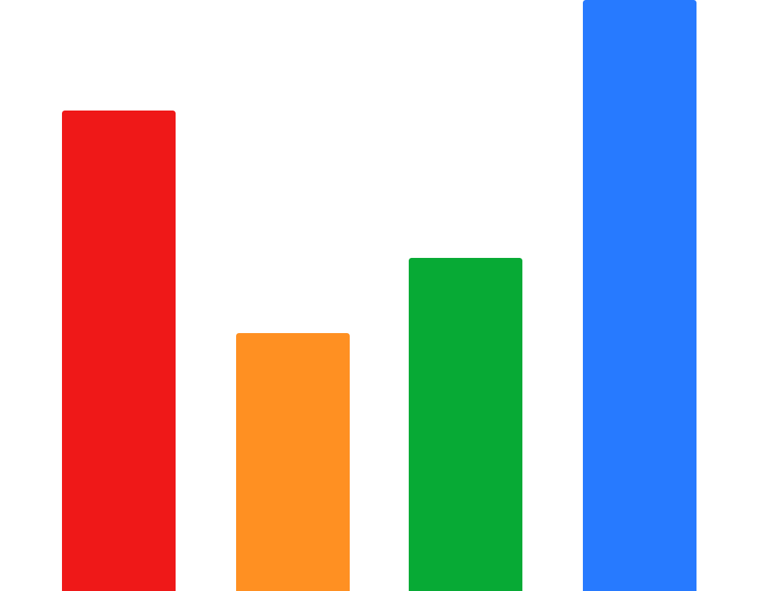
LGTB+ infographics
Jupiter is a gas giant and the biggest planet
Jupiter
75%
Venus is the second planet from the Sun
Venus
40%
Despite being red, Mars is a very cold place
Mars
50%
Mercury is the smallest planet of them all
Mercury
95%
Follow the link in the graph to modify its data and then paste the new one here. For more info, click here

Slide 4
LGTB+ infographics
Saturn
Mars
1
3
It’s composed of hydrogen and helium
Despite being red, Mars is a cold place
Neptune
Mercury
2
4
It’s the farthest planet from the Sun
It’s the closest planet to the Sun

Slide 5
LGTB+ infographics
Mars
Earth
Jupiter
Mars is a very very cold place
Earth is where we all live on
Jupiter is the biggest planet
Mercury
Venus
Saturn
Mercury is the smallest planet
Venus has a lovely name
Saturn is a ringed planet

Slide 6
LGTB+ infographics
Mercury
Jupiter
Mars
Earth
Venus
The closest planet to the Sun and the smallest one
Jupiter is the biggest planet in the Solar System
Despite being red, Mars is actually a very cold place
Earth is the beautiful planet where we all live on
Venus is the second planet from the Sun

Slide 7
LGTB+ infographics
Gay | Lesbian | Transexual | Bisexual | Intersexual | Heterosexual
Mercury is the closest planet to Sun. It’s hot | Venus is the second planet from the Sun | Saturn is a gas giant and has several rings | Neptune is the farthest planet from the Sun | Despite being red, Mars is a cold place | Jupiter is the fifth planet from the Sun. It’s big

Slide 8
LGTB+ infographics
Mercury
Earth
Jupiter
Venus
Mercury is the smallest planet
Earth is the planet where we live on
Jupiter is the biggest planet
Venus has a beautiful name

Slide 9
LGTB+ infographics
Jupiter
Earth
It is gas giant
and the biggest planet
Earth is the third planet from the Sun
Mercury
Neptune
It’s the closest planet to the Sun
It’s the farthest planet from the Sun

Slide 10
LGTB+ infographics
Mercury
The closest planet to the Sun and the smallest one
Venus
Venus is the second planet from the Sun
Saturn
It’s composed mostly of hydrogen and helium
Mars
Despite being red, Mars is actually a cold place
Jupiter
It’s the biggest planet in the Solar System
Earth
Earth is the planet where we all live on

Slide 11
LGTB+ infographics
Global laws regarding homosexual activity
Illegal
Female illegal
Male illegal
Ambiguous
Legal
Mercury is the smallest planet
Jupiter is the biggest planet
Despite being red, Mars is very cold
Earth is the planet where we all live on
Venus has a beautiful name

Slide 12
LGTB+ infographics
Mercury
Venus
It is the closest planet to the Sun and the smallest
It has a beautiful name and high temperatures
Jupiter
Earth
Jupiter is the fifth planet from the Sun
Earth is the third planet from the Sun

Slide 13
LGTB+ infographics
1949-1968
1969-1972
1973-1986
1987-2021
Jupiter is gas giant
and the biggest planet
Earth is the third planet from the Sun
It is the closest planet to the Sun
It’s the farthest planet from the Sun

Slide 14
LGTB+ infographics
Jupiter is the fifth planet from the Sun and the biggest one in the entire Solar System
1
Jupiter
Earth is the third planet from the Sun and the one that harbors life
2
Earth
It is the closest planet to the Sun and the smallest one in the Solar System
3
Mercury

Slide 15
LGTB+ infographics
Mercury
Venus
The closest planet to the Sun and the smallest one
Venus is the second planet from the Sun
Saturn
Mars
It’s composed mostly of hydrogen and helium
Despite being red, Mars is actually a cold place
Jupiter
Earth
It’s the biggest planet in the Solar System
Earth is the planet where we all live on

Slide 16
LGTB+ infographics
Mercury
Mercury is the smallest planet of them all
Jupiter
Jupiter is the biggest planet in the Solar System
Mars
Despite being red, Mars is a very cold place
Earth
Earth is the planet where we all live on
Saturn
Saturn is the ringed planet and a gas giant
Venus
Venus is the second planet from the Sun

Slide 17
LGTB+ infographics
L
G
B
T
Q
I
A
Lesbian
Gay
Bisexual
Trans
Queer
Intersex
Asexual
Mercury is a small planet
Mars is a very cold place
Saturn is a gas giant
Pluto is a dwarf planet
Earth is where we live on
Jupiter is the biggest one
Venus has a lovely name

Slide 18
LGTB+ infographics
Mercury
The closest planet to the Sun and the smallest one
Saturn
It’s composed mostly of hydrogen and helium
Jupiter
It’s the biggest planet in the Solar System

Slide 19
LGTB+ infographics
LGTB flag
Pansexual flag
Mercury is the closest planet to the Sun
Despite being red, Mars is actually a cold place
Lesbian flag
Asexual flag
Saturn is composed of hydrogen and helium
Earth is the planet where we all live on
Bisexual flag
Intergender flag
It’s the biggest planet in the Solar System
Venus has a beautiful name, but it’s hot

Slide 20
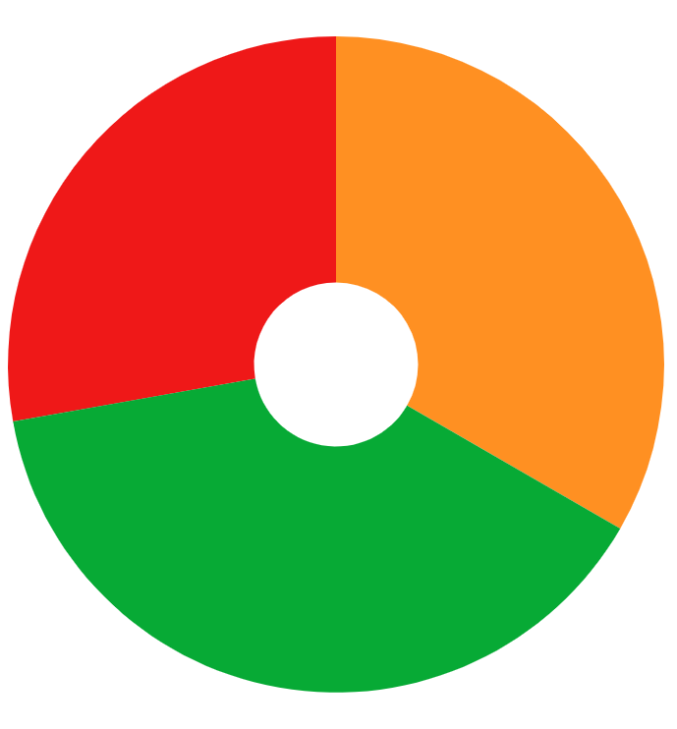
LGTB+ infographics
Jupiter
Jupiter is the fifth planet from the Sun and the biggest one
28%
33%
Venus
Venus has a beautiful name and also very high temperatures
39%
Earth
Earth is the third planet from the Sun and where we live on
Follow the link in the graph to modify its data and then paste the new one here. For more info, click here

Slide 21
LGTB+ infographics
Mercury
Saturn
Jupiter
Venus
Mars
Earth

Slide 22
LGTB+ infographics
Jupiter
Mercury
Earth
Jupiter is the biggest planet
It’s the smallest planet
Earth is where we all live on

Slide 23
LGTB+ infographics
Venus
Venus is the second planet from the Sun
Mars
Despite being red, Mars is a very cold place
Jupiter
It’s the biggest planet in the Solar System
Earth
Earth is the planet where we all live on

Slide 24
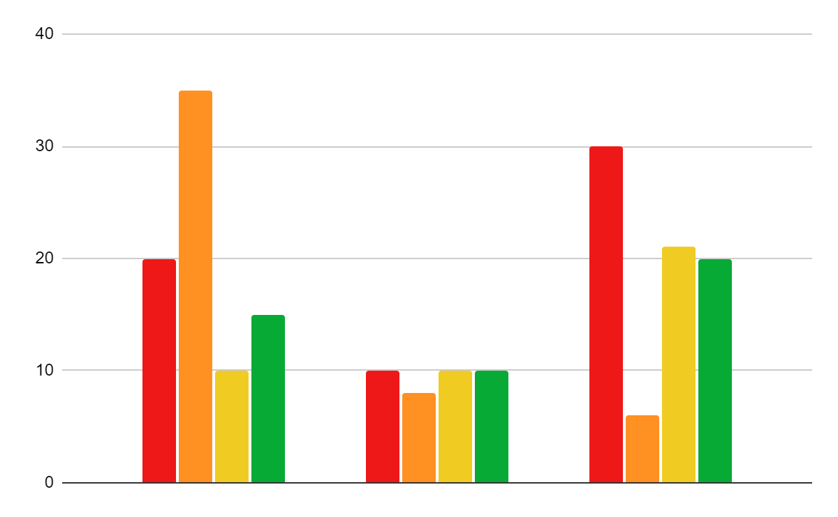
LGTB+ infographics
30K
35K
Mercury
Venus
Mercury is the closest planet to the Sun
Venus is the second planet from the Sun
22K
20K
Jupiter
Earth
Jupiter is the biggest planet of them all
2019
2020
2021
Earth is the planet where we live on
If you want to modify this graph, click on it, follow the link, change the data and replace it

Slide 25
LGTB+ infographics
65%
35%
Mars
Jupiter
Saturn
Mercury
Despite being red, Mars is a very cold place full of iron oxide dust
Jupiter is the fifth planet from the Sun and the biggest one
Saturn is composed mostly of hydrogen and also of helium
It is the closest planet to the Sun and also the smallest one

Slide 26
LGTB+ infographics
Jupiter
Mercury
Jupiter is the fifth planet from the Sun and the biggest of them all
It is the closest planet to the Sun and the smallest one in the Solar System

Slide 27
LGTB+ infographics
Venus
Mars
Earth
Venus is the second planet from the Sun
Despite being red, Mars is a cold place
Earth is the planet where we all live on
Year 1
Year 2
Year 3
Year 4
Year 5
Year 6
Mercury
Saturn
Jupiter
Mercury is the closest planet to the Sun
Saturn is a gas giant and has several rings
It’s the biggest planet in the Solar System

Slide 28
LGTB+ infographics
Mercury
Venus
Saturn
Mars
It is the closest planet to the Sun and the smallest one
Venus has a beautiful name and also very high temperatures
Saturn is composed mostly of hydrogen and also of helium
Despite being red, Mars is a very cold place full of iron dust

Slide 29
LGTB+ infographics
Mercury
Mars
Mercury is the closest planet to the Sun and the smallest one
Mars is actually a cold place. It’s full of iron oxide dust
Venus
Jupiter
Venus has a beautiful name, but it’s even hotter than Mercury
Jupiter is a gas giant and the biggest planet in the Solar System

Slide 30
LGTB+ infographics
Life
It is the closest planet to the Sun
Healing
It is the second planet from the Sun
Sunlight
Saturn is composed mostly of hydrogen
Nature
Mars is actually a very cold place
Serenity
It’s the biggest planet of them all
Spirit
Earth is the planet where we all live on

Slide 31
LGTB+ infographics
65%
Mercury
Mercury is the closest planet to the Sun and the smallest one in the Solar System
60%
Venus
Venus has a beautiful name and is the second planet from the Sun. It's terribly hot
45%
Saturn
Saturn is a gas giant and has several rings. It's composed mostly of hydrogen and helium
35%
Mars
Despite being red, Mars is actually a very cold place and it's full of iron oxide dust

Slide 32
Instructions for use (free users)
In order to use this template, you must credit Slidesgo by keeping the Thanks slide.
You are allowed to:
Modify this template.
Use it for both personal and commercial purposes.
You are not allowed to:
Sublicense, sell or rent any of Slidesgo Content (or a modified version of Slidesgo Content).
Distribute this Slidesgo Template (or a modified version of this Slidesgo Template) or include it in a database or in any other product or service that offers downloadable images, icons or presentations that may be subject to distribution or resale.
Use any of the elements that are part of this Slidesgo Template in an isolated and separated way from this Template.
Delete the “Thanks” or “Credits” slide.
Register any of the elements that are part of this template as a trademark or logo, or register it as a work in an intellectual property registry or similar.
For more information about editing slides, please read our FAQs or visit Slidesgo School:
https://slidesgo.com/faqs and https://slidesgo.com/slidesgo-school

Slide 33
Instructions for use (premium users)
In order to use this template, you must be a Premium user on Slidesgo.
You are allowed to:
Modify this template.
Use it for both personal and commercial purposes.
Hide or delete the “Thanks” slide and the mention to Slidesgo in the credits.
Share this template in an editable format with people who are not part of your team.
You are not allowed to:
Sublicense, sell or rent this Slidesgo Template (or a modified version of this Slidesgo Template).
Distribute this Slidesgo Template (or a modified version of this Slidesgo Template) or include it in a database or in any other product or service that offers downloadable images, icons or presentations that may be subject to distribution or resale.
Use any of the elements that are part of this Slidesgo Template in an isolated and separated way from this Template.
Register any of the elements that are part of this template as a trademark or logo, or register it as a work in an intellectual property registry or similar.
For more information about editing slides, please read our FAQs or visit Slidesgo School:
https://slidesgo.com/faqs and https://slidesgo.com/slidesgo-school

Slide 34
Infographics
You can add and edit some infographics to your presentation to show your data in a visual way.
Choose your favourite infographic and insert it in your presentation using Ctrl C + Ctrl V or Cmd C + Cmd V in Mac.
Select one of the parts and ungroup it by right-clicking and choosing “Ungroup”.
Change the color by clicking on the paint bucket.
Then resize the element by clicking and dragging one of the square-shaped points of its bounding box (the cursor should look like a double-headed arrow). Remember to hold Shift while dragging to keep the proportions.
Group the elements again by selecting them, right-clicking and choosing “Group”.
Repeat the steps above with the other parts and when you’re done editing, copy the end result and paste it into your presentation.
Remember to choose the “Keep source formatting” option so that it keeps the design. For more info, please visit Slidesgo School.

