Slide 1
Speak Up & Speak Out! East
Day 2
Washington DC
Center for Racial and Social Justice
Human and Civil Rights Department

Slide 2
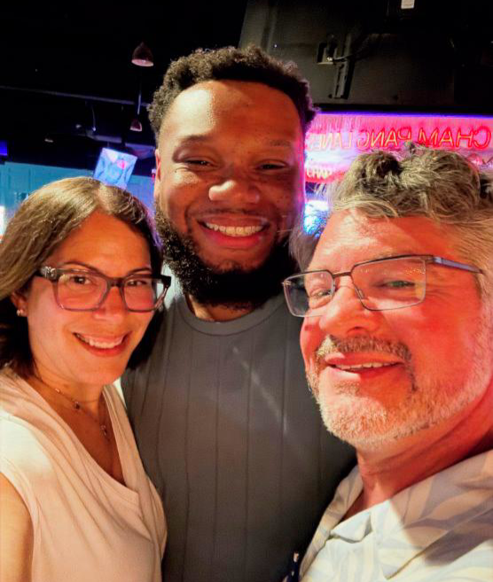
Greetings from Your Presentation Team
Albert Jones (he/him), MSEA
Matt Fargen (he/him), PSEA
Linda Torres (she/her), PSEA

Slide 3
Core Values
Core values are the fundamental beliefs of a person. These guiding principles dictate behavior and can help people understand the difference between right and wrong – These can often be expressed using one or two words.

Slide 4

Core Values
Report out:
Name
Pronouns
State Affiliate
CORE VALUE

Slide 5

Session OUtcomes
We will leave this training with a campaign plan that works for you.
In the process we will discuss and examine scenarios to:
Identify Key Issues and Problems
Design Strategic Actions
Build Power through Organizing
Develop Structures to Win

Slide 6
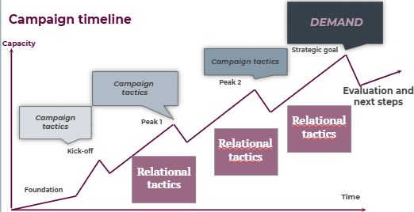
Key Parts of an IssuE Campaign
Problem and Issue
Power Analysis
Target
Demand
Strategy and Tactics
Escalation

Slide 7
Key Practices of Campaign Planning
Uses a series of planned actions that build on one another to solve a specific problem and win your campaign goal.
Increases pressure on the people with the power to make the decision until they act on your demand.
Builds your group's power by engaging more people, developing new leaders, and bringing people together around shared values and a common vision.
Sets clear milestones to help you know when you've built enough power to take bigger actions and ultimately win your campaign.

Slide 8
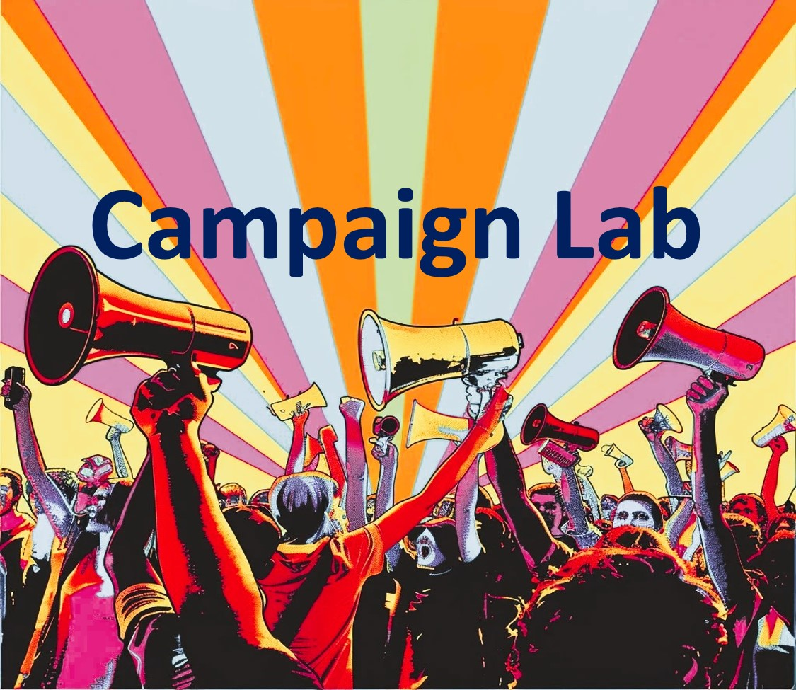

Information and Application

Slide 9
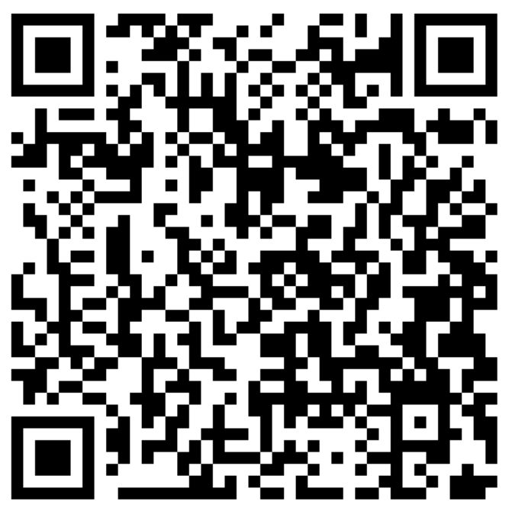
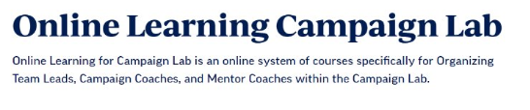
Online Learning Opportunities

Slide 10
Highest Hopes
Matt

Slide 11

If you had all the power you needed, what is the world you and your union would create?

Slide 12
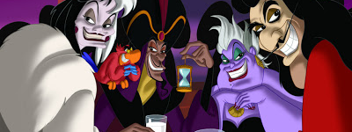
What or Who is preventing you from achieving this vision?

Slide 13
Three Theories of Change
Linda

Slide 14
Three Theories of Change
Advocacy
“Advocacy is the work of creating change through the actions of professionals or technical experts—lobbyists, pollsters, lawyers, communication specialists, researchers. Advocacy relies on the expertise, status, and know-how of these groups of people to make change. Advocacy usually happens in a closed-door room; ordinary people play a small to nonexistent role in its efficacy. Advocacy has become a dominant strategy for unions and liberals.”
Mobilizing
“Mobilizing, by contrast, activates an already-convinced membership. Mobilizing encourages those who already support a cause or a mission to take action to defend their belief—for example, by attending a protest, wearing a button, or signing a petition.”
Organizing
“To organize is to build mass support and strength among ordinary people. Organizing draws its power from working people’s biggest strength: our numbers. The work of organizing is systematic and rigorous: It requires connecting with every single worker in a shop, every educator in a building, every building in a district. At its core, it asks people to understand their own agency and to make choices about how they will exercise it.”

Slide 15
Read and Notice
Which words/ideas stand out in each theory?

Slide 16
Three Theories of Change
Advocacy
“Advocacy is the work of creating change through the actions of professionals or technical experts—lobbyists, pollsters, lawyers, communication specialists, researchers. Advocacy relies on the expertise, status, and know-how of these groups of people to make change. Advocacy usually happens in a closed-door room; ordinary people play a small to nonexistent role in its efficacy. Advocacy has become a dominant strategy for unions and liberals.”
Mobilizing
“Mobilizing, by contrast, activates an already-convinced membership. Mobilizing encourages those who already support a cause or a mission to take action to defend their belief—for example, by attending a protest, wearing a button, or signing a petition.”
Organizing
“To organize is to build mass support and strength among ordinary people. Organizing draws its power from working people’s biggest strength: our numbers. The work of organizing is systematic and rigorous: It requires connecting with every single worker in a shop, every educator in a building, every building in a district. At its core, it asks people to understand their own agency and to make choices about how they will exercise it.”

Slide 17

Table Talk
Which of these theories is most prevalent in your affiliate?
Which of these theories will build the power you need to achieve the BIG dreams you have for your affiliate?

Slide 18
Bring it to the room:
How you approach making the change you want to see will shape the culture, impact, and effectiveness of your affiliate.
How do you move your affiliate from one theory of change to another?

Slide 19

Moving towards Organizing Starts With YOU
Notes:
So, if we remember the first part of our Organizing definition: Organizers identify, recruit and develop leadership – I want to give you three structures to consider. As we move through these structures, keep track of where the power is and what your job would look like in each of these structures.

Slide 20
Leaders Across these Theories
In the next slides, you will see illustrations of leadership structures.
The lines represent relationships, resources, communication, and connectivity.
The circles represent people with accountability, responsibility, and knowledge.
Pay attention to WHERE the connections flow and fail, and where it is critical.

Slide 21
The superintendent is SO AFRAID of our union president!
Dependent
If I go on leave, it will all fall apart!
“I am the leader; everybody comes to me”

Slide 22
Independent
“We are all leaders” / No leader

Slide 23
“We are all leaders” / No leader

Slide 24

Stages of Interdependent

Slide 25

Stages of Interdependent
Distributed leadership

Slide 26
Interdependent, maximized
A small number of sustainable relationships
Capacity for exponential growth
Distributed Leadership
The Snowflake Model

Slide 27
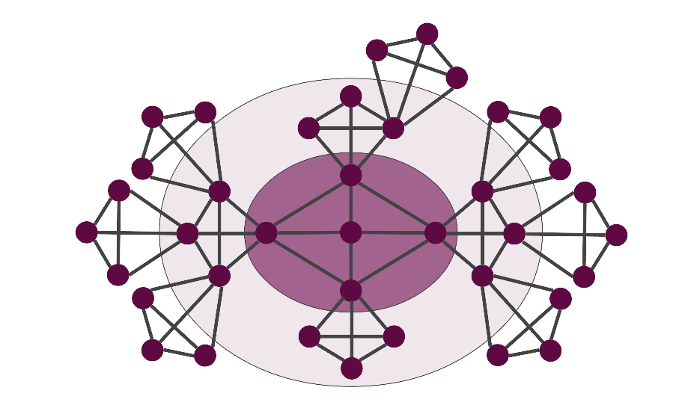
In each of these models, who holds the accountability and responsibility is different.
Remember, we build the most power when the members are accountable to one another and are responsible for the actions necessary to build that power.
If we (leaders) hold the responsibility and are the only ones held accountable, the members are not building power to address the issues that are important.
Notes:
Leaders who try to do everything for everyone set themselves up to be THE single point of power and when they leave the structure falls apart. Leaders who ONLY work with “the already willing” only continue the status quo – to grow you have to continually reach out and include others – invite them to do something not simply come to something you have developed- Leaders who are organizing are constantly making room for new people and allowing them to lead – taking in new ideas and building new work together.
In each of these models, who holds the accountability and responsibility is different.
Remember, we build the most power when the members are accountable to one another and are responsible for the actions necessary to build that power.
If we hold the responsibility and are the only ones held accountable, the members are not building power to address the issues that are important.

Slide 28
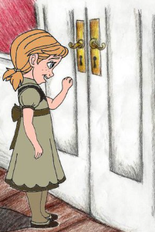
The Basic Skills of Organizing
Curious about others' issues
Ask good questions: don't fix all the problems
Listen 80%- Talk 20%
Be in a positive, public relationship with 75% of the members in your unit
Notes:
There some basic ideas, skills, and methods you need for this move
Basic Skills -- You need to know how to be
Curious about others issues
Asks Good Questions does not Tell Solutions
Listen 80%- Talk 20%
Be in a positive, public relationship with 75% of the members in your unit

Slide 29
The Organizing Basic Methods
One-to-Ones
Member Mapping
Member Lists
Data Collection
Team Coaching
Notes:
Basic Methods to Learn to Use Consistently
One on One’s
Worksite Mapping
Member Lists
Data Collection
Team Coaching

Slide 30

Key Ideas
Organizing is how we create the future we want to see. (Achieving our greatest hopes)
Creating lasting change requires more than good ideas or quick actions. It requires changing how we approach the work.
Real power comes from strong relationships. When members are connected to one another and working together across the affiliate, they build the collective power needed to win meaningful change and create a better future.

Slide 31

BREAK

Slide 32
Special Guest
Robert Rodriguez
NEA Secretary/Treasurer-Elect

Slide 33
Organizing, Power, and Campaigns
Matt

Slide 34
definitions
ORGANIZING IS:
  Identifying leaders and coordinating them into leadership teams
  Building community and commitment around common goals
  Building power from the resources of that community
  Using that power strategically to make concrete change in the world
Notes:
While organizing can be defined a number of ways, for today this is the one we are going to use.
Organizing is identifying leaders and coordinating them into leadership teams; Building community and commitment around common goals; Building power from the resources of that community; Using that power strategically to make concrete change in the world.
Take 5 minutes with your table and identify words and phrases in this definition that stand out to you.

Slide 35



Slide 36
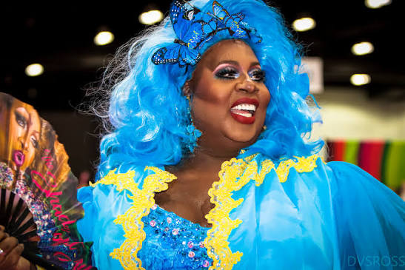


Who is powerful?
What makes them powerful?
Notes:
Facilitator note - Take all ideas – affirm and lift up any ideas about getting others to act, having control of money, can enact decisions, etc. Then move to defining power and make connections from the content to the people on the list as appropriate. (ex. President Trump might relate to the content about values affecting the way power is used)

Slide 37
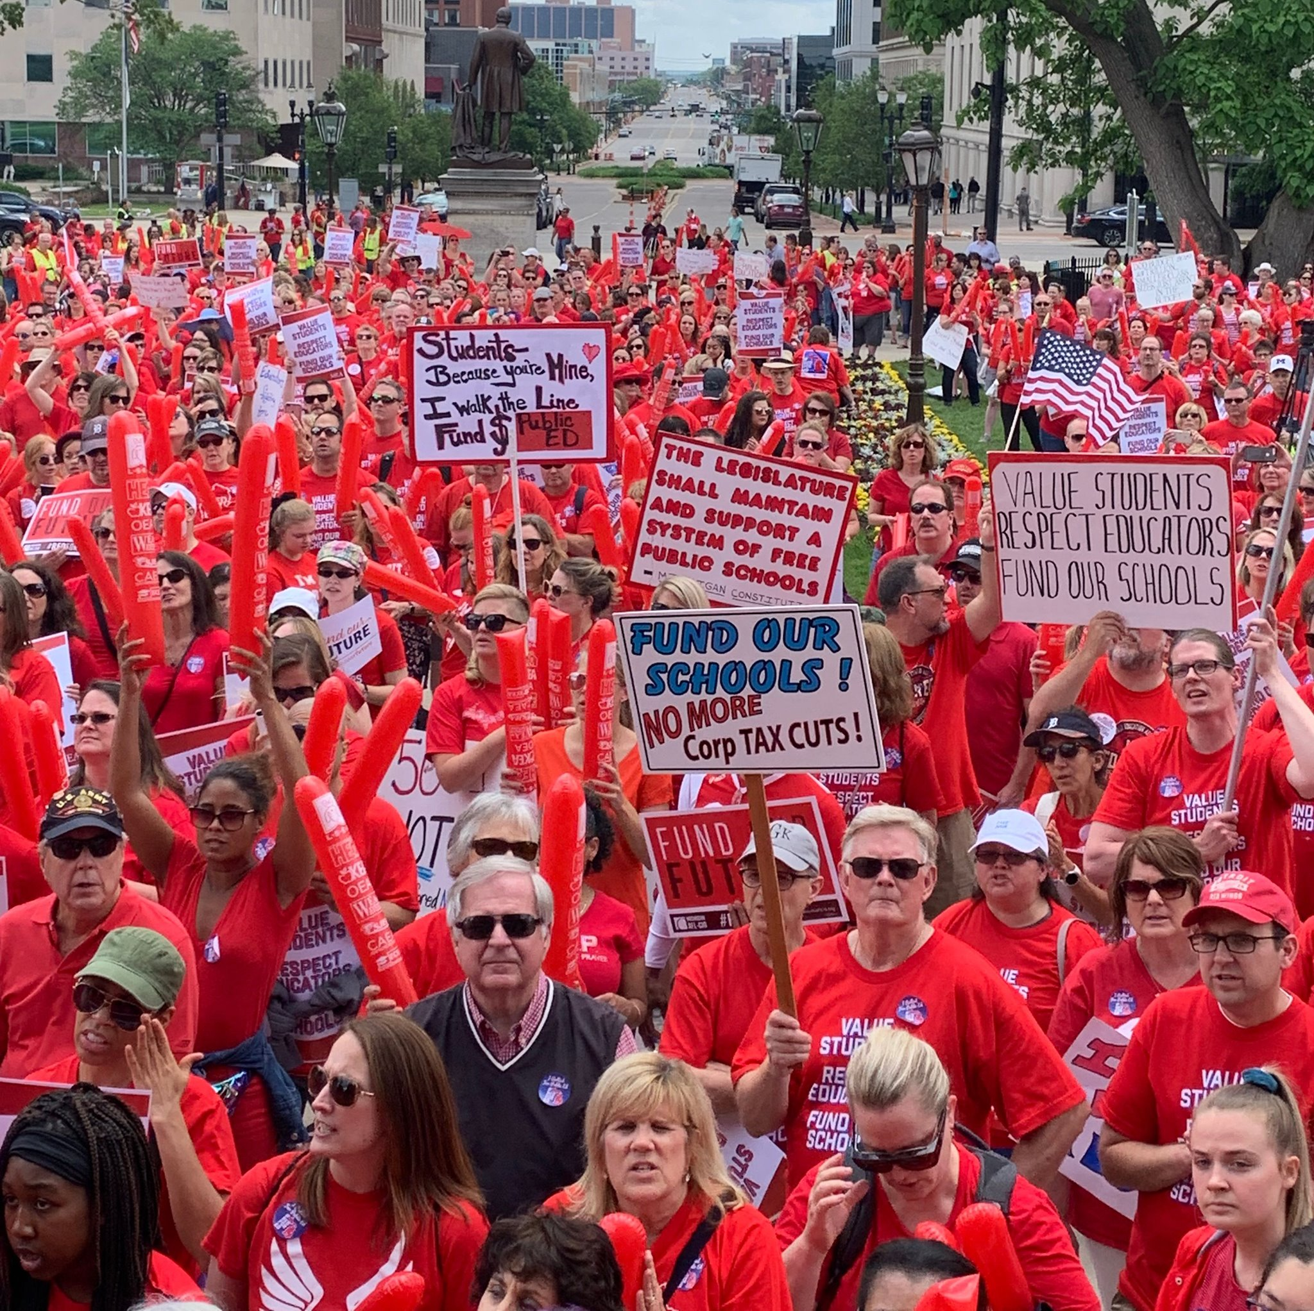

DEFINING POWER
Power is the ability to control, create, and/or prevent change.
Power is organized people and organized resources (money).
Power is not static, it is either waning or growing.
Notes:
Definition of power
Power is the ability to create, control, and prevent change.
Power is made up of organized people and organized resources
Power is not static, it is either growing or waning.

Slide 38
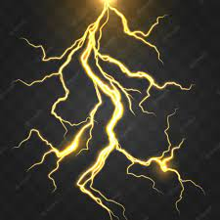
UNDERSTANDING POWER
Power "just is." It can be good. It can be bad.
Our values affect the way we use power
Notes:
Power is neutral. Power is simply the ability to make change. Society has biased our beliefs and feelings about who should have and how they should use power – but ultimately power is neutral – we bring all our feels and biases to that.
Our values affect the way we use power. If we are in relationship with people with a certain set of values we would find it easier to risk our resources and personal agency to advance an agenda based on our shared values. Power of the people is always grounded in our values and relationships.

Slide 39

TRUTHS ABOUT BUILDING POWER
Power must be consistently built and reinforced or it is waning
Not everyone wants us to have power (some people are paid to take our power away and some even do it for free)
Public actions through shared vision, shared purpose, shared resources, shared risk, and unity is how we build power
The bigger the win you want– the more power you need
Building power requires interdependency
Notes:
Truths About Building Power
Power has to be consistently built or it is waning
Not everyone wants us to have power and will actively work to take our power away
Public actions through shared vision, shared purpose, shared resources, shared risk, and unity is how we build power
The bigger the win – the more power you need
Building power requires leadership

Slide 40

MEASURING OUR POWER
We measure power by our ability to wage campaigns and win campaigns. Those campaigns bring concrete improvements to people’s lives and lead us toward social, racial, and economic justice.
Notes:
We measure power by our ability to wage and win campaigns that bring concrete improvements to people’s lives and lead to social, racial, and economic justice.

Slide 41
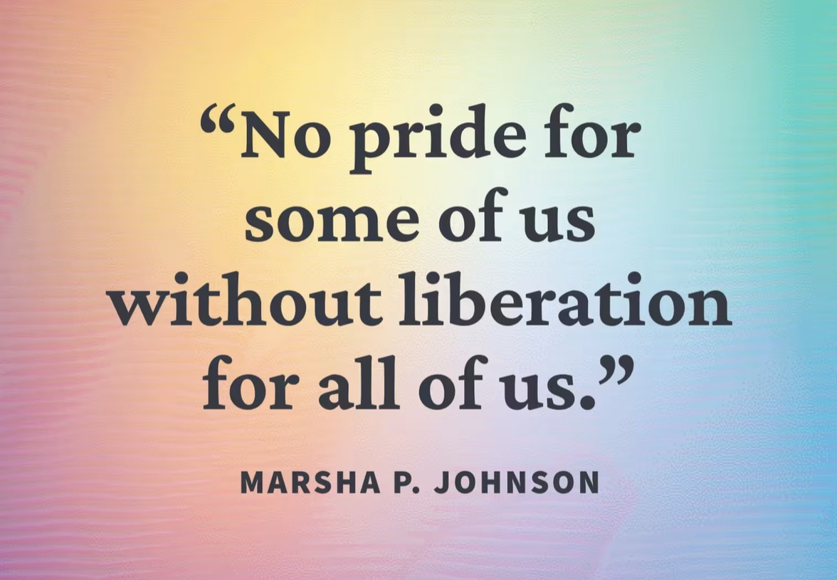
What do you think a campaign is?
Notes:
Defining Campaigns (Turn and Talk and Lecture)
Turn and talk to the person next to and say the first thing you think of when asked – What do think a campaign is?

Slide 42


An issue campaign is
the process through which
the workers organize around
leaders and structures to use their
resources in accomplishing goals that
achieve the change they need and want.
It is public. It involves risk.
It results in the story being about
the workers.
--Marshall Ganz

Slide 43

So, how do we assess if an issue campaign has built our power?

Slide 44
Strength AND Growth
Achieving public actions and accomplishing campaign demands are a show of your strength.
Issue campaigns ALSO grow membership, engagement, and leadership experience. This is how you measure your growth.
You support local leader teams making campaign plans to ensure these experiences are successful and grow unifying relationships through positive public actions for members and leaders.

Slide 45
Key Ideas
Issue Campaigns, when they are designed well, result in the ability to achieve wins that make a positive, concrete difference in the lives of workers.
Issue Campaigns develop good and effective leaders, results in positive engagement of members, builds trust, and grows the solidarity that we need in your movement to build the world you want to see.

Slide 46
Building a Campaign-Scenario Work
Albert

Slide 47
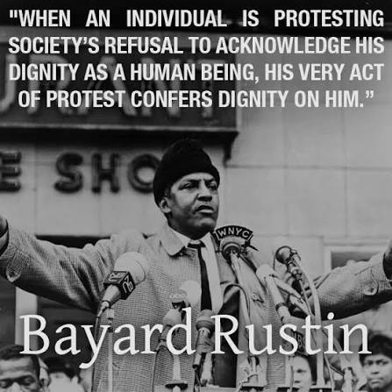
Key Parts of an Issue Campaign
Problem and Issue
Power Analysis
Target
Demand
Strategy and Tactics
Escalation
Notes:
There are six main parts to building a campaign. We are going to go through each-
Problem and Issue - The problem and issue is the spark! Why we are coming together, why we want a contract etc.
Power Analysis – What power do the decision makers have? Who has power over them? What power do we have?
Target- Who has the power to make a change? Who is the PERSON who can make the change.
Demand - What needs to be changed? By when? By who?
Strategy and Tactics -How will we get our demands met? Who needs to be in the fight?
Escalation-Always plan to escalate. What happens when the target says no? Or doesn’t respond?
Prince-
Problem- needed out of his contract and rights to his music
Power analysis-
Target- Warner bros President
Demand- brake free from his contract/ own his own music
Strategy – get this done by publicly increasing pressure by hurting their pocketbook
Escalation- Name change- unpronounceable name (can't market)- You own the name but no the talent
"salve protest" across his cheek in performances
Flooding the market with his albums- compressing his contract timeline
Alternate distrubution channels – musician to fan pipeline, sold music toll free hotline, mail order and free in European newspapers

Slide 48
Choose your issue
In the room, we have two issues:
1. Student's use of pride flags lead to teacher discipline
2. Community members push school board for book bans
Choose the issue you would like to work on for the next couple of hours and head to that location. Once there, find a team of no more than 5 folks to work with.
Notes:
Campaign plans, at their core, are simple. They should all have: on the slide
Remind folks: part of our work as leaders is to check in, look back and reflect. Benchmarks are a way to do that. Did we hit our benchmark? Is our strategy working? Are the current tactics we are using getting us to where we want to be? Are they building power? Are they moving the target? Do we need to pivot? Are we increasing our base?
Building a culture into our work and our plans of debrief/reflection and being nimble to adjust as needed helps keep us honest. Remember, the numbers tell us a story and checking them is important.

Slide 49
Problem and Issue
Albert, part deux

Slide 50
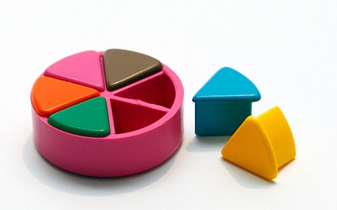
PROBLEM vs. ISSUE
A problem is the whole pie. Problems are vast, complex, and entrenched.
When we try to tackle a problem, we reinforce the hopelessness of the situation. We are trying to take on the full pie all at once.
Issues are the pieces of the pie. It’s a small chunk of the larger problem that we can make progress on, and in turn we are slowly taking on the full problem over time.
Notes:
10 Minutes PROBLEM , ISSUES and Values
Campaigns start with issues that people have value-based solidarity around.
An issue is a slice of a workplace problem.
Often a problem can have different issues depending on the perspective of the people we are working with.
It is KEY to get enough input on what the issues are that make up the problem so that YOU do not drive the solution.
Investigating the issue is necessary but not sufficient – we also need to identify workers’ SHARED values – WHY is this an issue? WHY do you want to fix this?

Slide 51
Issue
An issue is a slice of the larger problem that is manageable and solvable.

Slide 52

PROBLEM vs. ISSUE pg. 3
Notes:
I'm not a car guy but I can tell that the car has a problem and is blowing up.
I am not sure what the issue is and I will have to work on figuring that out.

Slide 53
Connecting to Values pt 1
Linda

Slide 54
Values
Values are fundamental beliefs that dictate behavior
Ideally, Unions advance the welfare of all members.
Values are based on the universal ideal of human rights, the idea of justice, progress, and betterment of self and of society.
Through shared values, members build solidarity and commit to active participation in the labor movement.
Shared values transform individual members into part of something larger than themselves.
Notes:
We Begin to Get to Values when we ask WHY?
VALUES are
Values are deeply-held beliefs that shape who you are.
Ideally, Unions advance the welfare of all workers.
They are based on the universal ideal of human rights, the idea of justice, progress, and betterment of self and of society.
Through shared values, workers build solidarity and commit to active participation in the labor movement.
Shared values transform individual members into part of something larger than themselves.

Slide 55
How to Link Issues and Values
Investigating member issues is necessary but not sufficient – we also need to identify workers’ SHARED values –
WHY is this an issue?
WHY do you want to fix this?
Notes:
How to Link Issues and Values – The Organizing Conversation Magic
You might ask, Do you want to fix this problem? Which of these do you think you can fix? Which one matters the most to you? Why does it Matter?
The radiator hose is something that my friend and I can fix and it matters to me because I can afford to fix it.
The radiator hose will be fixed by putting a new fitting on it. Is an issue that allows me to see the solution.
We can get to values by asking how do you feel about your car being a piece of junk? Do you think others feel the same way about cars that are pieces of junk? Why do you want to fix this problem?
We deserve safe and reliable transportation
We deserve access to affordable and quality car parts

Slide 56


ONE MINUTE table brainstorm

Slide 57
Some Union Values
Fairness, honesty/integrity, responsibility, compassion/empathy, safety,
health, generosity, hard work/responsibility, community, freedom, democracy, binding contracts, equality, opportunity,
respect, stability/security, unity,
quality work, justice, collective action, dignity/respect, charity/community service, and due process.

Slide 58
GROUP WORK – The Problems Pg 3
Looking at the scenario, identify the problems from a broad perspective.
For each of the problems you identify – try to think what the values are that are behind WHY you see this as a problem.
Example Problem – We want quality health care for everyone
Values behind wanting to fix this – equity, fairness, dignity
List your problems and values on your charts.

Slide 59
Lunch

Slide 60
Connecting to Values pt 2
Albert

Slide 61
GROUP WORK – Problems into Issues Pg 5
Example Problem – We want quality health care for everyone
Values behind wanting to fix this – equity, fairness, dignity
Possible Issues –
Not enough providers in our rural system
Values – access and equity
Drugs are not affordable
Values – fairness and access
No coverage for home health options
Values – equity and dignity
Cut your problems into issues on your charts.

Slide 62
Assessing Our Issues
Widely felt and/or deeply felt.
  The pain can be felt by just one, but the injustice of that pain is shared by many.
  The pain AND the injustice of that pain is felt by many.
Winnable.
Builds the union and builds leaders.
Has a connection to students and the public.
Secrets of a Successful Organizer “A Good Organizing Issue” handout

Slide 63
GROUP WORK – Problems into Issues
In your group, spend some time evaluating an issue.
Your group will need to have a single issue.

Slide 64
Key Ideas
Problems are big conditions of injustice
Issues are the smaller member identified components that make up the problem
Issues indicate a path to action
Values build a relatable why across people experiencing the pain of the problem
We intentionally work to connect members around issues and values to build Solidarity

Slide 65
THE
Key Idea
We listen for the values as we talk about problems.
THIS IS HOW WE BUILD SOLIDARITY.

Slide 66
Target and Demand
Matt

Slide 67

Target
Notes:
Ask group: Who has an idea of what we mean by a target in the context of a campaign?

Slide 68
A Target Is
The person with the power to give you what you are demanding.
This person
Has a name
Has a face
Has an address
Notes:
A target is the person who can make the decision to give you what you want. The target is the person who can meet your demands. We need to be very specific in identifying the target. A target is not an organization or a committee. A target is a person with a face, name, and an address.
WHO HAS THE POWER TO BRING A VOTE TO THE BOARD OF ED
WHO IS THE SWING VOTE –WHO IS THE KEY PERSON
Prince- President of Warner brothers

Slide 69
Targets also have VALUES
Values:
What are the target’s values?
What causes them to act?
What is behind their WHY?
Notes:
Understanding OUR values that are connected to our issues can help us to analyze the target.
Prince – Money, loss of money

Slide 70
Targets also have RELATIONSHIPS
Relationships:
What relationships does the target have?
Who influences the target?
Who are the target’s allies and opponents?
Notes:
The is key to remember that just as you and your members have values and relationships that cause you to act –
Targets do to and you have to understand these. Let’s look at an analysis that is helpful in designing campaigns.
Relationships:
What relationships does the target have? School board members - community
Who influences the target?
Who are the target’s allies and opponents?
To whom is the target accountable? (Is the target elected or appointed?)
Who’s the target’s base of support?

Slide 71
Targets also have SELF INTEREST
Self Interest:
Self-interest is what your values look like in the world.
What are the ways the target wants to make their values real to the public?
What are the target’s goals?
What does the target care about?
What motivates the target to act?
Possible examples: maximize profits, cut costs, cut taxes, weaken unions, have good public image, get re-elected, etc.
Notes:
Remember, self-interest is how the values look like in the world. What are the ways that the target wants to make their values real in the world?
What are the target’s goals?
What does the target care about?
What motivates the target to act?
Possible examples: maximize profits, cut costs, weaken unions, have good public image, get re-elected, etc
Prince- making money and keeping him under contract= keep rights to his music

Slide 72
Targets also have POWER pg. 10
Power:
What power does the target have and what is the source of their power?
How do they organize people?
How do they organize money and resources?
Notes:
What power does the target have and where does their power derive from?
How do they organize people?
How do they organize money and resources?
Prince- record sales- money

Slide 73
GROUP WORK – Target and Analysis
You identified an issue, now, identify the TARGET who has the power to fix this.
Name them and then build a chart that answers the following about the TARGET's:
  Values
  Relationships
  Self-Interests
  Power

Slide 74
Key Ideas
Everyone has values, each one of us, our members, our organizations, our allies, our opponents, and our targets.
Understanding the values of the members, of our Target, and our allies is critical in order to build an effective campaign.

Slide 75

The
Demand

Slide 76
Demand:
“Hey TARGET,
we demand ACTION
because HARM or IMPACT!”
Notes:
The demand should have the 3 components: the target, the action, and the harm or impact.

Slide 77
Demand:
Hey Superintendent Sam: We demand gender affirming bathrooms in every school because all students and staff need to feel safe and included in our schools.
Notes:
The demand is usually the first thing that your supporters or potential supporters will hear about the campaign. This is why it is important to include the harm or impact, because it creates a moral crisis in the listener and move them to act in support of the campaign.
Measurable
Achievable
The demand should be measurable in that we can clearly know whether the target takes the action in the demand or not

Slide 78
REVIEW
Issue: A slice of a workplace problem that is deeply/widely felt, winnable, and will build our power.
Power: The ability to control, create and/or prevent change. Power is organized people and organized resources (money).
Target: Is the person with the power to give you what you are demanding.
Demand: the desired outcome that solves the issue.

Slide 79
GROUP WORK – Demand
Use your Issue and Target.
Draft at least one demand of your Target that resolves your issue.
Notes:
5 mins

Slide 80
Key Ideas
A powerful demand makes clear who has the power to make the change that’s needed.
We can only fulfill a powerful demand when we have taken the steps to accurately identify the issue and determine who has the power to create change (the target).

Slide 81
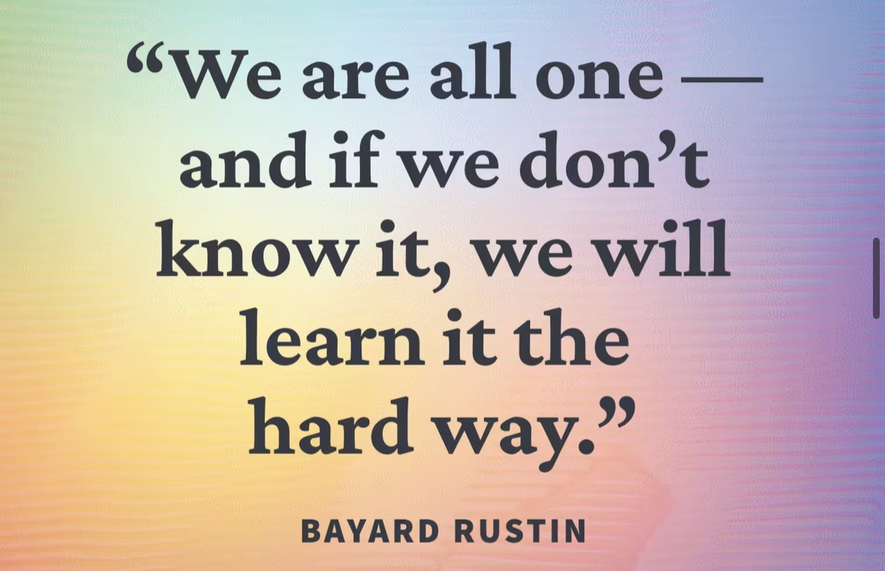
Spectrum of Allies
Albert
Notes:
30 mins 1:20 -1:50

Slide 82

Spectrum of Allies
  Active allies: people who agree with you & are organizing alongside you
  Passive allies: people who agree but aren't doing anything about it (yet!)
  Neutrals: people who aren't sure, or are unengaged (they might just not know about your issue yet)
  Passive opponents: people who disagree, but aren't trying to stop you
  Active opponents: people who have done something to prevent you from reaching your goal
Notes:
We are going to begin by learning a method Called Spectrum of Allies. All of our campaigns CAN include a wide range of groups, but particularly in the campaigns we are thinking about that you will be part of, you MUST include others outside of your constituency.
These include a wide range of groups that can be put on a kind of spectrum, from those closest to the point of view of the advocates to those who actively oppose change. Draw a horizontal line to represent that. Those who advocate change are represented by a point at one end of the line (say, on the left), and the opponents by a point at the other end.

Slide 83
Focusing your tactics matters
Only the Opposition – cynicism
Only the Active Allies – stagnation
Generalizations about Slices – missed opportunities
DO FOCUS ON THE PASSIVE ALLIES
  These are folks who know or care about what you’re up to, but aren’t doing anything about it, maybe because they "don't do politics." Give them a chance to participate and build power with you.
THE GOOD NEWS
  It is only necessary to move some or all of the pie wedges one step in your direction. If we shift each wedge one step, we are likely to win, even if the hardliners on the opponent’s side don’t budge.
Notes:
Focusing only on the opposition leads to becoming disheartened or cynical, which means you ignore potential allies and support. Focusing only on how to convince the important power-holder who is against you leads to ignoring all of the potential support you could build that could overpower her opposition
Focusing only on active allies leads to being an isolated interest-group, which also means you ignore potential allies and support Always doing events with the same group of individuals or organizations isolates you from creative, powerful community-building that can
arise from new alliances and partnerships
Generalizing about whole groups of people risks misunderstanding the nuances of communities If you think about "students" as an entire group, you ignore the huge number of different groups & organizations (potential allies!) that exist in a student community
DO focus on passive allies. These are folks who know or care
about what you’re up to, but aren’t doing anything about it! Give them a chance to participate and build power with you.

Slide 84
GROUP WORK - Spectrum of Allies
Notes:
5 mins

Slide 85

Spectrum of Allies Debrief – Whole Group
How does categorizing potential allies help focus your campaign possibilities?
Which group would you focus on moving first and why?
Notes:
5 mins

Slide 86
It is only necessary to move some or all of the pie wedges one step in your direction.
If we shift each wedge one step, we are likely to win, even if the hardliners on the opponent’s side don’t budge.
Key Ideas

Slide 87
Strategy and Tactics
Linda
Notes:
Once we know where we are going, we have to plan how to get there.

Slide 88
What do you think is the difference between a strategy and a tactic?

Slide 89


Strategizing is
turning what you have (resources)
into what you need (power)
to get what you want (change)
(pg. 12)

Slide 90
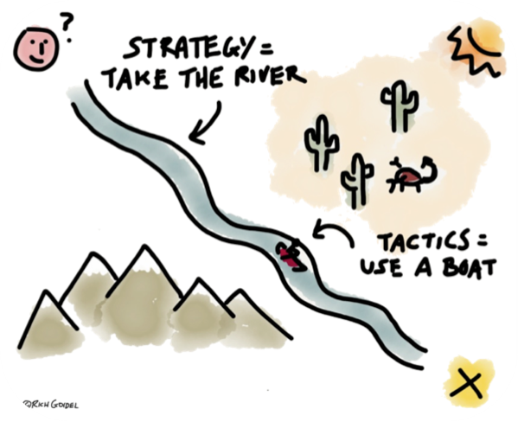
Tactic: Actions we take as a part of an escalation plan that increases pressure on the target to win our demand.
Tactics set strategy in motion

Slide 91
What are some of your favorite tactics that you have led, participated in and/or heard of?
What made them so great?

Slide 92

What makes tactics effective?
Does it help us achieve our strategic goal?
Is it rooted in our theory of change?
Does it use and build on our resources?
Does it create pressure against opposition (decision maker)?
Strategic
Does it enable us to experience solidarity, self-efficacy and hope through courage?
Is it fun, creative, and exciting? Does it deepen commitment?
Can anyone from our constituency join? (Is it accessible?)
Motivational
Does it support and celebrate the growth of our people and our organization? Does it bring in new people?
Are we learning as we go?
Build leadership

Slide 93
Relational and Campaign Tactics
Campaign tactics create moments of action, while relational tactics build the power that makes those actions possible
BOTH MATTER. The strongest campaigns intentionally use both.

Slide 94
Relational Tactics | Campaign Tactics
Build trust and commitment | Build visibility and momentum
Focus on people | Focus on issues and demands
Develop leaders | Demonstrate collective power
Create long-term capacity | Win short-term objectives

Slide 95
Evaluating Tactics pg. 13-14
Does the action relate to your issue?
Does it align with your values?
Will it increase the pressure on the decision-maker?
Is it visible?
Is it timed for effect?
Is it new and different—or tried and true?
Are enough people ready to do it?
Will it unify people?
How will management react?
Does it violate the law? (If so, are we prepared for the consequences?)
Will it be fun?

Slide 96
Key Ideas
Tactics allow workers to:
Share Resources, Values, and Commitment
Take risks together and achieve shared wins
Build trust in their own agency and the collective effectiveness of their union

Slide 97
Compression Points &
Escalation
Matt and Albert
Notes:
2:45 –3:15
Tactics are structure tests, and should come with a demand. We can’t just walk off the job, but not communicate why or what is needed to bring people back to work
In the last section, we wanted to show that escalations can be fun, and creative. In this section we will be talking about more of the nitty gritty of escalations.

Slide 98
DEMAND
Campaign timeline
Capacity
Strategic goal
Campaign tactics​
Campaign
tactics​
Peak 2
Evaluation and next steps
Campaign tactics
Relationaltactics
Peak 1
Relationaltactics
Kick-off
Relational tactics
Foundation
Time

Slide 99
Compression Points
Points on the calendar where you celebrate short term wins or escalate your tactics.
◦Naturally occurring deadlines - Breaks, Board Meetings
◦Artificial deadlines - Target has till day X to act
◦Help us to build urgency and crisis
Notes:
Tineline
How long can you wait for the demand to be met?
How long will it take to identify the problem, identify the issues, build a leadership team, build a presence, etc. etc. etc.
When do you make the starting point?

Slide 100
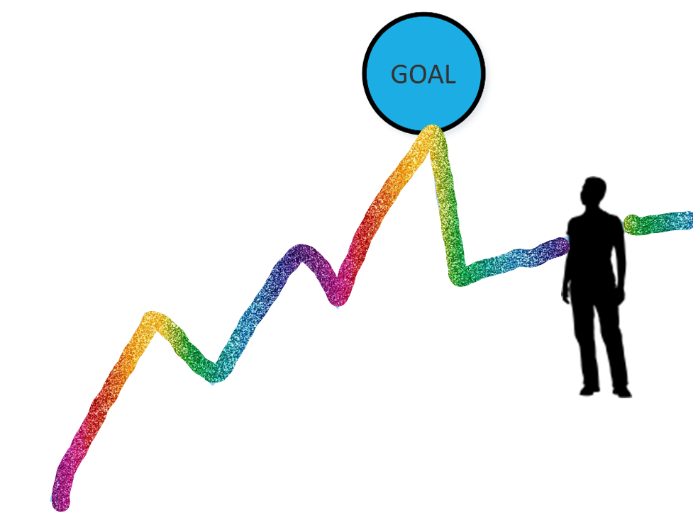
GOAL
Why do you think tactics escalate gradually?

Slide 101
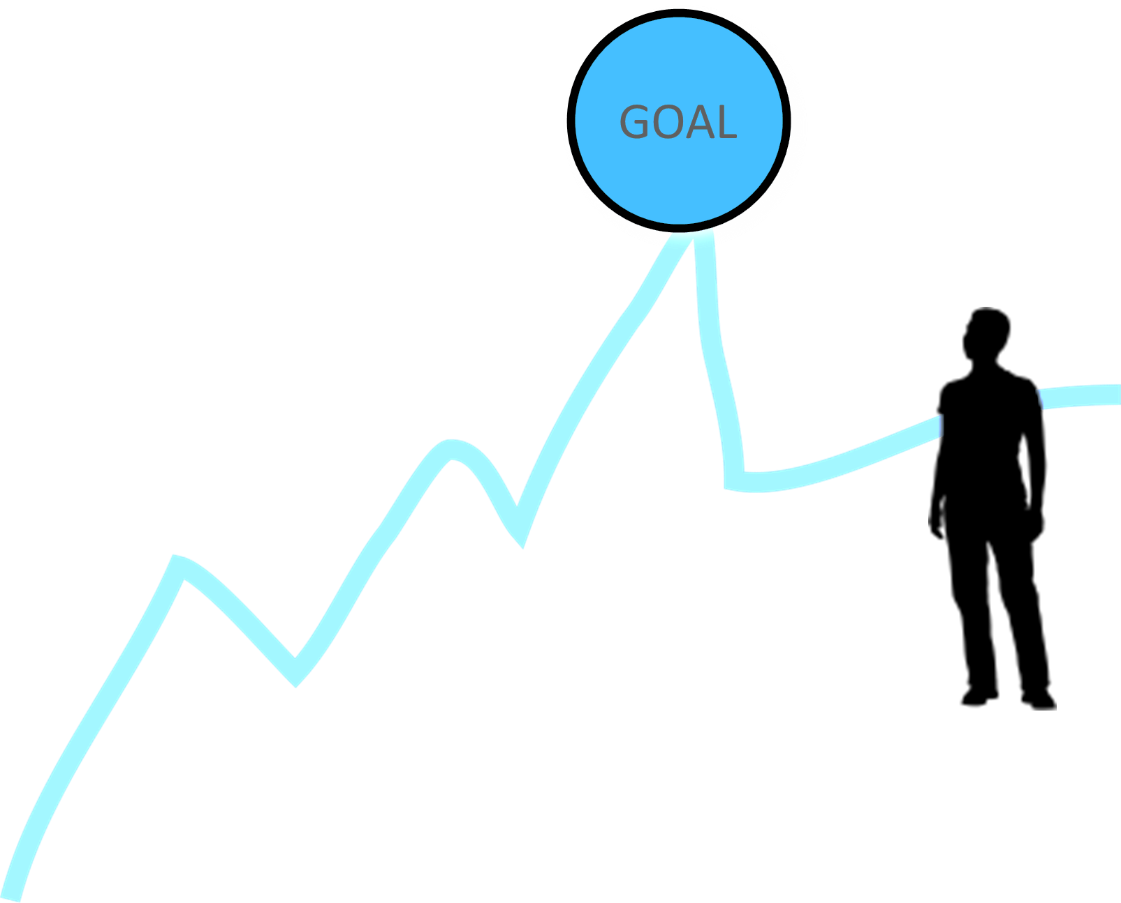
Escalating Actions
Less escalated actions prepare your people for more escalated actions
Gives you data about your readiness for the next step and how much pressure your target can resist
Gives the target the opportunity to do the right thing before things escalate
The threat of escalation can be as powerful as actual escalation
Notes:
Give the target a point to do the right thing before things escalate to the next tactic
Use the threat of escalation
Allows more people to join our base
Prince- started releasing albums quickly- no real harm but putting pressure

Slide 102
Key Ideas
An escalating campaign is held together by a set of values and shared commitment to a demand.
Escalating tactics are how we identify new leaders, develop leaders, and move more people into our base.
If we are organizing, we are always climbing the campaign mountain by building relationships that allow for escalating actions

Slide 103
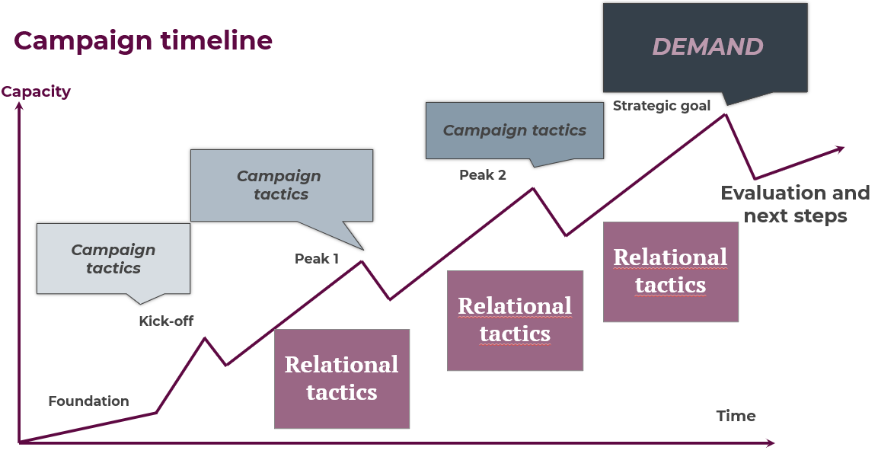
GROUP WORK – Campaign Planning
Now that we’ve covered the core components of campaign mountain, you are now going to return to your scenario.
Build a campaign mountain based on the issue, the target, and the demand you identified.
You may need to be creative about some of your compression points... (creating an artificial calendar date as an example)

Slide 104
DEMAND
Campaign timeline
Capacity
Strategic goal
Campaign tactics​
Campaign
tactics​
Peak 2
Evaluation and next steps
Campaign tactics
Relationaltactics
Peak 1
Relationaltactics
Kick-off
Relational tactics
Foundation
Time

Slide 105
Break
Notes:
2:45

Slide 106
DEMAND
Campaign timeline
Capacity
Strategic goal
Campaign tactics​
Campaign
tactics​
Peak 2
Evaluation and next steps
Campaign tactics
Relationaltactics
Peak 1
Relationaltactics
Kick-off
Relational tactics
Foundation
Time

Slide 107
Presentation Time
All of YOU!

Slide 108

What will you take with you into your future work?
Closing our time together…
Notes:
3:15 Grat

Slide 109

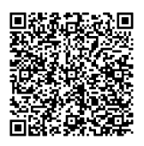

The NEA Campaign Lab
Notes:
Are you aware of local leaders, caucus leaders, rank and file leaders, and constituency leaders (retired, aspiring educators, higher ed, ESP) who WANT to use their union to organize around Ice Raids, Anti LGBTQ, Anti Truth in Teaching Black and Brown History? If yes, please connect them with Ellen Holmes so she can help them join these networks in the Campaign Lab via the application link — OR please simply have them fill out the application link for themselves. They do not need extensive experience, affiliate approval, or a staff person. They simply need to want to build power together with others to win on the issues that matter most to them. The requirements for attending 6 Weeks of Power have been taken away. They need a team, an issue, and a desire to learn with others how to link their fights for justice and worker issues. They receive $2500 in seed money and a developing network of coaching.

Slide 110
What We Need You to Do!
Share with your state and local leaders what you experienced.
Join the Campaign Lab!
Keep in touch! Let us know what you are doing to advance LGBTQ+ justice.
Educate and Empower others!
Remember, what you learned here, leaves here!

