Slide 1
Leading Change Academy
Public Narrative & Community Organizing Workshop
June 13-14, June 20-21, 2026
Notes:
Welcome everyone to day 2 of the workshop. Excited to be diving in with you more on narrative.
Just a quick reminder to turn on your cameras, wave at us, wonderful! And to turn on the interpretation.
Again a shoutout to Karla and Mariana for the magic they bring into this space.

Slide 2
Put in the chat
How are you feeling today coming into the space?
What is one word from last week you plan to bring with you today?
¿Cómo te sientes hoy al llegar a este espacio?
¿Qué palabra de ayer piensas traer contigo hoy?
Notes:
Let’s see how we are coming into this space…
Let’s get started with a grounding. Jennyfer will give you the floor.

Slide 3
Our Community Agreement
No Question is too small / Ninguna pregunta es demasiado pequeña
Respect and don’t judge/ Respeta y evita juzgar
Respect diversity/ Respeta la diversidad
Include all voices/Incluye todas las voces
Ask good questions to understand/Haz buenas preguntas para comprender mejor
Turn on Cameras/ Enciende tu cámara
Step Up, Step Back / Participa y también da espacio a otras personas
Correction: Tap on chest ‘my bad’ then spirit fingers with a sound of how you are feeling/ Toca el pecho y di “mi culpa”
Mute while not speaking/ Mantén el micrófono en silencio cuando no hables
Lean into curiosity/ braza la curiosidad
Actively listen/Escucha activamente
Be curious and open-minded/Mantén una mente abierta
Provide support/Brinda apoyo
Respect the time/Respeta el tiempo
Speak from a place of love and learning/ Habla desde el amor y el aprendizaje
Notes:
Before we get started, I would like us to do quick review of our community agreements. I must say, thank you everyone for really creating a beautiful brave space in which we are able to learn deeply, try hard, fall off that bike and get back on it!
If we can put in the chat, what norms do we want to keep in mind.

Slide 4
Grounding with Yuni Ortiz
Enraizamiento con Yuni Ortiz

Slide 5
“If I am not for myself, who will be for me?”
“If I am only for myself, what am I?”
“If not now, when?”
— Rabbi Hillel, 1st century Jerusalem sage
Notes:
We started last week our topic on leadership with a quote from Rabbi Hillel, in which he asks….
These 3 questions, he exams the intersection of the self, other and action.

Slide 6



Story of SELF
a call to leadership
Story of US
shared values & experiences
Story of NOW
strategy & action
Notes:
In asking ourselves these three questions, we dove into the practice of Public Narrative in stories help us make sense of the world and it gives us meaning and motivates us to act.
The story of self: identify what calls ME to leadership by answering the questions: when did I learn my values, what was the specific moment - and when did I face a challenge in which I acted on that value and how did it lead me to where I am today.
The story of us: identify the moments, values and experience of the “us”, the people in the room - by sharing specific moments in which our values as a community was challenged, and together we made a choice that that demonstrates our strength, our conviction and our capacity to do the work.
The story of now: identify the moments that gives our cause a sense of urgency, the strategic pathway to action that gives us hope that something can change and the action, the first step we must take in which we call our people to “join us in…” a specific ask.
And how to link them together by finding a value thread to tie them together.

Slide 7
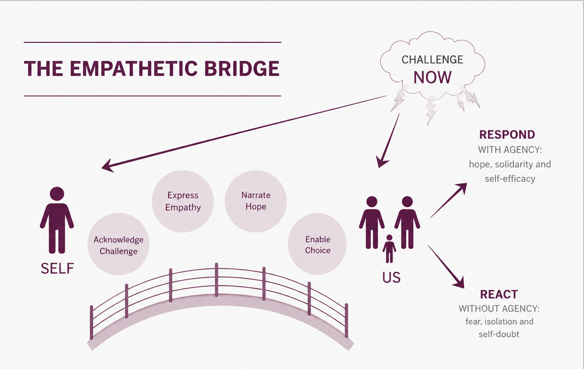
2. Express Empathy
3. Narrative Hope
1.Acknowledge
Challenge
2
3
4. Offer
Choice
1
4
Notes:
We ended last week with the definition of agency in which agency is the emotional capacity to make mindful choices. And in times of a leadership challenge, we can either react without agency or respond with agency. And Aditi provided a framework on how to address the challenge through the empathetic bridge acknowledge ppl’s emotional response to the challenge - through acknowledgement, express empathy, narrate hope and offer a choice.

Slide 8
Leadership is
accepting responsibility
for enabling others
to achieve shared purpose
under conditions of uncertainty
Notes:
And we defined leadership in organizing as…

Slide 9

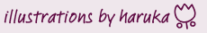
Head
Heart
Critical lens
How
Cognitive
Strategy
Analysis
Emotional lens
Why
Affective
Story
Motivation
Hands
Practical lens
What
Behavioral
Meaningful Action
Skills
Notes:
In which leadership requires us to build our capacity of the heart, head and hand.
Build the emotional capacity for our communities to face challenges [the work of the heart]
Build our strategic capacity to build power [the work of the head]
ability to mobilize [the work of the hands] and active our community to join us in action.
And to do so, we have 5 core practices.

Slide 10
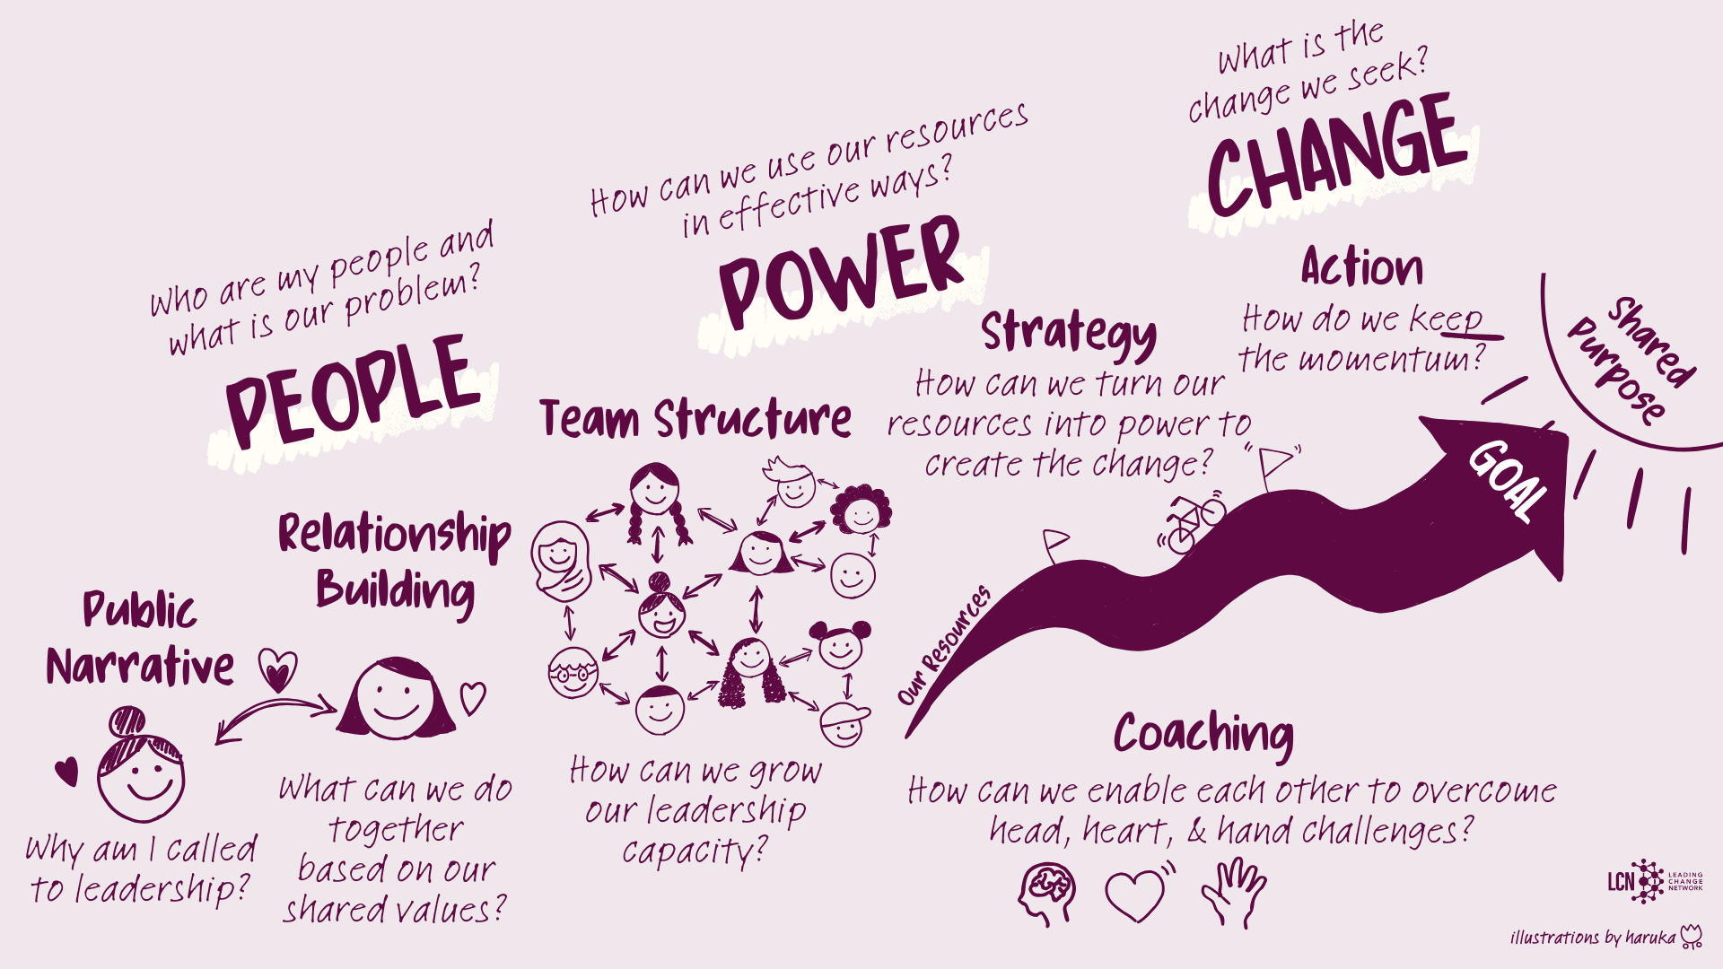
Notes:
Public narrative, relationship building, building teams, strategy and action and through that, we our moving our constituencies and their shared values towards a shared purpose. And we are building their capacity through coaching.

Slide 11
PUBLIC NARRATIVE
COMMUNITY ORGANIZING
Welcome & Setting Up
Introduction to Leadership
Introduction to Coaching
Introduction to Public Narrative
Introduction to Story of Self
Introduction to Story of Us
Wrap Up & Closing
Welcome
Introduction to Story of Now
Introduction to Linking
Introduction to Narrative as a Leadership Practice
Reflections
Q&A with Rosi Greenberg
Wrap Up & Closing
Welcome
Introduction to Community Organizing
Introduction to Relationship Building
Introduction to Teams
Introduction to Strategy I
Wrap Up & Closing
Welcome
Introduction to Strategy II: Tactics & Timeline
Introduction to Strategy III: Structure
Introduction to Action
Q&A with Professor Marshall Ganz
Wrap Up & Closing
SAT JUNE 13
SUN JUNE 14
SAT JUNE 20
SUN JUNE 21
Notes:
Today, we are going to continue with the heart work and see how we can build transformative relationships with our community to identify shared values, interests and resources. How we can build our capacity as a community by building strong interdependent teams and we will end the day with strategy with how we can use our resources to turn them into what we need to get what we want. And we will wrap up.
But before that, I would like to give a very special warm welcome to Professor Marshall Ganz who will be doing an introduction of community organizing to set the foundation for the next two days.
[if time - For 60+ years, Marshall Ganz has shaped movements from the American civil rights movement to organizing farm workers. As a professor at Harvard Kennedy School for the last 20+ years, his teaching and scholarship on Community Organizing and Public Narrative continues to shape the practice of civic and political leadership across the world today]

Slide 12
Introduction to Organizing
People, Power & Change
Notes:
1

Slide 13
Change
Power
People
Notes:
2

Slide 14
Campaign
Foundation
Organization
Constituency

Slide 15
Change
Power
People

Slide 16
Power is Relational
B’s Interest in A’s Resources = A’s power
A’s Interest in B’s Resources = B’s power

Slide 17
Three faces of power
Why is the problem not recognized as a problem?
How can the problem be recognized as a problem?
Who controls the narrative?
Who benefits and who loses?
Structure
Agenda
Who decides that the problem is a problem?
How can we bring it to the decision-making table?
Decision
Who makes the decision about the problem?
How can we win?

Slide 18
“If one person lacks what is necessary to live with dignity, it is because another person is detaining it” “We are called to love everyone without exception; at the same time, loving an oppressor does not mean allowing him to keep oppressing us, or letting him think that what he does is acceptable. On the contrary, true love for an oppressor means seeking ways to make him cease his oppression; it means stripping him of power that he does not know how to use, and that diminishes his own humanity and that of others……Those who suffer injustice have to defend strenuously their own rights and those of their family, precisely because they must preserve the dignity they have received as a loving gift from God.”
- Pope Francis

Slide 19
Organizing Impact
Goal
Capacity
Leadership
Problem Solved
Strengthened
Growth

Slide 20

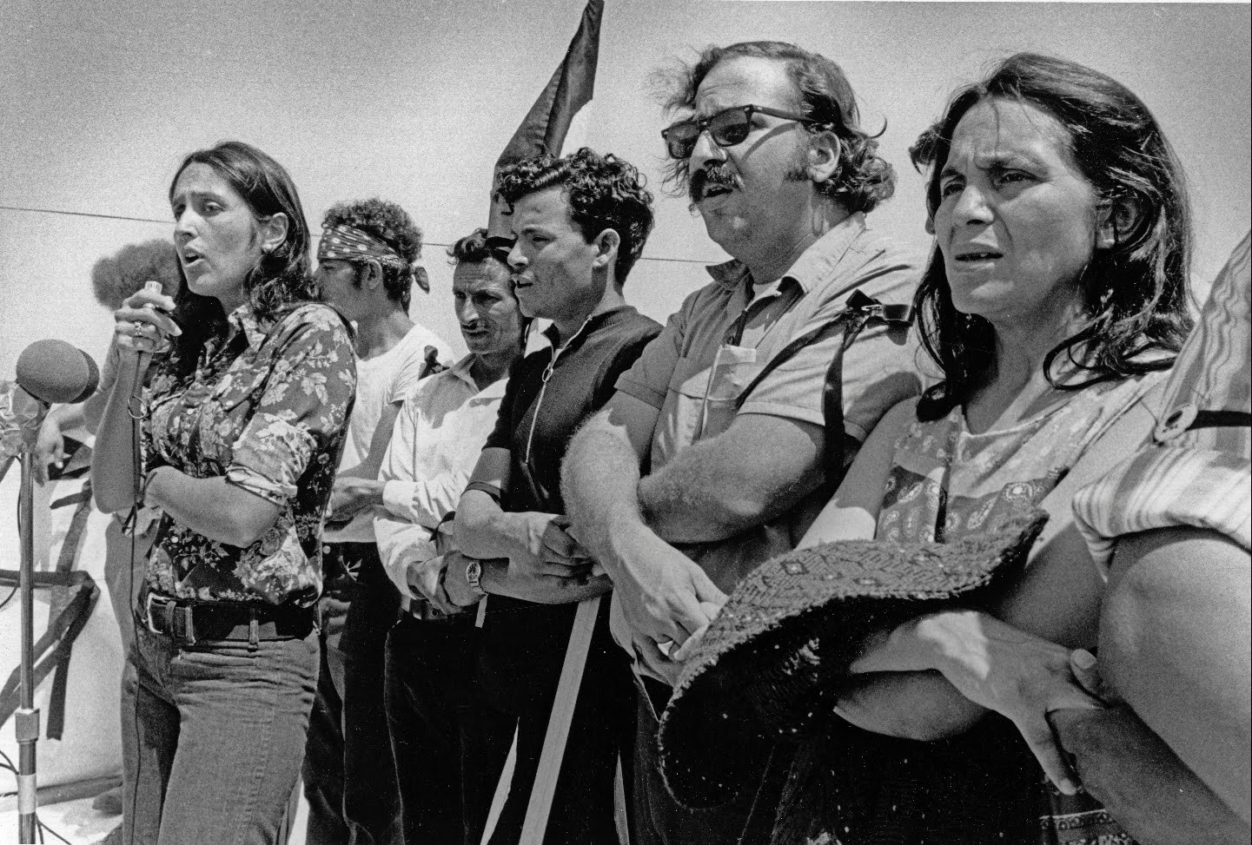
Learning to Organize
Be good to find an option.

Slide 21
Disorganisation
Disorganisation
Passive
Divided
Drifting
Reactive
Demobilized

Slide 22
Disorganisation to Organisation
Disorganisation
Organisation
Passive
Active
Divided
United
Drifting
Purpose
Reactive
Initiative
Demobilized
Mobilized

Slide 23
Disorganisation to Organisation
through Leadership
Disorganisation
Leadership
Organisation
Passive
Shared story
Active
Divided
Relational commitment
United
Drifting
Clear structure
Purpose
Reactive
Creative strategy
Initiative
Demobilized
Effective action
Mobilized

Slide 24
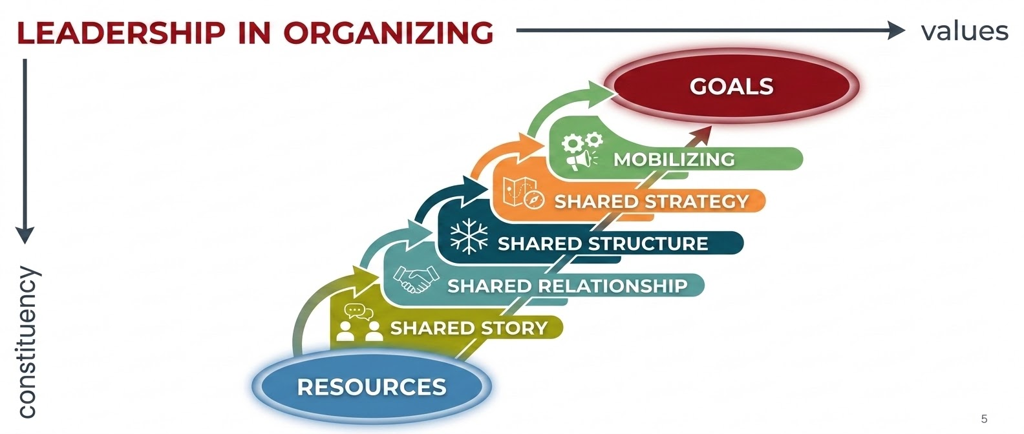

Five Leadership Practices

Slide 25
Shared interests / new interests
Interest
Interest
Shared
values
Commitment
Resources
Resources
Shared resources / new resources

Slide 26

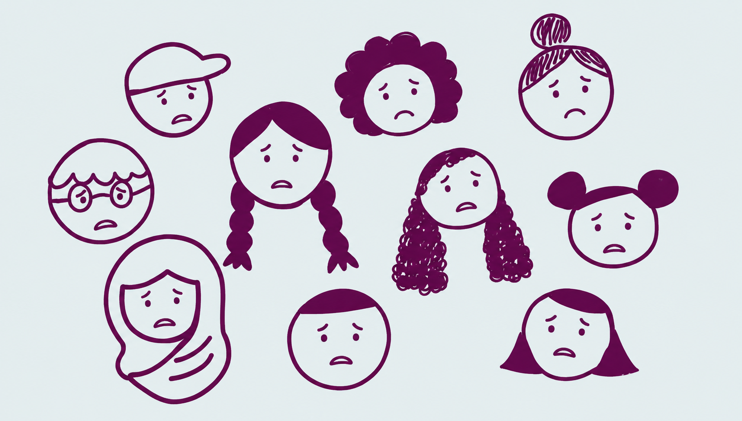


DISRUPTION
RESPOND with agency: hope, solidarity, self-efficacy
REACTIVE without agency: fear, isolation, self-doubt

Slide 27
Story of SELF
a call to leadership
Story of US
shared values & experiences
Story of NOW
strategy & action

Slide 28
Strategizing is
turning what you have (resources)
into what you need (power)
to get what you want (change)

Slide 29

TAKTIKAS
=
STRATEGOS
Ranks
=
General

Slide 30
A verb
Act
Act
Act
Plan
Plan
Plan
Result
Result
Result
Reflect
Reflect
Reflect

Slide 31
Motivation
Recruit resources
Deploy resources
Commitment

Slide 32
STRUCTURE
Leadership Development

Slide 33

Collaborative leadership

Slide 34
“I am the leader”

Slide 35
“We are all leaders” / No leader

Slide 36
“We are all leaders” / No leader

Slide 37


Slide 38

Distributed leadership

Slide 39
A small number of sustainable relationships
Capacity for exponential growth
Distributed Leadership
The Snowflake Model

Slide 40
CAMPAIGN CHART
Peak
Resolution
Peak
Peak
Kick-off
Organizational Cycle
Foundation
Campaign
Arrow

Slide 41


Slide 42
Interdependent
The snowflake model

Slide 43
Distributed leadership
The snowflake model

Slide 44
Leadership island

Slide 45
Distributed leadership

Slide 47
Tara and/or Samah had a good slide that allowed you to see with and over.

Slide 48
Power is relational
Person 1
Person 2
Needs /
Interests
Needs /
Interests
Resources
Resources

Slide 49
Power is relational
Person 1
Person 2
Needs /
Interests
Needs /
Interests
Resources
Resources

Slide 50
Power is relational
Person 1
Person 2
Needs /
Interests
Needs /
Interests
Resources
Resources

Slide 51
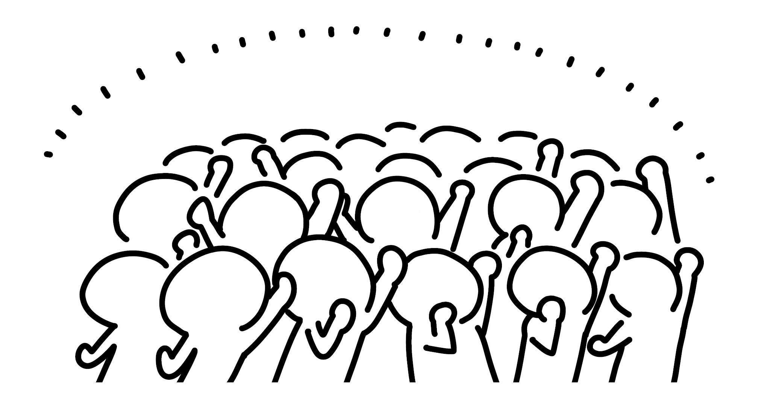
Building power and using power
Power with
If we can get what we want
only with our resources,
we combine our resources to create power needed by each other
Constituency
Constituency
Build power
(Relationships)
Needs /
Interests
Needs /
Interests
People power!
Resources
Resources

Slide 52

Building power and using power
Deploy power
Power over
If we cannot get what we want
only with our resources / we need the opposition’s resources (decision making) to achieve strategic goal,
we combine our resources to
create power and enough leverage so that the opposition will give us what we want
Power
Constituency
Opposition
Needs /
Interests
Needs /
Interests
Decision maker
People power!
Resources
Resources
Shift power

Slide 53
Slides start with a dot…then convergence on the dot …then several dots…and consequence of that…then we get to team

Slide 54
Collaborative leadership

Slide 55
Distributed leadership

Slide 56
A small number of sustainable relationships
Capacity for exponential growth
Distributed Leadership
“snowflake”

Slide 57
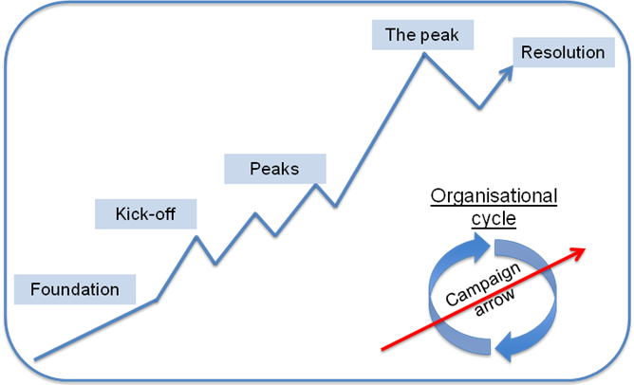

Slide 58
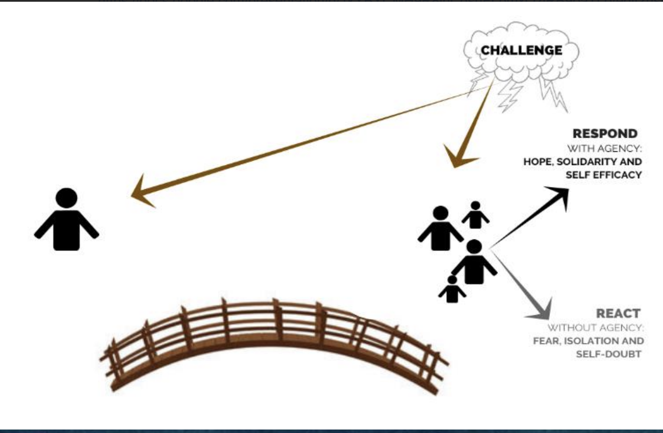

Slide 59
Relationship Building
Aprajita Pandey
20 June, 2026

Slide 60
Session Focus & Flow
Why Relationships in Organizing
What are Organizing Relationships
How Relationships Are Built
Practice
Reflection

Slide 61
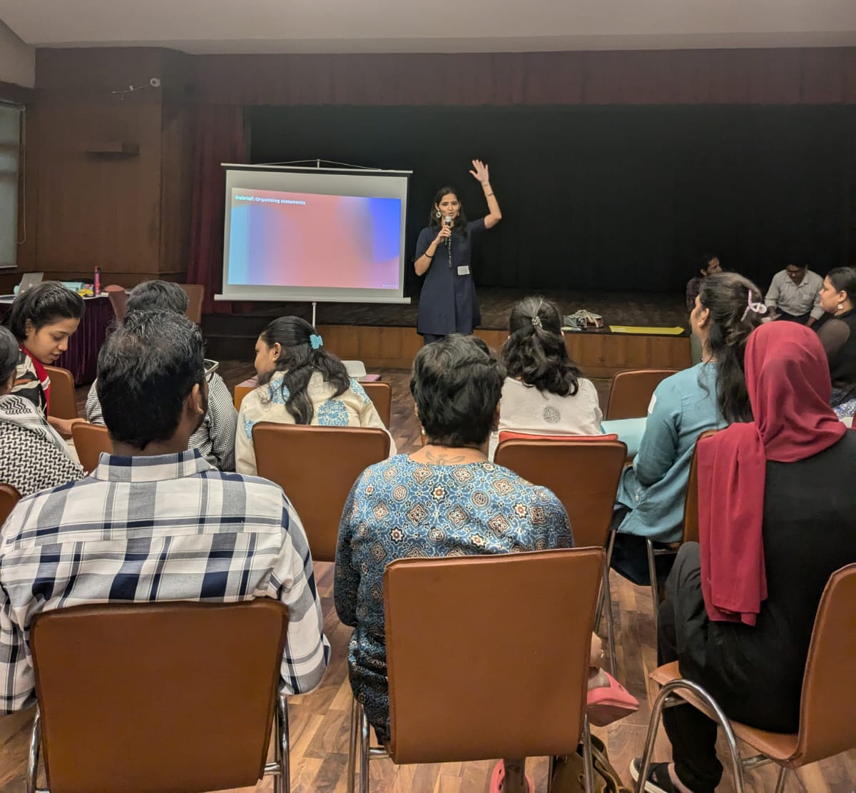
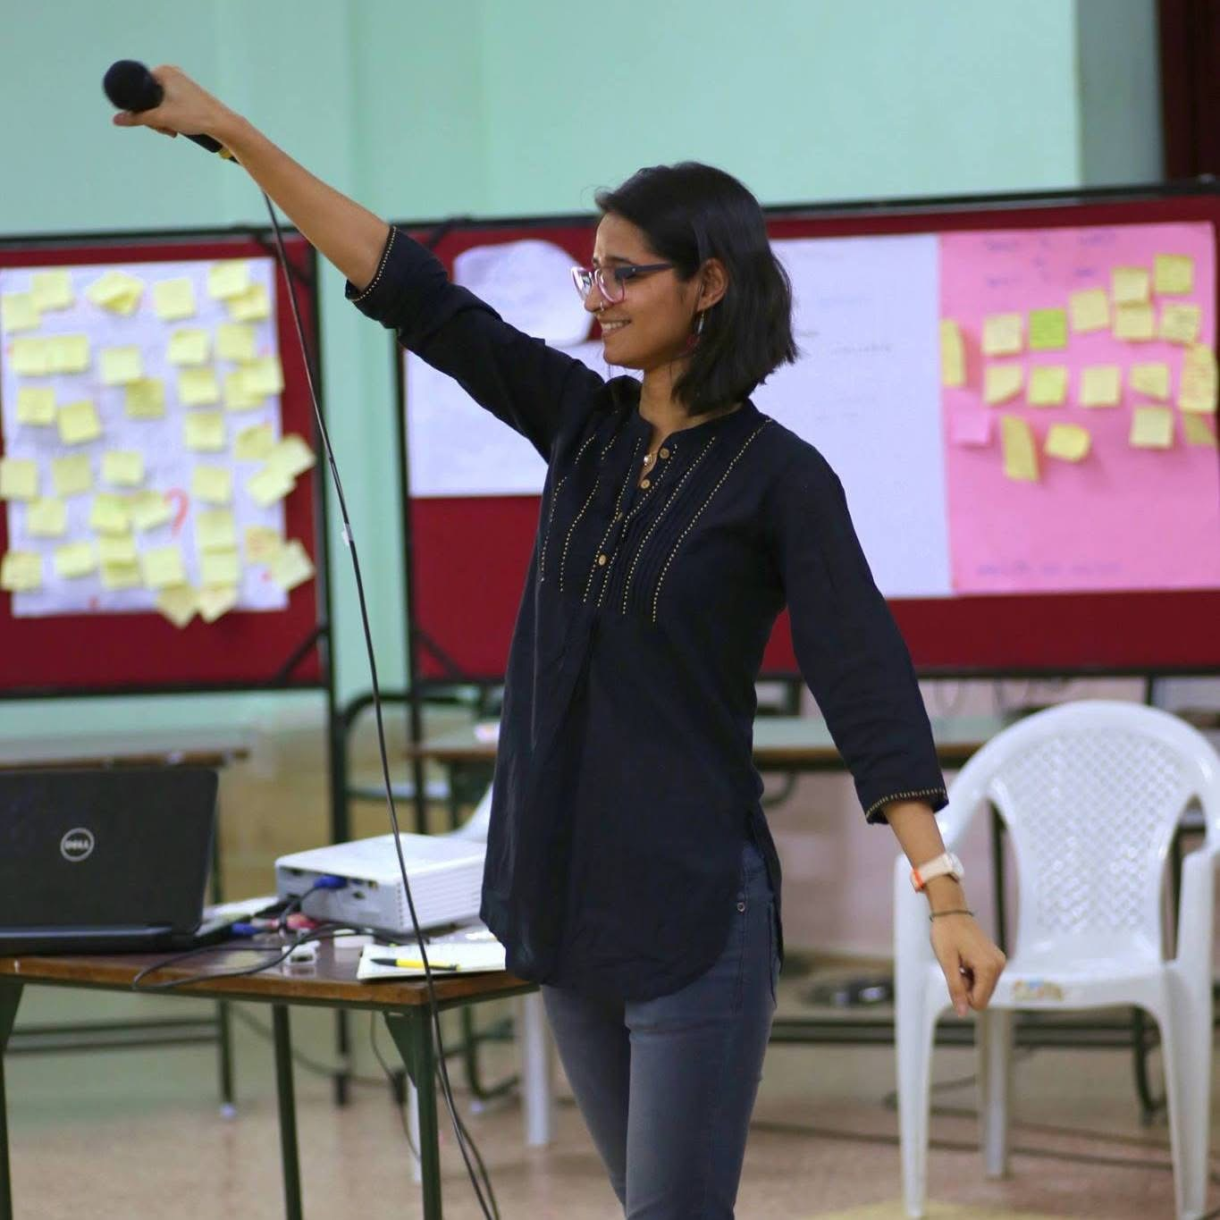
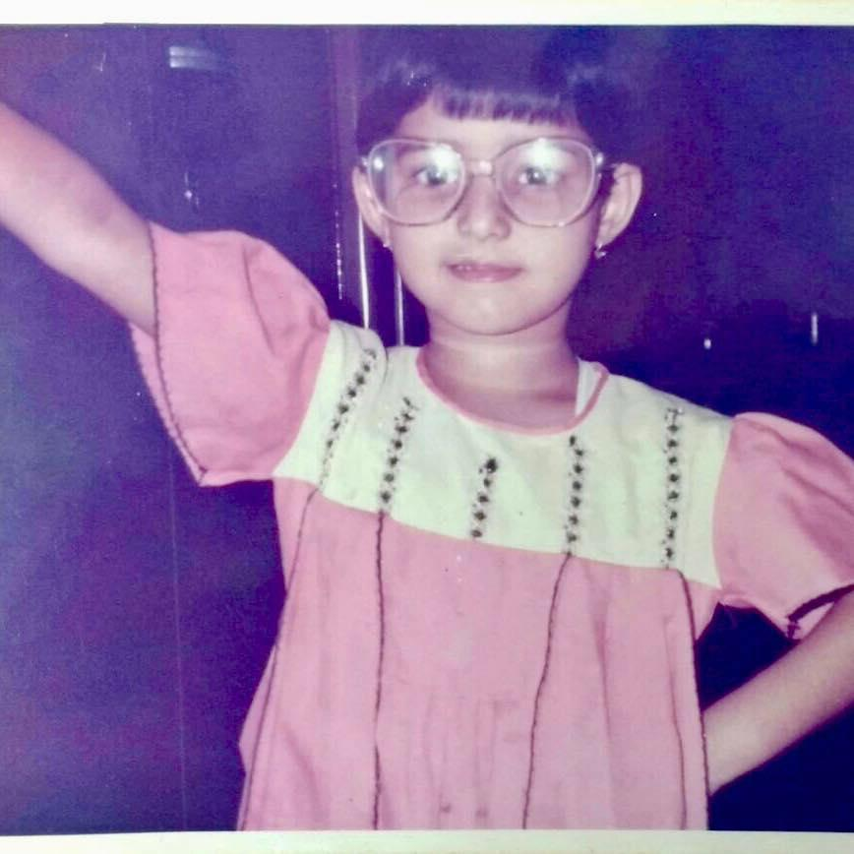

Slide 62
Think about a moment when you:
Took a risk
Joined a movement
Stepped into leadership
Discovered yourself and your call to action
Started a campaign/project
What and who helped make that possible?
Notes:
Looking back, every important leadership journey in our life started with a relationship.

Slide 63
The Paradox of Our Time
We have:
More connectivity
More loneliness
More information
Less trust
More visibility
Less belonging
Why do campaigns and movements struggle to sustain participation today?
Notes:
Most of our challenges are not simply crises of information. They are crises of relationship

Slide 64
Why do we need to build relationships
in organizing?
Notes:
Organizing is not about mobilizing people. It is about developing people. It is about transforming: Me → We Isolation → Solidarity. Concern → Commitment

Slide 66
Leadership is
accepting responsibility
for enabling others
to achieve shared purpose
under conditions of uncertainty
Each of these is
a relationship
= commitment
building power!
Notes:
If leadership is enabling others to achieve shared purpose, then relationships are the infrastructure that makes leadership possible.

Slide 67
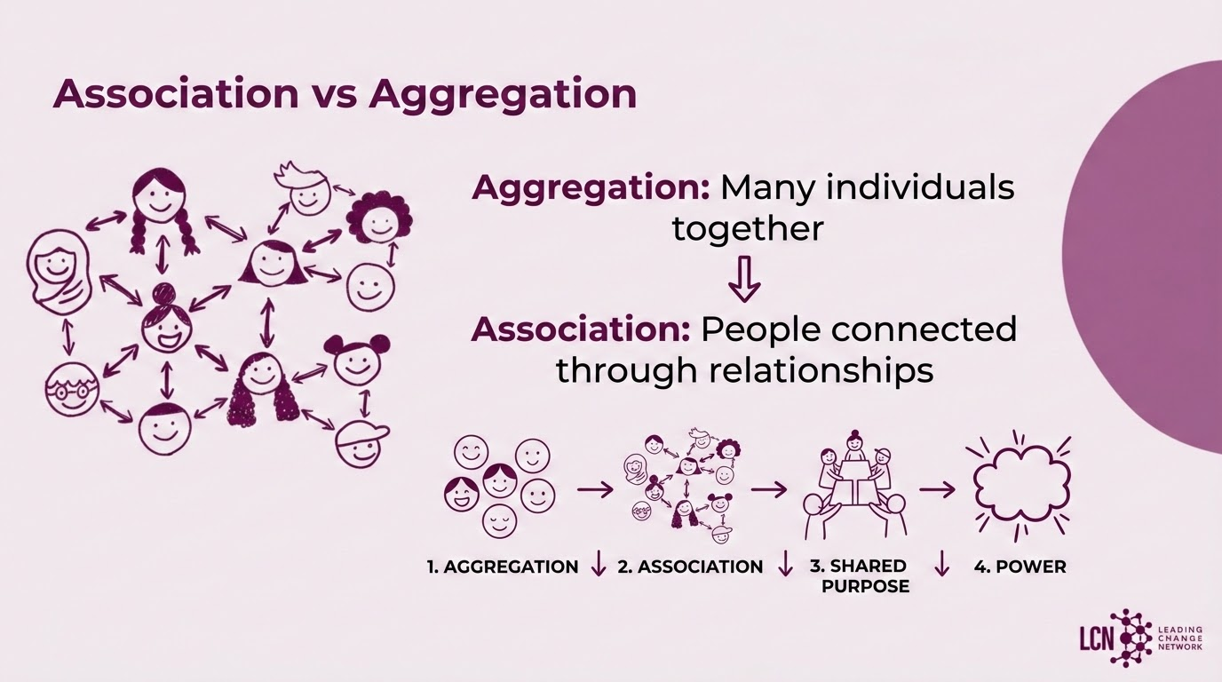
Notes:
The difference between a crowd and a movement is relationships.

Slide 68
What are Organizing Relationships?

Slide 69
Types of relationships
Private
Public
vs.
Transactional
Transformational
vs.
Obligation
Commitment
vs.

Slide 70
Which type do movements often mistake for organizing?
Friendship | Networking | Organizing
Affection | Exchange | Shared Purpose
Belonging | Contacts | Commitment
Personal | Transactional | Transformational
The Goal: The purpose of a relational meeting is not agreement. The purpose is discovering whether we can act together.

Slide 71
How do we build relationships?
What do we do when we want to
get commitments?

Slide 72
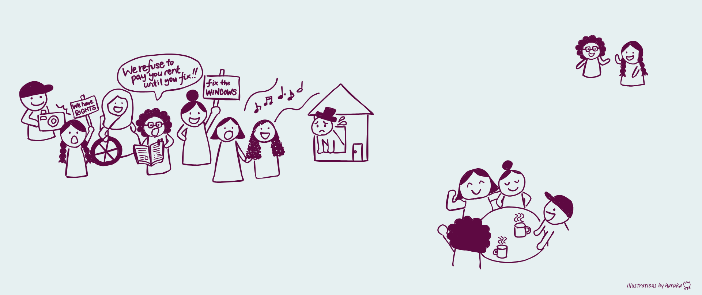
What does relationship building look like?
One-on-one meetings
House meetings
Team meetings…
It’s important not just to build the relationships with new people, but to deepen and sustain relationships with your team members

Slide 73
Most Organizers Start Here
Let’s work to reduce disposable plastic in Kamakura City!
Oh okay…
(I mean that’s great but I’m busy…)
“Will you join my campaign/cause?”

Slide 74
I want to reduce disposable plastic in Kamakura City
Interest
But why do I do this work?
Values
I care about disposable plastic because…
I have connections with people in the City interested in plastic issues
Resources

Slide 75
I care about disposable plastic because…
Interest
Interest
Ooh I can relate…
Shared
values
Resources
Resources

Slide 76
Shared interests / new interests
Interest
Interest
Shared
values
Commitment
Resources
Resources
Shared resources / new resources
Notes:
Stories reveal values
Values reveal interests
Interests reveal possibilities for action
This is where Public Narrative and Relationships meet.

Slide 77
Five step relationship building process
1
Attention
How did you find out about the other person? What made you want to have this talk with them?
2
Interest
What do you want to talk about today?
Be intentional about building the relationship!
3
Exploration
Who are you? What calls you to this work?
Explore each other’s values, interests, resources
4
Exchange
What values and interests do you share? How can you combine your resources to create change?
5
Commitment
Hard ask (personal, specific, and timebound) that results in a commitment to take an action

Slide 78

Watch a model by
Maria (Organizer) and Sreejani(Constituent)
As you watch the models, note:
Watch for curiosity, openness and vulnerability
Which of the 5 steps of relationship building are they in?
What questions did they ask each other?
When did you feel like they built a relationship?

Slide 79
Debrief the model
Model 1
Model 2

Slide 80
💁🏻‍♀️ 1:1 is: | 🙅🏻‍♀️ 1:1 is NOT:
A public relationship | An intimate relationship
Curious and compassionate learning | Prying
Purposeful | Chit-chat without agenda
Scheduled | Accidental
About commitments to specific actions | About vague commitments to action

Slide 81


Breakout room practice
Practice relational 1:1
3 min: Set-up the room, set time-keeper, choose roles
2 people per breakout room
  Rotate
    1 organizer
    1 person being organized
Each round (x 2 rounds)
  8 mins: relational 1:1
  2 mins: debrief
2 min: Wrap up
25 mins

Slide 82

Debrief the breakout room practice
Practice experience
Takeaways

Slide 83
Closing
Relationships are how
Strangers become collaborators.
Collaborators become leaders.
Leaders become capable of achieving shared purpose together.
In a fragmented world: Relationship Building is an act of democratic repair.

Slide 84
Team Structure

Slide 86
Leadership is
accepting responsibility
for enabling others
to achieve shared purpose
under conditions of uncertainty

Slide 87
Of all the teams you have ever been part of,
What was a “scream” team? 😭😬🥵
What was a “dream” team? 😍🥳🥰

Slide 88
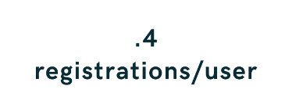



LONE WOLF
Healthcare providers signed up and received kits that they used on their own
LIMITED ACCOUNTABILITY
Providers only received occasional texts from Vot-ER encouraging them to use their kits
HEALTHY DEMOCRACY KITS

Slide 89



RELATIONAL ORGANIZING
Two team captains per medical school were taught basics of organizing and led teams of 5 to 10 friends
BUILT IN ACCOUNTABILITY
Team captains held their teams accountable to goals and led "field missions" to register voters
HEALTHY DEMOCRACY CAMPAIGN

Slide 90
Why work in structured teams?
Organized teams have more POWER than disorganized individuals
We can share resources and reach higher goals
Team members support and coach each other to
develop leaders
Interacting with each other deepens our relationships and commitment to common goals
Organizing with others is more fun and provides more satisfaction

Slide 91


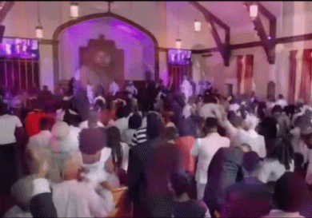

Structure is everywhere
Workplace
Sports
teams
Faith groups
Family

Slide 92
“I am the leader”

Slide 93
“We are all leaders” / No leader

Slide 94
Collaborative leadership

Slide 95
Leadership island

Slide 96
Leadership island

Slide 97
Distributed leadership

Slide 98
A small number of sustainable relationships
Capacity for exponential growth
Distributed leadership
The snowflake model

Slide 99

Leadership ladder
Leadership team member
Team leader
Coaching
For each step…
Team member
Identify
One-time member
Develop
Recruit
Supporter

Slide 100
Triple three of successful teams
Conditions
Enablers
Outcomes
?
?
?
?
?
?
?
?
?

Slide 101
Triple three of successful teams
Conditions
Enablers
Outcomes
?
?
Goals
?
?
Capacity
(Team)
?
?
Learning
(Individual)

Slide 102
Three outcomes of successful organizing
Individual
Organization
Society
Facilitates
learning
Increases organizational capacity
Reaches a clear and concise goal

Slide 103
Triple three of successful teams
Conditions
Enablers
Outcomes
Bounded
?
Goals
Stable
?
Capacity
(Team)
Diverse
?
Learning
(Individual)

Slide 104
Triple three of successful teams
Conditions
Enablers
Outcomes
Bounded
Purpose
Goals
Stable
Agreements
Capacity
(Team)
Diverse
Roles
Learning
(Individual)

Slide 105
Shared purpose
Purpose
Our team’s purpose is to…
Our people are…
We will achieve our purpose by…
WHAT?
WHO?
HOW?
E.g.
Our team’s purpose is to create a safe and welcoming environment for nonbinary and queer folks in choir
Our people are
150 members of Pomona College Choir
We will achieve our purpose by asking our conductor to create a gender neutral concert attire option and educating choir members to leverage our power as students

Slide 106
Shared norms
Agreements
How will we make decisions?
How will we show up in our team spaces?
How will we handle time?
When and where will we meet?
How and what platform will we use to communicate?
How will we handle our commitments?
IMPORTANT: How do we show respect to each other? How do we show, not just say mea culpa in a way that build team spirit? (Respect Norm)

Slide 107
Independent and interdependent roles
Roles
Different from assigning tasks
Establish roles with real responsibilities
List the members’ strengths, skills and experiences,
as well as areas they want to learn and improve
List roles and their responsibilities
Assign each role based on who can take on the responsibility, matching the strengths and areas of growth

Slide 108
Breakout room practice
Launch your leadership team by establishing:
  Shared purpose
  Norms
  Roles
  Team name & chant
In the main room, present your shared purpose and team name & chant
70 mins

Slide 109
Debrief the breakout room practice

Slide 110
Strategy I
Notes:
All right, hi everyone, I’m Haruka, she her pronouns, so excited to be here.
It’s 3:30am here in Japan and you’ve had a long day, so really glad we just had an exciting energizer, and we are going to make this last session of the day as interactive and fun as possible.
I’ll ask you questions along the way, please feel free to unmute and speak or raise your hand or digital hand, or put your answer in the chat, whatever is most comfortable for you.
I’m also going to do some temperature check throughout the session, asking you how you feel about what is being presented – so let’s practice – when I say thumbs up or down, can you show me your thumb? Yeah like this? And then show me kind of like where you are feeling, like yeah completely agree, or like, nah definitely not, or maybe somewhere in between. Good? Great.
—---------------------
Talking a lot
Gesture temperature check
Stand up
Covered everything really well
Why do people need to do the work - why do we need to build their capacity
Change is constant – we need to build capacity for the next campaign
Prepare the questions for the chat monitors
Who are the people, etc. paragraph - important key words
Feel free to ask others if someone says something off
How many people is a great question
—----------------------------------------
Begins at 3:30am JST
Notes: https://docs.google.com/document/d/1JD_f7ckSTd3phrg9kZGacJc-4sqkFy2tBkOlk8wBVLA/edit?usp=sharing
Brave
Skill (hands): Strategy is about being specific! How to come up with the theory of change, what questions they need to ask
Knowledge (head): Looking at the resources in a new way - You need to set a hypothesis to examine if you are using the resources. Strategic goal criteria
Attitude (heart): People is where the power lies - the more the people, the more resources you are getting, the more power
What can we omit?
What are the questions we ask the group and what questions can throw you off
Why are you asking the question? What do we want them to get through asking this question
Three faces of power interrupts the flow, map of actors also slow
Strategy: Skill Practice Session 1
[LCN ToT'25] Slide Deck_All Modules_Haruka_DRAFT

Slide 111

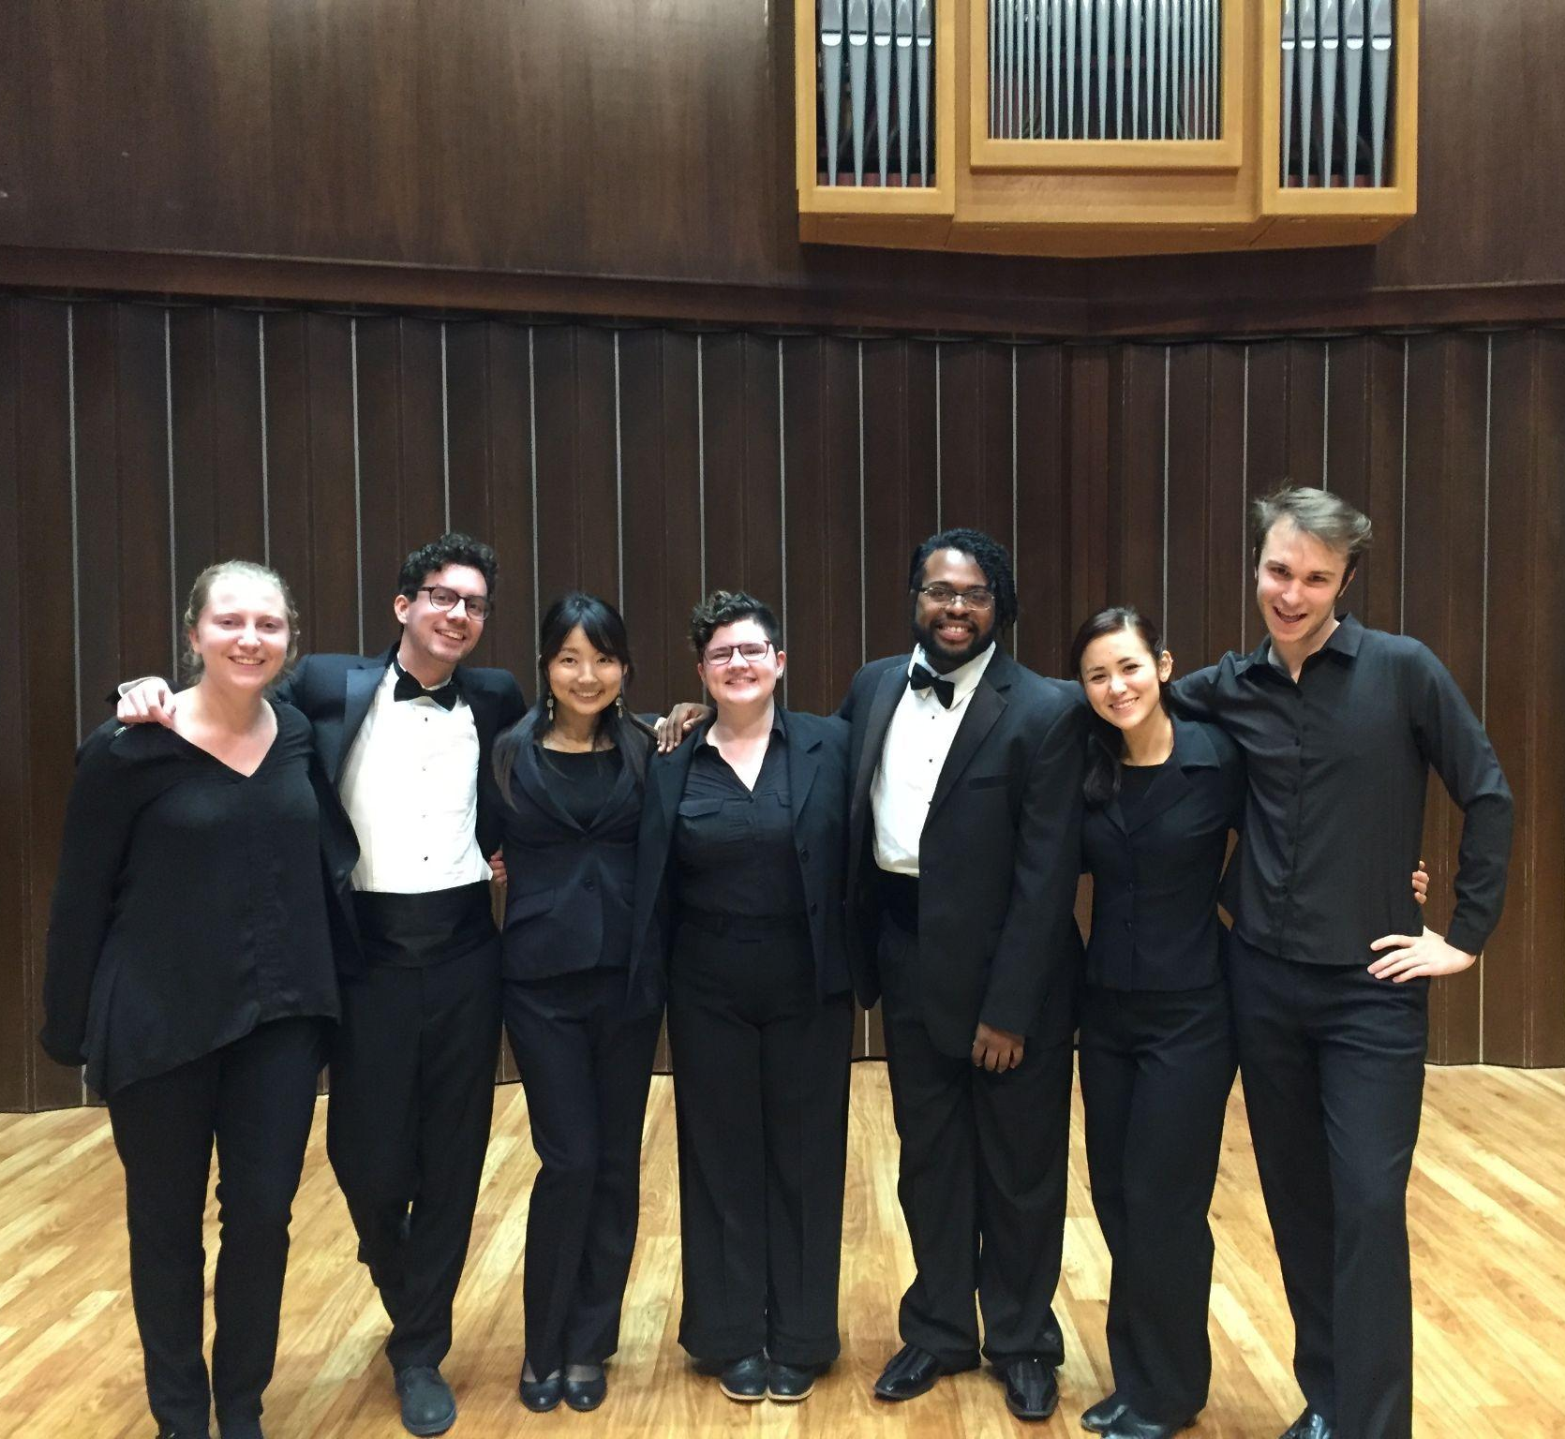
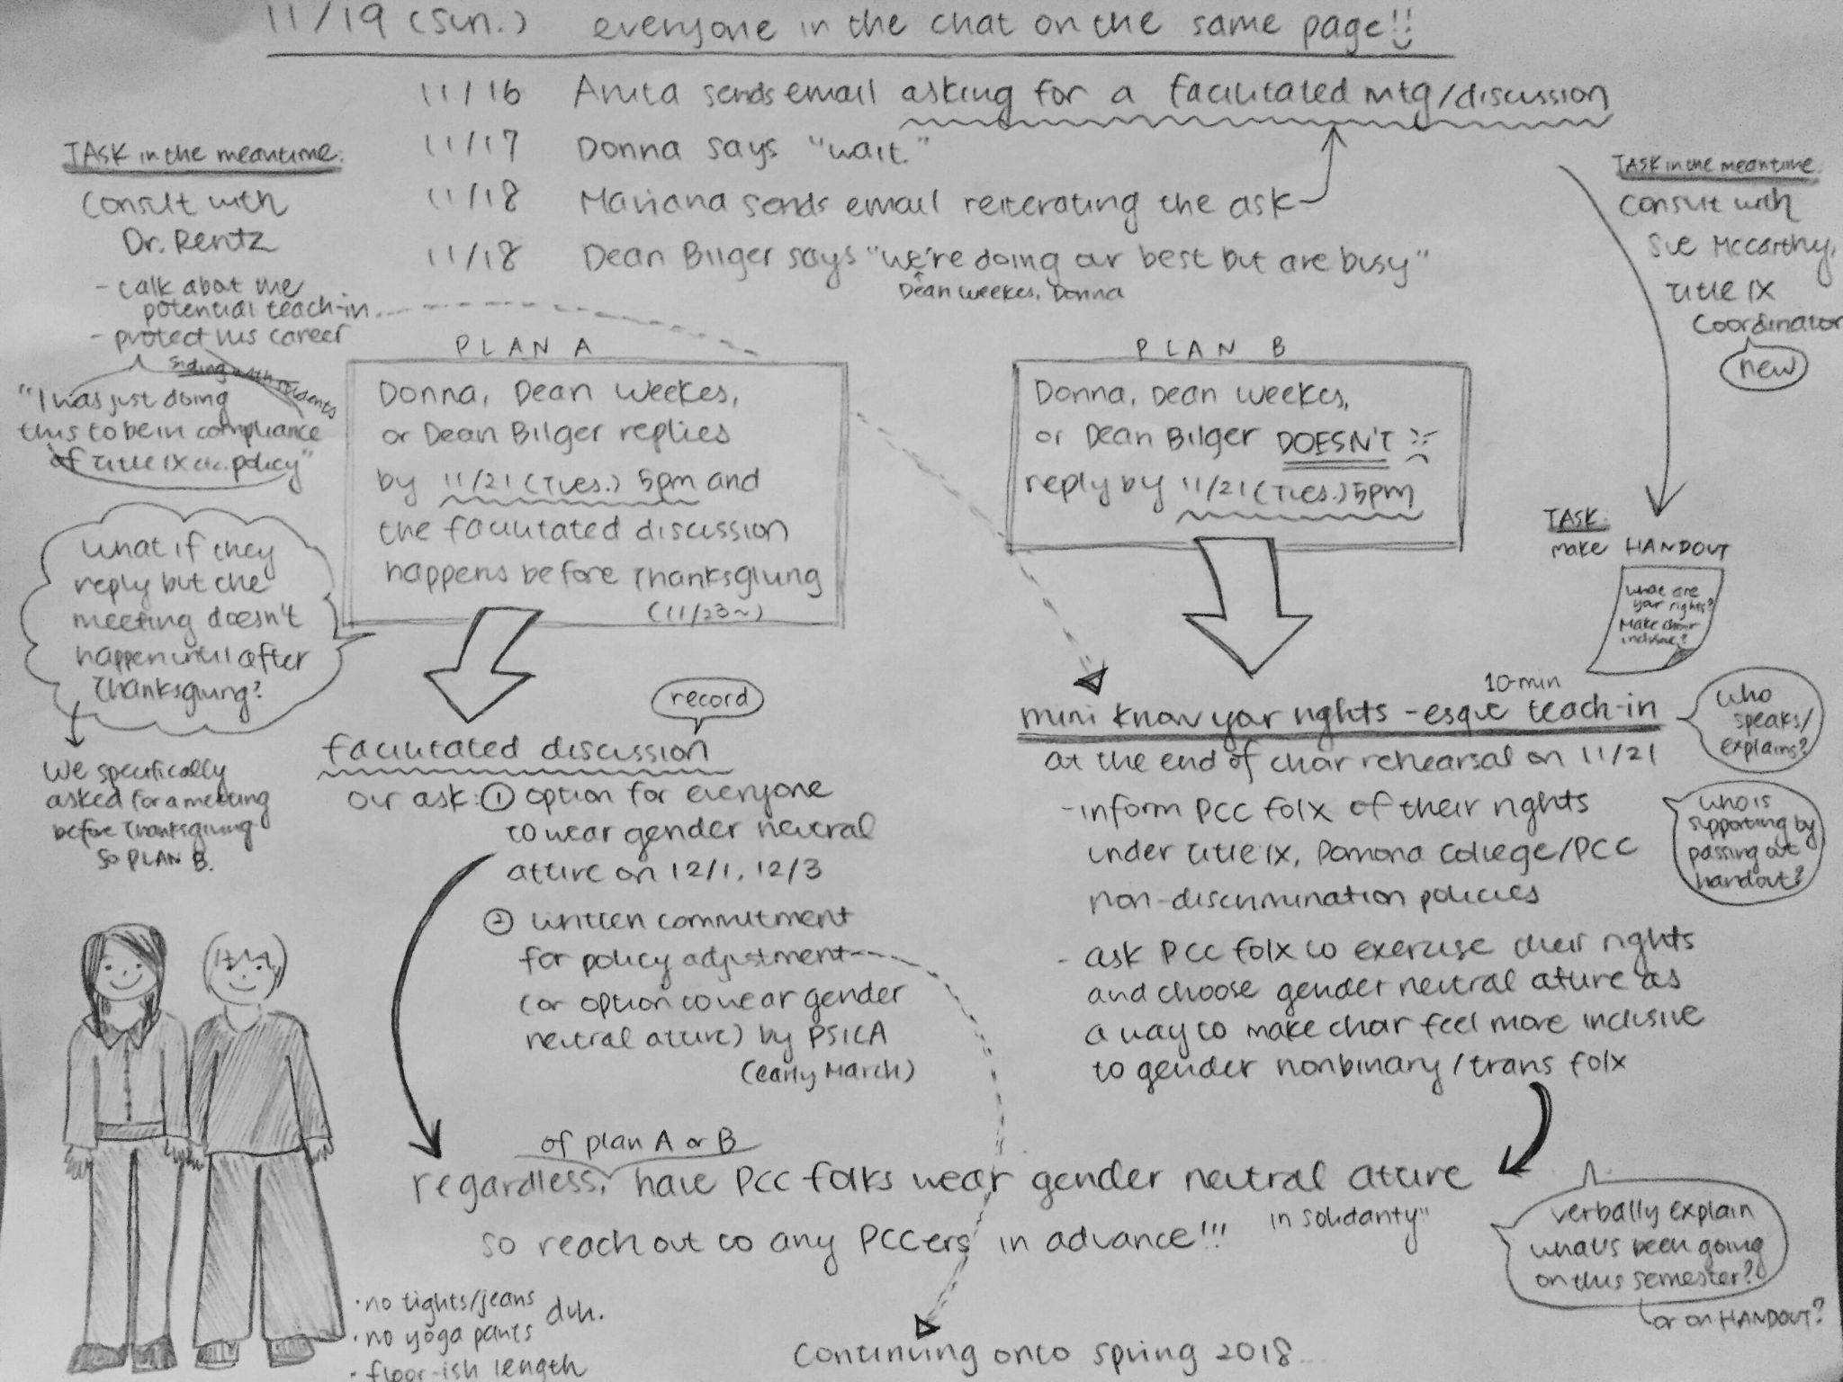
Notes:
Teaching point: Strategy is important because it makes action meaningful by clarifying the path to real change &
Strategizing is not something new but actually something everyone has experience doing in everyday lives
3 mins (~3:33)
Before we dive in, let me share my story.
I like singing and harmonizing! So in college, I was in a choir for four years.
One of my friends, Mariana, came out as nonbinary before our senior year began, and said there should be a gender neutral concert attire option, not the tuxedos or the floor length skirt. The choir conductor named Donna said, okay Mariana can wear pants, but it won’t be an available option for others unless they ask for it with a reason - because of the traditions of choir and what not.
Mariana, Aidan, and Anita, and I are on the way back to our dorm from this meeting with Donna, and even though it was night time and cold and dark, under the street lamps, mixed with smells of lawn getting watered, I could see Mariana had tears in their eyes and I felt something boiling inside me - Mariana is hurting and we need to do something about it.
When we get to our dorm, I grab my pencil and started drawing out some options. We analyzed the stakeholders, talked with college deans. We had conversations and meetings with the rest of the 100 members of the choir, talking about the safety of our choir members. In the end, Donna stopped resisting, we showed up in gender neutral concert attire, pictured here, with much joy and a sense of restored safety.
Today I work at Leading Change Network, pursuing the joy and safety and comfort of my people globally.
PAUSE
Ok so that’s my story of self but it’s also a story about strategizing - you see, in college, as students, we were furious about most everything that happened, from the way the college was handling sexual assault cases on campus to the right-wing visiting professor who was announced to join the sociology department.
But often times we would do sit-in’s in the admin building or sociology building and we didn’t quite have an idea of how the sit-in or the protest was actually going to make a difference.
I guess we were counting on the college staff feeling some sort of sympathy? But these decision makers do not change their decisions just because we beg them too.
Thumbs up or down if you had similar experiences? Like you are participating in an action but you don’t know how it’s actually going to make a concrete change? Yeah.
So that’s where strategizing comes in.
On the other hand, who here has strategized before? Doesn’t have to be an organizing project, even in everyday lives, do you strategize? Yeah! We are all natural strategists. What we are going to learn today is nothing super new, just making some concepts explicit, just like we learned relationship building and team launch earlier today.
So what exactly is strategy, anyway?

Slide 112
Strategizing is
turning what you have (resources)
into what you need (power)
to get what you want (change)
Notes:
Teaching point: Strategy is turning what you need to get what you want
1 min (~3:34)
In organizing, we define strategizing as turning what you have into what you need to get what you want.
When there is something you want, you look at the things you can use or people you can turn to, and think hmm, “how can I use those things to get what I want?”
In the choir attire case, Aidan knew about the relationships between college staff, I was good at taking notes and visualizing things, Anita was good at talking, so we worked together.
The goal today is not to learn a perfect strategy or find the best answers, but to learn what questions you can ask to build and continue refining an effective strategy.

Slide 113
Notes:
Teaching point: Strategy fits into the five practices of organizing as a bridge from team launch to action, as the head part of the head-heart-hand framework, and as a pathway to developing organizational capacity (not just to making an impact on the society)
4 mins (~3:38)
In the five leadership practices of organizing, strategizing fits right here, building on what we did over the last two days of the workshop. Now that we can communicate our values in our stories, and share values with others in relationship building, and build a strong team structure with shared values, interests, and creative resources, we have the foundation to step into the next practice: strategy.
Just a pause here–on top of the leadership practices here I added what we call this framework, People, Power, Change.
The first question is always, who are my people. It’s not what is the issue, but who are my people.
Why do you think in organizing we always begin with this question?
Probing questions:
Because people power is important → What does people power mean to you? We can’t organize alone, etc. Remember the Story of Now exercise where we brainstormed our resources?
Because we need to use people’s resources → Yes
Because people need to develop their leadership → And why is it important for people to develop their leadership? → People need to be able to solve their own problem
[Lift up comments such as people themselves need to be able to solve the problem, others coming in and solving will not solve the problem, etc.]

Slide 114
Develop organizational capacity to solve the problem and keep it solved
Launch a campaign
Campaign
Foundation
Organization
Constituency
Launch
a team
Notes:
Teaching point: Strategy fits into the five practices of organizing as a bridge from team launch to action, as the head part of the head-heart-hand framework, and as a pathway to developing organizational capacity (not just to making an impact on the society)
30 secs (~3:38:30)
And so we always begin with the constituency, our people.
And we want to not just build the foundation and launch a team, and run a campaign, but we want to develop organizational capacity through this campaign in order to build the power we need to continue tackling challenges.
So strategizing in a campaign is not just about achieving the campaign goal but is about developing organizational capacity in the long term.

Slide 115
Three outcomes of successful organizing
Individual
Organization
Society
Facilitates
learning
Increases organizational capacity
Reaches a clear and concise goal
Notes:
Teaching point: Strategy fits into the five practices of organizing as a bridge from team launch to action, as the head part of the head-heart-hand framework, and as a pathway to developing organizational capacity (not just to making an impact on the society)
30 secs (~3:39)
In fact, there are three outcomes of successful organizing. In addition to the societal impact of achieving a clear and concise goal, we look at organizational growth and individual growth.
In order to build power among our people, it’s important for us to ask, what have we learned to do together? Are we bringing more people in and growing our structure?
And how have we developed the leadership of each one of us through the campaign?

Slide 116
Strategy is…
Motivated
Nested
Situated
Challenge
PLOT
The mountain top goal
Outcome
TAKTIKAS
=
CHARACTER
STRATEGOS
Ranks
Strategic goal
=
Choice
General
MORAL
Resources
Intentional
A verb
Constraints
Goals
Act
Act
Act
Plan
Plan
Plan
Strategy
Reflect
Result
Result
Result
Reflect
Reflect
Resources
Opportunities

Slide 117
Six organizing questions
2. What change
do we seek?
Change
4. How do we get there? (theory of change)
3. What is our goal?
(strategic goal)
1. Who are my people?
Power
5. What are our tactics?
6. What is our timeline?
Notes:
Teaching point: There are 6 key questions when creating a strategy; the first 4 are: Who are our people? What changes do we seek? What is our goal? and How do we get there?
1 mins (~3:40)
With all that in mind, we are now going to build our strategy through 6 organizing questions, which are based on the definition of strategizing–turning what we have, into what we need, to get what we want.
Remember, today’s goal is to learn what questions we can ask ourselves in our own campaigns or work.
Who are my people?
What change do we seek?
What is our first specific goal toward that change?
How do we achieve that goal?
What are our tactics that implement the theory of change?
What timeline are we going to do the tactics?
In this strategy session, we will deal with the first 4 questions, and then we will do 5 and 6 with Rawan tomorrow.

Slide 118
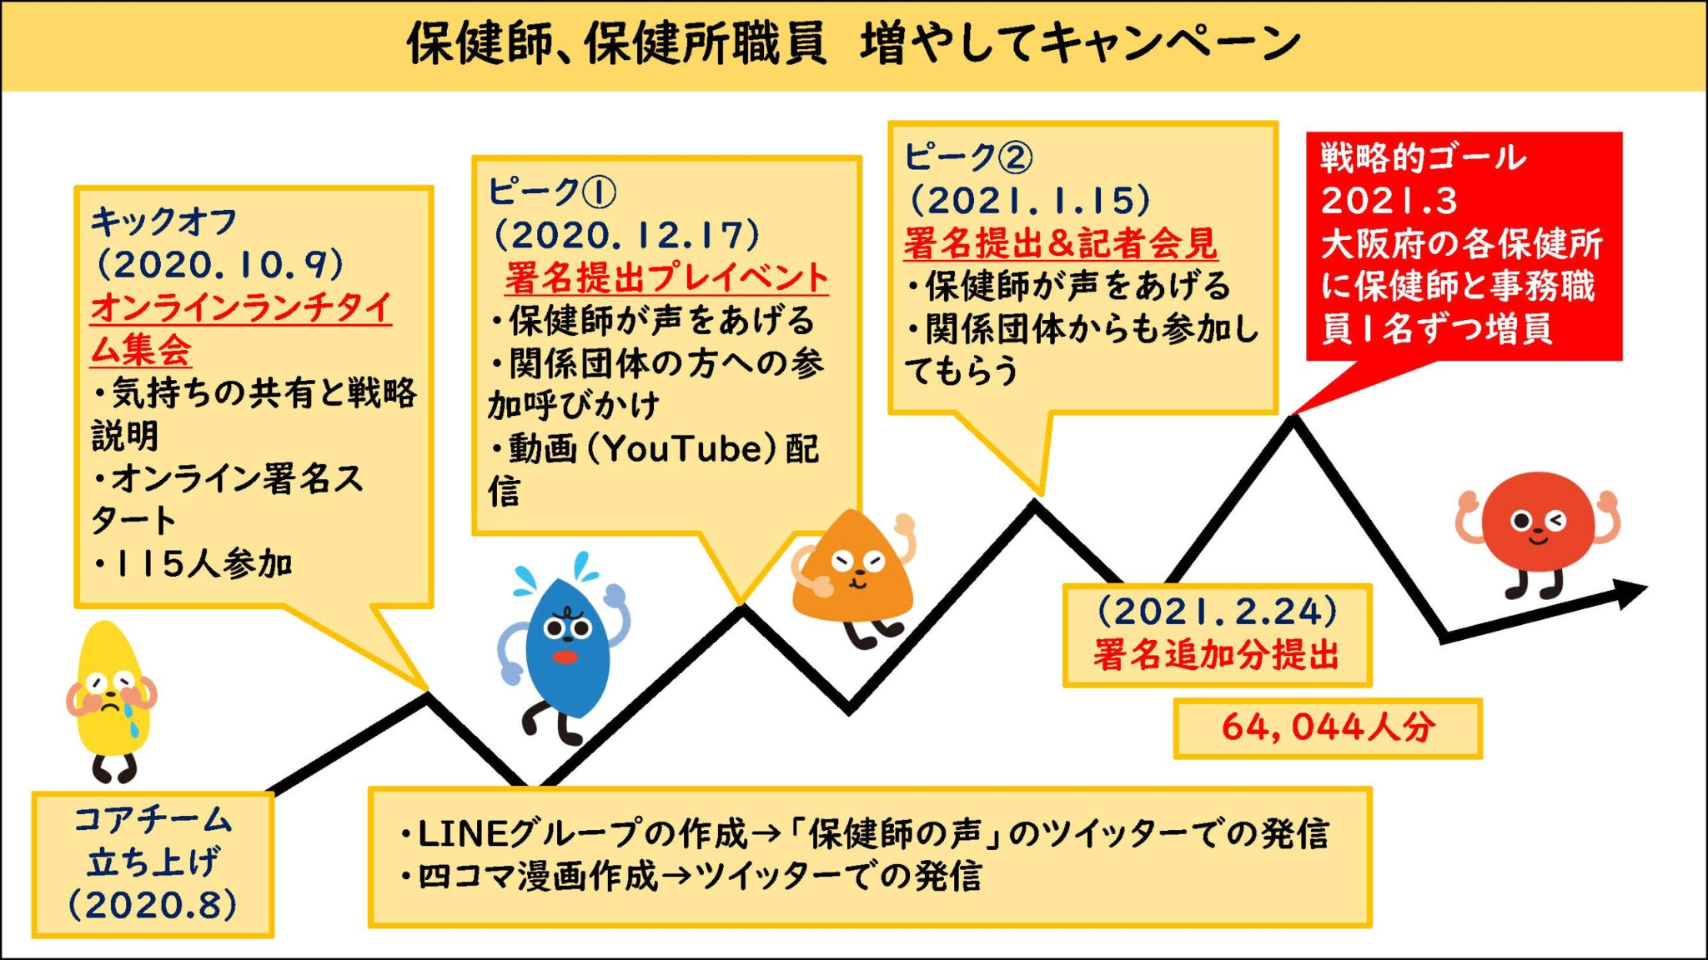

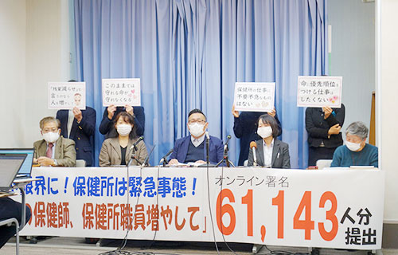
Osaka-fu Workers Union (Fusyokuro) Campaign to Increase Public Health Center Nurse & Staff
大阪府の保健師、保健所職員増やしてキャンペーン
Osaka-fu no Hokenshi Hokenjo Shokuin Fuyashite Campaign
61,143 petitions submitted (as of January 2021)
Book published in 2021
Notes:
30 secs (~3:40:30)
Today we are going to learn how those 6 questions work through a Japanese workers union organizing campaign from 2020.
It’s called 大阪府の保健師、保健所職員増やしてキャンペーン.
LCN’s partner organization, Community Organizing Japan, where I was also working until last summer, coached this campaign, and they even published a book on it in 2021.

Slide 119
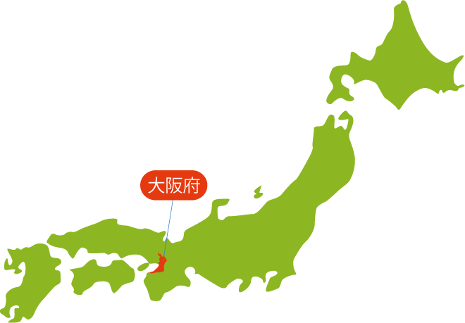
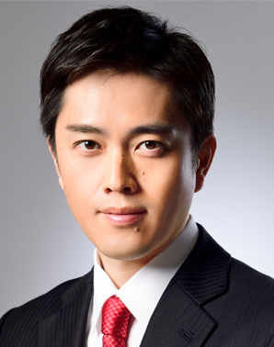
Campaign background
保健所 Hokenjo / Public Health Centers
In Japan, there are 462 public health centers that prevent diseases and improves public health
  Who works there?
    Public health nurses
    Nutritionists
    Veterinarians
    Pharmacists
    Social workers
  They support individuals and families of:
    Lifestyle diseases
    Child abuse
    Needs of disabled or elderly people
    Suicide prevention, mental health
    Infectious diseases
    Natural disasters
Since around 2000, public health centers have been reduced, budgets cuts, functions limited
  The number of public health centers in Osaka-fu has decreased from
  61 in 2000 to 18 in 2020
大阪府 Osaka-fu (a prefecture in Japan)
Population: close to 9 million people
Includes Osaka City, a major economic city
Home to the Japan Innovation Party (Nippon Ishin no Kai) which is a conservative party that increased its prominence since around 2016; the Party pushes for smaller government and cutting bureaucratic waste
Since 2019, Yoshimura, the Leader of the Japan Innovation Party, has been the governor of Osaka-fu
Notes:
1 min 30 secs (~3:42)
Let me explain a bit of the background of the campaign, which I’ve shared with you in advance for you to read.
The campaign takes place in Osaka-fu, a western prefecture in Japan, that includes Osaka City, which is one of the biggest cities in Japan.
It’s a geopolitically unique prefecture in that it is home to Japan Innovation Party, we call them Ishin, which pushes for smaller government among other conservative policies.
The governor of Osaka-fu since 2019 is Yoshimura, the Leader of this Ishin party.
The other context that is important is that of hokenjo or public health centers.
In Japan, we have these public health centers that not treat diseases but prevent diseases.
Public health nurses, nutritionists, vets, pharmacists, social workers, and many other stakeholders work there to support individuals and the families of individuals with lifestyle diseases, child abuse, disability, mental health struggles, etc.
Since 2000, the number of public health centers has been cut, in a major trend to making things less public and more private.
The number of public health centers in Osaka-fu decreased from 61 in 2000 to 18 in 2020.

Slide 120
Events leading up to the campaign
2000~
The number of public health centers and staff were reduced
Osaka-fu Workers Union had been asking to increase public health center staff in collective bargaining but to no avail
2020
January
The first case of COVID-19 patient was confirmed in Japan
COVID-19 became a designated infectious disease in Japan, which meant that
public health center nurses and staff became extremely busy, being in charge of:
  Receiving phone calls from people who suspected infection
  Figuring out which clinic / hospital for the suspected patients to consult at
  Coordinating COVID-19 tests and deciding where to send each COVID positive patient: to their home, a quarantine facility, or a hospital
  Keeping track of COVID patients’ health status
  Giving instructions to people who were in close contact with them, etc…
Komacchan (Yasunori Komatsu), the Chairperson of Osaka-fu Workers Union, who had taken an organizing workshop with Community Organizing Japan in 2017, had been pained by the voices of public health center staff… “We must do something!”
August
First core team meeting was held
Notes:
1 min 30 secs (~3:43:30)
Osaka-fu Workers Union, which is a labor union for any employee of Osaka-fu governmental facilities, had been asking to increase public health center staff in their collective bargaining, but it had not been successful.
In 2020, COVID-19 became a designated infectious disease in Japan, which meant that public health center nurses and staff became in charge of handling COVID cases – from receiving phone calls from people who thought they had COVID, to figuring out where they should go to get tested, and then after they test positive, figuring out where to send the patient, and then following up with their health status every day, etc.
Keep in mind, this is not even their main usual work of taking care of the disabled or elderly or lifestyle illness patients. They got really really busy.
Komacchan, who is the Chairperson of Osaka-fu Workers Union, had been hearing the painful voices of the public health center staff — that they can’t do their work! Too much to do.
He had taken an organizing workshop a few years back, and thought, maybe we can start a campaign.
In August of 2020, he put together a core team of public health nurses and staff, and a few workers union staff.

Slide 121
Six organizing questions
2. What change
do we seek?
Change
1. Who are my people?
Can we
reach them?
250 public health center nurses and staff in Osaka-fu
Notes:
Teaching point: Our constituency needs to be focused and specific
1 min 30 secs (~3:45)
We want to go through the six organizing questions with this campaign.
We said we start with who our people are.
So who do you think are the people, the constituency in this campaign?
[hear a few voices]
Patients → Hmm. So whose voices were Komacchan hearing? Patients and the elderly and those who receive the care of the public health center staff were definitely an important stakeholder in this campaign, but they were not the ones who stood up.
Public health center nurses → Okay, great! Did they organize all public health center nurses across the country? No. As we run our campaign, we need to reach our constituency. Komacchan was only able to reach the public health nurses in Osaka, so that’s where they concentrated their resources. When you are figuring out your constituency, also think: can we reach them? Where can you find them? Can we make a list of the constituency?
Then the second question is, what change do our people seek?

Slide 122
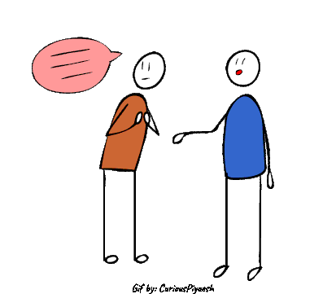
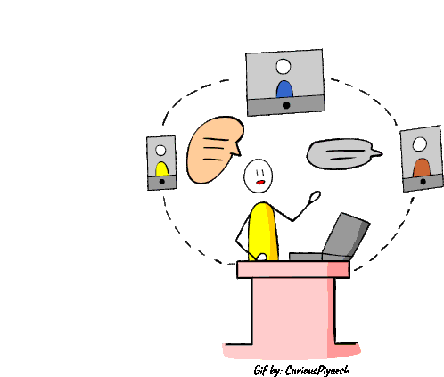
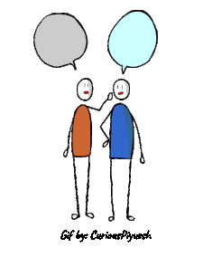
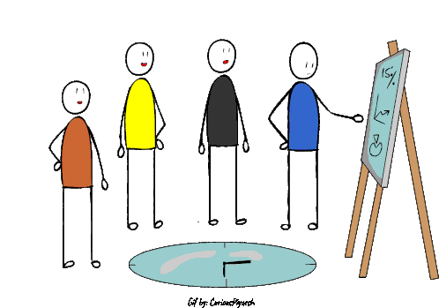
How do we figure out what the problem is?
Listening drive
Stories
Community research
Notes:
Teaching point: Strategy is motivated by a specific, urgent, shared challenge
1 mins (~3:46)
If we are not sure what exactly our people are struggling with, how can we find it out? Any ideas?
[hear a few voices}
Why is it important to listen?
Research → distinction between research and listening
We want to be as specific and real as possible about the change we seek.
So talk to the constituency!
It’s often common for a campaign to have a listening drive phase before fully fleshing out the strategy.

Slide 123
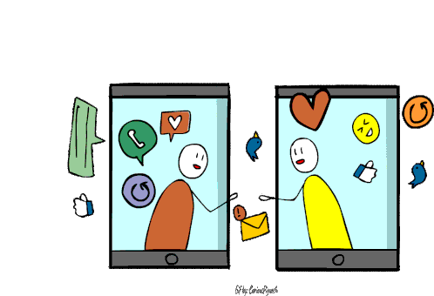
Setting up a LINE (≒ WhatsApp) group chat to hear from public health center nurses and staff
“My general flow of a busy day is waking up at 5:30am, leaving home past 7am, starting work at 9am, and finishing around 1am, getting home around 2am. Many younger public health nurses reported
mental and physical health issues due to stress.”
— Public Health Nurse on Infectious Disease Team, age 40s
“There are calls throughout the day. Some people call, worried that they have been in close contact with COVID-19 patients, and others call about non-COVID health consultations. Sometimes we get yelled by people who are feeling fear and frustration, and sometimes we get stuck between the Osaka-fu government and the people. I am always nervous and don’t remember when I take lunch. I get home past midnight on all seven consecutive work days.”
— Public Health Nurse on Infectious Disease Team, age 20s
“I support intractable disease patients usually and take on COVID-19 response in addition to that work.
I start work at 9am, responding to COVID-19 patient care and calls that rolled over from the day before. But new COVID-19 patients call us throughout the day, and work accumulates. That day, we didn’t have any breaks, even to eat. My head stopped working and I asked to leave work around 3am.”
— Public Health Nurse on Maternal Care, Intractable Disease Care, Community Care Team, age 20s
If we don’t do something about this, we can’t save lives that we could have saved!
Notes:
Teaching point: Strategy is motivated by a specific, urgent, shared challenge
1 min 30 secs (~3:47:30)
In this campaign, they set up a LINE, similar to WhatsApp group chat that all constituency could join. Komacchan told me, in the end, 50 out of all 250 public health nurses and staff in Osaka-fu were part of this group chat.
Every day, the public health nurses and staff would message the group at extreme times of the day like 1am, 3am, saying they are on their way home from work, they are exhausted, worried about other patients that they did not get to take care of because they had to spend all the time for COVID patients.
They were frustrated that they just don’t have enough time to care about each patient like they want to.
They mourned the lives lost that they could have saved if they could give more care.
Also the public health nurses and staff did not even have lunch time, so they did not have the downtime to share these struggles with each other, until this LINE group was made.

Slide 124
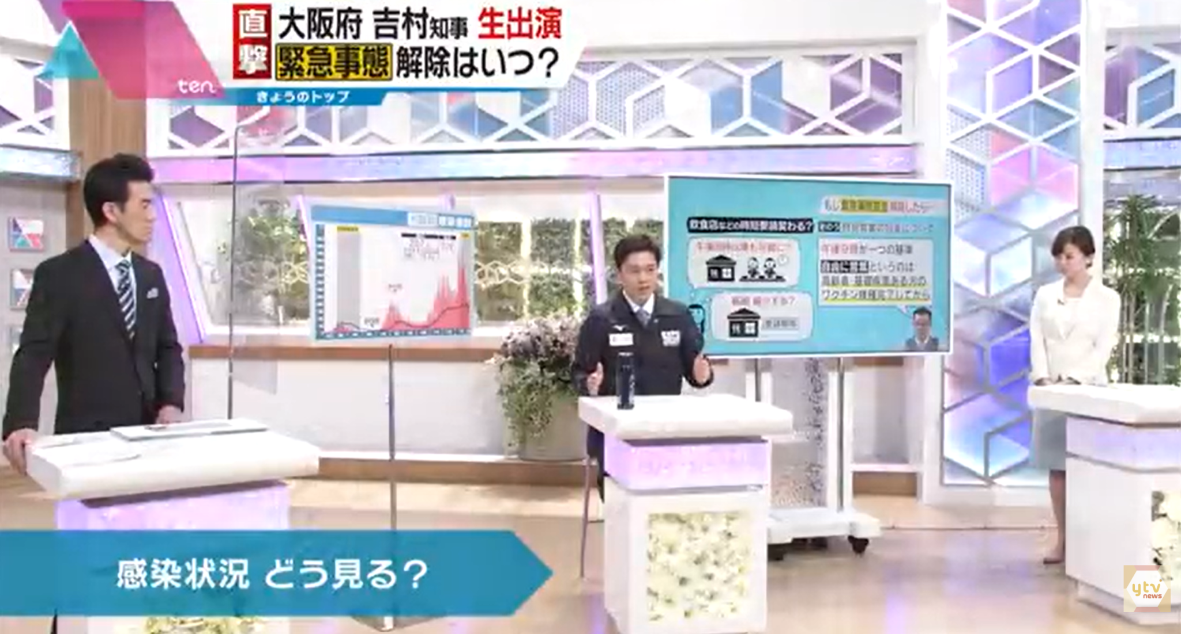
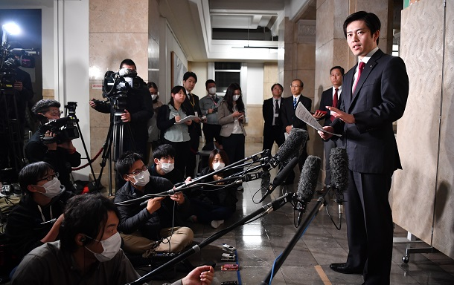

Governor Yoshimura’s popularity rising under COVID-19 pandemic
Talking on TV 10 times a month
People tweeting ＃吉村寝ろ
= Yoshimura, Go Sleep
Notes:
30 secs (~3:48)
To make things worse, Osaka-fu governor Yoshimura was rising in fame as he appeared in media, sharing his “efficient” approaches on handling COVID - to the point this hashtag #YoshimuraNero got popular - it means Yoshimura, Go Sleep, which is ironic because in the shadow of his fame were the sleepless public health center nurses and staff.

Slide 125
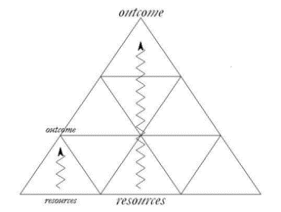
Worksheet
PEOPLE
Who are my people? (constituency)
PROBLEM
What is their problem? | How would the world look different if their problem were solved?
Why hasn’t their problem been solved? | What would it take to solve their problem?
CHANGE
What is the big picture outcome?
Strategy is motivated
Strategy is nested
Challenge
PLOT
The mountain top goal
Outcome
CHARACTER
Strategic goal
Choice
MORAL
Resources
Notes:
Dropping info but it’s not clear - not sitting
When you build your team’s strategy today, it’s important to narrow down the problem that your people are facing.
You will be doing this problem analysis on this worksheet on page 95. In it, there are questions like what is the problem, how would the world look different if it’s solved. I find it helpful to think about these questions with the challenge, choice, outcome structure from public narrative. It’s helpful to paint the picture of the urgent problem that people are facing daily.
And then at the end, you brainstorm the big picture outcome or the mountain top goal. So strategy is nested, and we will be breaking down this big goal later, but for now, think, top of the pyramid.

Slide 126
Worksheet
PEOPLE
Who are my people? (constituency)
PROBLEM
What is their problem? | How would the world look different if their problem were solved?
Why hasn’t their problem been solved? | What would it take to solve their problem?
CHANGE
What is the big picture outcome?
Notes:
Also when you are analyzing the problem and thinking, why hasn’t this problem been solved, here is another framework that could be helpful.

Slide 127
Three faces of power
Why is the problem not recognized as a problem?
How can the problem be recognized as a problem?
Who controls the narrative?
Who benefits and who loses?
Structure
Agenda
Who decides that the problem is a problem?
How can we bring it to the decision-making table?
Decision
Who makes the decision about the problem?
How can we win?
Notes:
Teaching point: Three faces of power framework helps us analyze the problem
1 min (~3:49)
In answering what change do our people seek, we ask difficult questions like “Why hasn’t the problem been solved?” and through that, we often analyze what is happening on the structural level.
The three faces of power, which Marshall introduced to you at the first session today, can be helpful here, so let’s review.
In the very first face is decision making power, where we ask, who makes the decision about the problem? How can we get the decision we want?
The second face is agenda setting power, where we ask, who decides that this problem is even a problem to begin with? How can we bring this to the decision making table?
And the third face is structural power, where we ask, why is the problem not recognized as a problem? And ultimately, who is benefitting and who is losing from this structure?
Three faces of power framework helps us to take a step back and look not only at the decision-maker but also at the structure of why this problem persists.

Slide 128


Three faces of power
Public health center nurses and staff did not feel like they could share their challenges with each other due to lack of time, space, a sense of responsibility, isolation, and stigma (normalization of overwork)
Structure
Agenda
Osaka-fu (Prefectural Government)
Health and Medical Care Department Head
  The department’s Human Resources Division
Decision
Osaka-fu Governor Yoshimura
Propose HR plan
in February
Announces HR plan
in March
Notes:
Teaching point: Organizing strategy should crack at the structural level of power
3 mins (~3:52)
Let’s look at the three faces of power in the Osaka-fu Workers Union Campaign.
In this campaign, who makes the decision about the problem?
The decision maker was the Governor Yoshimura. Every year he announces the human resources plan for the government facilities in March, for the next fiscal year starting in April.
This HR plan for the public health centers is proposed by the Osaka-fu Health and Medical Care Department, so they are the agenda setters.
But it’s really important to look at the third face of power, the structure.
Does anyone have any ideas – In this campaign, why is the problem not recognized as a problem?
What is the underlying problem?
Japanese culture - hard work culture, not challenging, non confrontational
[hear a few voices]
Normalization of overwork (workers’ own internalized beliefs)
Mainstream narrative was critical of “public servants” and supportive of Yoshimura who cut “bureaucratic waste.”
Why was it that way?
The public health center nurses and staff did not feel like they could share their challenges with each other due to lack of time, space, a sense of responsibility, isolation, and stigma, and even thought maybe this is normal, right, how there is nothing we can do about it.
READ THIS:
If we just wanted Governor Yoshimura to change his decisions, maybe we could find someone who could sway his opinions, maybe some political figure or something, etc.
But that would not have changed the lack of confidence the public health nurses and staff had in creating the change on their own.
Rawan taught me that the three faces of power is like three glass bowls – we might directly tackle the decision making bowl in the very center, but in doing so we try to crack the other glass bowls too. We can’t change the structure in one campaign, but slowly crack at it.
—--------------------------------
Took out
The general public did not understand the functions of public health center nurses and staff
and the general public did not understand the functions of public health center nurses and staff. The public opinion was that sure, during COVID, the nurses are busy, but if we increased them now, they won’t have anything to do after COVID is over. That was not true - they had already various functions at the public health centers that they were running on low capacity, even from before COVID.

Slide 129
Six organizing questions
2. What change
do we seek?
Public health nurses and staff win back their dignity in carrying out their responsibilities to save lives
Change
The mountain top goal
1. Who are my people?
3. What is our goal?
(strategic goal)
250 public health center nurses and staff in Osaka-fu
Resources
Notes:
1 min (~3:53)
Going back to the six organizing questions, we are trying to answer this mountain top goal change that we seek.
We heard from the LINE group chat how the public health nurses and staff were frustrated that they were unable to save the lives that they could have saved due to high workload.
We saw from three faces of power that they did not feel like they could change this situation, that they thought this is just how it is.
From these problem analyses, we can say that the mountain top goal was not just to increase the number of staff, but for the public health nurses and staff to win back their dignity in carrying out their job, their responsibilities to save and support lives in their community.
Okay, but that feels broad, right? We can’t completely win back their dignity just in a year or two. So then what can we do right now, in the next year or so, with the resources that we currently have, that builds toward that mountain top? That’s the strategic goal. It’s nested.

Slide 130
Breaking down the change into a strategic goal
Can we achieve this in a year?
Public health nurses and staff win back their dignity in carrying out their responsibilities to save lives
Change
Double the number of public health center nurses and staff in Osaka-fu
The mountain top goal
Increase the number of public health center nurses and staff by one* at every public health center in Osaka-fu, by March 2021
What does it look like to win back their dignity?
What’s the most pressing challenge?
Resources
*Without reducing the number of staff in other departments in Osaka-fu
Notes:
Teaching point: It’s important to break down the change into a concrete goal to focus our resources first
2 mins (~3:55)
There are various ways to break down the big mountain top goal into smaller goals that can potentially be strategic goals.
We can imagine what does it look like for public health nurses and staff to win back dignity in their work? What’s stopping them from doing that? What is the most urgent day-to-day challenge? We might brainstorm a few.
In this campaign case though, the most urgent day-to-day challenge was the overwork caused by not having enough nurses and staff.
We could then say, okay, if the number of public health center nurses and staff doubled, then we can get rid of overwork and have dignity in carrying out our jobs.
But then we might ask, can we achieve that in a year or so?
In the situation where the number of public health centers in Osaka-fu decreased from 61 in 2000 to 18 in 2020, doubling the number back in a year was completely out of the question.
Then, what is a step before that? What would be the first step?
After mulling over this for a while, the core team decided that their goal is to increase the number of public health center nurses and staff by one at every one of the 18 public health center in Osaka-fu, by March 2021. So at each of the 18 centers, there is one new nurse and one new staff.
They also added a condition that this must be achieved without reducing the total number of staff in other departments in governmental facilities across Osaka-fu – since sometimes governments often try to keep the total headcount the same, but that would harm staff in other departments.
So in your campaign too, let’s say you already have a concrete thing you want to win - like changing this law, or something. That’s great, but ask yourself, do our people currently have the resources to achieve that? Or do we need to set a goal before that, so we can build our capacity toward that bigger goal?
—-----------------------------
What is a step before that
this is not going to solve everything but we have to start somewhere
looking at the resources = you can't do that in one campaign
what are the different problems with dignity, what are the different ways in which dignity is taken away
which one is the biggest issue (they set some criteria)
get confidence and hope that
Honestly it was not going to
1人増えたからといって、コロナ禍で忙しい状況が解決するのか？という話も合った
保健所の数が減らされている
20年くらい前の水準に戻してほしいと思った
でも、現実にこのキャンペーンの期間中にどこまで自分ができるかってなったときに、まず1人でしょう
1人増えて変えるのか？
何十人減らされてきて、誰も増えないと思っている中で、1人増えることは希望につながる、必ず次につながる

Slide 131
Breaking down the change into a strategic goal
Public health nurses and staff win back their dignity in carrying out their responsibilities to save lives
Change
Double the number of public health center nurses and staff in Osaka-fu
The mountain top goal
Criteria for effective strategic goals
Concrete, measurable, meaningful (Contribute to a specific change)
Motivational
Leverage (makes use of our resources)
Builds capacity
Contagious (can be emulated)
Increase the number of public health center nurses and staff by one* at every public health center in Osaka-fu, by March 2021
Resources
*Without reducing the number of staff in other departments in Osaka-fu
Notes:
2 mins (~3:57)
We have some criteria for effective strategic goals. Let’s evaluate this goal with each criteria.
This is where we want to use the thumbs up or down thing!
The first one is… Is the goal concrete, measurable, meaningful? In other words, after all the effort, can we easily tell if we won or lost? Yes.
Is this motivational? Yes. It’s directly responding to the day-to-day needs of the people.
Does this leverage people’s resources? In this campaign, the goal alone can’t really tell that. Let’s keep this in mind when creating the theory of change.
Does this build capacity? Yes. In fact, Komacchan told me, increasing the number by one at each center was not at all enough to tangibly reduce the staff’s workload. The overwork was not going to be solved by adding just one person. But the team felt, and this is where the structural analysis we did comes in, that if they were able to increase even one nurse and one staff per center, after two decades of significant decrease, they will feel the confidence and hope that they can create change by themselves in this difficult situation. This goal was definitely not the end, it is just one milestone in the long climb that they had planned. And so this campaign needed to develop the people’s leadership and capacity so that they are able to continue leading and winning after this campaign.
Is this contagious? Yes! And it has actually been emulated in other non-health departments at Osaka-fu, as we will see toward the end of this presentation.

Slide 132
Six organizing questions
2. What change
do we seek?
Change
3. How do we get there? (theory of change)
3. What is our goal?
(strategic goal)
1. Who are my people?
Power
How can we use our resources creatively to build power to create change?
Increase the number of public health center nurses and staff by one at every public health center in Osaka-fu, by March 2021
250 public health center nurses and staff in Osaka-fu
Notes:
30 secs (~3:57:30)
So we figured out our people, the change we seek, and our strategic goal.
Then we think about how we can get from here to there. This we call the theory of change. It’s how can we use our resources creatively to build power to create change?
Just another note here that sometimes, we think about the theory of change and then align on the goal. In fact, strategizing is a very iterative process – going back and forth between the theory of change and strategic goal to refine them.

Slide 133
Map of actors
Leadership team
Common values
Constituency
Supporters
Competitors
Decision maker
Conflicting
values
Oppositions
Notes:
Teaching point: We map the actors to analyze who holds power, who has the ability to create change, where they sit, and how they relate to each other.
In order to figure out a theory of change, we map the actors to analyze who has the ability to create change, and how they relate to each other.
It helps us see the full landscape around the specific change we want to create.

Slide 134
Map of actors
Leadership team
Komacchan
Nagata
Uchiyama
Ueno
Ochi
250 public health center nurses and staff in Osaka-fu
Common values
Constituency
Supporters
Workers Diseases & Injuries Group
NPO Osaka Intractable Disease Assoc.
Staff from other unions
Competitors
Media
Decision maker
Conflicting
values
Governor Yoshimura
Ishin Party
Oppositions
Notes:
2 mins (~3:59:30)
In this campaign, this was the leadership team, and this was the constituency.
Next: Who are our supporters? They are not our constituency, but they share common values and support us.
So Workers Disease & Injuries Group, Intractable Disease Association, and other patient circles fit here; they are not the exact people facing the challenge of overwork, but they are in relationship to the constituency in receiving care from those public health center nurses and staff, right? So they wanted to support the constituency.
Also there were some members of other unions that Komacchan turned to for their experience.
Next: Who are our opponents? And within the opponents, who makes the decisions about the change we want? The conservative Ishin Party and the Governor Yoshimura.
Finally, competitors don’t necessarily share our values but they compete for the same resources we want.
In this campaign, the media was an important stakeholder - they were often amplifying Yoshimura’s popularity and adding to our challenges.
But could we get them to amplify our side of the story? The team actually reached out to newspapers and TV companies to attend their press conference, which we will talk about later.
So actually we can figure out how to work together with our competitors, and then they could potentially become our collaborators.
In your campaign, who might you be competing for the same resources now but can maybe collaborate if you are intentional?
One other thing to note is that in the limited time in this workshop, we list out our stakeholders in this way, but when creating a real campaign actor map, I recommend you use one post it per person. This looks like this:

Slide 135
Map of actors
Leadership team
1. Komacchan (Osaka-fu Workers Union Chairperson)
2. Support Osaka-fu workers, enable them to join the movement
3. Connections with union members
1. Nagata (public health nurse)
2. Grow the workers movement
3. Credibility and trust from others
1. Name
2. Interests
3. Resources
1. Ochi
(Workers Union secretary)
1. Uchiyama (social worker)
1. Ueno (public health nurse, Worker Union Board)
1. Nishikawa (public health center staff)
3. Can draw
1. Miwa
(public health center staff)
3. Can draw
1. Kayama
(public health center staff)
3. Can tell a story as a mother
1. Ishimura
(public health center staff)
3. Can tell a youth story
Common values
1. Fujino (Workers Diseases & Injuries Group)
3. Stories of getting support from public health center staff
Constituency
Supporters
1. Matsumoto (NPO Osaka Intractable Disease Association)
3. Stories of getting support from public health center staff
Competitors
1. Inoue & Yamada
(staff from other unions)
3. Experience with social media
1. Nakajima & Natori
(staff from other unions)
3. Experience with press conferences
1. Media
Decision maker
Conflicting
values
1. Governor Yoshimura
2. Popularity
3. Approves HR plan
Oppositions
Notes:
Teaching point: It’s important to identify unique resources of the constituency and supporters
1 min (~4:00:30)
Each post-it or box has that person’s name, interests, and resources.
You could do this on a slide or a whiteboard with post-it’s or on an app like Mural.
Because if you wrap up individuals into a group and say this association has these skills or something, we might miss out on identifying the unique, creative resources that the individuals have - such as drawing, baking, facilitating meetings. The more unique and creative the resources brainstormed here are, the more unique and creative we can be in our theory of change.
If you don’t know what individual interests and resources of your people are - have 1on1s!

Slide 136


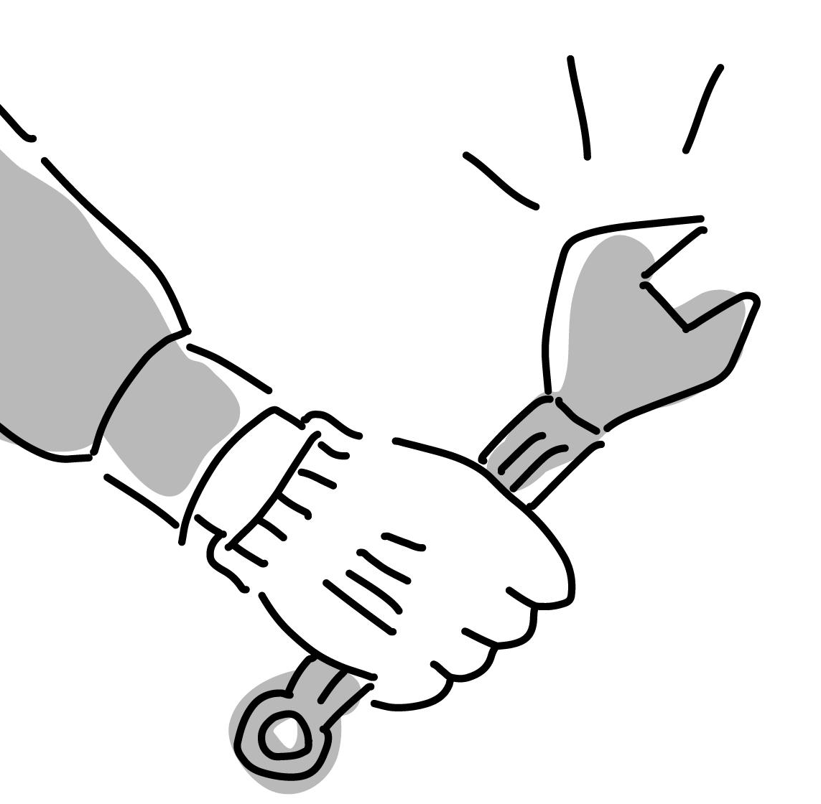

Broad types of theories of change
Informational
If people have more information about the problem, that will solve the problem
Legal
If people use the courts or change the laws, that will solve the problem (most efficiently/effectively)
Technological
If people create or invent something, that will solve the problem
Power (organizing)
If we address the underlying power relationship and shift the power, that will solve the problem (and sustain the change)
Notes:
MAYBE SKIP
1 min 30 secs (~4:02)
Now that we have done the map of actors, we are really getting into the theory of change, but I just wanted to share that there are various types of theories of change in the world.
For example, some theories of change are informational - like raising awareness. If politicians learned about the impact of climate crisis, they will pass laws to stop climate crisis. Some theories of change sound like that.
Some are legal. If people sued the government for not taking enough measures to stop climate crisis, they will win and the government will have to take action. This climate lawsuit is actually happening around the world, including Korea.
Some are technological. If technology for solar panels improved and they got cheaper, then more people will use them and we can stop climate crisis.
But sometimes none of those actually lead to a sustainable change, because the people who want to create that change and the decision maker who can make that change are not the same people. If people who learned about the impact of climate crisis and want to stop it are also the exact politicians who can stop it, they would, right? But that’s not always the case.
These problems are problems of power, and we can only solve it by shifting the power.
So what does it mean to shift power?

Slide 137
Power is relational
Person 1
Person 2
Needs /
Interests
Needs /
Interests
Resources
Resources
Notes:
Teaching point: Power is relational and can be shifted through interests and resources
Contextualize the movie part
3 slides total: 1 min (~4:03)
Power, according to Martin Luther King, is the ability to achieve purpose.
In organizing, we think that power is relational and can be shifted through interests and resources.

Slide 138
Power is relational
Person 1
Person 2
Needs /
Interests
Needs /
Interests
Resources
Resources
Notes:
Teaching point: Power is relational and can be shifted through interests and resources
(if we have time do the 1, 2 exercise but if not, move ahead!)
If person 1 is more interested in person 2’s resources, than how much person 2 is interested in person 1’s resources, then who’s got the power?
Show with your fingers–Who has more power? 1 or 2?
2!

Slide 139
Power is relational
Person 1
Person 2
Needs /
Interests
Needs /
Interests
Resources
Resources
Notes:
Teaching point: Power is relational and can be shifted through interests and resources
And if person 2 is more interested in person 1’s resources, than how much person 1 is interested in person 2’s resources, then who’s got the power?
Show with your fingers–Who has more power? 1 or 2?
1!
You can see the seesaw tilt heavier toward person 1, who has more power in this situation.
In this way, we think power is not some ultimate thing that someone always has a lot of, but is relational and can be shifted by looking at interests and resources.

Slide 140
Building power and using power
Deploy power
Constituency
Constituency
Opposition
Build power
(Relationships)
Needs /
Interests
Needs /
Interests
Needs /
Interests
Resources
Resources
Resources
Notes:
Teaching point: In order to shift power, we need to first build power by building relationships with our constituency
1 min (~4:04)
So we want to create a situation where the opposition or the decision maker is so interested in our resources that they decide to make a decision that we want.
But in order to shift power like this, we need to first create build power among ourselves.
In order to shift power, we need to first build power by building relationships with our constituency.
Only then you can use that power to leverage to shift the power.

Slide 141
Building power and using power
Power with
If we can get what we want
only with our resources,
we combine our resources to create power needed by each other
Constituency
Constituency
Build power
(Relationships)
Needs /
Interests
Needs /
Interests
People power!
Resources
Resources
Notes:
Teaching point: "Power with" is when we combine our resources to create power needed by each other
1 min 30 sec (~4:05:30)
What’s happening on this left side is called “power with.” It’s when we create power with others, among ourselves.
Sometimes, especially when we come up with a strategy like this, we are quick to jump to fighting, like pressuring a system, calling out an institution.
But as we said, in order to shift power, we need to first build power.
Power with is what happens when we take the resources our communities already have - our relationships, our skills, our time - and organize them with each other to meet our own needs.
There are campaigns that only need this power with part - it’s when the change people want is in their hands.
For example, in the northern part of Japan where there was a catastrophic earthquake in 2011, mothers were exhausted because of lack of available options for childcare, so they got together, combined their own skills like cooking, massaging, experience in childcare, and created a care institution run by mothers, for mothers and children. That’s a power with campaign.

Slide 142
Building power and using power
Deploy power
Power over
If we cannot get what we want
only with our resources / we need the opposition’s resources (decision making) to achieve strategic goal,
we combine our resources to
create power and enough leverage so that the opposition will give us what we want
Power
Constituency
Opposition
Needs /
Interests
Needs /
Interests
Decision maker
People power!
Resources
Resources
Shift power
Notes:
Teaching point: "Power over" is when we combine our resources to create power and enough leverage so that the opposition will give us what we want
1 min 30 secs (~4:07)
Other campaigns need this right side of the slide, which is called “power over,” like building our power over the decision maker.
Power over is when the decisions and resources we need are held outside of us - by a boss, a government agency, a corporation.
If in the case of the mothers in northern Japan creating a care institution, the mothers then decided we want to register their institution and get municipal funding, then it becomes a power over campaign, because they alone cannot decide that they get the funding – the decision maker is external.
In fact, some campaigns might have a power with goal first, and then after achieving that, a power over goal in the second phase.
In power over campaigns, we need to organize our strength to shift the power, shift the seesaw.
It’s not just shouting at authority, but making sure our people are strong enough, organized enough, that those in charge have to pay attention.
It’s when ignoring us costs them more than changing does.
So is the Osaka-fu Workers Union (Fusyokuro) Campaign (to Increase Public Health Center Nurse & Staff) a power over campaign or power with campaign?
Thumbs up or down — Who thinks it’s power over? Yeah.
But I want to emphasize that the power with part was very much there too, in the storytelling and relationship building that happened among the public health nurses and staff.

Slide 143
Power analysis
Public health center nurses and staff in Osaka-fu
Governor
Yoshimura
3. What do
they want?
1. What change
do we want?
Increase the number of public health center nurses and staff by one at every public health center in Osaka-fu
Needs /
Interests
Needs /
Interests
Resources
Resources
Approves the Osaka-fu HR plan including that of public health center nurses and staff
4. What resources do we have that they want?
2. Who has the resources to make that change?
Notes:
Teaching point: We analyze power through 4 questions to develop our theory of change, which is a hypothesis on what will happen if we do what
3 mins (~4:10)
So now that we think the Osaka-fu Workers Union (Fusyokuro) Campaign is a power over campaign, let’s go through four questions to analyze power to figure out how to use our resources to get at the decision-maker’s interests, which is the theory of change.
What change do we want?
Who has the resources to make that change?
The third one is important: What do the decision maker want? Let’s brainstorm a bit. What do you think Yoshimura is interested in?
[Get some answers from participants]
What does he want on his personal level
To do his job, organizational goal
His career goals
Okay, and then final question is also key: What resources do we have that Yoshimura might want? What can we leverage?
[Get some answers from participants]
Let’s think about our resources - what do you think we have
Sourdoughs, music,
What are the resources we have at work, bring in our expertise
Great!
Out of the things he wants what do we have
If we use our resources in this way, how is that going to get us there and why (chat)
Answers
Popularity (among Osaka-fu people and across Japan) – maintaining a public image of “doing his best under pandemic”
Osaka-fu workers to not cause trouble
Connections with union members
Stories of public health center nurses and staff
Stories of people who get support from public health center nurses and staff
Can draw
Experience with social media
Experience with press conference

Slide 144
Theory of change
If we / our constituency… (use our resources in this particular way)
then… (we will get the change we want)
because… (reason/assumption)
Person 1
Person 2
Needs /
Interests
A theory of change
exposes weak assumptions and forces refinement
and tough conversations
Needs /
Interests
Resources
Resources
Notes:
Teaching point: We analyze power through 4 questions to develop our theory of change, which is a hypothesis on what will happen if we do what
1 min (~4:11)
This power analysis leads us to our theory of change, which is a hypothesis: if we do this, then we will achieve our goal, because…
So if we go back to the slide before, what is one theory of change we can think of?
[Get some responses, make sure to ask for the “because”]
And do we have the resources to do that?

Slide 145
Theory of change
Is this organizing?
If we public health center nurses and staff in Osaka-fu
impact Governor Yoshimura's reputation by sharing our challenges,
visualizing and amplifying our stories, and
collecting 100,000 signatures on a nationwide online petition,
then we will be able to increase the number of public health center nurses and staff by one at every public health center in Osaka-fu
because 100,000 signatures nationwide will threaten the
nationwide popularity of Governor Yoshimura, who wants to
maintain a public image of “doing his best under pandemic.”
Is this assumption realistic?
Governor Yoshimura gets 2,000,000 votes in an election
→ What would be an impactful number to get his attention?
Notes:
2 mins (~4:13)
Read the ToC
When we create a theory of change, we ask: is this organizing?
Remember in the beginning we discussed how organizing develops leadership capacity of the people? Is this building that?
3 outcomes
Impact his public reputation
And we also ask, is this assumption realistic?
How do we know 100,000 signatures is going to threaten Yoshimura’s popularity?
Komacchan told me that they knew that when Yoshimura got elected as the governor in 2019, he got 2 million votes.
So just a few thousands signatures or tens of thousands of signatures seemed trivial next to that. They chose a hundred thousand signatures as their goal.
Of course, it would be great if we had more precise assumptions about what pushes the needle. But even if we don’t, setting a number target can make things specific - so we can evaluate whether that assumption was reasonable.
And we can evaluate as we run the campaign, and modify the theory of change. Remember, strategy is iterative.

Slide 146
Worksheet
If we need access to the resources held by others to achieve the goal, complete this side
POWER WITH | POWER OVER
What resources do our people hold that they can use to achieve their goal? (Make a creative and specific list) | What do WE want (our goal)?
 | Who DECIDES if we get it?
Why haven’t our people used these resources to achieve their goal? | What do THEY care most about?
How can our people combine their resources in new ways that can achieve their goal? | What resources do WE have that THEY want or need?
Notes:
1 min (~4:14)
In your worksheet, the power analysis looks like this in your handbook on page 97.
The four questions are on the right column. If your campaign is a power over campaign you fill both columns, but if your campaign is a power with campaign, then you only fill the left column.

Slide 147
Organizing sentence
We are organizing… WHO? (people)
to pursue… WHAT? (change)
by… HOW? (theory of change)
to achieve… (strategic goal)
2. What change
do we seek?
Change
3. How do we get there? (theory of change)
4. What is our goal?
(strategic goal)
Resources
1. Who are my people?
Power
Notes:
1 min (~4:15)
Okay, so great work everyone! We are almost done.
Finally, we are going to put everything we figured out so far into one sentence, called an organizing sentence or organizing statement.
We put who our people are, what change we seek, how we are going to achieve that change, and what is our first step goal toward that change into one sentence, a clear story of how we win.
This sentence helps you check that your strategy is consistent, that the change you are seeking is aligned with what the people are facing daily, and that the strategic goal is nested and is in line with a theory of change leading to a big picture goal.
This sentence also helps you tell others about your strategy very easily, like when someone joins your team.

Slide 148
Organizing sentence
We are organizing 250 public health center nurses and staff in Osaka-fu
to pursue dignity in carrying out their responsibilities to save lives
by impacting Governor Yoshimura's reputation
to achieve increasing the number
of public health center nurses and
staff by one at every public health
center in Osaka-fu, by March 2021
Strategy is a verb
Act
Act
Act
Plan
Plan
Plan
Reflect
Result
Result
Result
Reflect
Reflect
Notes:
1 min (~4:16)
(Read if we have time)

Slide 149
Six organizing questions
2. What change
do we seek?
Change
4. How do we get there? (theory of change)
3. What is our goal?
(strategic goal)
1. Who are my people?
Power
5. What are our tactics?
6. What is our timeline?
Notes:
So we went through the first four questions!
The remaining two questions we will explore deeper with Rawan tomorrow, but I wanted to briefly let you know what the tactics were for this campaign, because the tactics are really rooted in the theory of change.

Slide 150
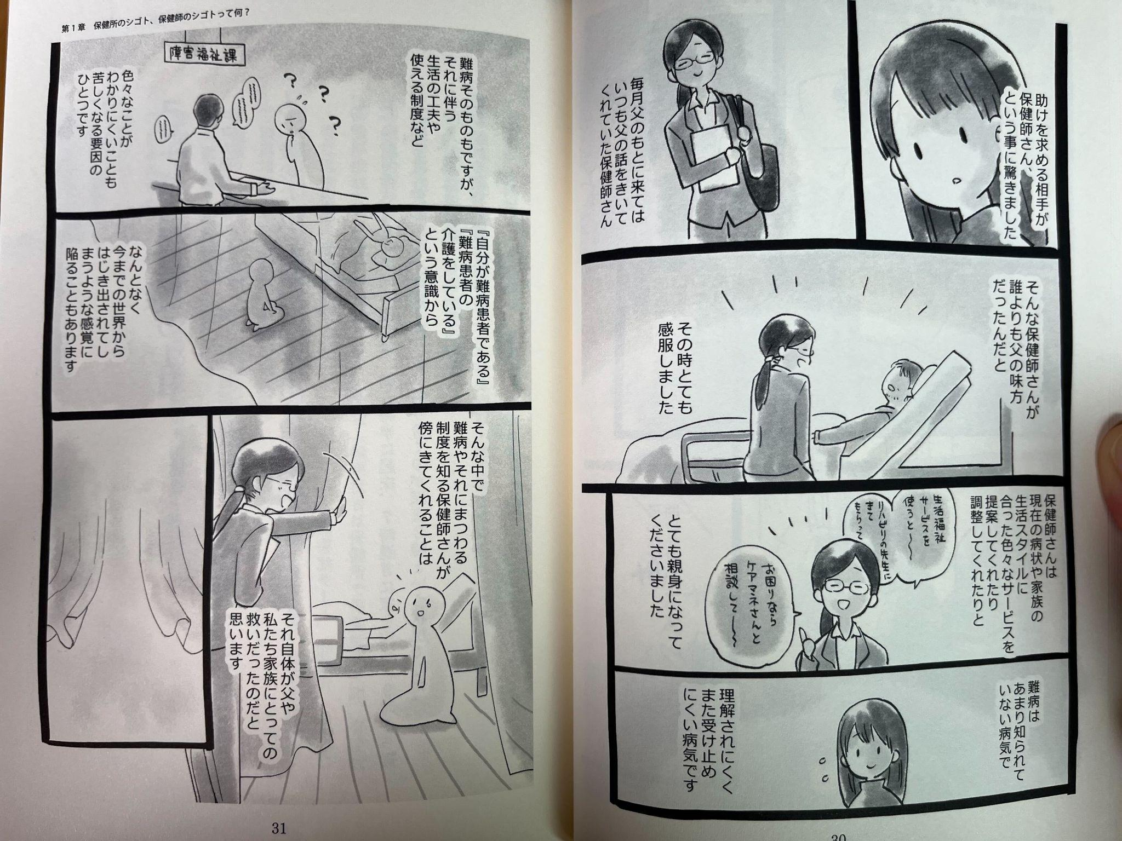
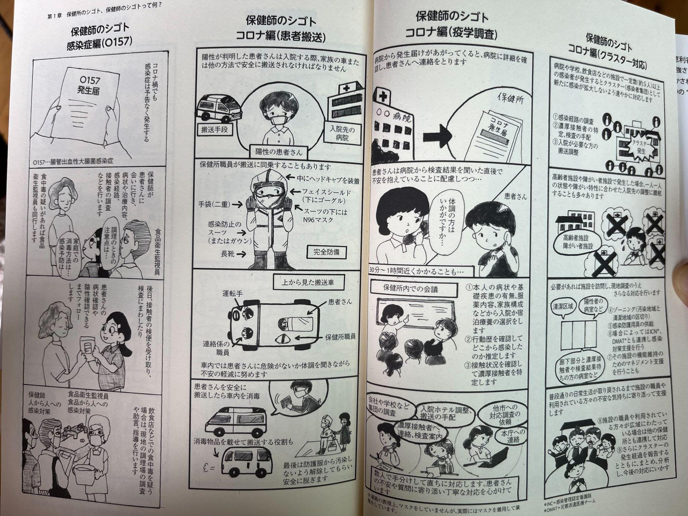
Visualizing and amplifying our stories through comics, including public health center functions
Notes:
30 secs (~4:16:30)
So for the visualizing and amplifying the stories of public health nurses and staff, the nurses and staff collected their stories in the LINE group chat, created these mini comic / manga storylines, and a few of them who were good at drawing, turned them into manga, to upload on Twitter. It reached a wide audience there, alongside the petition.

Slide 151
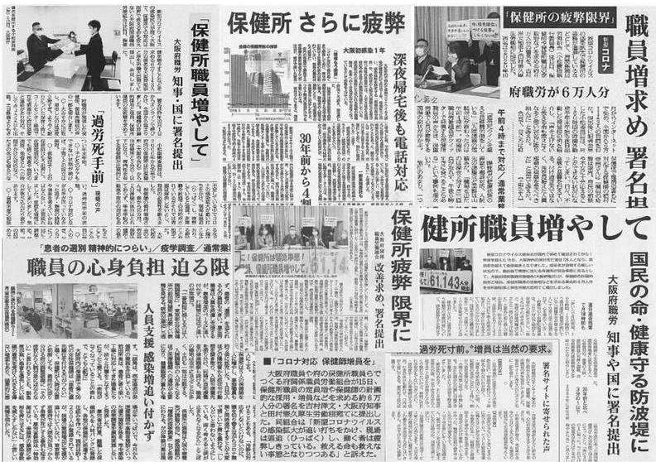
Collecting 100,000 signatures on a nationwide online petition
61,143 petitions submitted (as of January 2021)
Newspaper coverage of the action
12 media companies
(TV, newspaper) came to the press conference
https://www.facebook.com/events/153311046605867/?acontext=%7B%22event_action_history%22%3A[%7B%22surface%22%3A%22external_search_engine%22%7D%2C%7B%22mechanism%22%3A%22attachment%22%2C%22surface%22%3A%22newsfeed%22%7D]%2C%22ref_notif_type%22%3Anull%7D&locale=ja_JP
Notes:
30 secs (~4:17)
And the petition - they were able to collect 60,000 signatures, which did not meet the target number they set in the theory of change.
They did hold a press conference and successfully engaged a dozen or so media companies to come and report about it on newspaper and TV.
Komacchan told me that media eventually started asking Yoshimura questions in his press conferences about hey there are voices that are asking to increase the public health nurses and staff, are you not going to increase? And Yoshimura at some point started saying “I didn’t say I won’t increase” – which signaled to the team that their strategy was working!

Slide 152
Three outcomes of successful organizing
Individual
Organization
Society
Public health nurses and staff who participated in the campaign took on the role of the coordinator of their public health center, union board, etc.
115 out of 250 public health center nurses and staff participated in the kick-off lunchtime mtg
Functional second layer teams were developed
Other Osaka-fu workers wanted to start their own campaigns (e.g. Urban Development Dept workers gathered signatures from 85% of their workplace to achieve their goal)
The number of public health center nurses was increased by one at each public health center in Osaka-fu
Facilitates
learning
Increases organizational capacity
Reaches a clear and concise goal
Notes:
1 mins (~4:18)
Finally, I want to go over how this campaign brilliantly achieved the three outcomes of successful organizing.
In terms of the societal impact, yes, Yoshimura announced the HR plan in March and he had increased the number of public health center nurses by one at each public health center in Osaka-fu!
Unfortunately, he did not increase the public health center staff — so non-nurse staff like social workers or nutritionists — by one, so the goal was achieved half way, but we can say this was a historic win for the workers.
In terms of organization, in the end, the campaign engaged around half of the 250 public health center nurses and staff in the actions, and snowflaked into second layer teams. Also if we look at Osaka Workers Union as a whole, other Osaka-fu workers wanted to start their campaigns! Komacchant told me that the Urban Development Department workers also wanted to improve their work conditions, led their campaign, and won this past April. So this campaign was indeed contagious.
And in terms of individual growth, public health nurses and staff who participated in the campaign took on leadership roles and became the coordinator of their public health center or the board member of the union, etc., because now they saw how they can lead and facilitate those spaces, but also through the campaign they learned they have power. These new leaders later told the core team members and said “this campaign became my strength” or “I am able to live today because of this campaign.”

Slide 153
Breakout room practice
Build your team’s strategy by developing:
  People
  Change
  Map of actors
  Power (theory of change)
  Strategic goal
  Organizing sentence
  Visual of strategic goal (if you have time)
85 mins
Notes:
2 mins (~4:20)
When you come back, due to time constraints, one of the teams will present their organizing sentence, and we will learn from each other.

Slide 154
Debrief the breakout room practice

Slide 155
Osaka-fu Workers Union (Fusyokuro) Campaign to Increase Public Health Center Nurse & Staff - key strengths
This is just a memo slide (not to be shown during the upfront)
Power-with: Public Health Center Nurses and Staff shared their public narrative, experiences and emotions, connected through shared values of saving lives and invited the larger community to join in their collective action through those values (instead of making it an anti-Ishin Party issue)
Resources (demonstrates the use of resources): The constituency and supporters’ various resources were utilized (e.g. comic drawing, press conference, etc.)
Theory of change: The leadership team analyzed how many petitions would be impactful for the decision-maker, which was the governor of Osaka prefecture, Yoshimura — well-known nationwide and popular / highly praised. In order to get the petitions, the team also approached to shift the general public’s view on Public Health Centers and their functions
Goal-setting: The leadership team successfully narrowed down the big issue to a SMART (specific, measurable, achievable, relevant, and timely) goal, knowing that achieving this goal would create momentum for more change
Individual, organizational, and societal impact: Not only was the goal achieved, the people who were involved in the campaign built on this campaign to ask for more change, and also people outside the campaign were also inspired to start their own campaigns (the campaign built lasting power)

Slide 156
Evaluation & Closing

Slide 157
Pluses - what helped your learning
Deltas - what could we do differently
Key learnings

Slide 158
Closing with Sarah Junk Hatcher
Clausura con Sarah Junk Hatcher

Slide 159
Hope of the world is in our generation (let's straighten it out)It's all left up to us, to change this present situation (let's straighten it out)Our leaders make us fight, and we don't know what for (let's straighten it out)If they want people killed, let them fight the war!It's gotta end somewhere, this killing's got to ceaseIf no one were to fight, we'd all live in peaceOur generation (let's straighten it out)It's all left up to us (let's straighten it out)Our generation (let's straighten it out)Let's do just what we mustAnd straighten it out! (Straighten it out)Gotta straighten it out! (Straighten it out)Straighten it out! (Straighten it out)Yeah we gon' straighten it out, yeah!As long as there's a you, there's a better meIt's why we're together and stronger than they ever thought it could beA world motherless – can health care cover this?A love for all people no matter what the culture isOur generation, is making huge stridesA self-empowering movement that's on the riseThe more the door is open, the more the youth can seeA fair chance means a greater opportunityTo have a brighter future, deeper insightWork hard to be anything you want in lifeIt's what it's all about, the longevityEducated enough to know what's ahead of meNeed to straighten it out, seek and you'll findThey can cage your body, but not your mindWe lay it all on the line in the struggleWe grew, but together here's what we gotta doOur generation (let's straighten it out)It's all left up to us (let's straighten it out)Our generation (let's straighten it out)Let's do just what we must, and straighten it out!Our generation – straighten it out!Let's straighten it out – and straighten it out!Hey we can straighten it out, yeah!C'mon yeah! Our generation – let's straighten it outHey hey, we'll straighten it outWe'll straighten it out – straighten it outNew York City, better straighten it outAtlanta, better straighten it outIn Los Angeles, you better straighten it outWe can straighten it out, we can straighten it out[Fades out]

Slide 160
PUBLIC NARRATIVE
COMMUNITY ORGANIZING
Welcome & Setting Up
Introduction to Leadership
Introduction to Coaching
Introduction to Public Narrative
Introduction to Story of Self
Introduction to Story of Us
Wrap Up & Closing
Welcome
Introduction to Story of Now
Introduction to Linking
Introduction to Narrative as a Leadership Practice
Reflections
Q&A with Rosi Greenberg
Wrap Up & Closing
Welcome
Introduction to Community Organizing
Introduction to Relationship Building
Introduction to Teams
Introduction to Strategy I
Wrap Up & Closing
Welcome
Introduction to Strategy II: Tactics & Timeline
Introduction to Strategy III: Structure
Introduction to Action
Q&A with Professor Marshall Ganz
Wrap Up & Closing
SAT JUNE 13
SUN JUNE 14
SAT JUNE 20
SUN JUNE 21
Notes:
Today we will be diving into the story of Now and then take a 30 min break. Then we will come back and learning how to link all three stories together. Then take a 15 min break. Then we will dive into introduction to narrative as a narrative practice and go into small groups and reflect and prepare some questions for the Q&A. Then we will take a 10 min break and then have a Q&A session with Rosi Greenberg around narrative. Then we wrap up and close.
Remember, Leadership that requires us to build the emotional capacity for our communities to face challenges that is the practice we are working on this week.
Next week will build our practice on how to make space to activate the emotional capacity of our community through relationship building, and develop the the strategic capacity to build power and the ability to mobilize and active our community to join us in action.

Slide 161


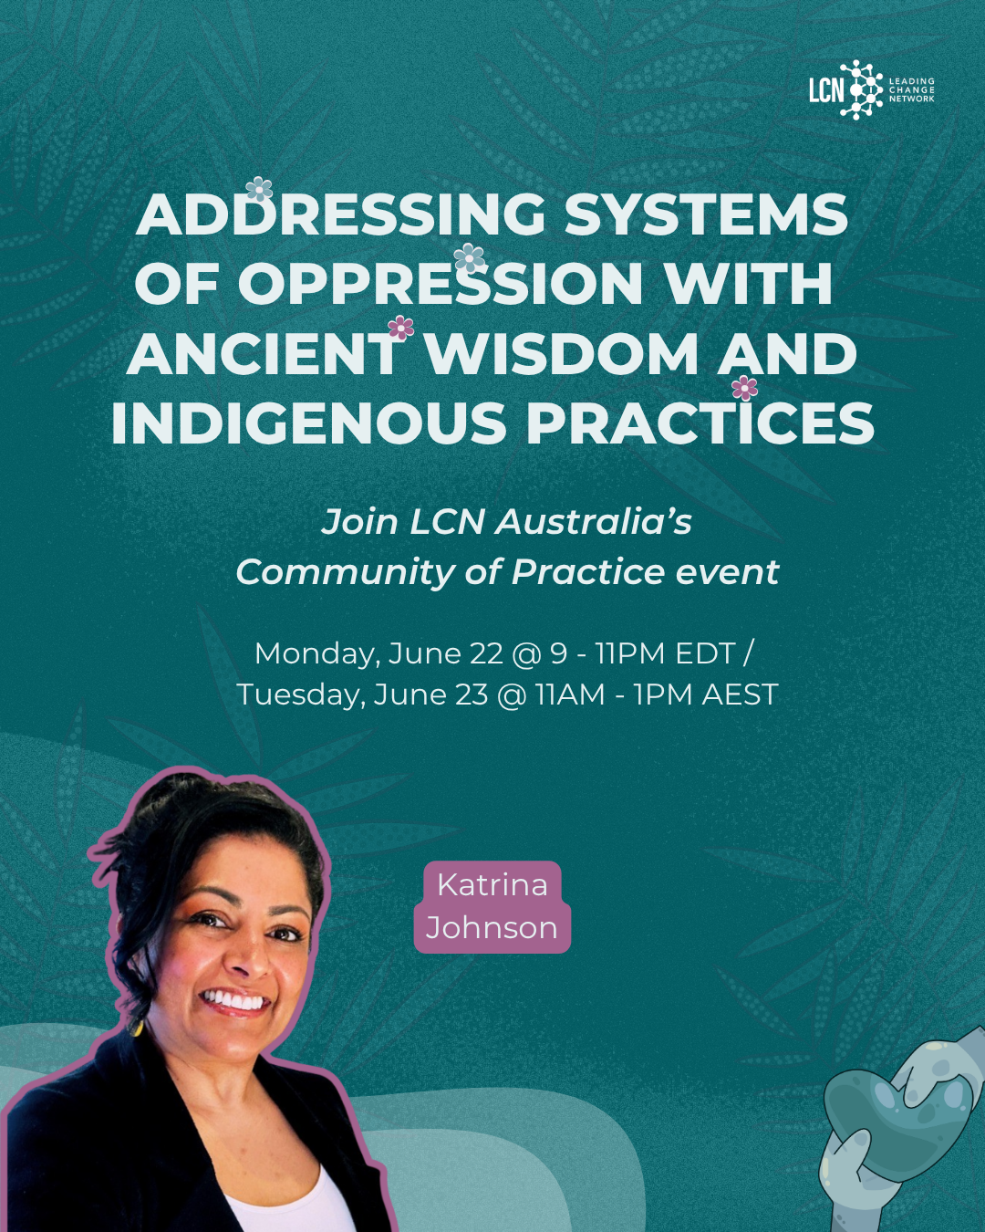
Upcoming LCN events

Slide 162

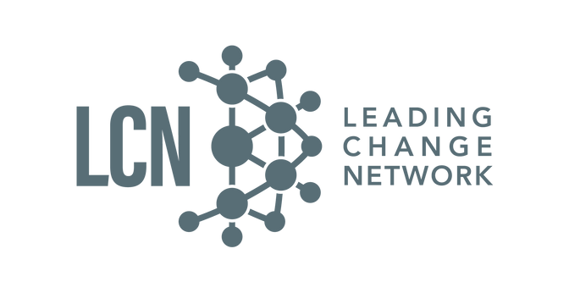
Upcoming LCN Academy Opportunities
Notes:
Reach out to me at sawsan@leadingchangenetwork.org to share more details and connect you with the relevant program coordinator

