Slide 1
Leading Change Academy
Public Narrative & Community Organizing Workshop
June 13-14, June 20-21, 2026
Notes:
Welcome everyone to day 2 of the workshop. Excited to be diving in with you more on narrative.
Just a quick reminder to turn on your cameras, wave at us, wonderful! And to turn on the interpretation.
Again a shoutout to Karla and Mariana for the magic they bring into this space.

Slide 2
Put in the chat
How are you feeling today coming into the space?
What is one word from yesterday you plan to bring with you today?
¿Cómo te sientes hoy al llegar a este espacio?
¿Qué palabra de ayer piensas traer contigo hoy?
Notes:
Let’s see how we are coming into this space…
Let’s get started with a grounding. Jennyfer will give you the floor.

Slide 3
Our Community Agreement
Mute while not speaking
Lean into curiosity
Actively listen
Be curious and open-minded
Provide support
Respect the time
Speak from a place of love and learning
No Question is too small
Respect and don’t judge
Respect diversity
Include all voices
Ask good questions to understand
Turn on Cameras
Step Up, Step Back
Correction: Tap on chest ‘my bad’ then spirit fingers with a sound of how you are feeling
Notes:
Before we get

Slide 4
Grounding with David Orth
Enraizamiento con David Orth

Slide 5
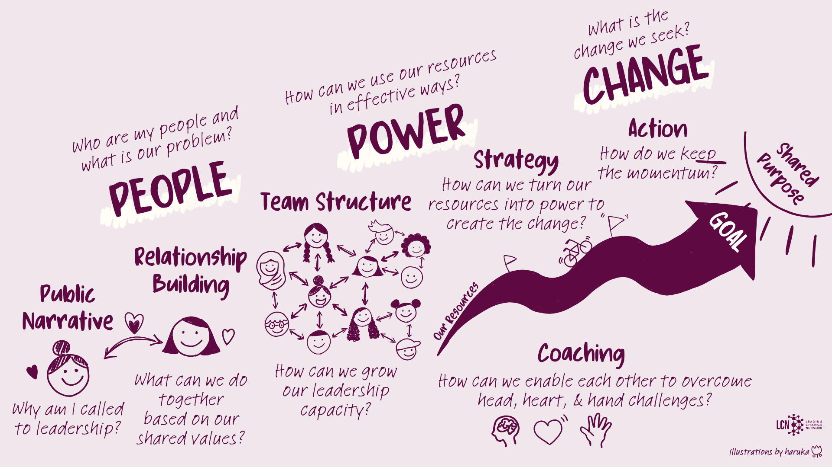
Notes:
Organizing aims to move our people and their shared values to work together to achieve a shared purpose. To do, organizing requires us to share our public narrative, build transformative relationships, create robust structures that enable leadership, strategy and action.

Slide 6
PUBLIC NARRATIVE
COMMUNITY ORGANIZING
Welcome & Setting Up
Introduction to Leadership
Introduction to Coaching
Introduction to Public Narrative
Introduction to Story of Self
Introduction to Story of Us
Wrap Up & Closing
Welcome
Introduction to Story of Now
Introduction to Linking
Introduction to Narrative as a Leadership Practice
Reflections
Q&A with Rosi Greenberg
Wrap Up & Closing
Welcome
Introduction to Community Organizing
Introduction to Relationship Building
Introduction to Teams
Introduction to Strategy I
Wrap Up & Closing
Welcome
Introduction to Strategy II: Tactics & Timeline
Introduction to Strategy III: Structure
Introduction to Action
Q&A with Professor Marshall Ganz
Wrap Up & Closing
SAT JUNE 13
SUN JUNE 14
SAT JUNE 20
SUN JUNE 21
Notes:
Today we will be diving into the story of Now and then take a 30 min break. Then we will come back and learning how to link all three stories together. Then take a 15 min break. Then we will dive into introduction to narrative as a narrative practice and go into small groups and reflect and prepare some questions for the Q&A. Then we will take a 10 min break and then have a Q&A session with Rosi Greenberg around narrative. Then we wrap up and close.
Remember, Leadership that requires us to build the emotional capacity for our communities to face challenges that is the practice we are working on this week.
Next week will build our practice on how to make space to activate the emotional capacity of our community through relationship building, and develop the the strategic capacity to build power and the ability to mobilize and active our community to join us in action.

Slide 7
Strategizing is
turning what you have (resources)
into what you need (power)
to get what you want (change)
Notes:
And yesterday we ended the day with strategy - where we defined strategy as ….
So it is not about looking at what we dont have —- but rather what do we have
And when we know what we have, we can be really creative in how we use those resources
And when looking at power, we are trying to find what we can leverage to shift the power

Slide 8


Six organizing questions
2. What change
do we seek?
Change
3. How do we get there? (theory of change)
4. What is our goal?
(strategic goal)
1. Who are my people?
Power
5. What are our tactics?
6. What is our timeline?
Notes:
And we said that organizers ask the following questions for putting the strategy together. And now we will be diving in tactics and timeline.

Slide 9
Strategy II
Tactics & Timeline

Slide 10
What is your definition of a tactic?

Slide 11
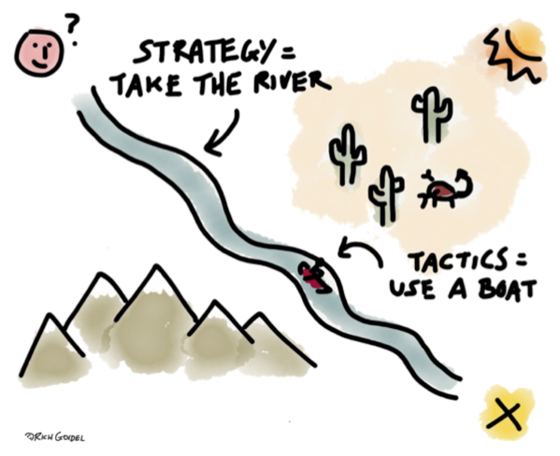
Tactics set strategy in motion
Notes:
Tactics are specific actions through strategy is implement - it is what we will be doing on the ground that will bring the strategy to life. The tactics are actions on the ground where we mobilizing people collectively and it will help us test out strategy and get to our achieve our strategic objective.
So in a nutshell,ُthe strategy is the WHAT - what do we need to achieve our goal? The tactics is the HOW - how are we going to do what we need to achieve our goal.
So here, we want to to get to x location as quick as possible.
What is your hypothesis to getting there the fastest? Would it be through the mountains, the desert or the river?
So we figure our hypothesis - so how are we travel on the river?
Very often, strategy and tactics get conflated. Why do you think it is important to make the distinction between the strategy and the tactics.

Slide 12
“Strategy without tactics is
the slowest route to victory.
Tactics without strategy is
the noise before defeat.”
— Sun Tzu

Slide 13
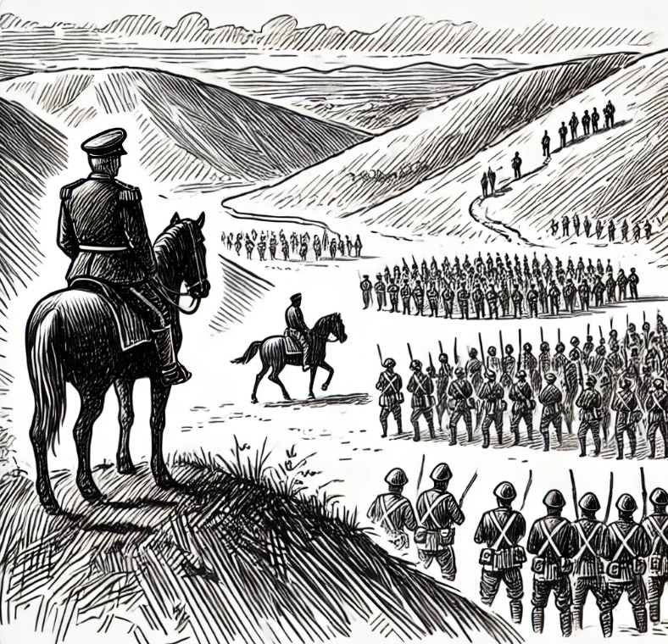
STRATEGOS = General
TAKTIKAS
= Ranks
Notes:
A strategy without tactics is a list of great ideas. A tactic without strategy is a waste of resources.
We set our strategy in motion through tactics.
Choosing an effective tactic that brings us closer to our strategic goal is just as important as choosing the right strategy.
So as you can see here, the strategist stands on the hilltop - s/he/they overlook the field, they do an analysis of the landscape, the people, the resources, their strengths, knows their weakness, has the data, etc. The ranks are the ones implementing the tactics. They are on the ground, doing the work…

Slide 14
What are some of your favorite tactics that you had led, participated in and/or heard of?
What made them so great?

Slide 15




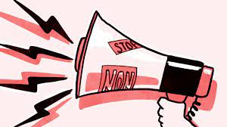
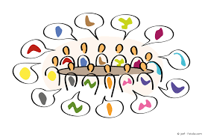


Leadership Ladder
Sympathizers
Volunteers
Team Members
Team Leaders
Organizers
Observers
Notes:
Just because someone attends and event or just because some says they are interested to join, we have a tendency to bring them straight into the team. Who we bring into the team needs to be intentional.
Using a ladder of engagement can help you build up the capacity of your structure and your team.
So there will be a LOT of observers, ppl just walking around campus and seeing all the work you're doing
Then there are sympathizer - these are people who may talk about the situation or share posts but not do more than that
Volunteers - they come up to your actions or are even to willing to take a small task to support
Team members are those who attend weekly meetings, are doin the planning
Team leaders are the ones who are coordinating the teams, making sure they are meeting, have a strong team culture, following up to make sure the team is achieving its goal
An organizer is someone who is supporting the team leaders

Slide 16
What makes tactics effective?
Does it help us achieve our strategic goal?
Is it rooted in our theory of change?
Does it use and build on our resources?
Does it create pressure against opposition (decision maker)?
Strategic
Does it enable us to experience solidarity, self-efficacy and hope through courage?
Is it fun, creative, and exciting? Does it deepen commitment?
Can anyone from our constituency join? (Is it accessible?)
Motivational
Does it support and celebrate the growth of our people and our organization? Does it bring in new people?
Are we learning as we go?
Build leadership

Slide 17
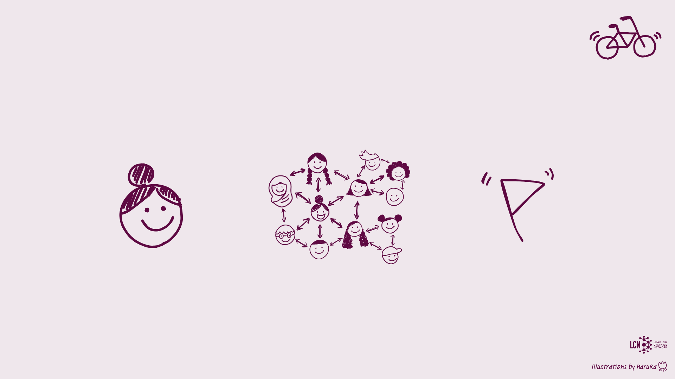
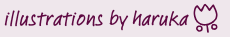
Three outcomes of successful organizing
Strategic
Reaches a clear and concise goal
Notes:
So how do we design good tactics? Let’s think together - let’s say we have a tactic, such as phone banking. We are trying to get our local representatives to give funding to art classes in our local school. And we the parents decided to call the administration so they can listen to us. We have 20 mothers willing to make calls. Our theory of change is that if the parents who are the voters tell the local representatives
First tactics should be strategic
First and foremost they should be bringing our theory of change to LIFE. Are the tactics we are coming up with helping our hypothesis?
Is it concrete? So it isn’t just make a bracelet - having people make a bracelet or put a post online can be perceived as a tactic - but you need to make it stronger
Is it concrete - can we concretely see that this tactic let’s say a protest will be bringing up close to our strategic goal. Can we see the link between the two?
Is it measurable? Often people think, let’s do a bracelet or let’s do a social media storm - good but we need to think ok - if we do that, what can we add to this strategy to make it stronger - to make it more concrete and to make it measurable. So maybe bring the community together to make the bracelets together and then they have 1:1s with ppl to tell them about the campaign and ask them to wear the bracelets on a specific day in a specific play. Or if you are doing a social media storm, rent a hall and invite the community to do it together, like phone banking, count the number of shares, etc. So the strategy should be strategic. It is getting us one step closer to our goal.

Slide 18
Three outcomes of successful organizing
Organization
Society
Increases organizational capacity
Reaches a clear and concise goal
Notes:
Tactics need to be building organizational capacity - so first, who has ever gone to tactic and found the same people are always there? Right! So our tactics need to be bringing in new people. So they need to be collective.
Who here has ever been event for an action, you attended, met the organizers, but then they never spoke to you again. They called invited you to show up and there was zero follow up. Imagine if the tactic was designed in a way to help the organizers identify the people attending, oh rawan has come to 5 of our actions - then we should get her contact info and meet her. Oh i invited so-and-so and they showed, so let’s do a 1:1 with.
At the same time of course, by organizational capacity is that we are seeing growth in attendance. So the first action 50 people showed up, the second on 100 people showed up, the third 200 people showed up! That demonstrates that you are activating the community and it is working. Mroe and more people are investing their time for this change.
So if we are doing a press conference, how many people do we need? [not many]. Will a press conference show our people power? [not really]. But we know a press conference is a good way to get the school to worry about their reputation. So, how can we bring people together to strengthen the press conference and give us an opportunity to identify other ppl who may be interested to join? And to invite our community to come in and join the action?

Slide 19
Three outcomes of successful organizing
Individual
Organization
Society
Facilitates
learning
Increases organizational capacity
Reaches a clear and concise goal
Notes:
When implementing the tactic - what is the involved of our teams and organizers? Are they being trained? Are they learning new skills, possibly police management like Marina wanted with Michael. Or maybe database collection and input? Or if it is phone banking, we are training people on how to make the calls?
Remember each tactic is all about mobilizing power, deploying power and mobilizing again
So how we develop the leadership or ppl already engaged?

Slide 20

TACTIC PREP
Training your constituents on tactic
AFTER TACTIC
IMPLEMENT TACTIC
Debrief and learn
Reach out to potential recruits and identify ppl on the leadership ladder
Demonstrate people power
Collect data and identify potential recruits

Slide 21
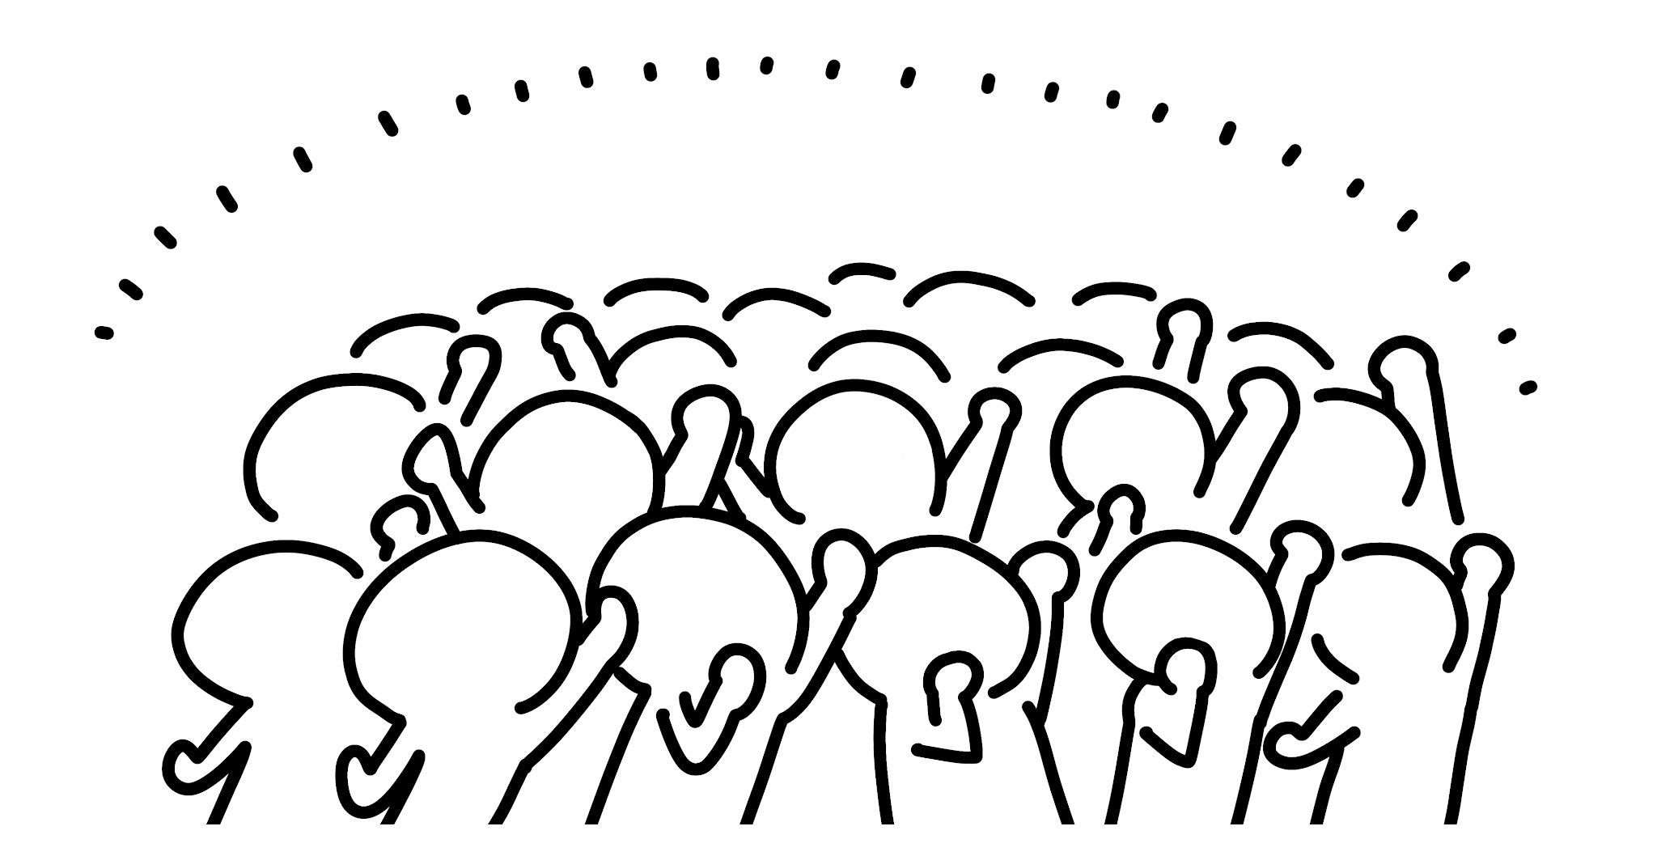
Why is the campaign timeline going up?
capacity
Strategic goal
Peak 2
Evaluation and next steps
Peak 1
Kick-off
Foundation
Time
Notes:
The first phase is the foundation - this where you are building your founding team, putting together your strategy and structure. You are doing a lot of one-on-ones, hearing the community, seeing who you want to bring in, etc.
The second phase is the kick-off - this is an event where your campaign is making itself public to the public. It could be a training, it could be a big event. At this event, you want to engage people, identify new leadership, see who shows up, who is interested, who do you want 1:1s with, who you want to bring into your teams, etc.
Then you have a series of peaks -: A peak is typically an event or action with your constituency that shows all the strengths that’s been generated since the last peak. a threshold moment when we have succeeded in creating a new capacity we can now put to work to achieving our next peak. When organizing a peak, keep in mind a specific outcome that you want the peak to generate.
So you start with a 1 team and halfway through you have a 5 teams - well your person-power has made a huge shift right! So the vertical line, you can think of as your resources - so each peak you are bring in resources, more and more and more and then at the PEAK - is where you reach them and usually USE them. Then well you gotta rest - emotional resources from exhaustions or material resources like money that you used…and then you start building again
EMPHASIZE _ PEAK _ organizational capacity - so how many people do we want there, what is the date, where is it going to be and what tactic/activity is it that is demonstrating our strenght
The most important thing is that you don’t plateau - each peak you need to be higher and gaining strength
Then hopefully you achieved your strategic objective - YEY or NOT - Booo
And in both cases you come together, celebrate the effort, evaluate and think of the next steps

Slide 22

Peak tactics and relational tactics
Peak tactics: deploy and show power to constituency and opposition (decision-maker)
Strategic goal
Peak 2
Evaluation and next steps
Peak 1
Relational tactics: build relationships with constituency and supporters and build power
Kick-off
Foundation
Time

Slide 23
Evaluating example tactics
If we change the law to increase prison sentence for deaths caused by drinking under the influence
then less car accidents will happen
because people will think twice before driving while drunk because of the risk of a life sentence in prison
Tactics:
Distribute flyers to raise awareness
Release balloons in the sky
Make bracelets (with campaign logo) and sell them in bazar
Wear T-shirts with campaign logo
Social media campaign + twitter storm
Are these tactics strategic?

Slide 24
Evaluating example tactics
If a supermajority of the Black population of Montgomery stop using the bus system
then the buslines in Montgomery will be desegregated
because the bus company wants to stay in business, and losing up to 75% of their ticket sales will bankrupt them if they do not back down
Tactics:
Bus Boycott
  Bus Stop Picket Line
  Community Carpooling
  "Black Cab" Services
  Walking
Church Sermons
  Organizational Meetings
  Coalition Building
Are these tactics strategic?

Slide 25
Campaign timeline
Insert
Capacity
Insert
Strategic goal
Insert
Peak 2
Evaluation and next steps
Insert
Peak 1
Insert relational tactics too, if any
Kick-off
Foundation
Time

Slide 26
Brainstorming tactics for an example campaign
Lunchtime Freedom Campaign
People: 5th Grade Class
Problem: Being treated unfairly; No lunchtime freedom
Goal: Win the right to go to recess after lunchtime by March 15th
Actors
  Mrs. Berry, Head Lunch Lady, prioritizes running a smooth lunch hour
  Mrs. Starr, School Principal, is on Mrs. Berry’s side
  Mr. Mazaros, PE Teacher, is a supporter
  Some teachers are possible supporters
Theory of Change: If the school is disrupted Mrs. Berry will allow lunchtime freedom, because she prioritizing running a smooth lunch hour
Organizing Sentence: We are organizing 5th graders at McGrath Elementary to win lunchtime freedom by disrupting the school Mrs. Berry to allow 5th graders to go to recess when they are done eating their lunch

Slide 27
Brainstorming tactics for an example campaign
List of resources
List of tactics

Slide 28
CAMPAIGN TIMELINE
Insert
Capacity
Insert
Strategic goal
Insert
Peak 2
Evaluation and next steps
Insert
Peak 1
Insert relational tactics too, if any
Kick-off
Foundation
Time

Slide 29
Considerations for building your timeline
Planning backwards and then planning forward
An opportunity to plant urgency when it does not exist
Mindfulness on organizers’ momentum
Escalation of efforts strategically towards the peak: threshold of successes
Country calendar and important dates
Planned celebration
Planned learning & evaluation
Anticipate oppositions’ reaction (Plan B timeline)
Remember: Strategy is a VERB!

Slide 30
“Plans are nothing.
Planning is everything.”
— Dwight D. Eisenhower

Slide 31
Debrief the breakout room practice

Slide 32
Strategy III
Mais Irqsusi

Slide 33
Session overall structure
Metrics and counting progress & Success
Snowflake building

Slide 34
Jumping from timeline to snowflake
Peak
Step 1: Campaign timeline
Step 3: Analyze the leadership needed
to build the snowflake
Peak
Peak
Kick-off
Foundation
Step 2: Break down peaks into metrics
Peak | Organizers | Metrics (Input) | Metrics (Output) | Goals (Outcomes)
Peak #1
Peak #2
Peak #3
Notes:
We just finished building a timeline. In organizing we know that each peak moves to the next one and is higher because of the higher capacity of our people which is the snowflake structure. For us to know how many teams to build and in which areas we need to have a realistic estimate of the number of teams needed. That’s why we are going to dive into metrics first and then snowflake.

Slide 35
Why count?
Notes:
One question is why should we cout, as organizers I want you to contribute in the chat why do you think we should count?

Slide 36
Why do we need data, evaluation and reflection?
To learn & strategize
  Learn what is and isn’t working, and modify our plans accordingly
  Understand what it would take to prioritize limited resources.
To set goals and maintain accountability
  Hold ourselves accountable to building leadership and winning campaign outcomes
  Identify successful teams / leaders to learn from the
To demonstrate success and power
  Report and communicate progress and success to our community and stakeholders
  Build our own narrative of power and progress
Notes:
Exactly like you mentioned, we count to learn & strategize. For example we are trying to recruit for our launch event. When looking at the metrics we see that one of our organizers recruited 90 people. Triple of the
Average others recruited. This is a good indication for us to learn from this person. The same on people or teams who couldn't recruit, there’s something there that is worth investigating coaching and evolving capacity. It’s also a
Great way to maintain accountability to the movement. Civic work is important, and we owe it to our volunteers once they leave not to say I volunteered a year but dont know what we achieved or I doubt if I wasted my time
Because this all feeds into building our own narrative, and if we as a movement dont tell our story someone else will. So its better be us.

Slide 37
What do we count?
Three outcomes of successful organizing
Individual
Organization
Society
Facilitates
learning
Increases organizational capacity
Reaches a clear and concise goal
Notes:
What we count and the way we design our metrics is rooted in the three outcomes organizng is trying to achieve, Building individual leadership, building organizaiton capacity and the community reaching its’ goal.

Slide 38
Goals vs. metrics
Goals measure consequential outcomes
  A goal you give someone is what you are asking that person
  to achieve over a long period of their work
Metrics track day-to-day activities
  Metrics track what you are asking volunteers to do
  Metrics are not an end in themselves
  Metrics help you decide which activities are helping you the best in meeting your overall campaign goal, so you can re-strategize
Notes:
The goal is big, it’s where we are going. Metrics track the quantity of our actions that will lead to the goal. So for example, back to the event example. The goal could be to recruit 1000 people to the launch. The metrics could count our 1:1 conversations, phone calls to recruit, social media reach of our posts ..etc it’s auctions we are taking to reach the goal. In metrics we count attempts even failed ones because this makes us learn about our people and their patterns. If we found that it took 200 calls to fill the room of 100 people it means that’s what we should plan next time. Also on comparing various tools if using phone worked better than social media ..etc anyone has other examples of why counting matters?

Slide 39
The data cycle in a campaign timeline
Adjust
Assess
Analyze
Set Goals
Kick-off
Collect Data
Choose Metrics
Analyze/ Evaluate
Collect Data
✔
Choose
Metrics
✔
Adjust
Set
Goals!
Assess
Notes:
As an organizer, you are always setting goals, choosing metrics that you will use to achieve it, collect the data and analysis. When we anlyse we find new information to help us adjust and asses and maybe affect the next set of goals.

Slide 40
6-minute campaign (case study)
Organizing sentence: We are organizing mothers, teachers, librarians and youth in the Jabal Al Natheef community, to pursue a love and enjoyment of reading for fun, by the local community becoming role models for their children and family members and showing joy in reading themselves, to achieve
10% of the community (5,000 pledges) reading for 6 minutes daily
by October 2011 (within a year)
→ How many organizers and teams do we need to reach this goal?
Organizers are leaders who belong in a team, committed to a shared purpose and responsible for enabling others to achieve the shared purpose
vs. Volunteers are people who join the campaign, even for one action (can be recruited
and developed into organizers)
Notes:
To take the learning home let’s dive into an example. 6 minutes campaign. It’s a campaign that took place in AMman jordan in 2011, the aim was to get 10% of 50,000 neighborhood community to commit to reading daily. A demonstration of that was singing pledges. What would it take for this core team of 9 people from the neighbourhood to achieve this goal. How many organizers do they need to recruit

Slide 41
If we… then… so that… peak goal
Over the next 12 months,
we will need [#] organizers to recruit [#] volunteers to
make [#] invitations for 1:1’s,
so that [#] 1:1’s conversations actually happen, so that
5,000 pledges will be signed
10% of the community reading for 6 minutes daily within a year
5,000 pledges
What percentage of 1:1 conversations will end up with a pledge signed?
?? 1:1’s
What percentage of invitations to 1:1 conversations will end up in an actual 1:1?
??
invitations to 1:1’s
How many 1:1 invitations can one volunteer commit to? (# per month x 12 months)
??
volunteers
How many volunteers can one organizer recruit? (# per month x 12 months)
??
organizers
How many organizers
in how many teams?
Notes:
A backward exercise from the top of the pyramid goal of 5000 is needed, how many 1:1s are needed to get the 5000 signatures, to get than number of 1:1s how many people shall we ask for a conversation with? To do that much invitations and expand our network in the neighbourhood how many organizers and volunteers will we need?

Slide 42
6-minute campaign: peaks to metrics breakdown
*Numbers are filled in as an example (not the actual numbers from the campaign)
Peak | Organizers | Metrics (Input / effort) | Metrics (Output) | Goals (Outcomes)
Peak #3 In 12 months | 160 organizers 26 volunteers | 15,000 1:1 invitations → 10,000 1:1’s 100 reading coffee circles 300 recruitment 1:1 invitations → 200 recruitment 1:1’s to recruit 2nd tier organizers | 5,000 pledges 6,000 community readings 160 organizers attend the 1st/2nd tier training | 10% of the community reading 5 constituency teams plus core team (23 teams) 160 organizers
To look at from the other side, if we need 5000 signatures this means we need to reach out to 10,000.
10,000/10 months= 1000 people need to be contacted per month
If each person can roughly do 5 reach outs a month
1000/5=200 people are needed for this operation between volunteers & organizers to reach the goal in 12 months

Slide 43
6-minute campaign: peaks to metrics breakdown
*Numbers are filled in as an example (not the actual numbers from the campaign)
Peak | Organizers | Metrics (Input / effort) | Metrics (Output) | Goals (Outcomes)
Peak #1 Kick-off | 25 organizers | 100 recruitment 1:1 invitations → 50 recruitment 1:1’s to recruit 1st tier organizers | 25 organizers attend the 1st tier training | Recruit and train 25 organizers for the 1st tier
Peak #2 In 6 months | 50 organizers | 7,500 1:1 invitations → 5,000 1:1’s 2,000 event invitations → 1,000 attend events | 2,500 pledges | 5% of the community reading 50 organizers
Peak #3 In 12 months | 160 organizers 26 volunteers | 15,000 1:1 invitations → 10,000 1:1’s 100 reading coffee circles 300 recruitment 1:1 invitations → 200 recruitment 1:1’s to recruit 2nd tier organizers | 5,000 pledges 6,000 community readings 160 organizers attend the 1st/2nd tier training | 10% of the community reading 5 constituency teams plus core team (23 teams) 160 organizers

Slide 44
Three outcomes of successful organizing
Individual
Organization
Society
160 organizers
5 constituency teams plus core team
23 teams total
10% of the community reading for 6 minutes daily within a year
Facilitates
learning
Increases organizational capacity
Reaches a clear and concise goal
Notes:
Also breaking that 10% goal to think of it from the 3 lenses of change. How many teams will b

Slide 45
Counting success
If you can’t count it, it didn’t happen!
It’s a culture, it’s a practice, it’s a commitment
We count because we respect our people;
we owe them proof of their agency
Counting as a way of motivating to act
—celebrate small wins!
What do we count? How we count it? MATTERS
Importance of data coordinator’s role in campaign operations

Slide 46
Jumping from timeline to snowflake
Peak
Step 1: Campaign timeline
Step 3: Analyze the leadership needed
to build the snowflake
Peak
Peak
Kick-off
Foundation
Step 2: Break down peaks into metrics
Peak | Organizers | Metrics (Input) | Metrics (Output) | Goals (Outcomes)
Peak #1
Peak #2
Peak #3

Slide 47
“I am the leader”

Slide 48
“We are all leaders” / No leader

Slide 49
Collaborative leadership

Slide 50
Leadership island

Slide 51
Leadership island

Slide 52
Distributed leadership

Slide 53
A small number of sustainable relationships
Capacity for exponential growth
Distributed leadership
The snowflake model

Slide 54
Why move from dot or island to snowflake?
Enabling
Mutual accountability
Collective strategy
Constituency-based roles
A campaign's strength stems from its capacity and commitment to develop leadership in the snowflake model, in which everyone is responsible for identifying, recruiting, and developing leaders

Slide 55
Designing the structure
Who is our constituency?
How many are we? Where are we?
How many teams will you need to reach the constituency?
What is our strategy?
Structure needs to be founded on our strategy
What is needed?
Technical skills vs. people power

Slide 56
Constituency team vs. functional team
Constituency team: a team rooted in the constituency that snowflakes
E.g. A team of mothers who we want to commit to reading for 6 minutes daily
Functional / technical team: a team that has a specific functional role that manifests a campaign strategy (might not need to snowflake)
E.g. Data team, media team, legal team, research team
It is often more effective to have a functional role inside constituency teams that also meet together as a functional team
E.g. There is a data coordinator in each of the teams of mothers, and these data coordinators meet as a data team, in addition to belonging to the main constituency team

Slide 57
Ask ourselves…
Does our theory of change require a specific role expertise?
  Is this role needed in every team?
  Do we need a separate functional / technical team or
  is it a role for 1 or 2 people?
  Is it a temporary team?
What is each team’s purpose / responsibility?
In which teams is people power built the most?
Which teams grow and build more teams?
What is the ideal team size ?
We build teams where we need to build power in our people,
thus constituency teams are the most essential in our snowflake
Sub-constituency?
Geographic?

Slide 58
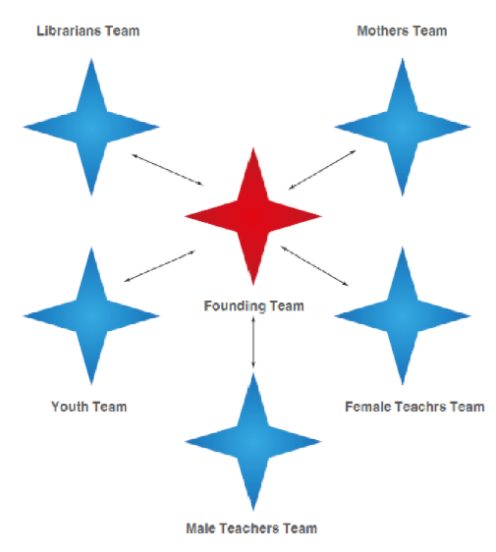
6-minute campaign: snowflake structure

Slide 59
6-minute campaign: actual metrics by team
Metrics | Mothers | Librarians | Youth | Teachers | Total
# of organizers | 70 | 35 | 30 | 25 | 160
# of readings | 3,400 | 470 | 250 | 2,500 | 6,620
# of teams | 10 | 5 | 4 | 4 | 23
# of pledges | 1,739 | 1,223 | 1,030 | 1,050 | 5,042
# of volunteers | 2 | 12 | 4 | 8 | 26

Slide 60
Make sure to build for a structure that can become your source of pride and hope,
not your worry!

Slide 61


Breakout room practice
Design the snowflake through:
  Who & how many
  Team & responsibilities
  Visualize & draw the snowflake structure
40 mins
Notes:
https://docs.google.com/presentation/d/1yHS9Bv7UTXlNjDnSV1RGz0IiXfARbVLw-xO-lCL5s04/edit?slide=id.g3e342c9abb3_0_6#slide=id.g3e342c9abb3_0_6

Slide 62
Designing the snowflake: who & how many
Based on your strategic goal, WHO are the people you need to organize to build real power and WHERE are those people?
Will you find them in specific towns, neighborhoods, institutions?
Are there pre-existing ways people identify as a group?
Reflecting on the last peak of the campaign and the metrics, how many organizers from the constituency should your campaign have by the last peak?
Reflecting on the last peak of the campaign and the metrics, how many people will you have mobilized by the time of the peak?
How many organized teams on the ground do you need to perform your strategy?
(A team size that is able to meet regularly and perform is between 5-9 organizers)

Slide 63
Designing the snowflake: team & responsibilities
Team name (Constituency or functional) | Purpose / Responsibility | # of members | Is this team temporary?

Slide 64
Visualizing and drawing the snowflake
Constituency team
Core leadership team
Functional team
Which team(s) would you recruit first?

Slide 65
A case from the teams to learn from

Slide 66
Key Learnings & reflections from this module

Slide 67
Action

Slide 68
Notes:
You guys just finished your strategies
Let’s dive into the action!
So let’s take moment to look at your learning journey
Bird’s view of the 5 practices.
So you as an organizer, developed the narrative of what calls you, your team for leadership and why now, you’ve built relationships with others to recruit to expand your leadership teams, and you’ve set your strategy and built the workplan.
All of that is to prepare for the action on the ground. And that is what we will be focusing on today.
First 2: is about the people (PN + RB)
Second 2: is about building people power (STRUCTURE + STRATEGY)
LAst 1: Building people power to do what? For change?

Slide 69
Can we reach our goal alone?
Notes:
Why do we need people with us? It’s quite plain and simple - If we start as 10 people, are 10 people enough to create change alone? So we need to have more people with us.

Slide 70
Campaign timeline
Capacity
Strategic goal
Action
Peak 2
Evaluation and next steps
Action
Peak 1
Action
Kick-off
Foundation
Time
Notes:
You guys just finished your strategies
In the last lecture, you learned about the campaign timeline.
You can see on the the Y-axis that your peaks need a higher capacity (accelerating). You have two options, either the same people who start have to keep doubling their efforts which can lead to burnout. OR you recruit in more people along the way.

Slide 71

Relationship building vs. mobilizing
Building relationships
Mobilizing (action)
Depth
Breadth
Notes:
Of course - not all people are going to be involved/committed the same way. Some will be recruited through relationship building to become permanent members, others will be mobilized in action.
But even so, mobilizing people is an opportunity to continuously explore new leadership. These instances of public action, whether you want to demonstrate infront of a the dean’s office, or you want to phonebank the parliament to pressure for the passing of a certain bill, or to canvass for elections through door2door, you will need the larger mass to join you and you will need to know for sure that they will commit during that peak moment in order to extend the impact to achieve the change that you want.

Slide 72
Recruit resources
Deploy resources
Relationship Building
Commitment
Notes:
This diagram out the continuous relationship-building process that transforms unorganized resources into collective community power.
Organizing is not just about aggregating an audience; it is about building a constituency “a community of people who commit to standing together to achieve a shared purpose”.
At the heart of this drawing is the commitment, that we as leadership and organizers need from others to be able to achieve our shared purpose. You begin building the commitment with others through relationship building, but you need it to be sustained over time. So how can we do that?
So as an organizer engaging in intentional relationship building, you explore the resources that others have by the mutual exchange that you do and start to recruit those resources into your expanded structure.
However, Next slide

Slide 73
Recruit resources
Deploy resources
Strategy
Relationship Building
Commitment
Notes:
However,
Recruiting resources and not deploying them is a waste: Once resources (people and their capacities) are secured at the center via commitment, they must be put to work. This is where strategy comes into play.
The goal is to translate those pooled resources into measurable, concrete actions (e.g., canvassing, running campaigns, or hosting meetings) that directly challenge the problem at hand.
Next slide

Slide 74
Public Narrative
Motivation
Recruit resources
Deploy resources
Strategy
Relationship Building
Commitment
Notes:
Practice it better - What
4. Motivation is what keeps the drive going - but how will you keep the motivation?
Motivation is accessed through Public Narrative (the story of self, us, and now).
When people see their resources being deployed successfully to make real change, it generates hope, efficacy, and further motivation. This motivation loops right back around into the left side, allowing the movement to recruit even more resources and build broader commitment.
To summarize, what we see in this diagram is that organizing is a perpetual, self-sustaining ecosystem.
You tell stories to motivate people, build relationships to recruit their resources, anchor them to a shared purpose through commitment, and strategically deploy them to make change—which in turn creates more motivation to start the loop all over again on a larger scale.
Question for the people: you want to make sure the infinity is balanced - if you have too many resources that you aren’t deploying, what happens? If there are not enough resources and your not recruiting resources, what happens?

Slide 75
Action consists of mobilizing and deploying constituency resources in ways that can create the power needed to win.
Notes:
So what is action then?

Slide 76

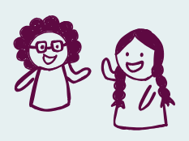
Which scenario makes you want
to join an event?
Saw a friend sharing about the event on Instagram…
A friend asked me directly
to attend the event…
Notes:
So how do we actually do the mobilizing for long term leadership building and LT commitment
They want you personally

Slide 77
A commitment is a specific pledge of
time, resources and energy
Getting clear commitments is essential
in building power
So why are we afraid to ask?
Notes:
What are the possible answers? THINk of counter answers
What if I’m harassing them. I’m giving them the opportunity.

Slide 78
Fear of rejection and fear of commitment
The other person might say NO…
What type of “NO” is it?
Not now
Not that
Not at all
Notes:
Rejection - someone saying no to me - when they are saying no to the action
What are we losing if we don’t ask
Data collection on where ppl are at - brings in an insight
If ppl are saying no - is it because of how i am doing it, is it because i am reaching the wrong people, because they aren’t convinced by the strategy/action

Slide 79
Fear of rejection and fear of commitment
The other person might say NO…
What type of “NO” is it?
Not now
Not that
Not at all
Have you ever been asked to join and
said “NO” but was glad to be asked?
Notes:
Rejection - someone saying no to me - when they are saying no to the action
What are we losing if we don’t ask
Data collection on where ppl are at - brings in an insight
If ppl are saying no - is it because of how i am doing it, is it because i am reaching the wrong people, because they aren’t convinced by the strategy/action

Slide 80
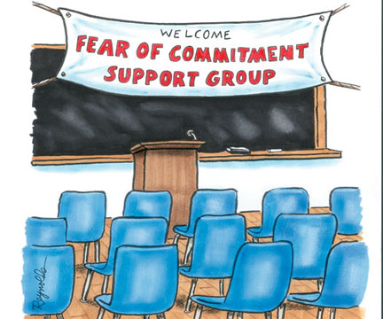
Fear of rejection and fear of commitment
The other person might say NO…
What type of “NO” is it?
or YES…!
Not now
Not that
Not at all
Have you ever been asked to join and
said “NO” but was glad to be asked?
Notes:
Rejection - someone saying no to me - when they are saying no to the action
What are we losing if we don’t ask
Data collection on where ppl are at - brings in an insight
If ppl are saying no - is it because of how i am doing it, is it because i am reaching the wrong people, because they aren’t convinced by the strategy/action

Slide 81

4C’s: four steps to meaningful commitments
1
Connection
Communicate why you care about this issue and share experiences
(Ask the other person questions too!)
2
3
4
Notes:
Before we go into the steps, I want to take a minute to mention 3 important things.
Time as a resource: Ppl are busy with other priorities - a good 4C makes this of value to compete with those priorities
This is a quick 3-4 min conversation which still requires making a value based connection
It’s a two way conversation, this is not a telemarketing call or information dump.
Connection: you need to say how you know them - “do you have a moment” - which no will give that time - so best to jump into “hi! Do you live here, or do you go to school here, do you know this person and got your contact from this person…” OR if you know them even more, I saw you post about this issue. This is the hook that you need to get right, to get their attention for the next 3 minutes.
Next slide

Slide 82
4C’s: four steps to meaningful commitments
1
Connection
Communicate why you care about this issue and share experiences
(Ask the other person questions too!)
2
Context
Create a sense of urgency; illustrate the specific challenge, as well as the hope (What is possible if we act together?)
3
4
Notes:
Context: what the problem, utilizing the story of now and why this urgent, what is the pathway to action, why this action is the first step

Slide 83
4C’s: four steps to meaningful commitments
1
Connection
Communicate why you care about this issue and share experiences
(Ask the other person questions too!)
2
Context
Create a sense of urgency; illustrate the specific challenge, as well as the hope (What is possible if we act together?)
3
Commitment
Make the ask (specify when/where/what) and get a clear “yes” (Don’t minimize your ask! If the other person is hesitant, ask why)
4
Notes:
Commitment - 1 clear ask - place, time, date - and how to get a clear answer - “a no is better than a maybe” - traps we fall into: trying to over convince, trying to over explain - remember you will probably be calling a lot of ppl so how are you using the time is important- a no is good data collection. Why do we need you to be there - you in specific. We are trying to reach 100 ppl, we have 80, you coming will help us reach 100. “Can I depend on you to join”

Slide 84
4C’s: four steps to meaningful commitments
1
Connection
Communicate why you care about this issue and share experiences
(Ask the other person questions too!)
2
Context
Create a sense of urgency; illustrate the specific challenge, as well as the hope (What is possible if we act together?)
3
Commitment
Make the ask (specify when/where/what) and get a clear “yes” (Don’t minimize your ask! If the other person is hesitant, ask why)
4
Catapult
Reinforce their participation by reducing obstacles, assigning roles, and/or
asking to invite others to the action
Notes:
Catapult: to ask them to bring more people - leverage more resources through their network and connections - you are also testing their leadership capacity to actually commit and bring in more people, who are actually committed and shows, etc.
When is the time to confirm 2 hours before the action to make the calls - because that window is when ppl start re-prioritizing

Slide 85

Watch a model
Insert a model video or do a live model
As you watch the model, note:
How did the organizer make a connection?
How did the organizer create urgency for context?
How did the organizer make a clear ask?
How did the organizer reinforce participation?

Slide 86
Debrief the model

Slide 87
Breakout room practice
What are you organizing for:
IF you are part of a campaign, and you have an upcoming action that you want to get a commitment from others on - you can use this space to practice obtaining commitment for your upcoming action on.
Otherwise, you can pretend that you are standing in front of a supermarket that most of the people living in this town go to, , and you are recruiting commitments from the people passing by to attend an assembly meeting with the town mayor have a healthcare clinic in the town.. The commitment you are asking for is their YES to attend the assembly.
Free to set up a different scenario
30 mins

Slide 88
5 minutes
Divide roles for each round:
Organizer
Constituent
Observer/Timekeeper
5 minutes
Prepare / Individual reflection (Connection, Context, Commitment, Catapult)
4 minutes
Round 1
4Cs Practice: Organizer recruits constituent to join an action
2 minutes
Feedback
Observer gives feedback
Remaining 12 minutes
Repeat for Round 2 and Round 3
Remember to switch your roles

Slide 89
Debrief the breakout room practice
Notes:
To identify similarities and difference in their own practice
What were some great skills you saw ppl in the room practice - could be one strong step (xx said this and it made me respond by yy)
What was challenging about it?

Slide 90
Evaluation & Closing

Slide 91
Pluses - what helped your learning
Deltas - what could we do differently
Key learnings
Marshall Ganz Session, 6/21/26
Seeking from the collective not seeking consensus
  Consensus is rooted in agendas (personal maybe not ill intent but it’s there)
Difference is not the same thing as hierarchy
Include stories of losing in the story of now (be real about the risk)
We confuse what will be with what could be. (We play the cards dealt)
Don’t get caught up in a cycle of reaction
Be curious
Build international solidarity
  Relationships
  Mechanisms to share and learn together (Example: London 1890s - building global movement)

Slide 92
Closing with xxx
Clausura con xxx

Slide 93
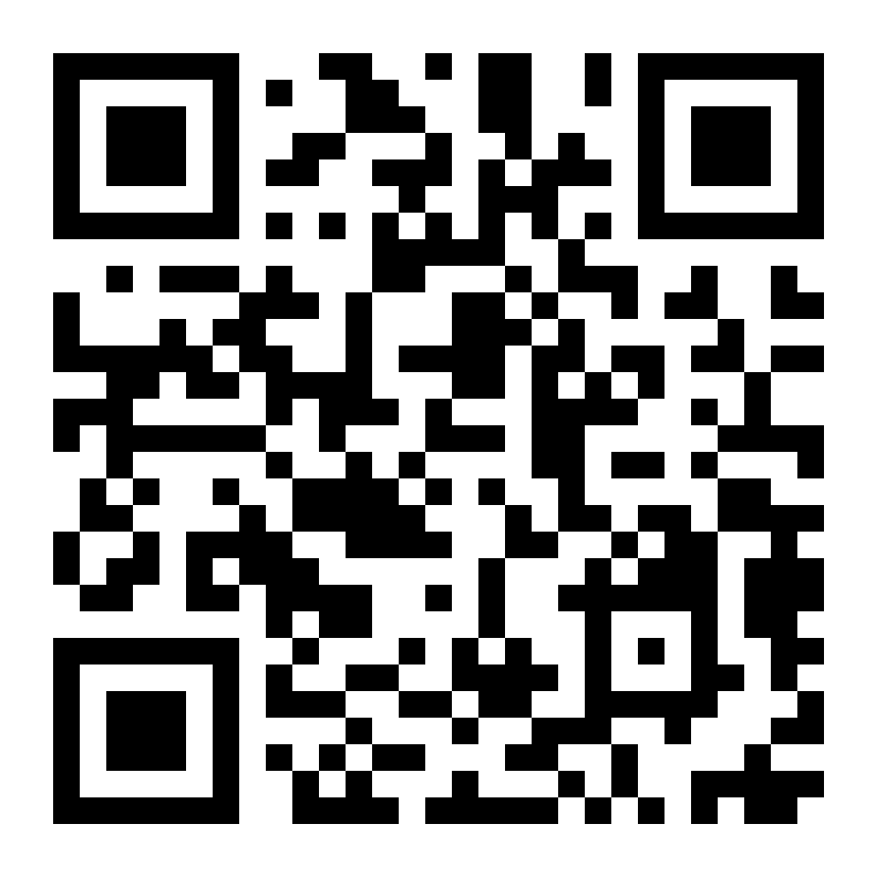
Post-Workshop Evaluation
Link:
https://forms.gle/U1mM7UavL9xfyQwC9

Slide 94
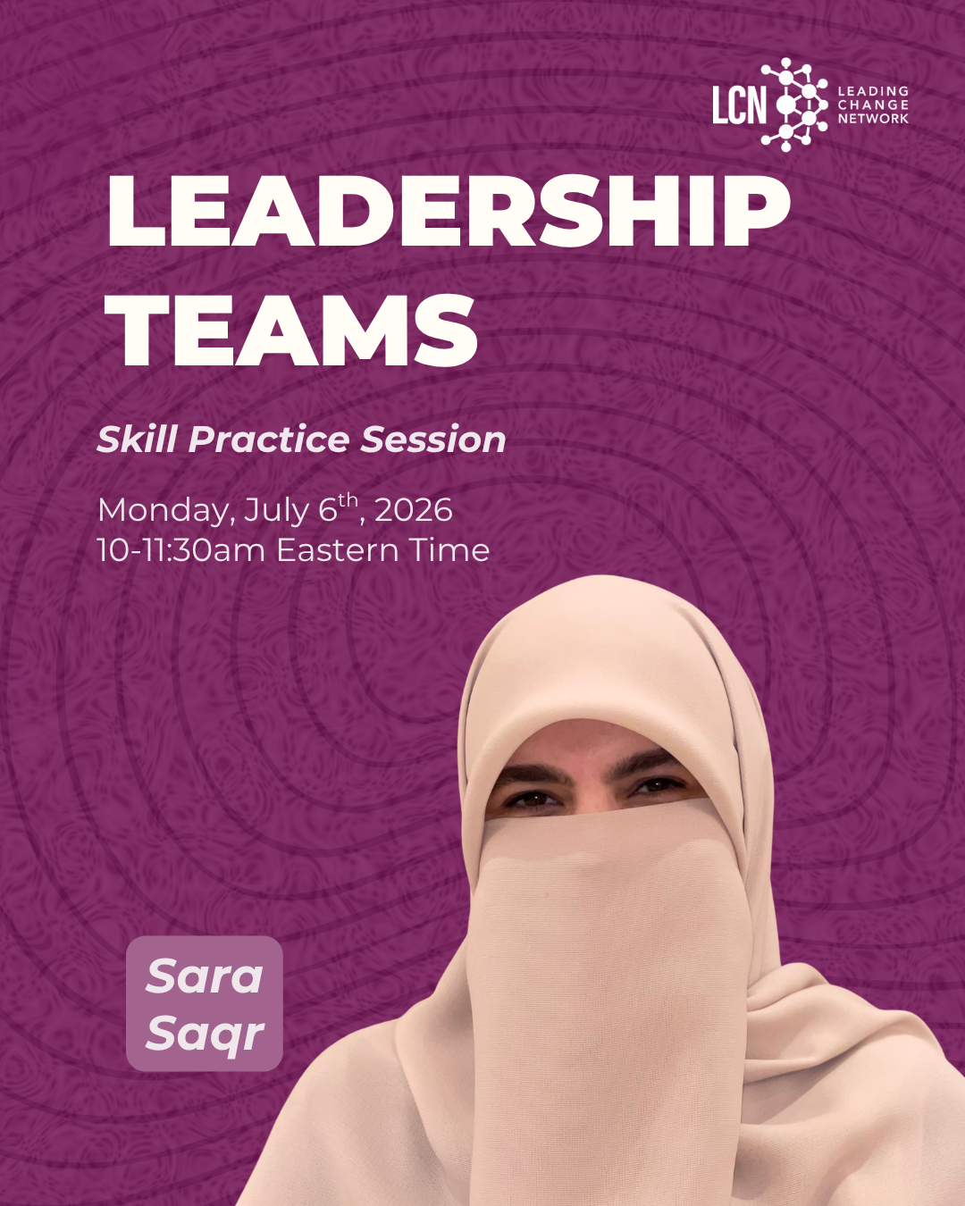
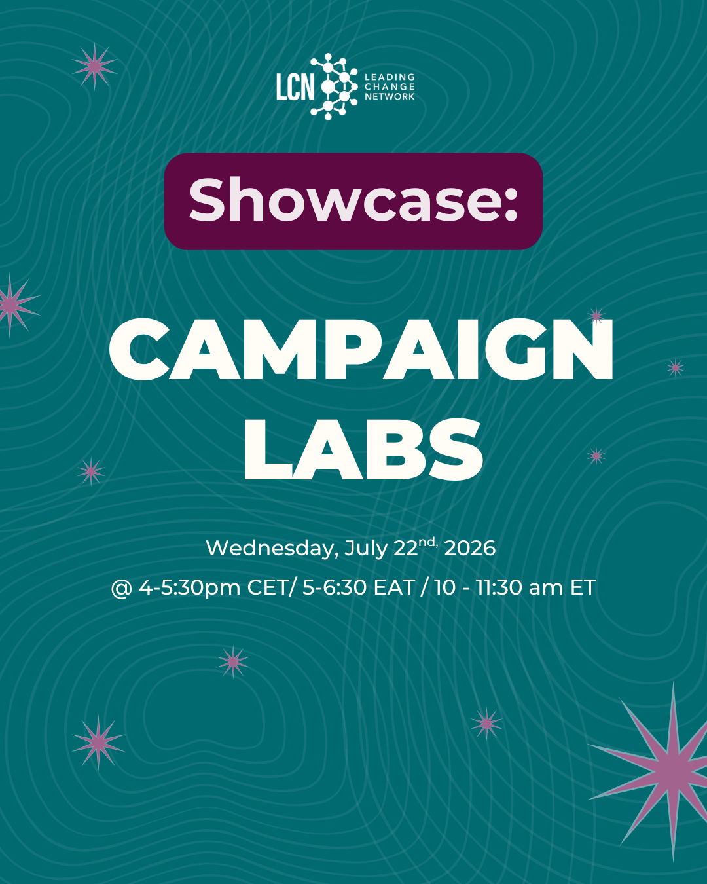
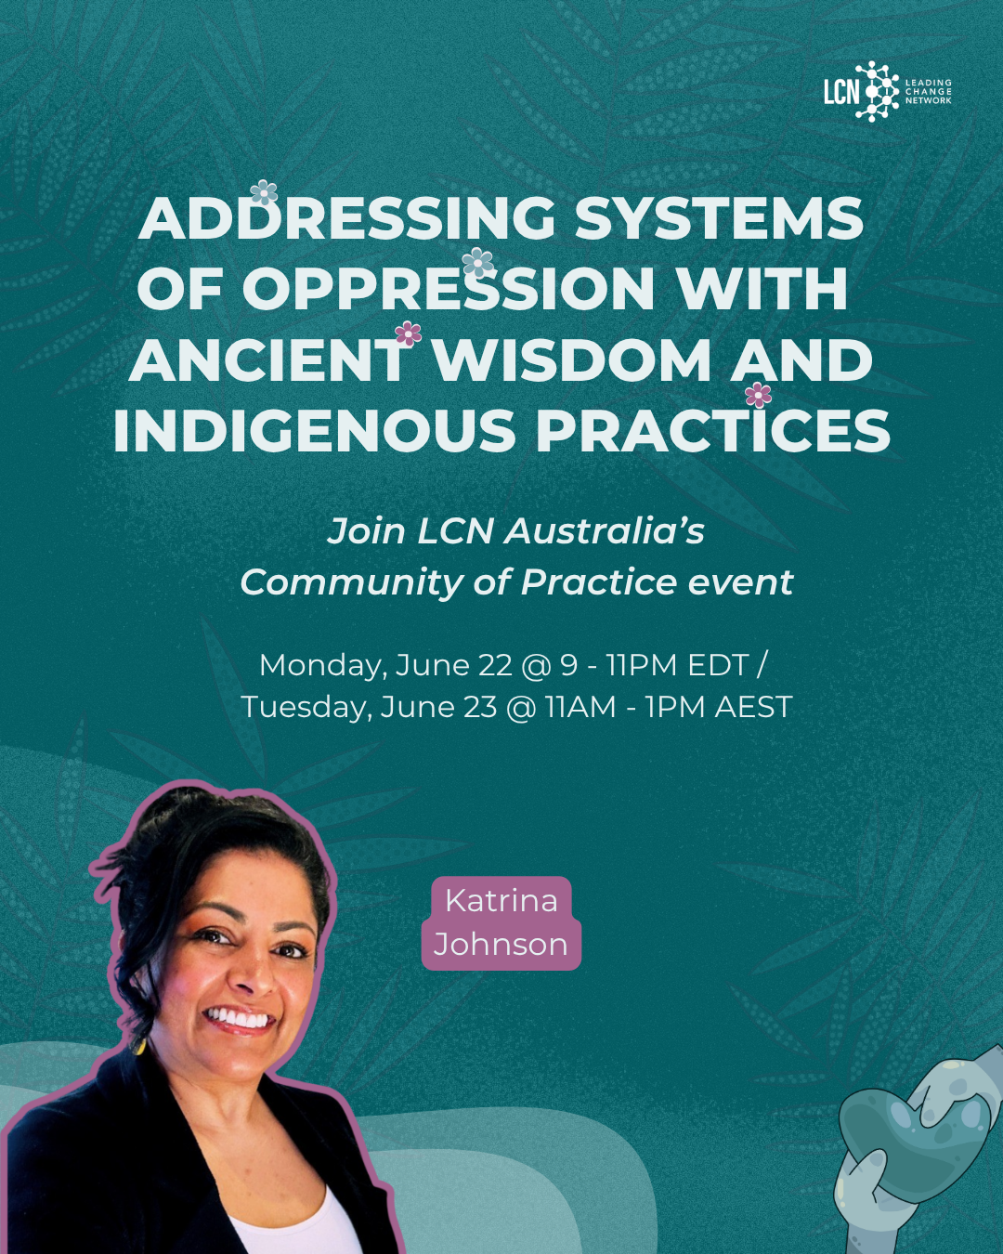
Upcoming LCN events

Slide 95
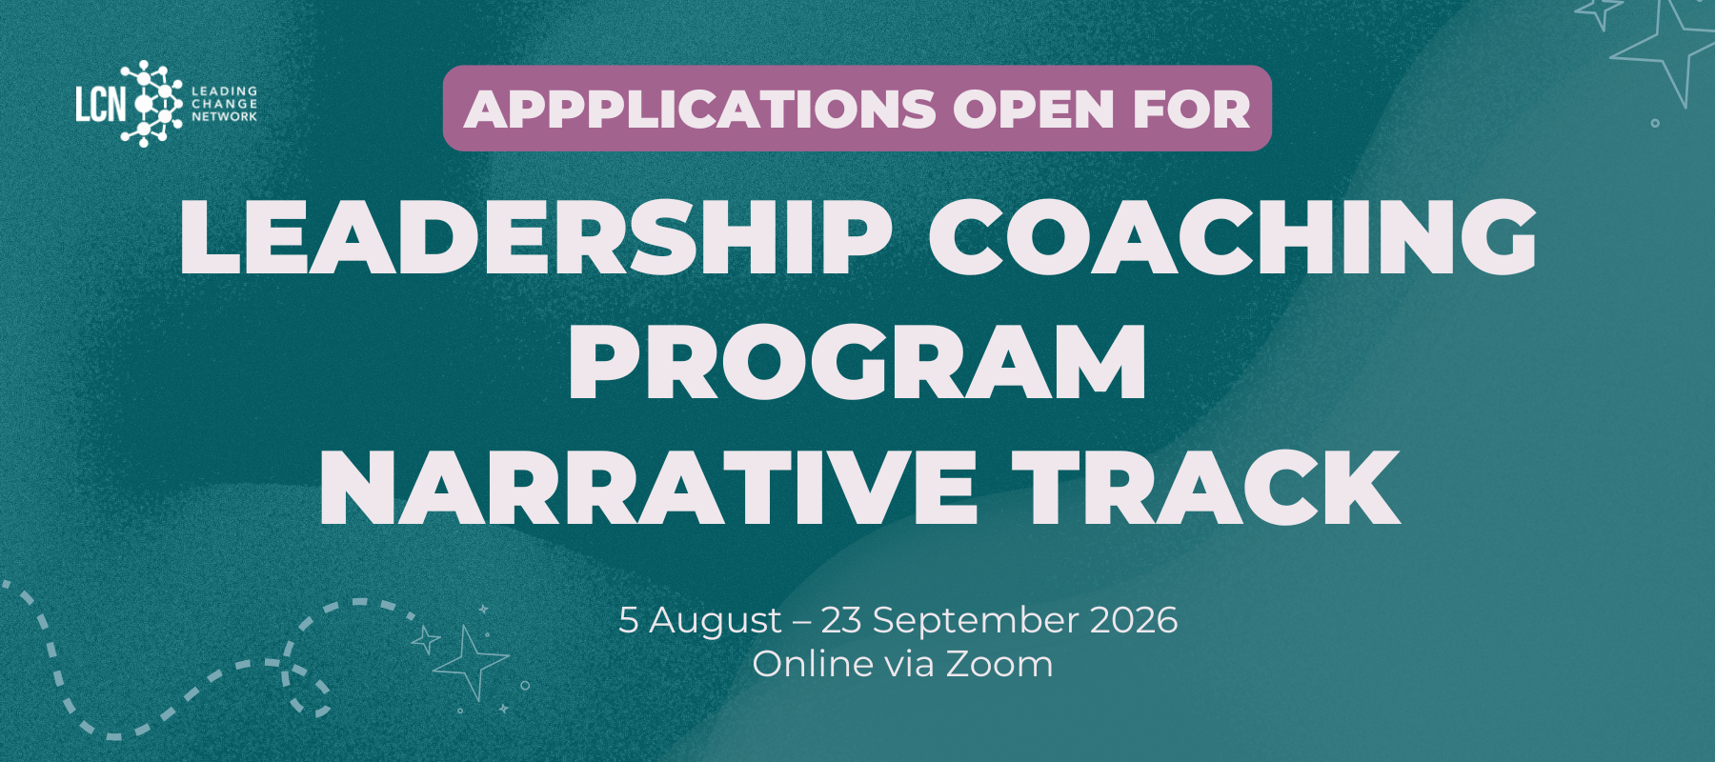

Upcoming LCN Academy Opportunities
Notes:
Reach out to me at sawsan@leadingchangenetwork.org to share more details and connect you with the relevant program coordinator

