Slide 1


Speak-Up! Speak-Out!:
LGBTQ+ Educator Voice Engagement
Minneapolis 2024

Slide 2
Issue-base Organizing

Slide 3
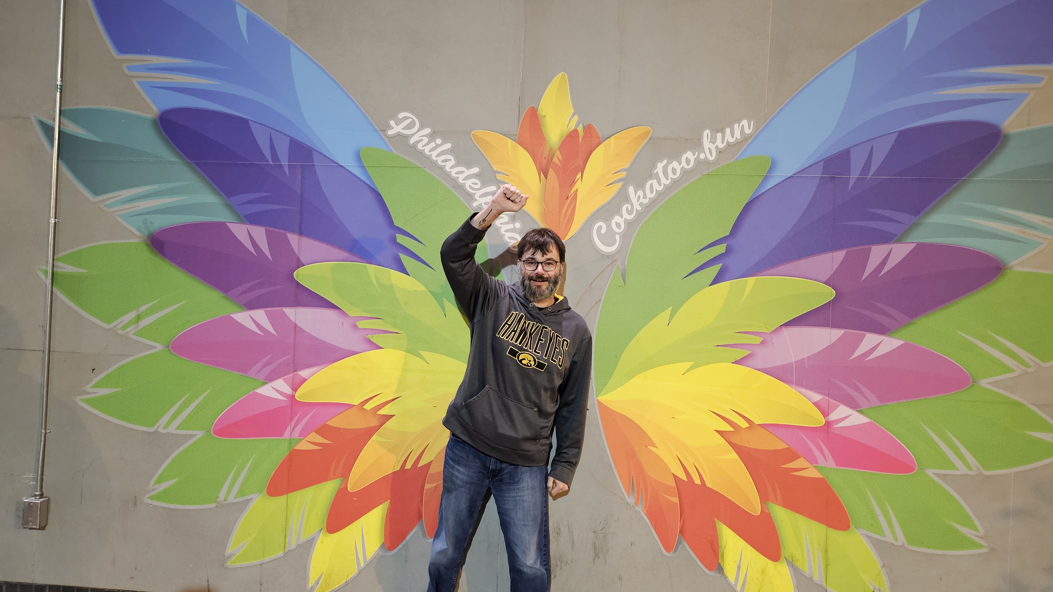
Who we are?​
NEA Training Facilitator Cohort
Pete Clancy, Iowa

Slide 4

45 Minute Dash
Why Organizing Works​
Problems vs. Issues ​
Lessons Learned and Actions to Apply

Slide 5

Can LGBTQIA+ Justice be achieved by only working with those under the umbrella?

Slide 6

Building Beyond the Umbrella​
How do you begin the work with your colleagues of seeking justice with those who don’t share the experiences, identities, and issues that you do?

Slide 7

Building Beyond the Umbrella
Solidarity
sol / i / dar / i / ty
Noun
  1. Unity or agreement of feeling or action especially among individuals with a common interest, mutual support; mutual support within a group.

Slide 8
Key Ideas
Our society and our unions reinforce the gender and sex binary – this is a construct
People under the umbrella AND people not under the umbrella suffer from the binary construct.
Building shared understanding and shared values IS the best way to begin.

Slide 9
Why do you think that it is important that we address concerns around LGBTQ+ justice through an organizing model ?
(as opposed to relying solely on lawsuits and grievances?)

Slide 10
What is an Organizing Campaign?
An action plan with a beginning, middle, and end, working towards a specific demand
Involves a series of escalating actions (or tactics)
Increases pressure on decision-makers
Builds power by increasing engagement, developing leaders, and building capacity.
Throughout the campaign we identify milestones that indicate we have enough power to try something more and something bigger and win!

Slide 11

Key Parts of an Organizing Campaign
Issue
Demand
Target
Tactics
Escalation

Slide 12
Why an Organizing Approach
Well-organized worksites and locals have a positive, visible presences
Members feel that they have the collective power to solve their problems and see themselves as responsible for the win – not a third party (UD, Lawyer, Lobbyist).
Builds power by continually increasing the amount of member leadership and ownership for the actions.

Slide 13
Why an Organizing Approach
We cannot assume that the law/policy will always be on the side of LGBTQ+ equity!!!

Slide 14
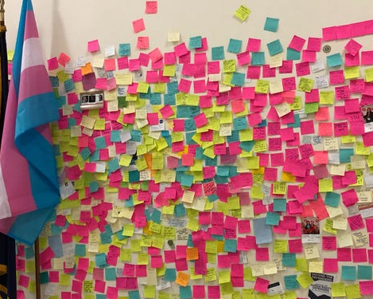
What are all the issues that LGBTQ+ people face in their work and union lives?
At Your Tables –
Get a stack of post-it notes
3 FULL Minute, list one issue per post-it that LGBTQ+ members face in their work or union life in your local/state.
5 Minutes – as a table sort the issues into categories – name the categories, and write those names EACH ON THEIR OWN Post-it
Possible POWER BUILDING Bring these those to the wall and cluster those that are alike

Slide 15

What are the issues?
What did you see that was common?
What was new to you?

Slide 16
What makes a good organizing issue?

Slide 17
PROBLEM vs. ISSUE
Campaigns start with issues that workers have value-based solidarity around.
An issue is a slice of a workplace problem.
Often a problem can have several different issues depending on the perspective of the people we are working with.
It is KEY to get enough input on what the issues are that make up the problem so that one person does not drive the campaign focus.
Investigating an issue is necessary but not sufficient – we also need to identify workers’ SHARED values – WHY is this an issue? WHY do we want to fix this?

Slide 18

PROBLEM vs. ISSUE
Values that build a relatable “why”
Deserve safe and reliable transportation
Access to quality parts

Slide 19
PROBLEM vs. ISSUE
Problems are big, often overwhelming with no clear solution.
They can be dismantled into issues which have clear solutions.
By organizing around the issues, we have hope to reach our long-term goal, fix the problem.

Slide 20

Issues Lead to Collective Action
• It is widely felt
• It is deeply felt
• It is winnable
• It builds the union and builds leaders
• It has a connection to students and the public

Slide 21
EXAMPLE- Problem and Issue
PROBLEM -Our school is hostile to LGBTQ+ staff and students
Issue – There are no gender inclusive bathrooms and/or transgender students are forced to use the wrong restroom
Values – Equity, Safety, Personal Choice, Student Choice
Issue – Our healthcare and leave benefits do not cover non-“traditional” family structures or are not fully accessible to people with same-gender partners.
Values – Equitable Access, Fair Pay, Family
Issue – Our administration forces us to “out” trans and queer students to their families.
Values- Professional Judgement, Safety, Student Choice

Slide 22
Key Ideas
Problems are disabling.
Issues build solidarity.
We don’t choose the issues, the people who want the change choose the issue AND work to build a bigger base.

Slide 23

Ending It Right
What did you learn about today that:
You’re going to immediately tell your union bestie?
You’re going to use in the near future as part of your union work?
You’re going to work to learn more about?

Slide 24

Thank you!

