Slide 1
Issue-base Organizing

Slide 2

Who we are?
NEA Uniserv Academy and Organizing Programs Training Facilitator Cohort
Jeny Gardner- WY

Slide 3

Our Time Together
45 Minute Dash
  Why Organizing Works
  Issues
  Actions
  Lessons Learned and Actions to Apply

Slide 4

Can LGBTQIA+ Justice be achieved by only working with those under the umbrella?

Slide 5

Building Beyond the Umbrella
How do you begin the work with your colleagues of seeking justice with those who don’t share the experiences, identities, and issues that you do?

Slide 6

Building Beyond the Umbrella
Solidarity
sol / i / dar / i / ty
Noun
  1. Unity or agreement of feeling or action especially among individuals with a common interest, mutual support; mutual support within a group.

Slide 7
Key Ideas
Our society and our unions reinforce the gender and sex binary – this is a construct
People under the umbrella AND people not under the umbrella suffer from the binary construct.
Building shared understanding and shared values IS the best way to begin.

Slide 8
Why do you think that it is important that we address concerns around LGBTQ+ justice through an organizing model ?
(as opposed to relying solely on lawsuits and grievances?)

Slide 9
What is an Organizing Campaign?
An action plan with a beginning, middle, and end, working towards a specific demand
•Involves a series of escalating actions (or tactics)
•Increases pressure on decision-makers
•Builds power by increasing engagement, developing leaders, and building capacity.
•Throughout the campaign we identify milestones that indicate we have enough power to try something more and something bigger and win!

Slide 10
Key Parts of an Organizing Campaign
•Issue
•Demand
•Target
•Tactics
•Escalation

Slide 11

Structure of a Campaign pg. 51

Slide 12
Why an Organizing Approach
Well-organized worksites and locals have a positive, visible presences
Members feel that they have the collective power to solve their problems and see themselves as responsible for the win – not a third party (UD, Lawyer, Lobbyist).
Builds power by continually increasing the amount of member leadership and ownership for the actions.
We cannot assume that the law/policy will always be on the side of LGBTQ+ equity!!!

Slide 13
What makes a good organizing issue?

Slide 14
PROBLEM vs. ISSUE
Campaigns start with issues that workers have value-based solidarity around.
An issue is a slice of a workplace problem.
Often a problem can have different issues depending on the perspective of the people we are working with.
It is KEY to get enough input on what the issues are that make up the problem so that YOU do not drive the solution.
Investigating the issue is necessary but not sufficient – we also need to identify workers’ SHARED values – WHY is this an issue? WHY do you want to fix this?

Slide 15

PROBLEM vs. ISSUE
Values that build a relatable “why”
Deserve safe and reliable transportation
Access to quality parts

Slide 16
EXAMPLE- Problem and Issue
PROBLEM -Our school is hostile to LGBTQ+ staff and students
◦ Issue – There are no gender inclusive bathrooms and/or transgender students are forced to use the wrong restroom
Values – Equity, Safety, Personal Choice, Student Choice
◦ Issue – Our healthcare and leave benefits do not cover non-“traditional” family structures or are not fully accessible to people with same-gender partners.
Values – Equitable Access, Fair Pay, Family
◦ Issue – Our administration forces us to “out” trans and queer students to their families.
Values- Professional Judgement, Safety, Student Choice

Slide 17

What are all the issues that LGBTQ+ people face in their work and union lives?
Notes:
11:00-11:30

Slide 18
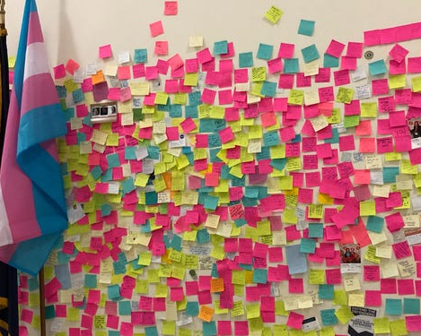
What are the issues?
At Your Tables –
Get a stack of post-it notes
3 FULL Minute, list one issue per post-it that LGBTQ+ members face in their work or union life
5 Minutes – as a table sort the issues into categories – name the categories, and write those names EACH ON THEIR OWN Post-it
Possible POWER BUILDING Bring these those to the wall and cluster those that are alike

Slide 19

What are the issues?
What did you see that was common?
What was new to you?

Slide 20

Issues Lead to Collective Action
• It is widely felt
• It is deeply felt
• It is winnable
• It builds the union and builds leaders
• It has a connection to students and the public
Notes:
Slide Time Allotment: 10 minutes
Share out issues from around the room.

Slide 21
Key Ideas
Problems are disabling.
Issues build solidarity.
We don’t choose the issues, the people who want the change choose the issue AND work to build a bigger base.

Slide 22

Ending It Right
What did you learn about today that:
You’re going to immediately tell your union bestie?
You’re going to use in the near future as part of your union work?
You’re going to work to learn more about?

Slide 23
Thank you!
Notes:
11:00-11:30

Slide 24

Using Intersectionality to Build Solidarity
Intersectionality is a framework for understanding a person, group of people, or social problem as affected by a number of discriminations and disadvantages. It takes into account people's overlapping identities and experiences in order to understand the complexity of prejudices they face.​

Slide 25
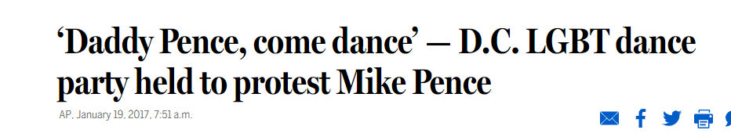
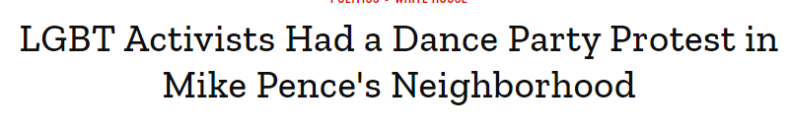
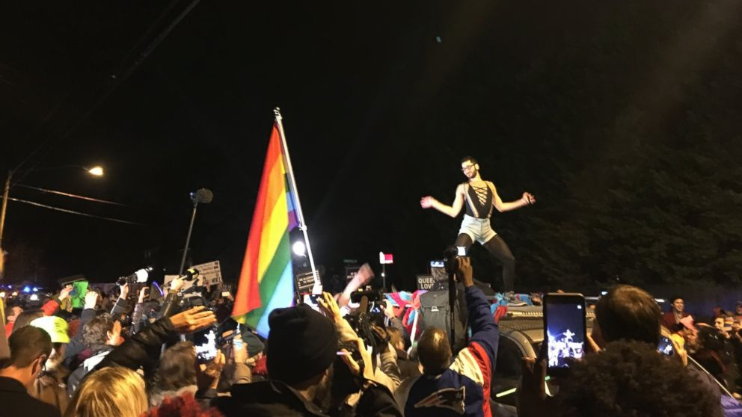
Historic LGBTQ+ Tactics

Slide 26
BRAINSTORM WORK!
TIME: 5 Minutes
TACTICS BRAINSTORM!
+++YOU HAVE 5 MINUTES!+++
Brainstorm AS MANY tactics as you can on 1 chart.
•Be creative!
•You are NOT evaluating right now! Everything goes on the board!

Slide 27
Evaluating Tactics
Does the action relate to your issue?
Will it increase the pressure on the decision-maker?
Is it visible?
Is it timed for effect?
Is it new and different—or tried and true?
Are enough people ready to do it?​
Will it unify people?​
How will management react?​
Does it violate the law? (If so, are we prepared for the consequences?)​
Will it be fun?

Slide 28
Compression Points
Points on the calendar where you celebrate short term wins or escalate your tactics.
◦Naturally occurring deadlines- Breaks, Board Meetings
◦Artificial deadlines-target has till day X to act
◦Help us build urgency and crisis

Slide 29

Why do you think tactics escalate gradually?

Slide 30
Less escalated actions prepare our people for more escalated actions
Give the target the chance to do the right thing before things escalate
Use the threat of escalation

Slide 31
Tactics
Tactic: Actions you to take as a part of an escalation plan that increases pressure on your target to try to win your demand.

Slide 32
A Tactic Should
Puts pressure on your Target
(puts them out of their comfort zone)
Builds your Power
(develops leaders, brings more people in, etc.)
Is Strategic

Slide 33
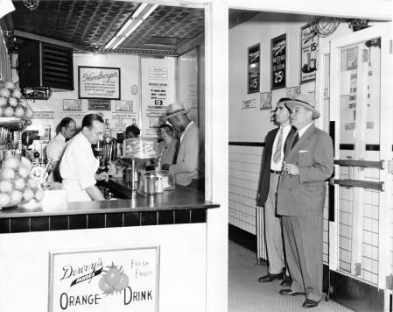
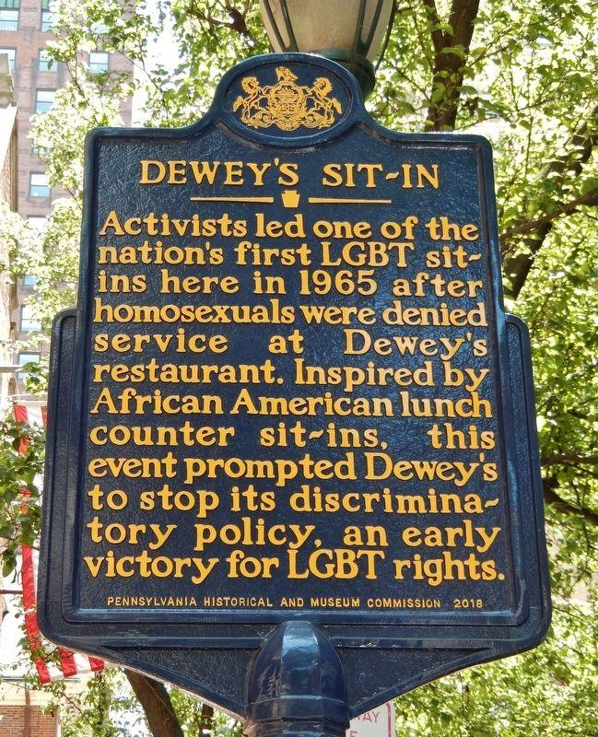
Historic LGBTQ+ Tactics

Slide 34
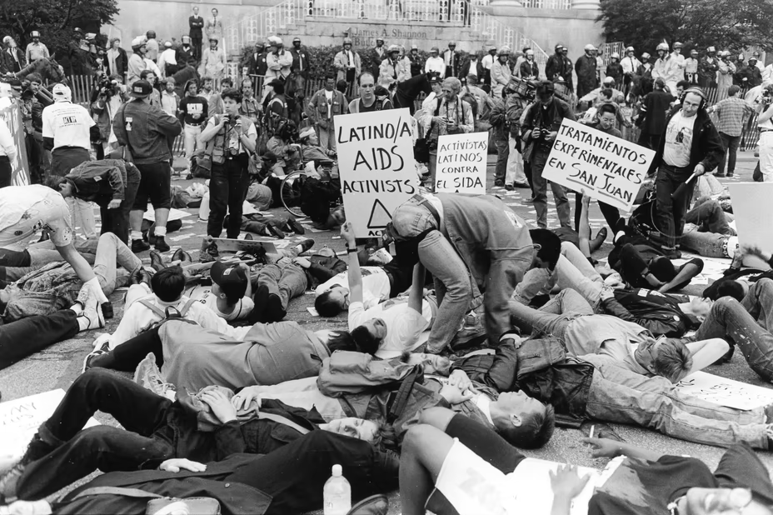

Historic LGBTQ+ Tactics
ACT UP!

Slide 35
How do we get what we want and who can give it to us?

Slide 36
Demand:
A demand is the outcome that addresses the issue that you are making of a target.
Measurable
Achievable
“We demand gender affirming bathrooms in every school because all students need to feel safe and included in our schools. ”

Slide 37
Targets:
Is the person with the power to give you what you are demanding.
A single person:
a name, face, & address
“ Hey Superintendent Sam - We demand gender affirming bathrooms in every school because all our students need to feel safe and included in our schools ”

