Slide 1
ENTRY ACTIVITY
Each of you will get a card that has information about HBCUs and/or a minority serving institution. Take a moment to read it for understanding and be prepared to share your card with others later in the morning.

Slide 2

Organizing on HBCU Campuses
Day 1

Slide 3

Organizing on HBCU and MSI Campuses
By attending this training, you confirm that you are a NEA affiliate staff member. The information you receive here is only for your use in your capacity as an NEA affiliate staff member.
This training and its contents are confidential and may not be further distributed or passed on to any other person or published or reproduced, in whole or in part, by any medium or in any form, for any purpose. Audio/video recording, copying of slides, and the use of AI note-taking tools are prohibited without the written consent from Ellen Holmes. Violation of these terms may result in legal action.

Slide 4
NEA Standards of Conduct
NEA has adopted a Standard of Conduct Policy to ensure that all of our gatherings are welcoming to and free from discriminatory, harassing, or otherwise unacceptable behavior. Discrimination or harassment based on race, color, ethnicity, religion, sex, age, national origin, sexual orientation, disability, gender identity, or expression, or any other characteristic protected by law willl not be tolerated. If you have experience any discriminatory or harassing behavior, please contact NEA Executive Committee members Robert Rodriguez or Christine Sampson-Clark to report the incident. Thank you for your commitment to ensuring a positive event for all.

Slide 5

Honoring This Space
We acknowledge the long history of systemic racism, oppression, and genocide that has shaped the land on which we stand today. This land was once home to Indigenous peoples who lived in harmony with their environment for millennia. Their sacred sites, cultural practices, cultural practices, and deep connections to the land were violently disrupted by colonial policies that sought to erase their existence. The forced removal, displacement, and dispossession of Indigenous communities from their ancestral lands continue to have lasting impacts on their social, cultural, and economic well-being.
We also acknowledge the trauma inflicted upon those who were trafficked, forced into servitude, or made undocumented through colonial and federal practices. This includes Indigenous peoples, enslaved Africans, and other marginalized groups who were brought to this land against their will, enduring systemic violence and exploitation.
We recognize that the United States was built on the backs of enslaved Black people, whose labor and sacrifices were exploited to build the foundations of this nation. The contributions of enslaved Black people, along with the struggles and perseverance of other immigrant communities throughout history, have been essential to the development of this country. Yet, their labor and humanity were often dehumanized, and their rights stripped away, perpetuating cycles of inequality and injustice that persist today.
We stand in solidarity with the ongoing efforts of Indigenous peoples, Black communities, and all marginalized groups fighting for justice, reparations, and the healing of the wounds inflicted by these histories of colonization, enslavement, and systemic oppression. We are committed to learning, unlearning, and working towards a more just, equitable, and inclusive future.
Notes:
Gina

Slide 6

Staff and Members in Same Training
Race Forward Training
All coming from a Different
Space of Privilege and Oppression
How do we Talk about this Space

Slide 7
Why we are here:
NEA’s Framework For Change
Awareness
Capacity Building
Action
Notes:
Framework for Change:
The National Education Association is uniquely positioned to impact racial justice in education by focusing the work on awareness, capacity building, and action. We will build a union of members who, through their organization, are more aware of racial justice, receive and use racial justice tools, and who, together with other educators and key stakeholders, take action to address racial injustice in schools and related institutions:
If we build awareness about institutional racism and work towards creating racial justice in education, the National Education Association can provide shared knowledge and conceptual clarity in racially aware work;
If we continuously create and disseminate capacity building tools, skills, strategies, and resources to our members, leaders, staff, students and partners, a more racially aware National Education Association can be the leader in publically demanding racial justice in education in more powerful and meaningful ways;
If we support, lift, connect and take action with an intentional focus on movement building, we will create racial equity in our classrooms, worksites, and in our communities.

Slide 8

Logistics to Remember
Questions to Ask
Bathroom
Materials
Food
Room Temperature
Karla as a Resource
Travel

Slide 9

3 Day Agenda
Day 1
7:30-8:30 Breakfast
8:30 Convene
10:20-10:35 Break
10:35-12:00 -Content
12:00- 1:00 LUNCH
1:00-2:15 Content
2:45-3:00 Break
3:00-4:30 Content
5:00 Adjourn

Slide 10
3 Day Agenda
Day 2
7:30-8:30 Breakfast
8:30 Convene
8:30-10:15 Content
10:15-10:30 Break
10:30-12:00 Content
12:00- 1:00 LUNCH
1:00-2:15 Content
2:15-2:30 Break
2:30-4:30 Content
5:00 Adjourn

Slide 11
3 Day Agenda
Day 3
7:30-8:30 Breakfast
8:30 Convene
8:30-11:30 Content
11:30-11:45 Break
11:45-1:00 Content
1:00-2:00 Content
2:00 Adjourn

Slide 12

Overview of Today’s Learning
Welcome & Introductions
Community Building
Setting the Stage
Building spaces, Trust and Opportunities
History of HBCUs,
HBCUs, Civil Rights Movement and Unionism
HBCU and BIPOC Serving Institutions
Collectivism, Value and Solidarity
Cultural Competencies
Moving Forward
Closing
Notes:
Lisa

Slide 13
Overview Of Today’s Learning
Socialization and Bias
Systemic Underfunding
Lived Values of Unionism and Anti-Racism
What is Your Role
Organizing Differently
Intentional Power Building
Agenda
Notes:
Lisa

Slide 14

How our work with you is framed
Racial justice is the systematic fair treatment of people of all races, resulting in equitable opportunities and outcomes for all.
To achieve this requires an explicit, though not exclusive, examination of race and ethnicity and a “race and ...” approach that examines how race compounds and intersects with other societal issues.

Slide 15
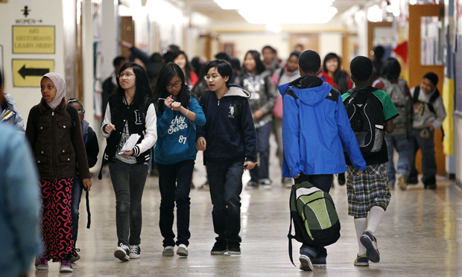
Guiding Question
As participants, what does this mean in your work?

Slide 16
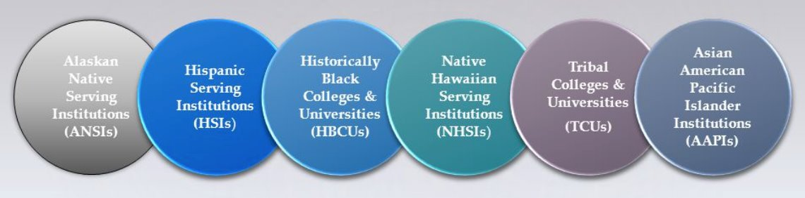
Introductions

Slide 17

Core values are the
fundamental beliefs of
a person. These guiding
principles dictate
behavior, choices, and
attitudes.
Our actions may not always reflect our stated core values.

Slide 18

Introductions
Community and relationships are important.
Please share
Name
Pronouns
State You Work In
Core Value Leading Your Work
Notes:
Lisa

Slide 19
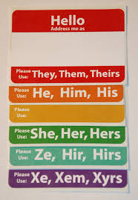
Why share your pronouns?
You can’t just assume by looking.
Asking and correctly using someone's pronouns is the easiest way to show your respect for their gender identity.
Wrong pronoun use can make a person feel disrespected, invalidated, dismissed, alienated, or dysphoric (or, often, all of the above.)
It is a privilege to not have to worry about which pronoun someone is going to use for you.

Slide 20

Community Agreements Pg 2-3
Awareness and Self-Knowledge
Listen for Understanding
Be Gracious
Stay Engaged
Be Open and Suspend Judgment
Say “I”- tell your truth
Lean into Discomfort
Reach for Empathy
Expect non- Resolution and non-Closure

Slide 21
Disclaimer
The content we are going to explore may bring up strong feelings. Throughout our time together, we will explore examples of racism, ableism, heterosexism, and sexism.
These oppressive ideas and assumptions are offensive, problematic and false. Yet, over time, they have become as pervasive and invisible as the air we breathe. We need to examine them so that we can understand and ultimately challenge them.
Modified ADL

Slide 22
LaQuita & Michelle

Slide 23

The Federal Administration

Slide 24
Federal Policy Shifts Affecting HBCUs and MSIs
- New White House Initiative on HBCUs
- Lack of guaranteed federal funding
- HSI/MSI funding cuts and reallocation to HBCUs/TCUs
- Philanthropic gifts from MacKenzie Scott

Slide 25
DEI, Academic Freedom & Immigration Challenges
- Termination of DEI programs
- Free speech and academic freedom concerns
- Impact on race-based scholarships and programming
- Institutional identity pressures for HBCUs/MSIs
-International & Immigrant Faculty & Students
-Compact for Higher Education – restrictions on teaching, hiring and admissions

Slide 26
Union Organizing Implications
- Organizing and people building power
-Strengthen campus coalitions
-Elevate Member Voices
-Vulnerability of non-tenure faculty
- Legislative threats to tenure
- Need for union protections and advocacy
- Messaging for member recruitment
-Alumni engagement

Slide 27
The Federal Administration
Which of your Core Values were highlighted, challenged, or affirmed by the current attacks on education?
How are you managing any anxieties or stress related to the current federal administration?

Slide 28
The Federal Administration - Reflection
In Closing
What key insights or takeaways stood out most to you? And Why?
Let's make sure each response adds a fresh perspective

Slide 29
The Federal Administration

Slide 30
Barb & Ilissa

Slide 31

  Building Knowledge of HBCUs
  and other MSIs

Slide 32
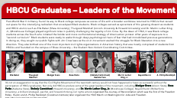
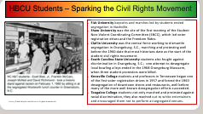

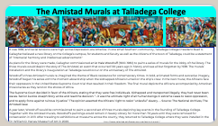
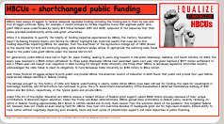
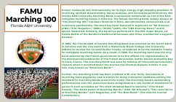
HBCU/MSI HISTORY MIXER
Each participant will receive an HBCU/MSI history card. Take some time to read your HBCU/MSI card.
Pair & share: When prompted, you will find a partner. You will have 90 seconds each to share two takeaways of your HBCU/MSI history card.
When signaled, you will find a different partner and repeat. there will be three (3) rounds in this activity.

Slide 33

Debrief
What surprised you?
What is the historical significance?
What is something that you learned that is still relevant today?
What aspects of this history/information align with “union values”?

Slide 34
Poster Session- What Makes Them Different
Notes:
Establishment of HBCU's, Tribal Colleges, HSI, Asian Pacific Islanders Institutions - REHE-A-Status-Report-Chapter-9.xlsx (live.com)
Tribal Colleges Resources/Data
Location of TCUs - Race and Ethnicity in Higher Education (equityinhighered.org)
TCU Exploration Guide by American Indian college fund.pdf
NativeAmericanFactSheet-October-2021-FINAL.pdf (pnpi.org)
Creating-Visibility-and-Healthy-Learning-Environments-for-Natives-in-Higher-Education_web.pdf (collegefund.org)
Tribal colleges empower Native students with an affordable, culturally relevant education – but need more funding (theconversation.com)
REHE-2020-Chapter-2-individual.pdf (equityinhighered.org)
Tribal Colleges & Universities – American Indian Higher Education Consortium (aihec.org)
Tribal Colleges and Universities: An Introduction | American Indian College Fund
Indigenous Peoples' Day Resources - Zinn Education Project (zinnedproject.org)
Resources for Teaching About Indigenous Peoples | NEA
TCU White Paper.pdf
Hispanic Serving Institutions Resources/Data
Hispanic-Serving Institutions (HSIs) Infographic: 2020-21 | Excelencia in Education (edexcelencia.org)
A Closer Look at Hispanic-Serving Institutions - Higher Education Today (higheredtoday.org)

Slide 35
Poster Session: Building Capacity
1: Tribal Colleges and Universities (TCUs) | 2: Hispanic Serving Institutions (HSIs)
Pages in your participant handout: 14-28 | Pages in your participant handout: 29-39
3: Historically Black Colleges and Universities (HBCUs) | 4: Asian American and Native American Pacific Islander-Serving Institutions (AANAPISI)
Pages in your participant handout: 40-68 | Pages in your participant handout: 69-95

Slide 36
Poster Session: Building Capacity
In groups you will create a poster on chart paper about your assigned institution
Make sure you select one or two speakers to present your mini poster
You will have 2 minutes to present your mini poster
Questions to consider when creating your mini poster:
  What information should others see/know that clearly communicates what this institution(s) is/are?
  What celebration, joy, and/or significance is found within these institution(s)?
  What challenges do these institution(s) face?
  Why are these types of institutions great places to organize students, faculty, and staff?
  Is there anything that the room should hear/see?

Slide 37
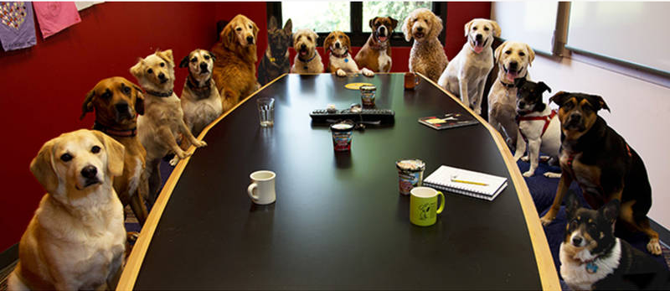
Presentations

Slide 38
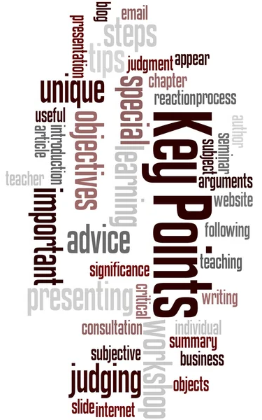
HBCUs and MSIs have a rich legacy and culture that is centered in shared equity and advancement.
These institutions have been centers of innovation and progress for marginalized people and their communities despite being systemically underfunded.
Collectivism over individualism.

Slide 39

Break

Slide 40
Kiesha & Albert

Slide 41
Socialization and Bias
Notes:
Establishment of HBCU's, Tribal Colleges, HSI, Asian Pacific Islanders Institutions - REHE-A-Status-Report-Chapter-9.xlsx (live.com)
Tribal Colleges Resources/Data
Location of TCUs - Race and Ethnicity in Higher Education (equityinhighered.org)
TCU Exploration Guide by American Indian college fund.pdf
NativeAmericanFactSheet-October-2021-FINAL.pdf (pnpi.org)
Creating-Visibility-and-Healthy-Learning-Environments-for-Natives-in-Higher-Education_web.pdf (collegefund.org)
Tribal colleges empower Native students with an affordable, culturally relevant education – but need more funding (theconversation.com)
REHE-2020-Chapter-2-individual.pdf (equityinhighered.org)
Tribal Colleges & Universities – American Indian Higher Education Consortium (aihec.org)
Tribal Colleges and Universities: An Introduction | American Indian College Fund
Indigenous Peoples' Day Resources - Zinn Education Project (zinnedproject.org)
Resources for Teaching About Indigenous Peoples | NEA
TCU White Paper.pdf
Hispanic Serving Institutions Resources/Data
Hispanic-Serving Institutions (HSIs) Infographic: 2020-21 | Excelencia in Education (edexcelencia.org)
A Closer Look at Hispanic-Serving Institutions - Higher Education Today (higheredtoday.org)

Slide 42
Socialization: (n) the process beginning during childhood by which individuals acquire the values, habits, and attitudes of a society (Merriam-Webster)
Bias: (n) a tendency to believe that some people, ideas, etc., are better than others that usually results in treating some people unfairly (Britannica)

Slide 43
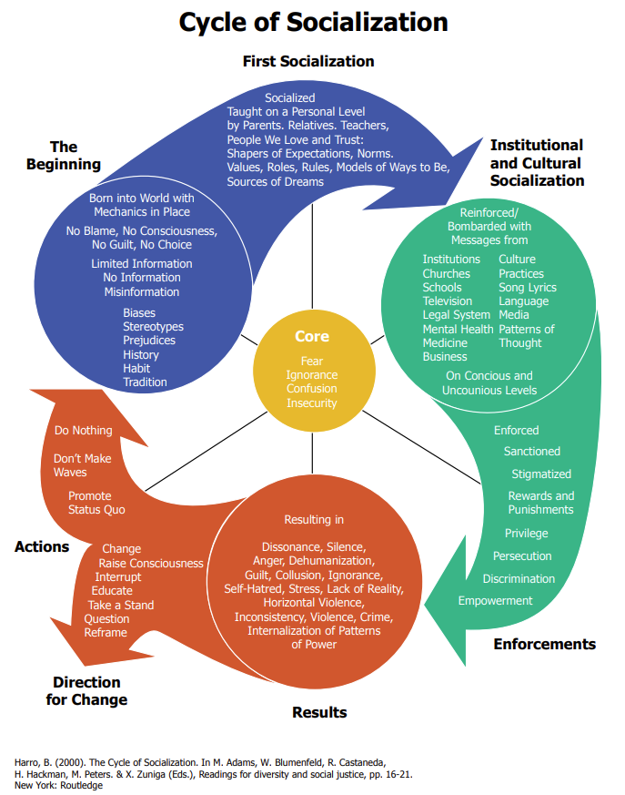
Cycles of Socialization
p.96 in your participant handout

Slide 44
Socialization Reflection Activity (p.97-98) 2nd file
Choose one social identity from the list below that you would like to reflect on and examine.
  Race: A social construct that artificially divides people into distinct groups based on certain characteristics such as physical appearance (particularly skin color) ancestral heritage, cultural affiliation, cultural history, ethnic classification
  Gender Identity: An internal, deeply felt sense of being female, male, a blend of both or neither. Refers to how individuals perceive themselves and what they call themselves. Can be the same as or different from their sex assigned at birth
  Sexual Orientation: An inherent or immutable enduring emotional, romantic, or sexual attraction to other people
  Class: Relative social rank in terms of income, wealth, education, status and/or power

Slide 45
Socialization Reflection Activity (p. 97-98) 2nd file
Using the Socialization Reflection Activity sheet on p. 97-98 and 2nd file of your participant handout, you will map what you have learned about this identity throughout this time.
Use the Cycle of Socialization as a reference and support
Questions to consider:
  What messages did you hear/learn about being ____?
  Where did the messages come from?
    Parents, other family members, religious organizations, schools, teachers, media, other institutions, peers, etc.
  What behaviors were encouraged, rewarded, and supported? How? What behaviors were discouraged, unsupported, and punished? How?
  What behaviors were discouraged, unsupported, and punished? How?

Slide 46
Debrief
What key insights did you arrive at through this activity?
What/who were some of the biggest influences on your understanding of the identity you chose to map?
What impact does your socialization play on your interactions in your work?
How has socialization influenced decision making within your affiliate?

Slide 47
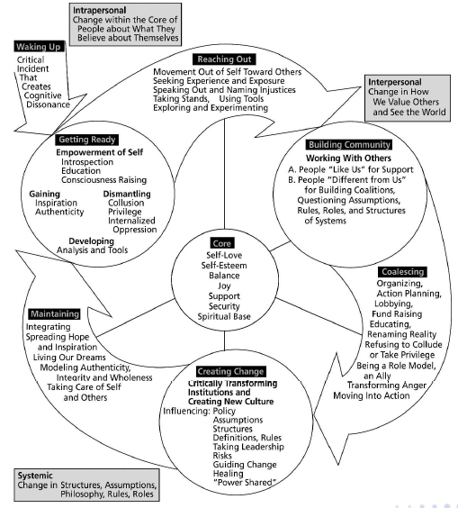
Cycle of Liberation
Page 99 in the Participant Handbook

Slide 48
Socialization impacts our daily actions, thoughts, and feelings
Messaging can be experienced differently based on race, class, gender, and sexual orientation
For us to turn in the “Direction for Change”, intentional and purposeful work must be done not just personally but also systematically

Slide 49
Rakia & Michelle

Slide 50
Systemic Underfunding:
Impacts on Workers and Resources
Notes:
Establishment of HBCU's, Tribal Colleges, HSI, Asian Pacific Islanders Institutions - REHE-A-Status-Report-Chapter-9.xlsx (live.com)
Tribal Colleges Resources/Data
Location of TCUs - Race and Ethnicity in Higher Education (equityinhighered.org)
TCU Exploration Guide by American Indian college fund.pdf
NativeAmericanFactSheet-October-2021-FINAL.pdf (pnpi.org)
Creating-Visibility-and-Healthy-Learning-Environments-for-Natives-in-Higher-Education_web.pdf (collegefund.org)
Tribal colleges empower Native students with an affordable, culturally relevant education – but need more funding (theconversation.com)
REHE-2020-Chapter-2-individual.pdf (equityinhighered.org)
Tribal Colleges & Universities – American Indian Higher Education Consortium (aihec.org)
Tribal Colleges and Universities: An Introduction | American Indian College Fund
Indigenous Peoples' Day Resources - Zinn Education Project (zinnedproject.org)
Resources for Teaching About Indigenous Peoples | NEA
TCU White Paper.pdf
Hispanic Serving Institutions Resources/Data
Hispanic-Serving Institutions (HSIs) Infographic: 2020-21 | Excelencia in Education (edexcelencia.org)
A Closer Look at Hispanic-Serving Institutions - Higher Education Today (higheredtoday.org)

Slide 51
Levels of Expression of Oppression p. 100
I n d i v i d u a l | Internalized Oppression lies within individuals. These are our private beliefs and biases about others, influenced by our culture, that reside inside our minds. | S y s t e m i c | Institutional Oppression occurs within institutions and systems of power. It is the norms, policies and practices that are structured into political, societal and economic institutions that have the net effect of imposing oppressive conditions and denying rights, opportunity, and equality to identifiable groups.
 | Interpersonal Oppression occurs between individuals. Once we bring our private beliefs into our interactions with others, we are now in the interpersonal realm. |  | Structural Oppression is bias across institutions and society. It’s the cumulative and compounded effects of an array of factors that systematically privilege some and disadvantage others.

Slide 52
Power and Oppression Question to Consider
Does the use of a legal approach transform the power required for a shift in the expression of oppression?
What does transform the power in an expression of oppression?

Slide 53
Create a Freyer Chart
Defining Organizing Issues
Pgs. 101-148
How is this a faculty issue?
How is this a campus worker issue?
Possible
Organizing
Issues?
How is this a student issue?
Who might be community allies in an issue campaign?

Slide 54
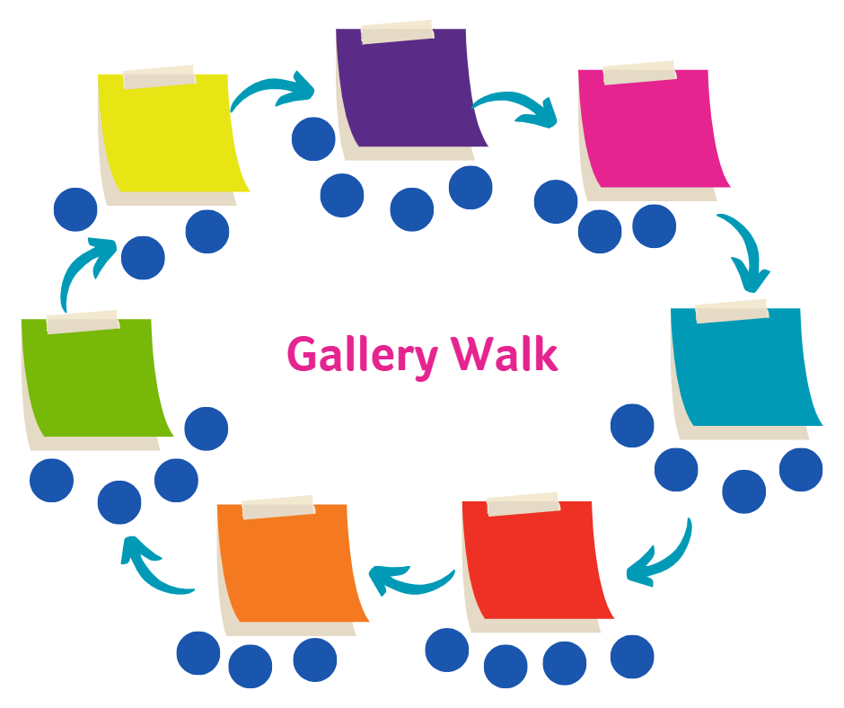
Gallery Walk Through the Charts
Make a check mark if you agree.
Draw a heart for something you love.
Make a question mark for something that leaves you wondering.
Back at your home chart -What did you notice?

Slide 55

Draft a Call to Action
Select one group from your chart and develop a message around why the issue of underfunding should matter to them.
Why should the group you selected join the fight for funding?
Define the why and ask the group to participate in organizing on this issue.

Slide 56
Team Presents Call to Action to the Room
Raise Your Hand if You Would Answer this Call
Why did you choose the group?

Slide 57

Systemic Underfunding:
Impacts on Workers and Resources
Why is it important?
How could this be used in your work?

Slide 58
Legal wins don’t result in system level power changes.
For legal wins to be actualized people need to act.

Slide 59
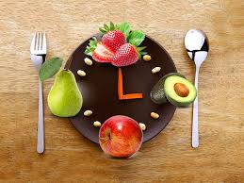
Lunch

Slide 60
Josh & Ilissa

Slide 61
Lived Values of Unionism and Anti-Racism
Notes:
Establishment of HBCU's, Tribal Colleges, HSI, Asian Pacific Islanders Institutions - REHE-A-Status-Report-Chapter-9.xlsx (live.com)
Tribal Colleges Resources/Data
Location of TCUs - Race and Ethnicity in Higher Education (equityinhighered.org)
TCU Exploration Guide by American Indian college fund.pdf
NativeAmericanFactSheet-October-2021-FINAL.pdf (pnpi.org)
Creating-Visibility-and-Healthy-Learning-Environments-for-Natives-in-Higher-Education_web.pdf (collegefund.org)
Tribal colleges empower Native students with an affordable, culturally relevant education – but need more funding (theconversation.com)
REHE-2020-Chapter-2-individual.pdf (equityinhighered.org)
Tribal Colleges & Universities – American Indian Higher Education Consortium (aihec.org)
Tribal Colleges and Universities: An Introduction | American Indian College Fund
Indigenous Peoples' Day Resources - Zinn Education Project (zinnedproject.org)
Resources for Teaching About Indigenous Peoples | NEA
TCU White Paper.pdf
Hispanic Serving Institutions Resources/Data
Hispanic-Serving Institutions (HSIs) Infographic: 2020-21 | Excelencia in Education (edexcelencia.org)
A Closer Look at Hispanic-Serving Institutions - Higher Education Today (higheredtoday.org)

Slide 62
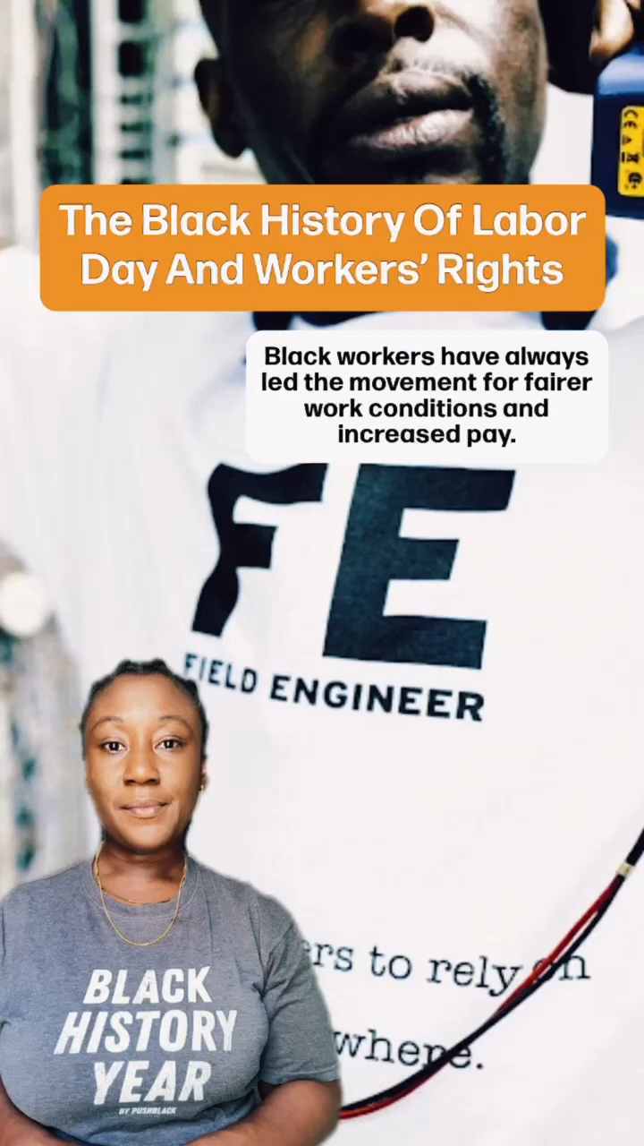
Black Workers Values Shape Unions

Slide 63
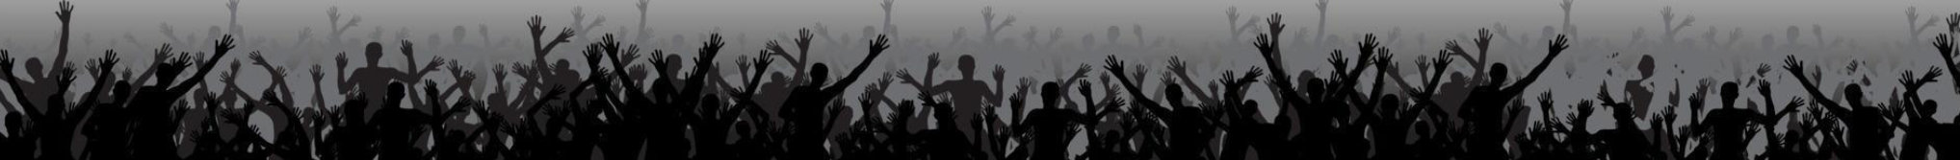
Core Values
Core values are the fundamental beliefs of a person or an organization. These guiding principles dictate behavior and can help people understand the difference between right and wrong. These can often be expressed in one or two words. We are taking a moment to consider our core values because they can provide a basis for solidarity in the midst of struggles.

Slide 64
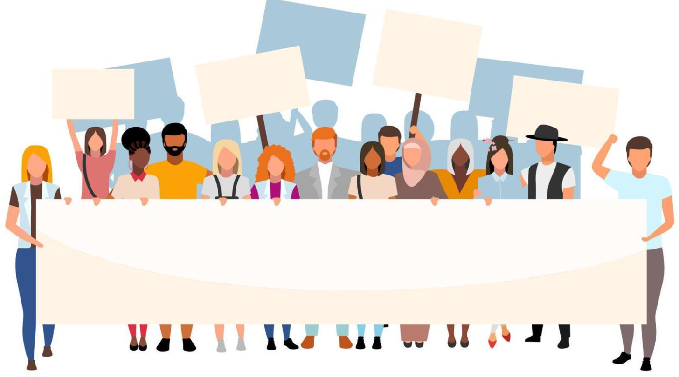
What are the core values of your union?

Slide 65
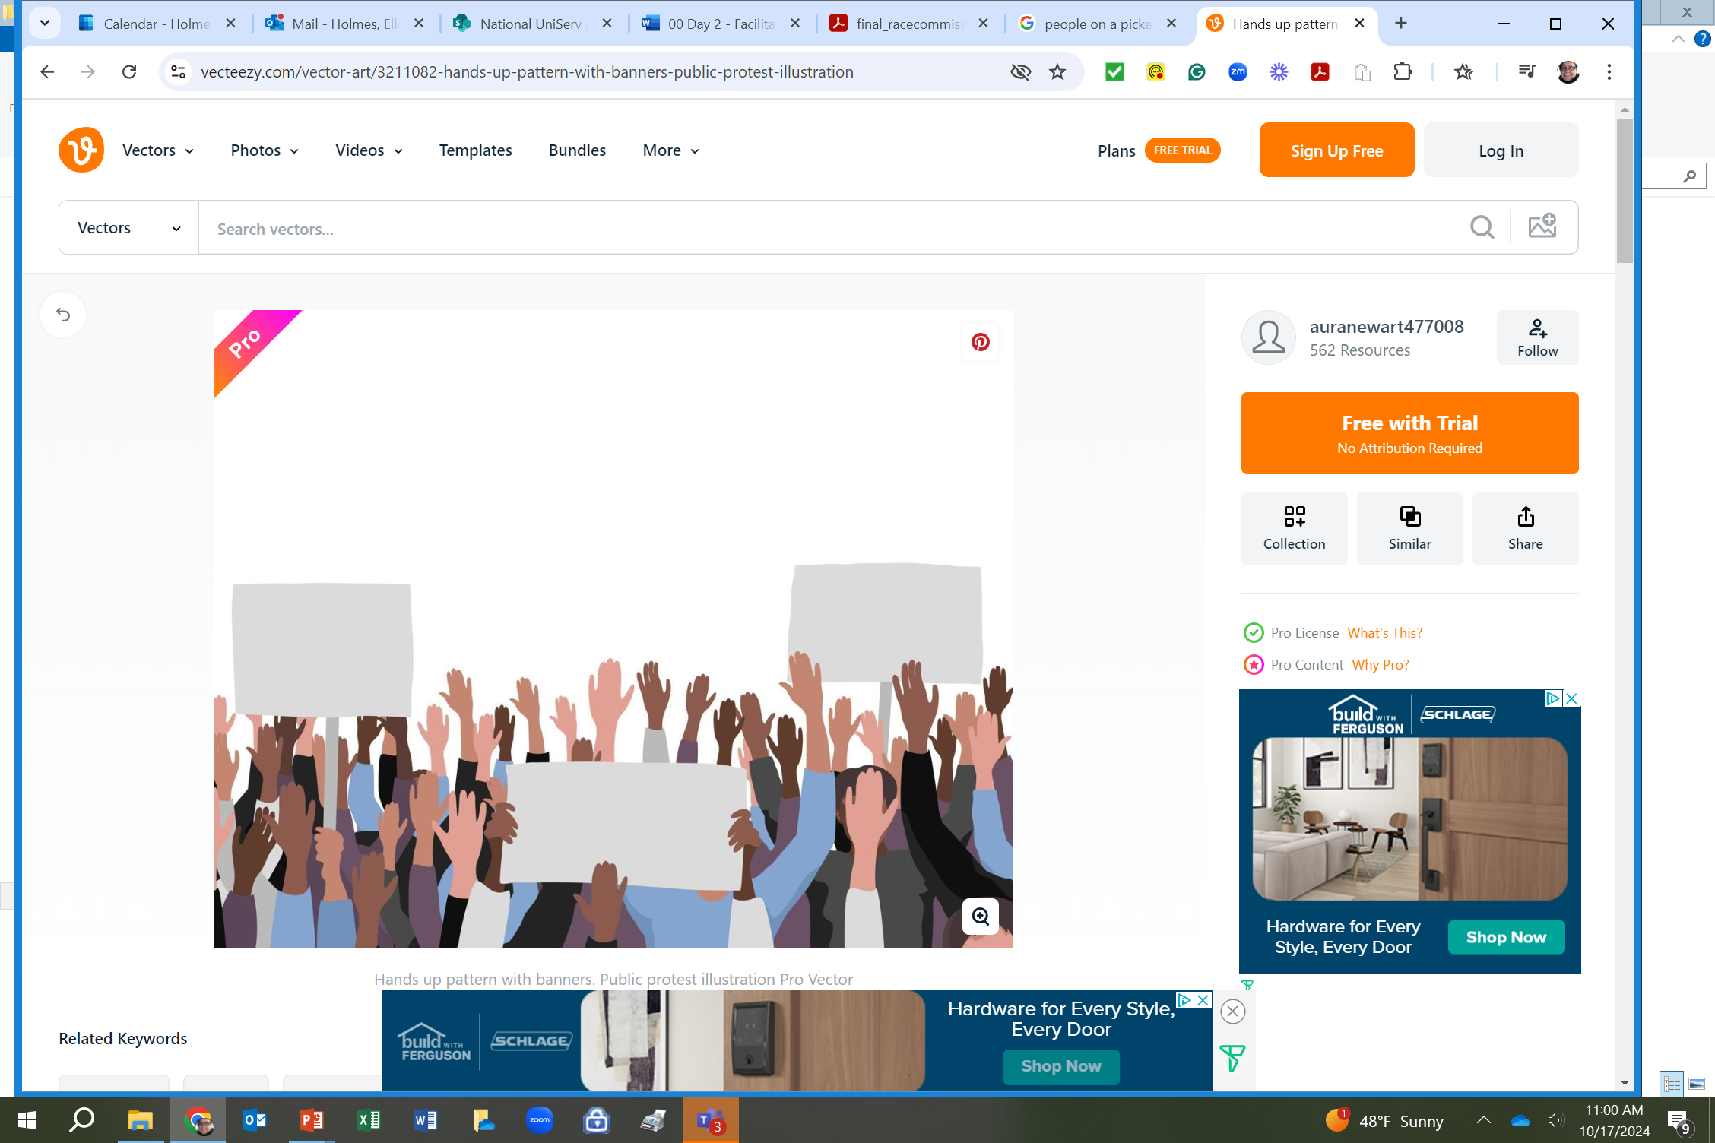
Report Out
Each table shares list of values.
Listen as tables share out and only add new values to the list.
What do you notice?

Slide 66
Union Values
Fairness, honesty/integrity, responsibility, compassion/empathy, safety, health, generosity, hard work/responsibility, community, freedom, democracy, binding contracts, equality, opportunity, respect, stability/security, unity, quality work, justice, collective action, dignity/respect, charity/community service, and due process.

Slide 67
Ideally - Unions advance the welfare of all workers. They are based on the idea of justice, progress, and betterment of self and of society. They embody the universal ideal of human rights and the need to aspire to become more complete human beings. By becoming an active participant in the labor movement, members become part of something larger than themselves. We experienced some of these same values exemplified in the interactions we have had with the HBCU here.
However, without INTENTIONAL APPLICATION of our stated values to dismantling systems of oppression we make no forward movement.

Slide 68
Walk the Line Activity
There will be six rounds
Listen to the union value statement, a description, and a short statement.
Based on how you have seen your affiliate live into this stated value, you will move on the line toward “Strongly Agree” or Strongly Disagree”
Keep in mind, this is a reflection activity. People may feel very differently about the values and how they see our work. The variety of perspectives is important.

Slide 69
Walk the Line Activity – Round 1
Calling People In Not Out
Calling people in means trying to create a culture and community that people actually want to be a part of. Calling people in means we don’t shame or blame. It requires direct, specific and compassionate communication with one another. We all have space to grow, and calling people in is how we support one another through growth.
STATEMENT: Our affiliate calls one another in when we need to communicate within our affiliate and with other white people.

Slide 70
Walk the Line Activity – Round 2
Accountability through Collective Action
Collective actions means that we look to build a movement of millions of people. Individual transformation is not enough. This is done through building accountability relationships with people of color who are doing racial justice work in the movement and who are accountable to a group of people. We don’t wait to be asked to take action to organize white people.
STATEMENT: Our affiliate is taking accountable collective action on a regular basis.

Slide 71
Walk the Line Activity – Round 3
Taking risks, making mistakes, learn, and keep going.
Making mistakes is part of life, and we know we have to be outside of our comfort zones in order to make change. Even when we take on real risk, we know that the risk is always greater for people of color. When we make mistakes, we want to reflect and stay in motion. We cannot let making mistakes prevent us from continuing our work. When others make mistakes, we do not shame, blame or exile.
STATEMENT: Our affiliate stays in the process of taking action, receiving feedback and staying in motion. We support one another through our mistakes.

Slide 72
Walk the Line Activity – Round 4
Mutual Interest
Racial justice isn’t something we help people of color with. The system of white supremacy harms all of us—including white people, though in very different ways than people of color. We need to get clear with ourselves about what we have to gain through this fight.
STATEMENT: Our affiliate and members are clear on our mutual interest. We’ve spent time getting clear on what’s at stake for us as individuals and as a group

Slide 73
Walk the Line Activity – Round 5
Enough for All
There are enough resources in the world for everyone's basic needs to be met— for folks to have decent housing, enough food, safety, etc. The problem isn’t that we don’t have enough stuff—it’s that it’s distributed unfairly. White supremacy tells us we need to compete with everyone, even other people doing this work.
STATEMENT: We organize from a place of abundance and cooperation.

Slide 74
Walk the Line Activity – Round 6
Growing is good
We need millions of white people to join the movement for racial justice, and in order for this to happen our groups need to keep growing. We need to constantly bring in new voices and leaders. This means more than inviting people to come to meetings. It means finding new and exciting ways to bring people into the work based on their skills.
STATEMENT: Our group is open to growth. We bring in new members and engage with them as leaders.

Slide 75
Debrief the Line
• What are you taking away from that activity that relates to our time here learning about HBCU organizing?
• Is there anything that surprised you?
• Where are we doing really well?
• Where do we need to grow?

Slide 76
Barb & Kiesha

Slide 77
What is Your Role

Slide 78

Theories for Change:
Advocacy, Mobilizing, Organizing
Mobilizing
Advocacy
Organizing
Notes:
Ellen
20 Mins Entry activity – 4 Corners of Union Work
How do you think your locals primarily view your role with them? Social Justice Advocate, Contract Manager and Problem Solver, Leadership Coach and Developer, Campaign/Organizing Leader –
Prompts -Once at your charts, what are the opportunities that this view could have for moving towards a win and what are the challenges that this view could have?
Where is our power?
Contract Negotiation, Grievances, Member Engagement, Staff Led Programs
10 MIN debrief – so now what?

Slide 79
What do we mean?
Advocacy
“Advocacy is the work of creating change through the actions of professionals or technical experts—lobbyists, pollsters, lawyers, communication specialists, researchers. Advocacy relies on the expertise, status, and know-how of these groups of people to make change. Advocacy usually happens in a closed-door room; ordinary people play a small to nonexistent role in its efficacy. Advocacy has become a dominant strategy for unions and liberals. ” Power is limited to those with the specific expertise and role.
Mobilizing
“Mobilizing, by contrast, activates an already-convinced membership. Mobilizing encourages those who already support a cause or a mission to take action to defend their belief—for example, by attending a protest, wearing a button, or signing a petition.” Power is static and is dependent on a predictable core of folks.
Organizing
“To organize is to build mass support and strength among ordinary people. Organizing draws its power from working people’s biggest strength: our numbers... The work of organizing is systematic and rigorous: It requires connecting with every single worker in a shop, every educator in a building, every building in a district. At its core, it asks people to understand their own agency and to make choices about how they will exercise it.” Power is distributed and growing as more and more people join the base and more and more leaders evolve through actions.

Slide 80

At your tables
Take 5 Minutes
How many actions at an HBCU campus can you list that are examples of each of these theories?
    Advocacy
    Mobilizing
    Organizing
Be ready to share your best ideas

Slide 81
Staff Led Actions are Typically Advocacy
Advocacy
“Advocacy is the work of creating change through the actions of professionals or technical experts—lobbyists, pollsters, lawyers, communication specialists, researchers. Advocacy relies on the expertise, status, and know-how of these groups of people to make change. Advocacy usually happens in a closed-door room; ordinary people play a small to nonexistent role in its efficacy. Advocacy has become a dominant strategy for unions and liberals.”
Bargaining that is staff led, or traditional methods of bargaining – little engagement from the rank and file and few public displays of collective action
Grievances and other legal actions that do not include and escalation of direct public actions – little engagement beyond leaders and staff, and few displays of power and risk that build solidarity between rank and file folks
Recruitment programs typically begin with advocacy in mind – join to get something.
Can you think of other advocacy examples?

Slide 82
Specific Programs are Typically Mobilizing
Mobilizing
“Mobilizing, by contrast, activates an already-convinced membership. Mobilizing encourages those who already support a cause or a mission to take action to defend their belief—for example, by attending a protest, wearing a button, or signing a petition.”
Aspiring Educators who meet to develop a network – they are self selecting and there is little risk for participating
Professional Development Conferences where faculty and ESP come to improve work skills or leadership skills or learn union roles – they are self selecting, already “convinced” about unions, and there is little risk for participating
Recruitment can happen as a result of mobilizing if it is member led.
Can you think of other mobilizing examples?

Slide 83
Escalating, Public Actions are Organizing
Organizing
“To organize is to build mass support and strength among ordinary people. Organizing draws its power from working people’s biggest strength: our numbers... The work of organizing is systematic and rigorous: It requires connecting with every single worker in a shop, every educator in a building, every building in a district. At its core, it asks people to understand their own agency and to make choices about how they will exercise it.”
Graduate Student Protests for fair compensation of their work – there is great risk, they develop leader in action skills, they build a base through bigger and bigger public actions
ESP workers fighting for a thriving wage – a campaign that strategically builds a base, increases membership, builds trust and relationship across workers, and transforms rank and file folks into leaders
Faculty and Community fighting for agency in the curriculum they teach – risky, requires strategic partnership, a broader and broader base, applying public pressure on decision makers to do the right thing.
Recruitment that is a result of ongoing actions, intentional base building, and leadership identification and tests are critical to organizing.
Can you think of other organizing examples?

Slide 84
Advocacy and Mobilizing are Opportunities to Organize.

Slide 85
Corner Discussion – Use Handout
Select the compass point that best answers where you are MOST OF THE Time for each of the following questions -
First Move- Which Theory do your Members expect your role to support? Why? Where is the power if this is your role?
Second Move - Which Theory does your Manager, Faculty Advisor, and/or State Organizer expect your role to support? Why? Where is the power if this is your role?
Third Move - Which Theory do your Elected Leaders expect your role to support? Why? Where is the power if this is your role?
Notes:
Ellen

Slide 86
Whole Group Reflection
What is some new thinking that evolved for you as a result of this activity?
What could you do differently to build power than what you are currently doing?
Why is this important to think about especially in the HBCU context?

Slide 87
We may see our roles differently than our managers, our members, and our elected leaders.
Our primary role is to build power, we only build power when we organize.

Slide 88
Break

Slide 89
Albert & Ilissa

Slide 90
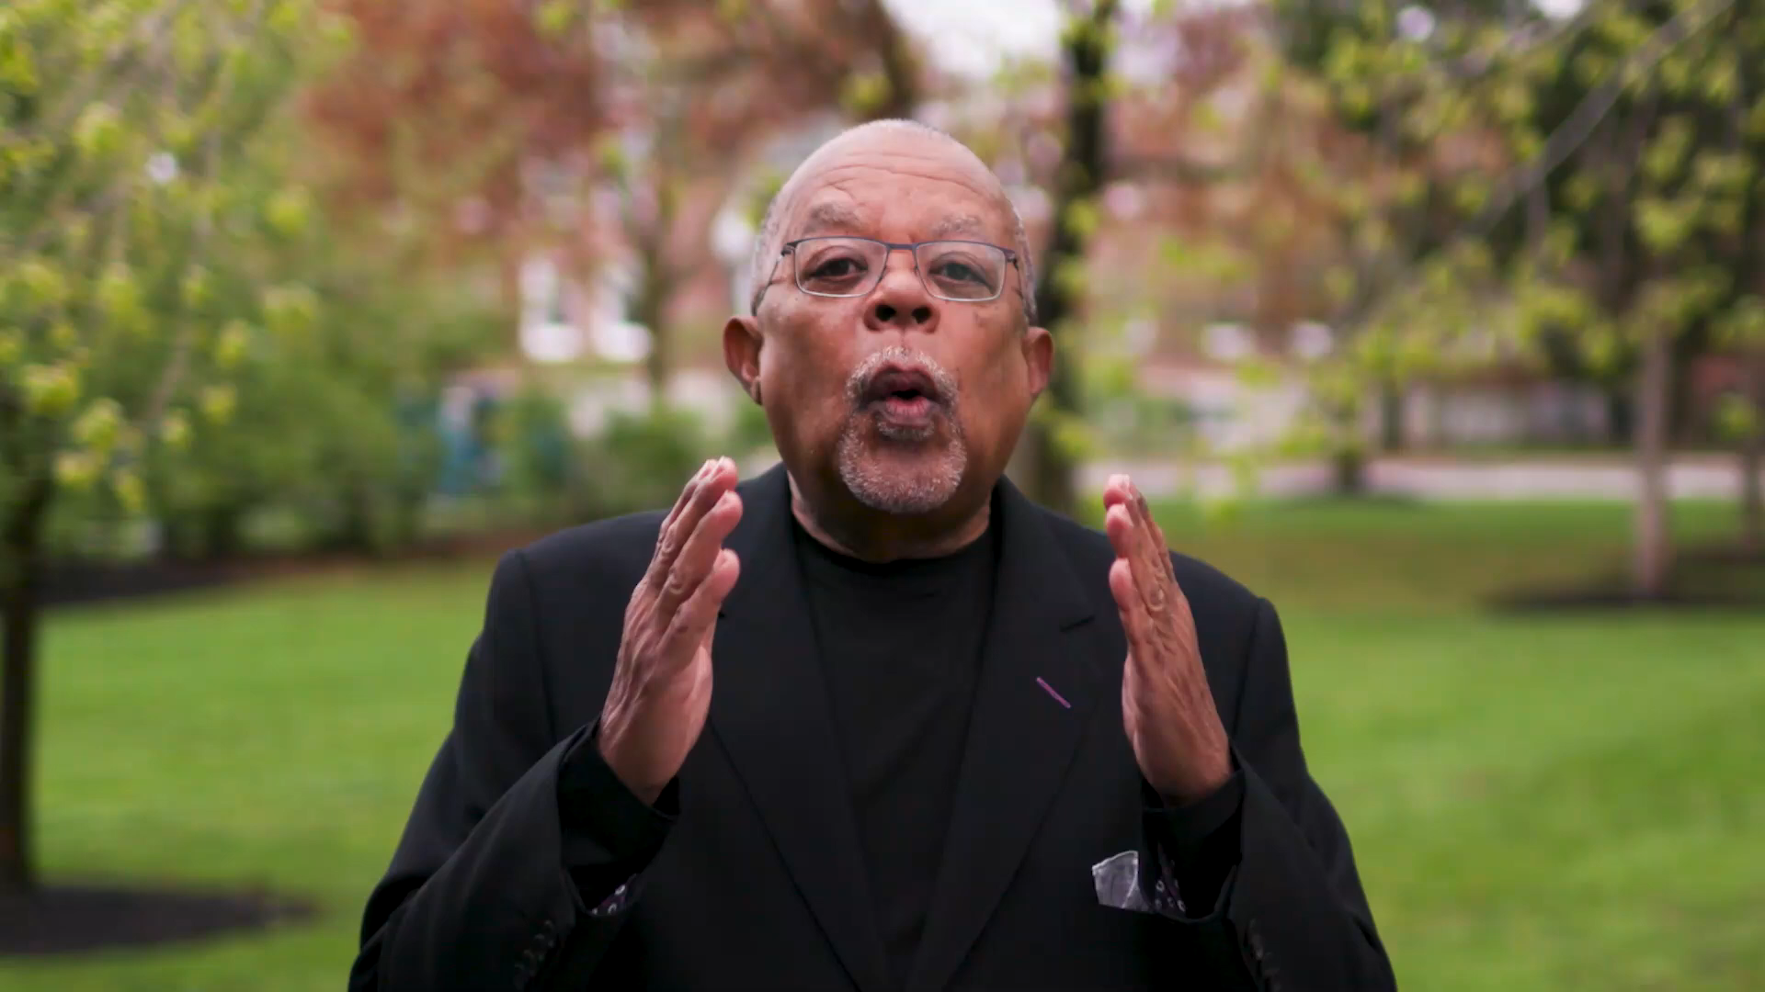
Meet Ella Baker

Slide 91
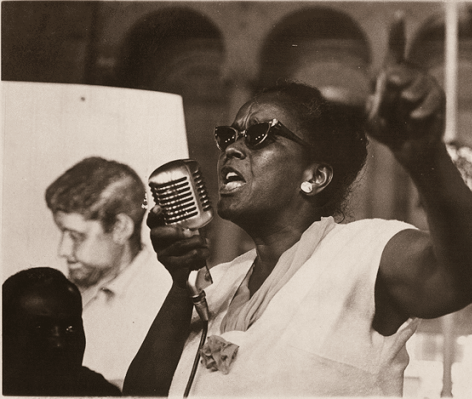
What stands out from this video about Ella’s thoughts on leadership?

Slide 92
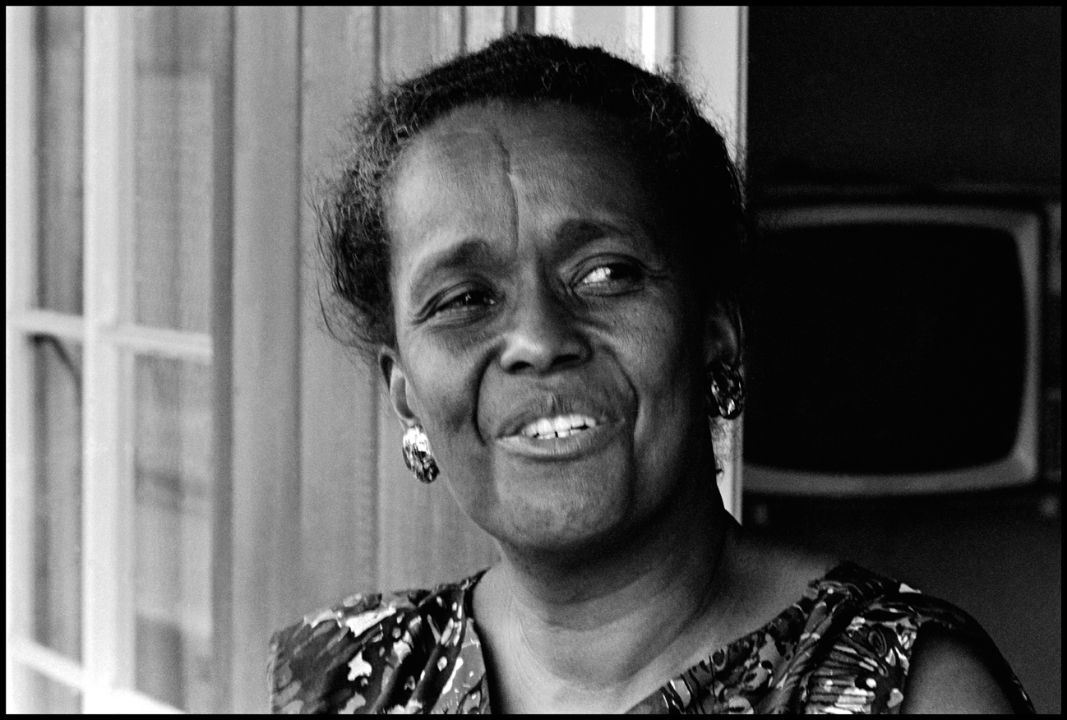
Teamwork
Ella Baker's Legacy: A Different Model of Leadership pgs.170-171
What did Ella believe was important about leadership?
How did this shape her approach to organizing and building power?
Why might this approach be especially helpful on an HBCU or MSI campus?

Slide 93
Ella Believed
  Leaders influence others
  Leaders are accountable
  Leaders are not singular
  Leaders are everyday people
  Leaders have emotional presence
  Leaders listen to others

Slide 94
Michelle & Josh

Slide 95
Intentional Power Building

Slide 96

Turn and Talk
What does the following definition of power make you think about when organizing in an HBCU setting?

Slide 97


Defining POWER
The ability to create, control, and prevent change.
ORGANIZED PEOPLE + ORGANIZED MONEY

Slide 98
Turn and Talk
What does the following quote about Ella Baker’s work make you think about when organizing in an HBCU setting?

Slide 99
Ella’s Power Building Basics
There is the danger in our culture that because a person is called upon to give public statements and is acclaimed by the establishment, such a person gets to the point of believing that he is the movement. The real power is with the people.
-Ella Baker
Read more at: https://www.blinkist.com/magazine/posts/empowering-words-ella-baker-quotes?utm_source=cpphttps://time.com/4633460/mlk-day-ella-baker/

Slide 100
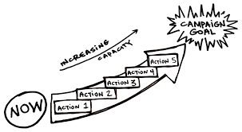
Review of the Basics for Building Power
The workers, their energy, and their leadership must be at the front of the campaign (Ella Baker)
Official union leadership and staff must be willing to work with rank and file members AND allow them to have meaningful roles in campaigns
Must make space for rank and file to develop as leaders (training, chance to take risks, space to prove)
Community-centric approach
Democratic organizing (Ella Barker)
Gradual escalation of tactics
Workers do have power- an organizer’s role is to
help THEM use it to make meaningful change

Slide 101

Tactical Guide to Power​
Political Power:
Ex: PAC, GR, legislative committees​
Consumer Power:
Ex: Montgomery Bus Boycott​
Legal/Regulatory Power:
Ex: Labor Board
Strikes/Disruptive Power​:
Ex: Writers Guild, #Red4Ed: MN, UTLA, Chicago, WV, Mass - Andover
Notes:
Kayla
Political Power: Getting
something passed by an elected body​
Consumer Power: Ability
to conduct a boycott​
Legal/Regulatory Power:
Win in Court/Regulatory Process​

Slide 102
Who has the Power to give or prevent the change you want? Senator Delegates Governor | What actions influences your target ? Letter writing Testifying on the bill Rallies Lobbying Hearing from constituents
Who influences your target? Other legislators People they see often in their community Community leaders | Who do you want to support your change? Universities Alumni Businesses who benefit from HBCU's Community leaders
Notes:
Kayla – do one thing at a time instead

Slide 103
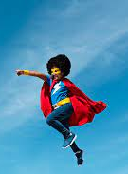
Our roles
What are the specific types of work people are engaged in that support and cultivate these types of cases?
What shifts in your work, expectations, or team practices could help you and your leader, manager, and/or state organizer make space for the lessons and perspectives shared in these cases?

Slide 104

Power Analysis Cases
Use your handout on pg # 192 to track the following:
What are the key issues in your case?
What are or might be some demands in your case?
Who has the power to grant the demands?
What actions influence the target?
What people influence your target?
Who do you want to join you in support of your campaign?
What might be the staff role in your case? - you may have to infer if it is not clearly stated

Slide 105
Power is always either growing or waning.
Power must be intentionally built.
If our work is focused primarily on advocacy, we are not building power.

Slide 106
Ending it Right
Notes:
Establishment of HBCU's, Tribal Colleges, HSI, Asian Pacific Islanders Institutions - REHE-A-Status-Report-Chapter-9.xlsx (live.com)
Tribal Colleges Resources/Data
Location of TCUs - Race and Ethnicity in Higher Education (equityinhighered.org)
TCU Exploration Guide by American Indian college fund.pdf
NativeAmericanFactSheet-October-2021-FINAL.pdf (pnpi.org)
Creating-Visibility-and-Healthy-Learning-Environments-for-Natives-in-Higher-Education_web.pdf (collegefund.org)
Tribal colleges empower Native students with an affordable, culturally relevant education – but need more funding (theconversation.com)
REHE-2020-Chapter-2-individual.pdf (equityinhighered.org)
Tribal Colleges & Universities – American Indian Higher Education Consortium (aihec.org)
Tribal Colleges and Universities: An Introduction | American Indian College Fund
Indigenous Peoples' Day Resources - Zinn Education Project (zinnedproject.org)
Resources for Teaching About Indigenous Peoples | NEA
TCU White Paper.pdf
Hispanic Serving Institutions Resources/Data
Hispanic-Serving Institutions (HSIs) Infographic: 2020-21 | Excelencia in Education (edexcelencia.org)
A Closer Look at Hispanic-Serving Institutions - Higher Education Today (higheredtoday.org)

Slide 107
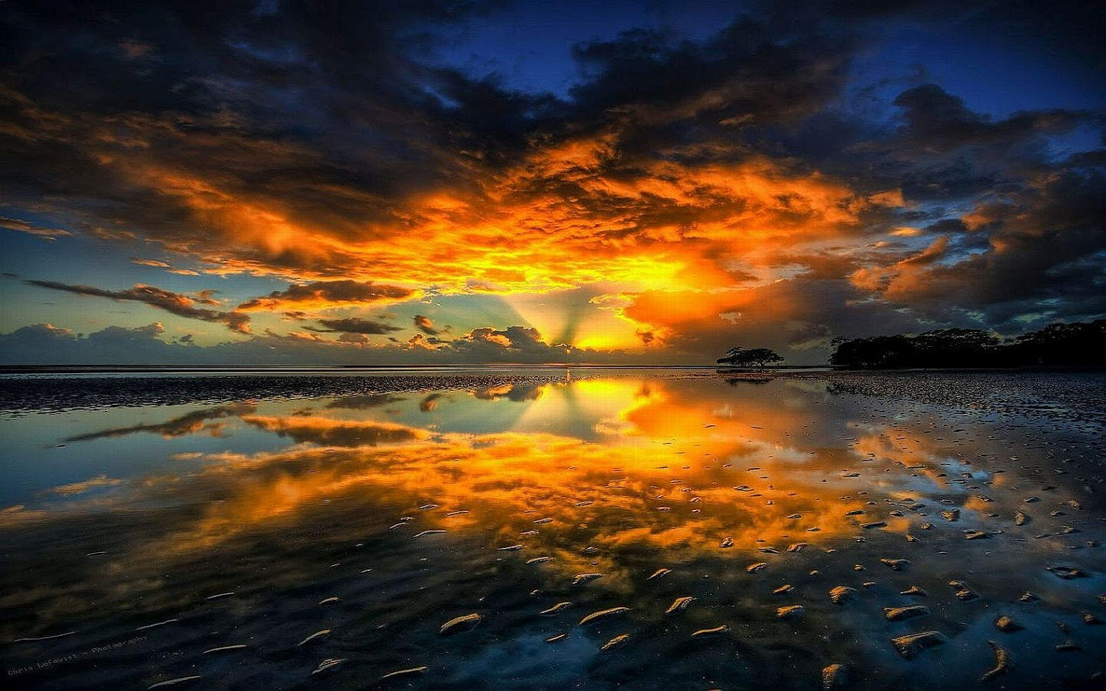
Final Reflections and Reminders

Slide 108
Closing

