Slide 1

Centering Race, Class and Gender in Your Campaigns

Slide 2
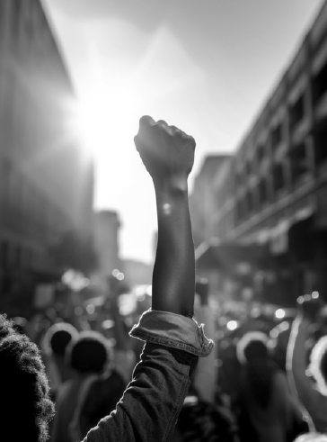
Make a list of student or worker issues found on HBCU campuses.
What will it take to achieve equity for the people who work and learn on our HBCU campuses?

Slide 3


Power
The ability to create, control, and prevent change.
ORGANIZED PEOPLE + ORGANIZED MONEY

Slide 4
What type of union builds power?
Campaigns
Public Action and Demands
Strategic and Ongoing
Continues to Add
  Base – Mobilizers - Leaders
  Allies – Partners - Coalitions
  Requires Risk
  Supported by Staff
  Leaders Build and Use Power
Programs
Build Presence
Episodic
Member Recruitment
Committee/Program Leaders
Low Risk
Often Staff Led
Power in Policy

Slide 5
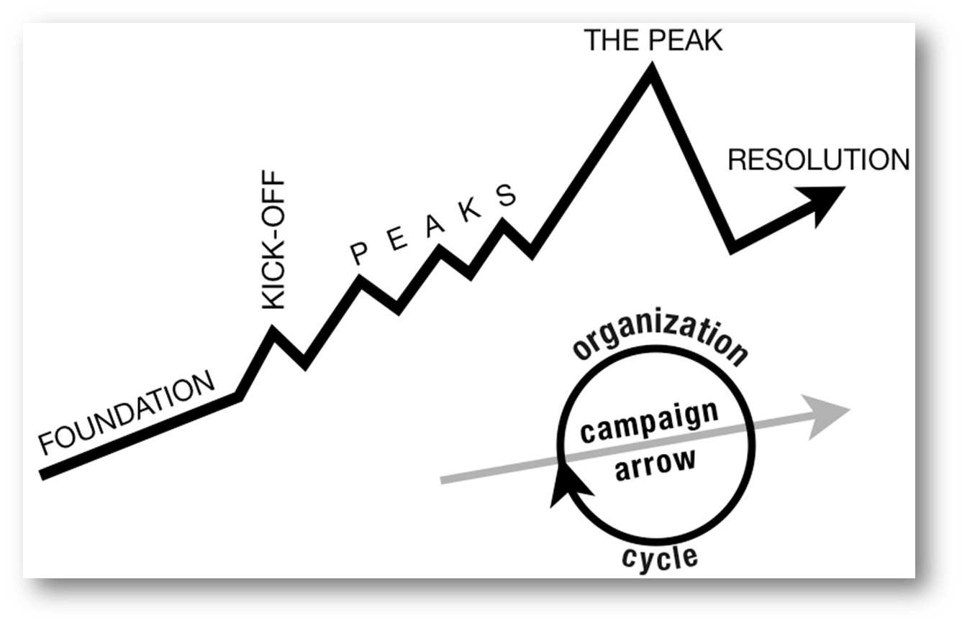
Campaigns Build Power and Unions
Well-structured, issue campaigns result in more people, more leaders, and more resources over time.
This provides more and more power to create, control, or prevent change.
WIN

Slide 6
An organizing leader asks:
Who are my people?
What are their issues?
What do they demand?
What are they willing to risk in order to win that demand?

Slide 7
For each of the issues on your list, come up with a demand that would solve that issue.

Slide 8
What about Race, Class, and Gender Justice?
Race, class, and gender justice is the systematic fair treatment of people resulting in equitable opportunities and outcomes for all.
It is not just the absence of discrimination and inequities, but also the presence of deliberate systems and supports to achieve and sustain race, class, and gender equity through proactive and preventative measures.

Slide 9

Race, Class, Gender Equity Tools
What they do:
Proactively seek to both eliminate systemic barriers and advance equity
Identify clear goals, objectives and measurable outcomes
Develop mechanisms for successful implementation
What they are:
A set of questions used to anticipate, assess, and prevent potential adverse consequences of proposed actions on different race, class, or gender groups.

Slide 10
Centering Race, Class, and Gender in requires intention.
Who are my people?
What are their issues?
What do they demand?
What are they willing to risk in order to win that demand?
For each of the four organizing questions also ask:
​Who is most directly impacted?
Who has been left out?
How can they be directly enagaged?
How do our demands advance race, class, or gender justice?

Slide 11
A different analysis is required.
Problems
Causes
Solutions
History
Strategies
Leadership
What race, class, or gender inequities are you noticing or experiencing? What are the impacts on different racial groups? Who benefits most and who is hurt most?
What institutions, policies, or practices are causing or contributing to the inequities? What social norms, popular myths, or cultural biases may be contributing?
How did things get this way and are things worsening or improving?
What solutions could address the root causes and eliminate the inequities? How would different racial groups be impacted by the proposed solutions?
What strategies and actions could be used to advance the solutions?
Who are the stakeholders most affected by the inequities? Are they involved in naming the issues and solutions? What kinds of active leadership roles could they take to advance the proposed solution?

Slide 12
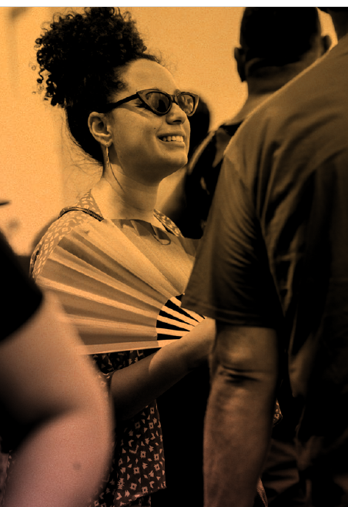
Applying Your Learning
Return to your issue and demands chart
With your group practice applying questions from the Equity Analysis Tool I just shared.
If your team did not create a set of issues and demands that you want to use for this, then you can use the ones on the following slide.

Slide 13
Problem
Issue Cut
Widely Felt Deeply Felt Winnable
Connected to Public Support
PROBLEM -Our campus is hostile to LGBTQ+ staff and students
Demand – We need gender inclusive bathrooms so that transgender staff and students are not forced to use the wrong restroom
PROBLEM – Our workplace reinforces classism by not providing equal pay and benefits to all faculty.
Demand– We need to create an initiative to ensure space in local apartment buildings is reserved for campus students. .
PROBLEM – There is not enough affordable housing for student on or near campus.
  Demand– We need to increase benefits and pay for adjunct faculty.

Slide 14
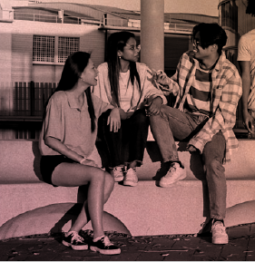
Your Thoughts?
What did your group learn using this analysis tool?
What did your group struggle with?
How can you use this in your own work?

Slide 15
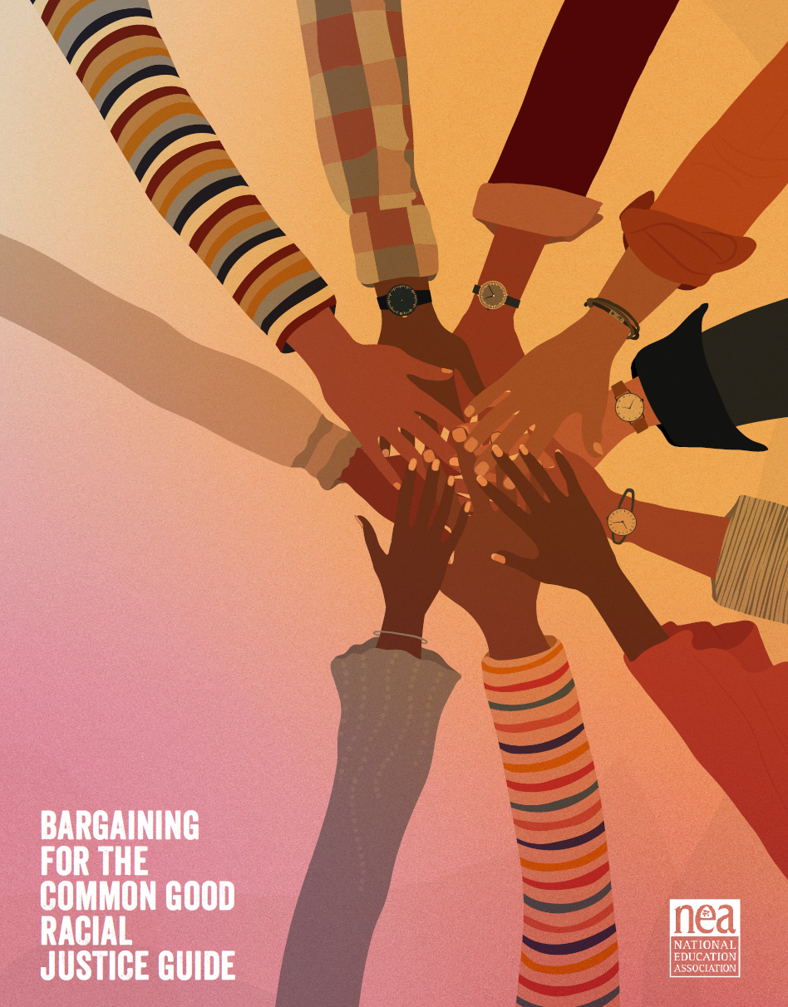
Resources
Center for Racial and Social Justice Guide
Equity Assessment Tool.

Slide 16

Key Points
Intentional campaigns, not programs build power.
Centering race, class, and gender justice in our campaigns increases the people engaged, the number of leaders involved, and the amount of resources we have to win the change we want.
Power is only built through people with a shared vision, making public commitments to act, to risk their collective resources, for the meaningful change they want.

