Slide 1

Organizing on HBCU Campuses
Day 3

Slide 2

Organizing on HBCU and MSI Campuses
By attending this training, you confirm that you are a NEA affiliate staff member. The information you receive here is only for your use in your capacity as an NEA affiliate staff member.
This presentation and its contents are confidential and may not be further distributed or passed on to any other person or published or reproduced, in whole or in part, by any medium or in any form, for any purpose. Audio/video recording, copying of slides, and the use of AI note-taking tools are prohibited without the written consent from Ellen Holmes. Violation of these terms may result in legal action.

Slide 3

Community Agreements Pg 2-3
Awareness and Self-Knowledge
Listen for Understanding
Be Gracious
Stay Engaged
Be Open and Suspend Judgment
Say “I”- tell your truth
Lean into Discomfort
Reach for Empathy
Expect non- Resolution and non-Closure

Slide 4
Feedback on Feedback
80% Response Rate – Range 4.2-4.8
Low was for online resources and high was the facilitator team
Themes –
Plus – great adult learning structures (movement, changes, application), engaging content and good discussion
Delta – side conversations and the room temperature

Slide 5
Your words
Appreciated hearing new voices today and learning from other people's perspectives and experiences. My debrief with my own students went well. Their overall energy and engagement increased and I feel joy knowing they had positive overall topics to share and discuss. I have about 2-3 generating thoughts of what next steps could be when we return, and the wheels are turning for others, I believe. Grateful they have taken advantage of the opportunity. It has definitely been interesting being in this UniServ academy in comparison to the several others I have attended with just staff.
Altering the plan to help the group understand and apply the analysis tool was beneficial.
It was good to practice with the students. We must remember we are still educators and it’s imperative to utilize every opportunity to increase skills. The move to another room was smooth and appreciative. Putting the affinity groups together was huge. Keep that energy!!

Slide 6

Overview of Today’s Learning
Demand, Target, Tactics, and Escalation
Team Campaign Design and Presentations
Agenda
Notes:
Lisa

Slide 7

Today, we build campaigns!

Slide 8
Ellen and Albert

Slide 9

What does a Loving Community or School look like?

Slide 10
What we focus on matters.

Slide 11
Base Building Matters
We have to recruit 250,000 new members a year just to maintain current levels of union density. (Necessary)
Maintenance does not build.
(Not Sufficient)

Slide 12
Why Base Building Matters
Increased membership and density isn't just about numbers, it's about the power to make systemic change through working together.
With high member density, we can claim the power to make the big decisions that will shape the changes that impact our lives in the years to come.
IF WE ARE WILLING TO ACT IN CERTAIN WAYS

Slide 13
Which Theory Builds Power?
Advocacy “ ...is the work of creating change through the actions of professionals or technical experts—lobbyists, pollsters, lawyers, communication specialists, researchers. Advocacy relies on the expertise, status, and know-how of these groups of people to make change. Advocacy usually happens in a closed-door room; ordinary people play a small to nonexistent role in its efficacy. Advocacy has become a dominant strategy for unions and liberals.”
Mobilizing “..., by contrast, activates an already-convinced membership. Mobilizing encourages those who already support a cause or a mission to take action to defend their belief—for example, by attending a protest, wearing a button, or signing a petition.”
Organizing “... is to build mass support and strength among ordinary people. Organizing draws its power from working people’s biggest strength: our numbers. The work of organizing is systematic and rigorous: It requires connecting with every single worker in a shop, every educator in a building, every building in a district. At its core, it asks people to understand their own agency and to make choices about how they will exercise it.”

Slide 14
Advocacy is about – using expertise.
Mobilizing is about – engaging the already committed.
These are necessary, but not sufficient to build the power we need.

Slide 15


Slide 16
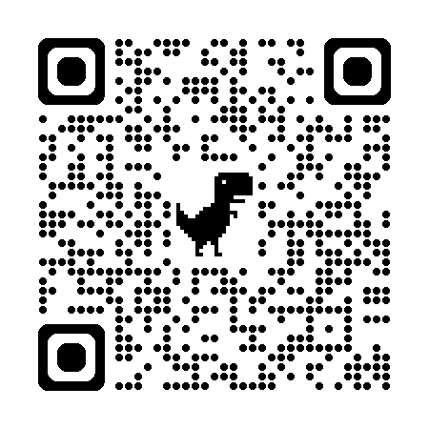
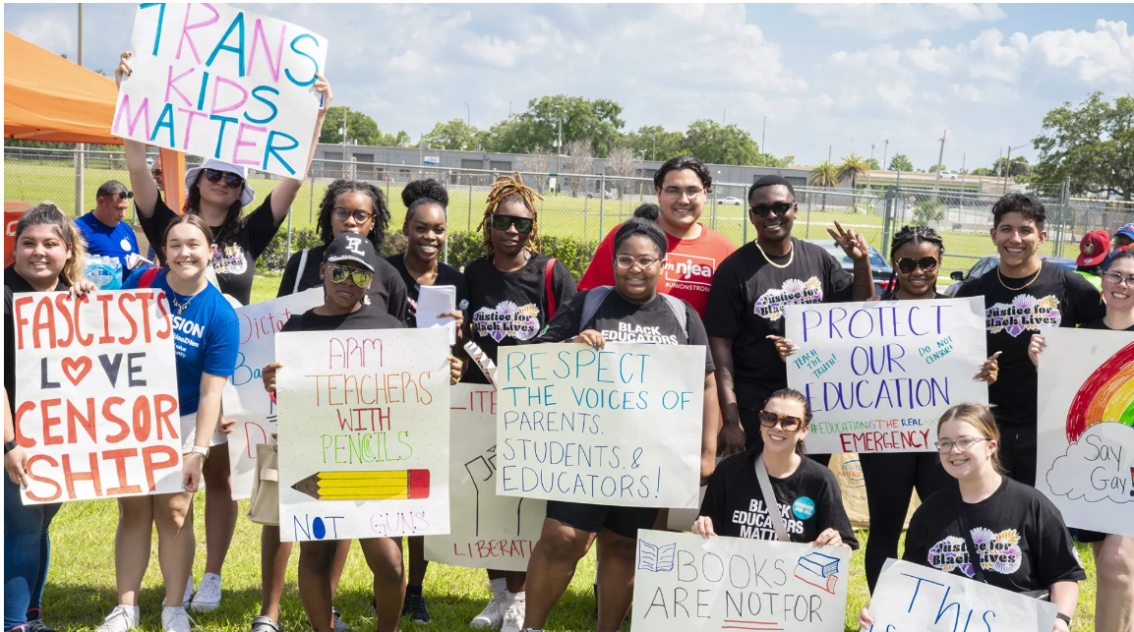
The Campaign to Promote, Protect, and Strengthen Public Education

Slide 17



Slide 18

Campaign Lab is about Building Power
This is an intentionally created and networked leadership structure focused on building and using power within and across issue campaigns.

Slide 19

Which builds a strong union faster, focusing on:
1.Membership recruitment or
2.People powered campaigns

Slide 20
Mentor Coach
Mostly staff-based
Monthly meetings with assigned Campaign Coaches and whole network
Campaign Coach
Holds coaching calls, documents progress
Team Lead
Coordinates team operations, meetings, and roles
Support Campaign Coaches problem solving and thought partnership
Coaches 1–2 local teams
Engages in peer problem solving and coaching
Upholds team norms and shared commitments
Focus on output, capacity building, and leadership development
Clarifies team membership and purpose
Team Members
Implements the plan
Assists in developing added structures
Attends regular meetings
Critical in building the base, increasing engagement, and gathering information

Slide 21

Key
Points
Intentional campaigns, not programs, build power.
The power to win is only built through people with a shared vision, making public commitments to act, to risk their collective resources, for the big meaningful changes they want.
This type of action ALSO builds membership and density – the kind of super majority we need to win
The kind of power we need depends on a distributed and interdependent leadership structure.

Slide 22
Ilissa & Michelle

Slide 23
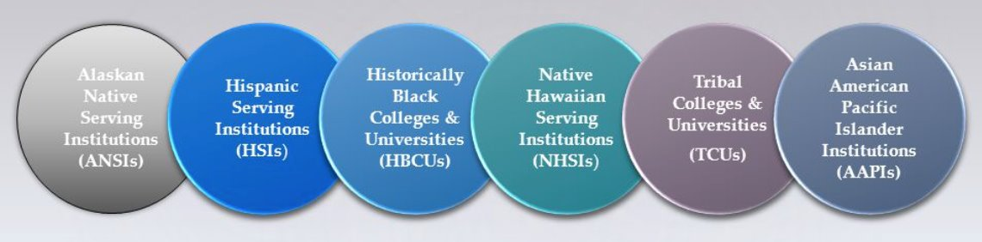
Demands, Targets, Tactics

Slide 24

Demand:
A demand is the outcome that addresses the issue that you are making of a target.
Measurable
Achievable
“We demand a thriving wage for ESP campus workers, grad students, and student workers because when we are all financially secure, we all rise!”

Slide 25

Targets:
Is the person with the power to give you what you are demanding.
A single person:
a name, face, & address
“Hey, Chancellor Bossenpants, we demand a thriving wage that allows all workers on this campus to work just one job and have time leftover to be the leaders, parents, and citizens this community deserves!”

Slide 26

Team Demands and Targets
In your group, decide the following:
• Issue
Revisit to make sure it's the one you want!
• Demand
What do you want to win (and why) to solve your issue?
• Target
Who has the power to give you your demand?
(feel free to make up names and titles if your scenario doesn’t have one!)

Slide 27
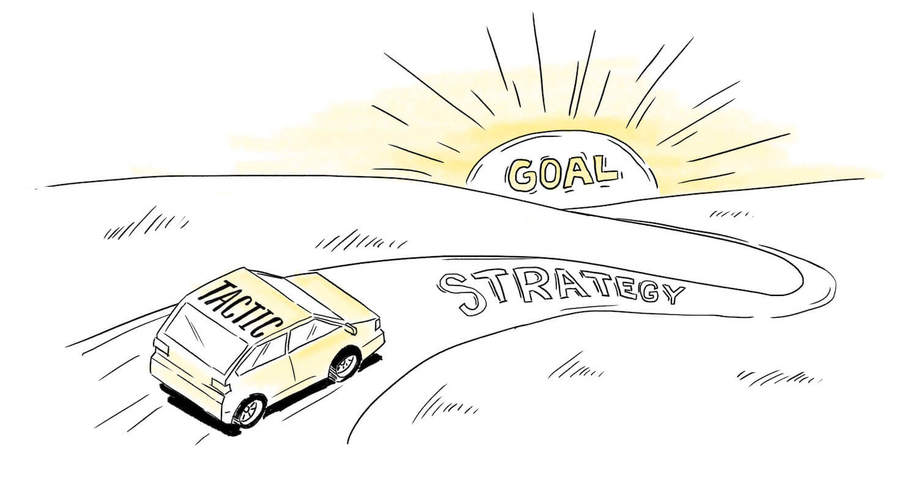
Tactics
Tactic: Actions you to take as a part of an escalation plan that increases pressure on your target to try to win your demand.

Slide 28
A Tactic Should
Put pressure on your Target
(puts them out of their comfort zone)
Build your Power
(develop leaders, bring more people in, etc.)
Be Strategic

Slide 29
Team Tactic Work
TACTICS BRAINSTORM!
+++YOU HAVE 5 MINUTES!+++
Brainstorm AS MANY tactics as you can on 1 chart.
  Be creative!
  You are NOT evaluating right now! Everything goes on the board!

Slide 30

Evaluating Tactics
Does the action relate to your issue?
Will it increase the pressure on the decision-maker?
Is it visible?
Is it timed for effect?
Is it new and different—or tried and true?
Will it be fun?
Are enough people ready to do it?​
Will it unify people?​
How will management react?​
Does it violate the law? (If so, are we prepared for the consequences?)​

Slide 31
Let’s Talk Escalation

Slide 32
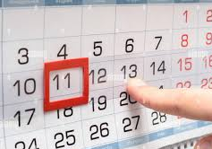
Compression Points
Points on the calendar where you celebrate short term wins or escalate your tactics.
◦Naturally occurring deadlines- Breaks, Board Meetings
◦Artificial deadlines-target has till day X to act
◦Help us build urgency and crisis

Slide 33

Why do you think tactics escalate gradually?

Slide 34
Debrief and Key Ideas about Escalation
Less escalated actions prepare our people for more escalated actions
Give the target the chance to do the right thing before things escalate
Use the threat of escalation

Slide 35

Target
  Name, face, address
  Has the power to grant your demand
Demand
  Outcome that the target can grant which addresses your issue
  Measureable and achievable
A Tactic
  Is Strategic – Time and resource
  Puts pressure on your Target (puts them out of their comfort zone) - Escalates
  Builds your Power (develops leaders, brings more people in, etc.)- Escalates

Slide 36
Josh

Slide 37
Team Campaign Design

Slide 38
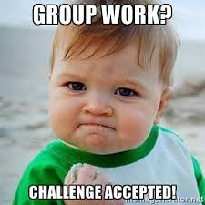
Campaign Planning
Using the scenario selected, identify a goal and a basic campaign timeline.
Focus is not on actions – but on leaders and structures needed to achieve the various “wins along the way” to reach the ultimate win.
Special emphasis:
1. How race, class, and gender impact the campaign.
2. What partnerships and coalitions are needed to win
3. The culture and connection of an HBCU/MSI Campus

Slide 39
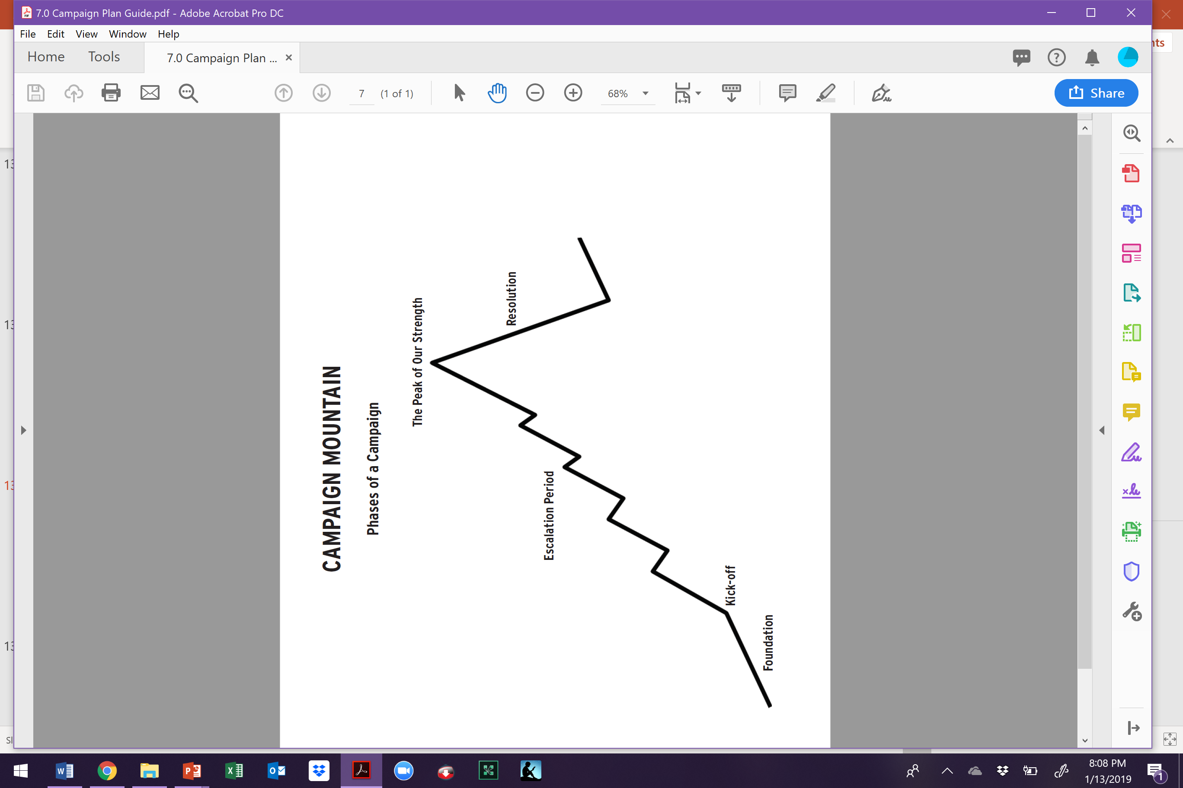
Example- Leaders, Structures, Message
What sort of leaders, structures, and message do you need in the foundation stage and what sort of structures are being developed?
EX. Want to make sure there are at least 3 leaders in each building who want to make sure the union turns out the vote for the democratic candidate who supports unions. This team is talking to members and non-members, doing surveys, and working ID'ing possible future volunteers for actions. Each team member has proven following.
Structure – Political Action Team in each building that is part of the local’s Political Action Network. “Democracy is a Union Right and a Union Fight”

Slide 40

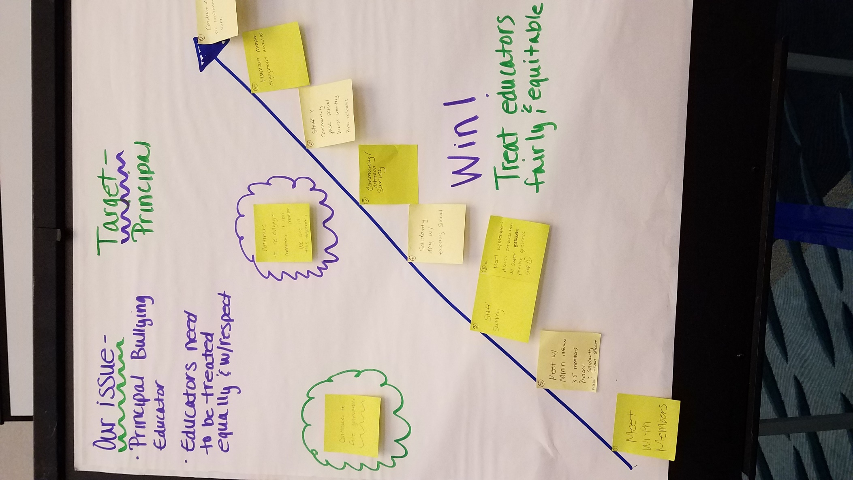
Team Work Time

Slide 41
Campaign Presentations

Slide 42
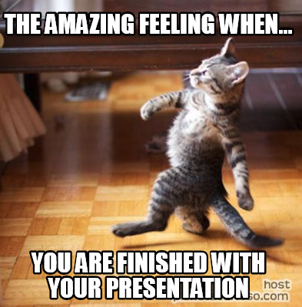
Team Presentation and Coaching Time

Slide 43
Closing

Slide 44
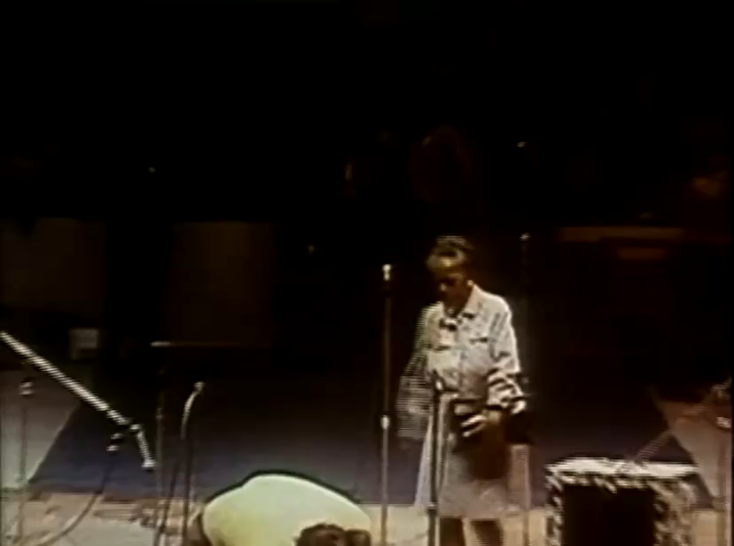
In Ella Baker's Own Words

Slide 45

Our Vision of Now and the Future
What will your workplace, locals, community look like after you have implemented campaigns like this?

Slide 46

Final Reflections
What is one thing you are going to do “tomorrow”?
What is one thing you are going to do next month?
What is one thing you might do in six month?

Slide 47

Gratitude
Evaluations
Final Words for the Good of the Order

