Slide 1

Organizing on HBCU Campuses
Day 2

Slide 2

Community Agreements Pg 2-3
Awareness and Self-Knowledge
Listen for Understanding
Be Gracious
Stay Engaged
Be Open and Suspend Judgment
Say “I”- tell your truth
Lean into Discomfort
Reach for Empathy
Expect non- Resolution and non-Closure

Slide 3
Feedback on Feedback

Slide 4
Your words
\

Slide 5

Overview Of Today’s Learning
Lived Values of Unionism and Anti-Racism
What is Your Role
Building Power in an HBCU Context
Partnerships and Coalitions
Problems to Issues
Centering Race in Your Campaign
Spectrum of Allies
Agenda
Notes:
Lisa

Slide 6
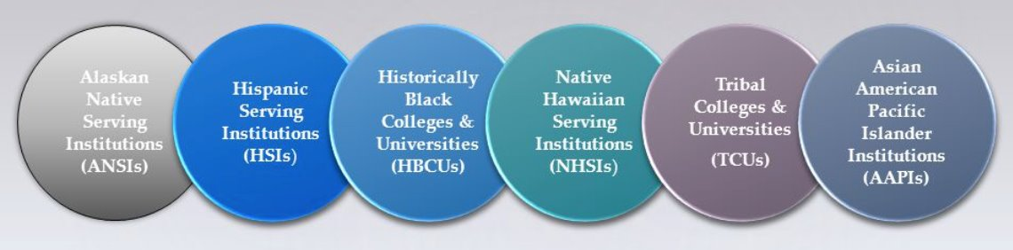
Applying the Core Values of Unionism

Slide 7
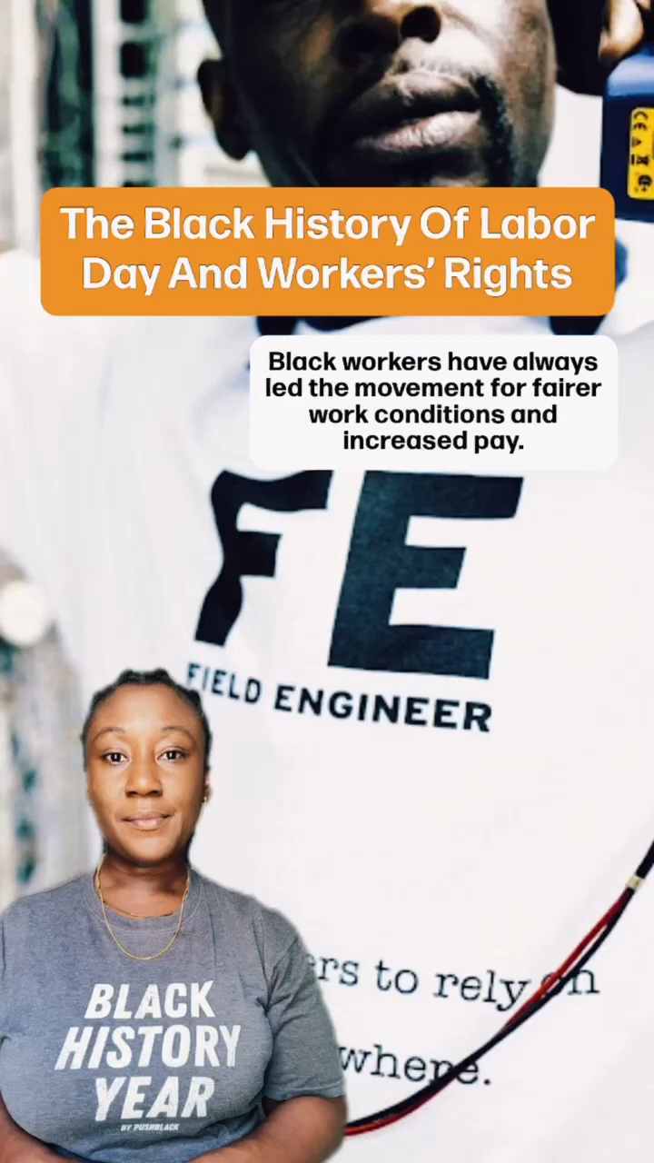
Black Workers Values Shape Unions

Slide 8
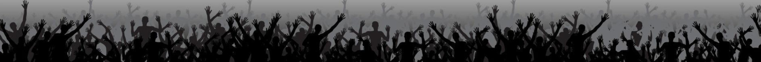
Core Values
Core values are the fundamental beliefs of a person or an organization. These guiding principles dictate behavior and can help people understand the difference between right and wrong. These can often be expressed in one or two words. We are taking a moment to consider our core values because they can provide a basis for solidarity in the midst of struggles.

Slide 9
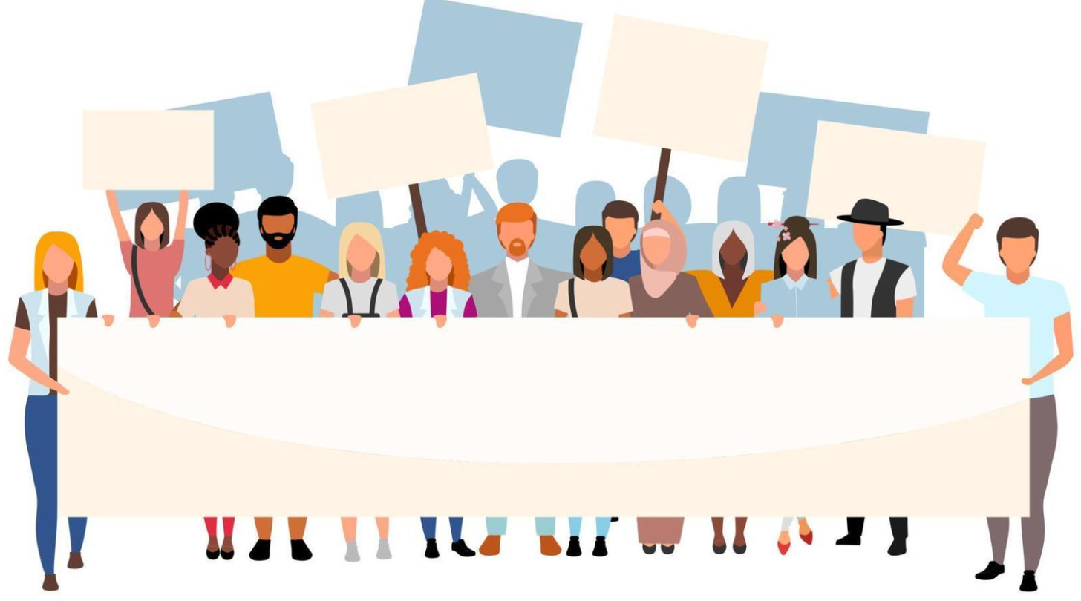
What are the core values of your union?

Slide 10
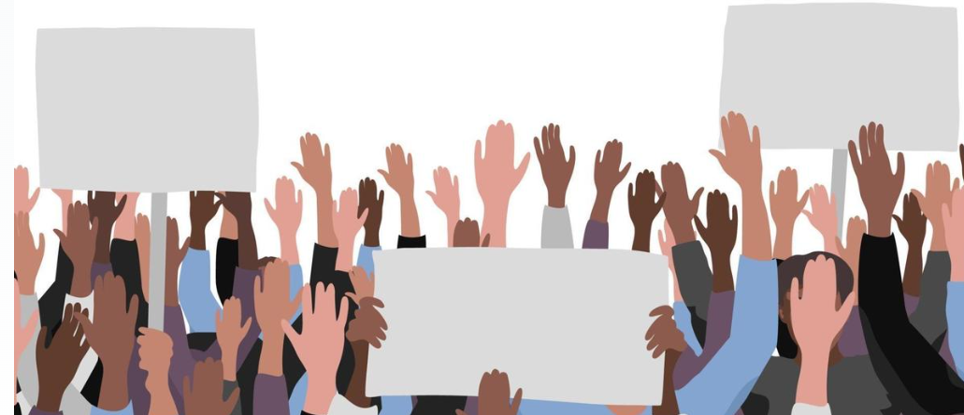
Report Out
Each table shares list of values.
Listen as tables share out and only add new values to the list.
What do you notice?

Slide 11
Union Values
Fairness, honesty/integrity, responsibility, compassion/empathy, safety, health, generosity, hard work/responsibility, community, freedom, democracy, binding contracts, equality, opportunity, respect, stability/security, unity, quality work, justice, collective action, dignity/respect, charity/community service, and due process.

Slide 12
How do you see union values exemplified in our time with our HBCU?

Slide 13
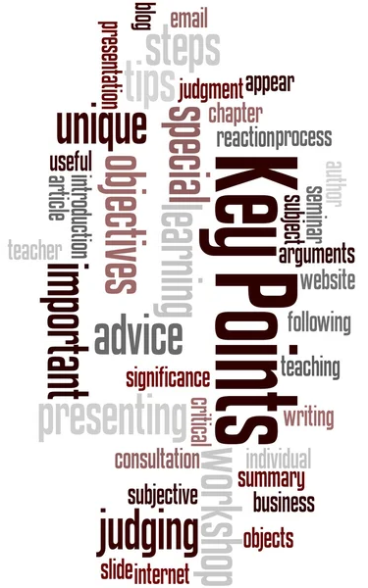
Ideally - Unions advance the welfare of all workers. They are based on the idea of justice, progress, and betterment of self and of society. They embody the universal ideal of human rights and the need to aspire to become more complete human beings. By becoming an active participant in the labor movement, members become part of something larger than themselves. We experienced some of these same values exemplified in the interactions we have had with the HBCU here.
However, without INTENTIONAL APPLICATION of our stated values to dismantling systems of oppression we make no forward movement movement.

Slide 14
Walk the Line Activity
There will be six rounds
Listen to the union value statement, a description, and a short statement.
Based on how you have seen your affiliate live into this stated value, you will move on the line toward “Strongly Agree” or Strongly Disagree”
Keep in mind, this is a reflection activity. People may feel very differently about the values and how they see our work. The variety of perspectives is important.

Slide 15
Walk the Line Activity – Round 1
Calling People In Not Out
Calling people in means trying to create a culture and community that people actually want to be a part of. Calling people in means we don’t shame or blame. It requires direct, specific and compassionate communication with one another. We all have space to grow, and calling people in is how we support one another through growth.
STATEMENT: Our affiliate calls one another in when we need to communicate within our affiliate and with other white people.

Slide 16
Walk the Line Activity – Round 2
Accountability through Collective Action
Collective actions means that we look to build a movement of millions of people. Individual transformation is not enough. This is done through building accountability relationships with people of color who are doing racial justice work in the movement and who are accountable to a group of people. We don’t wait to be asked to take action to organize white people.
STATEMENT: Our affiliate is taking accountable collective action on a regular basis.

Slide 17
Walk the Line Activity – Round 3
Taking risks, making mistakes, learn, and keep going.
Making mistakes is part of life, and we know we have to be outside of our comfort zones in order to make change. Even when we take on real risk, we know that the risk is always greater for people of color. When we make mistakes, we want to reflect and stay in motion. We cannot let making mistakes prevent us from continuing our work. When others make mistakes, we do not shame, blame or exile.
STATEMENT: Our affiliate stays in the process of taking action, receiving feedback and staying in motion. We support one another through our mistakes.

Slide 18
Walk the Line Activity – Round 4
Mutual Interest
Racial justice isn’t something we help people of color with. The system of white supremacy harms all of us—including white people, though in very different ways than people of color. We need to get clear with ourselves about what we have to gain through this fight.
STATEMENT: Our affiliate and members are clear on our mutual interest. We’ve spent time getting clear on what’s at stake for us as individuals and as a group

Slide 19
Walk the Line Activity – Round 5
Enough for All
There are enough resources in the world for everyone's basic needs to be met— for folks to have decent housing, enough food, safety, etc. The problem isn’t that we don’t have enough stuff—it’s that it’s distributed unfairly. White supremacy tells us we need to compete with everyone, even other people doing this work.
STATEMENT: We organize from a place of abundance and cooperation.

Slide 20
Walk the Line Activity – Round 6
Growing is good
We need millions of white people to join the movement for racial justice, and in order for this to happen our groups need to keep growing. We need to constantly bring in new voices and leaders. This means more than inviting people to come to meetings. It means finding new and exciting ways to bring people into the work based on their skills.
STATEMENT: Our group is open to growth. We bring in new members and engage with them as leaders.

Slide 21
Debrief the Line
• What are you taking away from that activity that relates to our time here learning about HBCU organizing?
• Is there anything that surprised you?
• Where are we doing really well?
• Where do we need to grow?

Slide 22
Like HBCUs and other non- PWIs our unions CAN be critical in the dismantling of systems of oppression – BUT
Organizations that adopt racial justice principles must ensure that they also invest in sustained forms of leadership, staff, and member development to create a shared understanding of race and racism (and gender or class for that matter).

Slide 23

Break

Slide 24
What is Your Role

Slide 25

Theories for Change:
Advocacy, Mobilizing, Organizing
Mobilizing
Advocacy
Organizing
Notes:
Ellen
20 Mins Entry activity – 4 Corners of Union Work
How do you think your locals primarily view your role with them? Social Justice Advocate, Contract Manager and Problem Solver, Leadership Coach and Developer, Campaign/Organizing Leader –
Prompts -Once at your charts, what are the opportunities that this view could have for moving towards a win and what are the challenges that this view could have?
Where is our power?
Contract Negotiation, Grievances, Member Engagement, Staff Led Programs
10 MIN debrief – so now what?

Slide 26
What do we mean?
Advocacy
“Advocacy is the work of creating change through the actions of professionals or technical experts—lobbyists, pollsters, lawyers, communication specialists, researchers. Advocacy relies on the expertise, status, and know-how of these groups of people to make change. Advocacy usually happens in a closed-door room; ordinary people play a small to nonexistent role in its efficacy. Advocacy has become a dominant strategy for unions and liberals. ” Power is limited to those with the specific expertise and role.
Mobilizing
“Mobilizing, by contrast, activates an already-convinced membership. Mobilizing encourages those who already support a cause or a mission to take action to defend their belief—for example, by attending a protest, wearing a button, or signing a petition.” Power is static and is dependent on a predictable core of folks.
Organizing
“To organize is to build mass support and strength among ordinary people. Organizing draws its power from working people’s biggest strength: our numbers... The work of organizing is systematic and rigorous: It requires connecting with every single worker in a shop, every educator in a building, every building in a district. At its core, it asks people to understand their own agency and to make choices about how they will exercise it.” Power is distributed and growing as more and more people join the base and more and more leaders evolve through actions.

Slide 27

At your tables
Take 6 Minutes
How many actions at an HBCU campus can list that are examples of each of these theories?
    Advocacy
    Mobilizing
    Organizing
Be ready to share your best ideas

Slide 28
Staff Led Actions are Typically Advocacy
Advocacy
“Advocacy is the work of creating change through the actions of professionals or technical experts—lobbyists, pollsters, lawyers, communication specialists, researchers. Advocacy relies on the expertise, status, and know-how of these groups of people to make change. Advocacy usually happens in a closed-door room; ordinary people play a small to nonexistent role in its efficacy. Advocacy has become a dominant strategy for unions and liberals.”
Bargaining that is staff led, or traditional methods of bargaining – little engagement from the rank and file and few public displays of collective action
Grievances and other legal actions that do not include and escalation of direct public actions – little engagement beyond leaders and staff, and few displays of power and risk that build solidarity between rank and file folks
Recruitment programs typically begin with advocacy in mind – join to get something.
Can you think of other advocacy examples?

Slide 29
Specific Programs are Typically Mobilizing
Mobilizing
“Mobilizing, by contrast, activates an already-convinced membership. Mobilizing encourages those who already support a cause or a mission to take action to defend their belief—for example, by attending a protest, wearing a button, or signing a petition.”
Aspiring Educators who meet to develop a network – they are self selecting and there is little risk for participating
Professional Development Conferences where faculty and ESP come to improve work skills or leadership skills or learn union roles – they are self selecting, already “convinced” about unions, and there is little risk for participating
Recruitment can happen as a result of mobilizing if it is member led.
Can you think of other mobilizing examples?

Slide 30
Escalating, Public Actions are Organizing
Organizing
“To organize is to build mass support and strength among ordinary people. Organizing draws its power from working people’s biggest strength: our numbers... The work of organizing is systematic and rigorous: It requires connecting with every single worker in a shop, every educator in a building, every building in a district. At its core, it asks people to understand their own agency and to make choices about how they will exercise it.”
Graduate Student Protests for fair compensation of their work – there is great risk, they develop leader in action skills, they build a base through bigger and bigger public actions
ESP workers fighting for a thriving wage – a campaign that strategically builds a base, increases membership, builds trust and relationship across workers, and transforms rank and file folks into leaders
Faculty and Community fighting for agency in the curriculum they teach – risky, requires strategic partnership, a broader and broader base, applying public pressure on decision makers to do the right thing.
Recruitment that is a result of ongoing actions, intentional base building, and leadership identification and tests are critical to organizing.
Can you think of other organizing examples?

Slide 31
Advocacy and Mobilizing are Opportunities to Organize.

Slide 32
Corner Discussion – Use Handout
Select the compass point that best answers where you are MOST OF THE Time for each of the following questions -
First Move- Which Theory do your Members expect your role to support? Why? Where is the power if this is your role?
Second Move - Which Theory does your Manager expect your role to support? Why? Where is the power if this is your role?
Third Move - Which Theory do your Elected Leaders expect your role to support? Why? Where is the power if this is your role?
Notes:
Ellen

Slide 33
Whole Group Reflection
Notes:
Ellen

Slide 34
We may see our roles differently than our managers, our members, and our elected leaders.
Our primary role is to build power, we only build power when we organize.

Slide 35
Intentional Power Building

Slide 36

Listen then Turn and Talk
What does the following definition make you think about as a staff person who may be organizing in an HBCU setting?

Slide 37


Defining POWER
The ability to create, control, and prevent change.
ORGANIZED PEOPLE + ORGANIZED MONEY

Slide 38
Listen then Turn and Talk
What does the following quote about Ella Baker’s work make you think about as a staff person who may be organizing in an HBCU setting?

Slide 39
Ella’s Power Building Basics
There is the danger in our culture that because a person is called upon to give public statements and is acclaimed by the establishment, such a person gets to the point of believing that he is the movement. The real power is with the people.
-Ella Baker
Read more at: https://www.blinkist.com/magazine/posts/empowering-words-ella-baker-quotes?utm_source=cpphttps://time.com/4633460/mlk-day-ella-baker/

Slide 40
Power Mapping (30 min)
In your breakout rooms you will complete the following:
Complete the Power Mapping Activity on Chart paper
Be sure to answer each question pertaining to your campaign
Questions are on your chart paper
Notes:
Kayla

Slide 41
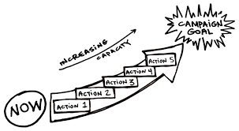
Review of the Basics for Building Power
The workers, their energy, and their leadership must be at the front of the campaign (Ella Baker)
Official union leadership and staff must be willing to work with rank and file members AND allow them to have meaningful roles in campaigns
Must make space for rank and file to develop as leaders (training, chance to take risks, space to prove)
Community-centric approach
Democratic organizing (Ella Barker)
Gradual escalation of tactics
Workers do have power- an organizer’s role is to
help THEM use it to make meaningful change

Slide 42

Tactical Guide to Power​
Political Power:
Ex: PAC, GR, legislative committees​
Consumer Power:
Ex: Montgomery Bus Boycott​
Legal/Regulatory Power:
Ex: Labor Board
Strikes/Disruptive Power​:
Ex: Writers Guild, #Red4Ed: MN, UTLA, Chicago, WV, Mass - Andover
Notes:
Kayla
Political Power: Getting
something passed by an elected body​
Consumer Power: Ability
to conduct a boycott​
Legal/Regulatory Power:
Win in Court/Regulatory Process​

Slide 43

Who has the Power to give or prevent the change you want?
What actions influences your target​?
​
Letter writing​
Testifying on the bill​
Rallies​
Lobbying​
Hearing from constituents​
Senator
Delegates
Governor
Who influences your target?
​
Who do you want to support your change?
​Other legislators ​
People they see often in their community​
Community leaders
Universities​
Alumni​
Businesses who benefit from HBCU's​
Community leaders​
Notes:
Kayla – do one thing at a time instead

Slide 44
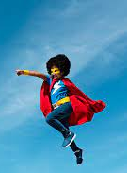
What is THE staff role?
What are the specific types of work Affiliate Staff people are engaged in that support and cultivate these types of cases?
What changes in your work/expectations would you (and your leader/manager) need to make room for these types of Lessons Learned as presented in these Cases?

Slide 45

Power Analysis Cases
Use your handout to track the following:
What are the key issues in your case?
What are or might be some demands in your case?
Who has the power to grant the demands?
What actions influence the target?
What people influence your target?
Who do you want to join you in support of your campaign?
What might be the staff role in your case? - you may have to infer if it is not clearly stated

Slide 46
Power is always either growing or waning.
Power must be intentionally built.
If our work is focused primarily on advocacy, we are not building power.

Slide 47

Lunch

Slide 48
Partnerships and Coalitions

Slide 49
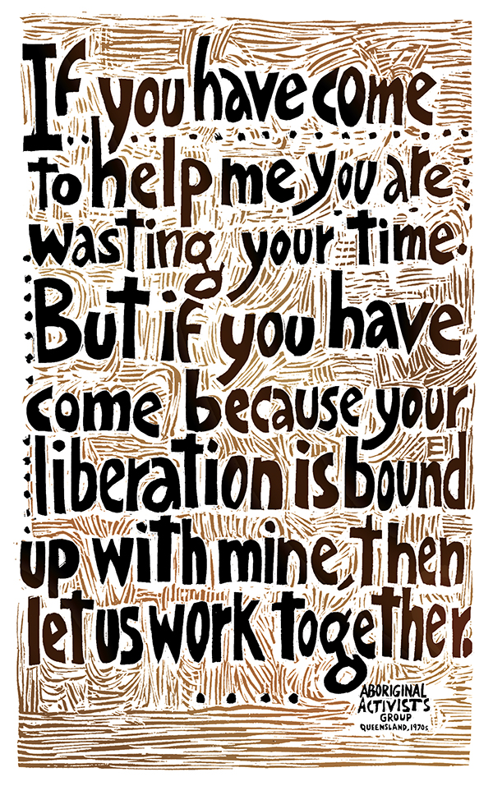
“If you have come here to help me you are wasting your time, but if you have come because your liberation is bound up with mine, then let us work together.”
― Aboriginal activists group, Queensland, 1970s
Art by Ricardo Levins Morales

Slide 50
Coalitions are...
an organization/structure of diverse interest groups that join resources to produce a specific change that they are unable to deliver as individual groups
require strong leadership and ongoing maintenance
allow groups to support each other – they do not exist for the benefit of just one of the partners

Slide 51
3 Types of Coalitions
Casual Coalitions
Clubs
Social Events
Traditional Coalitions
Issue Based
Alliances
Long term
Fundraising
Immediate Change
Value based
BCG

Slide 52
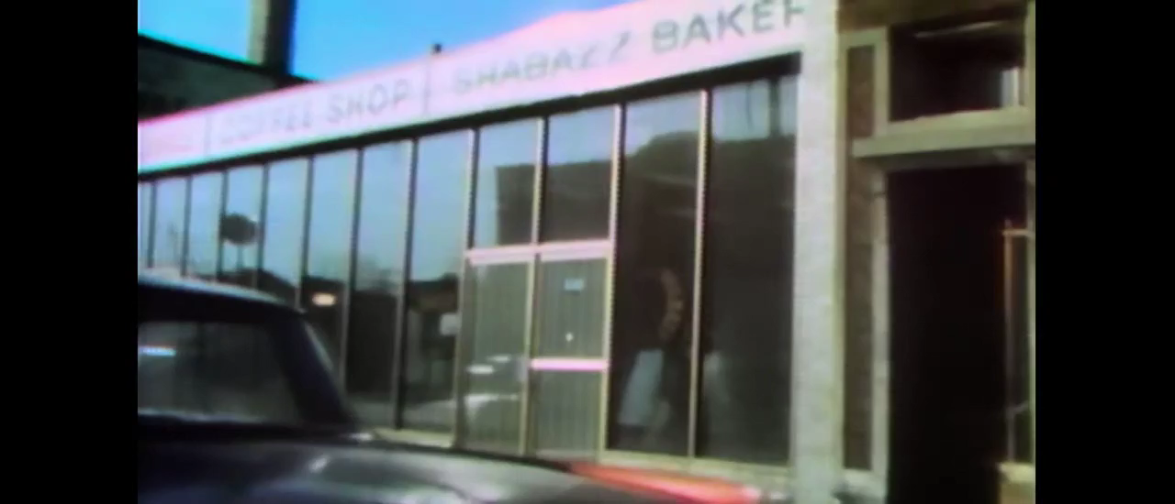
High On The Hog, The Defiance

Slide 53
At your tables, have a conversation around the following...
Who is missing at the table in your affiliates?
What are some strategies to ensure that organizing on HBCU/MSI campuses is seen as mutually beneficial by both your affiliate and the broader campus community?
How do we build trust with communities that may have a complicated or skeptical relationship with unions, especially in regions with historical or cultural opposition to organized labor?
How can we as staff manage our time to support partnerships/coalitions?
How can we as staff participate in or engage with partnerships/coalitions if the affiliate isn't all in?

Slide 54
We form coalitions around specific, shared values first and agendas second
Look beyond what you think may be "worthy" of partnership or what would "make sense"
The coalition is not how “we” achieve something – but how all the coalition members achieve something together
Solidarity is a verb

Slide 55
Problems to Issues

Slide 56
PROBLEM vs. ISSUE
People have problems, our job is to ask how they think they could solve the problem.
Solutions to problems indicate different issues depending on the perspective of the people we are working with.
Campaigns start with issues members care about.
An issue is a slice of a workplace problem.
It is KEY to get enough input on what the issues are that make up the problem so that YOU do not drive the solution.

Slide 57

PROBLEM vs. ISSUE
My car is a piece of junk.
Why is that a problem?
It is not safe to drive to work.
What do you want to do about that?
It is too much, I will need new tires, the brakes are weak, the exhaust is leaking.
Is any of this a problem for anyone else?
Yes, my kids are sick from the exhaust.
What do you want to do about that?
The first thing I can do is fix the exhaust.

Slide 58
EXAMPLE- Problem and Issue
PROBLEM – Workers on this campus don’t make enough money to thrive
“How would you solve that problem? – Raise wages.”
◦ Issue – ESP workers are often seen as role models here and could be great mentors to some students, but because they have to rush out to work second jobs, they cannot focus on strong relationships with students.
◦ Issue – Student workers are often already first generation students with limited financial support, when they work at low wage jobs on campus, that is one more stress that prevents them from being a leader on campus or focusing on the full opportunity of their schooling.
◦ Issue – Faculty are the lifeblood of this institution and paid below other institutions levels. Designing and implementing high value curriculum and providing important coaching and mentoring for students. They are financially stressed by low pay and can not commit to their students in the way they could if they felt values and financially secure.

Slide 59

Team Problem and Issue WORK!
In your group, spend time identifying the potential “Issues” in your scenario.

Slide 60

Assessing our Issues
What makes a good issue:
  It is widely felt and/or deeply felt.
  It is winnable.
  It builds the union and builds leaders.
  It has a connection to students and the public.

Slide 61
Problems are overwhelming and don’t focus people on the power they have to make change.
Issues indicate what is possible
Often, issues of equity are deeply felt by a marginalized few, and NOT by the privileged majority. If an issue is very deeply felt, it may not be widely felt, BUT does connect with shared values.

Slide 62
Break

Slide 63
Centering Race, Class, and Gender

Slide 64
Working Notes
Will apply a RET to demands and tactics - use the mateirl developed by The YRO ESP Team (Katie Bishop is lead)
Need to identify a structure and an expansion of the base at each tactic
Need to include a quick review of tactics and escalation
Presentation will include
Issue, Demand and Target
How you applied a RET analysis to each
Tactics and structure or base expansion at each level

Slide 65
SOME IDEAS FROM ARJ FOLLOW

Slide 66
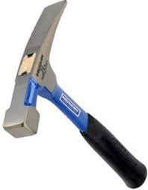
Racial Equity Tools
Proactively seek to both eliminate systemic barriers and advance equity
Identify clear goals, objectives and measurable outcomes
Develop mechanisms for successful implementation
A set of questions used to anticipate, assess and prevent potential adverse consequences of proposed actions on different racial groups.
A SET OF QUESTIONS THAT CAUSES PAUSES BEFORE ACTIONS

Slide 67
Factors that Support RET Success
Buy in from the organization and its leaders
Routine and ongoing use of the RET
Data- driven assessment
A commitment to making changes
Tenacity – A commitment to overcoming obstacles to making changes
WE HAVE TO DECIDE TO DO THINGS DIFFERENTLY AND STICK WITH IT

Slide 68
Racial Equity is something that has to be intentionally and explicitly planned for, implemented and monitored within an organization.
You can not move forward as an organization without honestly and openly assessing where you are.
Change happens, intentional change happens with a plan.

Slide 69
Campaign Plan – Spectrum of Allies

Slide 70
Keep it in mind…
Despite structural oppression, non-PWIs have been some of the greatest success stories of our nation, and some of the most under-represented by our unions.
They succeed because:
    Provide internal community support
    Offer unparalleled representation and mentorship
    Close relationships
    Focused on leadership beyond school
  Successful organizing campaigns need to match their strengths

Slide 71

Spectrum of Allies

Slide 72

Spectrum of Allies Part 1
  Active allies: people who agree with you & are organizing alongside you
  Passive allies: people who agree but aren't doing anything about it (yet!)
  Neutrals: people who aren't sure, or are unengaged (they might just not know about you yet)
  Passive opponents: people who disagree, but aren't trying to stop you
  Active opponents: people who have done something to prevent you from reaching your goal

Slide 73
Share Out Spectrum of Allies

Slide 74
Focusing your tactics matters
Only the Opposition – cynicism
Only the Active Allies – stagnation
Generalizations about Slices – missed opportunities
DO FOCUS ON THE PASSIVE ALLIES
  These are folks who know or care about what you’re up to, but aren’t doing anything about it! Give them a chance to participate and build power with you.
THE GOOD NEWS
  It is only necessary to move some or all of the pie wedges one step in your direction. If we shift each wedge one step, we are likely to win, even if the hardliners on the opponent’s side don’t budge.

Slide 75
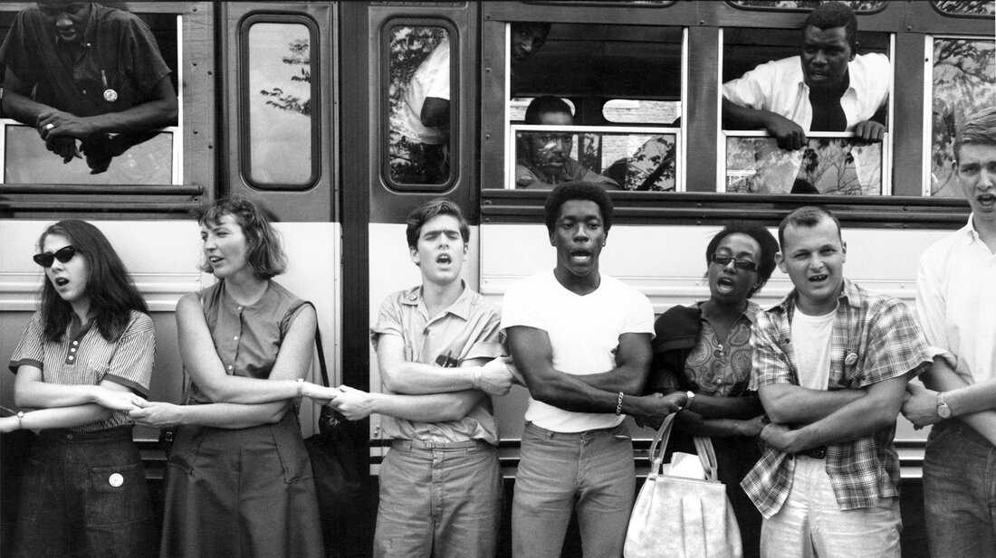
An example from history – Freedom Summer

Slide 76
Spectrum of Allies Part 2
Develop a convincing argument or values based narrative that will appeal to each wedge.
Design one tactic for each wedge that you can invite them to participate in that will move that wedge one closer to us.
Design one small achievable ask to engage one individual from that wedge to move closer to you

Slide 77
Team Pair Share of Spectrum of Allies

Slide 78
Spectrum of Allies Debrief – Whole Group
How did it feel to present your arguments for how to move your wedges?
What is something new you learned from this or from another team?
What do you think you could apply to your current work?

Slide 79
It is only necessary to move some or all of the pie wedges one step in your direction.
If we shift each wedge one step, we are likely to win, even if the hardliners on the opponent’s side don’t budge.

Slide 80

Taking you Home
Ellen

Slide 81

Ending it Right

Slide 82
Issues and Opportunities

Slide 83
From Marshall Ganz
A campaign is a process through which your constituency can organize itself to create the power it needs to accomplish goals that will achieve the positive change they need.

Slide 84

Problem vs. Issue
A problem is the whole pie. Problems are vast, complex, and entrenched.
When we try to tackle a problem, we reinforce the hopelessness of the situation. We are trying to take on the full pie all at once.
Issues are the pieces of the pie. It’s a small chunk of the larger problem that we can make progress on, and in turn we are slowly taking on the full problem over time.

Slide 85

Framing: Deeply and Widely Felt
Labor Notes’ Secrets of a Successful Organizer discusses a good organizing issue as being widely and deeply felt.
Socialization and Organizing in Unfamiliar Spaces (Day 1)
What you may consider as a molehill, may be a mountain
Union values
  An Injury to One is an Injury to All
  Solidarity

Slide 86

A Target Is...
The person with the power to give you what you are demanding.
This person
  Has a name
  Has a face
  Has an address

Slide 87
Demand
A demand is the outcome that addresses the issue that you are making directed at a target.
“Hey TARGET, we demand ACTION because HARM or IMPACT!”

Slide 88

Issues and Opportunities
In groups read the Issues and Opportunities scenario on page of your participant handout
After reading you will work collectively to identify the following on chart paper:
  Problem(s)
  Issue
  Target
  Demand
  Constituency
  Immediate next step

Slide 89

Thoughts and Feedback
Using sticky notes, comment on each poster using the following questions:
  Is the issue, target, and demand clear?
  How does the plan actively involve/engage the community?
ThePhoto by PhotoAuthor is licensed under CCYYSA.

Slide 90
Successful campaigns require complex and interdependent relationships
A clear and reasonable issue, target, and demand are foundations in any campaign plan
Organizing with HBCUs/MSIs requires fully centering the community and culture, as they are not just elements of the campaign but the very foundation of its success

