Slide 1

Organizing on HBCU Campuses
Day 3

Slide 2

Community Agreements Pg 2-3
Awareness and Self-Knowledge
Listen for Understanding
Be Gracious
Stay Engaged
Be Open and Suspend Judgment
Say “I”- tell your truth
Lean into Discomfort
Reach for Empathy
Expect non- Resolution and non-Closure

Slide 3
Feedback on Feedback
25% Response Rate – Range 4.5-5.0
Low was for content in the morning and high was for the materials
Themes –
Plus – great adult learning structures (movement, changes, application)
Delta – more time

Slide 4
Your words
I think everything has been the perfect amount of training, perfect "switch out" of trainers to keep us engaged. Information hasn't been too heavy and my students are absorbing everything and ready to head back home to organize the state and their campuses. Also, thank you all for all the support you have offered when I shared my frustrations
Today felt rushed. It was wonderful content, I just wish that there was more time to digest the information and process responses at the table. I still enjoyed everything, but more time would have been a huge benefit
Since this training was around HBCUs, it would be nice if all examples had to do with aspiring educators

Slide 5

Overview Of Today’s Learning
Reflection Activity
Demand, Target, Tactics, and Escalation
Team Campaign Design and Presentations
Agenda
Notes:
Lisa

Slide 6

Today, we build campaigns!

Slide 7

Let’s Get Graphic
Each table has only one sheet of chart paper
Only pictures - no words, letters or numbers
Must be a joint effort, all table members should contribute

Slide 8
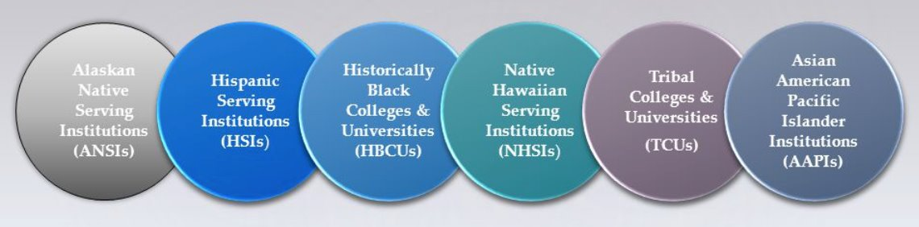
Demands, Targets, Tactics

Slide 9

Demand:
A demand is the outcome that addresses the issue that you are making of a target.
Measurable
Achievable
“We demand a thriving wage for ESP campus workers, grad students, and student workers because when we are all financially secure, we all rise!”

Slide 10

Targets:
Is the person with the power to give you what you are demanding.
A single person:
a name, face, & address
“Hey, Chancellor Bossenpants, we demand a thriving wage that allows all workers on this campus to work just one job and have time leftover to be the leaders, parents, and citizens this community deserves!”

Slide 11

Team Demands and Targets
In your group, decide the following:
• Issue
Revisit to make sure it's the one you want!
• Demand
What do you want to win (and why) to solve your issue?
• Target
Who has the power to give you your demand?
(feel free to make up names and titles if your scenario doesn’t have one!)

Slide 12
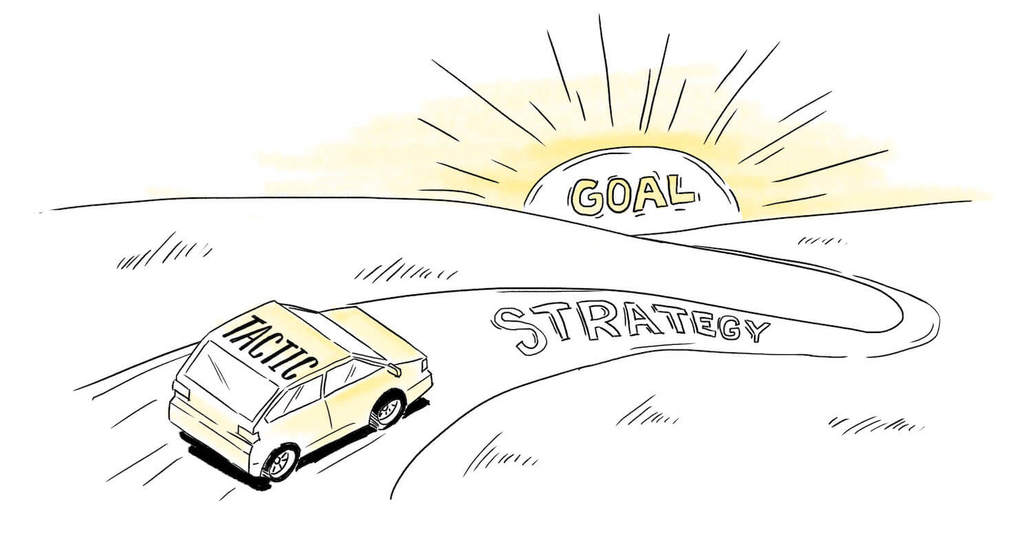
Tactics
Tactic: Actions you to take as a part of an escalation plan that increases pressure on your target to try to win your demand.

Slide 13
A Tactic Should
Put pressure on your Target
(puts them out of their comfort zone)
Build your Power
(develop leaders, bring more people in, etc.)
Be Strategic

Slide 14
Team Tactic Work
TACTICS BRAINSTORM!
+++YOU HAVE 5 MINUTES!+++
Brainstorm AS MANY tactics as you can on 1 chart.
  Be creative!
  You are NOT evaluating right now! Everything goes on the board!

Slide 15

Evaluating Tactics
Does the action relate to your issue?
Will it increase the pressure on the decision-maker?
Is it visible?
Is it timed for effect?
Is it new and different—or tried and true?
Will it be fun?
Are enough people ready to do it?​
Will it unify people?​
How will management react?​
Does it violate the law? (If so, are we prepared for the consequences?)​

Slide 16
Let’s Talk Escalation

Slide 17
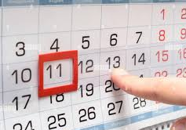
Compression Points
Points on the calendar where you celebrate short term wins or escalate your tactics.
◦Naturally occurring deadlines- Breaks, Board Meetings
◦Artificial deadlines-target has till day X to act
◦Help us build urgency and crisis

Slide 18

Why do you think tactics escalate gradually?

Slide 19
Debrief and Key Ideas about Escalation
Less escalated actions prepare our people for more escalated actions
Give the target the chance to do the right thing before things escalate
Use the threat of escalation

Slide 20

Target
  Name, face, address
  Has the power to grant your demand
Demand
  Outcome that the target can grant which addresses your issue
  Measureable and achievable
A Tactic
  Is Strategic – Time and resource
  Puts pressure on your Target (puts them out of their comfort zone) - Escalates
  Builds your Power (develops leaders, brings more people in, etc.)- Escalates

Slide 21
Team Campaign Design

Slide 22
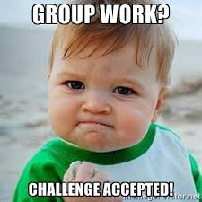
Campaign Planning
Teams will select a scenario.
Identify a goal for the scenario and a basic campaign timeline.
Focus is not on actions – but on leaders and structures needed to achieve the various “wins along the way” to reach the ultimate win.
An additional FOCUS is on how the narrative changes AND stays the same to bring more people to the campaign.

Slide 23
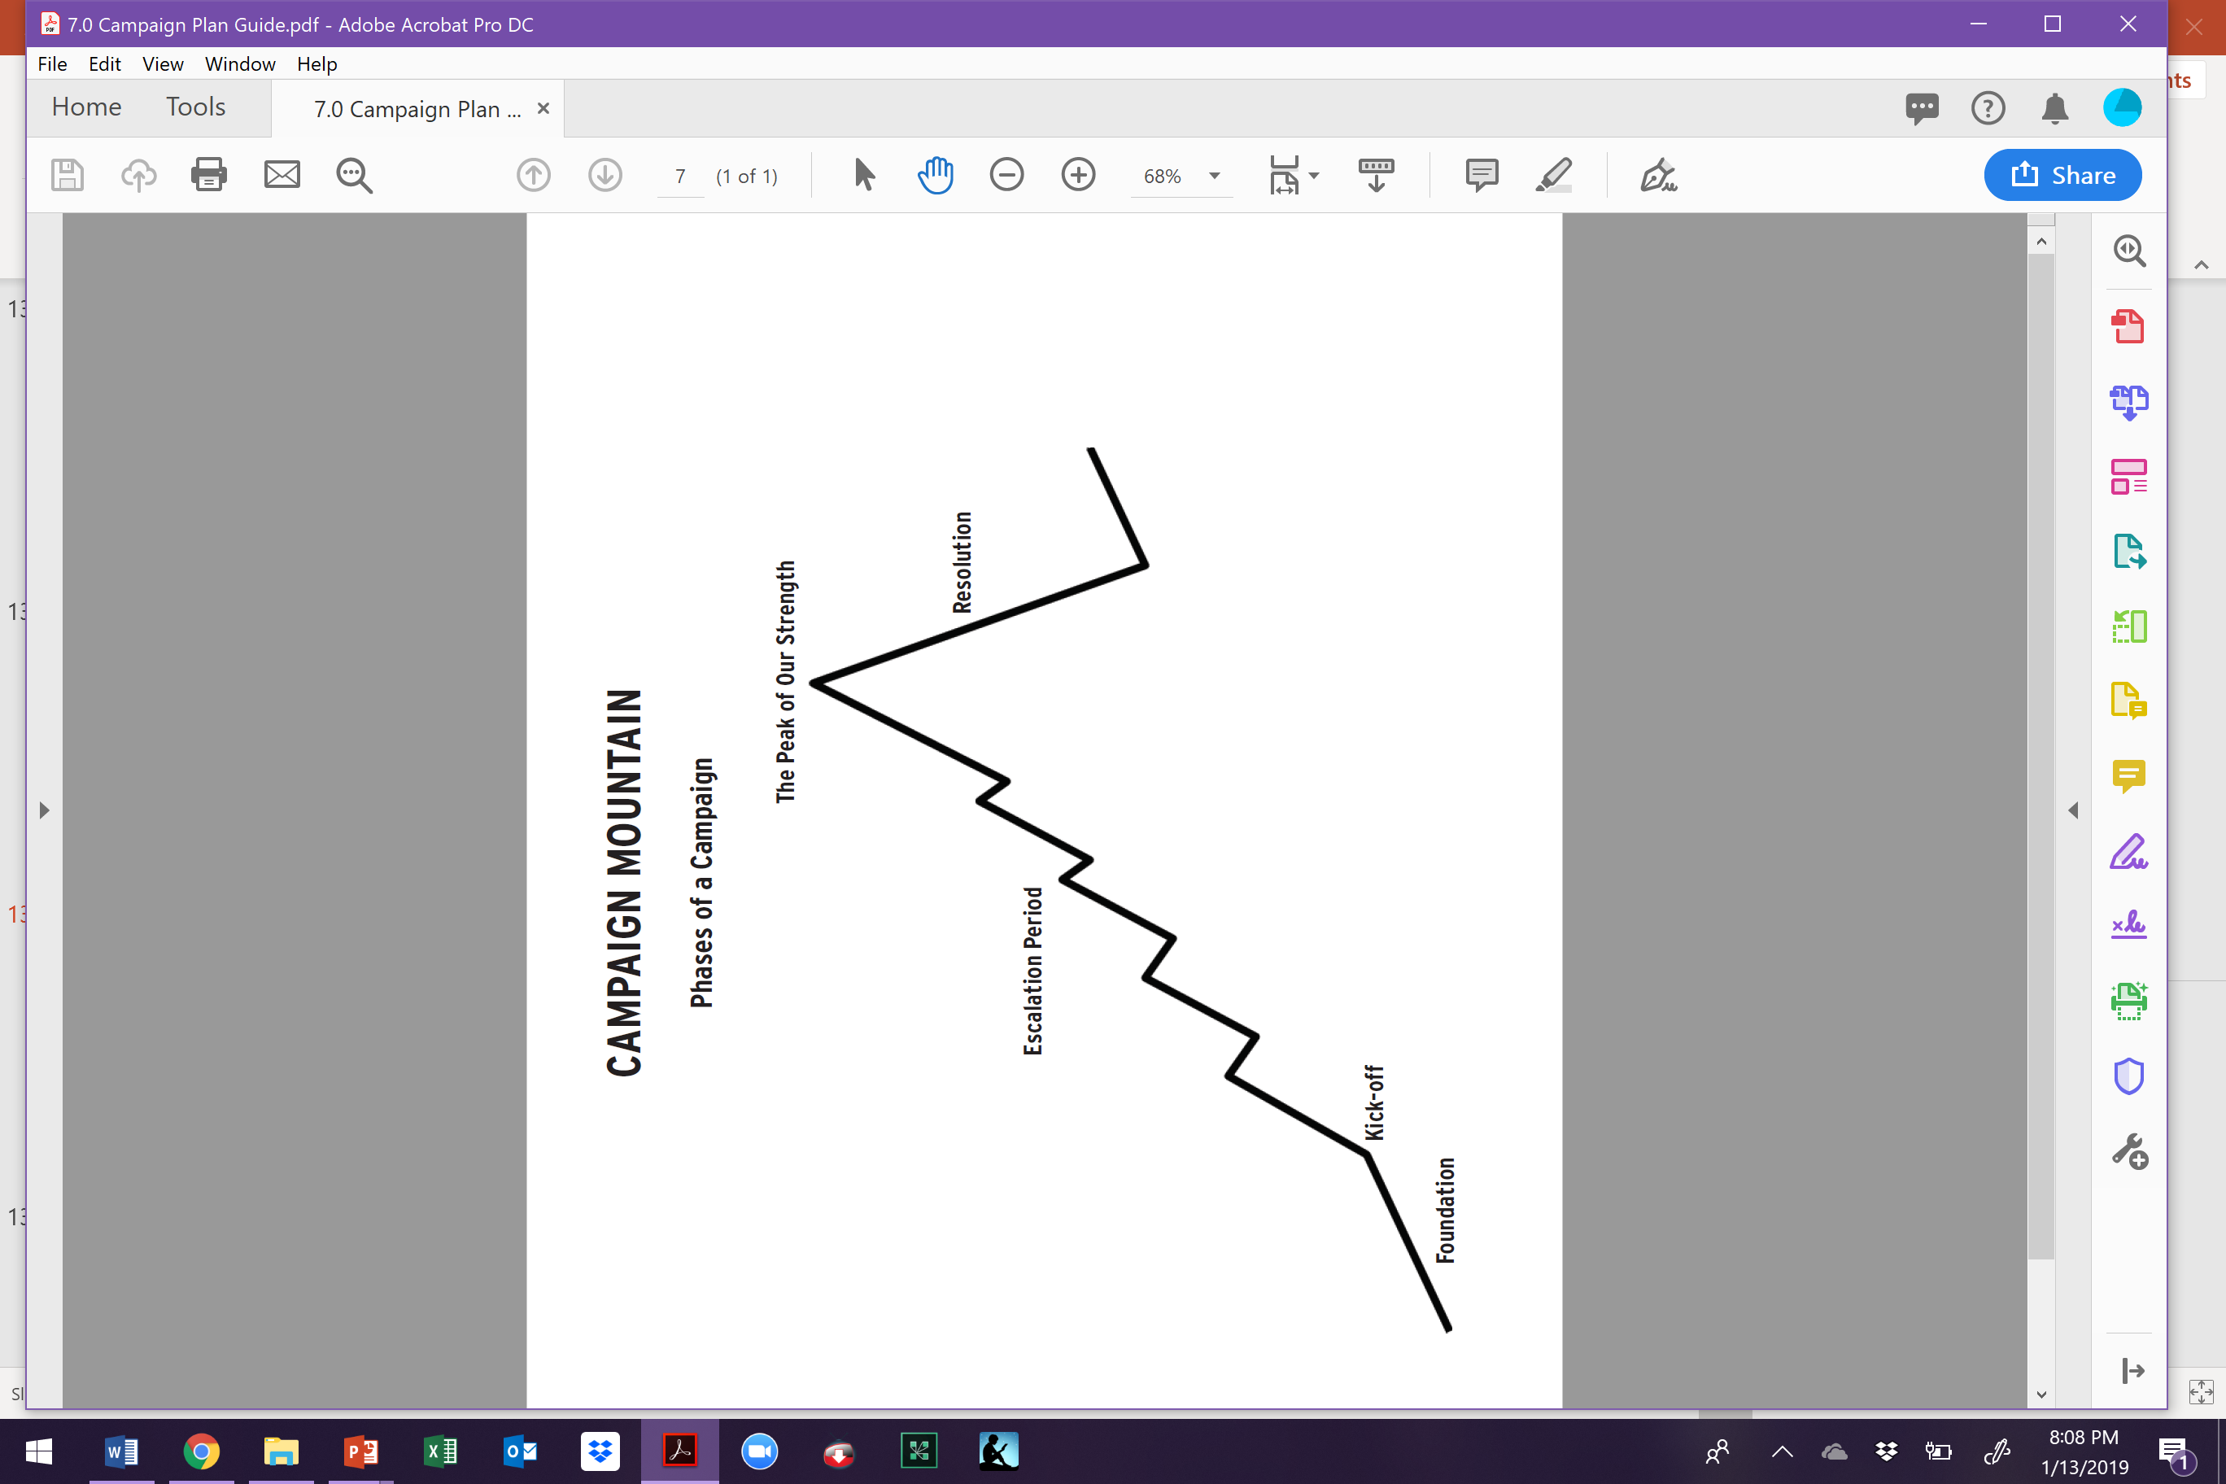
Example- Leaders, Structures, Message
What sort of leaders, structures, and message do you need in the foundation stage and what sort of structures are being developed?
EX. Want to make sure there are at least 3 leaders in each building who want to make sure the union turns out the vote for the democratic candidate who supports unions. This team is talking to members and non-members, doing surveys, and working ID'ing possible future volunteers for actions. Each team member has proven following.
Structure – Political Action Team in each building that is part of the local’s Political Action Network. “Democracy is a Union Right and a Union Fight”

Slide 24

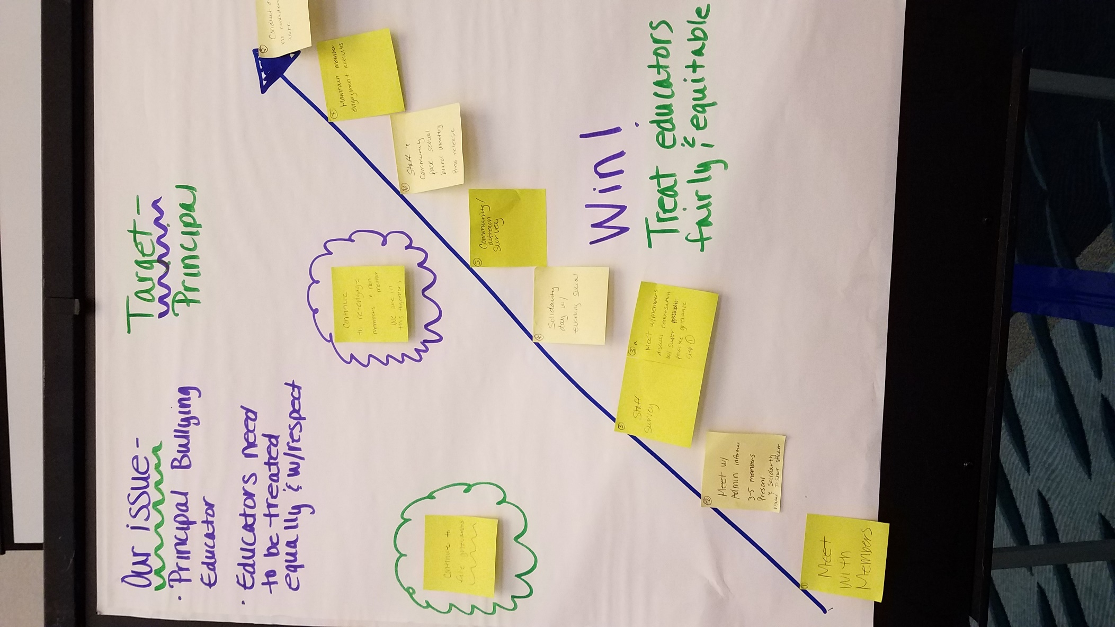
Team Work Time

Slide 26
Campaign Presentations

Slide 27
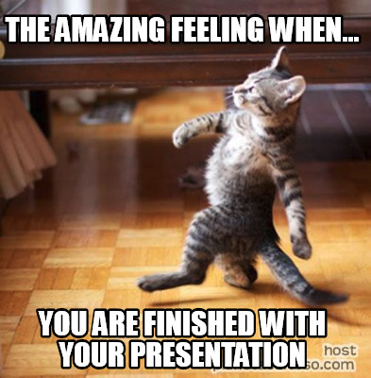
Team Presentation and Coaching Time

Slide 28
Closing

Slide 29
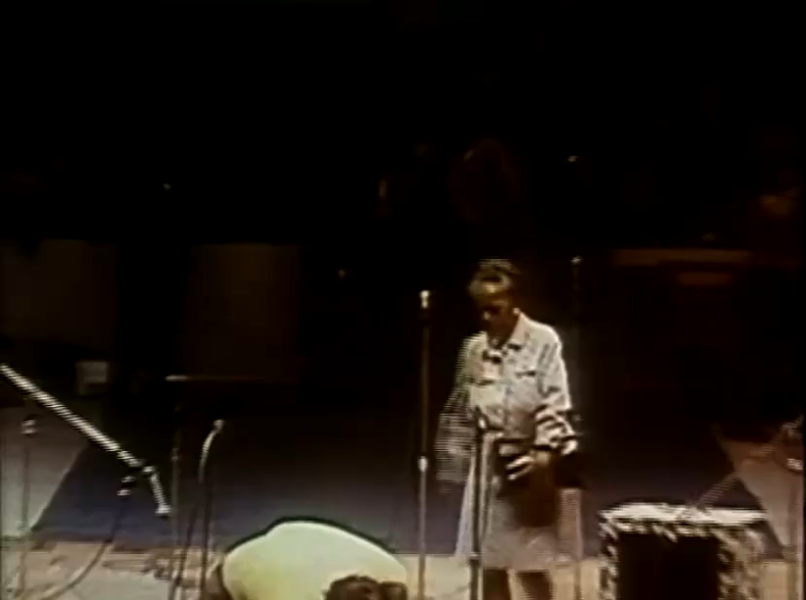
In Ella Baker's Own Words

Slide 30

Our Vision of Now and the Future
What will your workplace, locals, community look like after you have implemented campaigns like this?

Slide 31

Final Reflections
What is one thing you are going to do “tomorrow”?
What is one thing you are going to do next month?
What is one thing you might do in six month?

Slide 32

One Word
Thinking back to your core value that you shared earlier and today’s experience:
What is one word that describes your spirit right now?

Slide 33

Gratitude
Evaluations
Final Words for the Good of the Order

