Slide 1
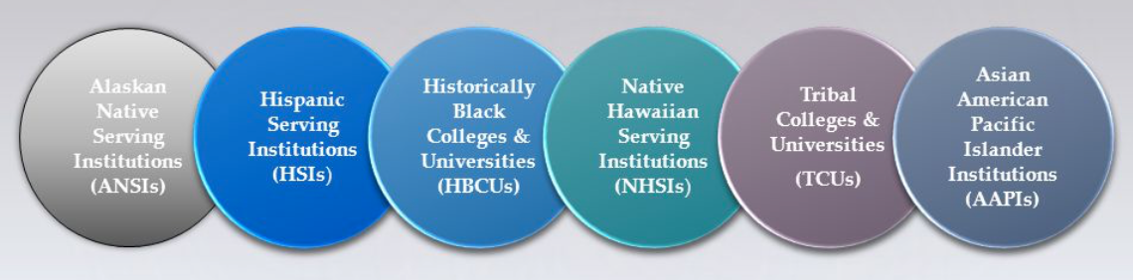
  Building Knowledge of HBCUs
  and other MSIs

Slide 2
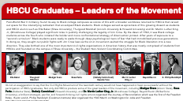
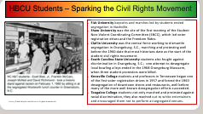



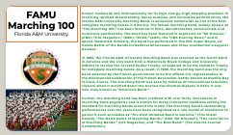
HBCU/MSI HISTORY MIXER
Each participant will receive an HBCU History Card. Take 3 minutes to read your HBCU/MSI card.
Pair & Share. When prompted, you will find a partner. You will have 90 seconds each to share th content of your HBCU/MSI history card.
When signaled, you will find a different partner and repeat. There will be three (3) rounds in this activity.

Slide 3
HBCU/MSI HISTORY MIXER
Debrief (5 minutes)
What surprised you?
What is the historical significance?
What is something that you learned that is still relevant today?
What aligns with union values?

Slide 4
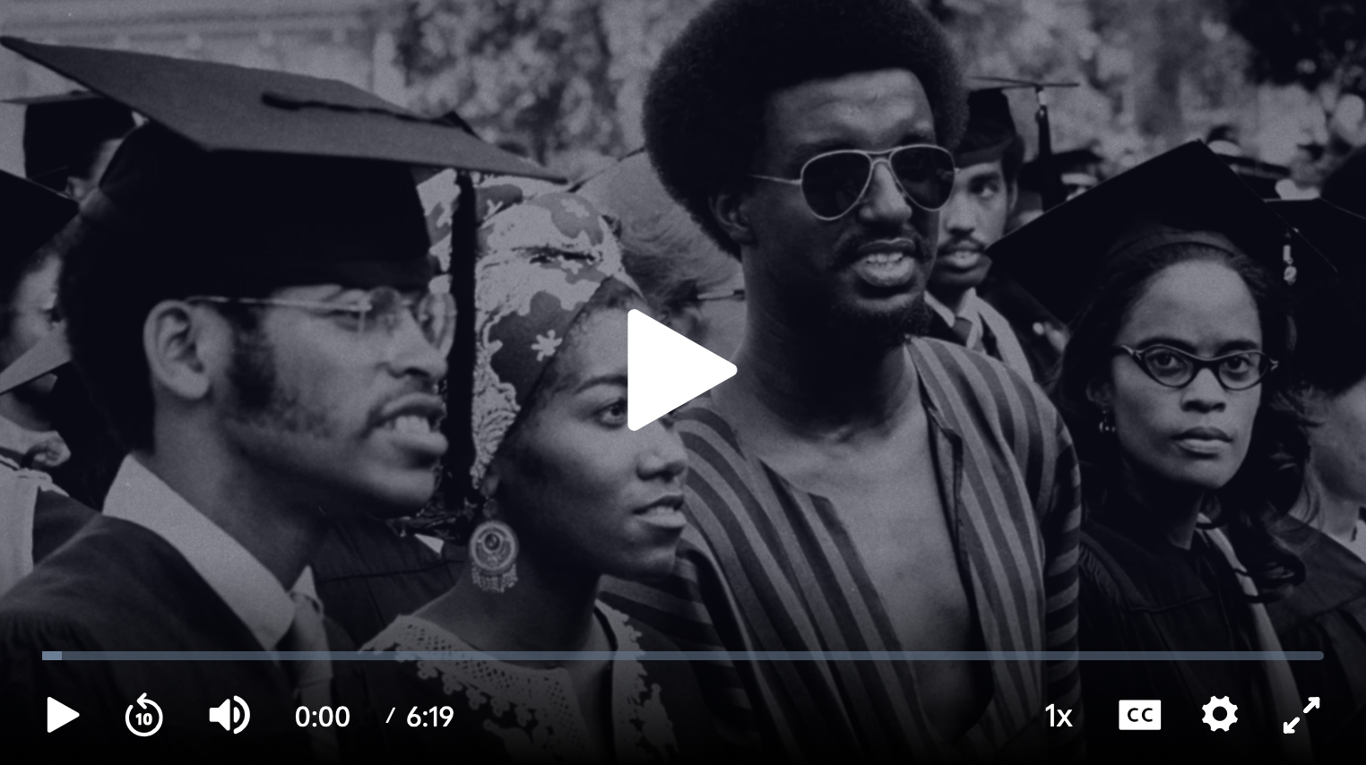
Historically Black Colleges and Universities | Making Black America
https://whyy.pbslearningmedia.org/resource/historically-black-colleges-and-universities-video/making-black-america-through-the-grapevine/

Slide 5

Historically Black Colleges and Universities | Making Black America
Debrief:
At their inception, how did HBCUs emerge and why were they an important step forward for African Americans?

Slide 6
The Early History of HBCUs
Throughout early U.S. history, Black Americans were discouraged and outright prohibited from accessing educational institutions in many Southern states. HBCUs were established to address this discrimination. Cheyney University of Pennsylvania, the oldest HBCU, was established in 1837. Lincoln University, the first degree granting HBCU was founded in 1854. Wilberforce University, the nation’s oldest private HBCU quickly followed in 1856, before the start of the American Civil War.
HBCUs for African Americans were established through the efforts of Black churches with the support of the American Missionary Association and the Freedmen’s Bureau.
The second Morrill Act of 1890 required states—especially former Confederate states—to provide land grants for institutions for black students if admission was not allowed elsewhere. As a result, many HCBUs were founded.
Early HBCUs were established to train teachers, preachers, and other community members.

Slide 7
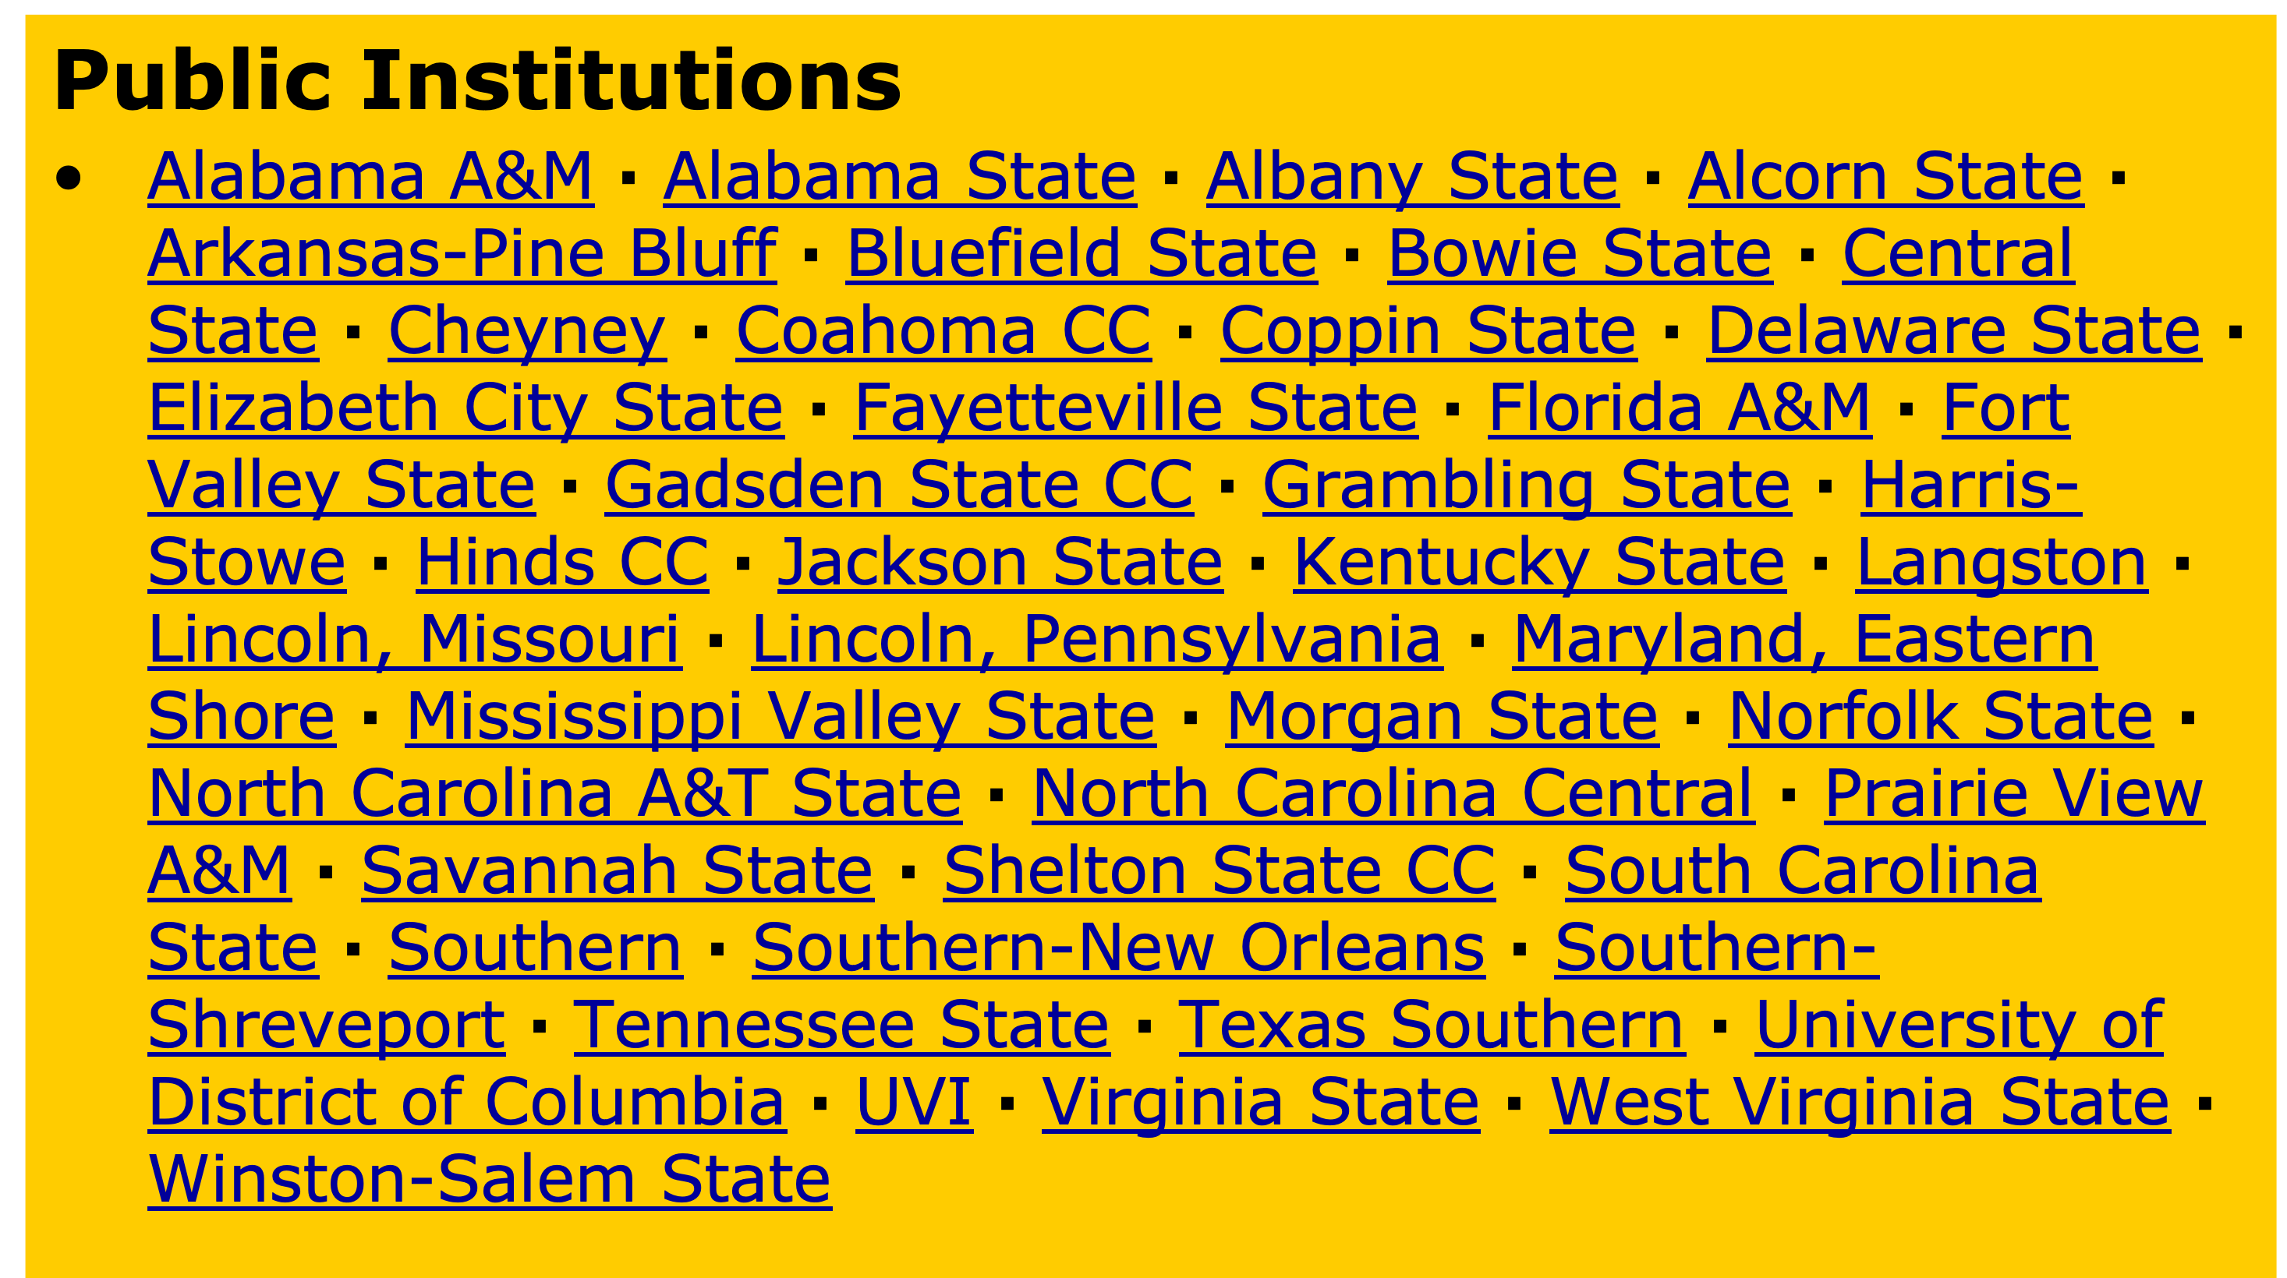
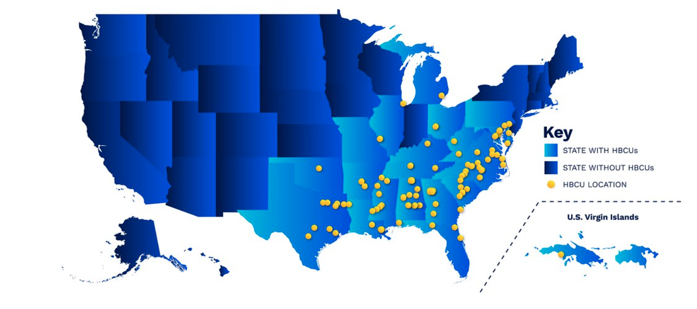
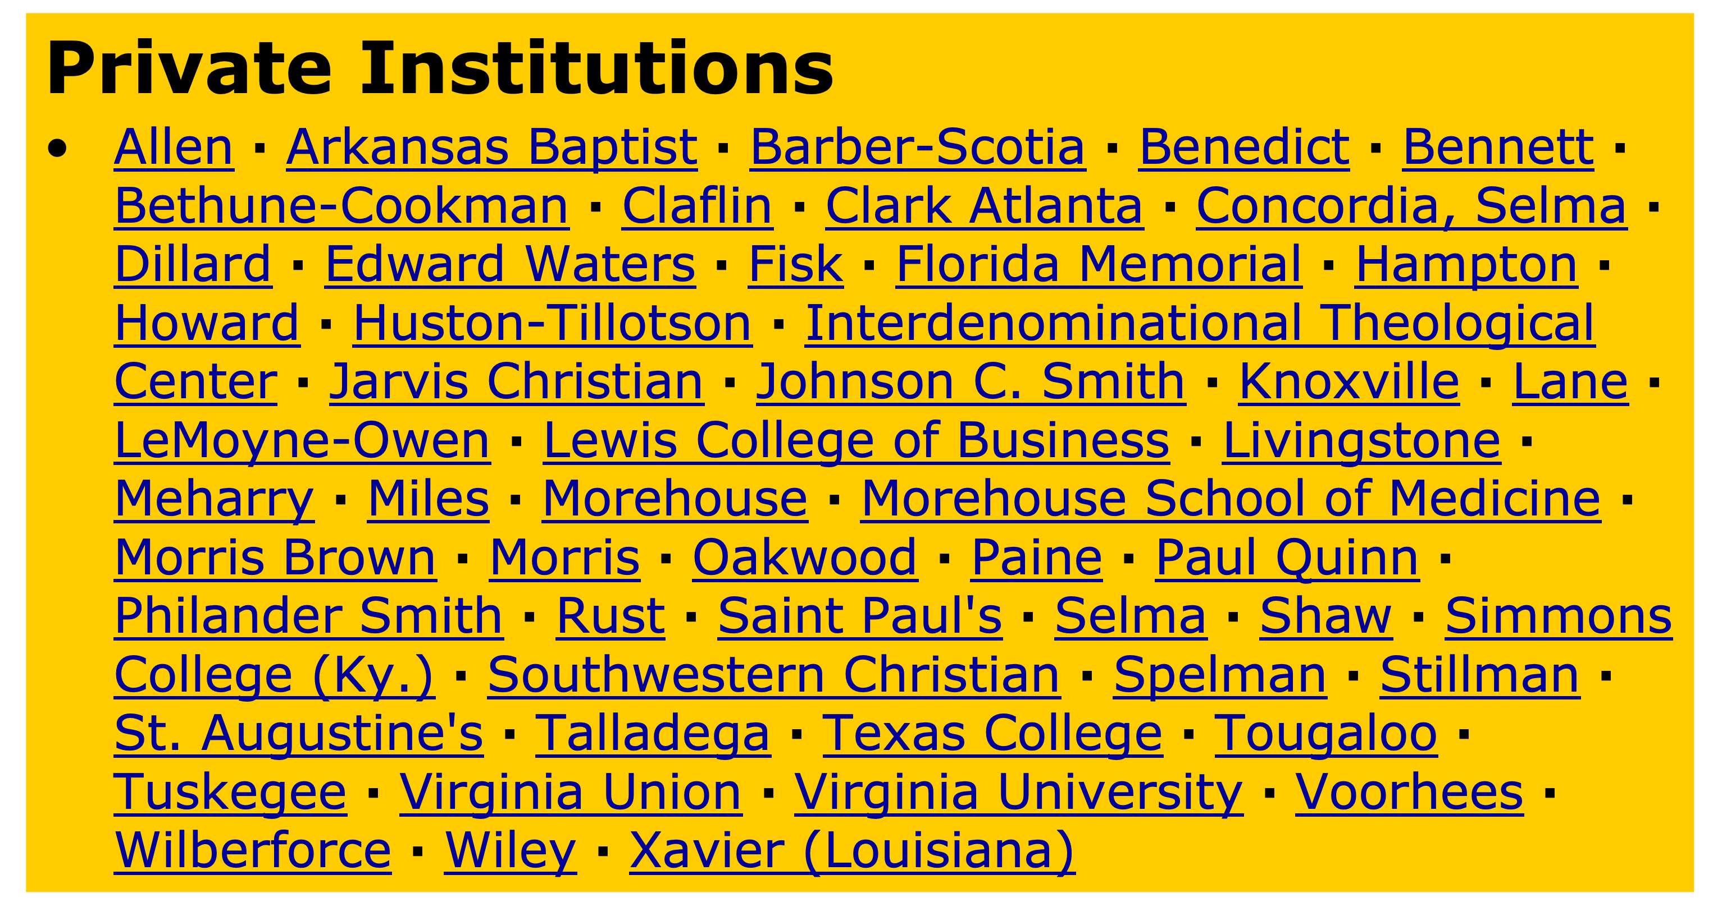
HBCUs by State
About 77 percent of HBCU students attended public institutions, while the remaining 23 percent attended private nonprofit institutions.
Notes:
HBCU Listings by State •HBCU's In Alabama (15) •HBCU's In Arkansas (4) •HBCU's In California (1) •HBCU's In Delaware (1) •HBCU's In District of Columbia (2) •HBCU's In Florida (4) •HBCU's In Georgia (10) •HBCU's In Illinois (1) •HBCU's In Kentucky (2) •HBCU's In Louisiana (6) •HBCU's In Maryland (4) •HBCU's In Michigan (1) •HBCU's In Mississippi (8) •HBCU's In Missouri (2) •HBCU's In New York (1) •HBCU's In North Carolina (11) •HBCU's In Ohio (2) •HBCU's In Oklahoma (1) •HBCU's In Pennsylvania (2) •HBCU's In South Carolina (8) •HBCU's In Tennessee (7) •HBCU's In Texas (10) •HBCU's In Virgin Islands (1) •HBCU's In Virginia (6) •HBCU's In West Virginia (2)

Slide 8
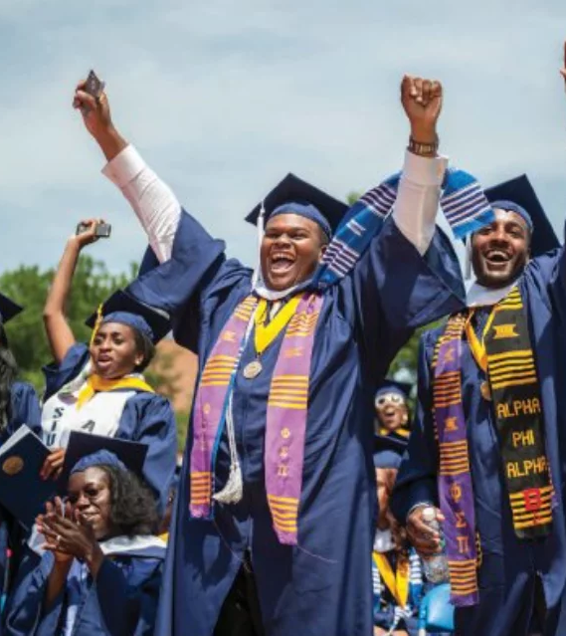
HBCU Facts
HBCUs have 1/8 of the average size of endowments than PWI.
HBCUs historically have provided an affordable education to millions of students of color.
HBCUs have graduated the majority of America’s African American teachers, doctors, judges, engineers, and other scientific and technological professionals.
HBCUs significantly contribute to the
making of African American science
degree holders;
  agriculture (51.5 percent),
  biology (42.2 percent),
  computer science (35 percent),
  physical science (43 percent), and
  social science(23.2 percent)

Slide 9
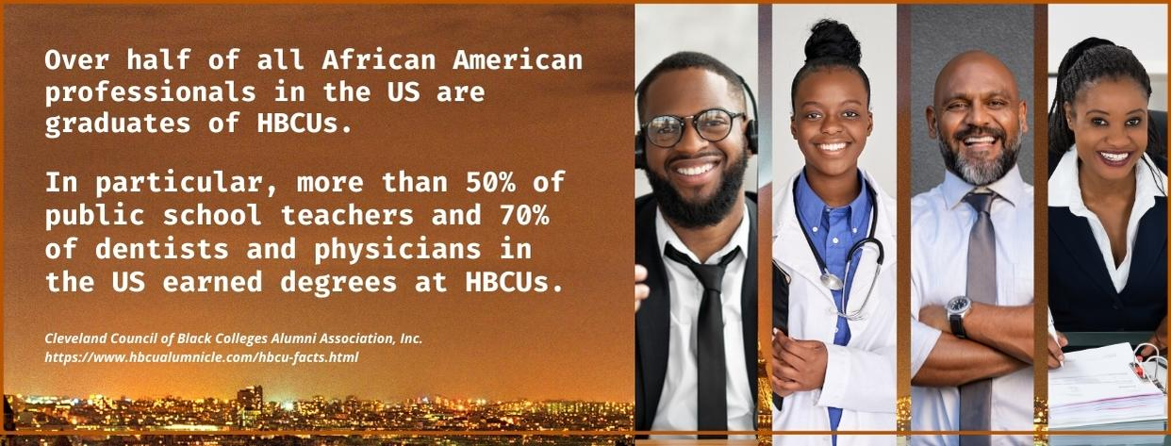
HBCUs ARE RESPONSIBLE
FOR
80% of all Black Federal Judges 75% of all Black Doctors 75% of all Black PhD’s 75% of all Black Military Officers 75% of all Black Veterinarians 50% of all Black Educators 50% of all Black Pharmacists 50% 0f all Black Attorneys 46% of all Black Business Executives 40% of all Black Dentists
In academic year 2021–22, some 48,800 degrees were conferred by HBCUs:
  11 percent were associate’s degrees,
  about two-thirds were bachelor’s degrees (67 percent),
  16 percent were master’s degrees, and
  6 percent were doctor’s degrees.
Of the degrees conferred by HBCUs,
  the majority (74 percent) were conferred to Black students.
https://www.mbastack.org/top-hbcu-mba-programs/

Slide 10

HBCU Facts
Law Schools at HBCUs - Howard University School of Law, North Carolina Central University School of Law, Thurgood Marshall School of Law at Texas Southern University, Southern University Law Center, Florida A&M University College of Law, University of the District of Columbia David A. Clarke School of Law
Medical programs at HBCUs - Howard University College of Medicine, Meharry Medical College, The Morehouse School of Medicine, The Charles R. Drew University of Medicine
Veterinary Medicine - The Tuskegee University College of Veterinary Medicine
Doctorate Programs with specialization in teacher education, sociology, pharmacy and 28 other majors are offered by 36 HBCU schools in 16 states.
There are over 75 HBCUs with Education Programs training a new generation of professionals who will go on to become educators: teachers, principals, superintendents, and professors.
In 2020–21, HBCUs awarded over 3,000 degrees in education. This is critically important now, as schools all over the country tell us they are having trouble finding enough teachers.

Slide 11
Hispanic-Serving Institutions (HSIs)
https://youtu.be/r0lwKjnyMmE?si=5Q-LKeL-gMQlD5Q6
Or
https://x.com/SecCardona/status/1701691456438653292
Watch video
Debrief:
How will HSIs be impacted if the Department of Education is eliminated?
Notes:
https://salud-america.org/report-number-of-hispanic-serving-institutions-increases/

Slide 12

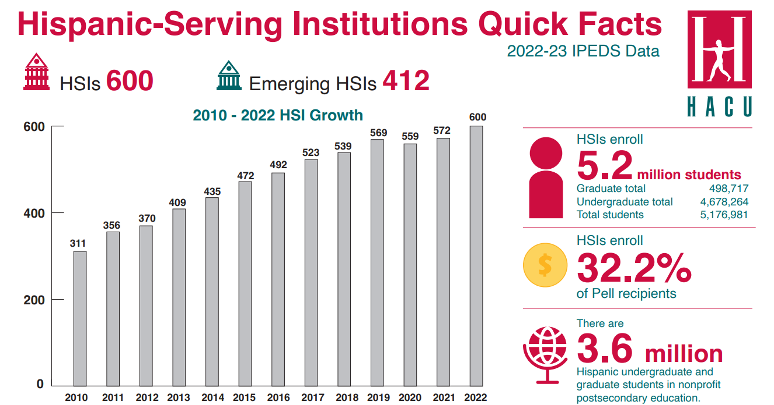
HSI Facts
HSIs are accredited, degree-granting public or private nonprofit institutions of higher education with 25% or more total undergraduate Hispanic full-time equivalent (FTE) student enrollment.
There are a now 600 U.S. colleges and universities designated as Hispanic-Serving Institutions (HSIs), a 5% increase over last year’s 572 recognized institutions.
HSIs enroll 5.2 million students and two-thirds of all Latino undergraduates, according to HACU.
As the number of HSIs continue to grow, data found that 60% of HSIs are 4-year institutions and 40% are 2-year institutions.
69% of HSIs are public and 31% are private.
Latinas have also experienced a 52% rise in college degree attainment at HSIs from 2015-2020.
https://salud-america.org/report-number-of-hispanic-serving-institutions-increases/
Notes:
https://salud-america.org/report-number-of-hispanic-serving-institutions-increases/

Slide 13

Servingness at Hispanic-Serving Institutions
Servingness is a concept that Garcia, Núñez, and Sansone (2019) argue is a multidimensional and conceptual way to understand what it means to move from simply enrolling Latinx students to actually serving them.
The HSI designation is a racialized designation, meaning it is connected to and evolves from the racial and ethnic identities of the students (Garcia 2019; Garcia and Dwyer 2018). As such, race and ethnicity must be considered a part of servingness, and yet the allowable activities outlined in federal grant programs do not require institutions to utilize these funds specifically to meet the needs of Latinx students.
Servingness is also difficult to define because of the extreme diversity within and across HSIs.
https://www.equityinhighered.org/resources/ideas-and-insights/defining-servingness-at-hispanic-serving-institutions-hsis-practical-implications-for-hsi-leaders/

Slide 14
National Teacher Shortage
There is a national teacher shortage.
The shortage for teachers of color - African American, Latino, Native, etc. - is particularly severe.
There has been a slight increase in teachers of color from 12% to 18% since 2006.
There remains a significant gap as the student population of color has grown to over 50%.

Slide 15
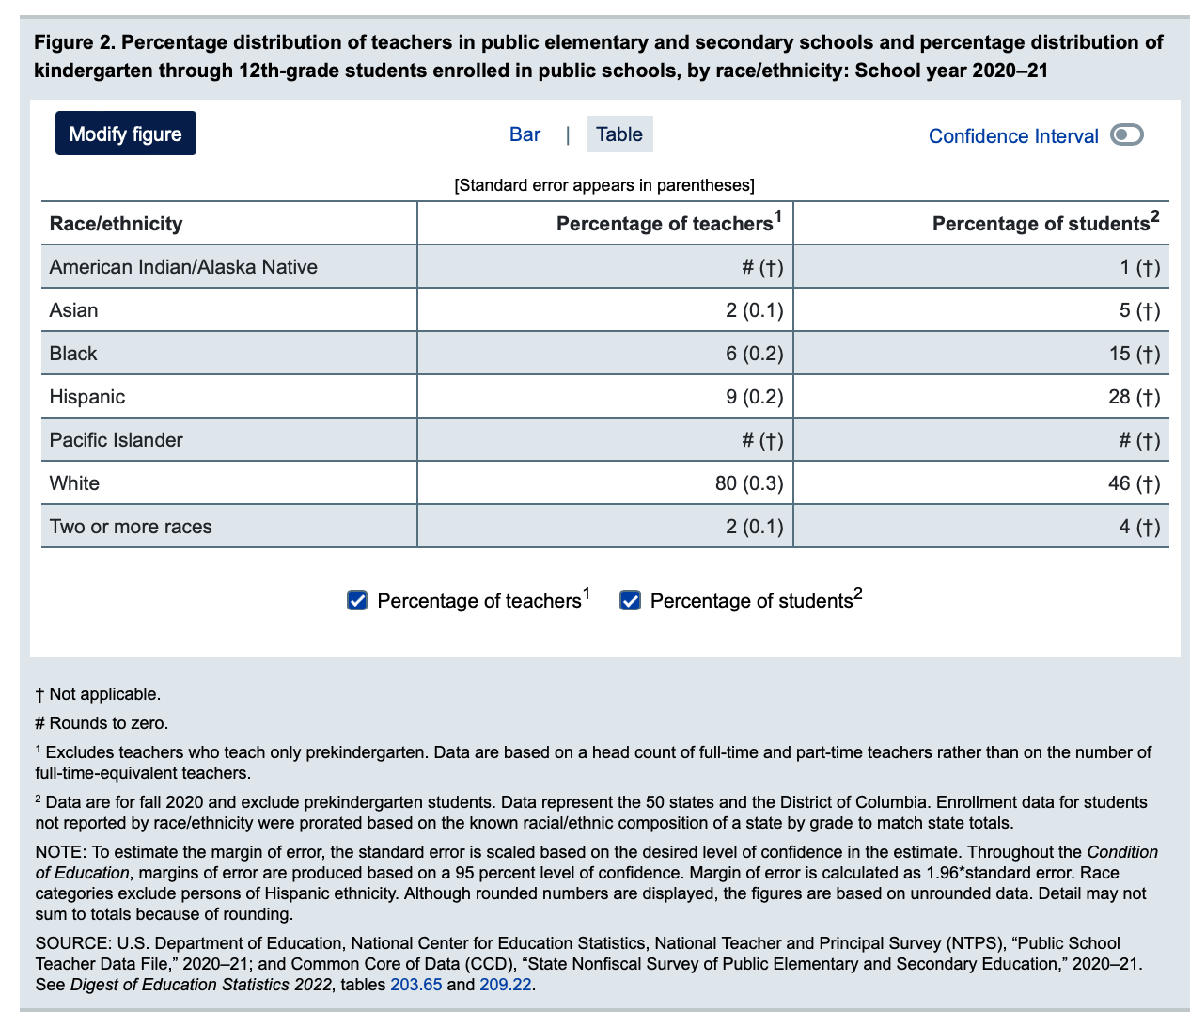
2020-2021
Educator -Student Demographics
https://nces.ed.gov/programs/coe/indicator/clr/public-school-teachers

Slide 16

Standardized Testing
A Barrier For Teachers of Color
Standardized testing has been shown to have racial biases and does not necessarily predict teaching effectiveness.
Teacher certification exam in the 1970s and 1980s had a significant effect on the Black teacher pipeline as the teacher certification requirements resulted in the elimination of almost 100,000 minority teachers in 35 states between the late 1970s and the early 1990s.
https://uncf.org/wp-content/uploads/Voya-Black-Teacher-Pipeline-Final-.pdf

Slide 17
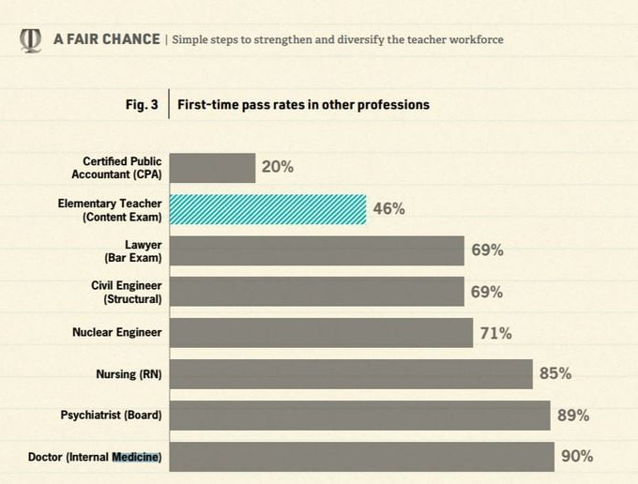
Professional Licensure Pass Rate
The pass rate is much higher in other professions requiring licensure.
The failure rate among teachers of color is much higher, which undermines the goal of increasing diversity in the workforce.
Only 38 percent of black teacher candidates and 57 percent of Hispanic teacher candidates pass the most widely used licensing test even after multiple attempts, compared to 75 percent of white candidates.
Only 21 of 817 undergraduate programs reasonably align content coverage with most (though not all) elementary content topics.
https://www.nctq.org/dmsView/A_Fair_Chance

Slide 18
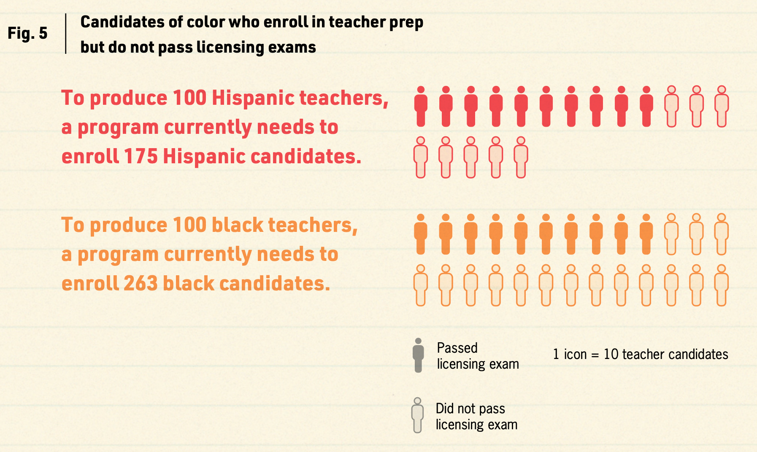
Teacher Candidates of Color
The National Education Association, the nation’s largest teachers union, has come out against teaching licensure exams due to the hurdles it can present — “particularly for candidates of color.”
Some states, however, are beginning to forego basic certification testing. New Jersey was one of the more recent states to do so.
https://www.nctq.org/dmsView/A_Fair_Chance

Slide 19
Myth or Fact
MSIs lack cultural diversity.
MSIs lack ethnic diversity.
HBCUs lack cultural diversity.
The majority of the student body at all HBCUs is Black.
Notes:
Bluefield State College in West Virginia has an 85% white student body.
West Virginia State University is 77.2% White, 8.24% Black or African American, 4.23% Two or More Races, 1.8% Hispanic or Latino, 1.61% Asian, 0.185% American Indian or Alaska Native, and 0.0528% Native Hawaiian or Other Pacific Islanders.
Kentucky State has nearly 50 percent African American students and 50 percent non-black students.
Simmons College in Kentucky, both undergraduate and graduate, is 50.4% White, 9.18% Hispanic or Latino, 8.77% Black or African American, 6.08% Asian, 2.24% Two or More Races, 0.0876% American Indian or Alaska Native, and 0.0175% Native Hawaiian or Other Pacific Islanders.

