Slide 1
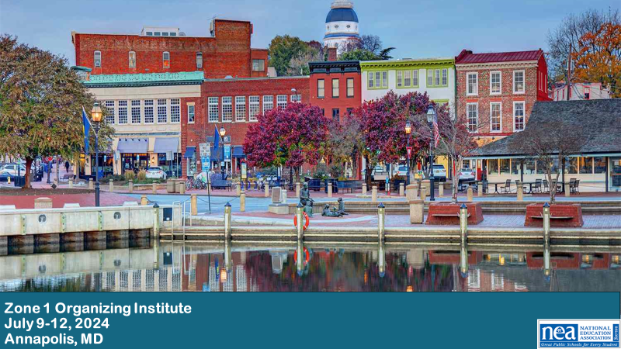


Slide 2
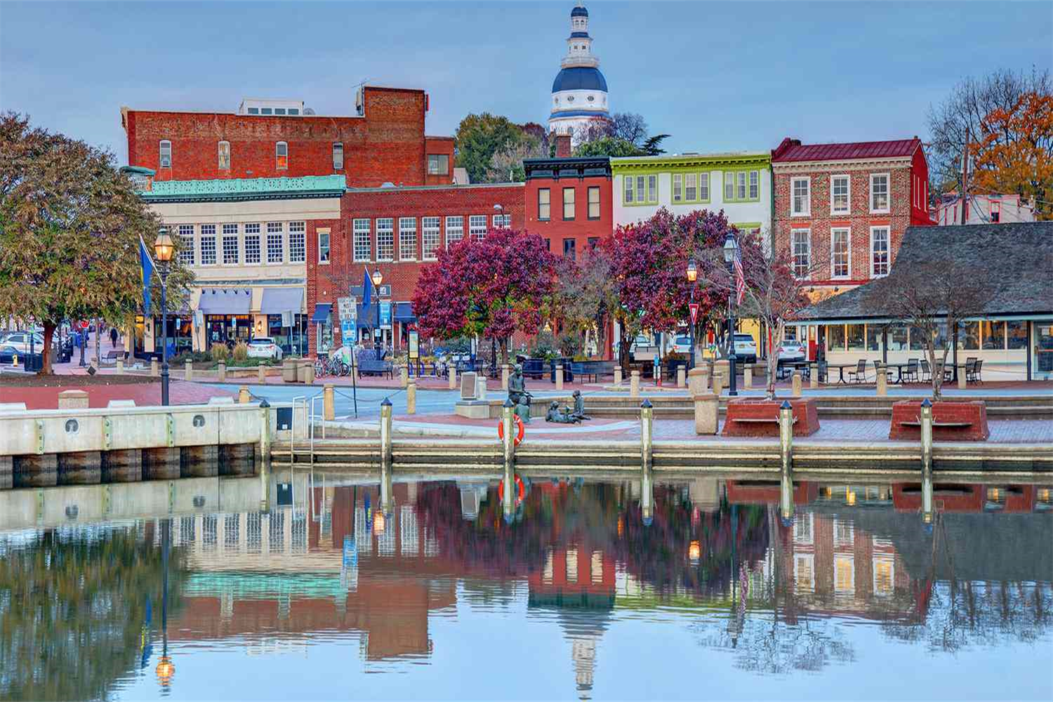

Zone 1 Organizing Institute
July 9-12, 2024
Annapolis, MD
AIN’T NO POWER
LIKE THE POWER OF THE PEOPLE
‘CUS THE POWER OF THE PEOPLE
DON’T STOP
Notes:
Both

Slide 3
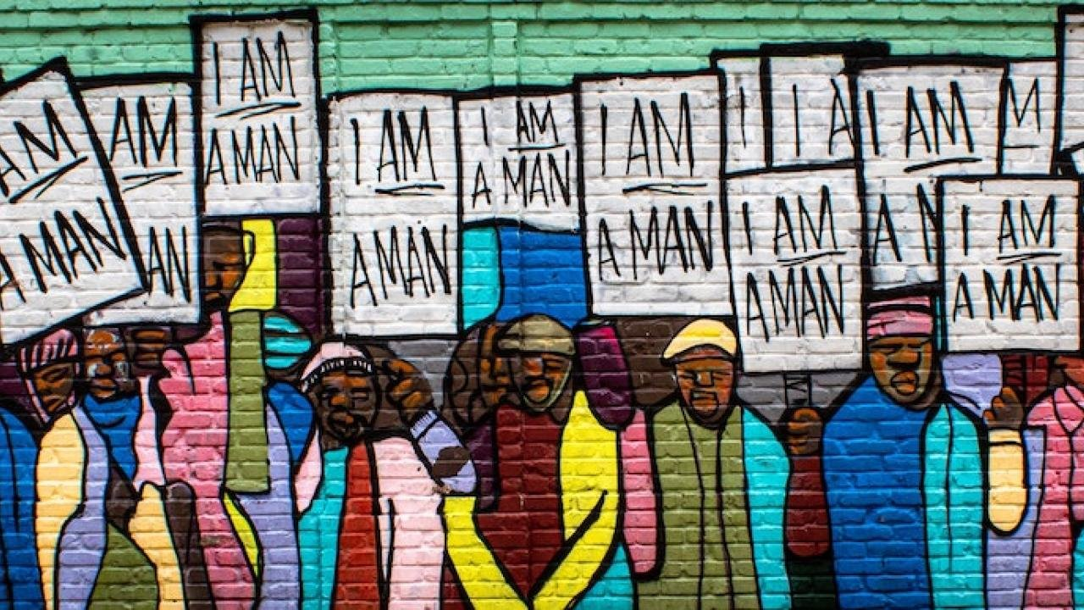
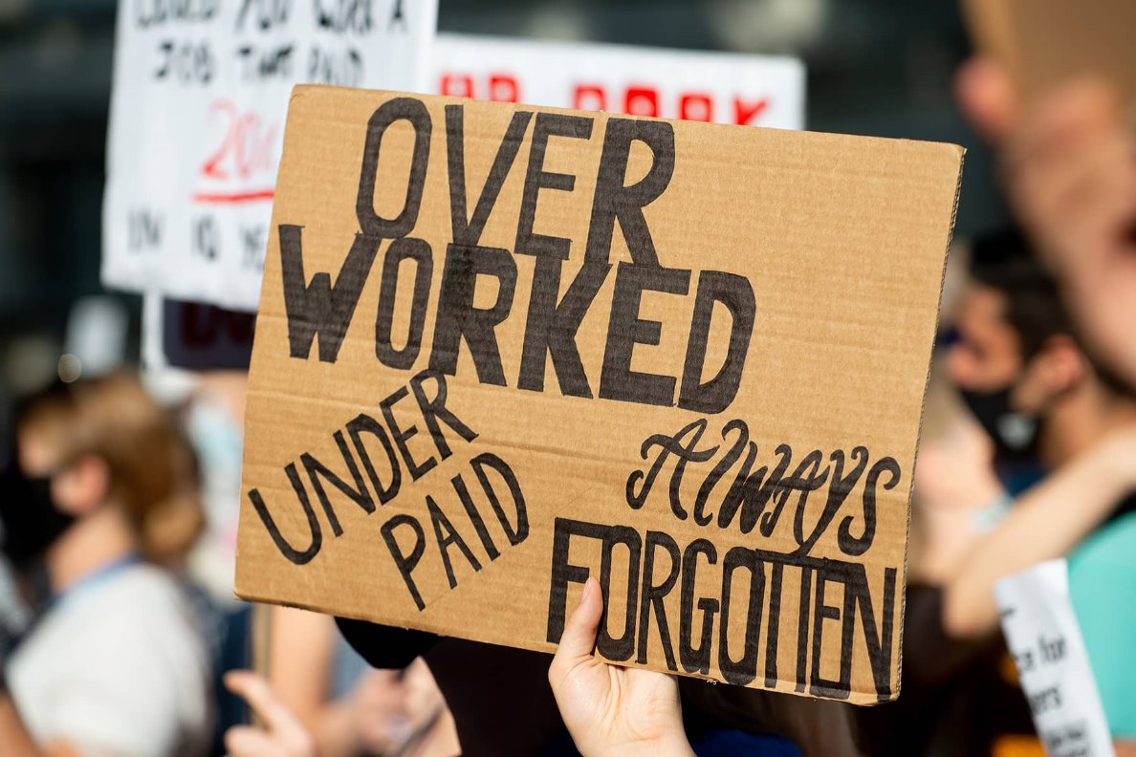

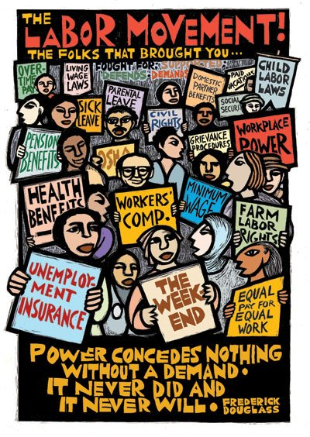
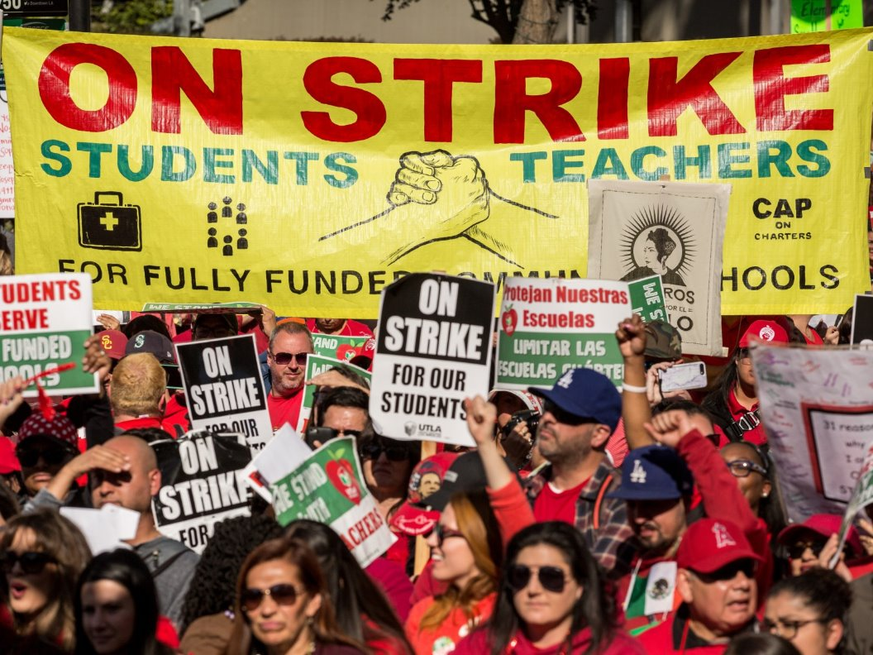
Power
Kayla Moore – Maryland State Education Association
Fatimah Hayes – New Jersey Education Association
Zone 1 Organizing Institute | July 9-12, 2024 | `Annapolis, MD
Notes:
Both

Slide 4

Objectives
Analyzing your local power using a SWOT Analysis.
How can your local use their power to bring about change.
Mobilizing power to gain greater member engagement.
How to use Power Mapping to get the win.

Slide 5
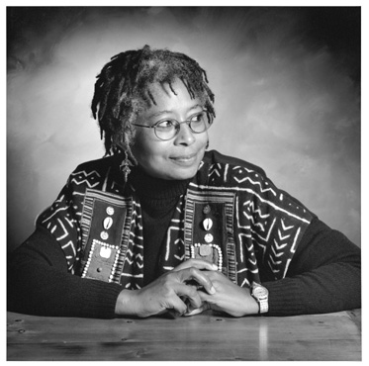
“The most common way people give up their power is by thinking they don't have any.”​
~Alice Walker​
Notes:
Kayla

Slide 6

The Starbucks Unionization Movement
Notes:
Fatimah (4 min) – consider getting rid of the video

Slide 7

Power & Change
Power is the capacity to ensure that others do as you would like them to do! (Eric Liu)​
A political system does not change because something is right, moral, and/or just.​
Political systems (including school boards) change because not changing creates more problems than changing.​
Notes:
Kayla

Slide 8
How to Make
Powerful Change​
Expand
Expand the frame of the possible​
Choose
Choose a defining fight (Identifying the Issue)​
Find
Find an Early Win
Notes:
Fatimah

Slide 9

Tactical Guide to Power​
Political Power:
Ex: PAC, GR, legislative committees​
Consumer Power:
Ex: Montgomery Bus Boycott​
Legal/Regulatory Power:
Ex: Labor Board
Strikes/Disruptive Power​:
Ex: Writers Guild, #Red4Ed: MN, UTLA, Chicago, WV, Mass - Andover
Notes:
Kayla
Political Power: Getting
something passed by an elected body​
Consumer Power: Ability
to conduct a boycott​
Legal/Regulatory Power:
Win in Court/Regulatory Process​

Slide 10

Notes:
Fatimah

Slide 11
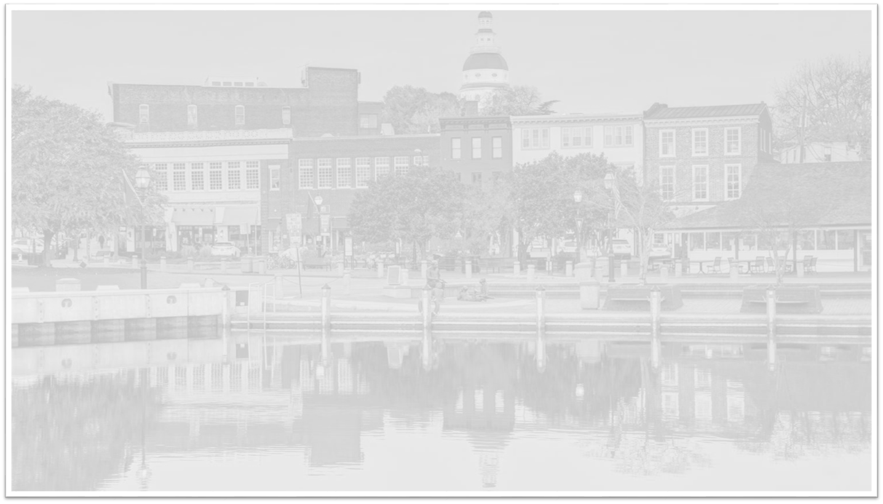
WHO ARE THEY
AND HOW​ DIDTHEY GET
THEIR POWER?​
Zone 1 Organizing Institute | July 9-12, 2024 | Annapolis, MD
Notes:
Fatimah

Slide 12
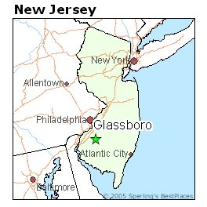

Glassboro, New Jersey
Notes:
Fatimah

Slide 13
Timeline of Events
March 17th - Local notified intent to privatize
Formation of Anti-Privatization Team
Meeting with Members - Survey, Planned Actions, etc.
April 19th - MOA/Deal Signed!!

Slide 14
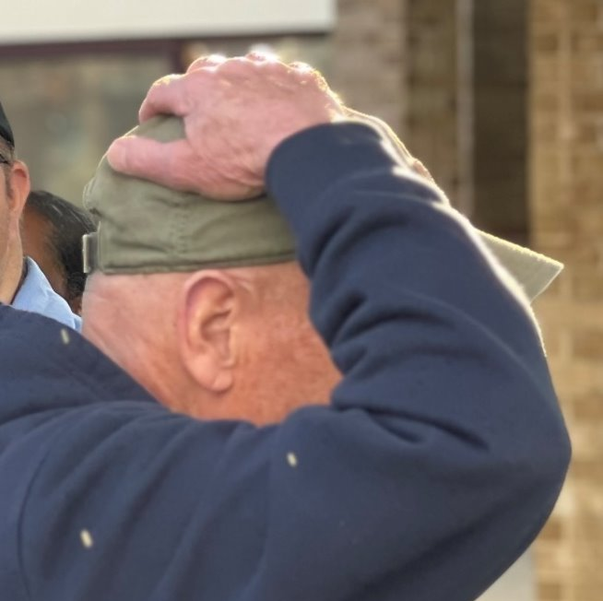
GESPA made it personal...​
Notes:
Fatimah

Slide 15
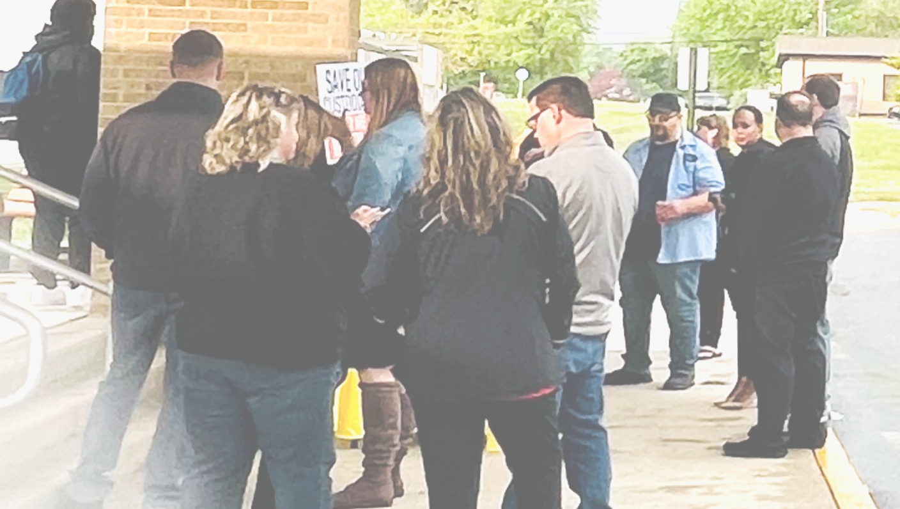
Notes:
Fatimah

Slide 16
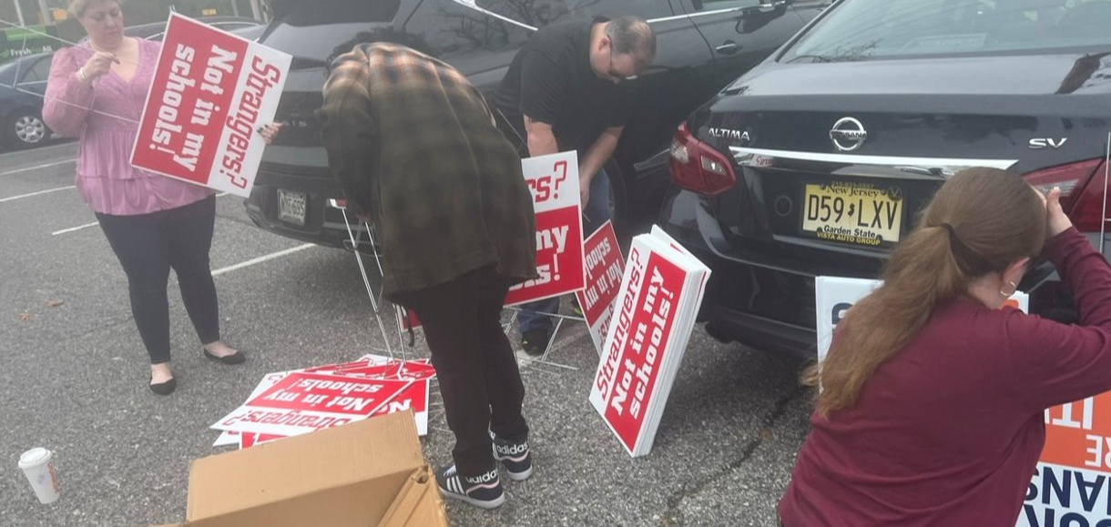
Notes:
Fatimah

Slide 17
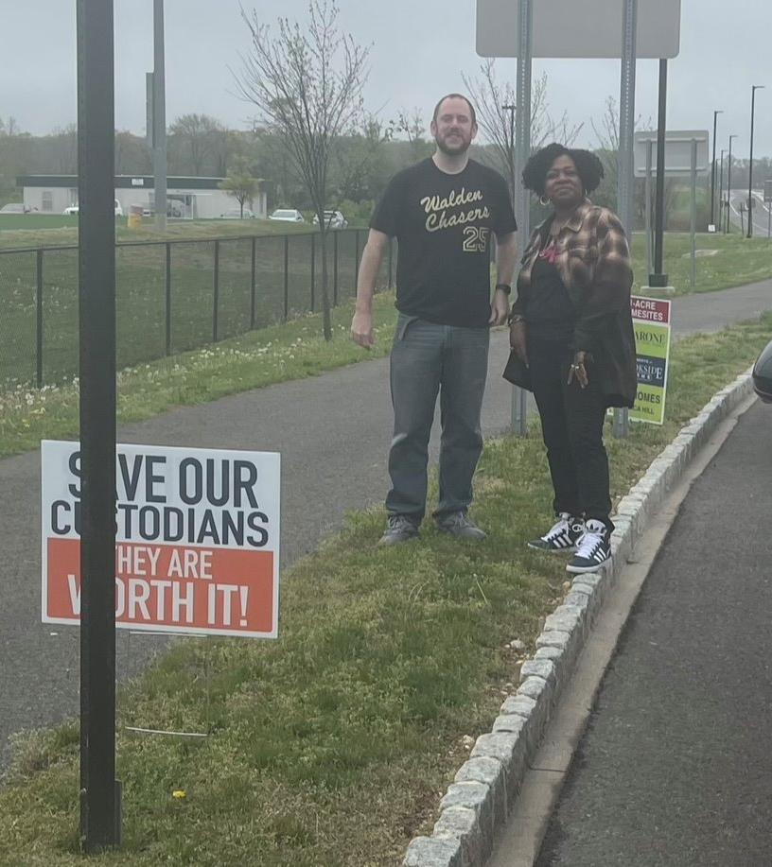
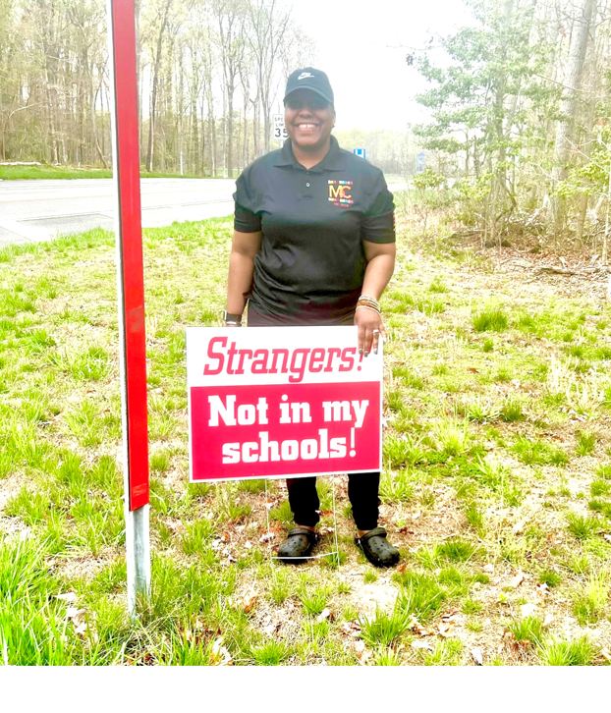
Notes:
Fatimah

Slide 18
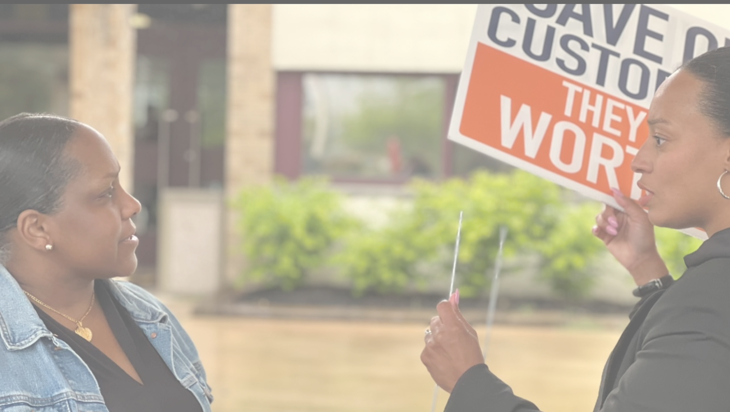
Notes:
Fatimah

Slide 19
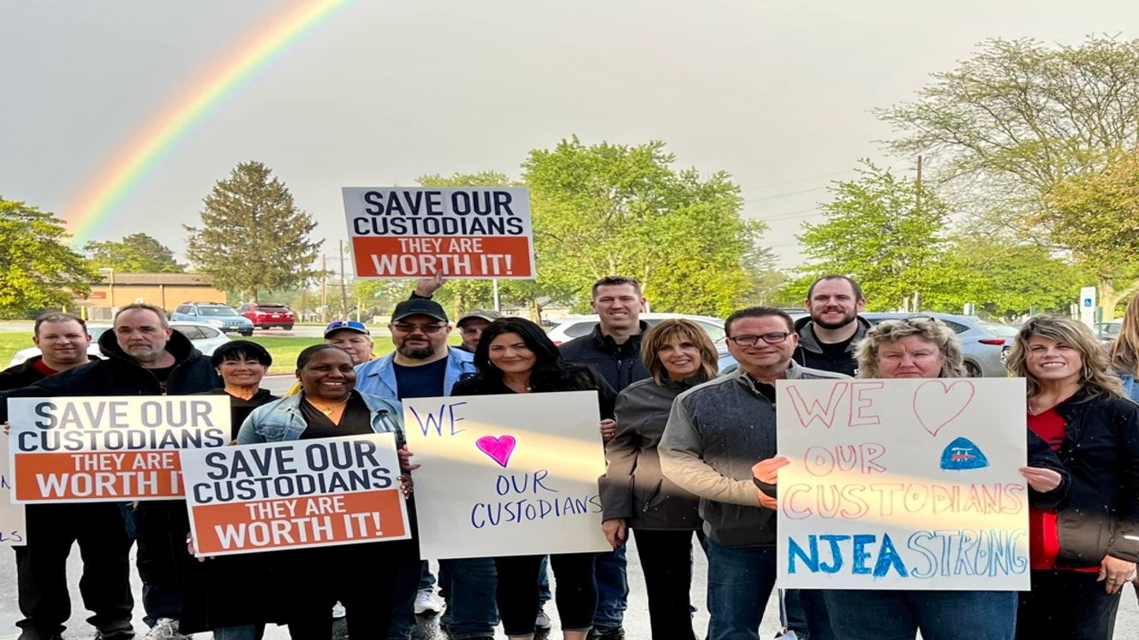
Notes:
Fatimah

Slide 20

Notes:
Fatimah

Slide 21


Strengths​
(internal)​
Membership​
Involvement​
Contract​
NJEA Resources
Natural/Organic Leaders​
Weakness​
(internal)​
Membership​ Density
Member Involvement​
Open Contract​
District Budgetary Concerns
Opportunity ​
(external)​
Endorsed Candidates ​
Policies​
Budget Process​
Threats​
(external)​
Superintendent/BA ​
Policies​
Budget Process​
Privatization​
Notes:
Fatimah

Slide 22
SWOT Analysis
As a team complete the SWOT Analysis located on page ____ of the Zone 1 Institute booklet.
Add the strengths, weaknesses, opportunities, and threats around your organizing issue.
You will have 5 minutes to complete the SWOT.
Notes:
Fatimah (5 min)

Slide 23
        Historically Black Colleges & Universities LAWSUIT
2006
Equity Lawsuit Filed
Equity Lawsuit filed against MD for operating a system of higher education that discriminates against HBCU students
2013
Ruling Favors HBCU
Judge Blake rules in favor of the HBCU plaintiffs
2013–2017
Mediation and Appeals
Mediation takes place and fails. MD Attorney General Frosh files appeals to dismiss the lawsuit
2018
Governor's Settlement Offer
Governor Hogan offers $100million to settle. Less than a quarter of what the MD advocates were asking for
2019
Maryland Appeals & Call to Action Rally
Maryland appeals Judge Blakes ruling. Information sessions across the state began. A Call-to-Action Rally was held in Annapolis
2020
HBCU Funding Bill Vetoed
MD General Assembly passes HBCU Funding Bill. The bill was vetoed by Governor Larry Hogan
2021
HBCU Funding Bill Passed and Signed
The HBCU Funding Bill was re-introduced and passed during the 2021 Maryland General Assembly legislative session. Governor Hogan signed the bill into law
Large scale protest begin nationwide – HBCU advocates joins the fight
Legislators received 700 emails and 450 written letters in support of MD's HBCU's
Notes:
Kayla

Slide 24
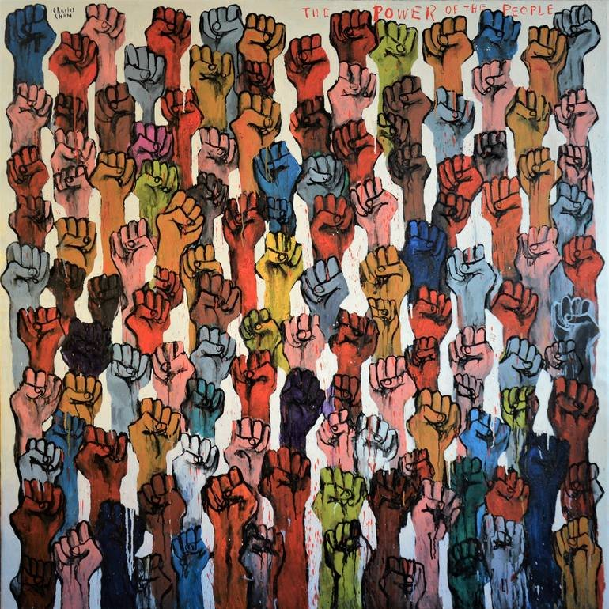
Power Mapping​
​ Person who has the power to give you what you want​
​ Brainstorming what influences your target
Determine who has the most influence on your decision maker​
Which person/group you'll spend time trying to get to support your campaign​
Notes:
Kayla

Slide 25

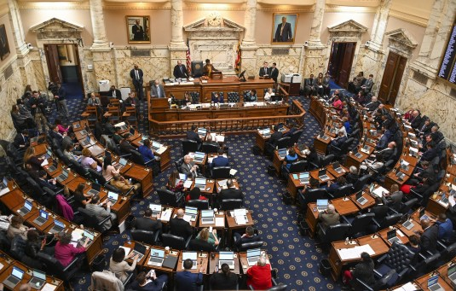
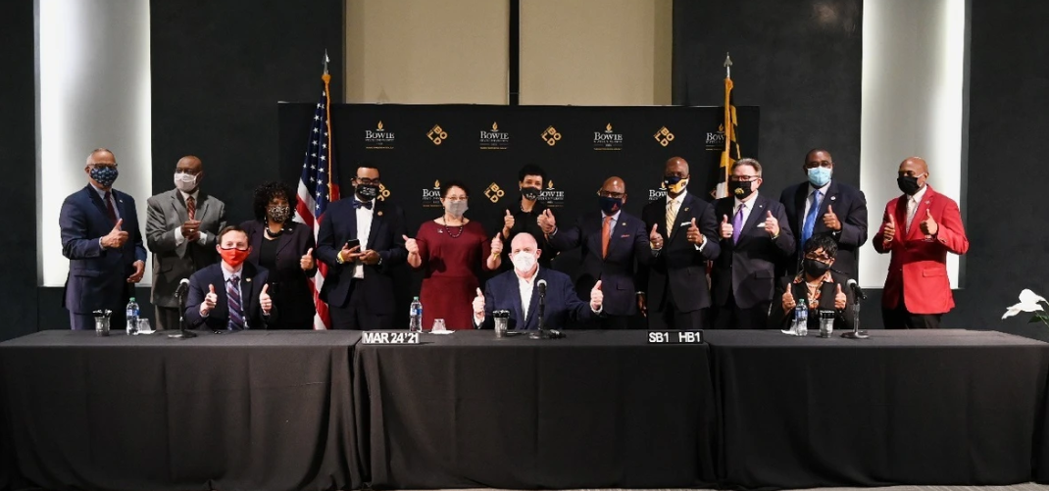
Notes:
Our main targets were the General Assembly and the Governor

Slide 26
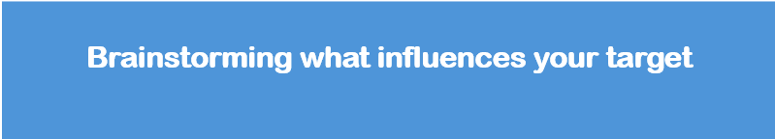
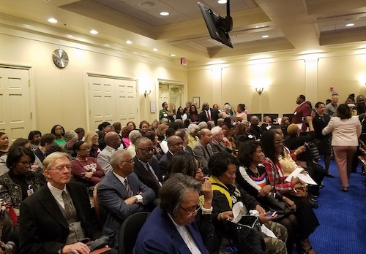
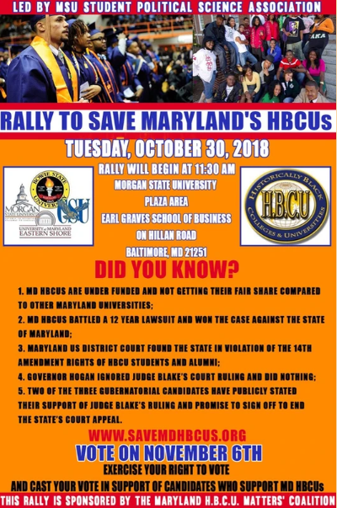
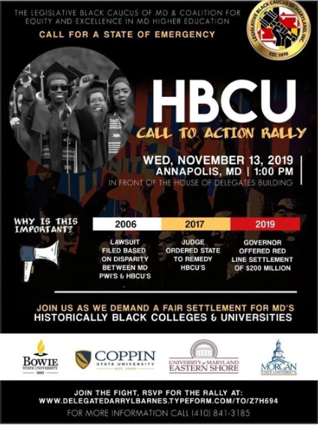
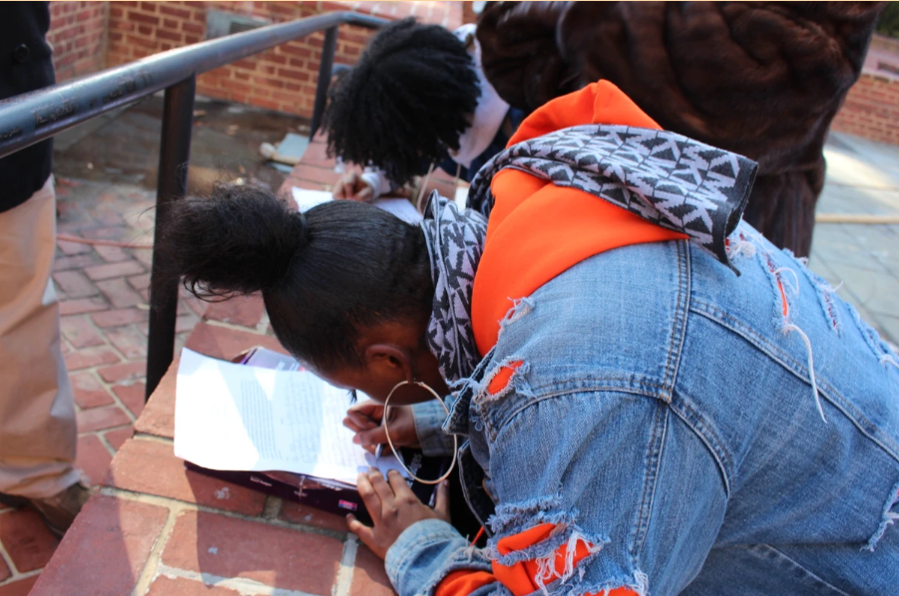
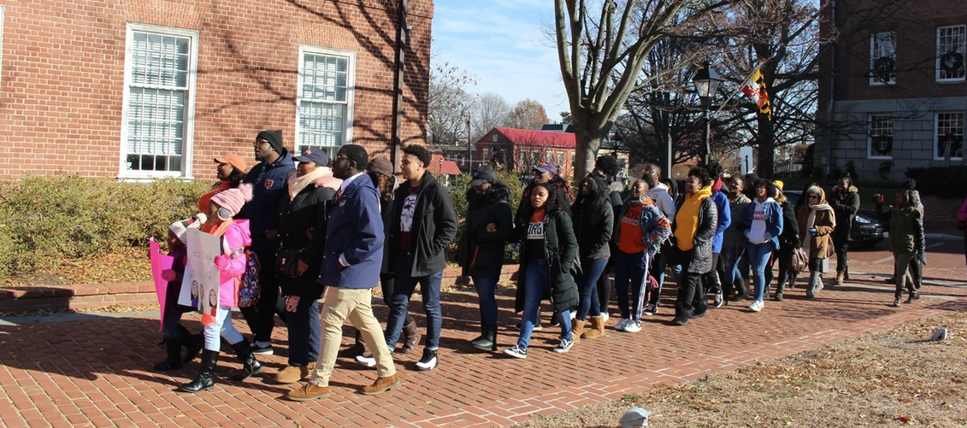
Notes:
College students and community members packed out bills hearings and testified in favor of the lawsuit
Students and community members wrote personal letters to senators, delegates and the governor. (Over 1,000 letters were sent via mail and email)
Multiple rallies were hosted on college campuses and in Annapolis

Slide 27


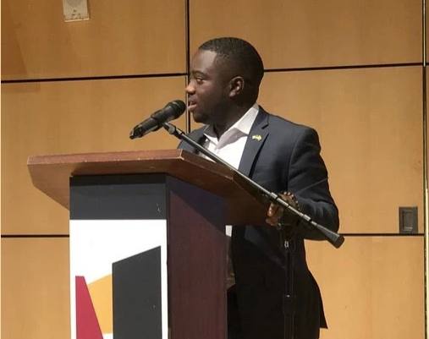
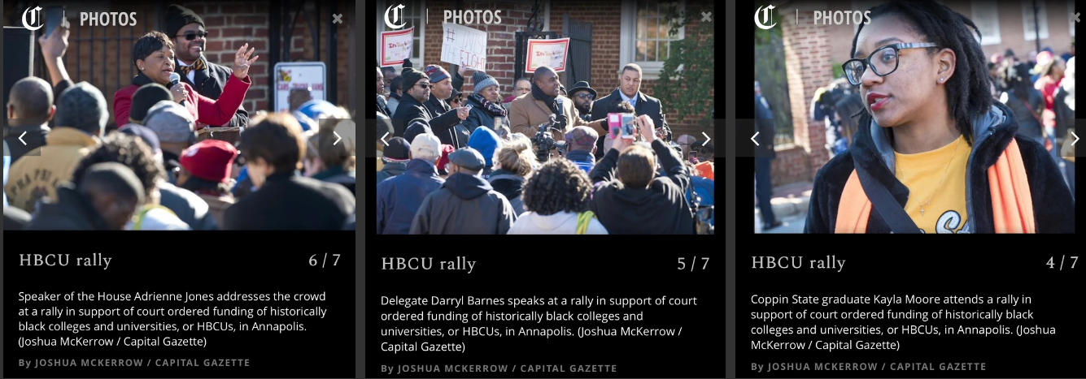
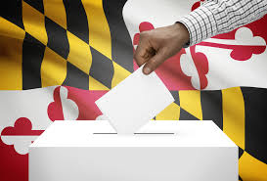
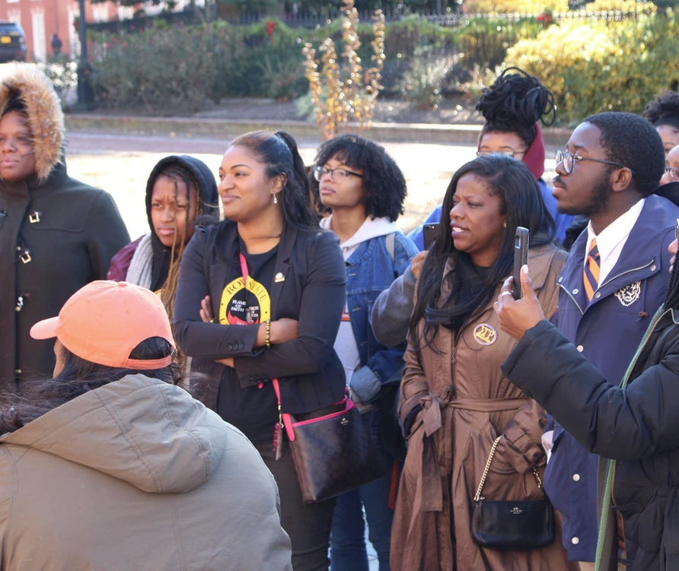
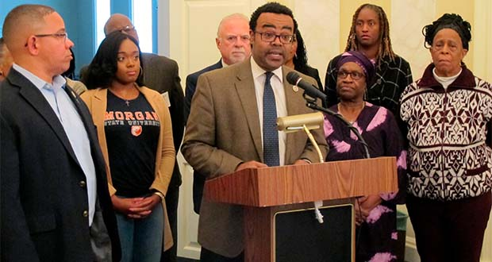
Notes:
College students and community activists met with local leaders to get them to not only support the campaign but vowed to talk to their colleagues and get them to vote accordingly
Speaker of the House Adrienne Jones and Senator Charles Sydnor worked with Republican colleagues to bring them onboard

Slide 28

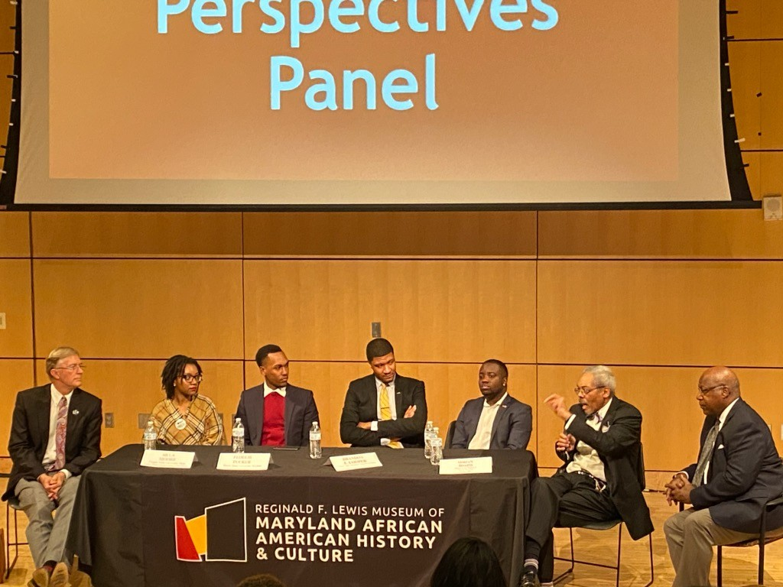
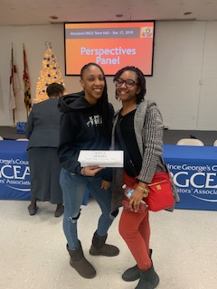

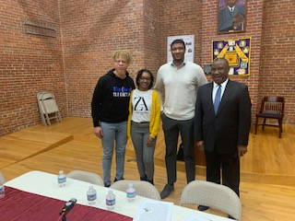
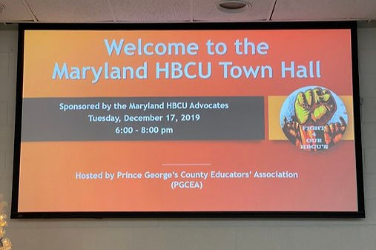
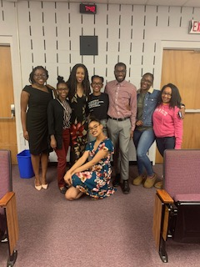

Notes:
It was important to get as many organizations to support this lawsuit. Starting on campuses we hosted townhalls for the Divine 9 to educate and move them to action.
We hosted over 30 informational sessions across the state of Maryland to educate students and community members.

Slide 29
Power to give you what you want​
What influences your target​
​
Letter writing​
Testifying on the bill​
Rallies​
Lobbying​
Hearing from constituents​
Senator
Delegates
Governor
Most influence over your decision maker ​
​
Who you want to support your campaign​
​Other legislators ​
People they see often in their community​
Community leaders
Universities​
Alumni​
Businesses who benefit from HBCU's​
Community leaders​
Notes:
Kayla – do one thing at a time instead

Slide 30
Power Mapping (30 min)
In your breakout rooms you will complete the following:
Complete the Power Mapping Activity on Chart paper
Be sure to answer each question pertaining to your campaign
Questions are on your chart paper
Notes:
Kayla

Slide 31
WHO GOT THE POWER
WE GOT THE POWER
WHO GOT THE POWER
WE GOT THE POWER
Zone 1 Organizing Institute | July 9-12, 2024 | Annapolis, MD
Notes:
Both

