Slide 1
Campaign Lab:
Strategy Circle Session
November, 2025

Slide 2

Strategy Circle Session at HBCU Summit
By attending this summit, you confirm that you are either an NEA affiliate staff person or NEA member in good standing. The information you receive here is only for your use in your capacity as an NEA affiliate staff person or NEA member.
This presentation and its contents are confidential and may not be further distributed or passed on to any other person or published or reproduced, in whole or in part, by any medium or in any form, for any purpose unless written consent has been provided by Ellen Holmes. Audio/video recording, copying of slides, and the use of AI note-taking tools are prohibited without the written consent from Kyle Serrette. Violation of these terms may result in legal action.

Slide 3
NEA Standards of Conduct
NEA has adopted a Standard of Conduct Policy to ensure that all of our gatherings are welcoming to and free from discriminatory, harassing, or otherwise unacceptable behavior. Discrimination or harassment based on race, color, ethnicity, religion, sex, age, national origin, sexual orientation, disability, gender identity, or expression, or any other characteristic protected by law will not be tolerated. If you have experience any discriminatory or harassing behavior, please report the incident. Thank you for your commitment to ensuring a positive event for all.

Slide 4

Key OUtcomes
Participants will understand: Participants will understand the purpose of NEA’s Campaign Lab Participants will understand how to apply to join NEA’s Campaign Lab

Slide 5

What does a Loving Community or School look like?

Slide 6
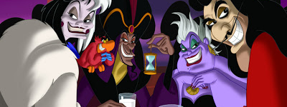
What or Who is preventing you from achieving this dream?
Notes:
Advocates, Mobilizers, Organizers Scenario

Slide 7
What do we focus on at NEA?

Slide 8
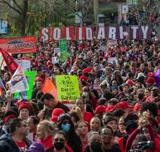
Strength and Growth to Win Our Wildest Dreams
Growth is a focus on building the base of members, leaders, structures, and partners.
Strength is the ability to use power to win.

Slide 9
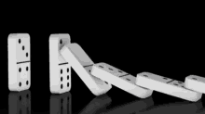
Base Building Matters - Growth
We have to recruit 250,000 new members a year just to maintain current levels of union density. (Necessary)
Member Recruitment is a year round, critical strategy.
Maintenance does not build. (Not Sufficient)

Slide 10
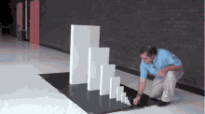
Exponential Base Building Matters More
With high member density, we can claim the wins we dream about AND control the outcomes of those wins across time.

Slide 11

Winning Matters Most - Strength

Slide 12
And this is the focus of the Campaign Lab.
An intentionally created and networked leadership structure focused on building and using power to win within and across issue campaigns.

Slide 13
Mentor Coach
Mostly staff-based
Monthly meetings with assigned Campaign Coaches and whole network
Campaign Coach
Holds coaching calls, documents progress
Team Lead
Coordinates team operations, meetings, and roles
Support Campaign Coaches problem solving and thought partnership
Coaches 1–2 local teams
Engages in peer problem solving and coaching
Upholds team norms and shared commitments
Focus on output, capacity building, and leadership development
Clarifies team membership and purpose
Team Members
Implements the plan
Assists in developing added structures
Attends regular meetings
Critical in building the base, increasing engagement, and gathering information

Slide 14
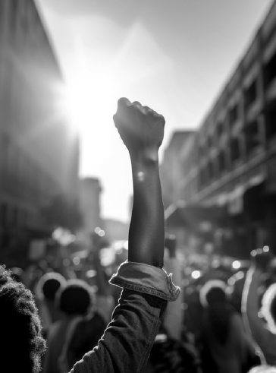
Who else wants to achieve your dream?
What actions could you begin to take?

Slide 15

Information and Application

Slide 16
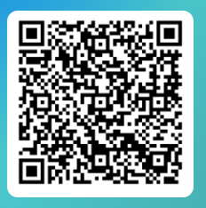
Apply to be a Campaign Lab Coach
Possess an organizing and leadership mindset
Engages in peer problem solving and coaching
Campaign Coach
Holds coaching calls, with team 2 times a month
Coaches 1–2 local teams
Attends campaign coach training
Works with a mentor coach

Slide 17
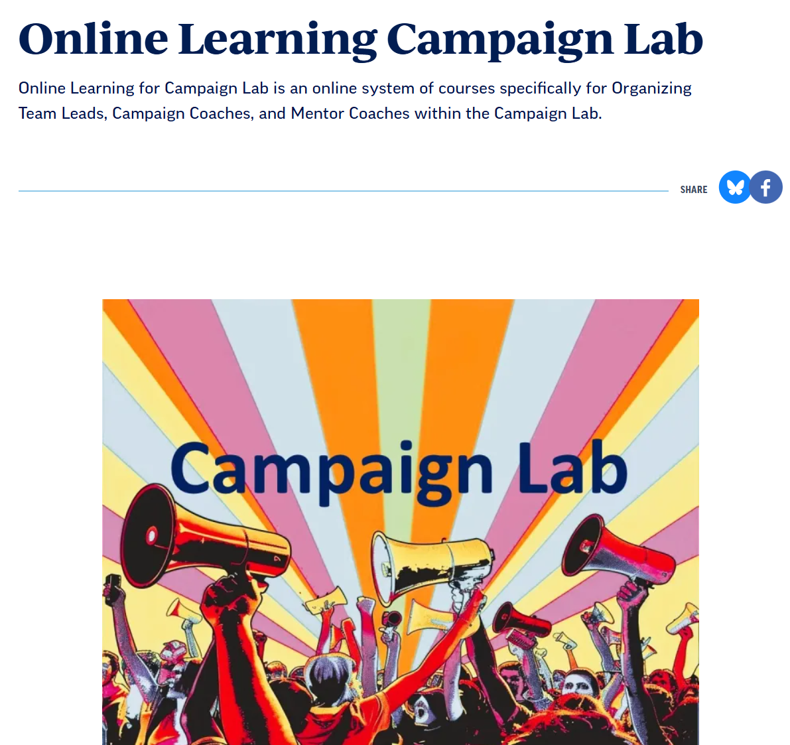
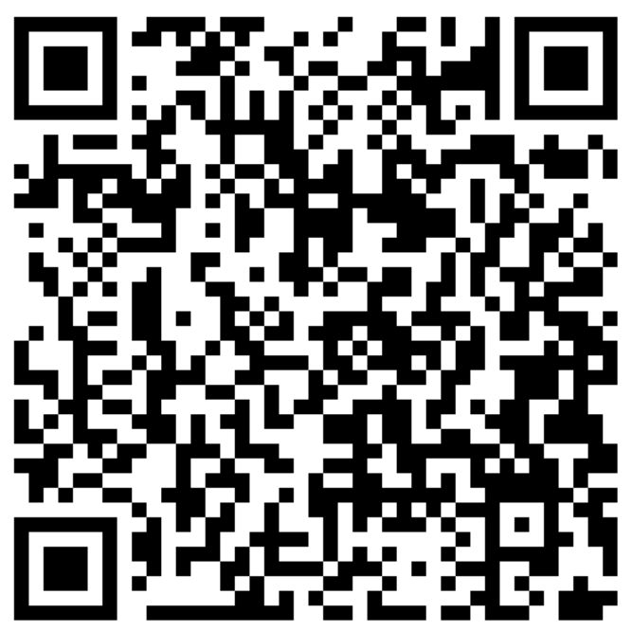
Online Learning Opportunities

Slide 18
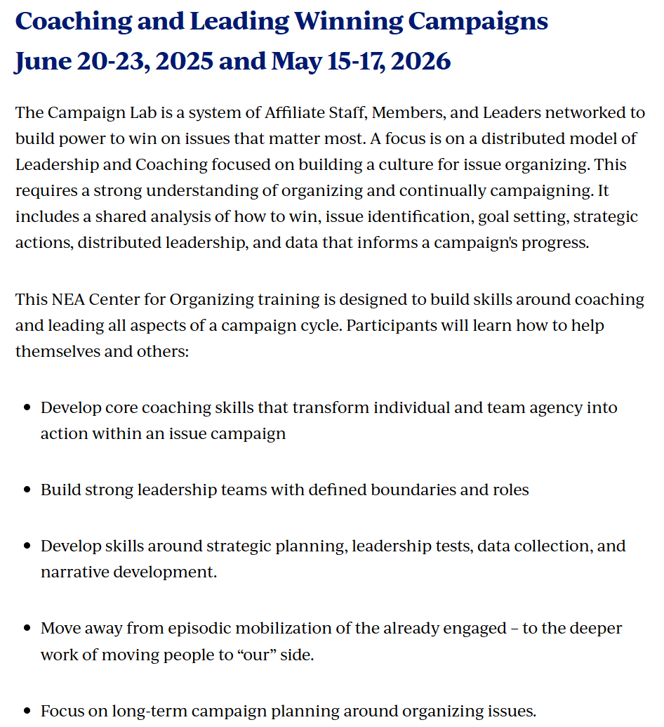
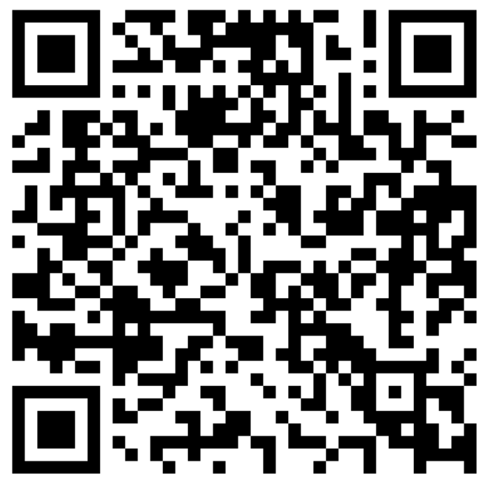


In Person Opportunities

Slide 19

Key
Points
Organizing, not only recruiting and program, build power.
The power to win is only built through people with a shared vision, making public commitments to act, to risk their collective resources, for the big meaningful changes they want.
Campaigns ALSO build membership and density – the kind of super majority we need to win
The kind of power we need depends on a distributed and interdependent leadership structure.

Slide 20
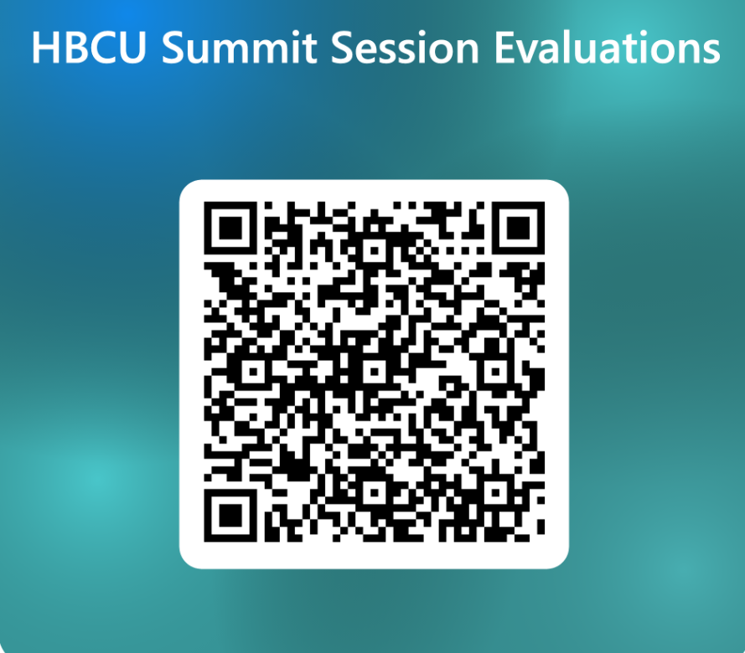
Questions?
What is becoming clearer?
What remains murky?

Slide 22
NEA has adopted a Standard of Conduct Policy to ensure that all of our gatherings are welcoming to and free from discriminatory, harassing, or otherwise unacceptable behavior. Discrimination or harassment based on race, color, ethnicity, religion, sex, age, national origin, sexual orientation, disability, gender identity, or expression, or any other characteristic protected by law will not be tolerated. If you have experience any discriminatory or harassing behavior, please report the incident. Thank you for your commitment to ensuring a positive event for all.

Slide 23
By attending this summit, you confirm that you are either an NEA affiliate staff person or NEA member in good standing. The information you receive here is only for your use in your capacity as an NEA affiliate staff person or NEA member.
This presentation and its contents are confidential and may not be further distributed or passed on to any other person or published or reproduced, in whole or in part, by any medium or in any form, for any purpose unless written consent has been provided by Albert Jones. Audio/video recording, copying of slides, and the use of AI note-taking tools are prohibited without written consent. Violation of these terms may result in legal action.

Slide 24
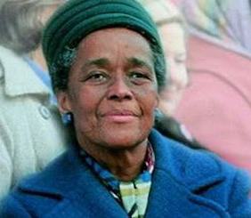
“Strong people don't need strong leaders.”
― Ella Baker

Slide 25
Turn to someone near you, ideally someone you didn’t come with, and share:
What moment, idea, or story from today moved you — and why?
It could be a word, an image, a speaker’s message, a conversation that challenged you, or something that affirmed your “why”.

Slide 26
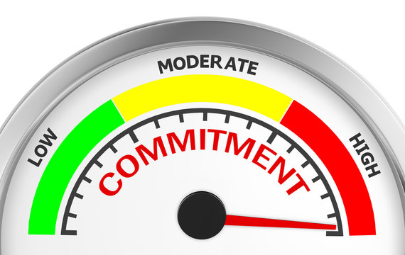
What will you carry into tomorrow?

Slide 27
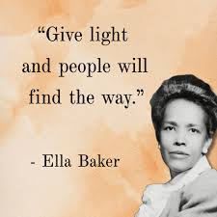
“Who builds this movement?”
“We do!”
“Who leads this movement?”
“We do!”
“Who is this movement?”
“We are!”

Slide 28
