Slide 1
HBCU and MSI Skills to Win
Centering Equity

Slide 2
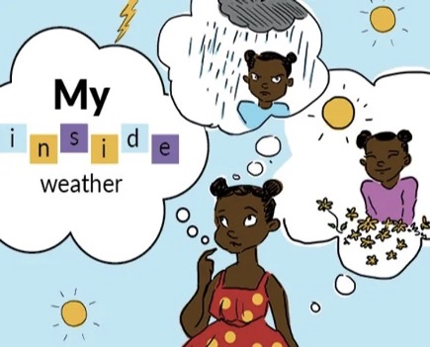
Drop in the Chat
Name
What University are you representing?
Describe your mood as if were weather
What area of education do you currently or plan to work in?

Slide 3
HBCU and MSI Skills to Win
By attending this training, you confirm that you are either an NEA affiliate staff person or NEA member in good standing. The information you receive here is only for your use in your capacity as an NEA affiliate staff person or NEA member.
This presentation and its contents are confidential and may not be further distributed or passed on to any other person or published or reproduced, in whole or in part, by any medium or in any form, for any purpose unless written consent has been provided by Ellen Holmes. Audio/video recording, copying of slides, and the use of AI note-taking tools are prohibited without the written consent from Kyle Serrette. Violation of these terms may result in legal action.

Slide 4
NEA Standards of Conduct
NEA has adopted a Standard of Conduct Policy to ensure that all of our gatherings are welcoming to and free from discriminatory, harassing, or otherwise unacceptable behavior. Discrimination or harassment based on race, color, ethnicity, religion, sex, age, national origin, sexual orientation, disability, gender identity, or expression, or any other characteristic protected by law will not be tolerated. If you have experience any discriminatory or harassing behavior, please report the incident by emailing Ron "Duff" Martin (rmartin@nea.org) and Gladys Marquez (gmarquez@nea.org). Thank you for your commitment to ensuring a positive event for all.

Slide 5
Honoring This Space
We begin by acknowledging that through a history of colonization and brutality, we are currently on the traditional lands stewarded by generations of indigenous people.
We honor these indigenous people, all elders, past, present, and emerging. We are called to learn and share these learnings about this tribal history, culture, and contributions that have been suppressed in the telling of the story of what we now call the United States of America.

Slide 6
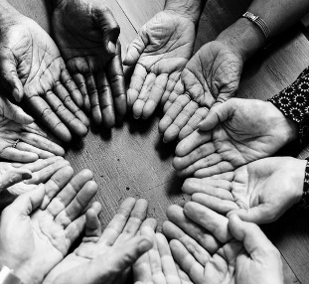
Our Invitation to YOU
Be present in this space
Listen with curiosity
Take care of yourself
Be willing to engage in this work with yourself and others
Leave with a new perspective

Slide 7
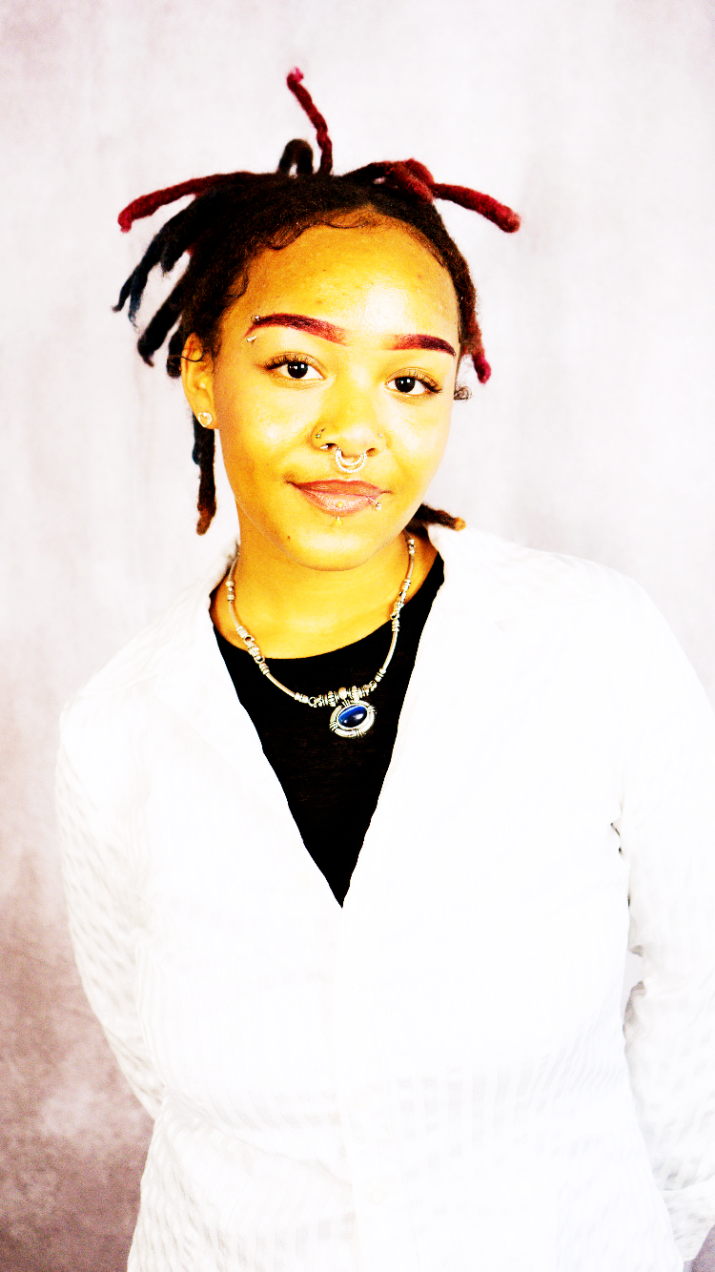
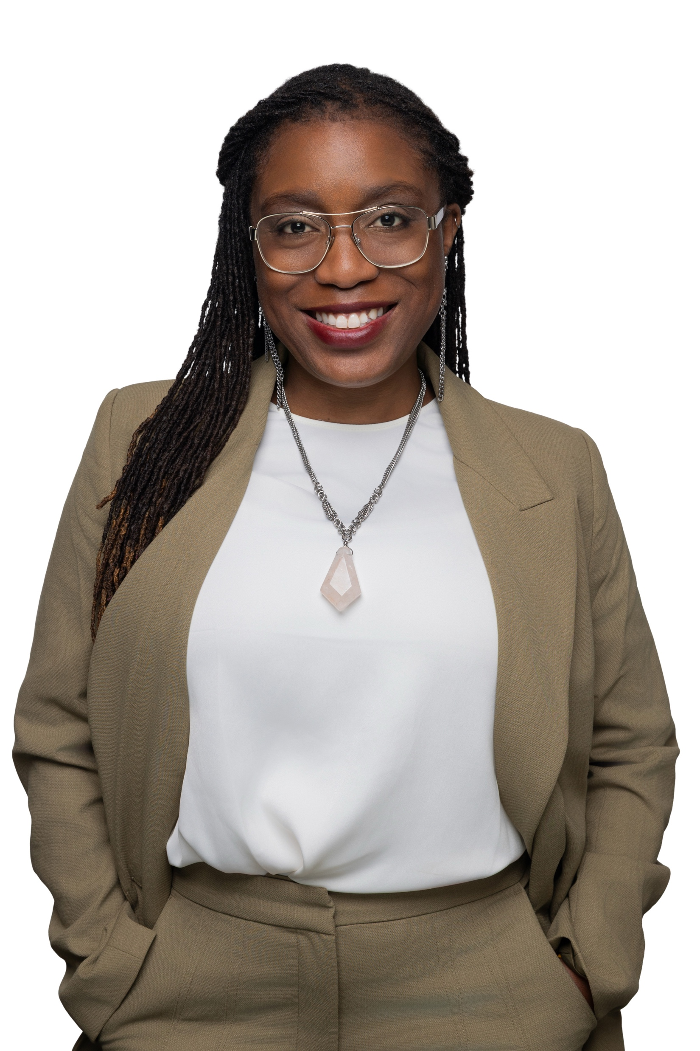
Meet Your Facilitators
Siala Ene II
(she/her/hers)
Central State University
Dr. Taraja Shephard Allen
(she/her/hers)
OEA Membership Consultant

Slide 8
Session objectives:
Today we will learn about issues of racial, social, and economic injustice within the education system and how it negatively impacts already underserved or marginalized populations.
We will discuss the Equity Lens Framework and how to use this assessment tool for decision making around programs, policies, and practices to ensure all students, faculty and staff have equal opportunities for success.
Notes:
Inner purple circle: students’ social emotional skills, mindset and academic learning
Green circle: classroom factors: adult beliefs, mindsets and behaviors
Orange circle: school/district system and policies
Outer teal circle: societal context
This keeps in mind the social, racial and economic injustices that are apart of the greater society and how those issues affect and show up inside the school in classrooms and other spaces like a bus or cafeteria Adapted from: https://edtrust.org/social-emotional-and-academic-development-through-an-equity-lens/

Slide 9
Equity: Clear Definitions
Fair Treatment: Ensuring all individuals are treated justly and without discrimination, while respecting their unique differences.
Needs-Based Support: Providing each person with what they need to succeed, considering their circumstances and rights.
Opportunity for All: Removing barriers that limit full participation and development.
Balanced Decisions: Distributing resources and benefits fairly, guided by social justice principles.

Slide 10
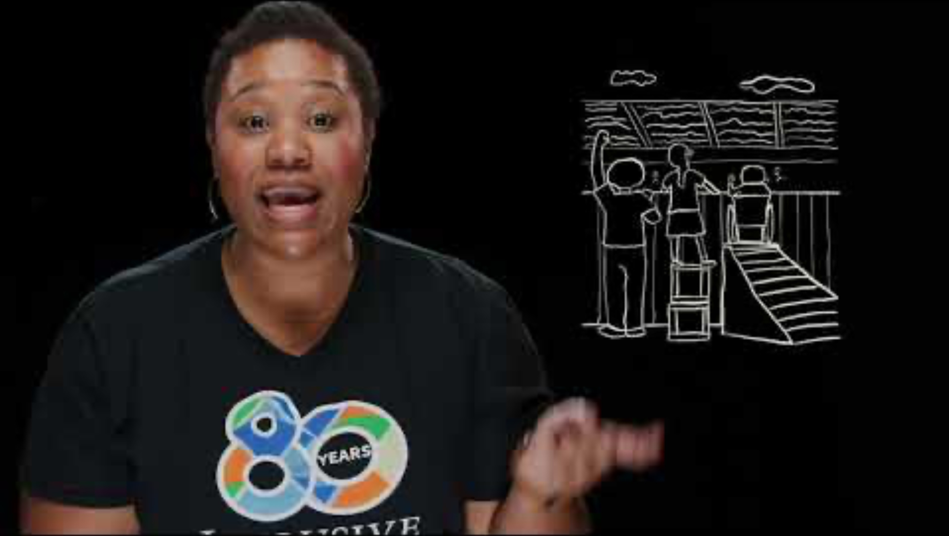

Slide 11
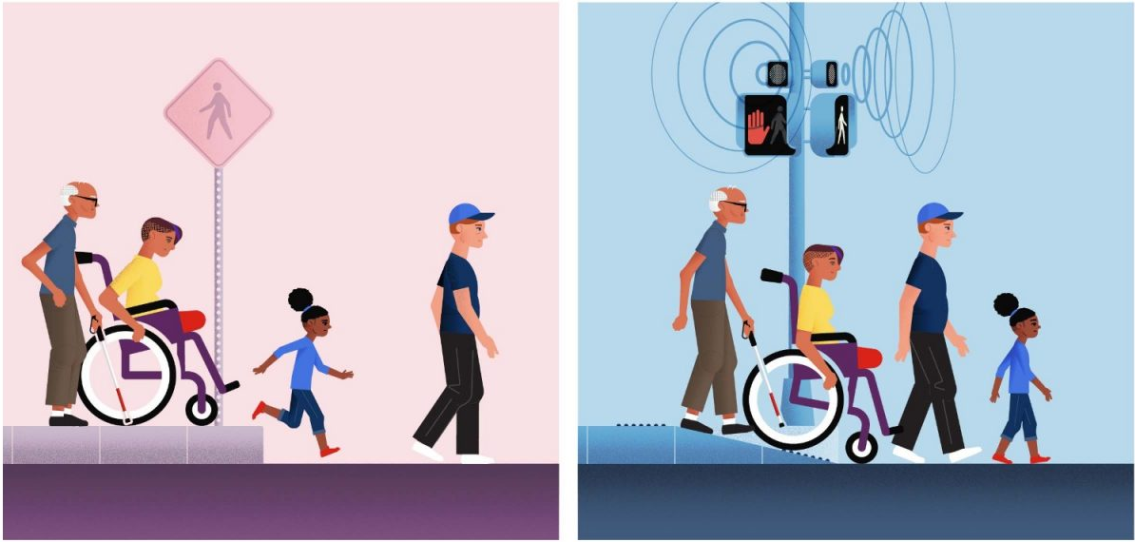
What Do You Notice?

Slide 12
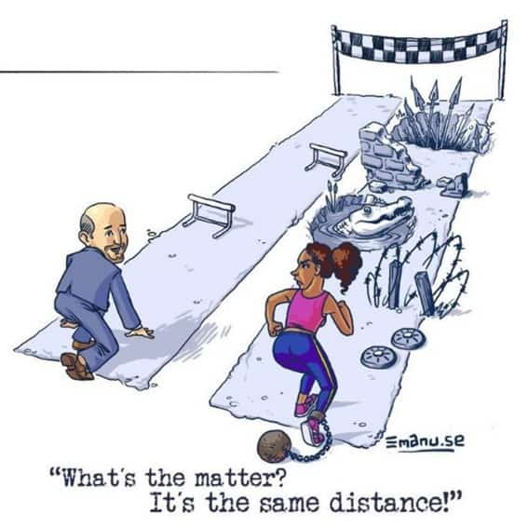

Slide 13
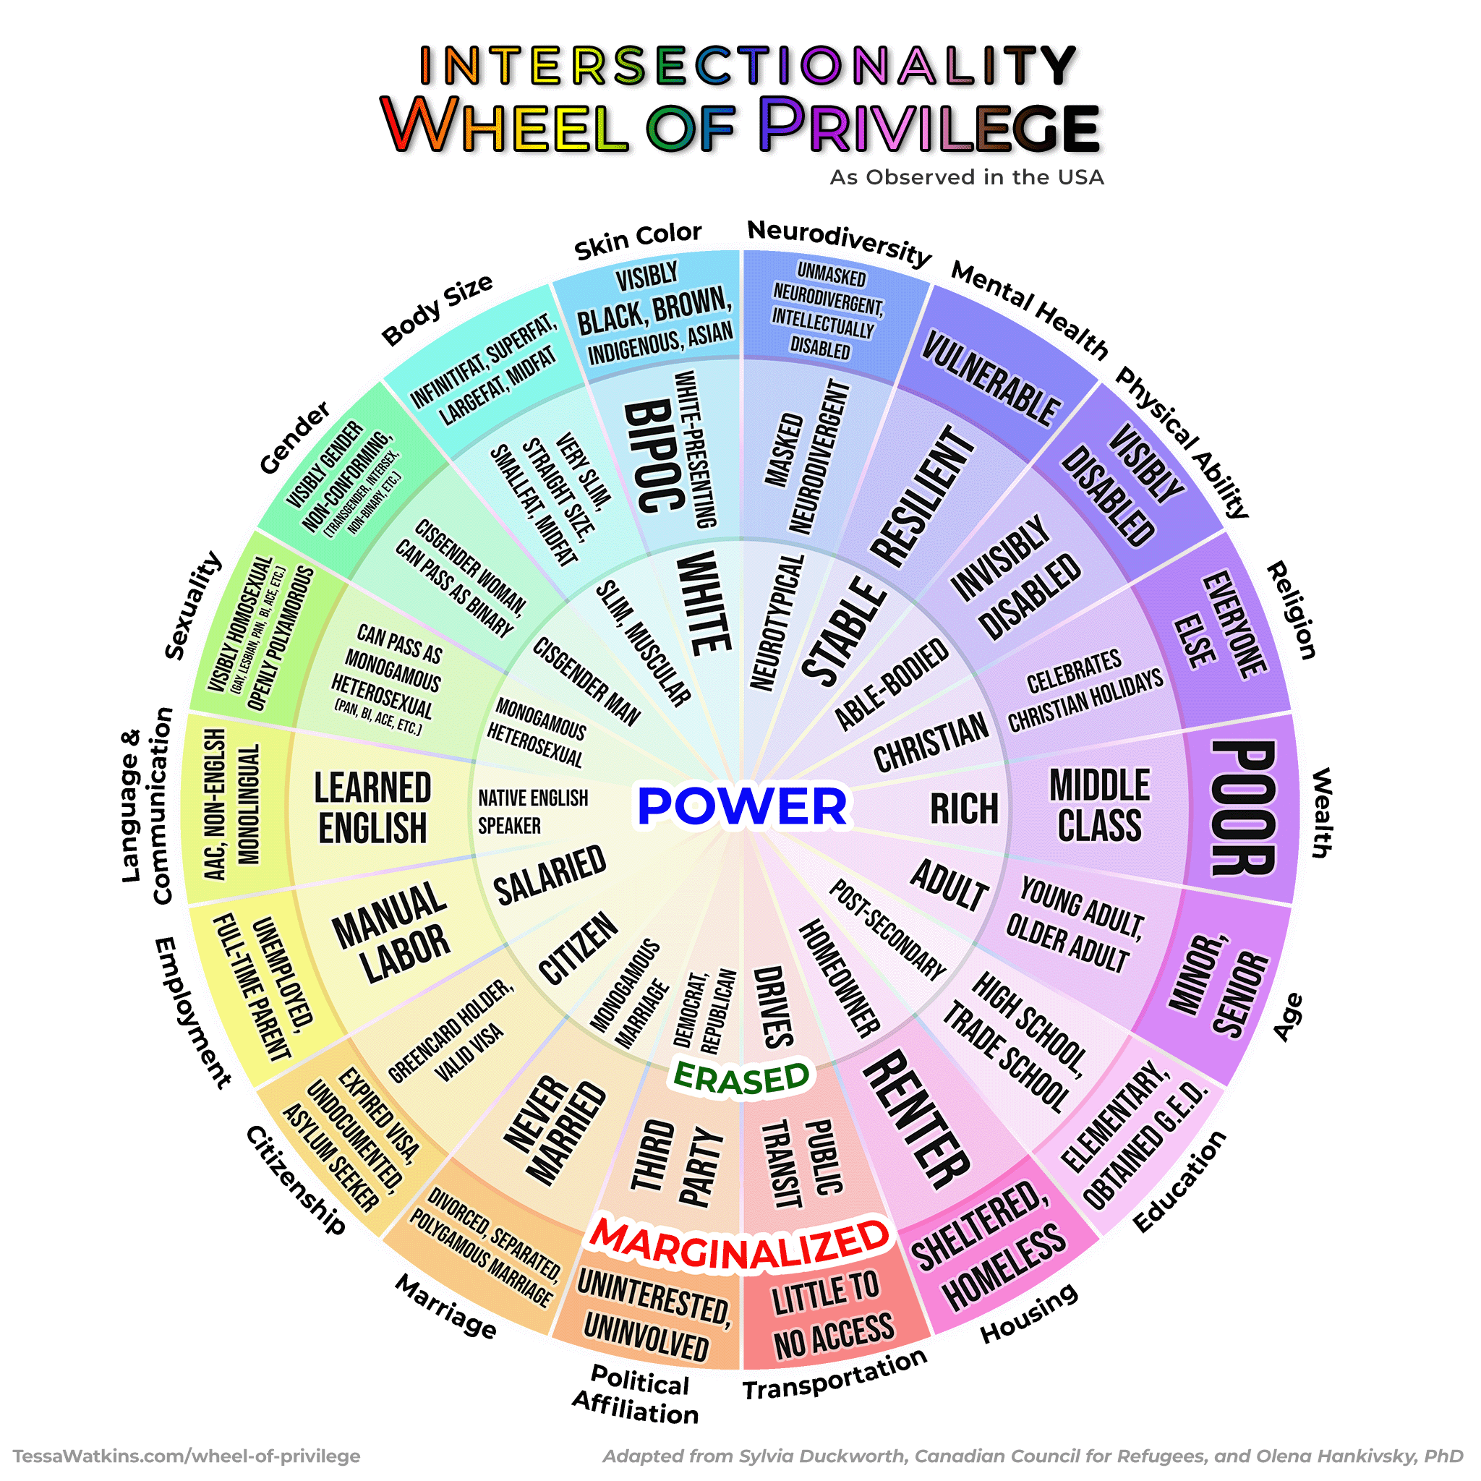
Who are Impacted by Systems of Inequity?
The Ring of Power
People who exist in this ring the are the most powerful and usually hold the most privileged in any room ( their voice, ideas, and opinions matter).
Notes:
It is important to see all the different pieces of intersectionality when thinking about equity. If we are only looking at one or two pieces on the wheel then you still leaving inequities unaddressed. Focus on class to help address inequities in school but that still leaves other inequities that disproportionately affect other groups i.e. students of color, LGBTQIA students, students with a disability . This is where allyship is important. If you’re a privileged and/or powerful person and you’re in the room with someone that isn’t, your job as an ally is to make space for them, amplify their voice, and listen. If they aren’t in the conversation, that is the only time when it is appropriate for you to speak on their behalf. Also, ask yourself why they’re not part of the discussion and look for ways to invite them to it.
https://just1voice.com/advocacy/wheel-of-privilege/

Slide 14
Who are Impacted by Systems of Inequity?
Erased:
People who exist in this ring the are often the forgotten ring or have their identities erased or are marginalized in unique ways.
Some these people can “pass” and “choose” to be marginalized or privileged when it benefits them.
Notes:
It is important to see all the different pieces of intersectionality when thinking about equity. If we are only looking at one or two pieces on the wheel then you still leaving inequities unaddressed. Focus on class to help address inequities in school but that still leaves other inequities that disproportionately affect other groups i.e. students of color, LGBTQIA students, students with a disability . This is where allyship is important. If you’re a privileged and/or powerful person and you’re in the room with someone that isn’t, your job as an ally is to make space for them, amplify their voice, and listen. If they aren’t in the conversation, that is the only time when it is appropriate for you to speak on their behalf. Also, ask yourself why they’re not part of the discussion and look for ways to invite them to it.
https://just1voice.com/advocacy/wheel-of-privilege/

Slide 15
Who are Impacted by Systems of Inequity?
Marginalized:
People who exist in this ring experience more overt discrimination and are most impacted by systemic discrimination.
Underrepresented in media unless they serve negative purpose:
the subject of jokes in comedy
villains in media
behavior or appearance is criminalized
Notes:
It is important to see all the different pieces of intersectionality when thinking about equity. If we are only looking at one or two pieces on the wheel then you still leaving inequities unaddressed. Focus on class to help address inequities in school but that still leaves other inequities that disproportionately affect other groups i.e. students of color, LGBTQIA students, students with a disability . This is where allyship is important. If you’re a privileged and/or powerful person and you’re in the room with someone that isn’t, your job as an ally is to make space for them, amplify their voice, and listen. If they aren’t in the conversation, that is the only time when it is appropriate for you to speak on their behalf. Also, ask yourself why they’re not part of the discussion and look for ways to invite them to it.
https://just1voice.com/advocacy/wheel-of-privilege/

Slide 16
How do Your Identities on show up on Campus?
“When you look around your campus, do you feel like your identity and experiences are represented? Where do you notice that most—and where least?”
“Can you share an example of a time when you felt truly included and connected on campus? What made that moment stand out?”
“If you could change one policy, practice, or tradition to make your campus more equitable and welcoming, what would it be—and why?”
Notes:
What spaces feel most welcoming?
- Are there places where you feel invisible?
Who helped create that experience?
- What could make that happen more often?
What would that change look like in action?
- Who needs to be involved to make it happen?

Slide 17
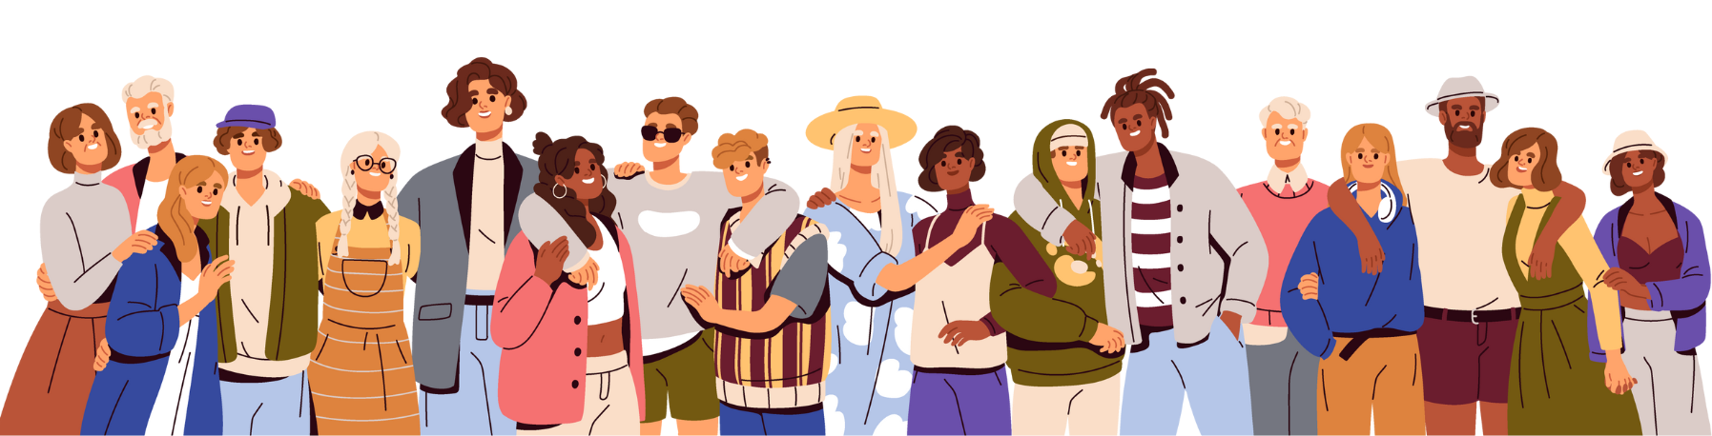
Who are the people that make up your school community?

Slide 18

Breakout Room Equity Questions
Representation: Which identities are represented by the people on your campus?
→ Consider race, ethnicity, gender, sexual orientation, ability, socioeconomic status, language, religion, and other dimensions of identity.
Inclusion & Connection: How are various identities being included and connected in different settings on your campus?
→ Think about classrooms, extracurricular activities, leadership roles, and informal spaces.
Policies & Practices: What policies and practices are in place to support those identities?
→ Reflect on hiring practices, curriculum design, accessibility measures, anti-discrimination policies, and cultural celebrations.
Gaps & Opportunities: What is missing?
→ Identify areas where representation, inclusion, or support is lacking.

Slide 19
Share out
What are the experiences on your campus?

Slide 20
Centering Equity

Slide 21
Race, Class, and Gender Justice…
Many of us value justice and equity, so we must apply a Race, Class, and Gender Justice lens to our work
This lens involves both personal and institutional commitment to advancing equity
It means proactively eliminating systemic barriers and setting clear, measurable equity goals
Use it to develop equity-focused campaigns and anticipate harm across race, class, and gender lines
It’s more than avoiding discrimination, it’s about creating systems that sustain equity

Slide 22

Building Equity Centered Power: Leadership Structures

Slide 23
Building Equity Centered Power: Leadership Structures
“I’m The Leader”
→ Power is concentrated. Marginalized voices are often excluded.
“We’re All Leaders”
→ Inclusion without coordination can lead to inequity and fragmentation.
Snowflake / Interdependent Leadership
→ Power is distributed, accountability is mutual, and equity is embedded through shared responsibility and intentional inclusion.

Slide 24
Building Equity Centered Power: Leadership Structures
What is your current union structure?
  Representation: Who is at the center of decision-making?
  Access: Are resources and opportunities shared fairly?
  Voice: Are those most affected by decisions shaping them?
  Responsibility: Is accountability collective, not hierarchical?

Slide 25
Building Equity Centered Power: Campaigns vs Programs
Programs
Build Presence
Episodic
Member Recruitment
Committee/Program Leaders
Low Risk
Often Staff Led
Power in Policy
Campaigns
Public Action and Demands
Strategic and Ongoing
Continues to Add
  Base – Mobilizers - Leaders
  Allies – Partners - Coalitions
  Requires Risk
  Supported by Staff
  Leaders Build and Use Power

Slide 26
Building Power: Campaigns vs Programs
An issue campaign is the process through which the people organize around leaders and structures to use their resources in accomplishing goals that achieve the change they need and want. It is public. It involves risk. It results in the story being about the workers.
- Marshall Ganz

Slide 27
Equity Centered Framework

Slide 28
Equity Centered Framework: Intentional Questions
Causes: What institutions, policies, or practices are causing or contributing to the inequities? What social norms, popular myths, or cultural biases may be contributing?
History: How did things get this way and are things worsening or improving?
Problems: What inequities are you noticing or experiencing? What are the impacts on different racial groups? Who benefits most and who is hurt most?

Slide 29
Equity Centered Framework: Intentional Questions
Solutions: What solutions could address the root causes and eliminate the inequities? How would different racial groups be impacted by the proposed solutions?
Strategies: What strategies and actions could be used to advance the solutions?
Leadership: Who are the stakeholders most affected by the inequities? Are they involved in naming the issues and solutions? What kinds of active leadership roles could they take to advance the proposed solution?
Additional Equity Tools: Who is most directly impacted? Who has been left out? How can they be directly engaged? How do our demands center race, class, and gender justice?

Slide 30
What can you do to center equity in your local, chapter, campus or community?
Brainstorm ideas!

Slide 31
Share out
What are your ideas, goals, and next steps?
What resources do you need?

Slide 32
5 Ways to Center Equity in Your Classroom or Campus
Diversify Books & Materials- Include texts and resources that reflect multiple cultures, identities, and perspectives.
Highlight Cultural Celebrations- Invite students to share traditions and holidays through classroom activities or campus events.
Create Story-Sharing Opportunities- Use discussion circles, digital storytelling, or art projects for students to share personal experiences.
Host Conversation Hours- Offer language practice sessions or cultural exchange hours to support multilingual learners and foster inclusion.
Organize Resource Fairs & Equity Events- Connect students with campus and community resources—such as mental health, financial aid, and cultural organizations.

Slide 33

Key Ideas:
Intentional equity centered campaigns build power.
Centering race, class, and gender justice in our campaigns increases the number of people engaged, the number of leaders involved, and the amount of resources we have to win the change we want.
Power is only built through people with a shared vision, making public commitments to act, to risk their collective resources, for the meaningful change they want

Slide 34
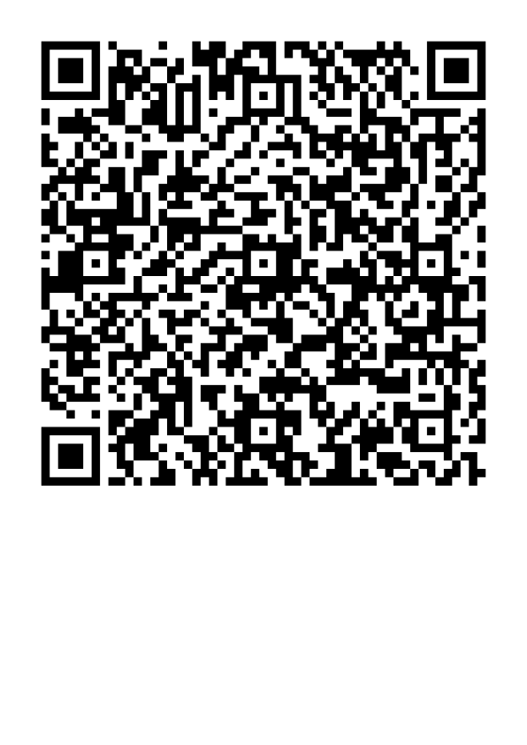
Organizing to Win on HBCU Campuses
This learning event was designed to provide a foundational experience of the key concepts and methods needed to organize on HBCU campuses.
The purpose of the six-session series is to both model a way to begin this work and build an urgency within you to continue this work.
Please let us know how we did.

Slide 35
Questions? Let’s Connect!
Dr. Taraja Shephard Allen
OEA Membership Consultant
Shephardallent@ohea.org

