Slide 1

Organizing to Win on HBCU and MSI Campuses
Spectrum of Allies

Slide 2
NEA Standards of Conduct
NEA has adopted a Standard of Conduct Policy to ensure that all of our gatherings are welcoming to and free from discriminatory, harassing, or otherwise unacceptable behavior. Discrimination or harassment based on race, color, ethnicity, religion, sex, age, national origin, sexual orientation, disability, gender identity, or expression, or any other characteristic protected by law will not be tolerated. If you experience any discriminatory or harassing behavior, please report the incident by emailing Hannah St. Clair (hstclair@nea.org). Thank you for your commitment to ensuring a positive event for all.

Slide 3

Organizing to Win on HBCU and MSI Campuses
By attending this training, you confirm that you are a NEA affiliate staff member. The information you receive here is only for your use in your capacity as an NEA affiliate staff member.
This training and its contents are confidential and may not be further distributed or passed on to any other person or published or reproduced, in whole or in part, by any medium or in any form, for any purpose. Audio/video recording, copying of slides, and the use of AI note-taking tools are prohibited without the written consent from Ellen Holmes. Violation of these terms may result in legal action.

Slide 4

Honoring This Space
We acknowledge the long history of systemic racism, oppression, and genocide that has shaped the land on which we stand today. This land was once home to Indigenous peoples who lived in harmony with their environment for millennia. Their sacred sites, cultural practices, cultural practices, and deep connections to the land were violently disrupted by colonial policies that sought to erase their existence. The forced removal, displacement, and dispossession of Indigenous communities from their ancestral lands continue to have lasting impacts on their social, cultural, and economic well-being.
We also acknowledge the trauma inflicted upon those who were trafficked, forced into servitude, or made undocumented through colonial and federal practices. This includes Indigenous peoples, enslaved Africans, and other marginalized groups who were brought to this land against their will, enduring systemic violence and exploitation.
We recognize that the United States was built on the backs of enslaved Black people, whose labor and sacrifices were exploited to build the foundations of this nation. The contributions of enslaved Black people, along with the struggles and perseverance of other immigrant communities throughout history, have been essential to the development of this country. Yet, their labor and humanity were often dehumanized, and their rights stripped away, perpetuating cycles of inequality and injustice that persist today.
We stand in solidarity with the ongoing efforts of Indigenous peoples, Black communities, and all marginalized groups fighting for justice, reparations, and the healing of the wounds inflicted by these histories of colonization, enslavement, and systemic oppression. We are committed to learning, unlearning, and working towards a more just, equitable, and inclusive future.
Notes:
Gina

Slide 5

Community Agreements
Awareness and Self-Knowledge
Listen for Understanding
Be Gracious
Stay Engaged
Be Open and Suspend Judgment
Say “I”- tell your truth
Lean into Discomfort
Reach for Empathy
Expect non- Resolution and non-Closure

Slide 6
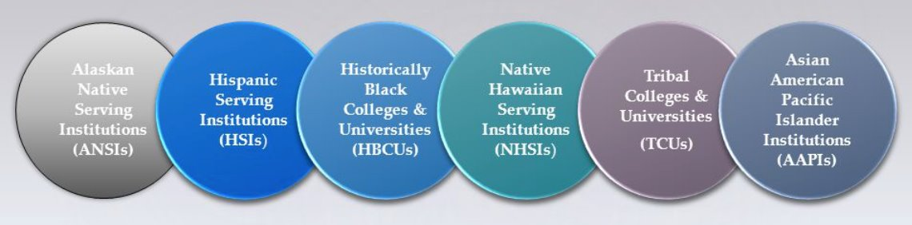
Campaign Plan – Spectrum of Allies

Slide 7
Keep it in mind…
Despite structural oppression, non-PWIs have been some of the greatest success stories of our nation, and some of the most under-represented by our unions.
They succeed because:
    Provide internal community support
    Offer unparalleled representation and mentorship
    Close relationships
    Focused on leadership beyond school
  Successful organizing campaigns need to match their strengths

Slide 8
Common Definitions
Organizing is comprised of the practices of identifying leaders and coordinating them into leadership teams; building community and commitment around common goals; building power from the resources of that community; using that power strategically to make concrete change in the world
Power is:
  The ability to act
  The possession of control, authority, or influence over others preventing or causing action
A campaign is a series of steps that help people focus on a common issue, identify a solution, and build pressure on the person with the power to solve the problem.
Tactics are the concrete actions people, often workers, take to build collective power and pressure decision-makers, ranging from lower-risk actions like surveys and coordinated emails to more assertive actions such as work stoppages, slowdowns, and public demonstrations.

Slide 9

Spectrum of Allies

Slide 10

Spectrum of Allies
  Active allies: people who agree with you & are organizing alongside you
  Passive allies: people who agree but aren't doing anything about it (yet!)
  Neutrals: people who aren't sure, or are unengaged (they might just not know about you yet)
  Passive opponents: people who disagree, but aren't trying to stop you
  Active opponents: people who have done something to prevent you from reaching your goal

Slide 11
Focusing your tactics matters
Only the Opposition – cynicism
Only the Active Allies – stagnation
Generalizations about Slices – missed opportunities
DO FOCUS ON THE PASSIVE ALLIES
  These are folks who know or care about what you’re up to, but aren’t doing anything about it! Give them a chance to participate and build power with you.
THE GOOD NEWS
  It is only necessary to move some or all of the pie wedges one step in your direction. If we shift each wedge one step, we are likely to win, even if the hardliners on the opponent’s side don’t budge.

Slide 12
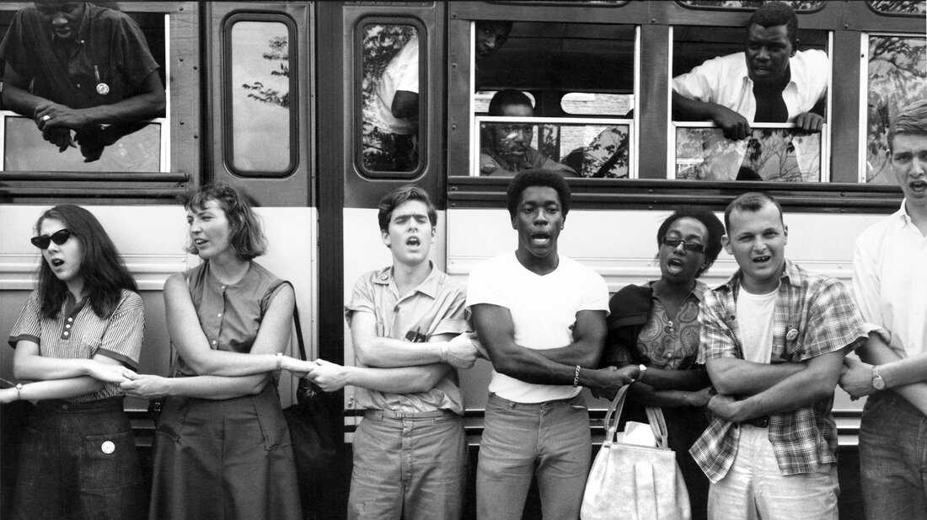
An example from history – Freedom Summer

Slide 13

Breakout Sessions
Which group should a campaign spend the least amount of time trying to move? Why?
Which group is the most dangerous to a campaign if they don’t move? Why?
Which tactics, messaging, or actions could be best suited for engaging each group on the spectrum?

Slide 14
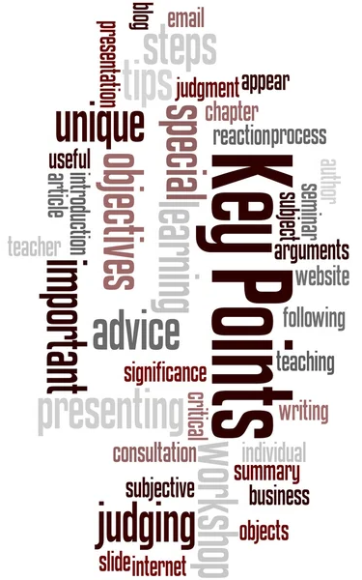
It is only necessary to move some or all of the pie wedges one step in your direction.
If we shift each wedge one step, we are likely to win, even if the hardliners on the opponent’s side don’t budge.

Slide 15
See You in the Future
Before Session 4, January 27, you will need to access and download the file found in this Module called " Theory of Change Worksheet." It has several pages that you will use during this live session. There are also two more detailed resources about Theory of Change, Strategic Planning, and Tactics. These are in the Participant Resources Module and their titles are "Creating Shared Strategy" and "Strategy Charts and Power Maps."
**Assignments for Sessions 5 and 6 will be updated at a later time.
Zoom Links for All Sessions
Strategy and Tactics January 27 https://nea-org.zoom.us/meeting/register/k9uzm9VDSnyZdi54C6nruw
People Power February 4 https://nea-org.zoom.us/meeting/register/nu8k9ubjSFWVmAQAudjdjA
Plans into Actions February 10https://nea-org.zoom.us/meeting/register/CjeJZ1ktSlO55v8XkVO1Mg

Slide 16
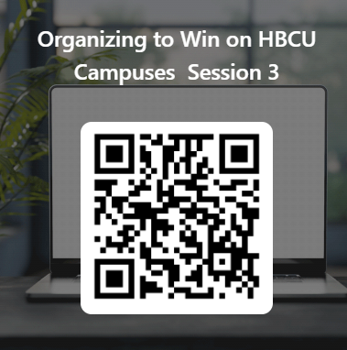
Organizing to Win on HBCU Campuses
This learning event was designed to provide a foundational experience of the key concepts and methods needed to organize on HBCU campuses.
The purpose of the six-session series is to both model a way to begin this work and build an urgency within you to continue this work.
Please let us know how we did.

