Slide 1
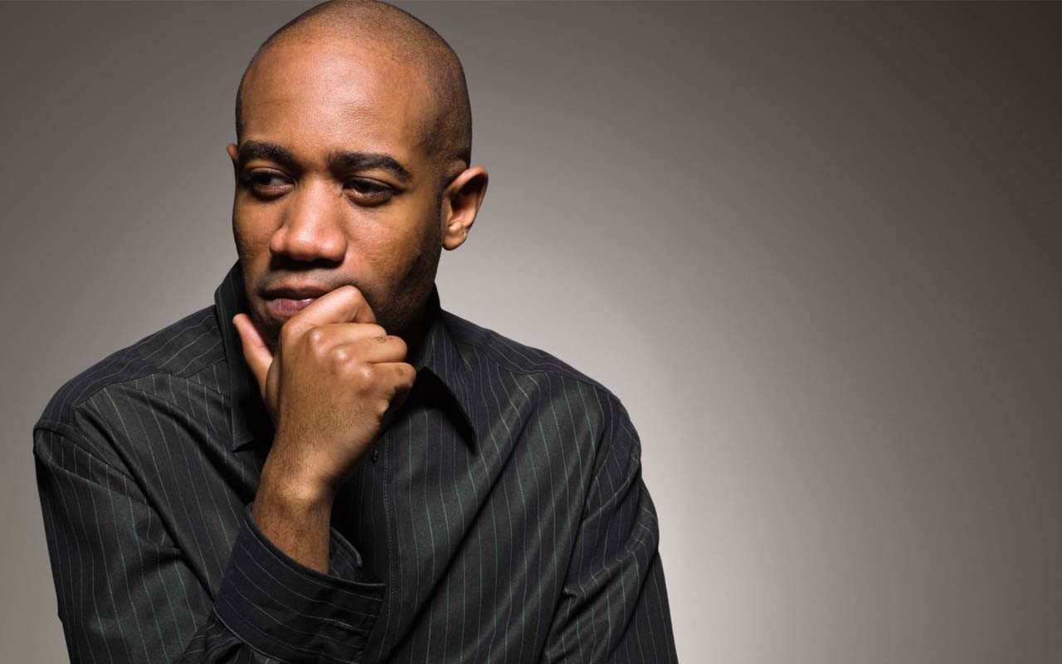
Entry Activity
What are the big issues that your ESP face in their… Work? Union? Lives?
Notes:
Set up charts
Table setup
Put pictures upside down on the table and remind the participants not to touch them until directed

Slide 2
Strategies for Organizing ESP
UniServ Focus Academy
Notes:
Ellen
Section Allotment: 30 minutes

Slide 3
NEA Members and Supporters
By attending this training you confirm that you are a registered attendee. The information you receive here is only for your use in your capacity as an NEA member or supporter.
This presentation and its contents are confidential OR closed to the press and may not be further distributed or passed on to any other person or published or reproduced, in whole or in part, by any medium or in any form, for any purpose. Audio/video recording, copying of slides, and the use of AI note-taking tools are prohibited without the written consent from NEA Presenters. Violation of these terms may result in legal action.
Notes:
Ellen

Slide 4

Honoring This Space
We begin by acknowledging that through a history of colonization and brutality, we are currently on the Shawnandasse Tula, Oage, Kaskaskia, Adena Culture, Hopewell Culture, and Muaamia land.
We honor these indigenous people, all elders, past, present, and emerging. We are called to learn and share these learnings about this tribal history, culture, and contributions that have been suppressed in the telling of the story of what we now call the United States of America.
Notes:
Ellen

Slide 5

Why are we here?
Notes:
Ellen

Slide 6

Meet the Team
Notes:
Ellen
Team will briefly introduce

Slide 7
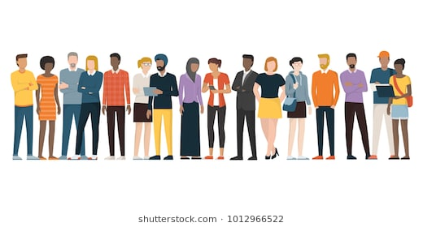
Getting to Know Each Other
Name
Location
Your Required Pronoun
Notes:
Ellen

Slide 8

Three Day Agenda Overview
Days 1-2
  Convene at 8:30
  Lunch from Noon to 1:00
  15 Min Breaks Morning and Afternoon
  4:30 to 5:00 Networking
  5:00 Adjourn
Day 3
  Break in the morning
  Lunch is a boxed lunch at 1:00 PM
  1:00 PM Adjourn, no flights before 4:00
Notes:
Ellen

Slide 9
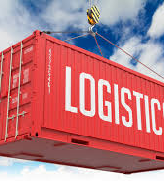
Logistics to Remember
Bathroom Location
Materials
Food Room
Room Temp
Karla as Resource
Questions?
POPs
Notes:
Ellen

Slide 10

Agenda Review - Today
Who are ESP
What are their issues
What is our work like with them
Obstacles to recruitment
Language Matters
What are some institutional challenges we have
Defining Class, Questioning systems, Reflections on practices
Issue identification
Spectrum of Allies
Notes:
Ellen

Slide 11
Community Agreements p. 2-3
Using Self-Awareness and Self-Knowledge
Listening for Understanding
Being Gracious
Staying Engaged
Being Open and Suspend Judgment
Saying “I”- tell your truth
Seeking Discomfort
Reaching Empathy
Expecting Non-Resolution and Non-Closure
*Adapted from “Embracing equity and inclusion”, Annie E. Casey Foundation
Notes:
Ellen
Community Agreements for Our Time
Awareness and Self-Knowledge
This requires self-knowledge and self-awareness. Self-knowledge allows you to see what causes you pain and conflict and enables you to embrace your contradictions and inconsistencies. It allows the space to work on things about yourself that you are not happy with. In turn, self-knowledge helps to prevent you from projecting your negative aspects onto other people. Bringing your best self also requires that you have a positive attitude, are willing to deeply explore your perspectives and remain open to the perspectives and experiences of others.
Listening for Understanding
Be an active listener. Active listening involves paying full and careful attention to the other person, looking him or her in the eye, avoiding interruptions, reflecting your understanding, clarifying information, summarizing the other person’s perspectives and sharing your own. Remember that most people need time to open up and might not be willing to immediately share their personal stories, hopes, fears and/or concerns.
Being Gracious
Being kind is a vital way of bringing meaning to our own lives, as well as the lives of others. Kindness is about caring genuinely for others around you, wanting the best for them and recognizing in them the same wants, needs, aspirations and even fears that you may have. Being kind and generous allows us to communicate better with others, to be more self-compassionate and to be a positive force in other people’s lives. This includes following the COVID protocols that are in place to protect the health of this learning community.
Stay Engaged
Staying engaged requires you to be morally, emotionally, intellectually and socially involved in the conversation. Staying engaged means that you are listening with curiosity and willing to deepen your understanding. Staying engaged might also require you to sustain the conversation even when it gets uncomfortable or diverted. This also means a commitment to keeping your electronic communications to a minimum with folks not present in this learning community.
Be Open and Suspend Judgment
Listening with an open mind includes being receptive to the influence of others. You can suspend judgment by becoming aware of preconceived notions and listening to everything someone has to say before jumping to conclusions. Most importantly, suspending judgment also means listening to what the speaker has to say for understanding, not just to determine whether the speaker is right or wrong.
Say “I”- tell your truth
Speaking your truth in authentic and courageous conversations about race requires a willingness to take risks. It means that you will be absolutely honest and candid about your own thoughts, feelings, experiences and opinions and not just saying what you perceive others want to hear. Speaking your truth will require you to speak from the “first person” and use “I” statements.
Seek Discomfort
Leaning in to discomfort will require you to let go of racial understandings and stereotypes that you may be holding onto in order to move forward. Leaning in means that you will avoid judgment, assume positive intent and be open to the kernel of wisdom in each individual’s experiences. Leaning in to discomfort will require you to sit through moments of embarrassment, confusion, anxiety and/or fear.
Reaching Empathy
Empathy and compassion allow you to understand the other person’s point of view. When you are empathetic, you are more understanding, patient and kind. Expanding your capacity to feel empathy will also allow others to enter your circle of human concern.
Resolution and Closure
Expect and accept that there may not be closure. It is not likely that you will resolve your personal understanding about race or another person’s racial experience in a single conversation. The more you talk about race with another person, the more you learn and the more they will learn. Authentic and productive conversations about race are continuous and always evolving.
*Adapted from “Embracing equity and inclusion”, Annie E. Casey Foundation

Slide 12


Slide 13
Challenges Our Members Face
Beth and Michael
Notes:
This is an activity that you might find useful to do with members who are getting ready to identify priorities for bargaining or campaigning.

Slide 14
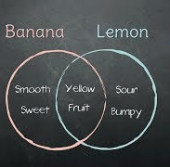
Similarities and Differences
On the center of the table are a number of Post it notes and a paper to make a Venn Diagram Mat.
Working with your table write ideas/characteristics/issues that you think are unique to Certified Employees and ESP Employees and ones that are the same.
Notes:
10 Min – Venn Diagram
On the center of the table are a number of Post it notes and a chart paper
Working with your table, write ideas/characteristics/issues that you think are unique to Certified Employees and ESP Employees and ones that are the same. Have them refer to the list they made during the entry activity

Slide 15
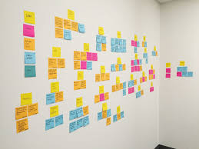
Affinity Wall
Brainstorm challenges/issues ESP members have - work, life, union, etc.
*write one challenge per post-it*
Notes:
Step 1 brainstorm challenges/issues ESP members have - work, life, union, etc. one challenge per post-it.
Step 2 Place post-its to a wall and begin to move them into clusters that are similar
Step 3 Name the clusters – ex. “Fair Pair”
Remember - people at the front to move back and those at the back to move up – keep churning and engaging.

Slide 16
Affinity Wall Debrief
What are the major clusters?
Are any issues related to each other? (Which/How)
What does this mean for our work with ESPs?
What surprises you?

Slide 17

Key Ideas
Organizers begin with issues
The issues of our members ARE the issues of their union
Their issues are our best campaigns

Slide 18
Our Experiences Supporting ESP
Dawn

Slide 19

Picturing Our Experience

Slide 20
Picturing Your Experience
Step 1 - Everyone Pick 2 Pictures – then I will give you a prompt
Step 2 – Create a two minute or less story using these two pictures

Slide 21
Picturing Our Experience
Step 3 – As a table, use ALL the pictures to tell a two minute or less story
Step 4 – Identify a storyteller who will tell your story to visiting groups
Step 5 – We will carousel through the tables

Slide 22
Debrief
What did you notice that
was similar in the table stories?
What most surprised you as you heard the stories?

Slide 23

BREAK
If you have not done so, please make sure you have read "Analyzing Everyday Oppressions in Union Work" on Pgs. 4-5 of the participant handouts

Slide 24
ESP Research Study: Language Matters
From November 2022 – February 2023, NEA conducted a multi-phase research project designed to help NEA and state affiliates recruit potential ESPs into membership.
Vanessa
Notes:
This is an activity that you might find useful to do with members who are getting ready to identify priorities for bargaining or campaigning.

Slide 25

There were three phases of the study:
Interviews with active ESP organizers.
Focus groups with potential ESP members.
Online survey of 1,038 potential ESP members.

Slide 26
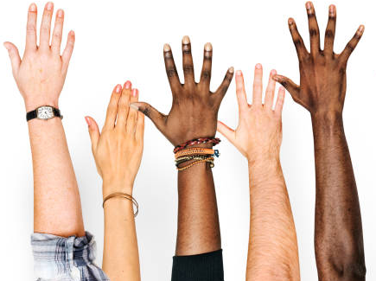
What do we know?
Who are ESPs?
What words do potential ESPs use when they refer to themselves?
What are the top worksite concerns for potential ESPs?
What questions/concerns do potential ESPs have about unions?

Slide 27
ESP?
ESP means "Education Support Professionals." Education Support Professionals play vital roles inside and outside the classroom. They keep schools and campuses running and ensure students are safe, healthy, and ready to learn.

Slide 28
ESPs work in PK-Higher Ed, in a variety of career families
  Clerical service
  Custodial and maintenance service
  Food service
  Health and student service
  Paraeducators
  Security service
  Skilled trade
  Technical service
  Transportation service

Slide 29
Potential ESPs recognize themselves as…
Not
✓
✗
✗
Support Staff
ESP or Educator
Job titles are always preferred. If you’re not sure just ask!

Slide 30
WAGES
According to research, potential member ESPs are most concerned about…
BENEFITS
WORKPLACE PROTECTIONS & SAFETY
RESPECT

Slide 31

Our association is a UNION. The word UNION conveys more meaning than “Association.”
What do potential ESP members need to know?
Unions negotiate, advocate, and organize on issues important to members.
Joining a union is legal in bargaining and non-bargaining states.
ESPs are eligible to join.

Slide 32
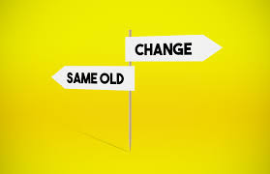
TRANSFORMATIONAL versus TRANSACTIONAL
Our voice is stronger and more effective when we band together.
When more people join the union, administrators listen to us.
With more members like you, we’ll have an even stronger voice and be able to secure real pay increases, COLA, and increases in retirement and healthcare.
“If you add up member benefits, dues pay for themselves…”
“You need to join because you need the insurance or legal services…”
Notes:
Remember start with the transformation message!
Potential members want to be heard, and they want to be a part of something larger than themselves.
We need to shift the conversation from a transactional pitch (asking members to join so they get something) to a transformational pitch (asking members to join so they can create change.)
Our overarching message for potential members should be transformational in nature, focusing on the potential of their affiliate to give education support professionals a stronger voice, boost wages, and improve ESPs’ daily lives.

Slide 33
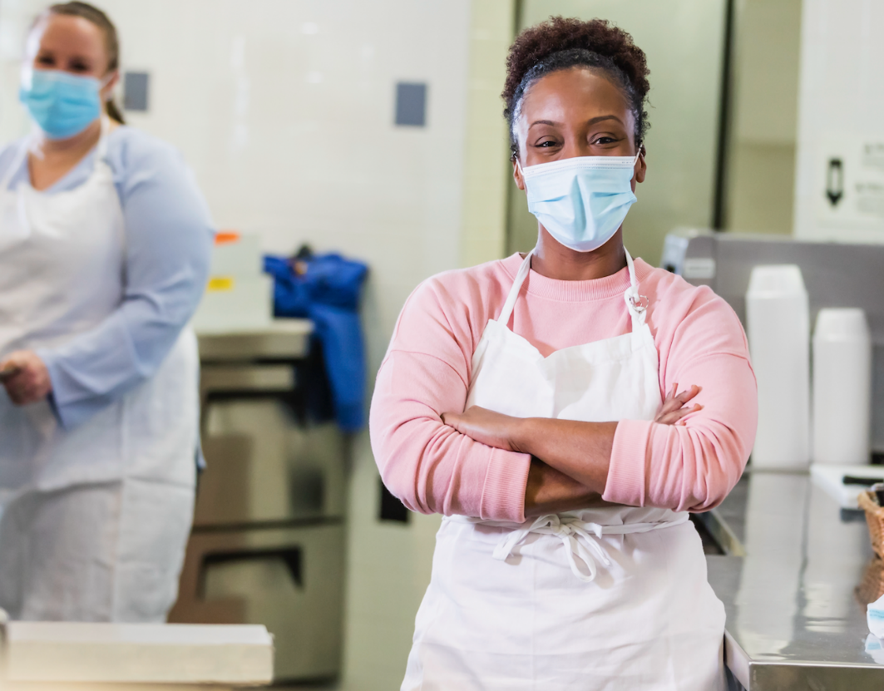
The importance of talking about “wins”
Higher salaries/benefits are at the core of our value proposition. Just short of that... Point to day-to-day wins, as a way of proving the union’s ability to deliver results.
Notes:
Don’t forget to BRAG about your wins. Point to the day to day and how working together we can improve our daily lives.

Slide 34
Dues: A Barrier to ESPs Joining
Dues
  Use monthly/weekly versus annual
  Don’t equate dues to a small consumer item
  Using terms like “freeloader” backfires.
  Consider an Affirm, Answer, Redirect approach
Notes:
Katrina

Slide 35
Politics: A Barrier to ESPs Joining
Unions are too political
  Use tone and language that conveys hope rather than hostility
  Focus the message on what is happening in their local and state unions; ESPs tend to identify more with their local and state rather than their national union
  For job classes that work directly with students, focus on how the work of their union impacts the learning environment of their students

Slide 36

Let’s Recruit Some ESPs
Thinking about a specific local in your assignment, develop what you would say as part of a 1:1 to recruit a potential ESP member:
  What’s your story around how we win?
  Write your story in 3-5 bullet statements.

Slide 37
Key Points Summary
Key Ideas
Potential member ESPs do not think of themselves as “ESP.” Support staff is a more recognized term; job title is best.
Unions are legal, and ESPs are eligible to join; recognize that many ESPs have never been asked to join their Union and may not know what a union does.
Transformational, not transactional. We need to invite ESPs into membership by focusing on how collective power helps them to have stronger work and home lives.

Slide 38
Financialization
Dawn

Slide 39

What is the purpose of public schools?

Slide 40

Timeline Tango
Quick! Get back-to-back with a partner!
Place your term cards on the wall in the era you believe each terms belongs.
As the content is provided, you and your partner can determine if any signs are incorrectly placed and move them to the right location.
NOTE: Changing the cards is FREE CHOICE so long as you and your partner agree—you can move ANY cards you feel need to be changed.

Slide 41

Key Ideas to Listen For:
Capitalism is CONSTRUCTED
Over time, Capitalism has been built around 3 Ideologies:

Slide 42
Key Ideas to Listen For:
    Kenysian (Supply and Demand driven)
    Free Enterprise (Trickle Down – low regulation and open market)
    Neoliberalism (anti-tax, anti-union, anti-regulation, and anti-public-sector)

Slide 43
Key Ideas to Listen For:
Financialization converts publicly provided goods into privately "financed goods.”
Public education reflects and advances the same norms and practices as the prevailing economic ideology.

Slide 44
How are schools and the economy related?
  Public education was created to benefit those in power (mostly white males) and to train a working class (still mostly male and white).
  Late 1800’s-1900’s
  Into the 1940’s

Slide 45
How are schools and the economy related?
      1800’s through late 20th Century
      1930s and ’40s
      Keynesian period in the development of US capitalism. (Supply and Demand)

Slide 46
How are schools and the economy related?
1970s
In response...1980s and 1990s
Free Enterprise (Trickle Down – low regulation and open market)
Neoliberalism (anti-tax, anti-union, anti-regulation, and anti-public-sector)

Slide 47
How financialization of public schools works:
Define High Standards
Design Tests to Measure Standards
Tie Funding to Tests
Cut Funding When Results are not Attained
Repeat Until All Public Schools have Failed
Private Schools, Charter Schools, Vouchers

Slide 48
How are schools and the economy related?
The meaning of public education shifted. Public education became less about cultural enrichment and civic engagement.
The purpose of public education was providing individuals with the skills and habits appropriate for the marketplace.
"Anyone could overcome the hardship of their circumstances so long as they were willing to work hard, first in school and later in the labor force."

Slide 49
How are schools and the economy related?
Public schools were expected to operate akin to businesses and adapt to the new era of iterative austerity, doing more with less, showing results that reflected a high return on investments.
Public education reflected and advanced the same norms and practices as the prevailing neoliberal capitalism it was embedded in.

Slide 50
FINANCIALIZATION Definition:
A process whereby financial markets, financial institutions, and financial elites gain greater influence over economic policy and economic outcomes.
Financialization transforms the functioning of economic systems at both the macro and micro levels.

Slide 51
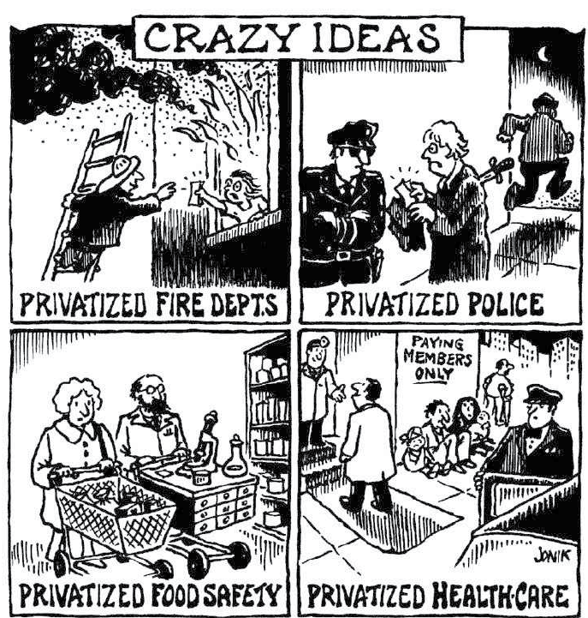
Financialization converts publicly provided goods into privately "financed goods."
Who benefits?

Slide 52
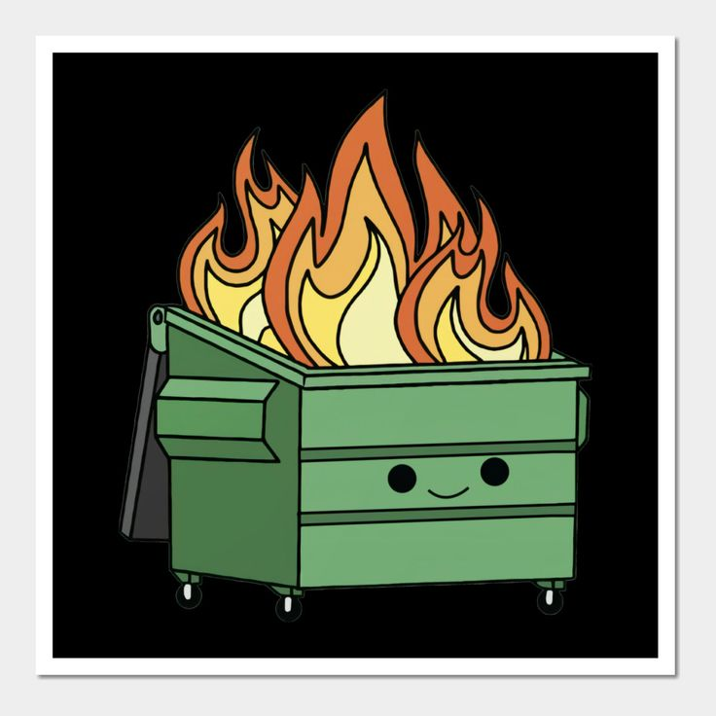
How have recent events affected the financialization of public schools?

Slide 53

1. Return to your "home" table.
2. As a team, collaboratively determine the wealth distribution by placing the pie pieces onto the chart paper.
3. Be ready to share your reasoning.
ACTIVITY:
Wealth Distribution--Divvying Up "the American Pie"

Slide 54
How Big is YOUR Slice of the American Pie ?

Slide 55
Add video from Day 2 slides 122
America's economic pie CBS This Morning

Slide 56
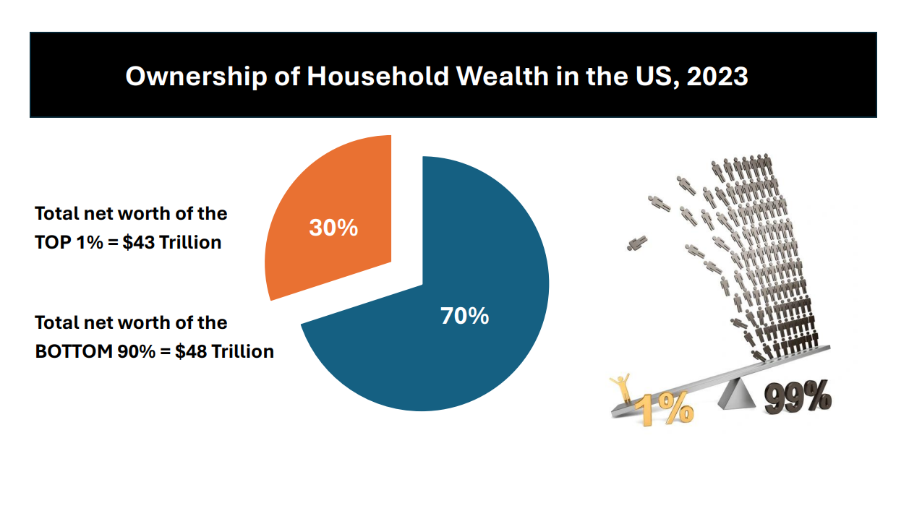

Slide 57
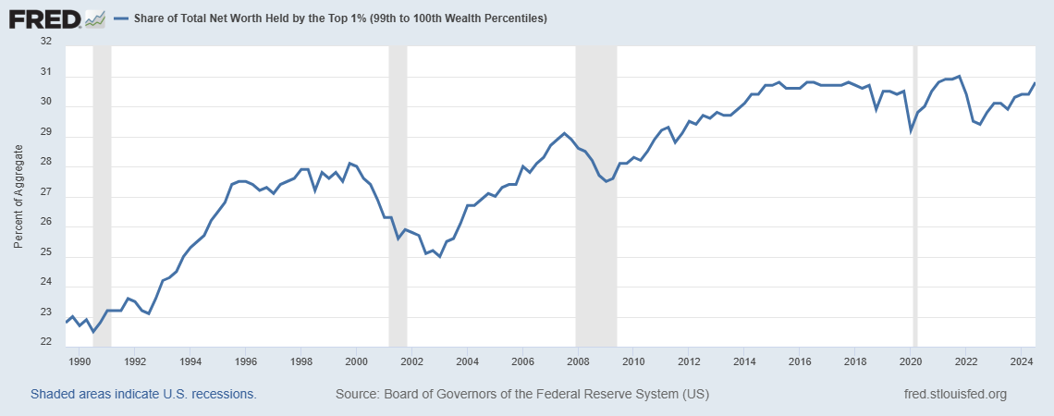
Share of Total Net Worth Held by Top 1% (1990-2024)

Slide 58
Key Points
Our system is designed to extract wealth and power from the lower levels of our system and move it to the top.
Financialization benefits the wealthiest.
When tax codes are changed so that corporations pay less than individual, there's a we need folks in the system to create a tax system that is real
Comes from fight for a fair economy

Slide 59
An Institutional Problem
Hedy and Jeny

Slide 60
Oppression Continuum
Stereotype
Prejudice
Discrimination
Oppression
Notes:
Dorian

Slide 61
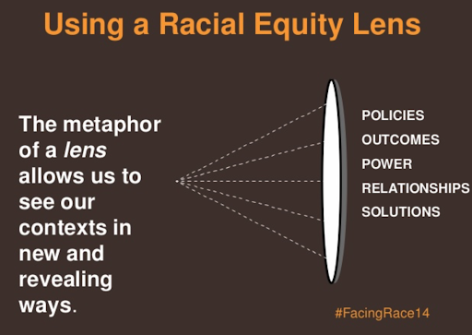
A set of questions that allow a system to identify ways that policies and practices oppress others
Race, Class, Gender Justice Lens P. 6

Slide 62
Table Work
You will need Analyzing Union Engagement Misses and Opportunities found on p. 4-5
  Discuss all 5 Questions on the second page of this story.
  Question 5 is the most important.

Slide 63
Table Work Debrief
Is Angel thriving? What is your evidence?
What are the ways the Union could do better?
What the examples of missed opportunities?
What would you do to help Angel? Be specific.

Slide 64
What race, gender, and class is Angel?
How do you know?

Slide 65
Key Ideas to remember
Race, class, and gender are socially and emotionally constructed concepts that intersects with many other forms of oppressions
Two people can have totally different understandings of the same reality
Recognizing and interrupting systems of oppression is all our work.

Slide 66

Lunch

Slide 67
Narrative Matters
Hedy

Slide 68

Narrative
Intentionally constructed stories
What are the common narratives that are told about ESPs in our organizations?
Who controls the development of these narratives?
Stand and move into triads to discuss

Slide 69
Why does the story matter?
A dominant narrative is an explanation or story that is told in service of the dominant social group’s interests and ideologies.
It achieves dominance through repetition, the perceived authority of the speaker, and the silencing of alternative accounts/voices.

Slide 70

Narratives-pg. 7-14
Because dominant narratives are so normalized through their repetition and authority, they have the illusion of being objective and apolitical (neutral), when in fact they are neither.
Narratives are used to:
  1) Trigger imagination and make connection
  2) Are expressions of or a counter to cultures
  3) Are resources for empowerment or oppression

Slide 71
Shifting the Narrative - DON’Ts
Focus on challenging facts or interpretations of information.
    Your arguments, as convincing as they may be, will lose to the dominant narrative.
Attack people for their worldview.
    Many people operate out of the dominate narrative, even if unconsciously. You cannot move people by attacking them.

Slide 72
Shifting the Narrative - DON’Ts
Name the dominant narrative as “wrong.”
    Accountability with respect
Try to convert or convince people.
    We are trying to bring out the best in people, help them find that in themselves.

Slide 73
Key Ideas
We want to hold people accountable but be respectful.

Slide 74
Shifting the Narrative Example
You are at a large staff meeting and a rather outspoken colleague says, "I can't believe these ESP members! They get all of the same benefits of our certified members. They take up much more of our time in services and they are complaining about the amount of their dues and the money they make! Why can't they just be content with what we give them? Why don't they just join another union that better fits their need?!"

Slide 75
Shifting and Using Narratives
Unmask
Name the dominant narrative when you see it at work.
Point out that what you just saw on the news or heard from a friend, or the law that was just passed, was based on particular values and beliefs.
"I hear you saying we have one class of members that is more valuable than the other."

Slide 76
Shifting and Using Narratives
Elevate
Name the values and beliefs from our new narrative that you want to see lived out in the world.
Connect it to places where your audience may see that happening already.
"All work is respectable work I believe we have a duty to equally support all workers In our locals."

Slide 77
Shifting and Using Narratives
Contrast
Lay out what might be different if your values/convictions were the ones shaping what happens in the world.
Be specific about how we have the choice to approach situations through a different belief system.
Invite a rethinking of the situation.
"Imagine if our dues structure, our managers directives about our work, and our support system for all members were aligned. What could that look like?"

Slide 78
Shifting and Using Narratives
Draw on your own journey
While it’s important to personalize this, it’s also important to do it in a way that anyone can see themselves in it. Describing your own realizations and shifts will help others
Find their own way in the conversation.
"I understand the frustration that we do not have enough resources for all our work, that is not the fault of our members. We need a system that equally values and provides equal access for all members."

Slide 79
Key Points to Remember…
Sustain your efforts and connect with others
  Shifting a dominant narrative does not happen quickly – it takes sustained effort, over time, with many people working at it.
Demonstrate your worldview, don’t just write / talk about it.
  Our actions say as much or more about our values and beliefs as our words.

Slide 80
Try the Shift!
At your tables
  We are all going to explore more examples
  Apply the steps we discussed to shift the narrative
  Use your handouts for support

Slide 81
Debrief that Shift!
What do you notice?
What was tough?
What worked well?

Slide 82
Key Points
Narratives are powerful tools that can be used to maintain power over an oppressed group
Narratives can be intentionally changed and used by an oppressed group to advance a change agenda

Slide 83
Defining Class
Michael

Slide 84
While you watch...
Notice what's missing
Notice what's new learning for you
Think about questions you want to ask

Slide 85

Video

Slide 86
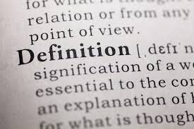
How do you define class?

Slide 87
Our Definitions – p.15-16
Class – relative social rank in terms of income, wealth, education, status and/or power.
Classism – differential treatment based on social class or perceived social class. Classism is the systematic assignment of worth based on social class; policies and practices set up to benefit more class-privileged people at the expense of the less class-privileged people.

Slide 88
Key Points
Race, class, and gender are all connected.
It's intersectionality and cannot be separated.

Slide 89
BREAK

Slide 90
Anti-Class Conciousness
Jeny and Dawn

Slide 91
Anti-Classist Consciousness
Count off by 7’s
Each team will be assigned one of the 7 “Shifts”

Slide 92
Anti-Classist Consciousness(pg. 19)
Read your “shift” and identify how the conditions described show up in your work with ESPs and our organization’s relationship with ESPs.
Be ready with a 2 minute or less report out

Slide 93
Questions to Discuss
What is your most important take away from this activity?
How will you fold this learning into your work with ESPs?
What are the consequences for not discussing and understanding classism?
What are the consequences for not including an intersectional perspective?

Slide 94
Key Points
Classism is code for institutional racism
Classism is a complex set of intersectional privileges and oppressions
Advancing justice for our ESPs will require both intentional and strategic action to dismantle these systems

Slide 95
Problem to Issue Identification
Beth

Slide 96

PROBLEM vs. ISSUE
A problem is the whole pie. Problems are vast, complex, and entrenched.
When we try to tackle a problem, we reinforce the hopelessness of the situation. We are trying to take on the full pie all at once.
Issues are the pieces of the pie. It’s a small chunk of the larger problem that we can make progress on, and in turn we are slowly taking on the full problem over time.
Notes:
Campaigns start with issues that people have value-based solidarity around.
An issue is a slice of a workplace problem.
Often a problem can have different issues depending on the perspective of the people we are working with.
It is KEY to get enough input on what the issues are that make up the problem so that YOU do not drive the solution.
Investigating the issue is necessary but not sufficient – we also need to identify workers’ SHARED values – WHY is this an issue? WHY do you want to fix this?
out for when identifying the issue?

Slide 97
Issue
An issue is a slice of the larger problem that is manageable and solvable.

Slide 98

PROBLEM vs. ISSUE

Slide 99
Values
Values are fundamental beliefs that dictate behavior
Ideally, Unions advance the welfare of all members.
They are based on the universal ideal of human rights, the idea of justice, progress, and betterment of self and of society.
Through shared values, members build solidarity and commit to active participation in the labor movement.
Shared values transform individual members into part of something larger than themselves.

Slide 100
Some Union Values
Fairness, honesty/integrity, responsibility, compassion/empathy, safety, health, generosity, hard work/responsibility, community, freedom, democracy, binding contracts, equality, opportunity, respect, stability/security, unity, quality work, justice, collective action, dignity/respect, charity/community service, and due process.

Slide 101
How to Link Issues and Values
Investigating member issues is necessary but not sufficient – we also need to identify workers’ SHARED values –
WHY is this an issue?
WHY do you want to fix this?

Slide 102
EXAMPLES- Problems to Issues + Values
VALUES – Public Schools should be safe, equitable, and inclusive learning and working environments for all people.
PROBLEM -Our administration does not address violent / hostile students
  ◦ Issue Cut – The MTSS / RTI / PBIS plan does not adequately address the behavior.
PROBLEM - Our school reinforces racism and the experiences of marginalized populations.
◦ Issue Cut– ESPs are the lowest paid employees.

Slide 103
Key Ideas
Problems are big conditions of injustice
Issues are the smaller member identified components that make up the problem
Issues indicate a path to action
Values build a relatable why across people experiencing the pain of the problem
We intentionally work to connect members around issues and values to build Solidarity

Slide 104
TEAM WORK – The Problems- this slide and next need some reworking for clarity
Go to a theme that resonates with you
You will be forming a team no smaller than 2 no larger than 5
Use the theme to create a list of issues
For each of the issues you identify – try to think what the values are that are behind WHY you see these as issues.
Example Problem – We want quality health care for everyone
Values behind wanting to fix this – equity, fairness, dignity
List your problems and values on a chart.

Slide 105
TEAM WORK – Problems into Issues
Example Problem – We want quality health care for everyone
Values behind wanting to fix this – equity, fairness, dignity
Possible Issues –
Not enough providers in our rural system
Values – access and equity
Drugs are not affordable
Values – fairness and access
No coverage for home health options
Values – equity and dignity
Cut your problems into issues on your charts.

Slide 106

Issue Criteria Checklist
p. 39-41 :Reference only

Slide 107
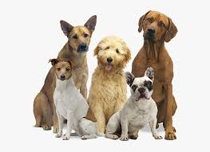
Group work
What’s your issue?
Is it widely/deeply felt?
What’s your win look like?
Notes:
Slide Time Allotment: 25 minutes

Slide 108
Key Point
We don’t choose the issues, the people who want the change choose the issue.
Notes:
Slide Time Allotment: 1 minute

Slide 109
Spectrum of Allies
Vanessa

Slide 110

Spectrum of Allies

Slide 111

Spectrum of Allies Part 1
  Active allies: people who agree with you & are organizing alongside you
  Passive allies: people who agree but aren't doing anything about it (yet!)
  Neutrals: people who aren't sure, or are unengaged (they might just not know about you yet)
  Passive opponents: people who disagree, but aren't trying to stop you
  Active opponents: people who have done something to prevent you from reaching your goal

Slide 112
Where You Focus Your Energy Matters
Only the Opposition – cynicism
Only the Active Allies – stagnation
Generalizations about Slices – missed opportunities
DO FOCUS ON THE PASSIVE ALLIES
  These are folks who know or care about what you’re up to, but aren’t doing anything about it! Give them a chance to participate and build power with you.
THE GOOD NEWS
  It is only necessary to move some or all of the pie wedges one step in your direction. If we shift each wedge one step, we are likely to win, even if the hardliners on the opponent’s side don’t budge.

Slide 113
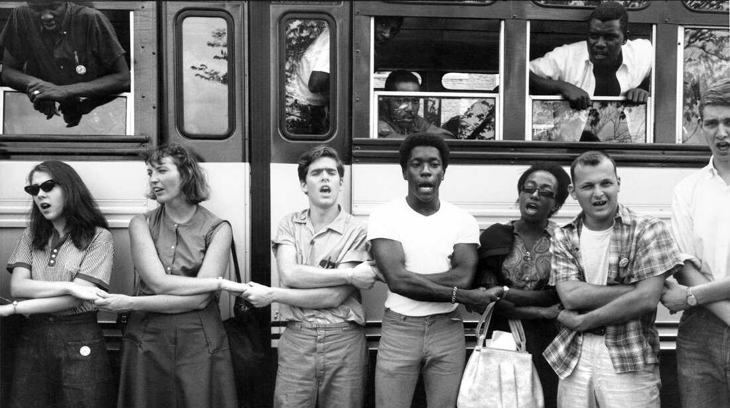
An example from history – Freedom Summer

Slide 114
Spectrum of Allies Part 2
Develop a convincing argument or values based narrative that will appeal to each wedge.
Design one tactic for each wedge that you can invite them to participate in that will move that wedge one closer to us.
Design one small achievable ask to engage one individual from that wedge to move closer to you

Slide 115
Team Pair Share of Spectrum of Allies

Slide 116
Spectrum of Allies Debrief – Whole Group
How did it feel to present your arguments for how to move your wedges?
What is something new you learned from this or from another team?
What do you think you could apply to your current work?

Slide 117
Key Ideas
It is only necessary to move some or all of the pie wedges one step in your direction.
If we shift each wedge one step, we are likely to win, even if the hardliners on the opponent’s side don’t budge.

Slide 118
Ending It Right
Ellen

Slide 119

Ending it Right
Choice Networking
Housekeeping
Feedback Form

Slide 121
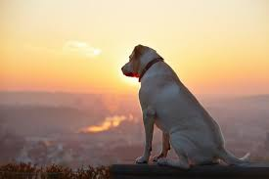
What will you take with you into your future work?
Closing our time together…

Slide 122
Closing our time together…

Slide 123

Choice Network Time

