Slide 1
Problem of Practice
A problem of practice is something that you care about that would make a difference for your locals if you improved it.
The more specific the problem of practice is, the more helpful the recommendations for your next level of work will be.

Slide 2
Organizing ESP
UniServ Focus Academy

Slide 3
NEA Members and Supporters
By attending this training you confirm that you are a registered attendee. The information you receive here is only for your use in your capacity as an NEA member or supporter.
This presentation and its contents are confidential OR closed to the press and may not be further distributed or passed on to any other person or published or reproduced, in whole or in part, by any medium or in any form, for any purpose. Audio/video recording, copying of slides, and the use of AI note-taking tools are prohibited without the written consent from NEA Presenters. Violation of these terms may result in legal action.
Notes:
Ellen

Slide 4
Feedback on Feedback
Just over 50% responding
  High of 4.8 for Overall Outcomes
  Low of 4.5 for Materials, Facilitators, Content
Themes
  +The support from the facilitators, financialization, living wage, one on ones, living wage
  - Connections, Directions, Timing

Slide 5
Your Words
Knowing half don’t love moving and churning but still doing it feels off. Dismissive. Things still move really fast for processing and I have some years of experience doing this work.
I wish that POPs could be organized in a better way. I spend a lot of time scrolling. It is all there and it is better than paper to travel with. Just needs a little more organization.
The timeline and financialization portion of today's learning was interesting. It offered a good segue into talking about a living wage campaign.
I appreciate the movement and conversation with other people in the room. Our table talk time is long enough to engage but not so long that it is belabored. Every meeting I have ever attended with other NEA groups is sit and lecture… The facilitators don't hover for the sake of seeing if we are working… Someone at my table got real help with their plan and for those that wanted to work on their own they weren't chased down unnecessarily.

Slide 6

Agenda Review - Today
Consultancy Protocol
Leaders, from Clubs to Unions
Building Engaged Leaders
Team time and presentations
Lunch
Adjourn

Slide 7
Community Agreements p. 2
Using Self-Awareness and Self-Knowledge
Listening for Understanding
Being Gracious
Staying Engaged
Being Open and Suspend Judgment
Saying “I”- tell your truth
Seeking Discomfort
Reaching Empathy
Expecting Non-Resolution and Non-Closure
*Adapted from “Embracing equity and inclusion”, Annie E. Casey Foundation
Notes:
Community Agreements for Our Time
Awareness and Self-Knowledge
This requires self-knowledge and self-awareness. Self-knowledge allows you to see what causes you pain and conflict and enables you to embrace your contradictions and inconsistencies. It allows the space to work on things about yourself that you are not happy with. In turn, self-knowledge helps to prevent you from projecting your negative aspects onto other people. Bringing your best self also requires that you have a positive attitude, are willing to deeply explore your perspectives and remain open to the perspectives and experiences of others.
Listening for Understanding
Be an active listener. Active listening involves paying full and careful attention to the other person, looking him or her in the eye, avoiding interruptions, reflecting your understanding, clarifying information, summarizing the other person’s perspectives and sharing your own. Remember that most people need time to open up and might not be willing to immediately share their personal stories, hopes, fears and/or concerns.
Being Gracious
Being kind is a vital way of bringing meaning to our own lives, as well as the lives of others. Kindness is about caring genuinely for others around you, wanting the best for them and recognizing in them the same wants, needs, aspirations and even fears that you may have. Being kind and generous allows us to communicate better with others, to be more self-compassionate and to be a positive force in other people’s lives. This includes following the COVID protocols that are in place to protect the health of this learning community.
Stay Engaged
Staying engaged requires you to be morally, emotionally, intellectually and socially involved in the conversation. Staying engaged means that you are listening with curiosity and willing to deepen your understanding. Staying engaged might also require you to sustain the conversation even when it gets uncomfortable or diverted. This also means a commitment to keeping your electronic communications to a minimum with folks not present in this learning community.
Be Open and Suspend Judgment
Listening with an open mind includes being receptive to the influence of others. You can suspend judgment by becoming aware of preconceived notions and listening to everything someone has to say before jumping to conclusions. Most importantly, suspending judgment also means listening to what the speaker has to say for understanding, not just to determine whether the speaker is right or wrong.
Say “I”- tell your truth
Speaking your truth in authentic and courageous conversations about race requires a willingness to take risks. It means that you will be absolutely honest and candid about your own thoughts, feelings, experiences and opinions and not just saying what you perceive others want to hear. Speaking your truth will require you to speak from the “first person” and use “I” statements.
Seek Discomfort
Leaning in to discomfort will require you to let go of racial understandings and stereotypes that you may be holding onto in order to move forward. Leaning in means that you will avoid judgment, assume positive intent and be open to the kernel of wisdom in each individual’s experiences. Leaning in to discomfort will require you to sit through moments of embarrassment, confusion, anxiety and/or fear.
Reaching Empathy
Empathy and compassion allow you to understand the other person’s point of view. When you are empathetic, you are more understanding, patient and kind. Expanding your capacity to feel empathy will also allow others to enter your circle of human concern.
Resolution and Closure
Expect and accept that there may not be closure. It is not likely that you will resolve your personal understanding about race or another person’s racial experience in a single conversation. The more you talk about race with another person, the more you learn and the more they will learn. Authentic and productive conversations about race are continuous and always evolving.
*Adapted from “Embracing equity and inclusion”, Annie E. Casey Foundation

Slide 8
Consultancy Protocol
Hedy and Vanessa

Slide 9
Problem of Practice
The problem of practice is something that you care about that would make a difference for your locals if you improved it.
The more specific the problem of practice is, the more helpful the recommendations for your next level of work will be.

Slide 10
What is the Consultancy Protocol?
Allows a person, the presenter, to identify a barrier in their work
The role of the listeners is to ask good questions – not provide answers; this provides the presenter the ability to step back and listen to a different way of thinking of the barrier

Slide 11
How does the Consultancy Protocol Work? Page 73
Step 1: Facilitator Opening
Step 2: Presenter – Shares the Dilemma- including a key question for which they are seeking clarity
Step 3: Group asks Clarifying questions (NOT Probing) - Review p. 74 – 75
Step 4: Presenter steps out & Group Converses (asks questions, brainstorms, reflects)
Step 5: Closing – Presenter shares reactions, insights, feelings

Slide 12

Modeling the Consultancy Protocol
Facilitators: Hedy & Vanessa
Presenter: one of you
Consultant Group: the rest of you

Slide 13

Problems of Practice
Form groups of six
  Use the “Consultancy Protocol” on page 73 as a reference
25 Minutes Total
  At least two people will have a chance to be the presenter
  10 Minutes per round
  Flexibility for transition

Slide 14

Protocol Debrief
What was surprising to you in the difference between following a protocol and just “problem solving” within a conversation?
Was it difficult to stay in the protocol?
Given your learning so far, why might using a protocol be particularly useful when exploring your challenges working with ESP locals and leaders?

Slide 15

Key Points
Coaching requires asking and listening and enables individual choices
Coaching is as much about you changing your behavior and growing your skill as it is about growing a leader.
We only get good at coaching by practicing it.
A protocol is a framework to help reshape old habits of mind into new ones.

Slide 16
Leaders
Dawn

Slide 17
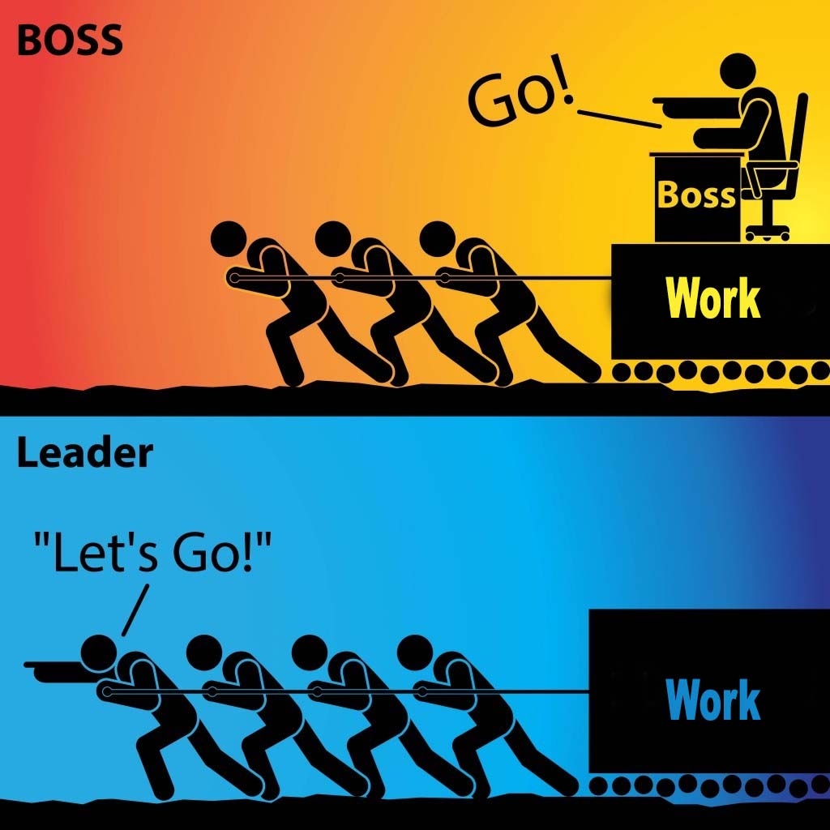
Organizing and Leadership
Leadership is taking responsibility for enabling others to achieve shared purpose in the face of uncertainty.
The members who can lead most successfully are those who already have followers, i.e. people who trust and respect them.

Slide 18
How it typically goes…
Members self-select into leadership roles
“We don’t have a building rep, so I told everyone I would volunteer.”
We recruit members without confirming their leadership
“She’s excited about the union; I invited her to an event and to become a building rep.”
Result: “leaders” struggle to deliver when it counts
PLUS, lots of implicit bias as we choose “leaders” who meet our criteria.

Slide 19
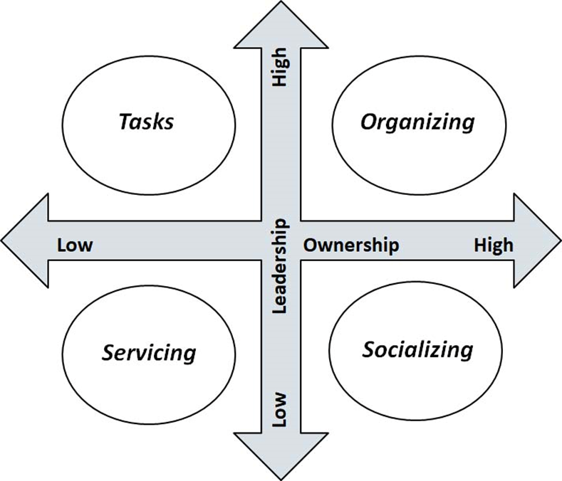
What did Seattle do?
Member to Leader
Identify Leaders
Know what your leader's issues are
Ask them to join in shaping the agenda with other leaders
Give leaders meaningful tasks/roles around the issues they care about.

Slide 20

The Blitz, an organizing tool
Have 10-minute individual conversations with as many members as possible in a building:
What do you think are the biggest issues facing us in public education? In our school district?
Who’s trusted and respected here in the building?

Slide 21
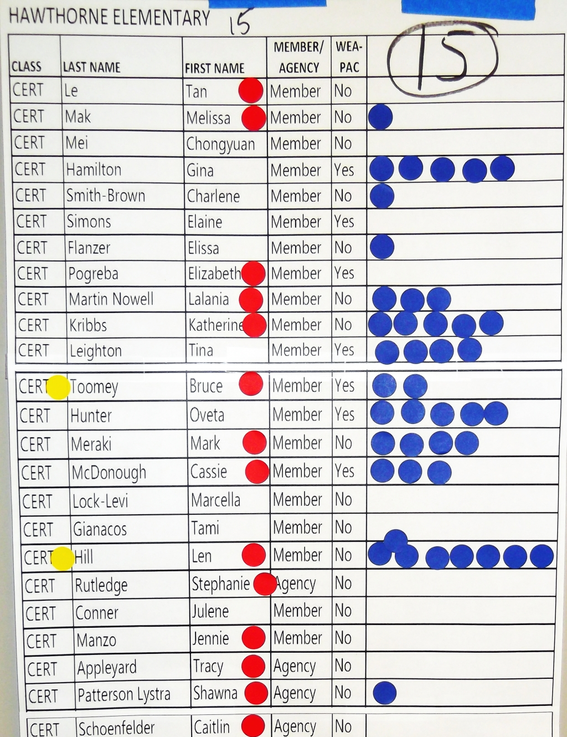
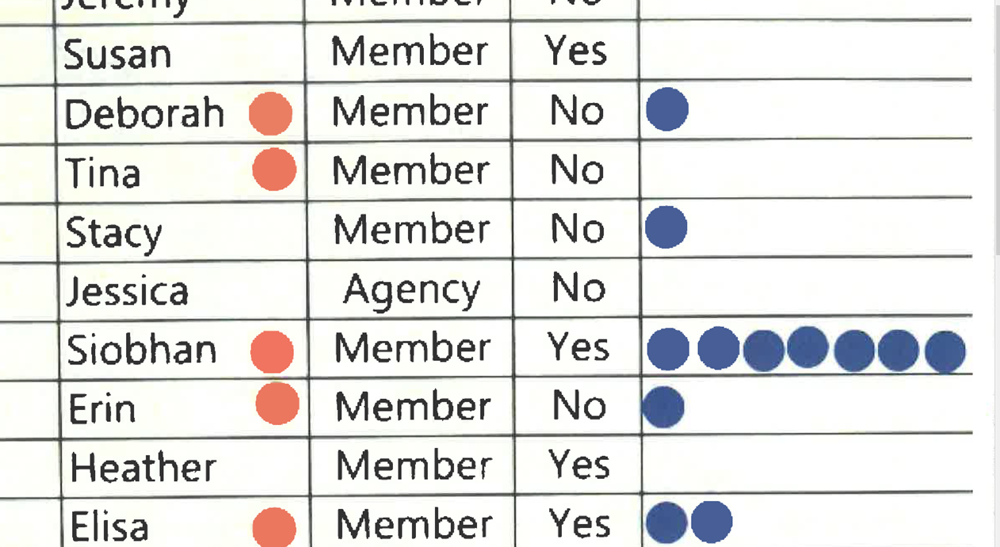
Looking at the data - what do you notice?

Slide 22
Key Points
Just because they have been identified by a number of colleagues does not immediately mean members are the “best” leaders for what the local needs.
There needs to be more work to build a relationship with members about what their agenda is and what the agenda of the union is – moving them to work with the union’s agenda.

Slide 23
Club to Union
Dawn

Slide 24
Opportunities for Leadership
Fighting Union
Members Lead with Courage and Risk
Staff Advise and Coach
Focus on Recruitment and Engagement
Unorganized
Staff Lead – No Risk by Members
Staff Focus on Engagement and Leader ID
Club
Staff Lead – Already Active Members –Low Risk Activities
Staff Coach and Build Leader Capacity
Union
Member and Staff Partners – Mid Risk Activities

Slide 25
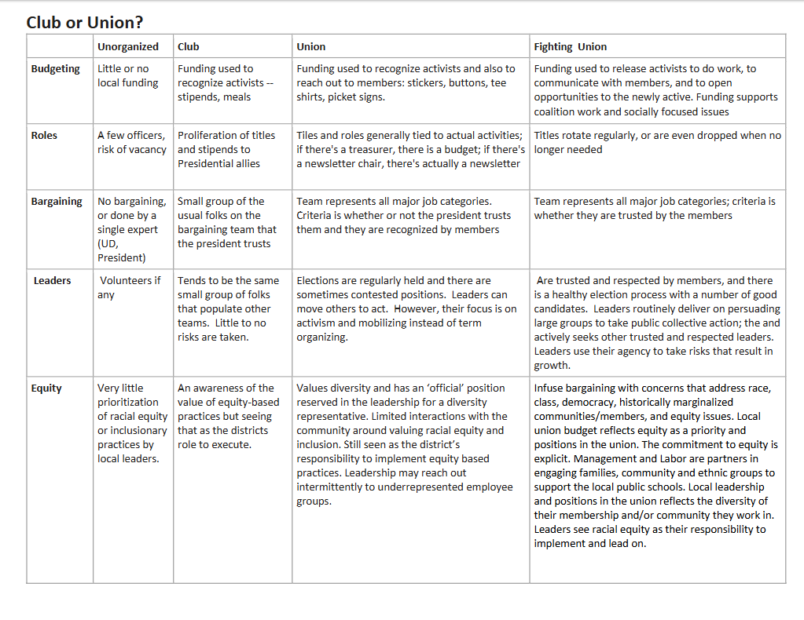

Slide 26
Club or Union? ACTIVITY (In additional participant resources)
Unorganized
Club
Union
Fighting Union
Think of a local you work with – at what point of the continuum are they on?
What is your role in moving locals from left to right in this framework?
What do you think is most required to move from left to right?

Slide 27
Club or Union Debrief
Unorganized
Club
Union
Fighting Union
What did you learn?
How useful was this in thinking about your work with ESP units?
What would you add to it?

Slide 28
Key Ideas
Unions with leaders who are unwilling to take any level of risk will not be able to grow into unions that can demand and win what members want and need.
The way to build leaders is to not do for them what they can do for themselves, design “tasks” that cause people to have more leadership and ownership

Slide 29

BREAK

Slide 30
Building Engaged Leaders
Michael

Slide 31

Building Engaged Leaders
“Social scientists have found that tasks designed to yield “intrinsic” (inherently satisfying) rewards by overcoming some level of risk produces great motivation, commitment, and adaptive learning more than tasks that only yield financial, recognition or status rewards.”
-Hackman and Olham, 1980

Slide 32
Building Engaged Leaders
The best way to grow leaders is to give them meaningful, challenging (risky) tasks (tests), and see if they can achieve them. Then give them another task to do . . .

Slide 33
Conditions of Motivational Task Design
Experience meaningfulness: the task is important in the overall scheme of things and is big enough that it will be a challenge to achieve.
1
Experience responsibility: how well the task gets done is up to me.
2
Experience results: as I attempt to do the work, I can see whether or not I am doing well.
3

Slide 34
How you make the ask matters
Communicate:
Why the task is significant
Why their input and contribution are key
That multiple skills are involved...and you'll help coach them if needed

Slide 35
Nothing is meaningful if you aren't expected to be accountable

Slide 36
Conditions of Motivational Task Design are achieved when the leader:
Task Significance (Why) – understand and recognize the impact of the work on the world and the risks involved
Task Identity – one’s own contribution, from start to finish, is clear in the final result
Skill Variety – engaging a variety of skills, including heart, hands, and head.
Autonomy – having the space to make competent choices about how to do the work.
Feedback – results are visible to the person performing the task as they perform it.

Slide 37
“enabling others to achieve shared purpose in the face of uncertainty” (Ganz) p.87
Tasks
Organizing
Low Leadership High
Low Ownership High
Servicing
Socializing

Slide 38
As a team discuss how you could move those not in the org quadrant into the org quadrant or higher up either axis.
How would you bring this back to your locals?
Could it be a tool for you to self-evaluate or tool for a local to use with leadership to discuss?

Slide 39
Key Points
Tasks must be meaningful and members need to own them.
Our job is to look for opportunities to increase ownership and leadership whenever possible.
Leaders grow by taking risk, accepting ownership, and sharing accountability

Slide 40
Campaign Planning Team Time

Slide 41


Slide 42
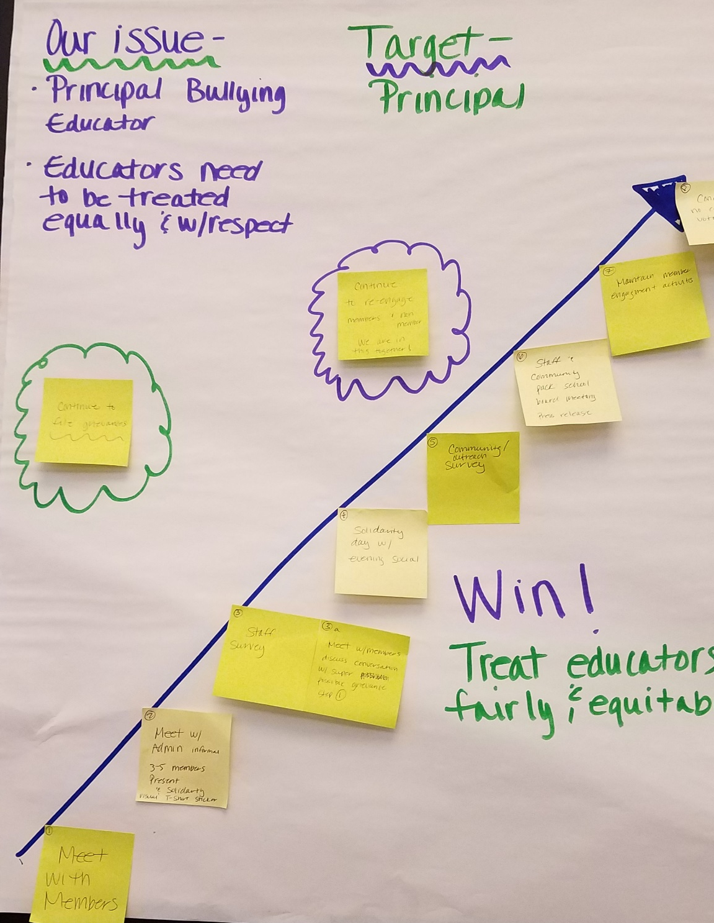

Team Work Time
Notes:
Ellen

Slide 43
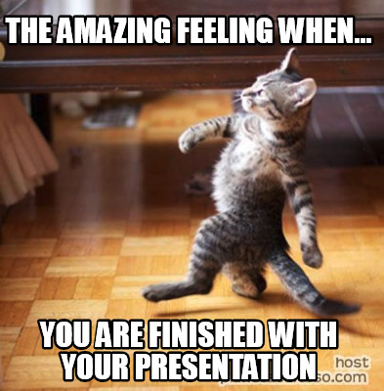
Team Presentation and Coaching Time

Slide 44
Feedback Questions
What specific elements of the plan stood out to you?
How did the plan engage others around the values they share?
How did the plan address finding and developing leaders to help implement the plan?
In what ways does the plan use opportunities to build structure and power?

Slide 45
Ending it Right
Ellen

Slide 46

Ending it Right
Choice Networking
Housekeeping

