Slide 1
Organizing ESP
UniServ Focus Academy

Slide 2

Campaign Academy
By attending this training, you confirm that you are either an NEA affiliate staff person or NEA member in good standing. The information you receive here is only for your use in your capacity as an NEA affiliate staff person or NEA member.
This presentation and its contents are confidential and may not be further distributed or passed on to any other person or published or reproduced, in whole or in part, by any medium or in any form, for any purpose unless written consent has been provided by Ellen Holmes. Audio/video recording, copying of slides, and the use of AI note-taking tools are prohibited without the written consent from Kyle Serrette. Violation of these terms may result in legal action.

Slide 3
NEA Standards of Conduct
NEA has adopted a Standard of Conduct Policy to ensure that all of our gatherings are welcoming to and free from discriminatory, harassing, or otherwise unacceptable behavior. Discrimination or harassment based on race, color, ethnicity, religion, sex, age, national origin, sexual orientation, disability, gender identity, or expression, or any other characteristic protected by law will not be tolerated. If you have experience any discriminatory or harassing behavior, please report the incident by emailing Ron "Duff" Martin (rmartin@nea.org) and Gladys Marquez (gmarquez@nea.org). Thank you for your commitment to ensuring a positive event for all.

Slide 4
Feedback on Feedback
90% response rate – Range 4.5-4.6 High for the content and outcomes, low for the materials
Themes:
Plus – Conversations; side talking improved
Deltas – time for conversations

Slide 5
Your Words
It is always nice when it's fun but informative The 1:1 conversation part would have benefitted for more share out time or inviting a successful local ESP leader to share their tactics. Talking and directions were much better! Thank you for waiting to get quiet in the room. The materials and trainers are engaging and easy to follow. The biggest struggle is the amount of time needed to create the full campaign. For many members, this is the first time the are hearing/seeing the content/materials and need more time to process and ask questions. It would be helpful to give a full day to draw out the plan after they are provided all of the information. The reminder to keep evaluating the racial and social issues lens was important and vital to our work & growth. Thank you 😊 Just an idea overall great experience and connecting with good likeminded individuals with a passion for change

Slide 6

Agenda Review - Today
Leaders, from Clubs to Unions
Building Engaged Leaders
Ladder of Engagement
Team time and presentations
Lunch
Adjourn

Slide 7
Community Agreements p. 2-3
Using Self-Awareness and Self-Knowledge
Listening for Understanding
Being Gracious
Staying Engaged
Being Open and Suspend Judgment
Saying “I”- tell your truth
Seeking Discomfort
Reaching Empathy
Expecting Non-Resolution and Non-Closure
*Adapted from “Embracing equity and inclusion”, Annie E. Casey Foundation
Notes:
Community Agreements for Our Time
Awareness and Self-Knowledge
This requires self-knowledge and self-awareness. Self-knowledge allows you to see what causes you pain and conflict and enables you to embrace your contradictions and inconsistencies. It allows the space to work on things about yourself that you are not happy with. In turn, self-knowledge helps to prevent you from projecting your negative aspects onto other people. Bringing your best self also requires that you have a positive attitude, are willing to deeply explore your perspectives and remain open to the perspectives and experiences of others.
Listening for Understanding
Be an active listener. Active listening involves paying full and careful attention to the other person, looking him or her in the eye, avoiding interruptions, reflecting your understanding, clarifying information, summarizing the other person’s perspectives and sharing your own. Remember that most people need time to open up and might not be willing to immediately share their personal stories, hopes, fears and/or concerns.
Being Gracious
Being kind is a vital way of bringing meaning to our own lives, as well as the lives of others. Kindness is about caring genuinely for others around you, wanting the best for them and recognizing in them the same wants, needs, aspirations and even fears that you may have. Being kind and generous allows us to communicate better with others, to be more self-compassionate and to be a positive force in other people’s lives. This includes following the COVID protocols that are in place to protect the health of this learning community.
Stay Engaged
Staying engaged requires you to be morally, emotionally, intellectually and socially involved in the conversation. Staying engaged means that you are listening with curiosity and willing to deepen your understanding. Staying engaged might also require you to sustain the conversation even when it gets uncomfortable or diverted. This also means a commitment to keeping your electronic communications to a minimum with folks not present in this learning community.
Be Open and Suspend Judgment
Listening with an open mind includes being receptive to the influence of others. You can suspend judgment by becoming aware of preconceived notions and listening to everything someone has to say before jumping to conclusions. Most importantly, suspending judgment also means listening to what the speaker has to say for understanding, not just to determine whether the speaker is right or wrong.
Say “I”- tell your truth
Speaking your truth in authentic and courageous conversations about race requires a willingness to take risks. It means that you will be absolutely honest and candid about your own thoughts, feelings, experiences and opinions and not just saying what you perceive others want to hear. Speaking your truth will require you to speak from the “first person” and use “I” statements.
Seek Discomfort
Leaning in to discomfort will require you to let go of racial understandings and stereotypes that you may be holding onto in order to move forward. Leaning in means that you will avoid judgment, assume positive intent and be open to the kernel of wisdom in each individual’s experiences. Leaning in to discomfort will require you to sit through moments of embarrassment, confusion, anxiety and/or fear.
Reaching Empathy
Empathy and compassion allow you to understand the other person’s point of view. When you are empathetic, you are more understanding, patient and kind. Expanding your capacity to feel empathy will also allow others to enter your circle of human concern.
Resolution and Closure
Expect and accept that there may not be closure. It is not likely that you will resolve your personal understanding about race or another person’s racial experience in a single conversation. The more you talk about race with another person, the more you learn and the more they will learn. Authentic and productive conversations about race are continuous and always evolving.
*Adapted from “Embracing equity and inclusion”, Annie E. Casey Foundation

Slide 8


Campaign Lab Information and Application
https://www.nea.org/resource-library/campaign-lab

Slide 9
Leaders
Monet & Ben

Slide 10
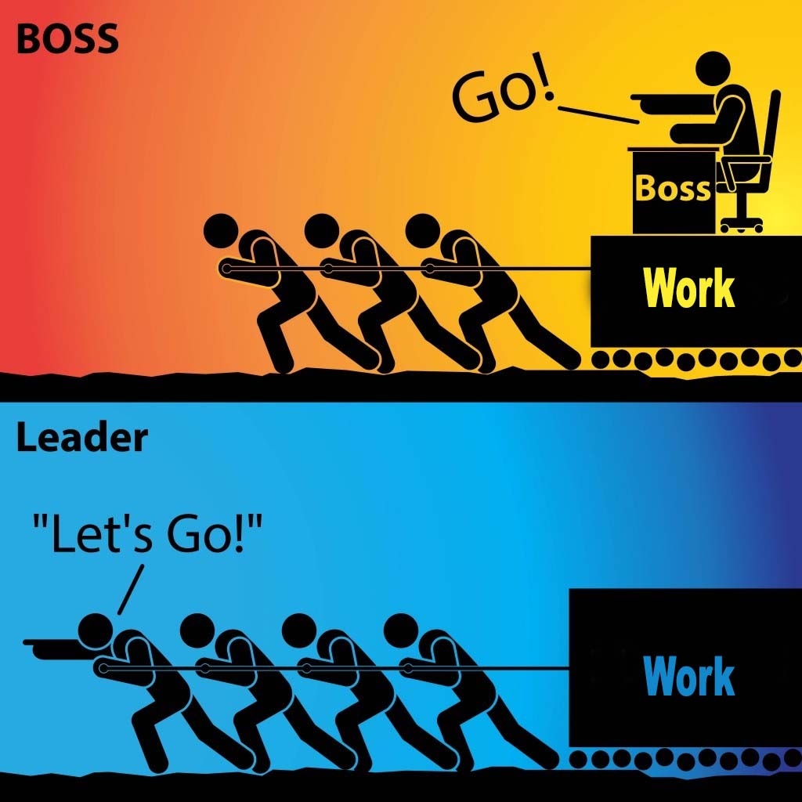
Organizing and Leadership
Leadership is taking responsibility for enabling others to achieve shared purpose in the face of uncertainty.
The members who can lead most successfully are those who already have followers, i.e. people who trust and respect them.

Slide 11
How it typically goes…
Members self-select into leadership roles
“We don’t have a building rep, so I told everyone I would volunteer.”
We recruit members without confirming their leadership
“She’s excited about the union; I invited her to an event and to become a building rep.”
Result: “leaders” struggle to deliver when it counts
PLUS, lots of implicit bias as we choose “leaders” who meet our criteria.

Slide 12
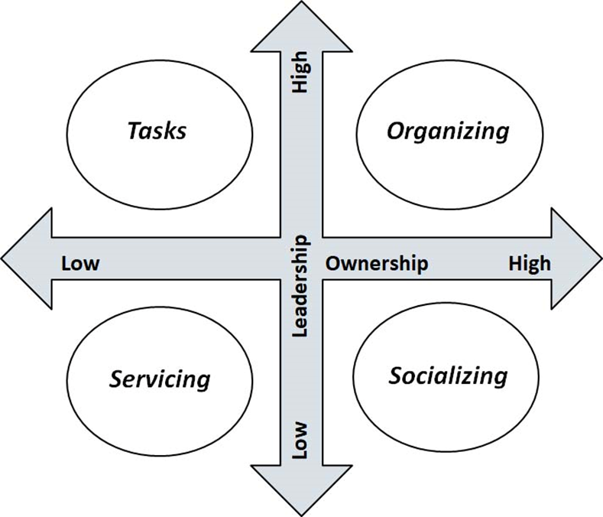
What did Seattle do?
Member to Leader p.102
Identify Leaders
Know what your leader's issues are
Ask them to join in shaping the agenda with other leaders
Give leaders meaningful tasks/roles around the issues they care about.

Slide 13

The Blitz, an organizing tool
Have 10-minute individual conversations with as many members as possible in a building:
What do you think are the biggest issues facing us in public education? In our school district?
Who’s trusted and respected here in the building?

Slide 14
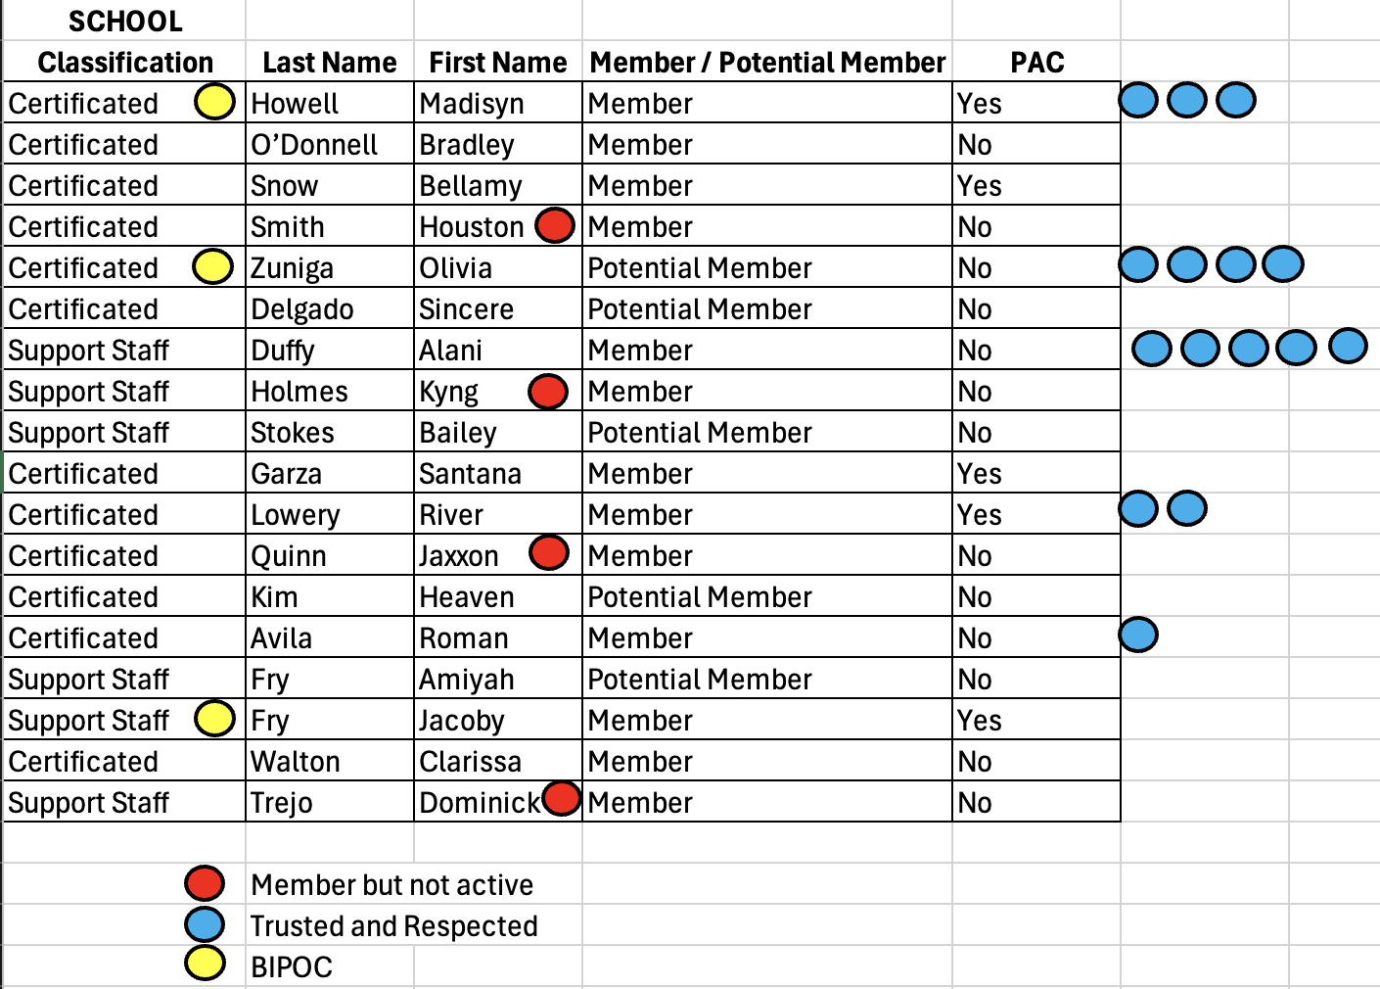
Looking at the data - what do you notice?

Slide 15

Key Points
Just because they have been identified by a number of colleagues does not immediately mean members are the “best” leaders for what the local needs.
There needs to be more work to build a relationship with members about what their agenda is and what the agenda of the union is – moving them to work with the union’s agenda.

Slide 16
Club to Union
Monet & Ben

Slide 17
Opportunities for Leadership
Fighting Union
Members Lead with Courage and Risk
Staff Advise and Coach
Focus on Recruitment and Engagement
Unorganized
Staff Lead – No Risk by Members
Staff Focus on Engagement and Leader ID
Club
Staff Lead – Already Active Members –Low Risk Activities
Staff Coach and Build Leader Capacity
Union
Member and Staff Partners – Mid Risk Activities

Slide 18
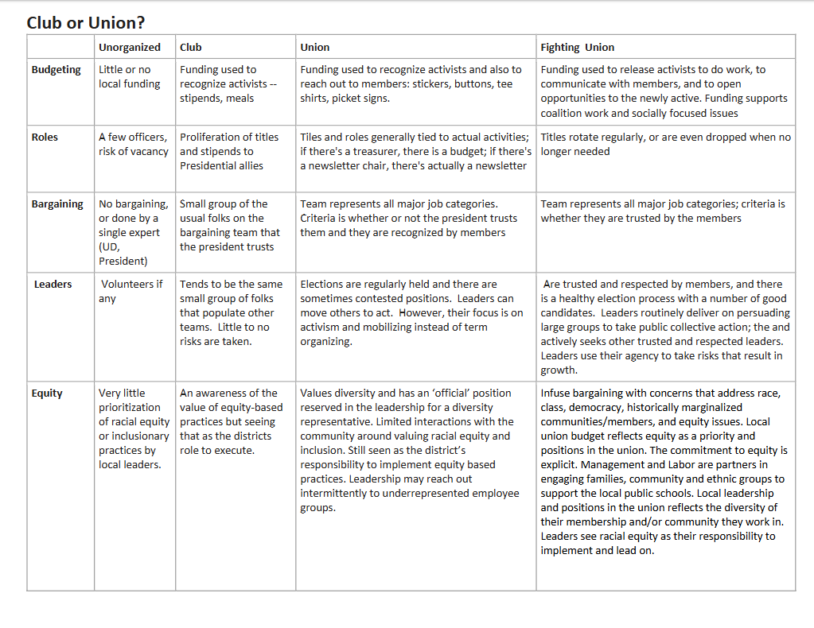
P. 100

Slide 19
Club or Union? ACTIVITY (In additional participant resources)
Unorganized
Club
Union
Fighting Union
Think of a local you work with – at what point of the continuum are they on?
What is your role in moving locals from left to right in this framework?
What do you think is most required to move from left to right?

Slide 20
Club or Union Debrief
Unorganized
Club
Union
Fighting Union
What did you learn?
How useful was this in thinking about your work with ESP units?
What would you add to it?

Slide 21
Key Ideas
Unions with leaders who are unwilling to take any level of risk will not be able to grow into unions that can demand and win what members want and need.
The way to build leaders is to not do for them what they can do for themselves, design “tasks” that cause people to have more leadership and ownership

Slide 22
Building Engaged Leaders
Michael & Eric

Slide 23
Building Engaged Leaders
The best way to grow leaders is to give them meaningful, challenging (risky) tasks (tests), and see if they can achieve them. Then give them another task to do . . .

Slide 24
Conditions of Motivational Task Design
Experience meaningfulness: the task is important in the overall scheme of things and is big enough that it will be a challenge to achieve.
1
Experience responsibility: how well the task gets done is up to me.
2
Experience results: as I attempt to do the work, I can see whether or not I am doing well.
3

Slide 25
How you make the ask matters
Communicate:
Why the task is significant
Why their input and contribution are key
That multiple skills are involved...and you'll help coach them if needed

Slide 26
Nothing is meaningful if you aren't expected to be accountable

Slide 27
“enabling others to achieve shared purpose in the face of uncertainty” (Ganz) p.102
Tasks
Organizing
Low Leadership High
Low Ownership High
Servicing
Socializing

Slide 28
As a team discuss how you could move those not in the organizing quadrant into the organizing quadrant or higher up either axis.
How would you bring this back to your locals?
Could it be a tool for you to self-evaluate or tool for a local to use with leadership to discuss?

Slide 29
Debrief
Why were your activities placed where they were?
Were there any engagement activities that your table struggled with placing?
How could you use this activity in practice?

Slide 30
Key Points
Tasks must be meaningful and members need to own them.
Our job is to look for opportunities to increase ownership and leadership whenever possible.
Leaders grow by taking risk, accepting ownership, and sharing accountability.

Slide 31

BREAK

Slide 32
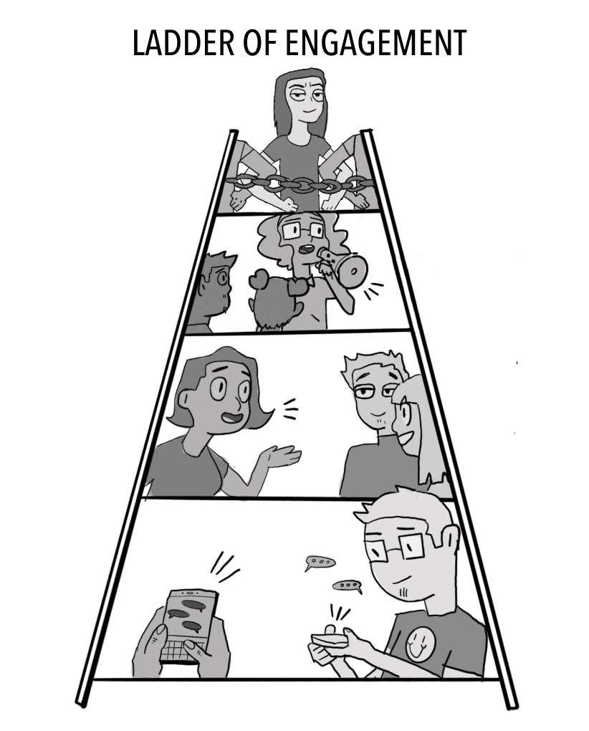
A Strategic Ladder for Union Campaigns
Jessica & Hedy

Slide 33
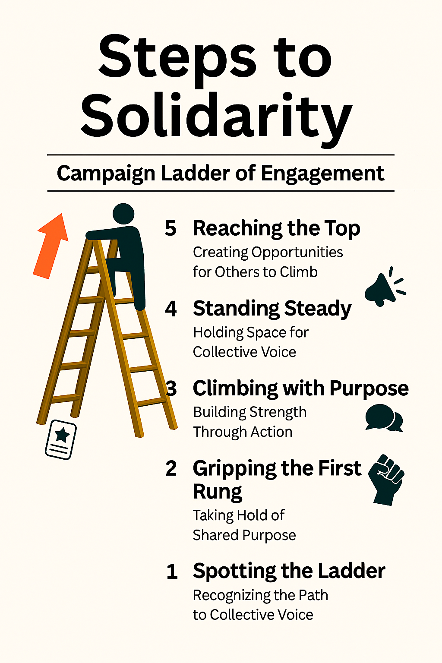
What is the Ladder of Engagement? P. 106
A framework to help union leaders activate and elevate member participation through a series of intentional steps.
Each stage builds trust, capacity, and ownership—turning passive members into powerful advocates and leaders.

Slide 34
Step 1: Spotting the Ladder – Recognizing the Path to Collective Power
Objective: Introduce the campaign and spark initial interest.
Tactics:
  Send targeted emails or texts with campaign goals and relevance to educators.
  Share compelling stories or visuals on social media.
  Host informal info sessions or coffee chats at school sites.
Leadership Focus:
Equip building reps and site leaders with talking points and flyers.
Use warm, inclusive language that affirms educators’ values and concerns.

Slide 35
Step 2: Gripping the First Rung – Taking Hold of Shared Purpose
Objective: Encourage members to express curiosity and take a first step.
Tactics:
  Invite members to sign a petition or pledge of support.*
  Conduct short surveys to gather input and build buy-in.*
  Offer low-barrier opportunities to attend virtual briefings or town halls.
Leadership Focus:
  Track engagement* and follow up personally.
  Celebrate participation publicly to build momentum.

Slide 36
Step 3: Climbing with Purpose – Building Strength through Action
Objective: Move members from passive support to active involvement.
Tactics:
  Recruit/Track volunteers for canvassing, phone banking, or event support.*
  Form working groups* around specific campaign issues (e.g., class size, funding).
  Host action nights or community forums.*
Leadership Focus:
  Provide clear roles, training, and support.
  Recognize contributions and foster team spirit.

Slide 37
Step 4: Standing Steady – Holding Space for Collective Voice
Objective: Cultivate consistent, reliable contributors.
Tactics:
  Invite members to take on formal roles (e.g., site coordinator, committee lead).*
  Offer leadership development workshops.*
  Engage committed members in strategic planning or negotiations.*
Leadership Focus:
  Build trust through transparency and shared decision-making.
  Create pathways for growth and mentorship.

Slide 38
Step 5: Reaching the Top – Creating Opportunities for Others to Climb
Objective: Enable members to lead, organize, and inspire others.
Tactics:
  Support members in organizing their own events or initiatives.
  Encourage representation at regional or statewide union gatherings.
  Develop a leadership pipeline with coaching and peer support.
Leadership Focus:
  Shift from directing to enabling.
  Celebrate leadership as a collective legacy.

Slide 39
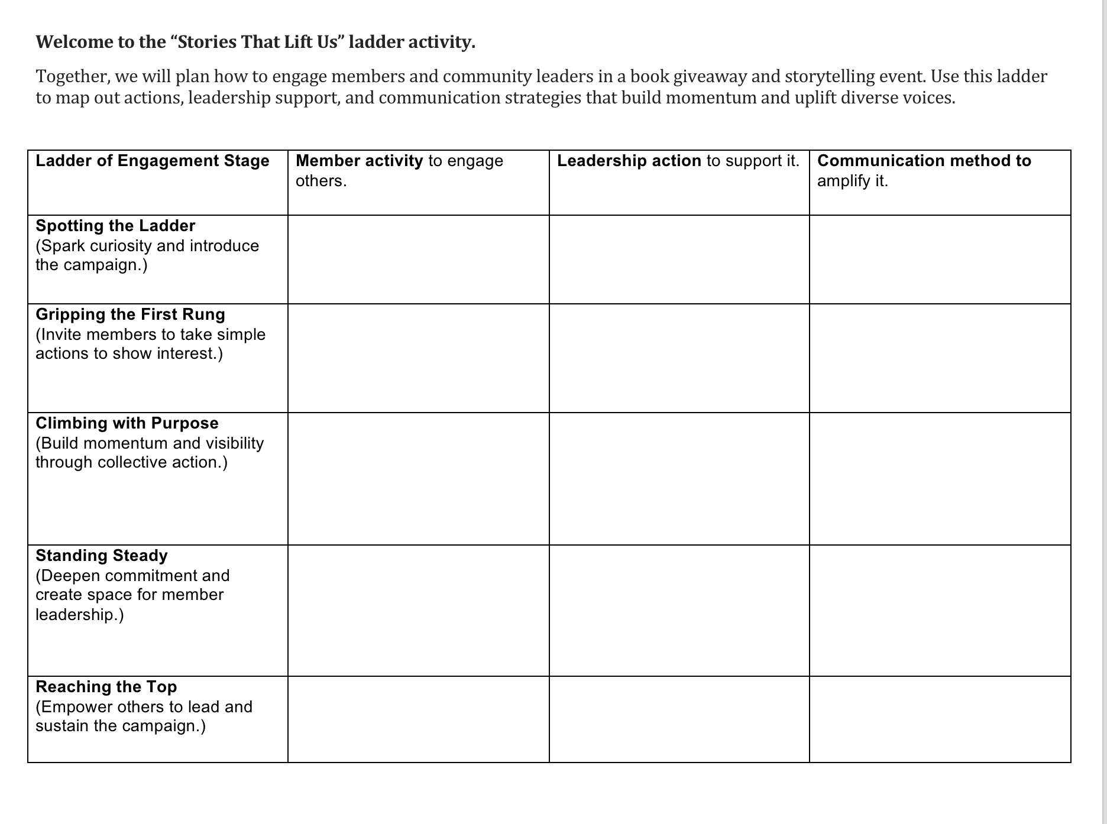
Let’s Practice!
P. 106

Slide 40
Share Out!

Slide 41
Debrief
What ideas or perspectives shifted as your group built the ladder?
Which stage did you see a strong potential for impact?
What strategies felt most effective for supporting and amplifying member voices?
What’s one action you feel ready to take after this session?
How can you help others climb the ladder with you?

Slide 42
Key Points:
Using the Ladder Strategically
Map your members: Identify where individuals currently sit on the ladder.
Design your campaign: Align tactics with each stage to meet members where they are.
Track progress: Use engagement data to assess movement and adjust strategy.
Build culture: Reinforce that union work is shared, valued, and visionary.

Slide 43
Campaign Planning Team Time
Beth & Sonia

Slide 44
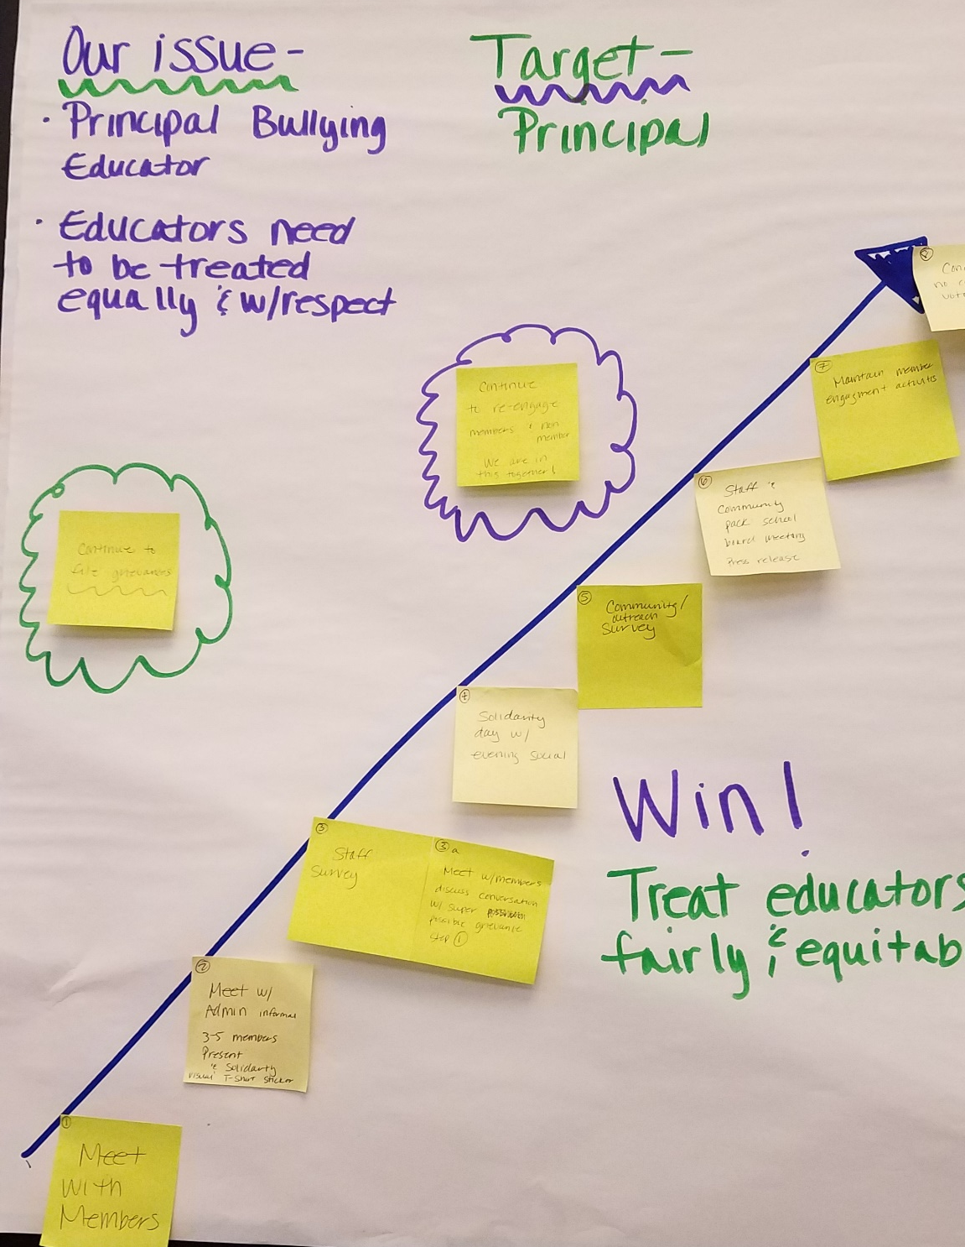

Team Work Time
Notes:
Ellen

Slide 45
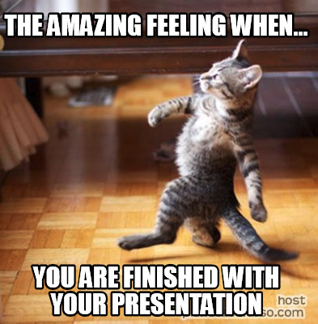
Team Presentation and Coaching Time

Slide 46
Feedback Questions
What specific elements of the plan stood out to you?
How did the plan engage others around the values they share?
How did the plan address finding and developing leaders to help implement the plan?
In what ways does the plan use opportunities to build structure and power?

Slide 47
Ending it Right
Ellen

Slide 48
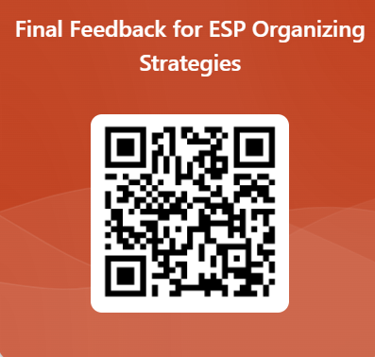
Please share your feedback with us

Slide 49
Campaign Lab Information and Application
https://www.nea.org/resource-library/campaign-lab

Slide 50

Ending it Right
Choice Networking
Housekeeping

