Slide 1
Organizing ESP
UniServ Focus Academy

Slide 2

Campaign Academy
By attending this training, you confirm that you are either an NEA affiliate staff person or NEA member in good standing. The information you receive here is only for your use in your capacity as an NEA affiliate staff person or NEA member.
This presentation and its contents are confidential and may not be further distributed or passed on to any other person or published or reproduced, in whole or in part, by any medium or in any form, for any purpose unless written consent has been provided by Ellen Holmes. Audio/video recording, copying of slides, and the use of AI note-taking tools are prohibited without the written consent from Kyle Serrette. Violation of these terms may result in legal action.

Slide 3
NEA Standards of Conduct
NEA has adopted a Standard of Conduct Policy to ensure that all of our gatherings are welcoming to and free from discriminatory, harassing, or otherwise unacceptable behavior. Discrimination or harassment based on race, color, ethnicity, religion, sex, age, national origin, sexual orientation, disability, gender identity, or expression, or any other characteristic protected by law will not be tolerated. If you have experience any discriminatory or harassing behavior, please report the incident by emailing Ron "Duff" Martin (rmartin@nea.org) and Gladys Marquez (gmarquez@nea.org). Thank you for your commitment to ensuring a positive event for all.

Slide 4
Feedback on Feedback
90% response rate – Range 4.6-4.8 High for the content, low for the materials
Themes:
Plus – Movement, facilitators, engagement with different folks
Deltas – Who is talking, side talking

Slide 5
Your Words
I really like that non staff is included. I also love that we aren’t just sitting and being talked at. I love the interaction. Although there were great conversations happening, I wonder if there is a way the facilitating team could help with side conversations that may distract others in the room while facilitators or others are speaking We spent time working on our biases, and yet some people hold on to those about ESP. This has been an amazing experience so far – I finally feel like an equal.

Slide 6

Agenda Review - Today
One to One Conversations/AAR
Spectrum of Allies
Living Wage
Coaching
Demand and Target
Tactics and Escalation
Organizing Plan Team Time

Slide 7
Community Agreements p. 2-3
Using Self-Awareness and Self-Knowledge
Listening for Understanding
Being Gracious
Staying Engaged
Being Open and Suspend Judgment
Saying “I”- tell your truth
Seeking Discomfort
Reaching Empathy
Expecting Non-Resolution and Non-Closure
*Adapted from “Embracing equity and inclusion”, Annie E. Casey Foundation
Notes:
Community Agreements for Our Time
Awareness and Self-Knowledge
This requires self-knowledge and self-awareness. Self-knowledge allows you to see what causes you pain and conflict and enables you to embrace your contradictions and inconsistencies. It allows the space to work on things about yourself that you are not happy with. In turn, self-knowledge helps to prevent you from projecting your negative aspects onto other people. Bringing your best self also requires that you have a positive attitude, are willing to deeply explore your perspectives and remain open to the perspectives and experiences of others.
Listening for Understanding
Be an active listener. Active listening involves paying full and careful attention to the other person, looking him or her in the eye, avoiding interruptions, reflecting your understanding, clarifying information, summarizing the other person’s perspectives and sharing your own. Remember that most people need time to open up and might not be willing to immediately share their personal stories, hopes, fears and/or concerns.
Being Gracious
Being kind is a vital way of bringing meaning to our own lives, as well as the lives of others. Kindness is about caring genuinely for others around you, wanting the best for them and recognizing in them the same wants, needs, aspirations and even fears that you may have. Being kind and generous allows us to communicate better with others, to be more self-compassionate and to be a positive force in other people’s lives. This includes following the COVID protocols that are in place to protect the health of this learning community.
Stay Engaged
Staying engaged requires you to be morally, emotionally, intellectually and socially involved in the conversation. Staying engaged means that you are listening with curiosity and willing to deepen your understanding. Staying engaged might also require you to sustain the conversation even when it gets uncomfortable or diverted. This also means a commitment to keeping your electronic communications to a minimum with folks not present in this learning community.
Be Open and Suspend Judgment
Listening with an open mind includes being receptive to the influence of others. You can suspend judgment by becoming aware of preconceived notions and listening to everything someone has to say before jumping to conclusions. Most importantly, suspending judgment also means listening to what the speaker has to say for understanding, not just to determine whether the speaker is right or wrong.
Say “I”- tell your truth
Speaking your truth in authentic and courageous conversations about race requires a willingness to take risks. It means that you will be absolutely honest and candid about your own thoughts, feelings, experiences and opinions and not just saying what you perceive others want to hear. Speaking your truth will require you to speak from the “first person” and use “I” statements.
Seek Discomfort
Leaning in to discomfort will require you to let go of racial understandings and stereotypes that you may be holding onto in order to move forward. Leaning in means that you will avoid judgment, assume positive intent and be open to the kernel of wisdom in each individual’s experiences. Leaning in to discomfort will require you to sit through moments of embarrassment, confusion, anxiety and/or fear.
Reaching Empathy
Empathy and compassion allow you to understand the other person’s point of view. When you are empathetic, you are more understanding, patient and kind. Expanding your capacity to feel empathy will also allow others to enter your circle of human concern.
Resolution and Closure
Expect and accept that there may not be closure. It is not likely that you will resolve your personal understanding about race or another person’s racial experience in a single conversation. The more you talk about race with another person, the more you learn and the more they will learn. Authentic and productive conversations about race are continuous and always evolving.
*Adapted from “Embracing equity and inclusion”, Annie E. Casey Foundation

Slide 8

What else has been on your mind about this work?

Slide 9


Campaign Lab Information and Application
https://www.nea.org/resource-library/campaign-lab

Slide 10
Organizing Conversations
Jessica & Monet

Slide 11

Why do you think we need to talk about doing member conversations in a training for ESPs?
Talk at your table and be ready to talk as a room.
Notes:
Why do you think we need to talk about...
Take some time – about 5 mins – and be ready to talk as a room
What did you come up with?

Slide 12
Basics of One on Ones
Notes:
Quick content set

Slide 13
One on Ones can be...
Recruitment
  Values and Commitment
Escalation
  Member to Activist to Mobilizer to Leader
Maintenance
  Relationship, Leadership, Strategic
Notes:
When one person talks to another person
And its primarly to get to know each other, but can be used for
Recruitment, Escalation, Maintenance

Slide 14
We listen to relate to our people p.31
Listen 80%; talk 20%
Use open ended questions-
  "Will you become a member?" Or "Why are you not yet a member?"
Not about winning an argument or interrogating
Learning where our stories connect
Shared values, commitments, risks
Notes:
What do we do when we have one on ones
Listen 80%; talk 20%
Use open ended questions (Not will you become a member as opposed to
Not about winning an argument or interrogating even is they are wrong
Learning where our stories connect
Shared values, commitments, risks

Slide 15
We listen to identify their issues and values
Use open-ended questions
  What’s not right here?
  What would you change?
  Why is this an issue for you?
  Why do you care about this?
Notes:
As Organizers we are listening to identiry their issues and values, not TELL them what the issues are
We use probing questions such as:
Use probing questions
What’s not right here?
What would you change?
Why is this an issue for you?
Why do you care about this?

Slide 16
We ask for commitment when we recruit
Use direct and specific language
Stress the shared values you have exchanged
Frame it so that the person IS the solution to the ask
Move them towards the next level of action
Notes:
Use direct and specific language – Are you ready to sign this pledge cards, will you bring 5 people with you
Stress the shared values you have exchanged - Like you, I have been a low paid person that has felt disrespected by my managers
Frame it so that the person IS the solution to the ask – We cant win this if you do not show up, You are critical to the success of this action
Move them towards the next level of action – You joined us last month at Happy Hour, can you bring 5 people

Slide 17
We ask to identify leaders when we escalate
Who is trusted and respected?
  Why?
To objectively identify leaders, we must ask our people
Notes:
We do not organize worksites, worksites are already organized by natural leaders
We have to ask who is trusted and respected
Even if they are not a member, we need to be in contact
We cannot idently leaders based on our own observations and bias' - They wear the swag, they have been here 20 years but no one talks to them
We have to ask our people who they trust.
The attendance at the most recent ESP Conference

Slide 18
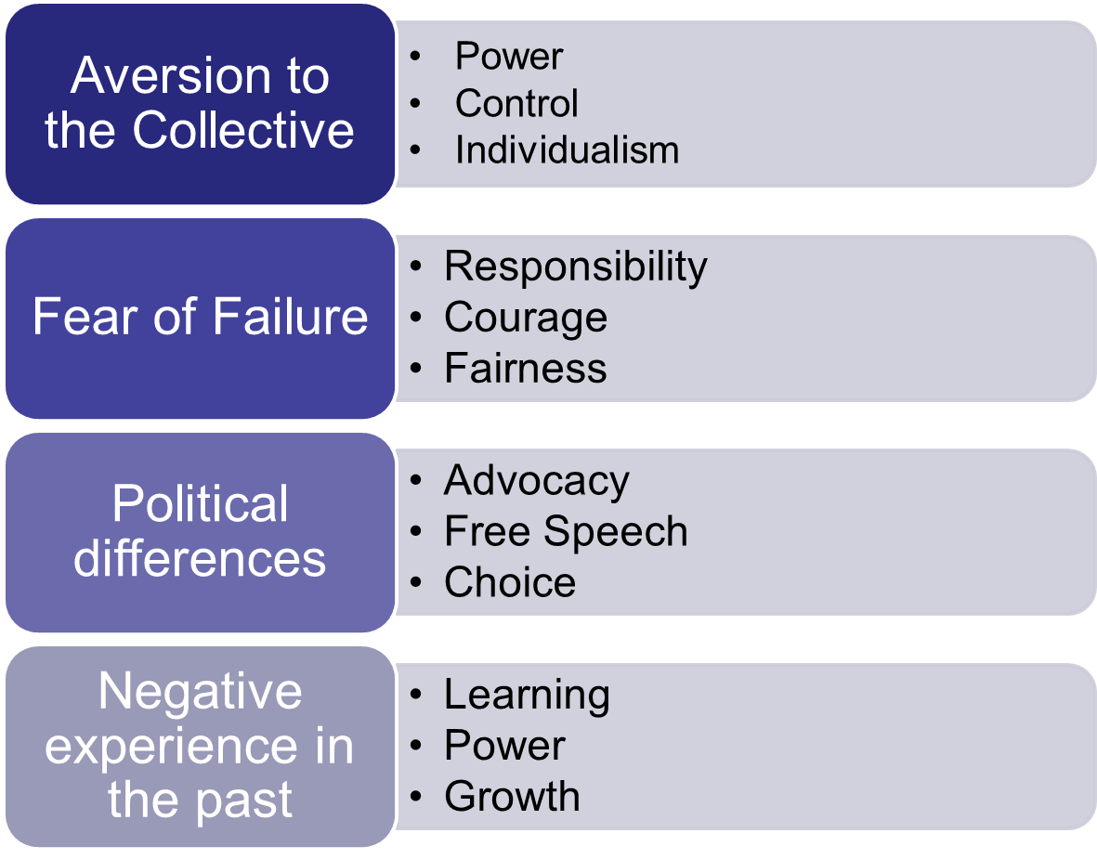
Possible Tensions
The Answer Dig for Values

Slide 19

Responding with AAR

Slide 20
Responding with AAR
Affirm: Let them know you validate their feelings.
Answer: Give them an answer to the question. (Or get back to them.)
Redirect: Bring the conversation back to the ask.

Slide 21

Practicing AAR (Affirm, Answer, and Redirect)
Find a Partner who you have not yet worked with.
One will be the Organizer, one will be the Potential Member.
After the first round you will switch roles for the second round.
We will then find a new partner and repeat for rounds three and four.

Slide 22
Practicing AAR (Affirm, Answer, and Redirect)
Organizer [Mid-conversation]: "Will you join our association as a member?"
Potential member: respond with one of the following:
Dues are too expensive
Unions are too Political
It is not for me
I didn't even know I could belong
I don't feel valued by the people in charge
What other reasons do ESP give for not being members, engaged in action, or feeling heard by their union.

Slide 23
Debrief
How did that go?
What part(s), if any, were most challenging?

Slide 24

Key Points
Organizers listen and ask questions!
  Organizers prepare to respond to difficult questions
  Organizers work to understand a person's values that drive their concerns
We want our workers to realize:
  They care about a problem (issue)
  There is a decision-maker who has the power to fix this problem
  The decision-maker won’t fix it until someone pushes them to
  To solve the problem they need to join their colleagues, share their resources and take action together

Slide 25
Spectrum of Allies
Jessica & Hedy

Slide 26

Analysis of Allies
The urgency of your message. - why do people need a solution? What are the shared values?
Your Structure – leaders & teams
Your linked communities – who are people in your community connected though your shared values?

Slide 27

Spectrum of Allies

Slide 28
Spectrum of Allies Part 1 p. 122-3
  Active allies: people who agree with you & are organizing alongside you
  Passive allies: people who agree but aren't doing anything about it (yet!)
  Neutrals: people who aren't sure, or are unengaged (they might just not know about you yet)
  Passive opponents: people who disagree, but aren't trying to stop you
  Active opponents: people who have done something to prevent you from reaching your goal

Slide 29
Who are your Spectrum of Allies
  Who will be most supportive, least supportive, or neutral?
    Unions
    Business Community
    PTA
  Identify these groups (and why?)and put them on your spectrum - write them into the pie.
  Be as specific as possible – names
  Identify why you placed people where yo placed them

Slide 30
Where You Focus Your Energy Matters
Only the Opposition – cynicism
Only the Active Allies – stagnation
Generalizations about Slices – missed opportunities
DO FOCUS ON THE PASSIVE ALLIES
  These are folks who know or care about what you’re up to, but aren’t doing anything about it! Give them a chance to participate and build power with you.
THE GOOD NEWS
  It is only necessary to move some or all of the pie wedges one step in your direction. If we shift each wedge one step, we are likely to win, even if the hardliners on the opponent’s side don’t budge.

Slide 31
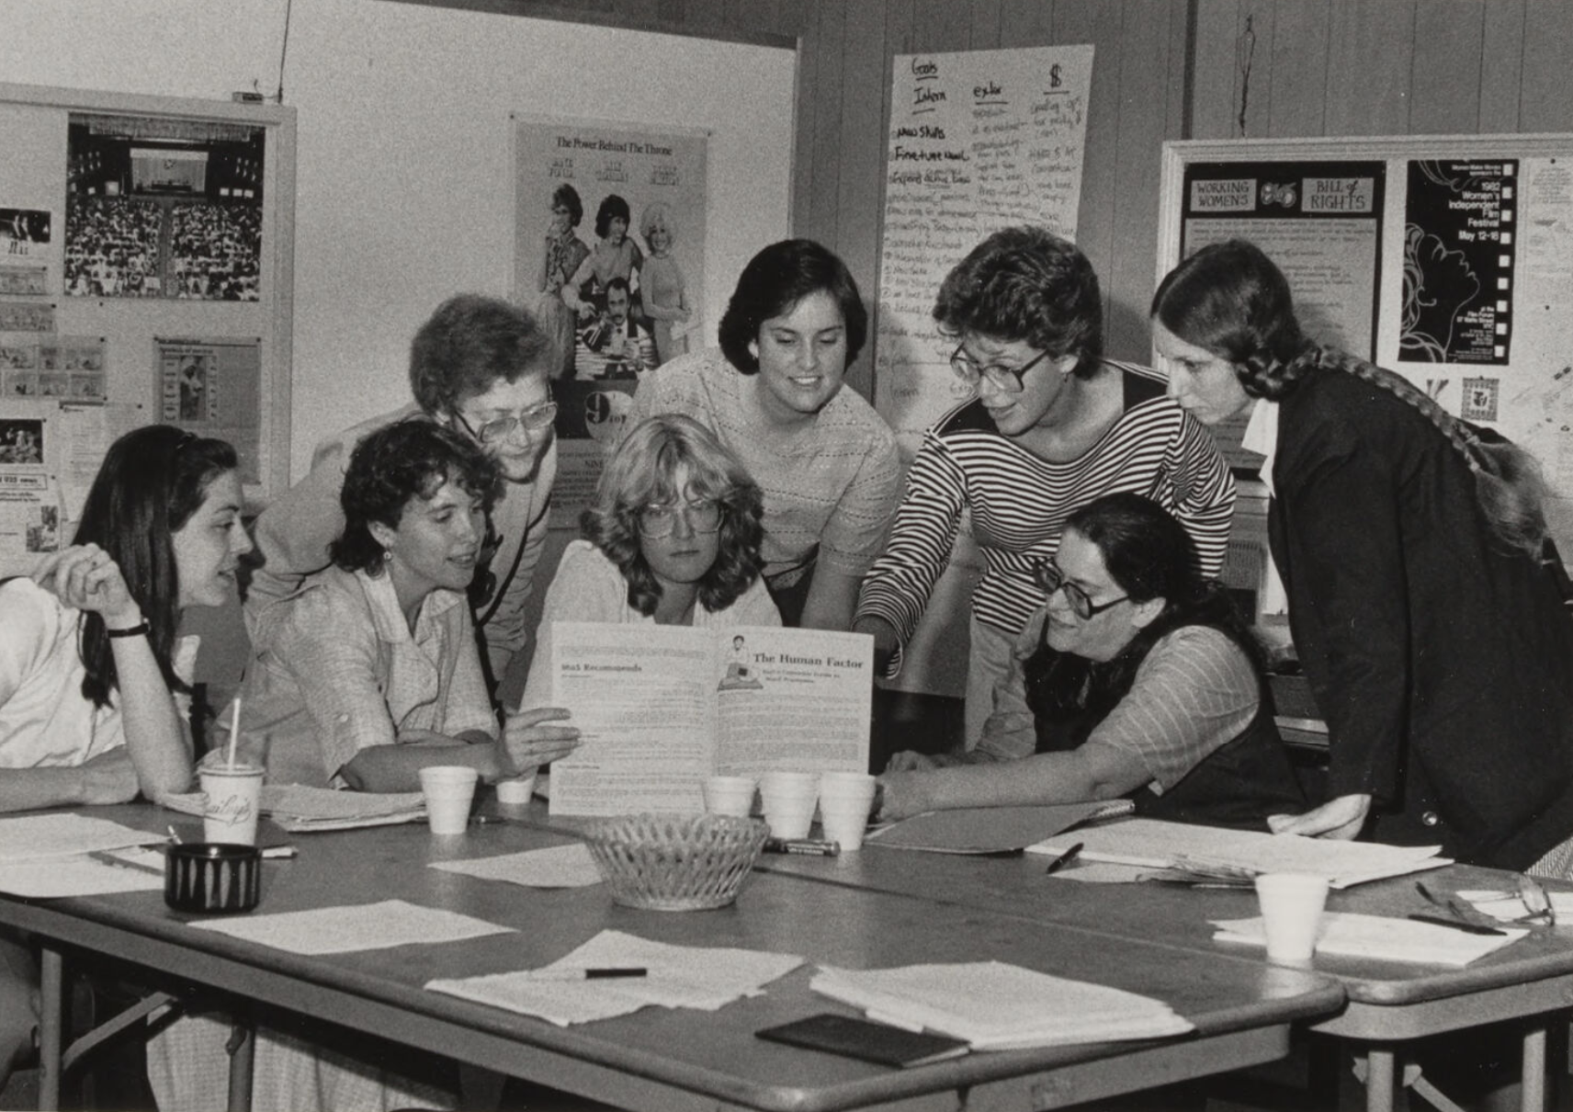
An example from history –
9 to 5 National Association of Working Women

Slide 32
Spectrum of Allies Part 2 p.123 & 124
Develop a convincing argument or values-based narrative that will appeal to the neutral or passive ally wedge.
Design one small achievable ask to engage one individual from that wedge to move closer to you.

Slide 33
Team Pair Share of Spectrum of Allies

Slide 34
Spectrum of Allies Debrief – Whole Group
How did it feel to present your arguments for how to move your wedges?
What is something new you learned from this or from another team?
What do you think you could apply to your current work?

Slide 35
Key Ideas
It is only necessary to move some or all of the pie wedges one step in your direction.
If we shift each wedge one step, we are likely to win, even if the hardliners on the opponent’s side don’t budge.

Slide 36

BREAK

Slide 37
Living Wage Campaign
Beth & Michael

Slide 38
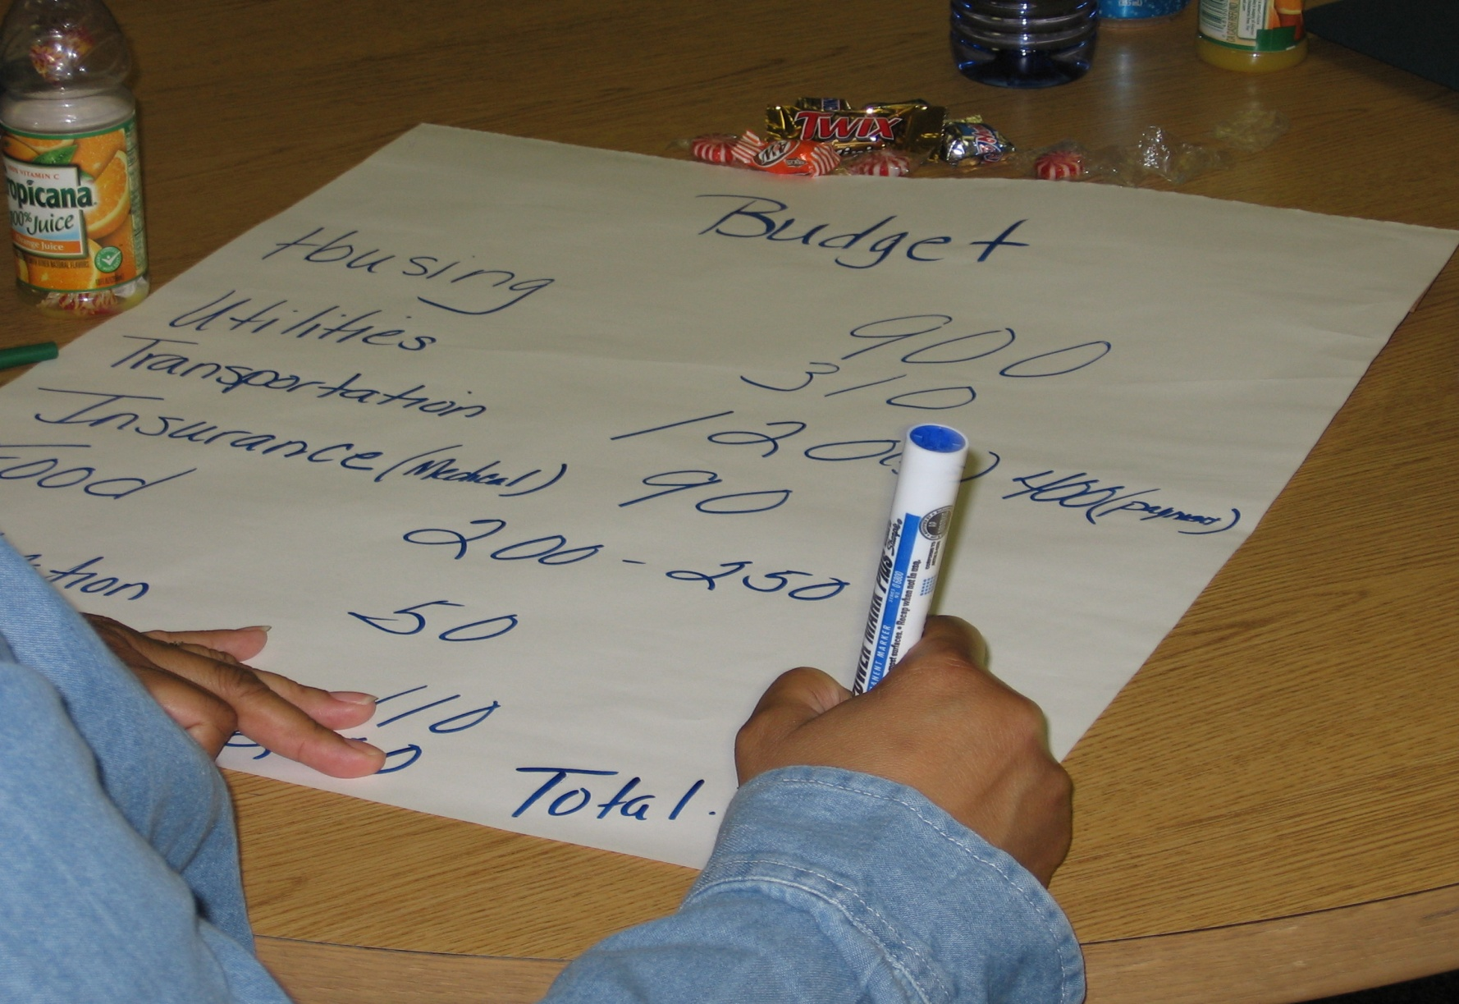
What is a Living Wage?
Group work: Make a list

Slide 39

Living Wage: The Basics
A Living Wage defined: Sufficient earnings to cover basic needs
food
housing
clothing
transportation
utilities
child-care
taxes
health care
Notes:
This is just an existence, not a living. But it’s a start

Slide 40
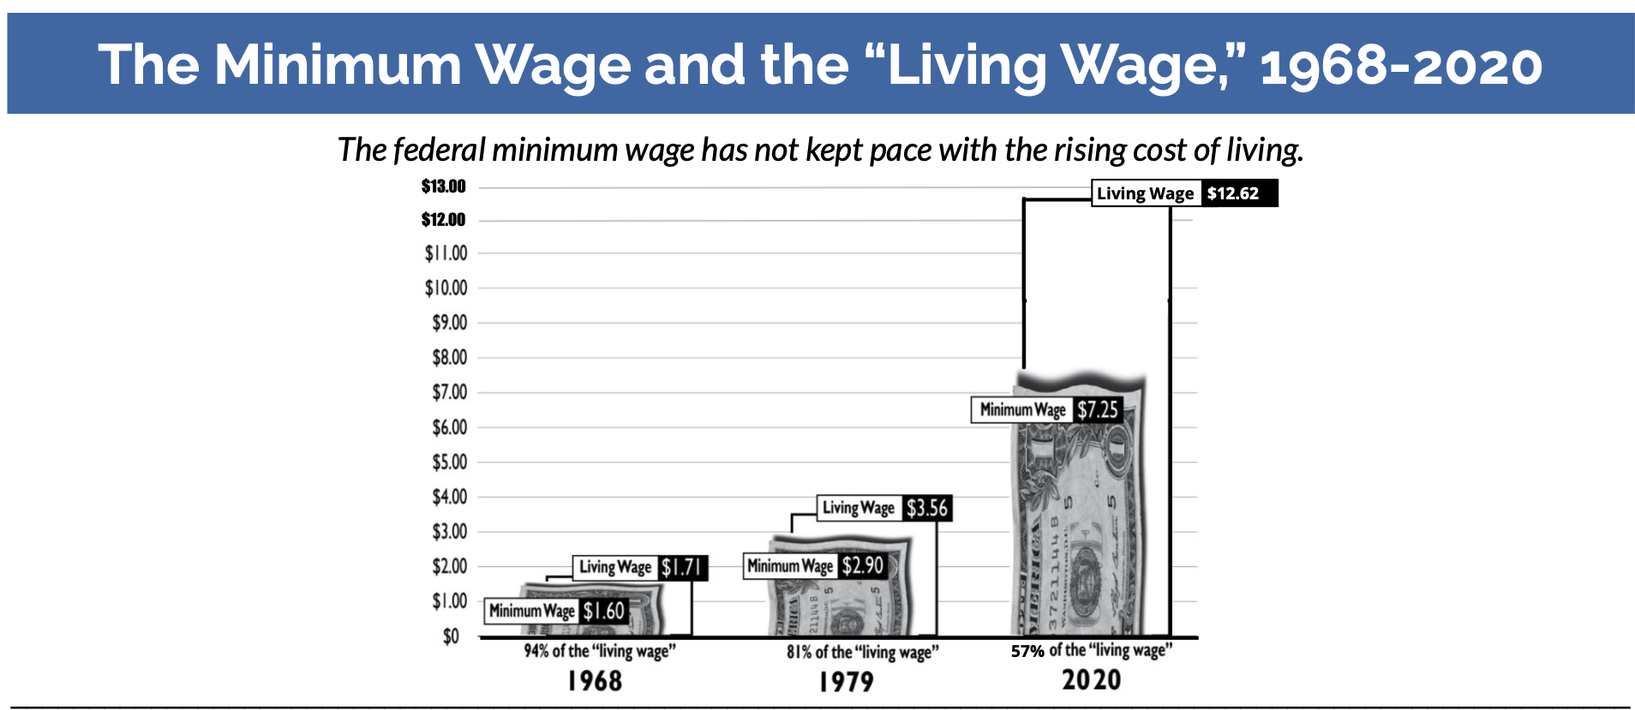
2026 - $15.87
Notes:
Chart reference - https://www.faireconomy.org
The growing divide charts (2022 edition) - https://www.faireconomy.org/training_guides?page=1

Slide 41
Currently
The U.S. federal minimum ($7.25) is less than twenty percent of the “living wage” for a single adult ($40.38 an hour, or roughly $84,000 a year pretax)
Less than a third of what a family of four needs to live — around $40 per hour per parent/guardian, or about $167,000 a year combined.
Notes:
https://www.epi.org/resources/budget/budget-factsheets/
Change for the city the training is in

Slide 42
What is a Thriving Wage?
Group work: Make a list

Slide 43

Identifying the 10 Steps

Slide 44

10 Steps to a Living Wage Campaign

Slide 45
10 Steps of a Living Wage Campaign
Pick an issue
Buy In
Timeline
Action Plan
Gather Data
Internal Organizing
External Organizing
Messaging / PR
Escalate
Celebrate!

Slide 46
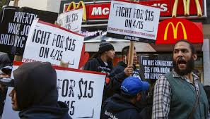
Group work
Seattle
Pg. 53
Somerville
Pg. 62
Minnesota
Pg. 72
Notes:
Split the participants into 6 groups.
Chart Paper Step 1 – 10

Slide 47
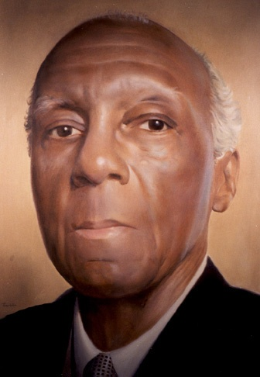
It’s All About Organizing!
“At the banquet table of nature there are no reserved seats. You get what you can take and you keep what you can hold. If you can’t take anything, you won’t get anything; and if you can’t hold anything you won’t keep anything. And you can’t take or hold anything without organizing.”
-A. Phillip Randolph, founder,
Brotherhood of Sleeping Car Porters
Notes:
-If a local leader doesn’t get this.. They’re not ready for a campaign.
A LW campaign can be done in a non-bargaining state as well as a bargaining state. Whether you are bargaining or advocating and lobbying – the campaign strategies are the same

Slide 48
A Living Wage Campaign is…
About seeking more than the usual modest raise.
As much about grassroots organizing, intensive planning and union building as it is about gathering salary data or arguments.
About winning professional, competitive pay by “surrounding” the employer with your members and community allies.
Notes:
Salary campaign strategy always involves unity, consensus, strategic planning, solid research and arguments, member organizing and engagement, coalition work, constant communications, and the sense that “We’re worth it.”
What is It REALLY About?
Working only one job and having time for your family, friends, and yourself.
Social Justice, Worker’s rights, Human rights, Women’s rights,
Self-worth, respect, and dignity on the job.

Slide 49
What Makes a Living Wage Campaign Different ?
Social Justice
Living Wage Data
External Organizing
Internal Organizing
Notes:
Not settled at the bargaining table, but out in the community.

Slide 50
Revisiting the scenarios
If you were able to change one thing about your scenarios campaign, what would it be?
OR
How would you change your scenarios campaign to include steps that may have been incomplete and/or missing?
Notes:
Section Time Allotment: 60 minutes
Facilitators are encouraged to float around the room and talk to tables

Slide 51
Key Points
A living wage can be done effectively in a bargaining or non-bargaining state because it is all about organizing.
A federal policy strategy to addressing living wage is unlikely to give our members what they need.
Moving the narrative of a minimum wage to a living wage and ultimately towards a thriving wage

Slide 52

Lunch

Slide 53
Organizer Math: Building Exponential Power
Hedy

Slide 54
How many people does it take to win a campaign?

Slide 55

How can I make a difference?

Slide 56
What does this have to do with building structures and power in a campaign?

Slide 57
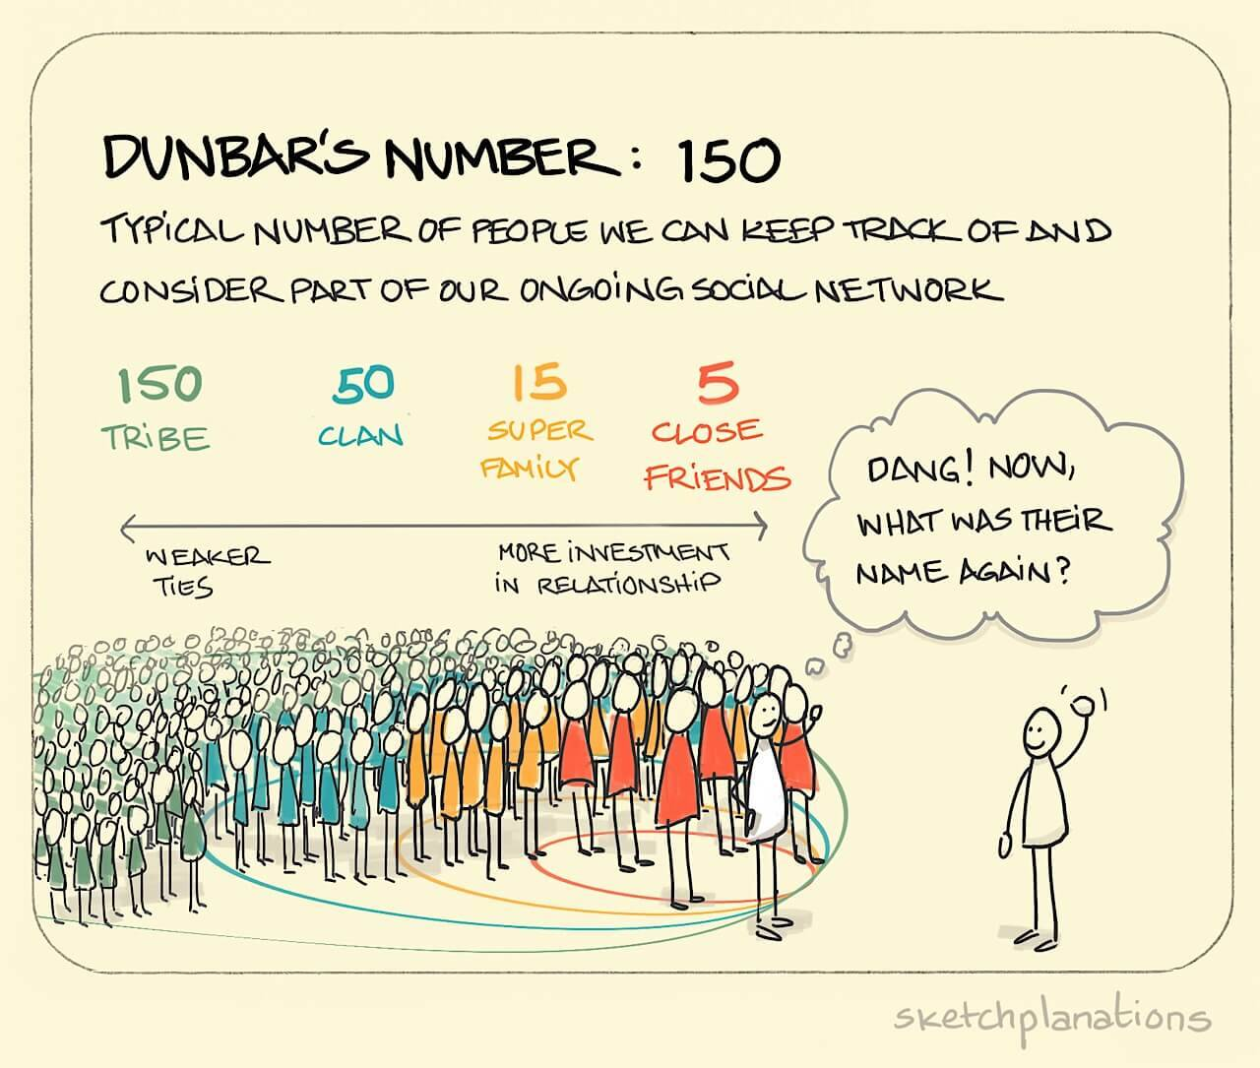

Slide 58
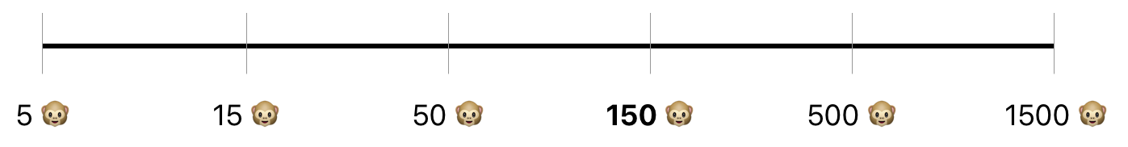
Why do we care about Dunbar’s Numbers? Pages 89
Stable - Relationship
Connections
Developing Leaders
Engaged Members
Aware Members
Disengaged Members - Supporters
“Driver” Leaders
Natural Leaders

Slide 59

Challenges of Growth Beyond 150
Loss of Solidarity – The sense of common purpose weakens.
Weakened Communication – Communication shifts from fluid and informal to more structured and formalized – this reduces face-to-face interaction.
Need for Formal Structure – A more formal, hierarchical structure becomes necessary to maintain organization.

Slide 60
Case Study: The ESP Bill of Rights Campaign
Page 93
Crisis: Board announced cut (outsource bus drivers, custodial, food service jobs, cut paraeducator hours).
Union’s Shift: From service unionism → organizing for the Common Good.
Victory Metric: 6,200 public pledges.
Notes:
Explain the strategic pivot: HPSEU reframed demands as Common Good issues, enabling coalition building and political leverage.

Slide 61
Team Work Time Pg. 90-97
At your table, answer the Debrief Questions in the Case Study (p. 97)
  How did framing demands as Common Good issues change the campaign's reach & impact?
  What were the key turning points in the campaign that shifted power toward the union?
  Why was achieving 88% internal unity before going public critical for success?
  How did the coalition with parents, teachers, and community groups amplify the union’s leverage?
Use all of the information included in pages 90-97 to answer the questions
Be ready to report out.

Slide 62

Report out

Slide 63
At your table, answer the Debrief Questions in the Case Study (p. 97)
  How did framing demands as Common Good issues change the campaign's reach & impact?
  What were the key turning points in the campaign that shifted power toward the union?
  Why was achieving 88% internal unity before going public critical for success?
  How did the coalition with parents, teachers, and community groups amplify the union’s leverage?
Use all of the information included in pages 90-97 to answer the questions

Slide 64
Phase 1 – Internal Unity (The Spark)- p. 96
Leadership Team 12
Organizer
Organizer
Organizer
Organizer
Organizer
Organizer
Organizer
Organizer
Organizer
Organizer
12 Core Leaders → 120 organizers (10% of union).
1,150 ESPs "Purple for Dignity Day" ; 88% internal unity
Internal Unity
Victory
External Coalition
Notes:
Stress importance of structure tests and supermajority commitment before going public. This phase builds internal strength.

Slide 65
Phase 2 – External Coalition (The Multiplier)- p. 96
Internal
External
200
40 community allies (teachers, parents, clergy).
Rally: 1,800 attendees at districtwide rally.
Internal Unity
Victory
External Coalition
Notes:
Show how Common Good framing multiplies power and builds political pressure through external allies.

Slide 66
Final Phase – The Turning Point (Victory) - p.96
6,200 pledges +95% of members authorized strike vote
Board backed down from outsourcing, wage adjustments
Paid training and PD
Job security and respect in decision making
Bill of Rights adopted
Internal Unity
Victory
External Coalition
Notes:
Emphasize measurable commitment as ultimate power metric. Translate numbers into political cost for decision-makers.

Slide 67
Planning Checklist for Organizers- page 98
Identify
Identify 10% organizers.
Test
Test structure with measurable asks.
Frame
Frame demands as Common Good.
Build
Build coalition.
Track
Track power metrics.
Notes:
Provide practical steps for replication. Encourage organizers to apply these immediately in their campaigns.

Slide 68
Team Work Time
As a Team, complete the Planning Checklist for your own campaign (p. 98)
Be ready to report out

Slide 69
Team Work Time
1. Leadership Team: Do we have a diverse, action-oriented team of 5–12 dedicated leaders?
2. Structure Test: Have we identified and trained 10% of our base to be organizers?
3. Measurable Ask: Does our first action (e.g., a pledge, a color day) have a clear participation goal (e.g., 90%)?
4. Narrative: Is our demand framed as a Common Good issue that attracts external allies?
5. Coalition: Have we recruited at least 50 external partners (parents, teachers, clergy, community leaders)?
6. Power Metric: What is our final, public measure of power (pledges, signatures, votes)?
7. Accountability: Do we track participation, follow-up, and progress weekly?

Slide 70
Report Out

Slide 71

Key Points:
Power is not what you have, but what you can mobilize because you have working structures.
Organizing success depends on measurable commitment, not just membership size.
More people = More power

Slide 72
Centering Race, Class, and Gender
Ben

Slide 73
What type of union builds power?
Campaigns
Public Action and Demands
Strategic and Ongoing
Continues to Add
  Base – Mobilizers - Leaders
  Allies – Partners - Coalitions
  Requires Risk
  Supported by Staff
  Leaders Build and Use Power
Programs
Build Presence
Episodic
Member Recruitment
Committee/Program Leaders
Low Risk
Often Staff Led
Power in Policy

Slide 74
Centering Race, Class, and Gender Justice
Race, class, and gender justice is the systematic fair treatment of people resulting in equitable opportunities and outcomes for all.
It is not just the absence of discrimination and inequities, but also the presence of deliberate systems and supports to achieve and sustain race, class, and gender equity through proactive and preventative measures.

Slide 75

Race, Class, Gender Equity Tools Pg. 99
What they do:
Proactively seek to both eliminate systemic barriers and advance equity
Identify clear goals, objectives and measurable outcomes
Develop mechanisms for successful implementation
What they are:
A set of questions used to anticipate, assess, and prevent potential adverse consequences of proposed actions on different race, class, or gender groups.

Slide 76
Key Points about Equity Tool Success
Buy in from the organization and its leaders
Routine and ongoing use of the ET
Data- driven assessment
A commitment to making changes
Tenacity – A commitment to overcoming obstacles to making changes
WE HAVE TO DECIDE TO DO THINGS DIFFERENTLY AND STICK WITH IT

Slide 77
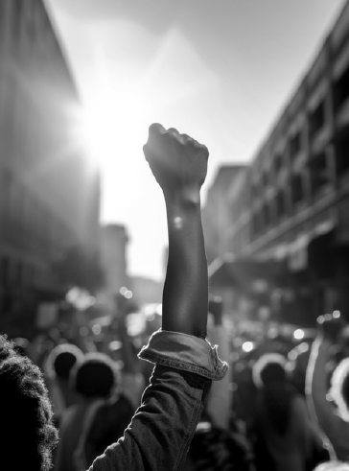
TEAM WORK
Review your Problem and Issue charts.
What will it take to achieve equity for the people who work in our schools?

Slide 78
TEAM WORK - Return to Your Problem Charts
Who are my people?
What are their issues?
What do they demand?
What are they willing to risk in order to win that demand?
STEP 1
For Your Issues ask these 4 Questions

Slide 79
STEP 2
For each of the answers in step 1, ask these 4 questions.
For each of the four organizing questions also ask:
​Who is most directly impacted?
Who has been left out?
How can they be directly engaged?
How do our demands advance race, class, or gender justice?

Slide 80
Key Points
Intentional campaigns, not programs build power.
Centering race, class, and gender justice in our campaigns increases the people engaged, the number of leaders involved, and the amount of resources we have to win the change we want.
Power is only built through people with a shared vision, making public commitments to act, to risk their collective resources, for the meaningful change they want.

Slide 81
BREAK

Slide 82
Demand and Target
Eric

Slide 83

REVISITING YOUR ISSUE
In your local teams determine your ISSUE...
  List the ISSUE at the TOP of the CHART PAPER
5 MINUTES

Slide 84
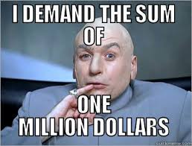
When making a demand …
  A demand is the outcome that addresses the issue.
  Measurable
  Achievable
  You will need pgs. 117 and 120
Notes:
Hedy

Slide 85

Targets:
A single person:
  - a name, face, & address
They have the power to give you what you are demanding
If the issue is what is wrong, the target is who can fix the issue.
Notes:
Hedy

Slide 86

Issue Work! (Charts)
Identifying Demands, and Targets
Return to your chart groups and revisit your issue(s)
    Demand
      What do you want to win to solve your issue?
    Target
      Who has the power to give you your demand?
      Who can influence this target?

Slide 87
Ask these 4 Race and Equity Tool questions of your Target and Demand.
For each of the four organizing questions also ask:
​Who is most directly impacted?
Who has been left out?
How can they be directly enagaged?
How do our demands advance race, class, or gender justice?

Slide 88
Key Points
A well thought out campaign has a strong issue, with an identifiable target and a strategic demand.
A target is a specific person!
We don’t choose the issues! We identify the issues from talking to members!
Notes:
Hedy

Slide 89
Tactics and Escalation
Eric

Slide 90
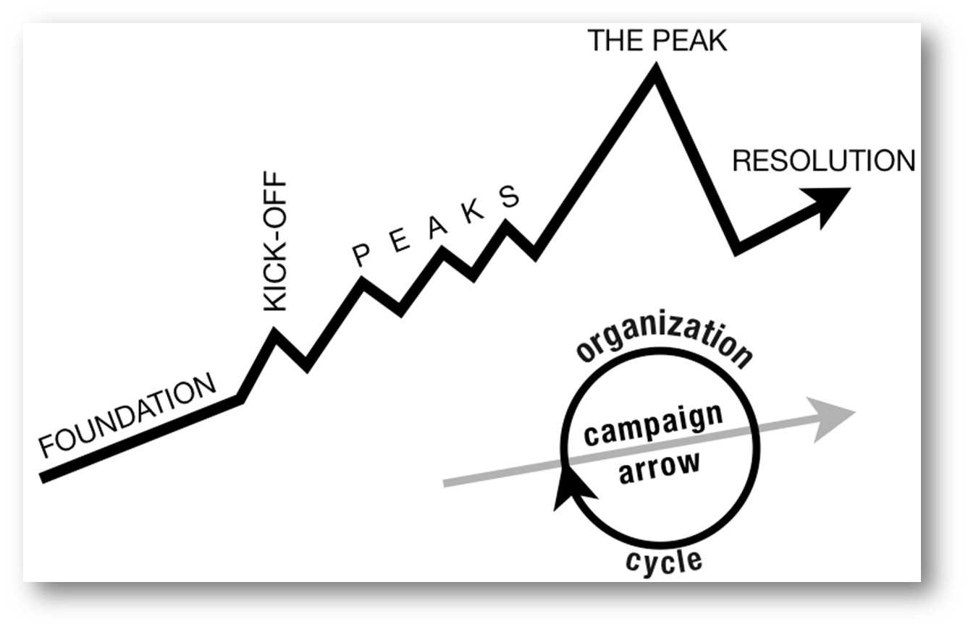
Structure of a Campaign
WIN
Notes:
Hedy
Tactic scramble!

Slide 91

Tactics
Tactic – Actions you take as a part of an escalation plan that increases pressure on your target to try to win your demand.
Notes:
Sara

Slide 92


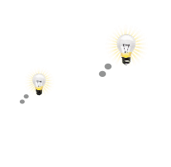

A TACTIC SHOULD:
Goal
Puts pressure on your Target
(puts them out of their comfort zone)
1.
Builds your Power
(develops leaders, brings more people in, etc.)
2.
Is Strategic
Notes:
Sara

Slide 93
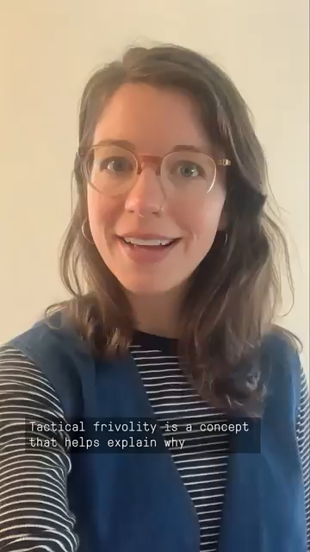
Were these effective tactics?

Slide 94
Scenario Work!
Tactics Brainstorm p. 126
+++YOU HAVE 5 MINUTES!+++
Brainstorm AS MANY tactics as you can on 1 chart.
Be creative!
You are NOT evaluating right now! Everything goes on the board!

Slide 95
Evaluating Tactics
Are enough people ready to do it?​
Will it unify people?​
How will management react?​
How will your target react?
Does it violate the law? (If so, are we prepared for the consequences?)​
Will it be fun?
Does the action relate to your issue?
Will it increase the pressure on the decision-maker?
Is it visible?
Is it timed for effect?
Is it new and different—or tried and true?

Slide 96
Evaluating your Tactics!
+++YOU HAVE 10 MINUTES!+++
Look at the list of tactics on your chart.
Circle the ones that are strategic!
Cross out the ones that are NOT strategic

Slide 97
Compression Points
Points on the calendar where you celebrate short term wins or escalate your tactics based on how you have assessed your readiness to escalate.
  Naturally occurring deadlines
  Artificial deadlines
  Help us build urgency and crisis
  Opportunities to debrief and reassess

Slide 98

Why do you think tactics escalate gradually?
Building an Escalation Plan
GOAL
Tactic
Tactic
Notes:
Sara

Slide 99
Each escalation is more public, more visible, and has more risk. We transform members to activists, activists to leaders by asking them to take bigger risks.
GOAL
Tactic
Tactic
Notes:
Sara

Slide 100



Resources that shrink as you use them:
Time/Energy
Tangible Items - materials
Money

Slide 101



Resources that grow as you use them:
Relationships
Skills
Hope
Trust

Slide 102
Ask these 4 questions of your tactics.
For each of the four organizing questions also ask:
​Who is most directly impacted?
Who has been left out?
How can they be directly enagaged?
How do our demands advance race, class, or gender justice?

Slide 103
Key Points
Strategy without tactics is simply a collection of good ideas and big dreams.
Tactics without strategy are a random collection of activities and wasted resources.
The bigger the win you want, the more resources you need.
Good tactics actually result in more resources – relationships, skills, hope and trust.
Notes:
Sara

Slide 104
Campaign Planning
Sonia

Slide 105
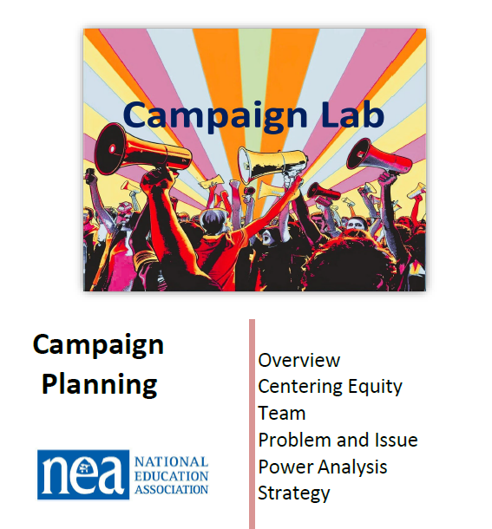
Begins on page
P. 107

Slide 106
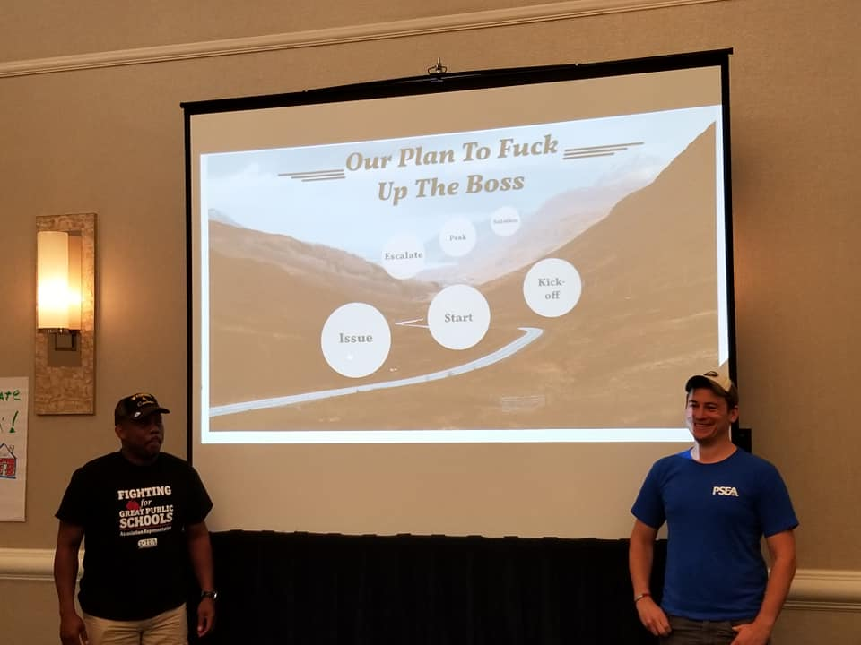
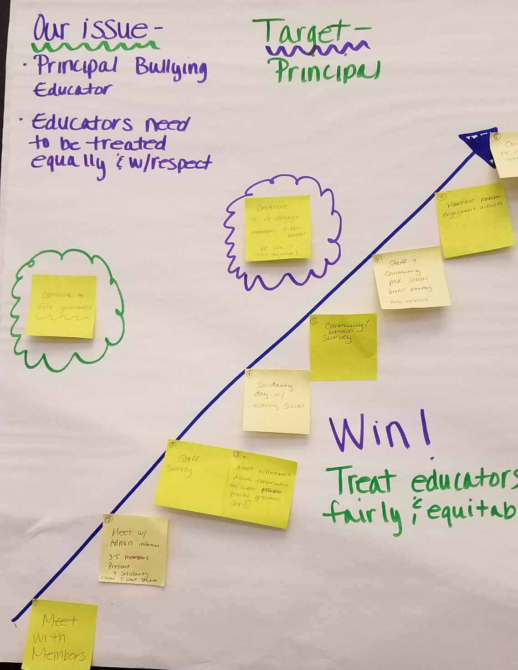

Team Work Time

Slide 107
Guidelines
Consider using 18 months timeline
Remember the 10 steps
Incorporate "test/tasks" design into tactics
Increase Success:
Plan should motivate
Consider risks
Accountability imbedded into plan

Slide 108
Ending it Right
Ellen

Slide 109

Your thoughts so far…

Slide 110
Problem of Practice
The problem of practice is something that you care about that would make a difference for your locals if you improved it.
The more specific the problem of practice is, the more helpful the recommendations for your next level of work will be.

Slide 111
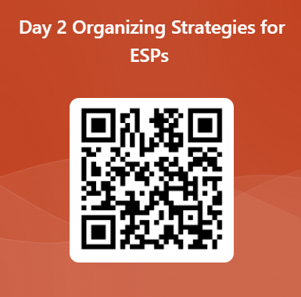
Please share your feedback with us

Slide 112
Campaign Lab Information and Application
https://www.nea.org/resource-library/campaign-lab

Slide 113

Ending it Right
Choice Networking
Housekeeping
Checking out, Flights, Taxis
Plus and Delta at the Door

Slide 114

Choice Network Time

Slide 115

What will you take with you into your future work?
Closing our time together…

