Slide 1
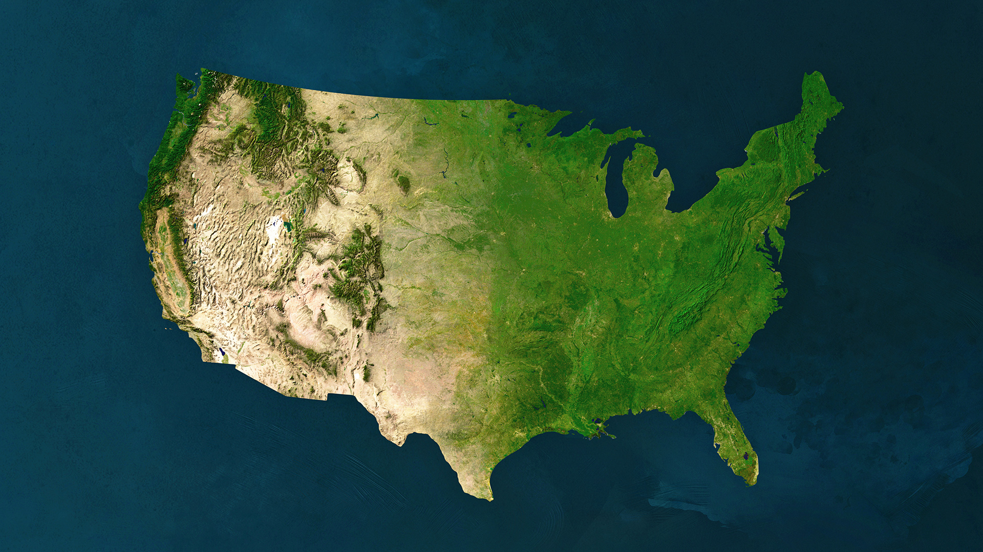
Notes:
We are going to today by talking about what we’re up against: how our enemies have systematically moved an agenda against us over the last 40 years.
We are doing this to set the context, because we can only be clear about the power we need if we are clear about the nature of the beast we are fighting.
Why are we focusing on the last 40 years? It’s not because everything was cool before 1975. Not at all. This country was built on exploitation, theft, slavery and genocide.
But, as of forty years ago, our movement had won some important victories. We had started – just started – to build the power we needed to win the changes our communities need and deserve. And that made our enemies scared.
But we are also doing this because the 1% has had a serious orientation to power and strategy; it’s an important part of why they’ve been able to shape our economy and society so powerfully over the last 40 years. We need to be that serious

Slide 2
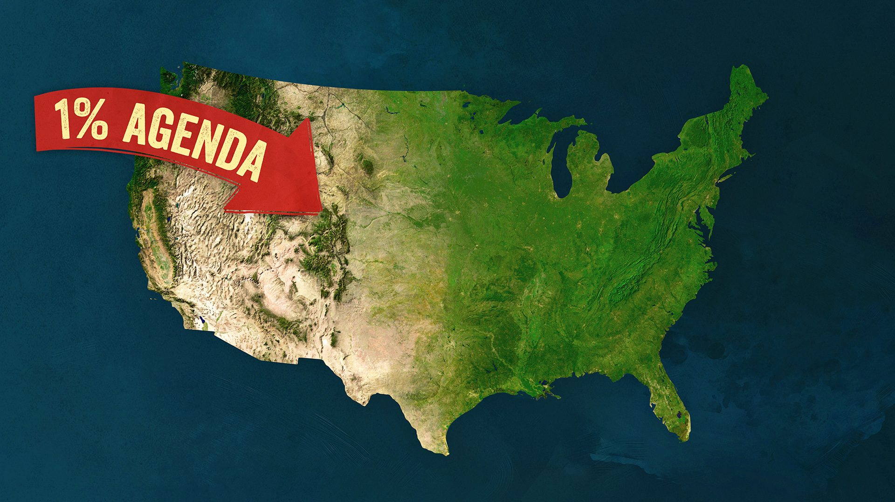
Notes:
So they made a systematic plan to reverse those victories…and we have a lot to learn from how they did it.
The economic and political reality of today didn’t just happen. For more than 40 years, the 1% has been advancing a political agenda to rebuild the economy and the government to serve their interests. We call this the 1% economy.

Slide 3
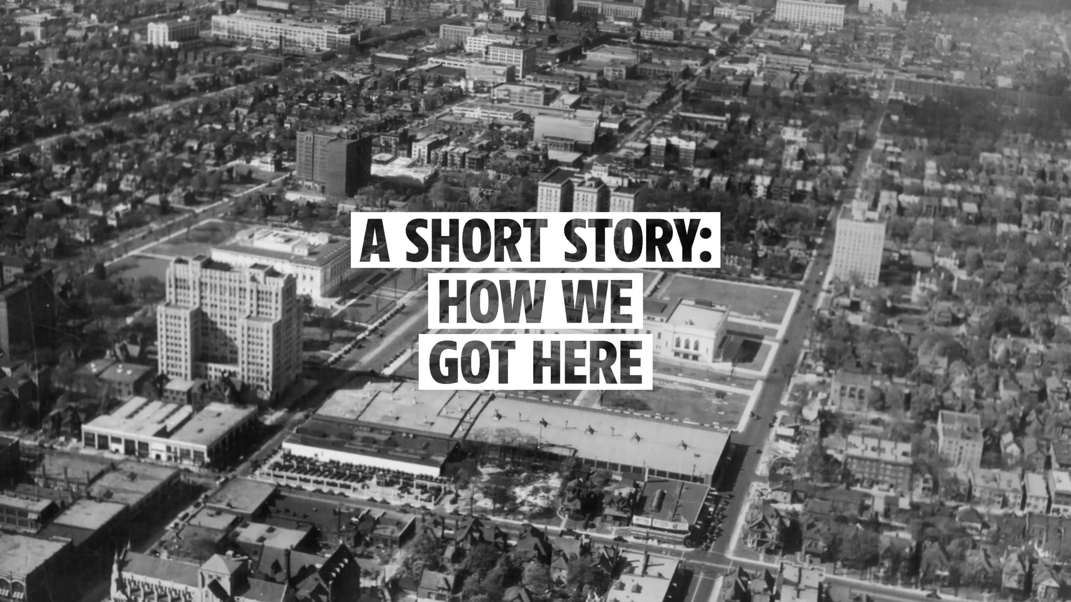
Notes:
Over the course of the last century, poor and working people made massive economic gains.

Slide 4
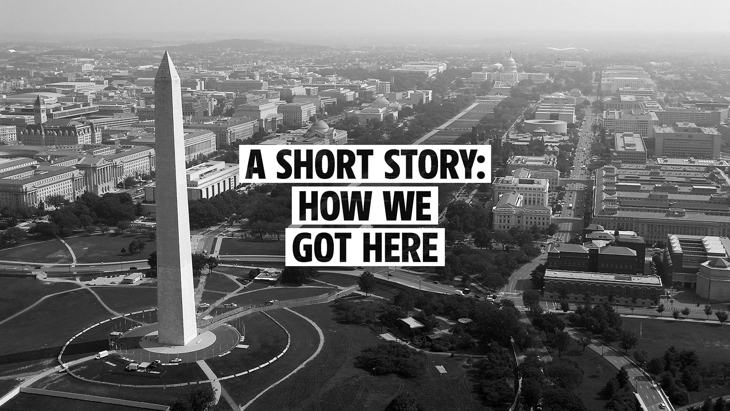
Notes:
In the 1930s, people’s movements won a package of economic rights - known as the New Deal - that reined in the worst excesses of corporations and built a social safety net that included programs like Social Security and laws like the minimum wage.

Slide 5


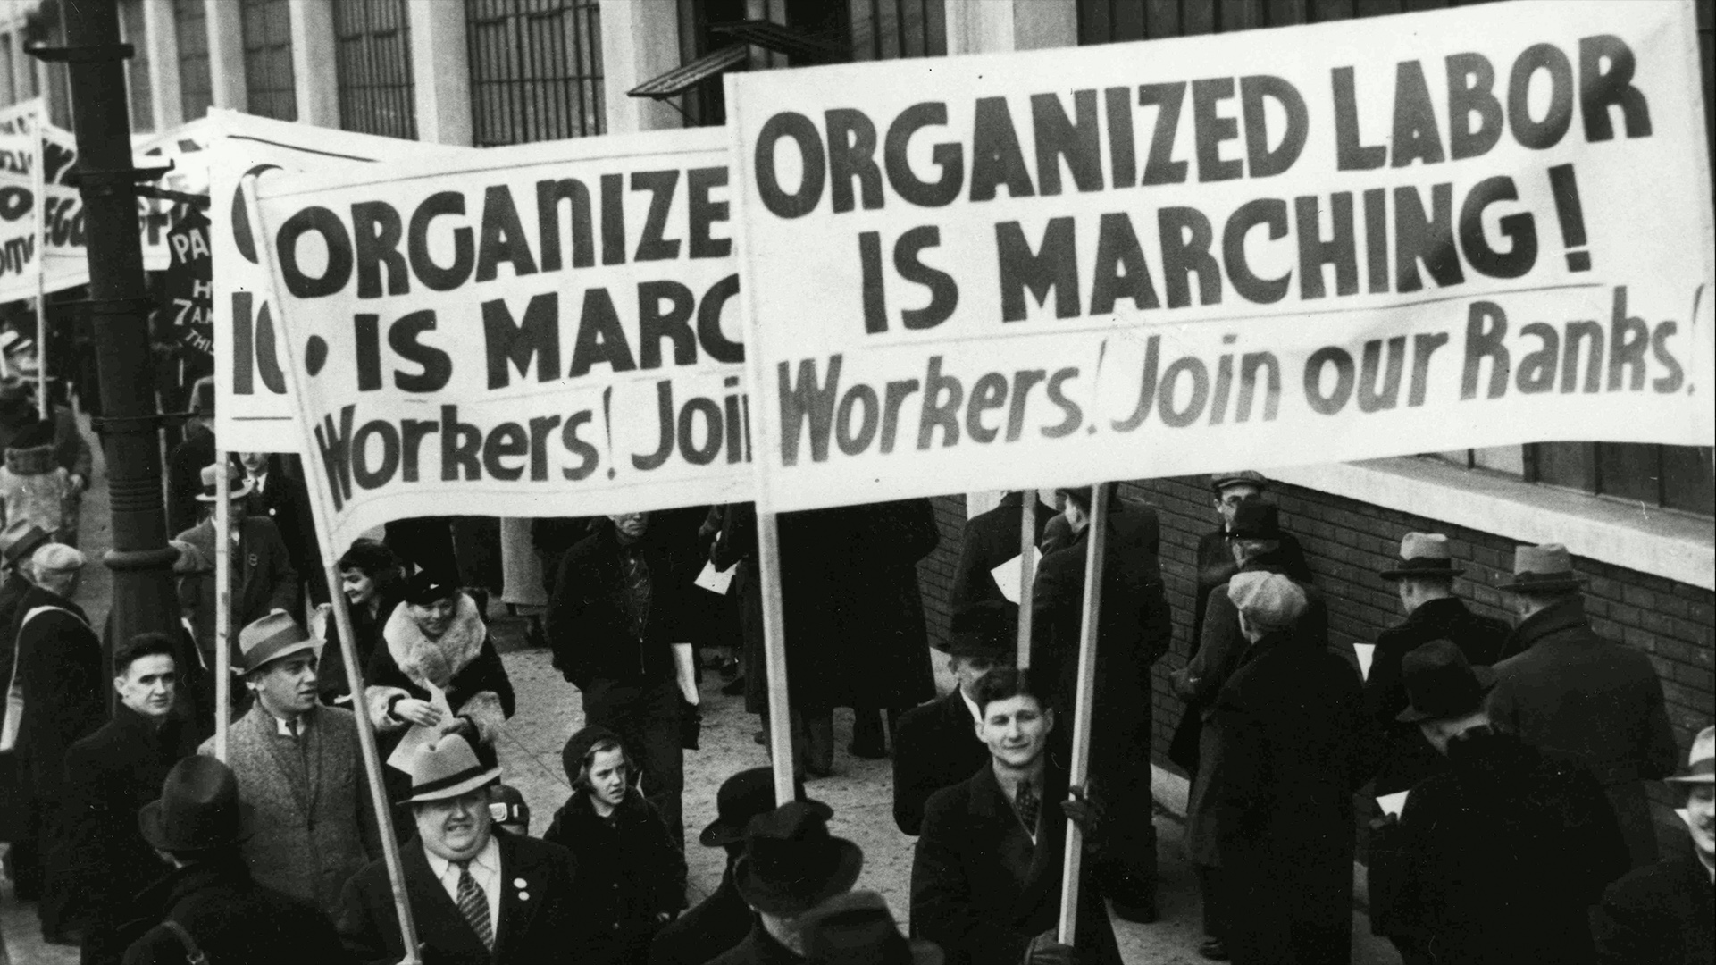

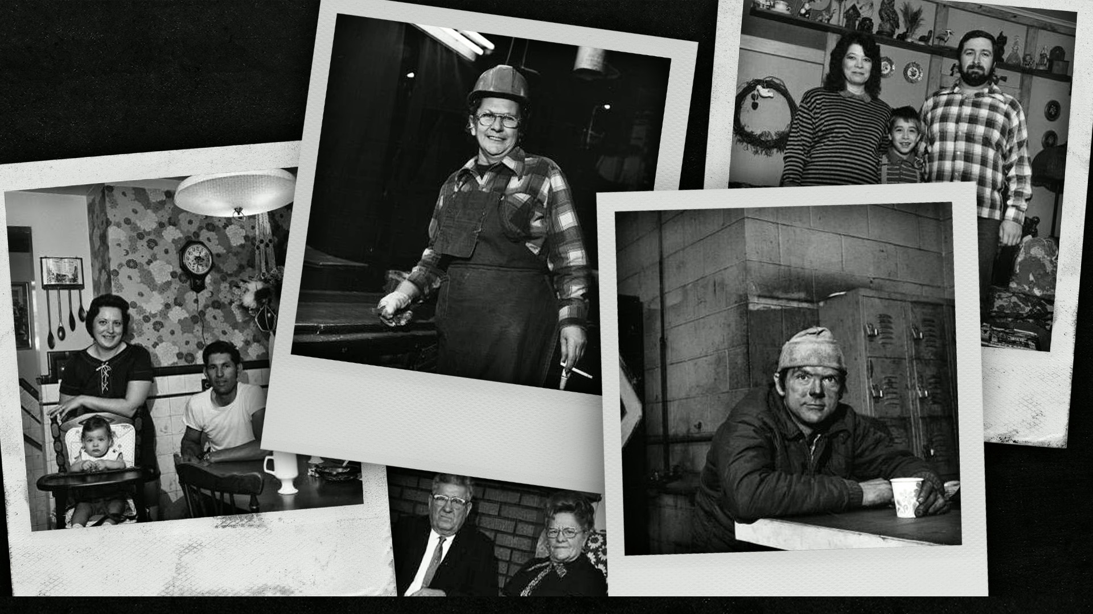
Notes:
These victories made lives better for millions of poor and working people, but they didn’t help everyone.

Slide 6
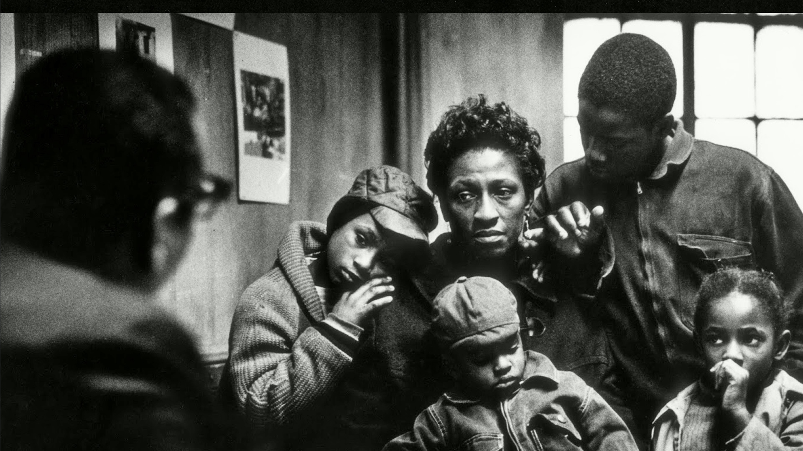




Notes:
They disproportionately benefitted white people because the New Deal excluded women, Black people, Latino people and immigrants in many ways.
But in the 1960s, social movements organized to challenge those exclusions.

Slide 7

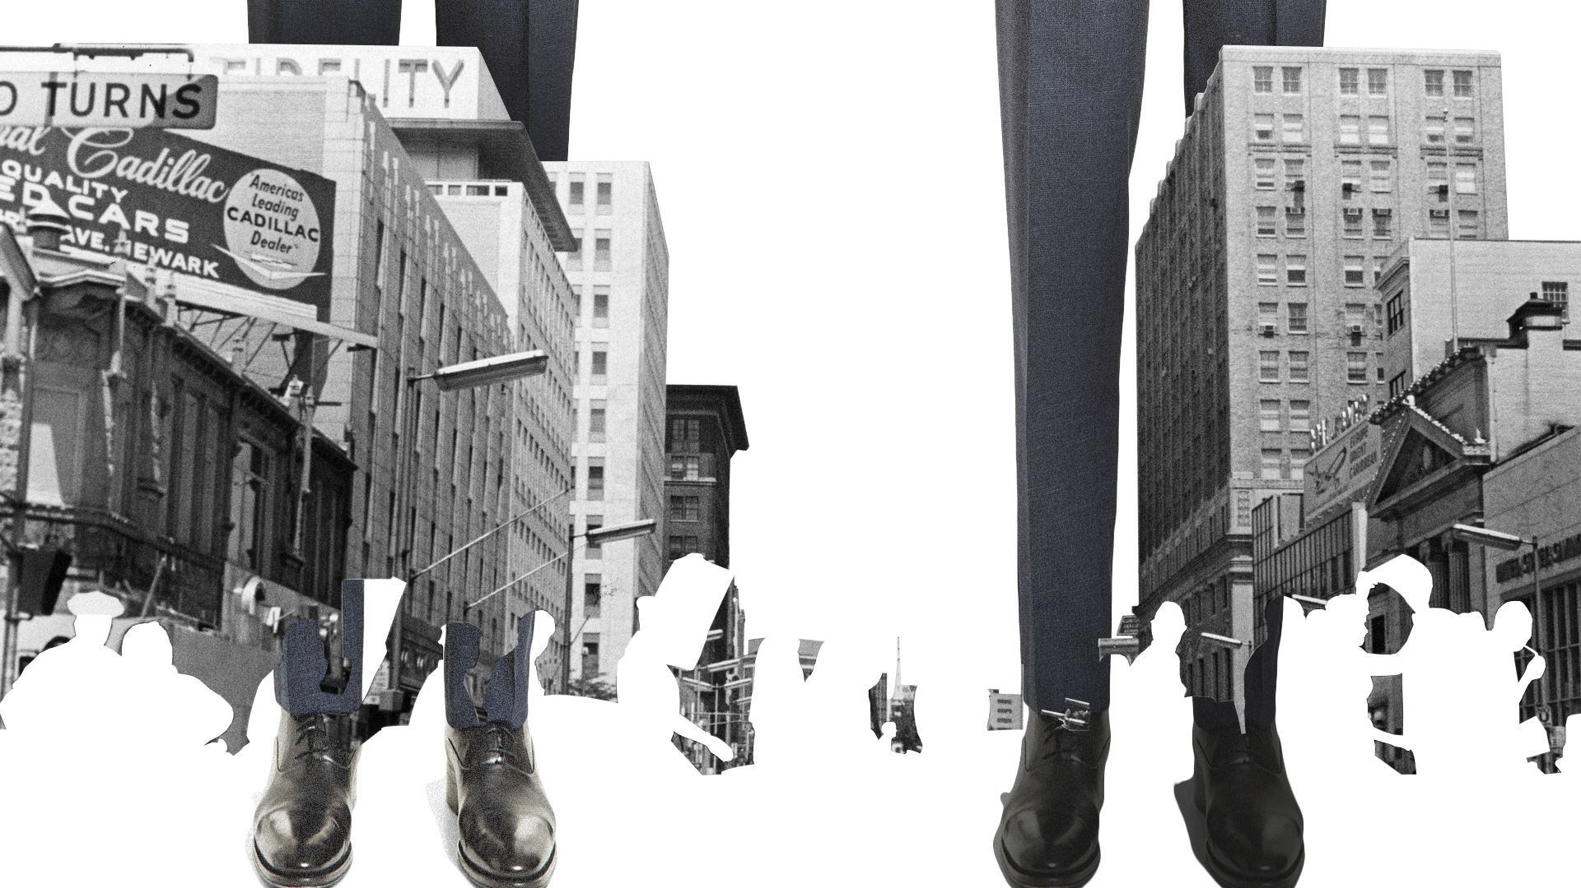
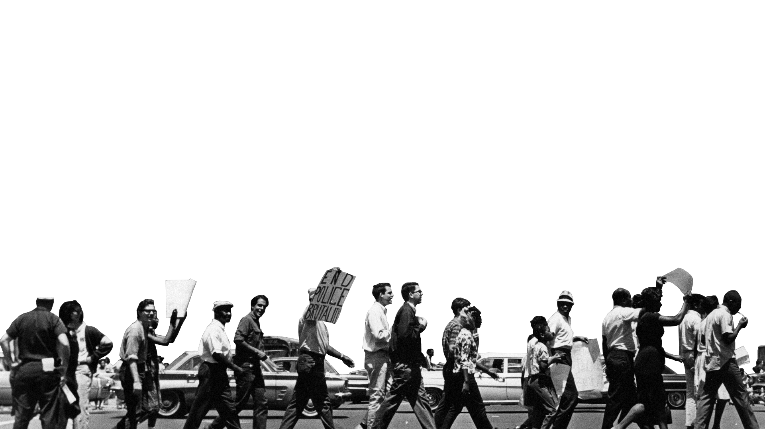
Notes:
There was powerful organizing for civil rights, women’s rights, indigenous sovereignty, and gay liberation, workers rights and poor people.
They ended those exclusions, and the communities who had been excluded started to see the possibility of accessing that “American Dream.”
Our movements got stronger and won new political rights like the Voting Rights Act and economic benefits like food stamps, Medicare and Medicaid. We also won major environmental regulations in this period, like the clean air and clean water acts.

Slide 8
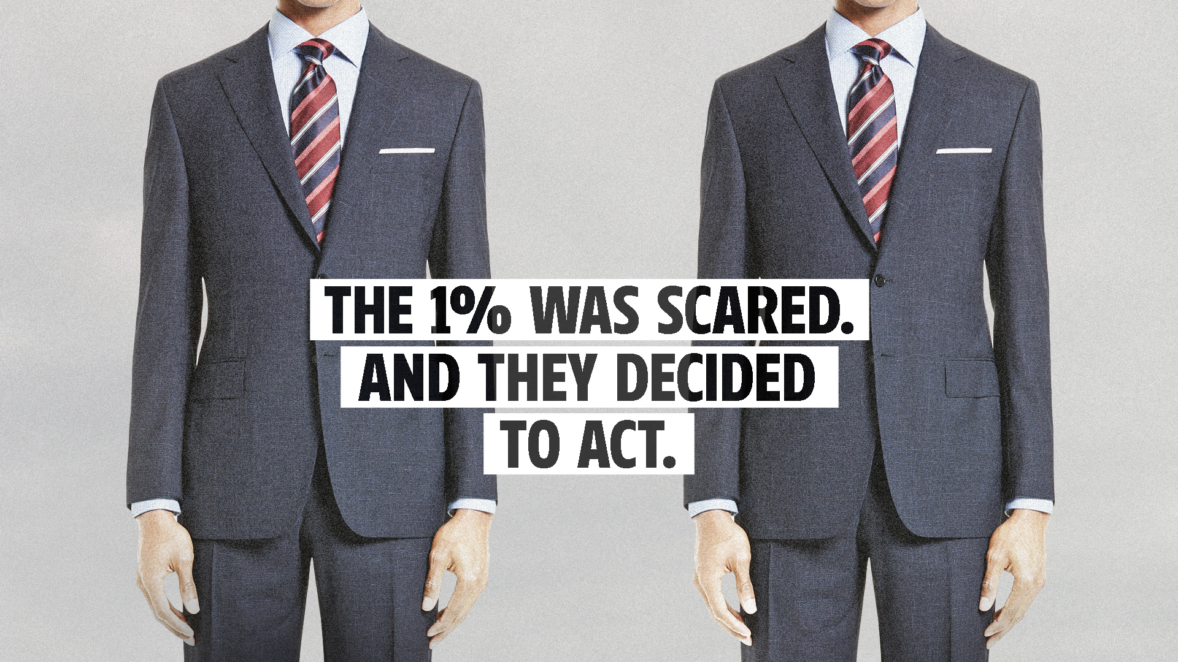
Notes:
The economy went through a major expansion in this period, but corporations and wealthy individuals saw these changes as a threat. And they decided to act.

Slide 9
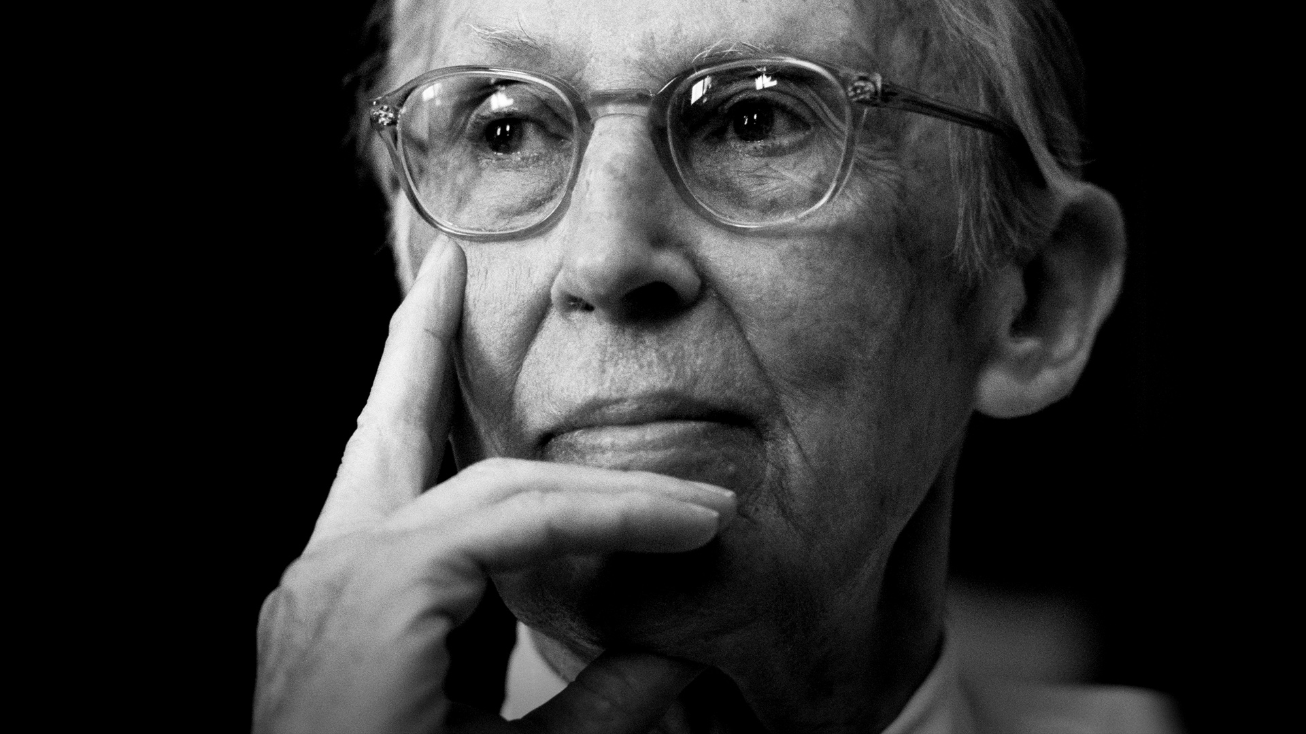

Notes:
In 1971, a corporate lawyer and future Supreme Court Justice, Lewis Powell, wrote a memo to the Director of the U.S. Chamber of Commerce.

Slide 10
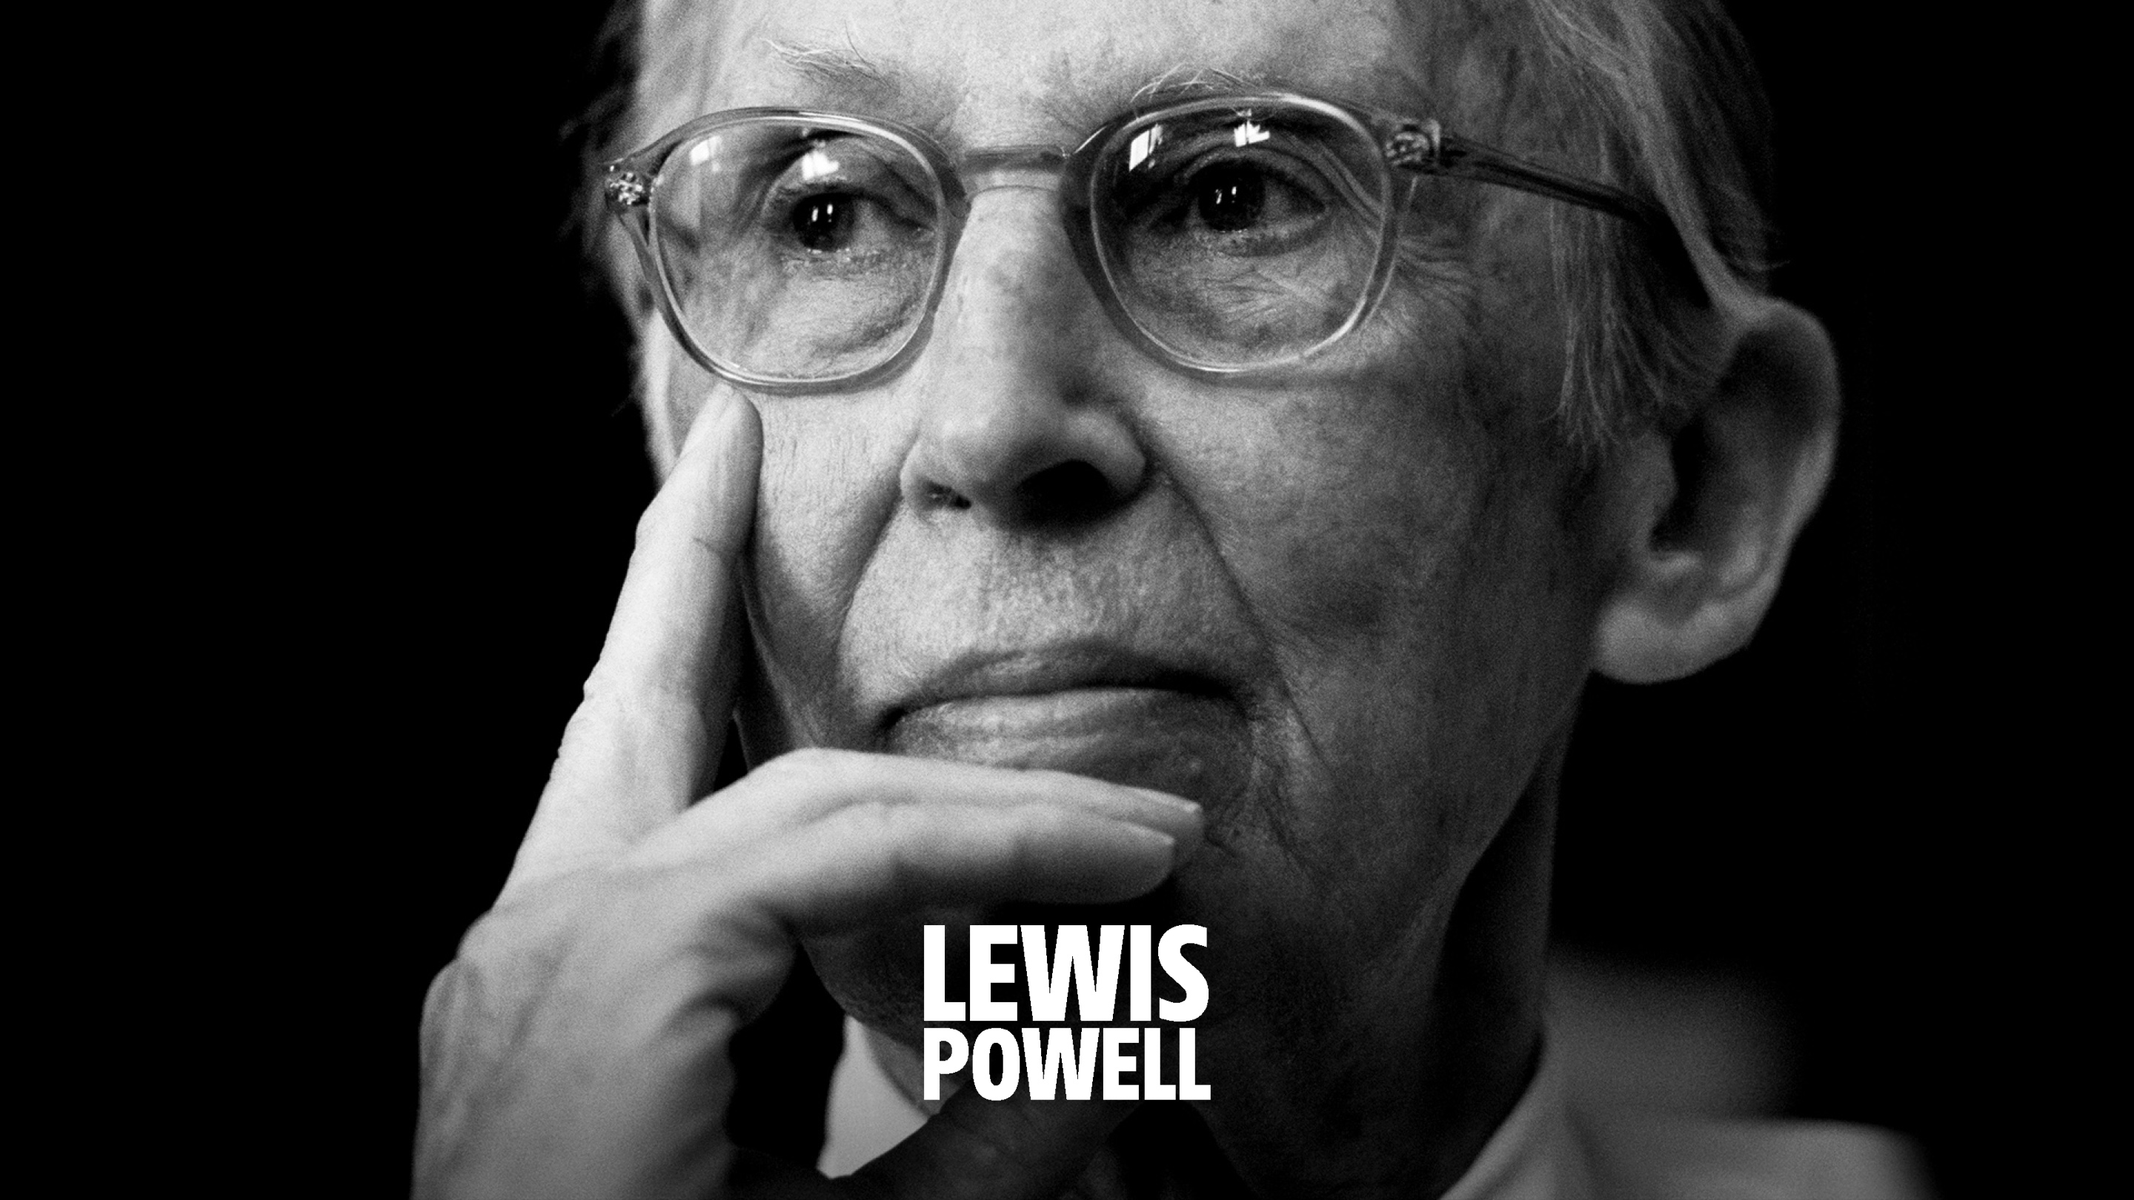
Notes:
The Powell Memo was a warning to corporations that they must take the fight for power as seriously as the drive for profits.

Slide 11

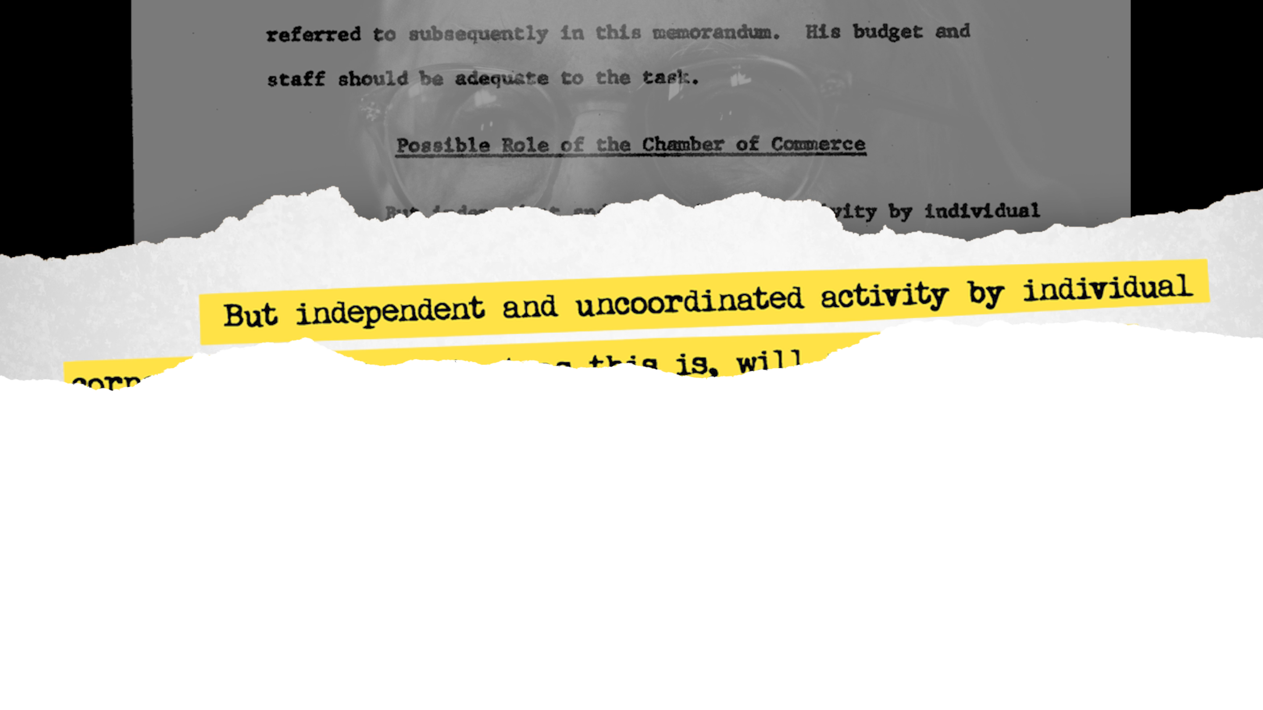
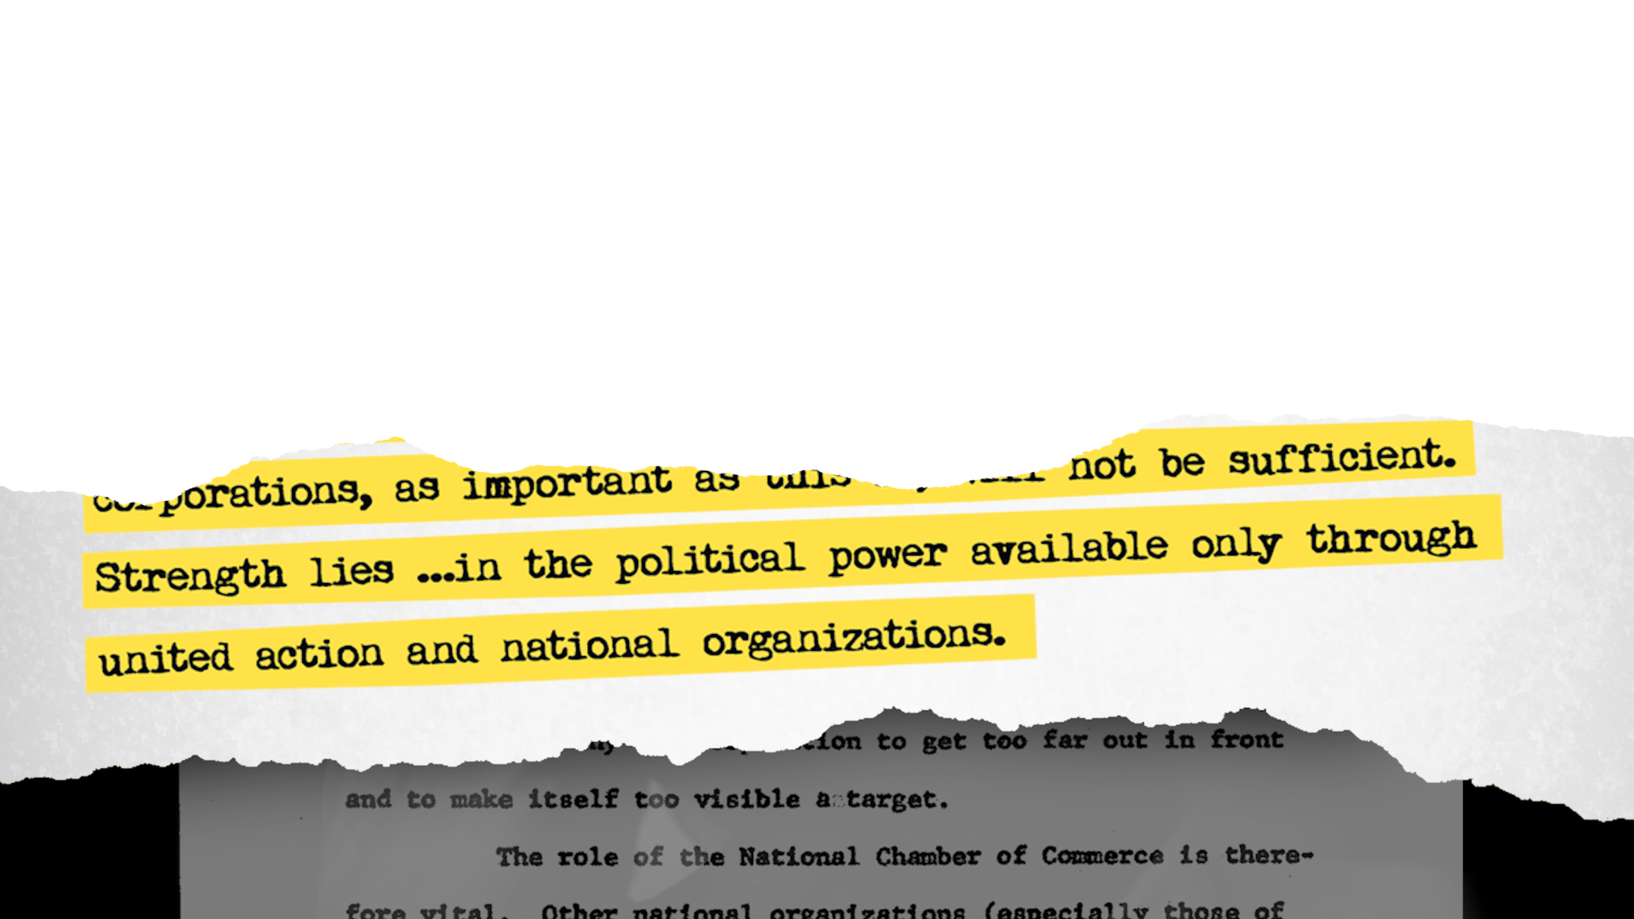
Notes:
Corporations and their operatives developed a long-term agenda to take power, which guided the transformation to the 1% economy of today.

Slide 12

Notes:
The 1%’s agenda - which is sometimes called “neoliberalism” - has a few core components:

Slide 13


Notes:
They wanted to shift government policy to serve corporate interests rather than having the government serve the interests of our communities. What did that mean?

Slide 14
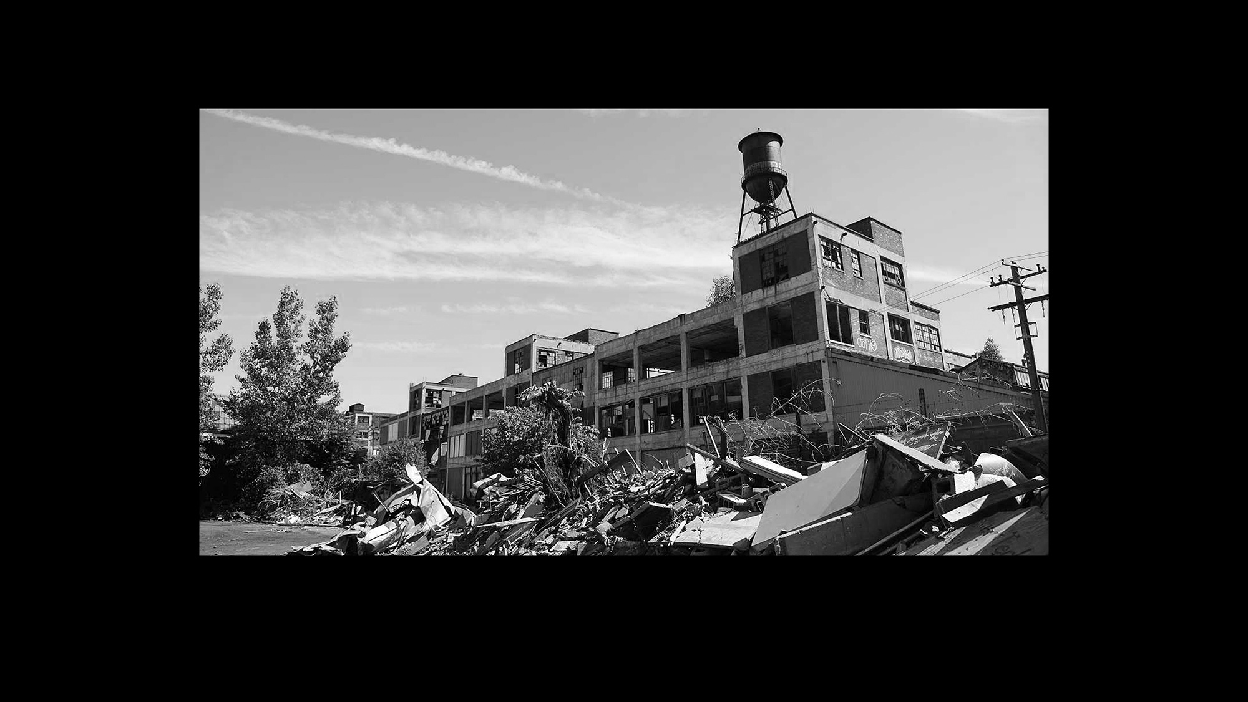

Notes:
It means Globalization: They tore down trade protections so that corporations could make money off of poor people around the world.

Slide 15
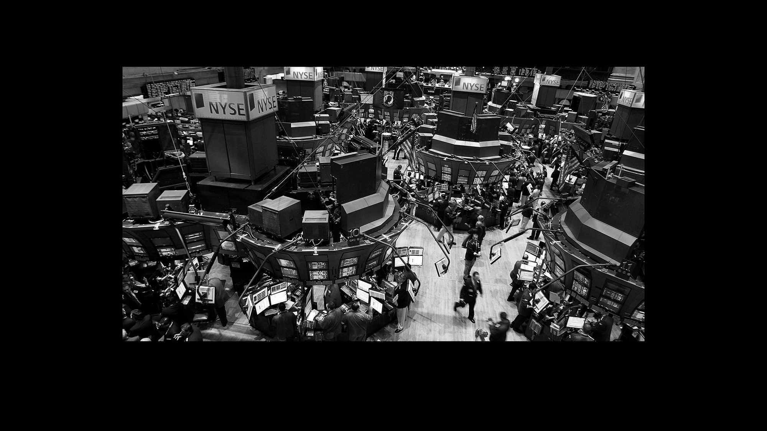

Notes:
It means Deregulation: They dismantled government regulations that restrained them from making unrestrained profits, like environmental laws and financial regulations that kept people on Wall Street from turning our economy into a casino.

Slide 16


Notes:
It means Privatization: They privatized parts of the government so they could make money off of public goods - like education. And they fought to cut any restrictions on their ability to use their power and money to influence government officials.

Slide 17
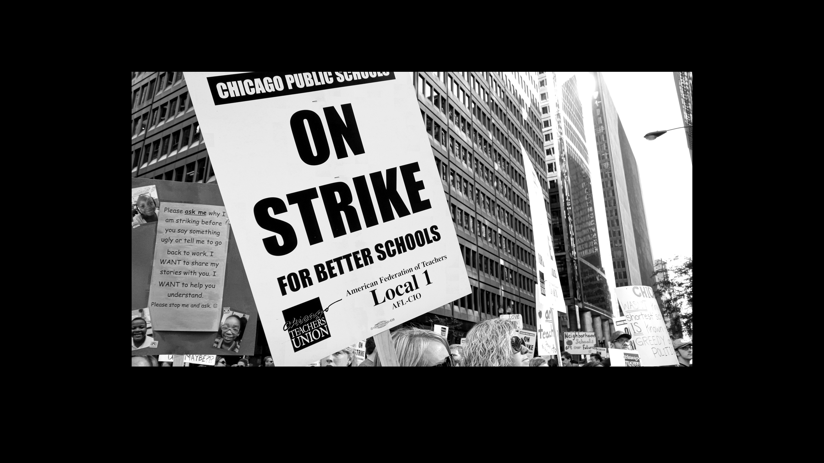

Notes:
They went after unions and workers rights, trying to weaken the strongest institutions that had challenged their power.
Big group straw poll: How many of us have been involved in organizing fights that have taken on the “corporate power” agenda? (If time permits, ask a few people to share examples of these fights.)
SUMMATION:
Through these policies, the 1% reshaped the US economy in a big way.
As trade restrictions were lifted, corporations moved manufacturing overseas in search of lower wages, and well-paid union jobs in manufacturing have disappeared.
Once the government lifted restrictions on Wall Street, corporations shifted resources out of production into finance, looking to make faster money in the casino economy. This also meant fewer good jobs for working people in this country.
Many of the new jobs that have taken the place of those well-paid union jobs have been low-wage jobs in the service sector.
Many communities have been pushed out of the workforce altogether. Black and Latino communities face disproportionate rates of unemployment.

Slide 18


Notes:
The 1% also set out to tear apart our social safety net! That meant that all the people who had been thrown out of the workforce by the 1%’s economic policies had fewer and fewer places to turn.
Examples if you want to draw on them (but don’t get lost in the details!):
President Clinton ended welfare as we knew it in 1996
Defunding of public housing programs
Cuts to funding for public education
Cuts to food stamps
Big group straw poll: Can people think of fights we’ve taken up to combat their agenda to “attack the public sector”?
(If time permits, ask for a few examples of these fights.)

Slide 19


Notes:
Crackdowns: To deal with the consequences of these shifts, they needed to develop strategies to keep our communities - and especially Black and Latino communities - under control.

Slide 20
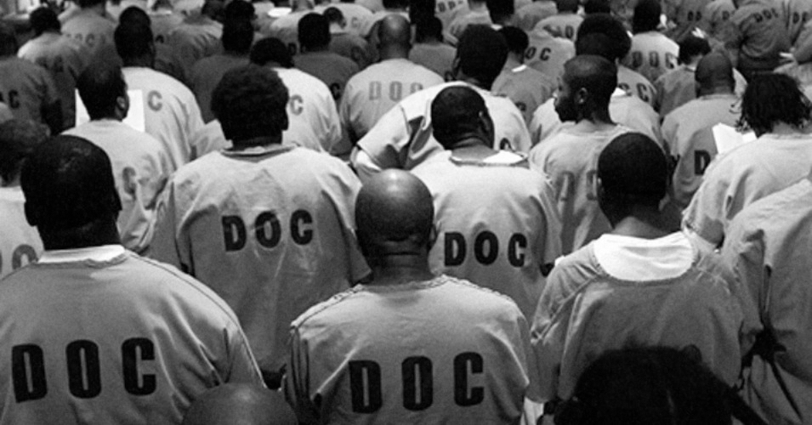
MASS INCARCERATION
Notes:
They expanded policing and incarceration on an unprecedented scale…
Example if you want to draw on them (but don’t get lost in the details!):
Reagan’s War on Drugs and Clinton’s Crime Bill we re two key moments in the rapid expansion of the prison industrial complex.

Slide 21
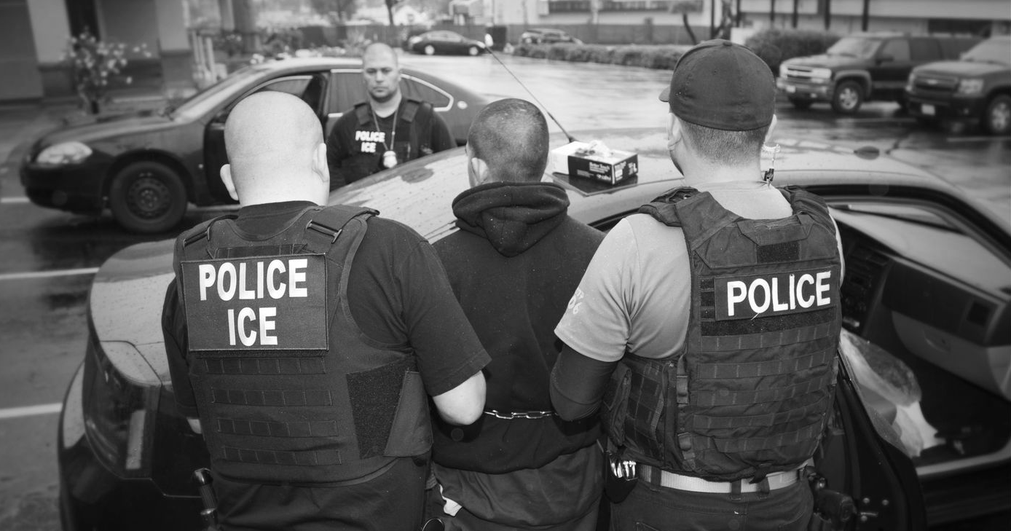
DEPORTATIONS
Notes:
…and they criminalized immigrants
Example if you want to draw on them (but don’t get lost in the details!):
Reagan and Clinton also passed some of the most significant legislation criminalizing immigrants and strengthening broader enforcement (Immigration Reform and Control Act in 1986 and Illegal Immigration Reform and Immigrant Responsibility Act in 1986). Every president since has continued to carry out mass deportations.
Big group straw poll: What sort of fights (if any) has your organization taken on to combat their “crackdowns” agenda?
(If time permits, ask a few people to shout out examples of these fights.)

Slide 22
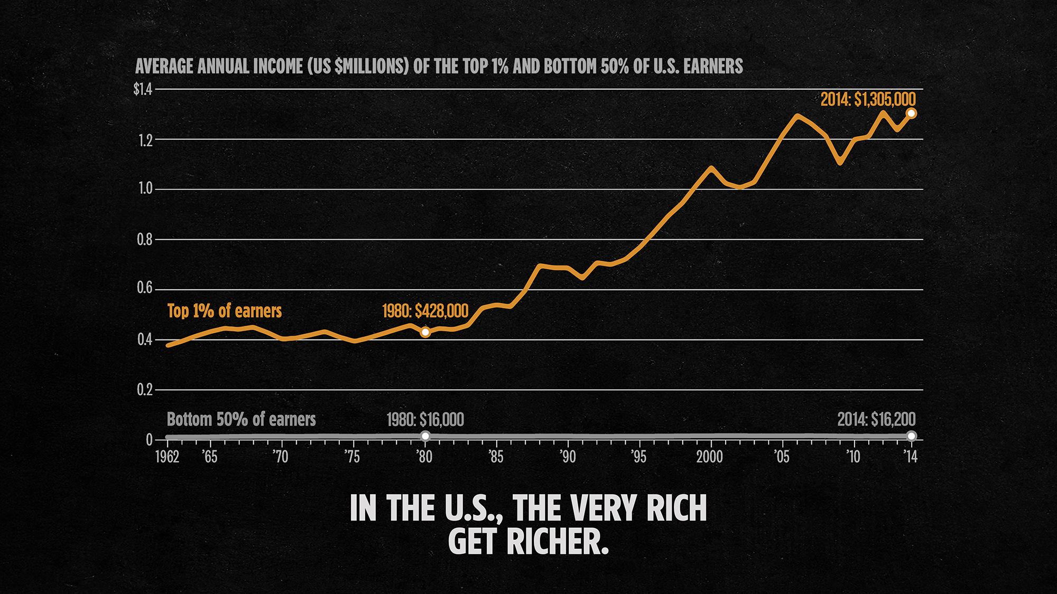
Notes:
What impact did these policies have? Unprecedented profits for the 1% and struggles for our families and communities.
There has always been inequality, but this chart shows that inequality started to grow radically once their agenda started to take hold in the 1980s. That orange line is their income. This gray line is the income of the poorest 50% of the population. We stagnated, while their profits skyrocketed.

Slide 23

Notes:
They have been moving this all-out class war against us for decades, seeking profit at the expense of our families and communities.
They were out for profit, but their agenda has never been just a narrow economic agenda. They have had a racial agenda, too. They started moving their program to slash government programs as soon as people of color gained access to those benefits. And that has hurt all of us.
Pair Reflection (8 minutes)
Before we move on, we want to take some time to talk about how these policies have impacted us personally.
Pairs: Turn to the person next to you and share about how the 1%’s agenda has impacted your life, personally, or the conditions in your community.
Ask for a couple of people who want to share about the impacts their agenda has had on our lives and our communities. Create some tension here by talking about the stakes.
Ask the group: How has this policy agenda impacted our organizing?
Some sample answers:
It has pushed us into a defensive posture. Most of our time is spent trying to stop them from taking away our rights. They’ve made it hard to think big and fight for the changes we really need.
Sometimes we accept these policies, arguing for more police protection or for private schools to address the limits of the defunded public education system.

Slide 24

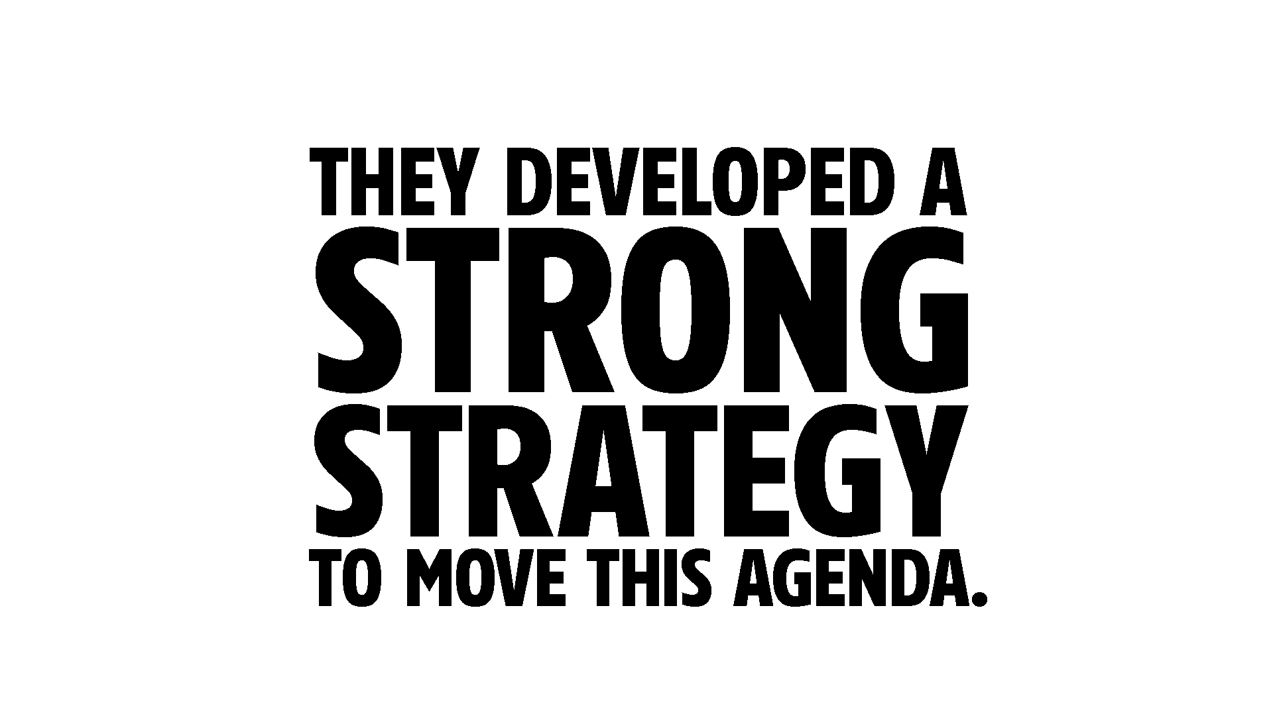
Notes:
Their agenda has shaped the lives of our people and the landscape of our struggle for decades.
How did they do it? Because they developed a strong strategy to move this agenda. We have a lot to learn from their strategies.

Slide 25

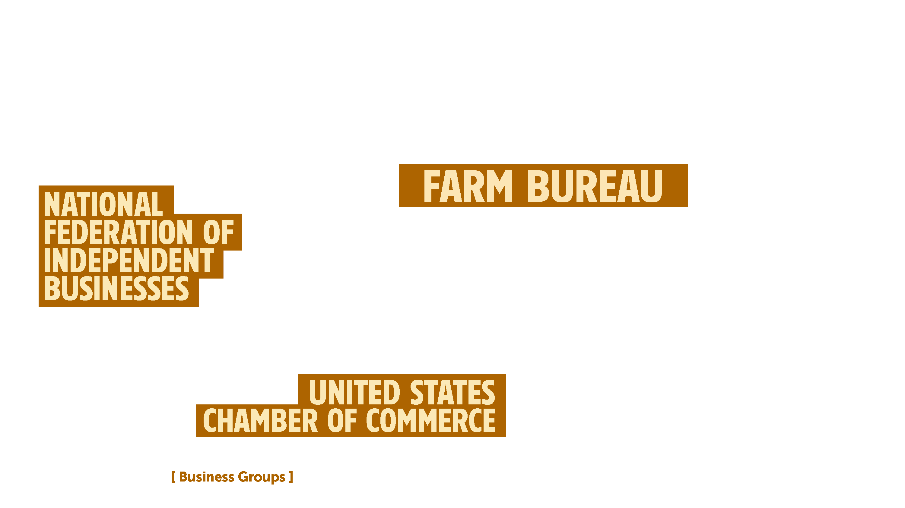

Notes:
Instead of acting as only individual companies focused solely on their own profit, they built a corporate infrastructure.
They built business association that allowed them to act collectively.

Slide 26
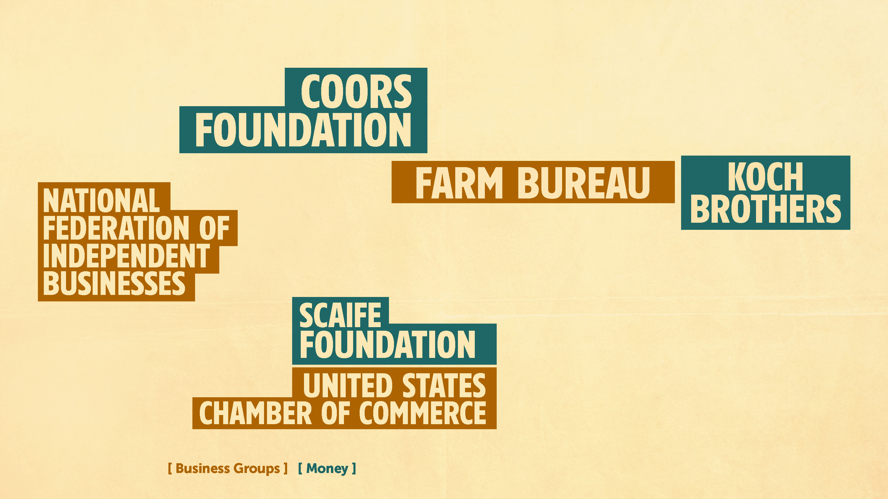
Notes:
They organized foundations that dumped millions of dollars into building organizations to advance their agenda.

Slide 27
Notes:
They built think tanks like the Cato Institute to develop new ideas and policies.

Slide 28
Notes:
They built media outlets like Fox to get their ideas in the public debate and to try to get inside our heads.

Slide 29
Notes:
And they invested in mass membership organizations like the NRA and the Tea Party to recruit poor and working people behind their agenda.

Slide 30
Notes:
They took advantage of crises to move their agenda. When the oil crisis hit in 1973 and economic growth started to slow down, the corporations swooped in with a new economic plan, saying they had all the solutions. They used that opening to rebuild the economy in their own interests.

Slide 31
Notes:
Slide 27: This is how Milton Friedman, one of the economic architects of corporate agenda, thought about how to use crises to advance his agenda.

Slide 33
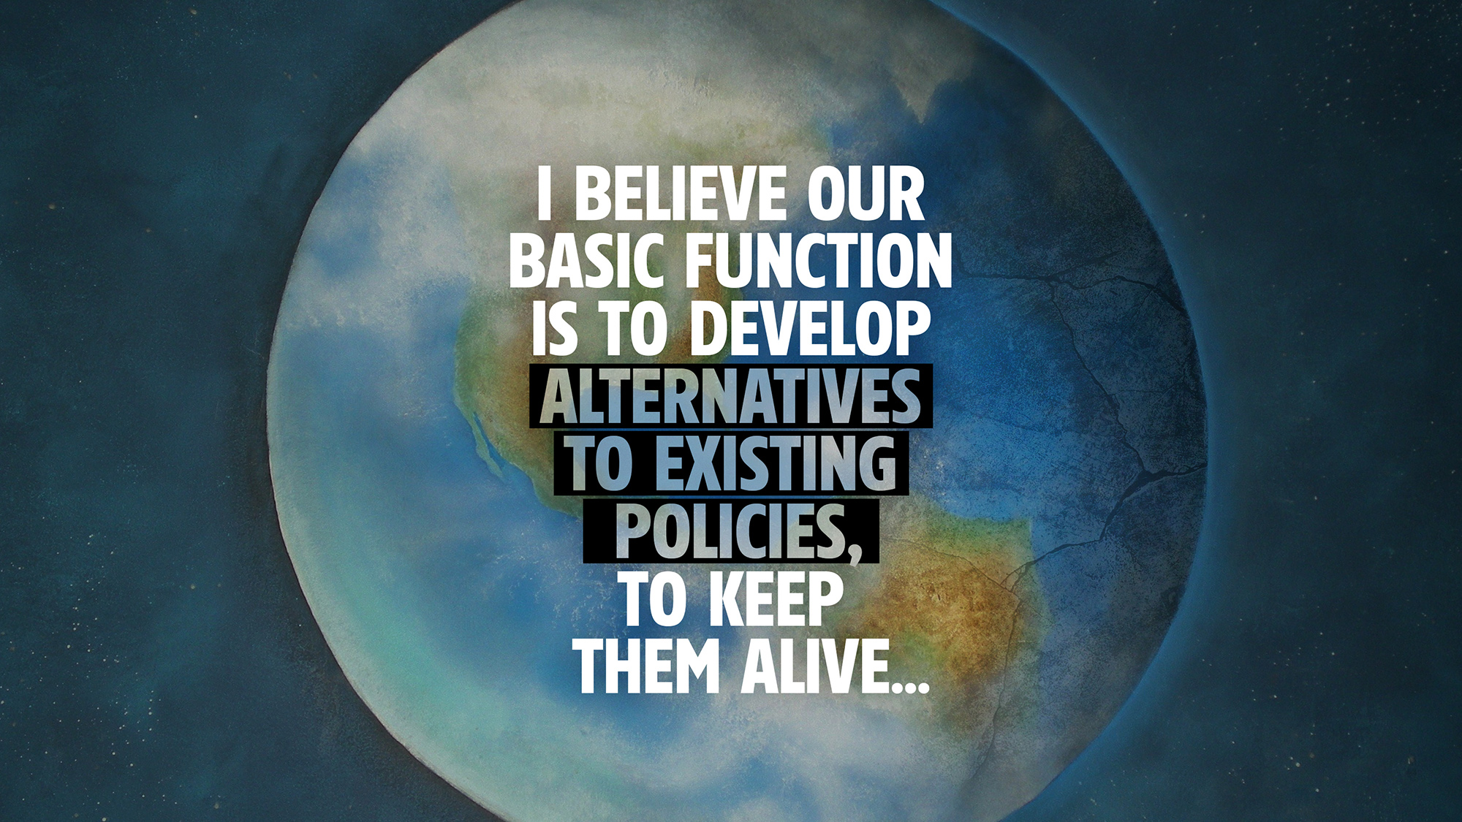

Slide 35
Notes:
Example:
They are currently trying to manufacture a sense of crisis in the social security system because they think it will create an opening to dismantle it.

Slide 36
Notes:
They had a clear plan to totally change the rules to produce the 1% economy, but they didn’t just go for their whole vision all at once.
They tried. They went after Social Security in the 1970s and it blew up in their faces. So they learned they couldn’t go after their whole agenda all at once.
Instead, they learned to their big ideas out over time, with the goal of changing the terrain as they went.

Slide 37
Notes:
Let’s look at how they advanced their agenda for privatization, as an example. Privatization of the public sector didn’t happen all at once. They had to unfold a long-term process to make the idea of privatization seem normal.
They set out to convince us that private profit-based programs always works better than government public programs.

Slide 38
Notes:
They started with changing small rules, like the rules in the Bureau of the Budget Bulletin. They won a change that said, "The Federal government will not start or carry on any commercial activity to provide a service or product....if such product or service can be procured from private enterprise."

Slide 39
Notes:
Then they privatized smaller services that no one cared about much (like parking lots and trash collection)

Slide 40
Notes:
and celebrated their success in order to win the privatization of much larger public services (like schools and prison).

Slide 41
Notes:
And they changed the terrain enough so that now they have their eyes set on privatizing the largest government programs, like social security.
That would have been a crazy idea 40 years ago, but now it seems like it’s a normal part of the political conversation.

Slide 42
Notes:
In order to move these policies, they created narratives that support their agenda. Their narratives convinced people that that their programs were in everyone’s interests.

Slide 44
Notes:
They sold us on rugged individualism. Everyone has the opportunity to succeed, if they just work hard enough.

Slide 45
Notes:
They told us that the free market fixes everything. When corporations profit, we all do better.

Slide 46
Notes:
They told is that government is wasteful and inefficient. We should look to the private sector for answers.

Slide 47
Notes:
They said that unions are bad for workers and the economy.

Slide 48
Notes:
Race was a central part of their strategy. They had lots of different ways that they used racism to advance their agenda.
One way they did that was to say that racism is in the past. Now, we live in a colorblind society, and racism is just a bad behavior of some bad individuals.
They used this to cover up all of the laws and systems that have oppressed communities of color and excluded them from democracy and the best parts of the economy.
Then they used that narrative to create public support for dismantling affirmative action and other programs won by racial justice organizing.

Slide 49
Notes:
At the same time, the 1% used coded and blatant racism to weaken public support for government programs while building support for police, prisons and ICE.
Today, with the election Donald Trump and white supremacists marching in the streets, we are seeing the impacts of the 1%’s constant use of coded racism. Racism has burst out of the box, and no one is pretending that it’s just in the past anymore.
Ask the group: How many of us have heard these ideas when we talk to politicians? In the media? In our communities?

Slide 50
Notes:
Let’s dig more deeply into how the 1% strategically used racism to try to win the support of poor and working white people to support their corporate agenda.
After the Civil Rights Movement, Republicans started to play up racism to convince poor white voters in the South to start voting for the Republican Party.
They developed stories blaming people of color for everything, breeding resentment and anger against people of color while simultaneously seeding sympathy with the 1%.
It worked so well that the party decided to take that strategy national: they started to use sometimes coded and sometimes blatant racial messages to try to buy poor and working white people into their corporate agenda.

Slide 51
Notes:
This is how Lee Atwater, one of the strategists who engineered Reagan’s presidential victory, talked about using race and racism as a strategy

Slide 54


Slide 55





Slide 56


Slide 57



Notes:
Let’s look at how they did this when it came to cutting welfare.
Even though the majority of people who were on welfare were white, they told a story that implied that everyone on welfare was Black and Latino.
President Reagan used racist ideas - like the “welfare queen” - to imply that Black and Latino women on welfare were just lazy “takers” who were living large off of taxes paid by hard-working “makers,” that is, people with jobs, who he implied were all white.
The 1% linked the idea of “government program” to “communities of color,” and then they used racism to attack government programs.
These ideas changed the terrain of politics in the U.S. They undermined support for government safety net programs, and they bought poor white people into opposing welfare, even though welfare actually served their interests.
Cuts to welfare ending up hurting hundreds of thousands of poor Black and Latino people and even more poor white people. And it couldn’t have happened if they hadn’t used racism as their secret weapon.
Ask the group: Does this racist strategy sound familiar?

Slide 58
Notes:
The 1% knew that it couldn’t just be an outside voice influencing the government, if they wanted to move this program. They knew they had to aim to control the government if they were going to move their bold agenda. So they set their sights on winning governing power. How did they do that?

Slide 59
Notes:
They started by taking over the Republican Party. By the 1970s, the Republican Party had become the political party of big business, and its main social base was white people in the South.
At this time, the Democratic Party was seen as the party that represented working people and the Black community in particular. So it was an easy choice for the 1%, to see the Republican Party as their first vehicle.

Slide 60
Notes:
The 1% lifted up a national champion to promote their worldview. Ronald Reagan, a former movie star became the face of their agenda.
But the 1% knew they couldn’t move their agenda if they only organized millionaires and billionaires. They had to build a broader social base. They decided that they were going to try to win over a number of poor and working class white people to support their agenda, even though it went against their economic interests. We already talked about how they used racism to do that.

Slide 61
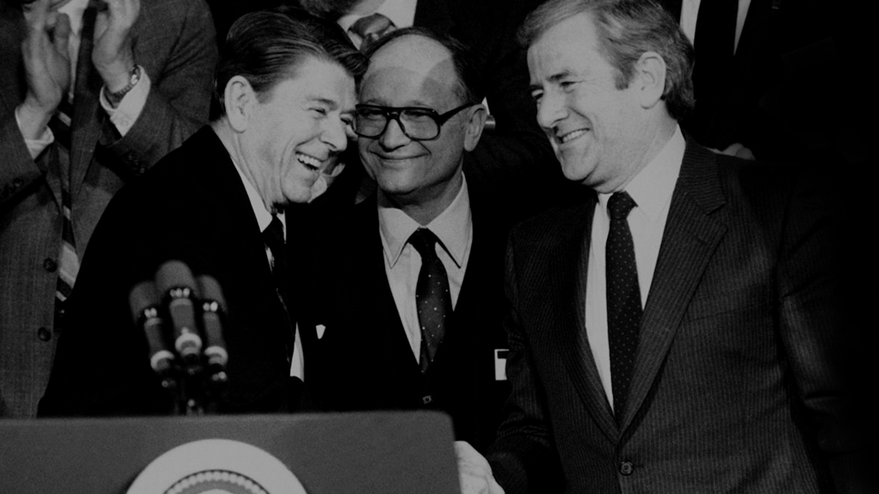
Notes:
Another way they tried to win over poor and working white people to their corporate agenda was to have Reagan build an alliance with the Christian Right, connecting their corporate economic program with socially conservative policies
Click
like opposing women’s right to choose whether or not to have an abortion
Click
and gay marriage.
The Christian Right played an important role in helping Reagan win the election.

Slide 62

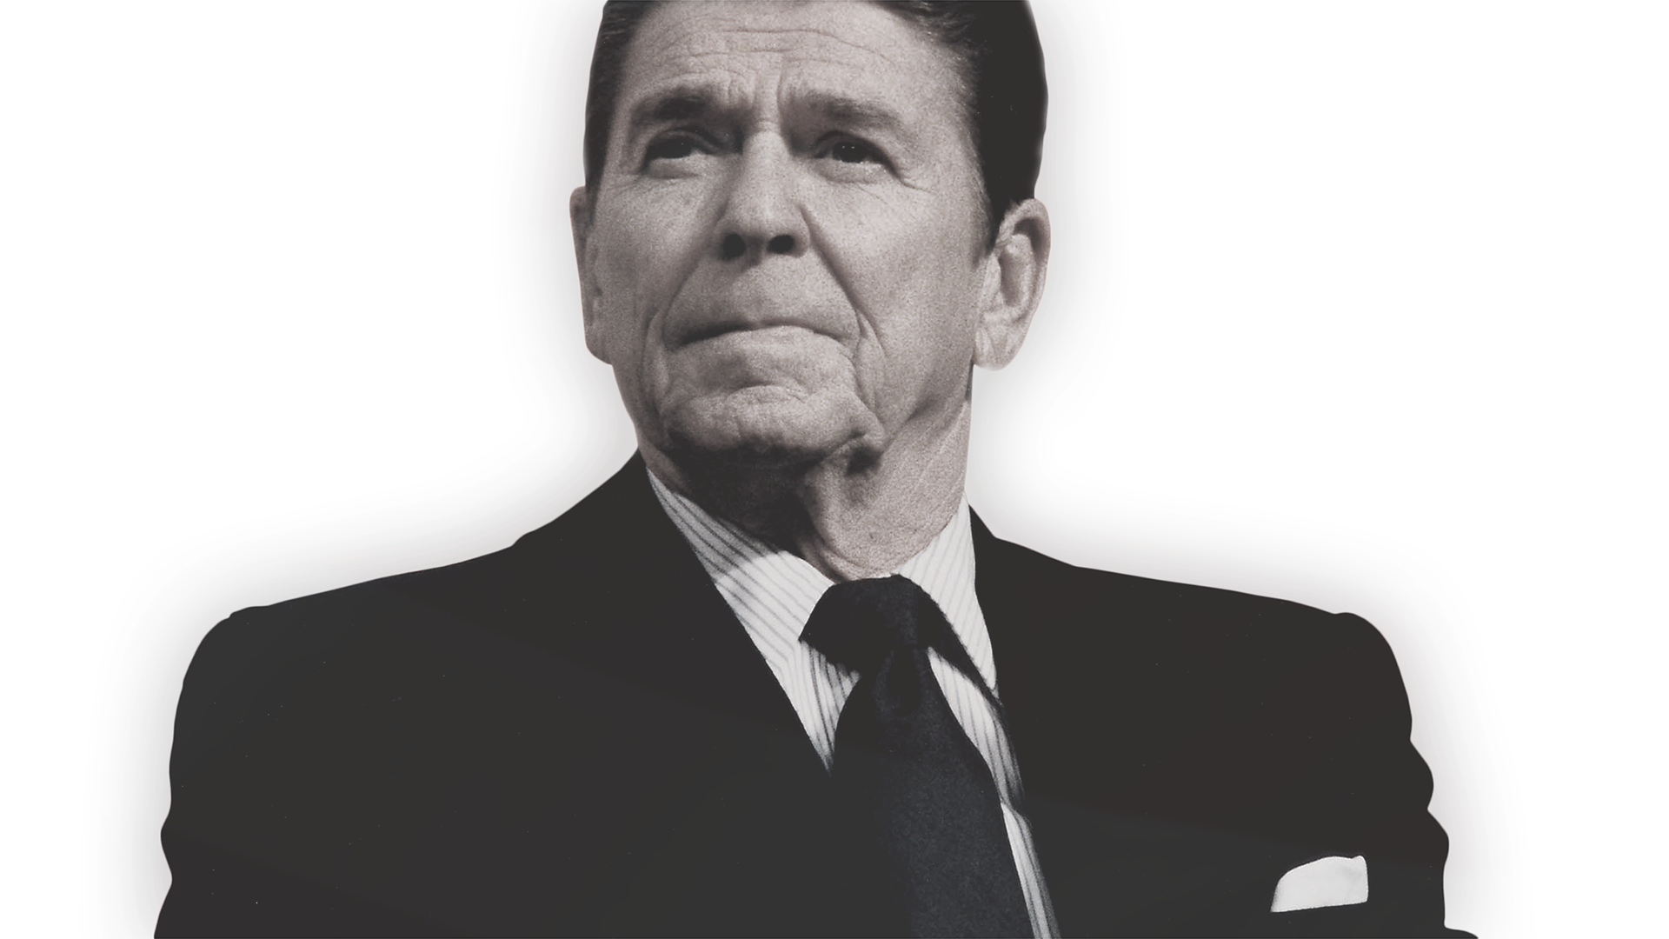
Notes:
Ronald Reagan used these two strategies - building an alliance with the Christian Right and using racism as a strategic force - to break off a significant number of white working class voters from the Democratic Party. With that new base, he won the Presidency in 1980 and shook up both political parties in the process.

Slide 63

Notes:
But the 1% didn’t only aim for the national office. They fought hard on the local level too. They fought to win local and state offices so they could move their agenda town by town, city by city and state by state: from local utility boards and school boards to mayor’s offices and state legislatures.

Slide 64
Notes:
Together, these strategies reshaped our political terrain. Ideas and policies that would have seemed insane in the 1970s became the new normal, and politicians from both parties have taken up this same corporate agenda.

Slide 65
Notes:
Controlling the Republican Party wasn’t enough for the 1%.

Slide 66
Notes:
They started to work to break off sections of the Democratic Party, too, starting with Bill Clinton in 1992 who passed some of the core legislation towards this agenda: ending welfare as we know it, making crossing the border more and more deadly, signing the North American Free Trade Agreement and spearheading a crime bill that expanded policing and incarceration.
There is now a strong corporate wing within the Democratic Party, and they are an important part of the alliance that is behind the 1%’s agenda.
So now we have to fight to both defeat the Republicans and win the Democratic Party back from the corporate elite.

Slide 67
Notes:
Review the strategies.
Have the group break down in pairs to reflect on these strategies, using the following two questions
How have these strategies shaped the terrain of our organizing?
What can we learn from these strategies? What do we need to do in response to them?
Bring the group back together and walk through the questions.

Slide 68
POWER
Notes:
At the core of all these strategies is the question of power. The 1% had a systematic approach to building power in order to reshape our society in their interests. Yes, they have the weight of history on their side. But they also built a systematic plan to move their interests even further.
And we aren’t going to win unless we take questions of power just as seriously.

Slide 69
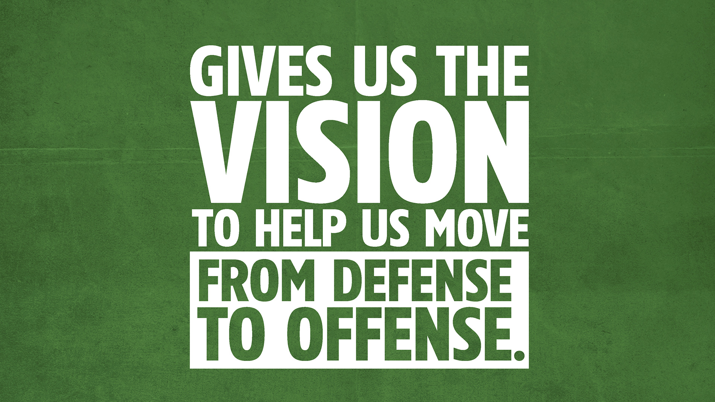
Notes:
It will give us a vision to help light our way through these dark times. That agenda will help us organize in this period of defense in ways that help us build towards fighting offense, building a force strong enough to not only push back Trump’s agenda but to win this whole damn thing.

Slide 70
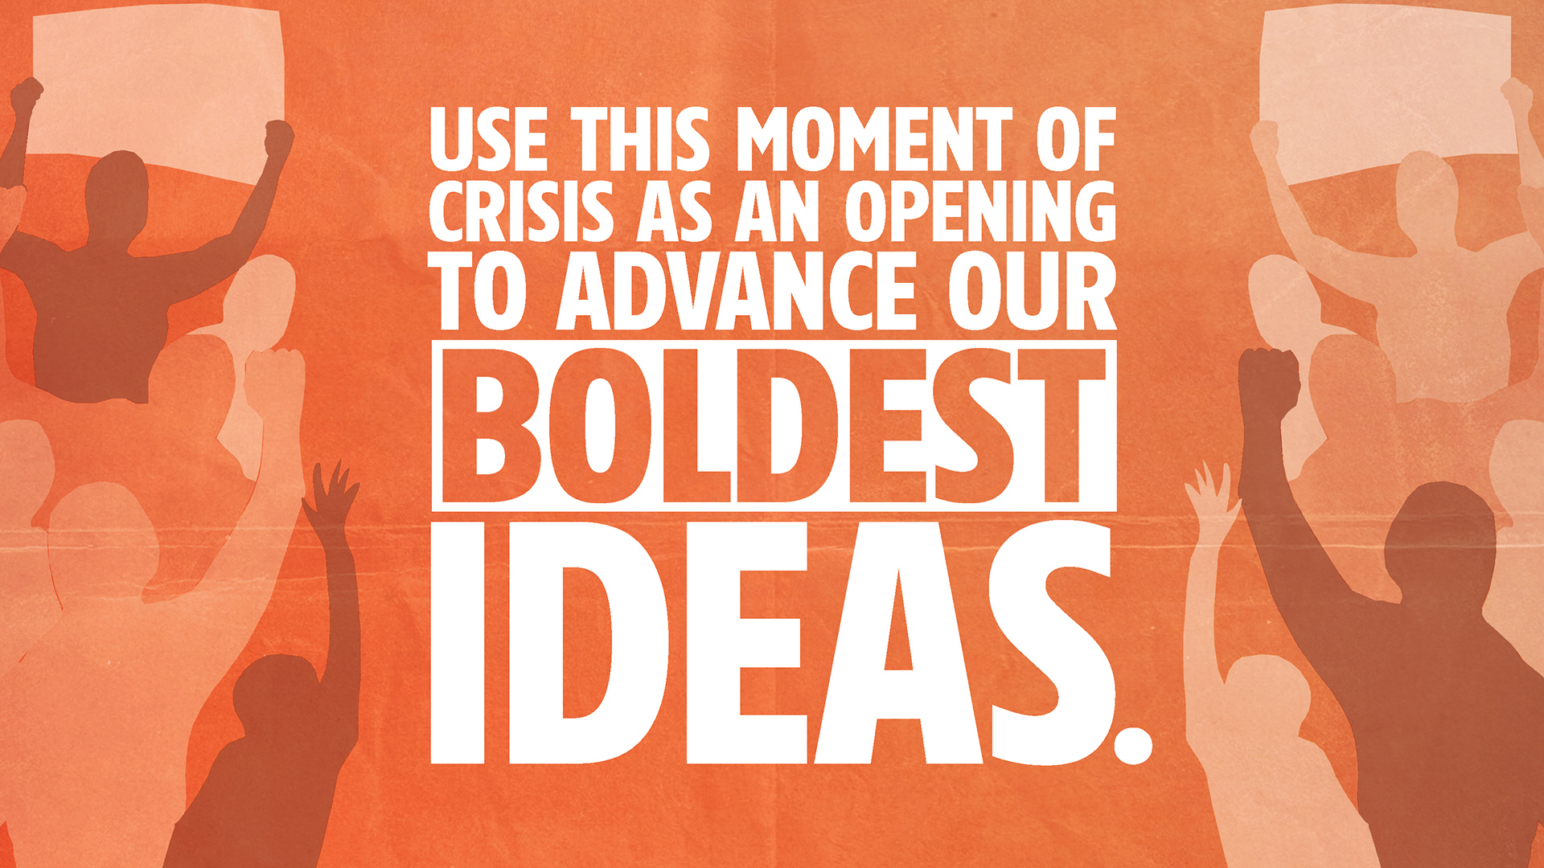
Notes:
It will help us take advantage of this moment of social and economic crisis and use it as an opening to advance our biggest ideas.

Slide 71
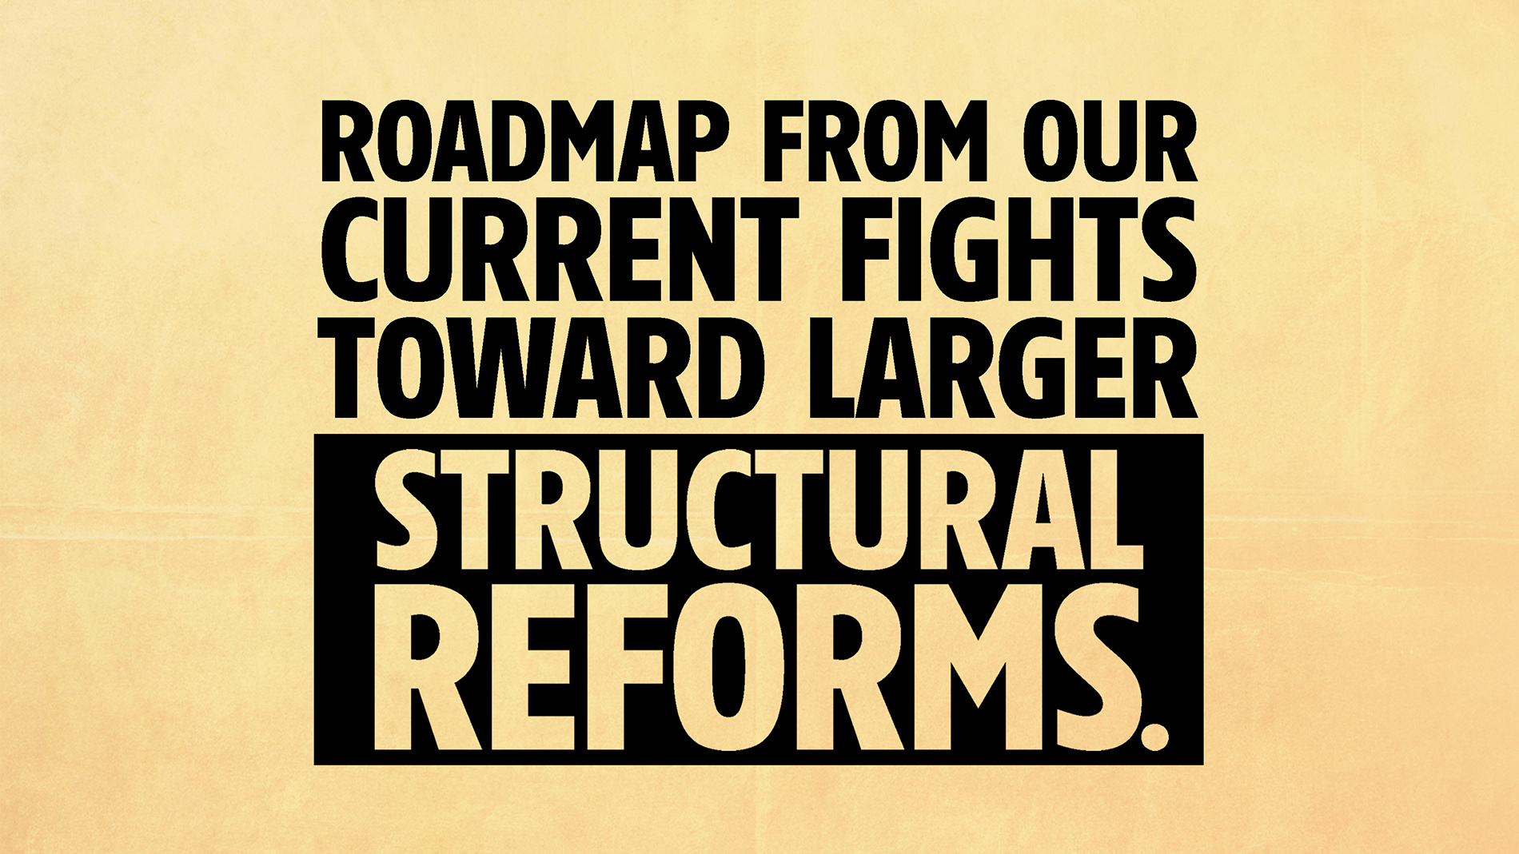
Notes:
It will give us a roadmap for how we can use our current fights to build toward larger “structural” reforms

Slide 72
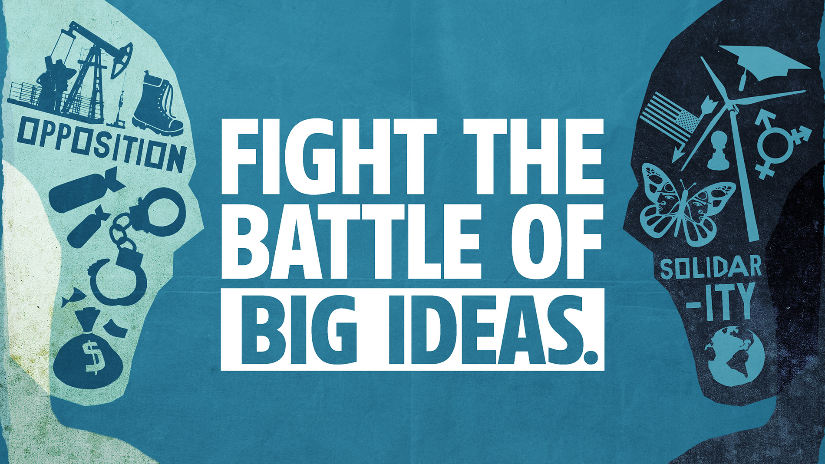
Notes:
It will help us “fight the battle of big ideas” that is more important today than ever. We have to go head-to-head with Trump’s fake populism, pushing back on his racism and putting forward a real populism that talk about real economic equality and an America that belongs to everyone who lives and works here.

Slide 73
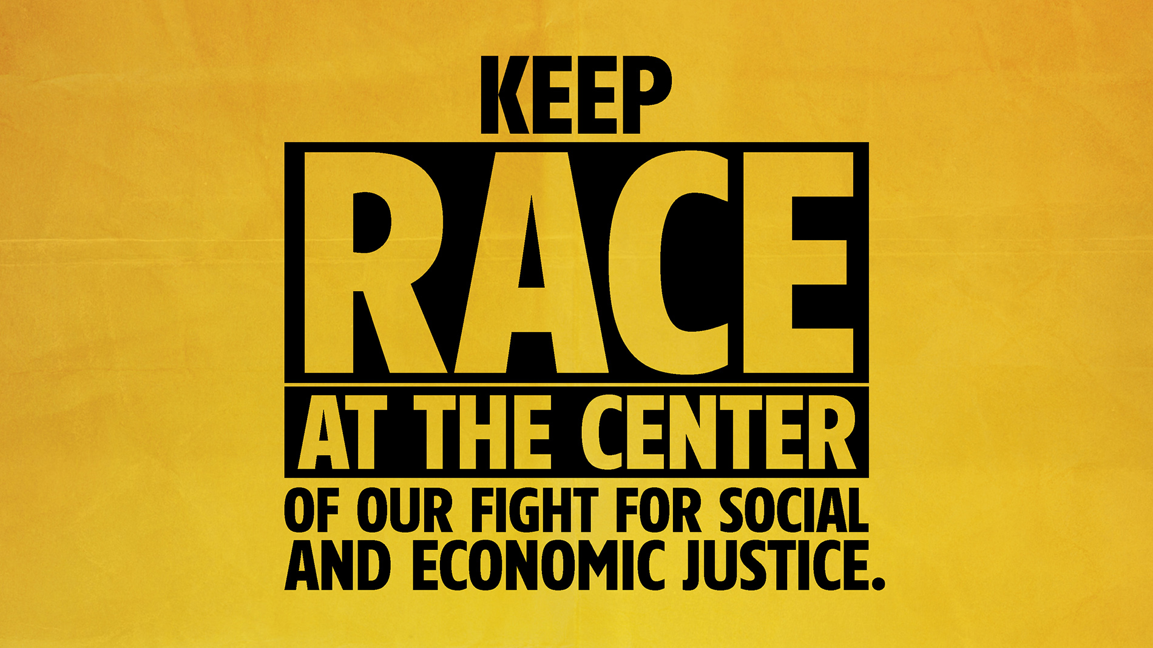
Notes:
Our long-term agenda will help us keep race at the center of our fight for social and economic justice, reminding us that there is no path to economic justice that doesn’t include all of us.

Slide 74
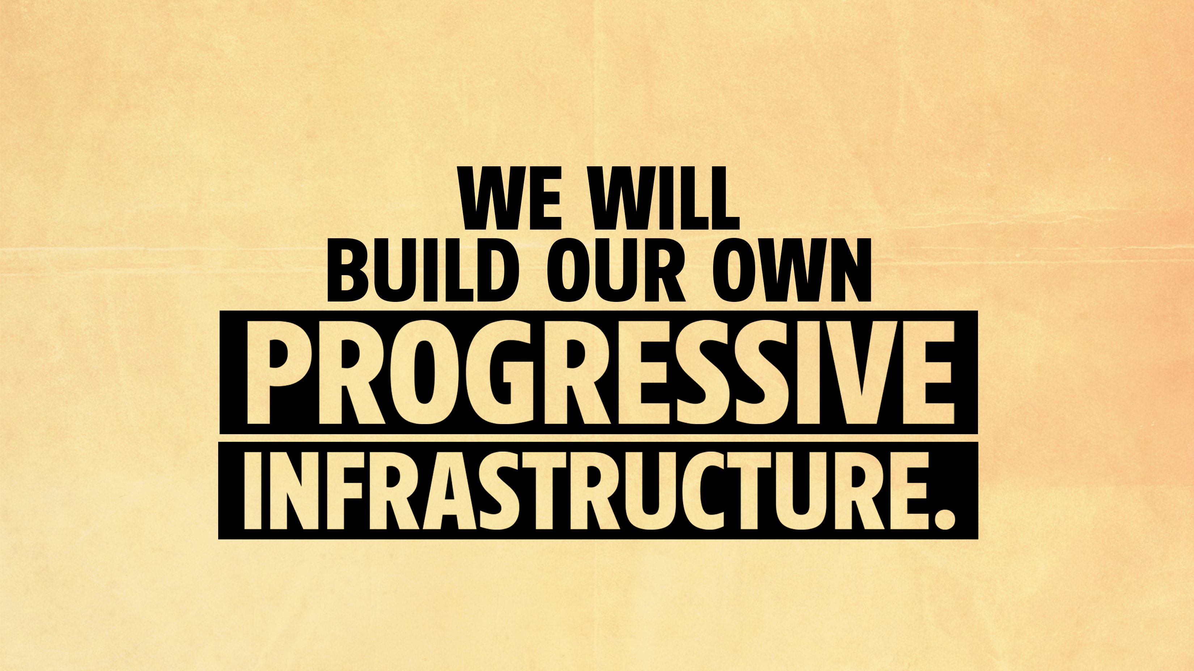
Notes:
And it will challenge us to help build a progressive infrastructure to build our collective power. That is what inspired us to build Peoples’ Action...we knew that as separate organizations, we did not have the power to win what needs to be won.

Slide 75
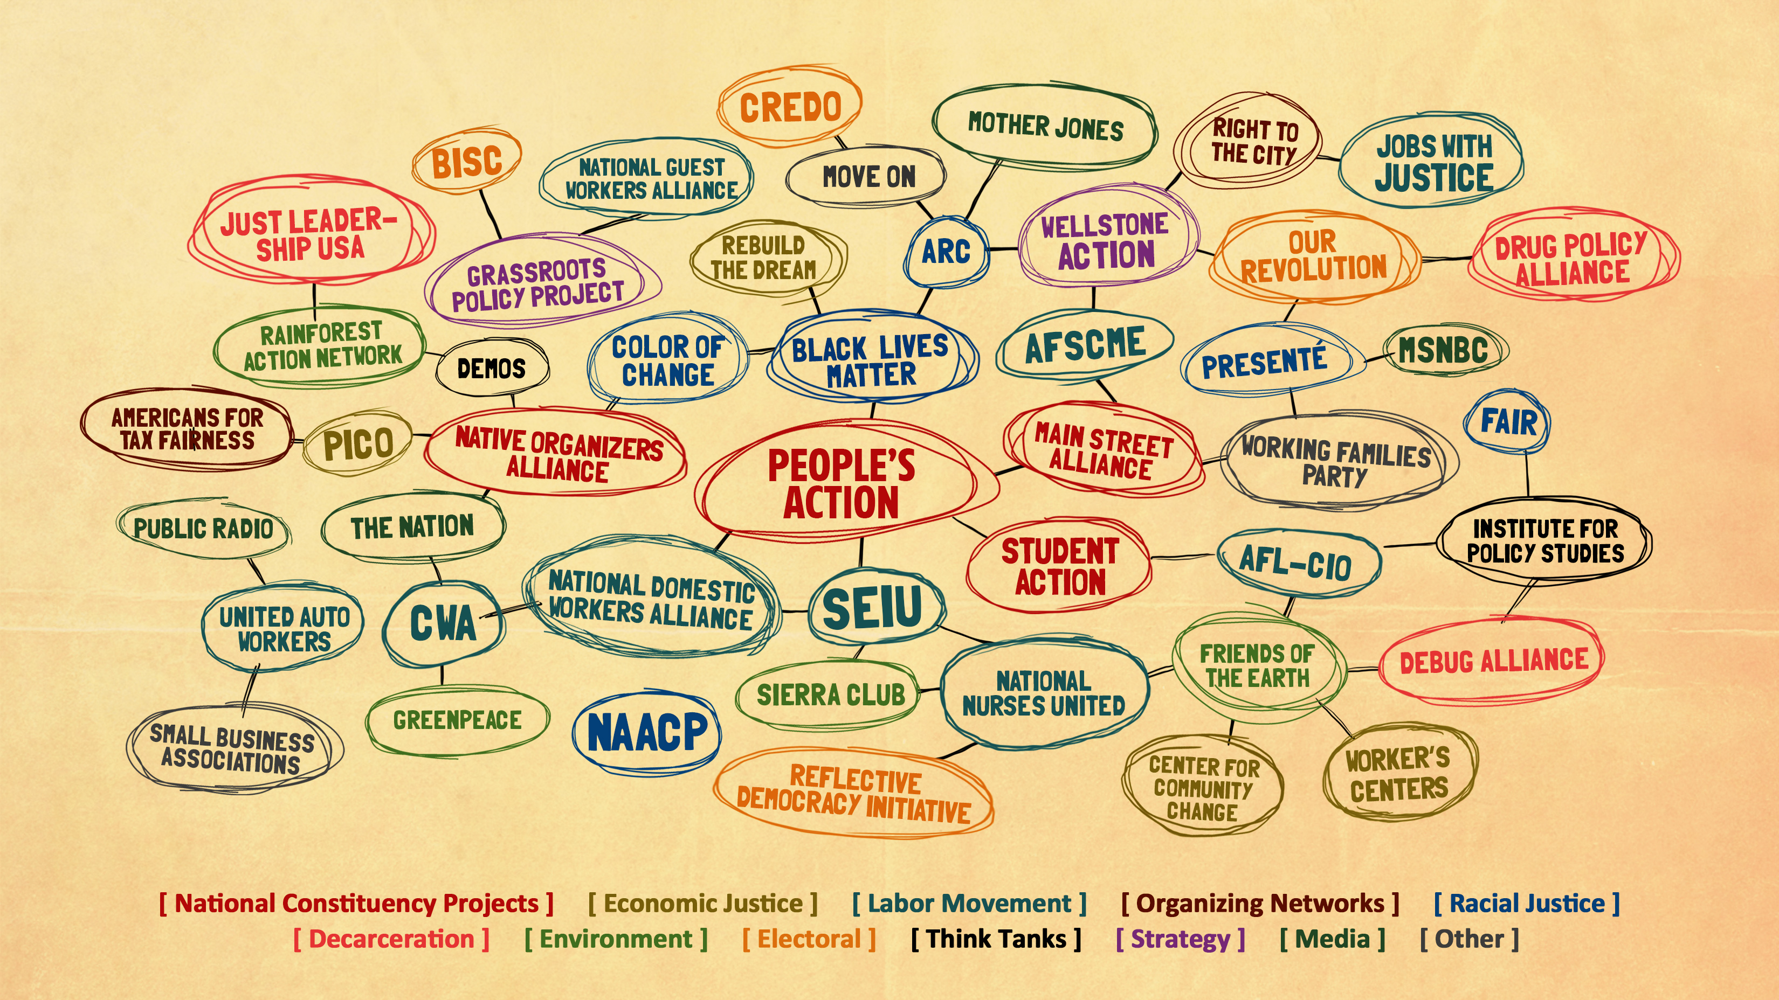
Notes:
Now we need to come together with our brothers and sisters in other parts of the progressive movement - with domestic workers and construction workers, with the women’s movement and the movement for Black Lives, with the Dreamers and the Native movement at Standing Rock - to build the power we need to win this whole thing.

Slide 76

Notes:
It will also help us build broad social alliances that reach far beyond anyone who is already engaged in the progressive movement, brining in poor and working people of all races, small business owners, farmers and all people who want and need a new economy and society. If we want to win a bold agenda, we need to move beyond lead just in our own communities. We need to aim to lead all of society.

Slide 77
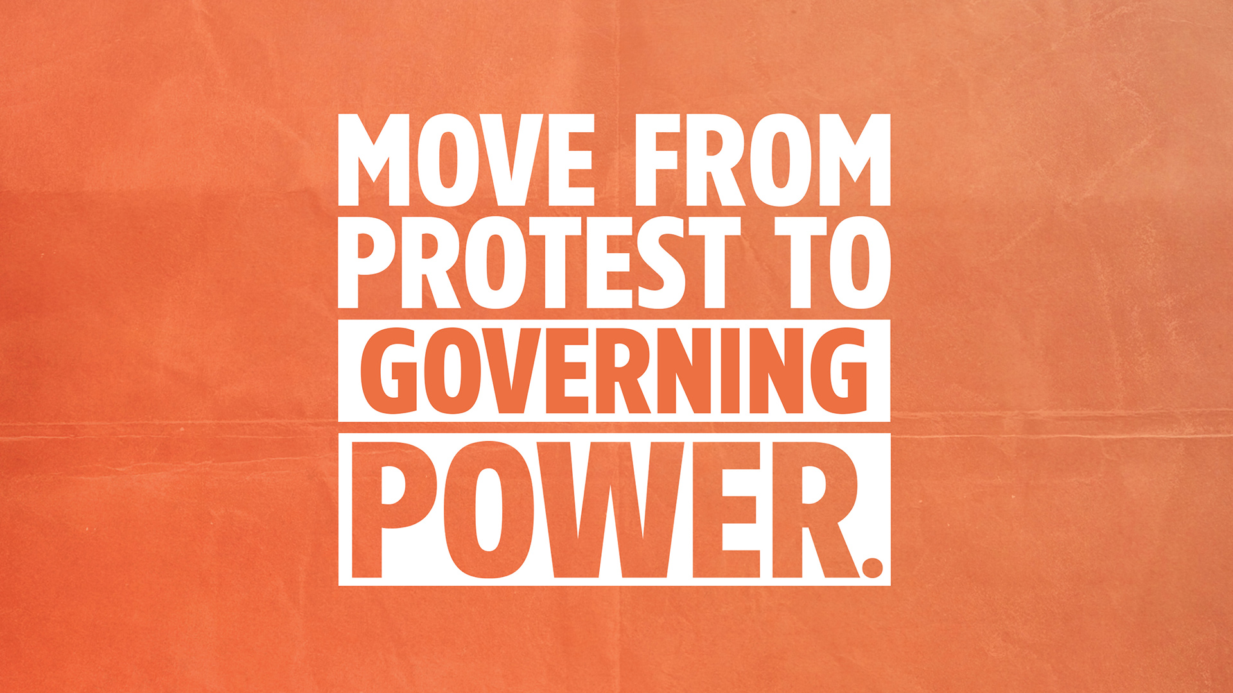
Notes:
And we will leverage that broad social base to move from protest to power. We will fight for and win governing power, starting by organizing to win government offices in cities and states all around this country, until we have built the ability to take this country back from the bottom up!

Slide 78


