Slide 1
Organizing ESP
UniServ Focus Academy

Slide 2
Feedback on Feedback
Response rate - less than 25% ?
Range 4.6 - 5.0 -- lowest for organization of the day and highest for materials and facilitators.
Your Words
“I really enjoyed the discussion on analyzing union engagement misses and opportunities.”
“It was a good day.”
“Everything was superb.”

Slide 3

Agenda Review - Today
One to One Conversations
Financialization
Living Wage
Coaching
Demand and Target
Tactics and Escalation
Organizing Plan Team Time

Slide 4

Community Agreements p. 2
Using Self-Awareness and Self-Knowledge
Listening for Understanding
Being Gracious
Staying Engaged
Being Open and Suspend Judgment
Saying “I”- tell your truth
Seeking Discomfort
Reaching Empathy
Expecting Non-Resolution and Non-Closure
*Adapted from “Embracing equity and inclusion”, Annie E. Casey Foundation
Notes:
Community Agreements for Our Time
Awareness and Self-Knowledge
This requires self-knowledge and self-awareness. Self-knowledge allows you to see what causes you pain and conflict and enables you to embrace your contradictions and inconsistencies. It allows the space to work on things about yourself that you are not happy with. In turn, self-knowledge helps to prevent you from projecting your negative aspects onto other people. Bringing your best self also requires that you have a positive attitude, are willing to deeply explore your perspectives and remain open to the perspectives and experiences of others.
Listening for Understanding
Be an active listener. Active listening involves paying full and careful attention to the other person, looking him or her in the eye, avoiding interruptions, reflecting your understanding, clarifying information, summarizing the other person’s perspectives and sharing your own. Remember that most people need time to open up and might not be willing to immediately share their personal stories, hopes, fears and/or concerns.
Being Gracious
Being kind is a vital way of bringing meaning to our own lives, as well as the lives of others. Kindness is about caring genuinely for others around you, wanting the best for them and recognizing in them the same wants, needs, aspirations and even fears that you may have. Being kind and generous allows us to communicate better with others, to be more self-compassionate and to be a positive force in other people’s lives. This includes following the COVID protocols that are in place to protect the health of this learning community.
Stay Engaged
Staying engaged requires you to be morally, emotionally, intellectually and socially involved in the conversation. Staying engaged means that you are listening with curiosity and willing to deepen your understanding. Staying engaged might also require you to sustain the conversation even when it gets uncomfortable or diverted. This also means a commitment to keeping your electronic communications to a minimum with folks not present in this learning community.
Be Open and Suspend Judgment
Listening with an open mind includes being receptive to the influence of others. You can suspend judgment by becoming aware of preconceived notions and listening to everything someone has to say before jumping to conclusions. Most importantly, suspending judgment also means listening to what the speaker has to say for understanding, not just to determine whether the speaker is right or wrong.
Say “I”- tell your truth
Speaking your truth in authentic and courageous conversations about race requires a willingness to take risks. It means that you will be absolutely honest and candid about your own thoughts, feelings, experiences and opinions and not just saying what you perceive others want to hear. Speaking your truth will require you to speak from the “first person” and use “I” statements.
Seek Discomfort
Leaning in to discomfort will require you to let go of racial understandings and stereotypes that you may be holding onto in order to move forward. Leaning in means that you will avoid judgment, assume positive intent and be open to the kernel of wisdom in each individual’s experiences. Leaning in to discomfort will require you to sit through moments of embarrassment, confusion, anxiety and/or fear.
Reaching Empathy
Empathy and compassion allow you to understand the other person’s point of view. When you are empathetic, you are more understanding, patient and kind. Expanding your capacity to feel empathy will also allow others to enter your circle of human concern.
Resolution and Closure
Expect and accept that there may not be closure. It is not likely that you will resolve your personal understanding about race or another person’s racial experience in a single conversation. The more you talk about race with another person, the more you learn and the more they will learn. Authentic and productive conversations about race are continuous and always evolving.
*Adapted from “Embracing equity and inclusion”, Annie E. Casey Foundation

Slide 5

What else has been on your mind about this work?

Slide 6
Hedy and Helenna

Slide 7
Why do we want to build relationships?
Notes:
How many of you have best friends? When you met you didn’t have immediate commitment to one another. It grew over time as you built your relationship.
In the same way, we are building public relationship based on values to build commitment. We are taking the time to learn about the others values and interests and taking time to learn what motivates us and others to act.
How do we do this?
We do this by being vulnerable enough to connect and grow together while also being intentional about how and what we communicate. You are strengthening this muscle today.

Slide 8
Organizing is a set of leadership practices that enables people to turn the resources they have into the power they need to make the change they want.
Power comes from our commitment to work together to achieve common purpose, and commitment is developed through our public relationships.
Relationships
Notes:
Resources can mean financial resources, after all, dues are our members money. It is their union and their collective pot of money. But our strongest resources are the members themselves.

Slide 9
“Organizing is a fancy word for relationship building.”
– Mary Beth Rogers

Slide 10
Relationships are
Relationships are
Built Around Shared Values
Long Term
Mutual Commitment
Involve Consistent Attention and Work
Notes:
Like in other parts of our lives, relationships in organizing are based on shared values and shared purpose.
So finding common values and purpose is important. However, if we just build relationships with people just like us, or with people who will just agree with us all the time, what type of campaign or organization will we end up in?
Relationships are based as much on difference as on similarities. When we’re building our leadership teams, organization and campaign, we need to recruit and build relationships with people who are different from each other, who have diverse resources, experiences & skills, which will strengthen our common effort.
But remember, having shared values, a shared purpose and some skills & resources doesn’t mean that you have a relationship. If there is no commitment, there isn’t any glue in your campaign. A relationship with no commitment is not a relationship. If several people come to an association event but I don’t ask them to explicitly to make a commitment to joining me in this work, then they may have a relationship to with me, but not with the campaign or the association.

Slide 11

How do we identify what issues people care about?
Notes:
How do we identify what issues people care about?
-We talk to them. We ask. We have intentional organizing conversations (one-on-ones).
Quick Note: Sometimes we default into talking about students and how educators working conditions are students learning conditions. From the research on ESPs that is not always the case for our ESPs and if we simply default to talking about students, we are not only alienating some workers but also repeating the line of "for the students" that bosses use.
I'm sure all of us at some point have said the line of "if you had a magic wand, what would you change about your workplace." That is a great tool to get workers issues, but it is also a radical act in and of itself. We are asking workers to paint us a vision of what their workplace should/could be. That doesn't sound super radical, but our workplaces are set up to discourage people from dreaming of more and seeing themselves as change makers. It is our job to get the issue but also to communicate to them that their issues are IMPORTANT, not because it impacts students but because they are workers who deserve better and they know the best solutions for the problems they face. We know that improving working conditions in schools will benefit students, the community, the WORLD, but in this moment

Slide 12
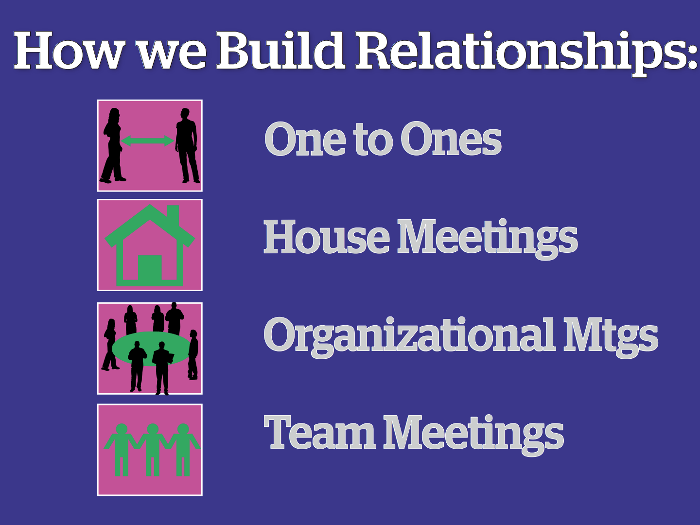
Notes:
So how do we build and maintain that commitment to each other in order to build our capacity and create change?
Basically the same way we build relationships in other parts of our lives, but in an intentional and transparent way.
These are several ways you can build relationships but the one we will focus on now is the One-to-One.
This is a great tool to identify leaders and recruit them into leadership teams. They are critical for building strong relationships in which both people grow and learn together over time. We use them to build community and commitment within a new leadership team. We use them to build deeper relationship with some people we may already know from other work.

Slide 13
Basics of One on Ones
Notes:
We need to be in relationship with our people.

Slide 14
We listen to relate to our people
Listen 80%; talk 20%
Use open ended questions
Not about winning an argument or interrogating
Learning where our stories connect
Notes:
We build these relationships by

Slide 15
We listen to identify Issues
Use probing questions
What’s not right?
What would they change?
If you had a magic wand, what would you change about your workplace?
This is your union. What would you like to see you and your colleagues work on?

Slide 16
We ask for commitment
Use direct and specific language
Stress the shared values you have exchanged
Frame it so that the person IS the solution to the ask

Slide 17
We ask to identify leaders
Who is trusted and respected?
  Why?
To objectively identify leaders, we must ask our people

Slide 18
3 Types of One on Ones
Recruitment
Escalation
Maintenance
Definitions on page 51

Slide 19

Practicing One on One’s
Triads
1. Organizer – Asks questions
2. Worker – Answers
3. Observer – Coaches
*If a recruitment or escalation conversation, make an ask.

Slide 20
Debrief
As a staff person, what do you need to do to make this a member led practice back home?

Slide 21

Key Points
Organizers listen and ask questions!
We want our workers to realize:
  They care about a problem
  There is a decision-maker who has the power to fix this problem
  The decision-maker won’t fix it until someone pushes them to
  To solve the problem they need to join their colleagues, share their resources and take action together

Slide 22

BREAK

Slide 23
Ben

Slide 24
Financialization

Slide 25

What is the purpose of public schools?

Slide 26
Key Ideas to Listen For
1. Capitalism is Constructed
2. Over time Capitalism has been built around 3 Ideologies:
  Kenysian (Supply and Demand driven)
  Free Enterprise (Trickle Down – low regulation and open market)
  Neoliberalism (anti-tax, anti-union, anti-regulation, and anti-public-sector)
  3. Financialization converts publicly provided goods into privately "financed goods.”
  4. Public education reflects and advances the same norms and practices as the prevailing economic ideology.

Slide 27
How are schools and the economy related?
  Public education was created to benefit those in power, mostly white males, and also to train a working class but still mostly male and white.
  Late 1800’s-1900’s Over time public schools began to elevate the workforce, again mostly for those deemed worthy.
  Into the 1940’s, it was a time of increased power for workers and labor unions. Education became even more widely available but still not universal (racism in access)

Slide 28
How are schools and the economy related?
1800’s through late 20th Century - Universally accessible, tuition-free, public, K–12 education contributed to the social wage, the mix of publicly provided goods and services that add to the normative standard of living.
Universal access to tuition-free public K–12 education was rolled out alongside other New Deal reforms of the 1930s and ’40s — taxing the rich, the expansion of unions, and regulation of finance and industry — associated with the Keynesian period in the development of US capitalism. (Supply and Demand)

Slide 29
How are schools and the economy related?
By the 1970s, high wages and high fixed costs cut into the corporate profit rate.
In response, during the 1980s and 1990s, an ideologically committed and organized capitalist class rolled out free enterprise capitalism or trickle down with open markets and light regulation was held up as the ideal institutional arrangement for organizing the production and distribution of nearly all goods and services.

Slide 30
How are schools and the economy related?
By the 1990s, an anti-tax, anti-union, anti-regulation, and anti-public-sector ideological bi-partisan conventional wisdom that the public sector was inherently “inefficient.” Neoliberalism
Here – the meaning of public education shifted. Public education became less about cultural enrichment and civic engagement.
The purpose of public education was providing individuals with the skills and habits appropriate for the marketplace. Anyone could overcome the hardship of their circumstances so long as they were willing to work hard, first in school and later in the labor force.

Slide 31
How financialization of public schools works.
Define High Standards
Design Tests to Measure Standards
Tie Funding to Tests
Cut Funding When Results are not Attained
Repeat Until All Public Schools have Failed
Private Schools, Charter Schools, Vouchers

Slide 32
How are schools and the economy related?
Public schools were expected to operate akin to businesses and adapt to the new era of iterative austerity, doing more with less. Showing results that reflected a high return on investments.
Public education reflected and advanced the same norms and practices as the prevailing neoliberal capitalism it was embedded in.

Slide 33
Financialization is a process whereby financial markets, financial institutions, and financial elites gain greater influence over economic policy and economic outcomes.
Financialization transforms the functioning of economic systems at both the macro and micro levels.

Slide 34
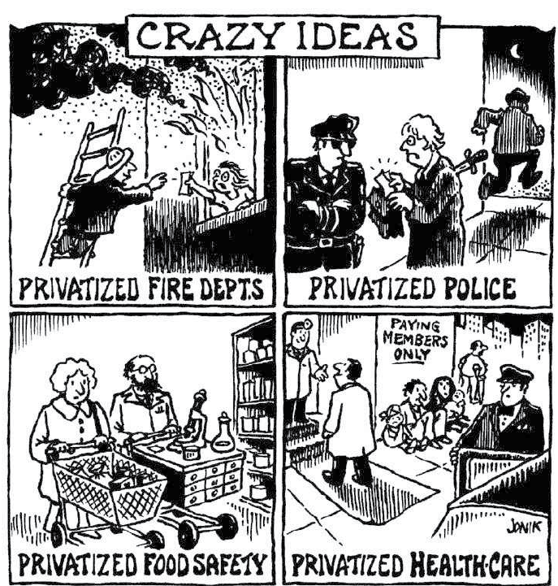
Financialization converts publicly provided goods into privately "financed goods."
Who benefits?

Slide 35
How has COVID affected the financialization of public schools?

Slide 36
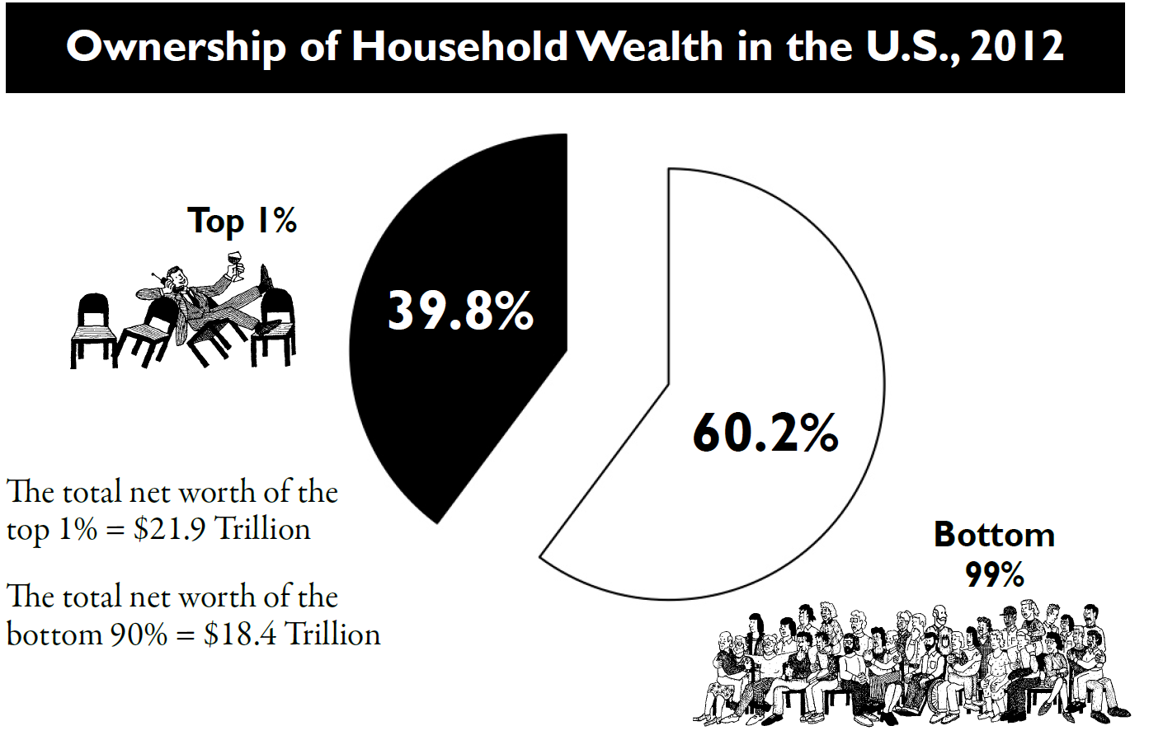

Slide 37
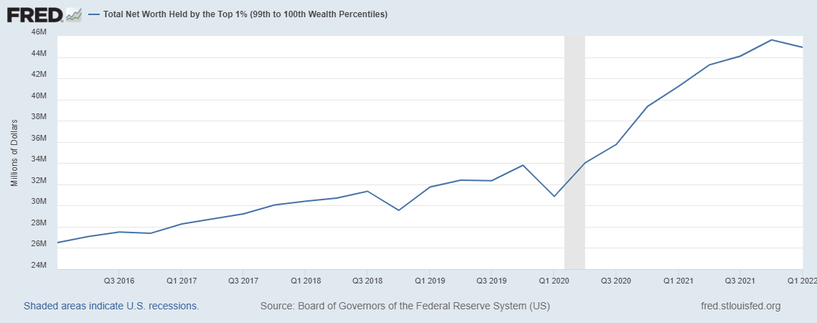

Slide 38

Key Points
Our system is designed to extract wealth and power from the lower levels of our system and move it to the top.
Financialization benefits the wealthiest.

Slide 39
Adam
Notes:
Section Time Allotment: 60 minutes
Facilitators are encouraged to float around the room and talk to tables

Slide 40
Living Wage Basics

Slide 41
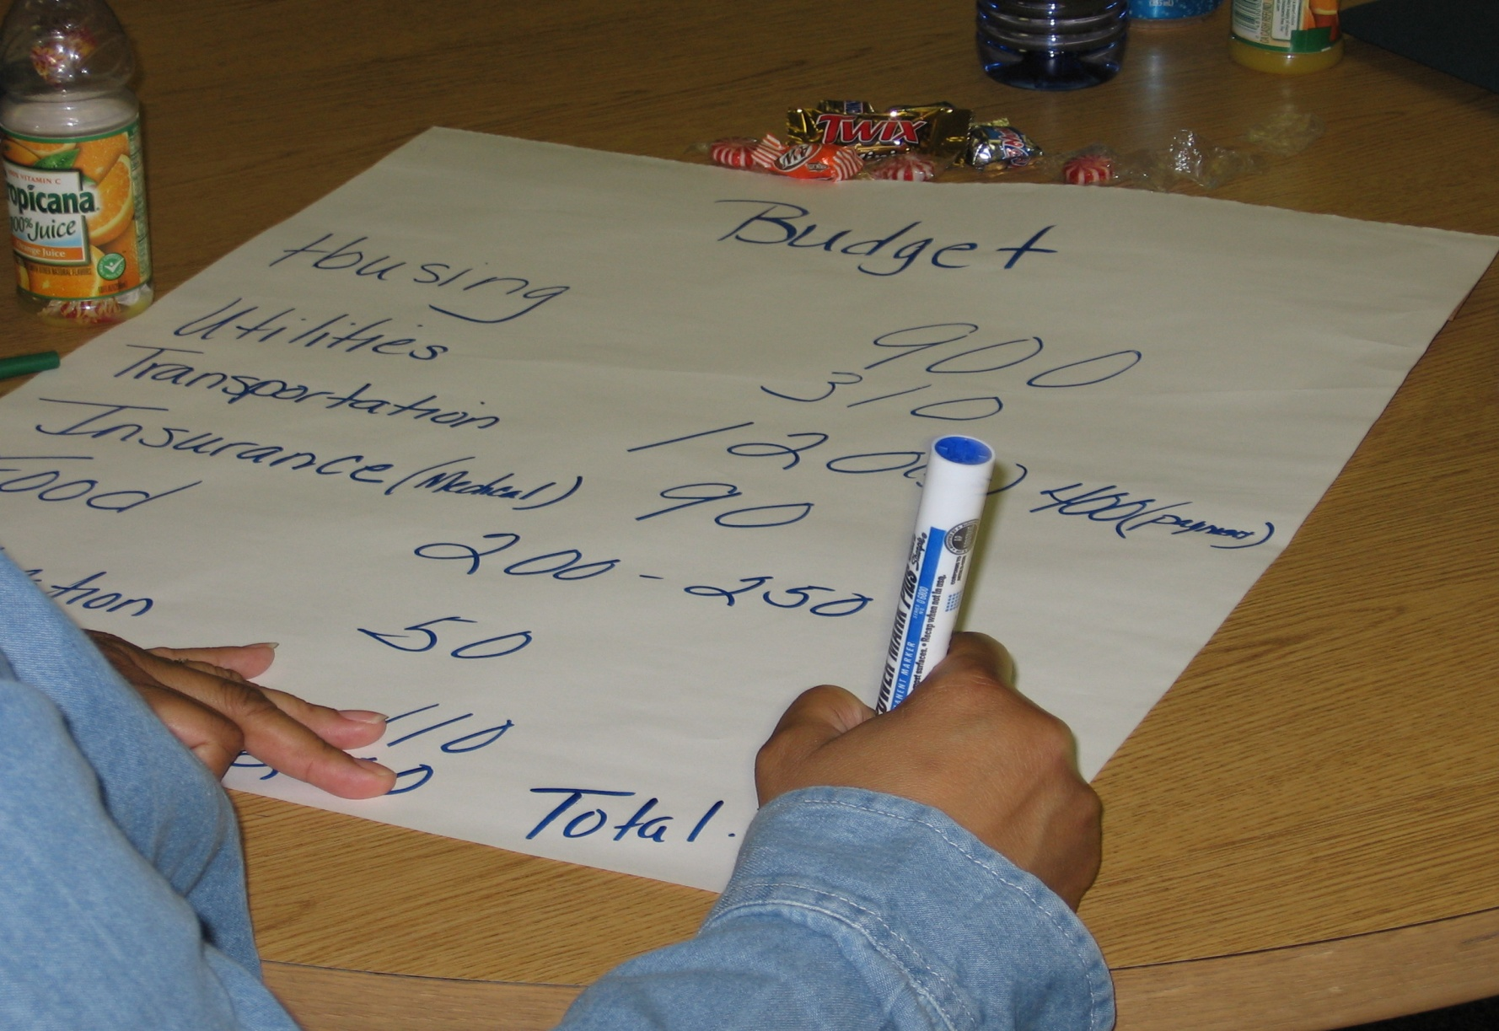
What is a Living Wage?

Slide 42

Living Wage: The Basics
A Living Wage defined: Sufficient earnings to cover basic needs
food
housing
clothing
transportation
utilities
child-care
taxes
health care
Notes:
This is just an existence, not a living. But it’s a start

Slide 43
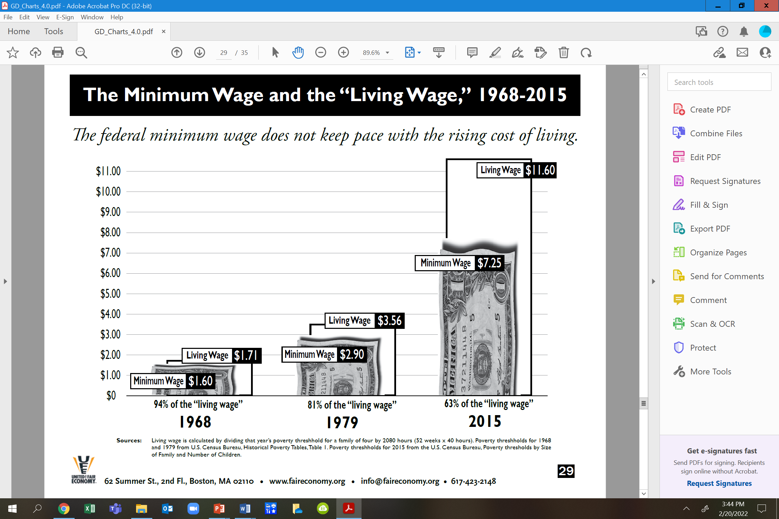

Slide 44
Currently
The U.S. federal minimum ($7.25) is less than half the “living wage” for a single adult ($18.81 an hour, or roughly $39,000 a year pretax)
Less than a third of what a family of four needs to live — around $25 per hour per parent, or about $100,000 a year combined.

Slide 45
Living Wage Websites
Economic Policy Institute www.epi.org
Living Wage Calculator https://livingwage.mit.edu/
United for a Fair Economy www.faireconomy.org
Federal Poverty Line www.aspe.hhs.gov
Notes:
Economic Policy Institute www.epi.org
Living Wage Calculator https://livingwage.mit.edu/
United for a Fair Economy www.faireconomy.org
Federal Poverty Line www.aspe.hhs.gov

Slide 46
Basic Family Budget Calculator
Varies by both location and family size
Includes:
Monthly housing
Monthly food
Monthly child-care
Monthly transportation
Monthly health care
Monthly other necessities
Monthly taxes
https://www.epi.org/resources/budget/
Notes:
Change to another state

Slide 47
Key Points
A federal policy strategy to addressing living wage is unlikely to give our members what they need.
Moving the narrative of a minimum wage to a living wage and ultimately towards a thriving wage

Slide 48
Living Wage Campaigns

Slide 49
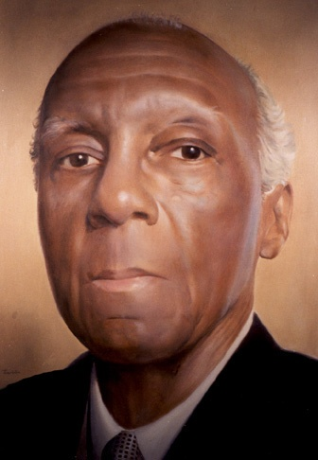
It’s All About Organizing!
“At the banquet table of nature there are no reserved seats. You get what you can take and you keep what you can hold. If you can’t take anything, you won’t get anything; and if you can’t hold anything you won’t keep anything. And you can’t take or hold anything without organizing.”
-A. Phillip Randolph, founder,
Brotherhood of Sleeping Car Porters
Notes:
-If a local leader doesn’t get this.. They’re not ready for a campaign.
A LW campaign can be done in a non-bargaining state as well as a bargaining state. Whether you are bargaining or advocating and lobbying – the campaign strategies are the same

Slide 50
A Living Wage Campaign is…
About seeking more than the usual modest raise.
As much about grassroots organizing, intensive planning and union building as it is about gathering salary data or arguments.
About winning professional, competitive pay by “surrounding” the employer with your members and community allies.
Notes:
Salary campaign strategy always involves unity, consensus, strategic planning, solid research and arguments, member organizing and engagement, coalition work, constant communications, and the sense that “We’re worth it.”
What is It REALLY About?
Working only one job and having time for your family, friends, and yourself.
Social Justice, Worker’s rights, Human rights, Women’s rights,
Self-worth, respect, and dignity on the job.

Slide 51
What Makes a Living Wage Campaign Different ?
Social Justice
Living Wage Data
External Organizing
Internal Organizing
Notes:
Not settled at the bargaining table, but out in the community.

Slide 52

10 Steps to a Living Wage Campaign

Slide 53
#1 Pick an Issue
Privatization
Benefits
Working Conditions
Job Security
Lack of Professional Development
Workload
Differential Pay
Wages
Notes:
LIVING WAGE

Slide 54

It takes more than just a “handful” of members…
#2 Buy-In
Notes:
This is a campaign for all of the members.. Not just the local leaders and the Uniserv!
Everyone should have a chance to contribute and feel ownership. In actuality, a salary campaign builds better, stronger, more knowledgeable and independent locals and in the long run makes for a lighter work load for the UniServ.

Slide 55
#3 Timeline
Is this a good time for a Living Wage Campaign?
Notes:
What About The Economy =WATE?
YES!!! There is never a better time than now! The lowest paid ESP’s are struggling to survive in this economy
Don’t Wait - It takes a good year – 18 months to prepare for a well thought out LW campaign – whether it’s bargaining or lobbying your legislators. When the economy does start to get better , you’re just that much further ahead, prepared to start your campaign, not starting from square one!

Slide 56
#3 Timeline
Form a committee
Survey members
Develop a Plan
Hold training sessions
List of possible activities (incremental)
Member recordkeeping (contact info, involvement info)
Calendar all meetings
Constantly revisit and adjust

Slide 57
#4 Action Plan
Plan WAY Ahead:
Write a strategic plan.
Build internally and externally.
How will we finance the campaign?
Include assignments and responsibilities.
Affirm your salary philosophy.
Adopt ambitious salary demands.
Notes:
Salary campaign model: internal organizing, external organizing, use of media, civil rights style tactics, social justice issue, bold salary goals, salary data /cost of living locally
Write a strategic plan: with clear goals, priorities, timelines, assignments and milestones to celebrate.

Slide 58
#5 Gather DATA
Prepare, prepare, prepare!
Engage members in research.
Gather, solid reliable data.
Gather strong arguments for professional pay.
Document your employer’s role in economic development.
Notes:
don’t let comparable pay be the districts argument – poverty pay is poverty pay –even if it is what the surrounding districts get paid – it’s just not right!
Economic Development- includes faculty and ESP local spending power, institutional purchasing power and direct ties between quality local education, housing values, corporate site selection decisions, creation of rural entrepreneurs
Research – help verify current payroll data but don’t let comparable pay be the districts argument-“ The district always says that we make what surrounding districts make.”
Document regional living costs –it’s the districts problem to find the money
Look at management spending priorities, waste…
Quality… highest salaries attract highest quality applicants
Economic Development- includes ESP local spending power, institutional purchasing power and direct ties between quality local education, housing values, corporate site selection decisions, creation of rural entrepreneurs

Slide 59
#6 Internal Organizing
Well-organized locals
Displays solidarity with other bargaining units.
Finds, recruits, and trains new leaders/members and volunteers.
Has a strong building rep system and tested leadership structures.
Has a broad base of engaged workers.
Has community ties.

Slide 60
#7 External Organizing
Building community coalitions
Assess your standing in the community.
Survey members to map their community connections.
Build coalitions AHEAD of time —with allies such as parents, other unions, community and religious leaders.
“Reciprocal” view of coalition building .
Identify “key communicators” in the community who are potential supporters.

Slide 61
#8 Messaging/PR
Have the state affiliate provide communication training for the local to provide rationale, messages and talking points.
Learn to write a press release, plan for a press conference or speak at a board meeting.
Take control of communications and communicate constantly.

Slide 62

#8 Messaging/PR Communicate Your Case
Develop a clear and simple salary message.
Select member spokespeople.
Create a theme, message and a media “buzz”.
Notes:
Communication NO MORE SECRETS!! Do not hide the districts dirty little secrets (poverty wages)anymore- and the other secret that the community doesn’t know – TAXES should not now , not ever create or perpetuate poverty!
Humanize your members – Thanksgiving story- video your members-

Slide 63
#8 Messaging/PR Humanize the Members
Establish workers as real people with real needs.
It’s time to speak out. Prepare workers to tell stories about financial struggles and work with students.
Publicize workers’ good, often-hidden work.
It's about breaking systems of oppression and countering narratives
Help them understand and believe that “they are WORTH it!”
Notes:
“Humanize” your members, tell their stories.
Educators are way to modest about the work they do.
We MUST start speaking out! Nobody knows how much they make!
Taxes should not create or perpetuate poverty!
Video tape them!
Help them believe they are worth it BUT if they don’t speak out about it nothing will change

Slide 64
#9 Escalate
Know when to… Turn Up the Heat!!
Apply incremental pressure on the employer.
Approach every educator.
Engage every member.
Reach every likely supporter.
“Surround” decision makers.
Notes:
Approach every educator – 1:1 conversations
Engage every member- a job for everyone, spread the work out-prevent burnout
Supporters- community allies-parents, students, other union, religious leaders, college faculty, community organizations
Incremental Pressure – candlelight vigils to full blown rallies, protests
Surround-pressure on the decision-makers

Slide 65
Internal Organizing leading to:
Public, direct-actions and tactics, including on the job actions
Surround the Decision-Maker
Legal Strategies
Churches
Other Unions
Research
DECISION
MAKER
Community Support
Media campaign
Political Allies
Parental Support
Board Actions
Legislative Agenda
Notes:
For bargaining states and non-bargaining states. Decision–maker; Supt., Board of Ed. Members, Legislators, Public
It’s all about your community connections (coalitions) putting pressure on the decision makers (whomever that may be)

Slide 66
#10 Celebrate!
Don’t wait for “the end”, celebrate small victories.
You settled–the local is now “a force to be reckoned with.”
Celebrate, plan for the future, and keep organizing!
This is the beginning of organizing and power building!
Notes:
Keep improving salary schedules, keep organizing , plan for the next.
“A force to be reckoned with…” - you may not be the districts favorite local president or association but they know you are a force to be reckoned with,, you have the communities support..you’re now a player, where before you weren’t even in the game.

Slide 67

Lunch

Slide 68
Heidi and Juli
Notes:
Section Time Allotment: 60 minutes
Facilitators are encouraged to float around the room and talk to tables

Slide 69

Identifying the 10 Steps

Slide 70

Group work
Ithica – p. 105
Somerville – p. 108
Chart – p.115
Notes:
May continue after lunch

Slide 71
Key Points
A living wage can be done effectively in a bargaining or non-bargaining state because it is all about organizing.

Slide 72
Ben

Slide 73

Coaching
Coaching is a direct intervention in an individual or team’s work process to help them improve effectiveness.
Coaching enables others to build their own capacity to act.
Coaching moves leaders from a relationship where staff have an external control to one where they focus on how to grow.

Slide 74
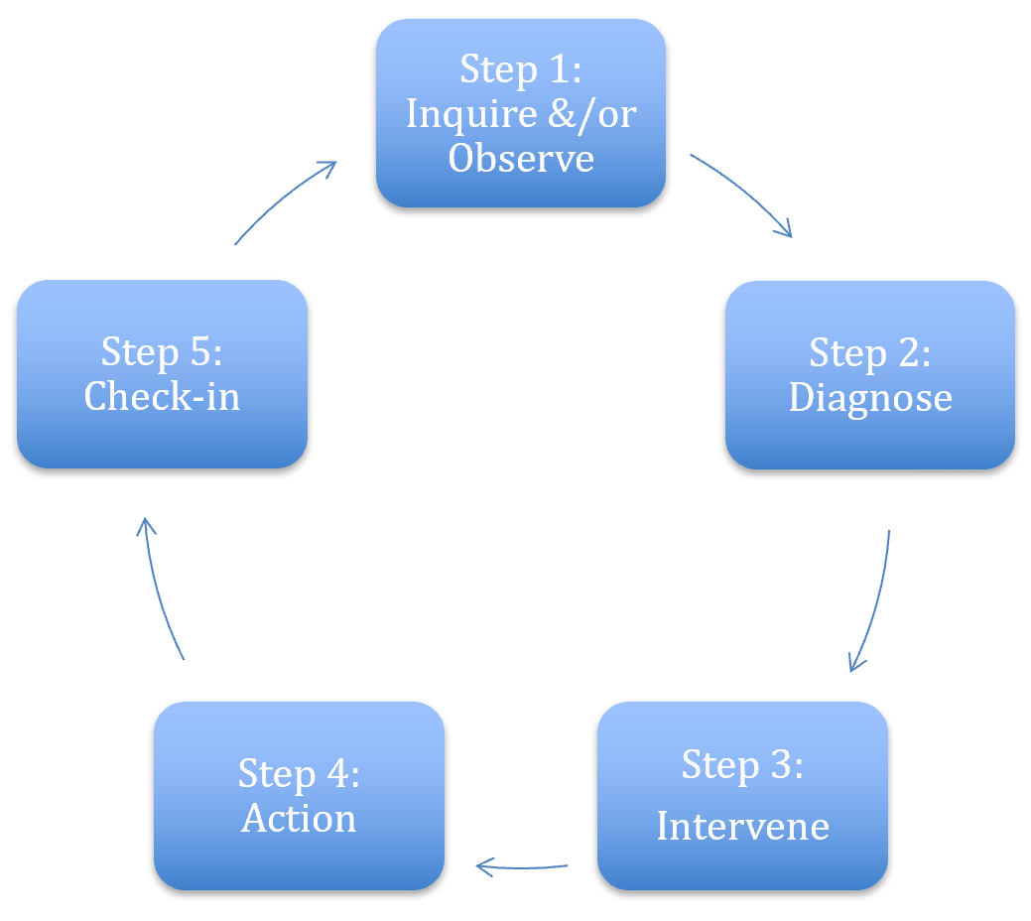
Coaching Cycle – p.120
The reason to apply this cycle is to stop yourself from providing THE answer.
Leaders grow from productive struggle.

Slide 75
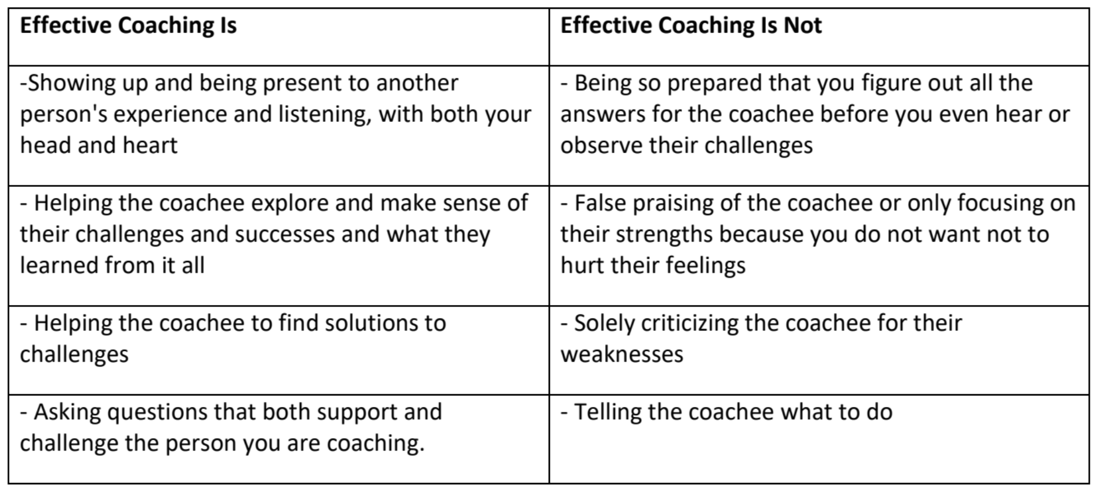
p. 119

Slide 76
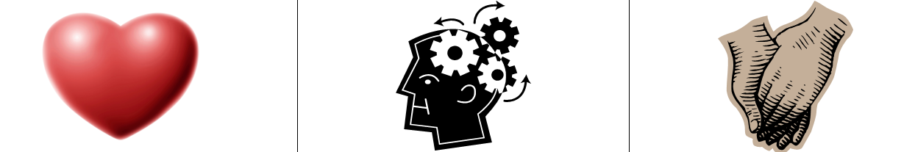
3 Kinds of Coaching – p. 121
Motivational - Heart Coaching aimed at enhancing motivation
Strategic – Head Coaching aimed at helping plan, evaluate, strategize
Skills-based – Hands Coaching aimed at effective execution of a skill

Slide 77
Now it is your turn… p. 124
Get into Teams - 3…there may be 1 team of 4
Four Scenarios
Which “kind” of coaching “diagnoses” would you make

Slide 78
Coaching
Regroup!
You will need to get into groups of 3.
Note: there may be 1 group of 4

Slide 79
Key Points
It's not our local.
Our own biases show up when we are directive and patronizing.
Coaching requires asking and listening and enables individual choices
Coaching is as much about you changing your behavior and growing your skill as it is about growing a leader.
We only get good at coaching by practicing it.

Slide 80
BREAK

Slide 81
Naomi

Slide 82
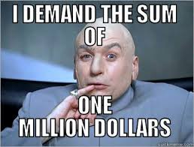
When making a demand …
  A demand is the outcome that addresses the issue that you are making of a target
  Measurable
  Achievable
Notes:
Hedy

Slide 83

Targets:
A single person:
  - a name, face, & address
Has the power to give you what you are demanding
Notes:
Hedy

Slide 84

Issue Work! (Charts)
Identifying Issues, Demands, and Targets
In your groups, return to your scenario and decide the:
    Issue
    Keep in mind what makes a good issue!
    Demand
    What do you want to win to solve your issue?
    Target
    Who has the power to give you your demand?
    Who can influence this target?

Slide 85
Key Points
A well thought out campaign has a strong issue, with an identifiable target and a strategic demand.
A target is a specific person!
We don’t choose the issues! We identify the issues from talking to members!
Notes:
Hedy

Slide 86
Helenna

Slide 87
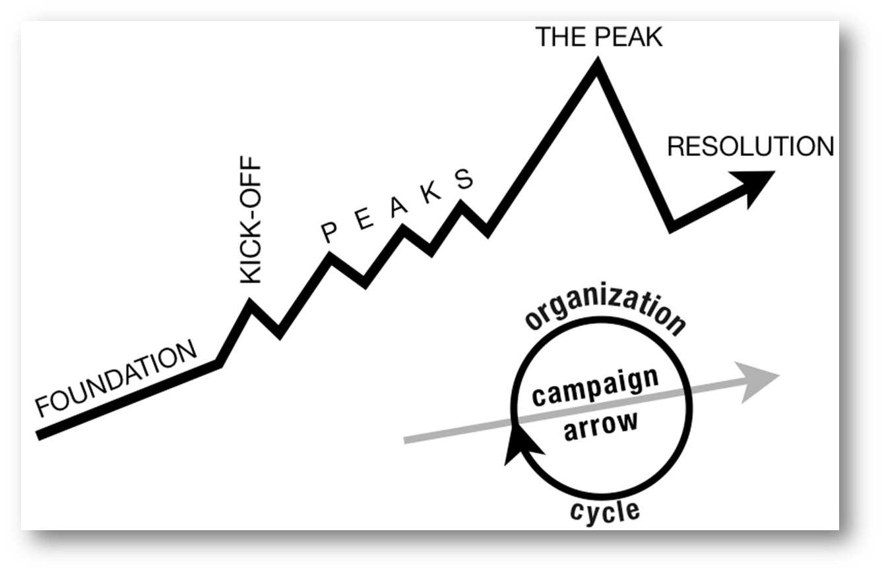
Structure of a Campaign
WIN
Notes:
Hedy
Tactic scramble!

Slide 88

Tactics
Tactic – Actions you take as a part of an escalation plan that increases pressure on your target to try to win your demand.
Notes:
Sara

Slide 89


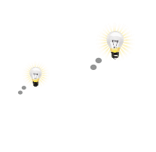

A TACTIC SHOULD:
Goal
Puts pressure on your Target
(puts them out of their comfort zone)
1.
Builds your Power
(develops leaders, brings more people in, etc.)
2.
Is Strategic
Notes:
Sara

Slide 90
Scenario Work!
Tactics Brainstorm
+++YOU HAVE 5 MINUTES!+++
Brainstorm AS MANY tactics as you can on 1 chart.
Be creative!
You are NOT evaluating right now! Everything goes on the board!

Slide 91
Evaluating Tactics
Does the action relate to your issue?
Will it increase the pressure on the decision-maker?
Is it visible?
Is it timed for effect?
Is it new and different—or tried and true?
Are enough people ready to do it?​
Will it unify people?​
How will management react?​
How will your target react?
Does it violate the law? (If so, are we prepared for the consequences?)​
Will it be fun?

Slide 92
Compression Points
Points on the calendar where you celebrate short term wins or escalate your tactics based on how you have assessed your readiness to escalate.
  Naturally occurring deadlines
  Artificial deadlines
  Help us build urgency and crisis
  Opportunities to debrief and reassess

Slide 93

Why do you think tactics escalate gradually?
Building an Escalation Plan
GOAL
Tactic
Tactic
Notes:
Sara

Slide 94
Each escalation is more public, more visible, and has more risk. We transform members to activists, activists to leaders by asking them to take bigger risks.
GOAL
Tactic
Tactic
Notes:
Sara

Slide 95



Resources that shrink as you use them:
-Time/Energy
-Tangible Items- materials
-Money

Slide 96



Resources that grow as you use them:
-Relationships
-Skills
-Hope
-Trust

Slide 97
ORGANIZE TACTICS INTO… A CAMPAIGN Timeline
WIN
Notes:
Sara
Tactic scramble!

Slide 98
Key Points
Strategy without tactics is simply a collection of good ideas and big dreams.
Tactics without strategy are a random collection of activities and wasted resources.
The bigger the win you want, the more resource you need.
Good tactics actually result in more resources – relationships, skills, hope and trust.
Notes:
Sara

Slide 99
Hedy

Slide 100
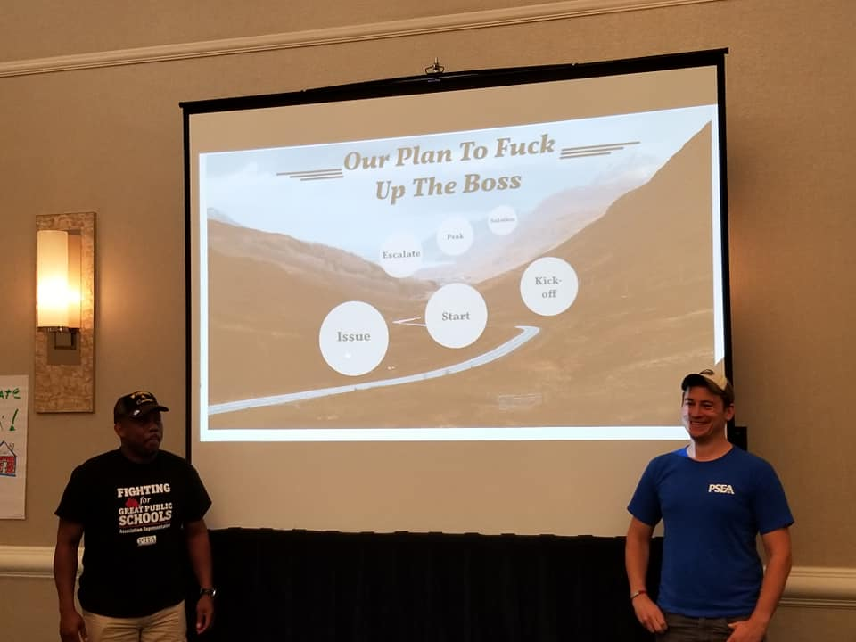
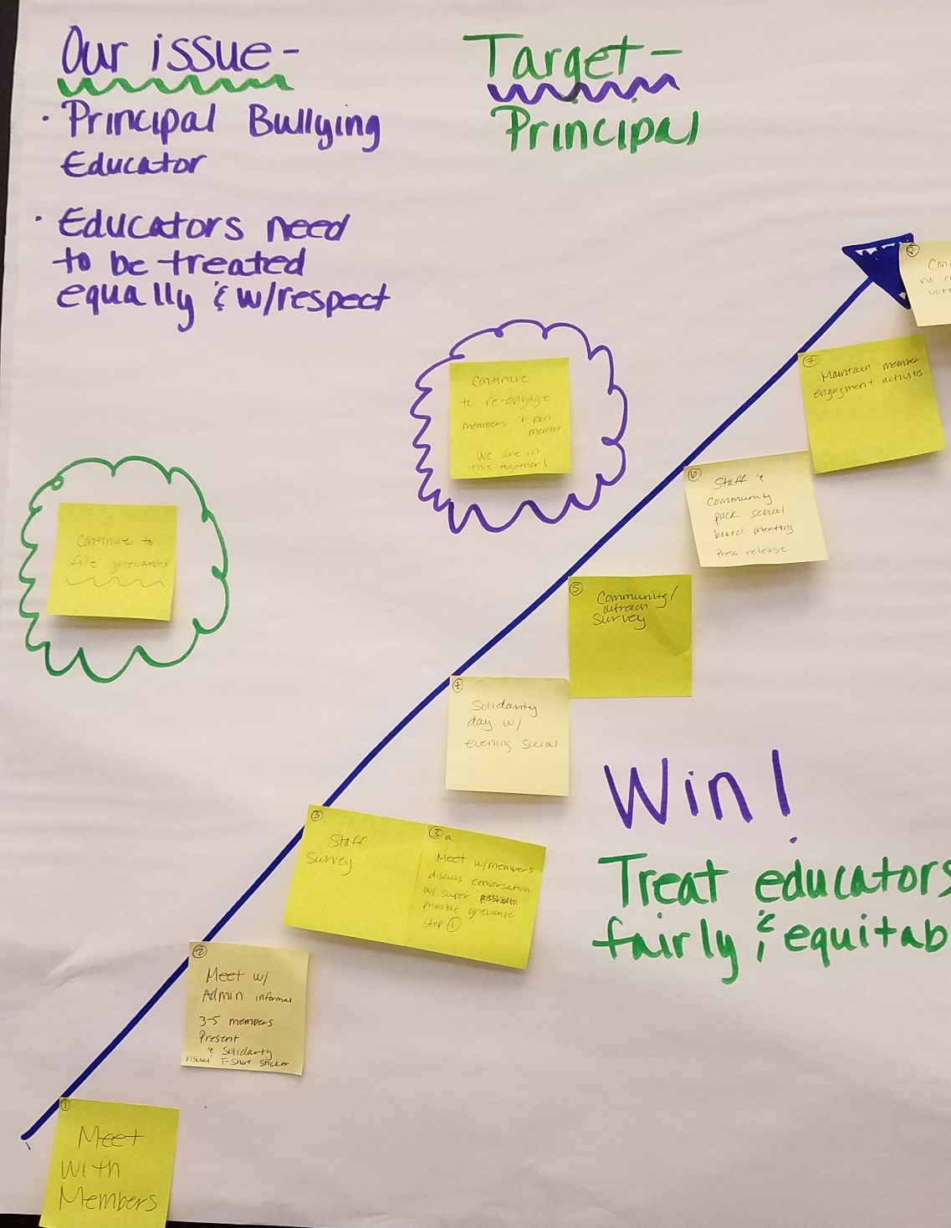

Team Work Time
p. 129

Slide 101
Ellen

Slide 102

Your thoughts so far…

Slide 103

Problem of Practice
The problem of practice is something that you care about that would make a difference for your locals if you improved it.
The more specific the problem of practice is, the more helpful the recommendations for your next level of work will be.

Slide 104

Ending it Right
Choice Networking
Housekeeping
Checking out, Flights, Taxis
Plus and Delta at the Door

Slide 105

Choice Network Time

