Slide 1
Organizing ESP
UniServ Focus Academy

Slide 2
Feedback on Feedback
We were at 45% participation range of scores 4.2 to 4.5 one respondant reported 1's in each category. And there was one 2 in another category.
Lowest was in the category that facilitators know my work and highest was for the overall content and materials.

Slide 3
Your Words
Reframing Organizing ESPs as an opportunity for deeper conversation within our own state affiliates about classism & racism in our own staff practices. Really gave me hope to return to my state & be courageous enough to begin these kinds of conversations & call people in through difficult but necessary conversations.
Specific shoutouts for the financialization and the living wage sections – love them
Troubleshooting with the presenters really helped me to understand these topics more in depth.
Love to see how the training is broken down so it can be used with members

Slide 4
Your Words
Want to see more research on what works with ESPs I know how to make a campaign.
Wish that we maybe were building our issue organizing plans around existing ESP 1:1 data around a certain organizing issue somewhere, as the campaign should ideally be created from the ground up with that kind of data & then continued ownership & feedback from them.
I am very frustrated and disappointed with this training. I came here hoping to come back with specific strategies and concepts geared directly toward ESP-specific concerns. Instead I got cookie-cutter organizing and relationship-building training (with the words "ESP" sprinkled in from time to time) that was in no way tailored to the unique needs and challenges of the ESP world - it was repackaged general organizing tips with a lot of ethereal "society needs to change" chest-thumping… Sometimes trainers need agitation to change as well.
I would love a training that says bring a brief overview of a campaign you are planning and then at the workshop plan the campaign with input from colleagues. Or bring a campaign you are doing or have done to share with colleagues to discuss it.

Slide 5

Agenda Review - Today
Consultancy Protocol
Leaders, from Clubs to Unions
Building Engaged Leaders
Team time and presentations
Lunch 1:00
Adjourn 2:00 PM

Slide 6

Community Agreements p. 2
Using Self-Awareness and Self-Knowledge
Listening for Understanding
Being Gracious
Staying Engaged
Being Open and Suspend Judgment
Saying “I”- tell your truth
Seeking Discomfort
Reaching Empathy
Expecting Non-Resolution and Non-Closure
*Adapted from “Embracing equity and inclusion”, Annie E. Casey Foundation
Notes:
Community Agreements for Our Time
Awareness and Self-Knowledge
This requires self-knowledge and self-awareness. Self-knowledge allows you to see what causes you pain and conflict and enables you to embrace your contradictions and inconsistencies. It allows the space to work on things about yourself that you are not happy with. In turn, self-knowledge helps to prevent you from projecting your negative aspects onto other people. Bringing your best self also requires that you have a positive attitude, are willing to deeply explore your perspectives and remain open to the perspectives and experiences of others.
Listening for Understanding
Be an active listener. Active listening involves paying full and careful attention to the other person, looking him or her in the eye, avoiding interruptions, reflecting your understanding, clarifying information, summarizing the other person’s perspectives and sharing your own. Remember that most people need time to open up and might not be willing to immediately share their personal stories, hopes, fears and/or concerns.
Being Gracious
Being kind is a vital way of bringing meaning to our own lives, as well as the lives of others. Kindness is about caring genuinely for others around you, wanting the best for them and recognizing in them the same wants, needs, aspirations and even fears that you may have. Being kind and generous allows us to communicate better with others, to be more self-compassionate and to be a positive force in other people’s lives. This includes following the COVID protocols that are in place to protect the health of this learning community.
Stay Engaged
Staying engaged requires you to be morally, emotionally, intellectually and socially involved in the conversation. Staying engaged means that you are listening with curiosity and willing to deepen your understanding. Staying engaged might also require you to sustain the conversation even when it gets uncomfortable or diverted. This also means a commitment to keeping your electronic communications to a minimum with folks not present in this learning community.
Be Open and Suspend Judgment
Listening with an open mind includes being receptive to the influence of others. You can suspend judgment by becoming aware of preconceived notions and listening to everything someone has to say before jumping to conclusions. Most importantly, suspending judgment also means listening to what the speaker has to say for understanding, not just to determine whether the speaker is right or wrong.
Say “I”- tell your truth
Speaking your truth in authentic and courageous conversations about race requires a willingness to take risks. It means that you will be absolutely honest and candid about your own thoughts, feelings, experiences and opinions and not just saying what you perceive others want to hear. Speaking your truth will require you to speak from the “first person” and use “I” statements.
Seek Discomfort
Leaning in to discomfort will require you to let go of racial understandings and stereotypes that you may be holding onto in order to move forward. Leaning in means that you will avoid judgment, assume positive intent and be open to the kernel of wisdom in each individual’s experiences. Leaning in to discomfort will require you to sit through moments of embarrassment, confusion, anxiety and/or fear.
Reaching Empathy
Empathy and compassion allow you to understand the other person’s point of view. When you are empathetic, you are more understanding, patient and kind. Expanding your capacity to feel empathy will also allow others to enter your circle of human concern.
Resolution and Closure
Expect and accept that there may not be closure. It is not likely that you will resolve your personal understanding about race or another person’s racial experience in a single conversation. The more you talk about race with another person, the more you learn and the more they will learn. Authentic and productive conversations about race are continuous and always evolving.
*Adapted from “Embracing equity and inclusion”, Annie E. Casey Foundation

Slide 7
Consultancy protocol p.125
Ellen and Juli

Slide 8

Problem of Practice
The problem of practice is something that you care about that would make a difference for your locals if you improved it.
The more specific the problem of practice is, the more helpful the recommendations for your next level of work will be.

Slide 9
Problems of Practice
Form Triads
Find the “Consultancy Protocol” on p.125
The purpose for the listeners is to ask good questions – not provide answers.
The purpose for the presenter is to determine what about their work with this problem needs to change.
There will not be a group debrief.

Slide 10
Discuss the Protocol Page 125
Opening (We are doing that part now)
Presenter – Shares the Dilemma
Clarifying questions (NOT Probing)- Review p.126-127
Group Fishbowl – Presenter steps out and listens to the group.
Closing – Presenter shares what they learned

Slide 11
Problems of Practice
30 Minutes Total
At least two people will have a chance to be the presenter
15 Minutes per round

Slide 12
Protocol Debrief
What was surprising to you the difference in following a protocol and just “problem solving” within a conversation?
Was it difficult to stay in the protocol?
Given your learning so far, why might using a protocol be particularly useful when exploring your challenges working with ESP locals and leaders?

Slide 13

Key Points
Coaching requires asking and listening and enables individual choices
Coaching is as much about you changing your behavior and growing your skill as it is about growing a leader.
We only get good at coaching by practicing it.
A protocol is a framework to help reshape old habits of mind into new ones.

Slide 14
Ben and Heidi

Slide 15
Leaders

Slide 16
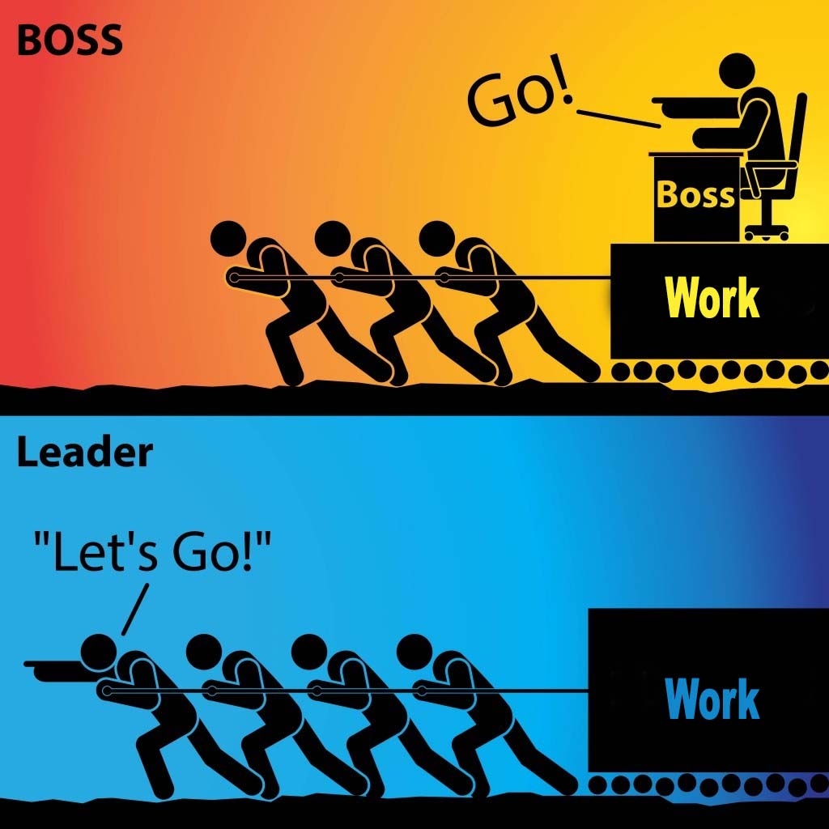
Organizing and Leadership
Leadership is taking responsibility for enabling others to achieve shared purpose in the face of uncertainty.
The members who can lead most successfully are those who already have followers, i.e. people who trust and respect them.

Slide 17
How it typically goes…
Members self-select into leadership roles
“We don’t have a building rep, so I told everyone I would volunteer.”
We recruit members without confirming their leadership
“She’s excited about the union; I invited her to an event and to become a building rep.”
Result: “leaders” struggle to deliver when it counts
PLUS, lots of implicit bias as we choose “leaders” who meet our criteria

Slide 18
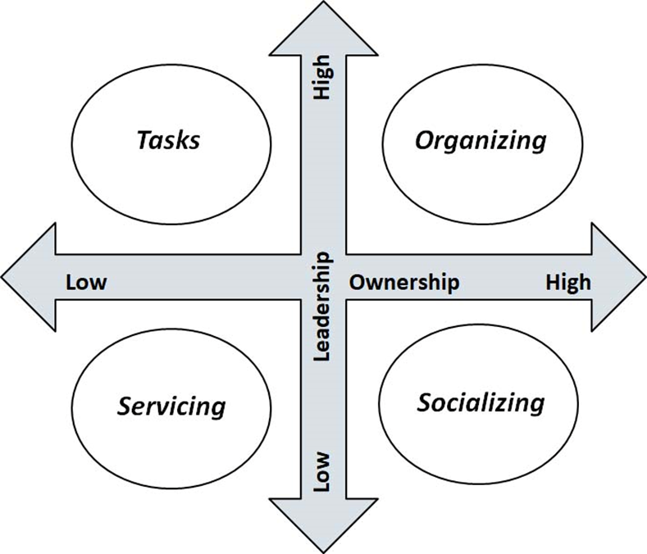
What did Seattle do?
Member to Leader
Identify Leaders
Know what your leader's issues are
Ask them to join in shaping the agenda with other leaders
Give leaders meaningful tasks/roles around the issues they care about.

Slide 19

The Blitz, an organizing tool
Have 10 minute individual conversations with as many members as possible in a building:
What do you think are the biggest issues facing us in public education? In our school district?
Who’s trusted and respected here in the building?

Slide 20
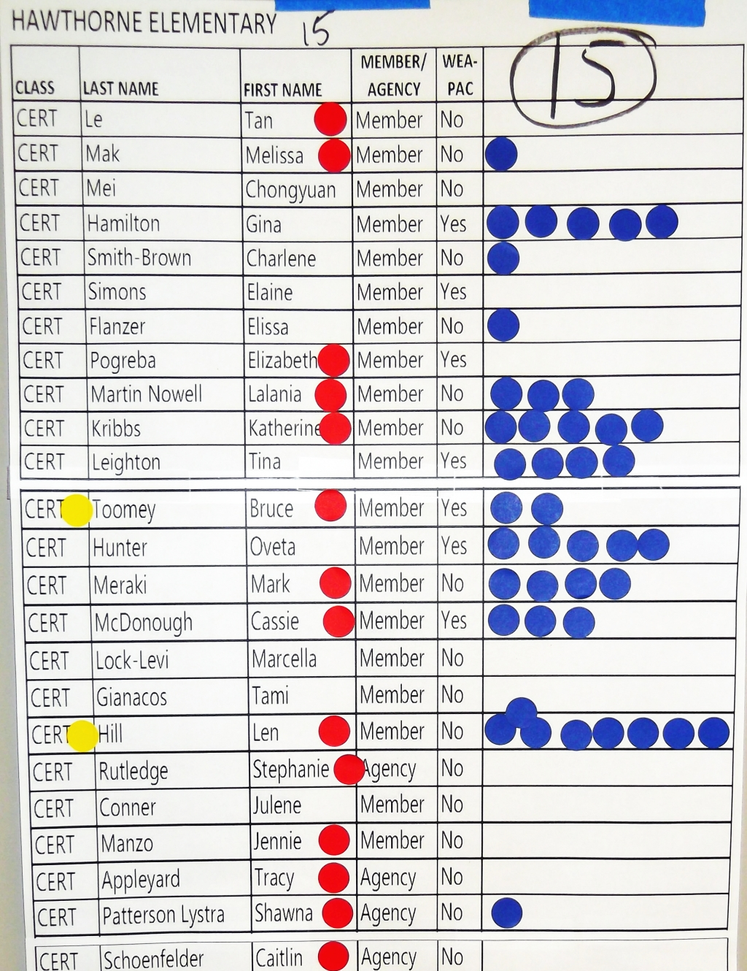
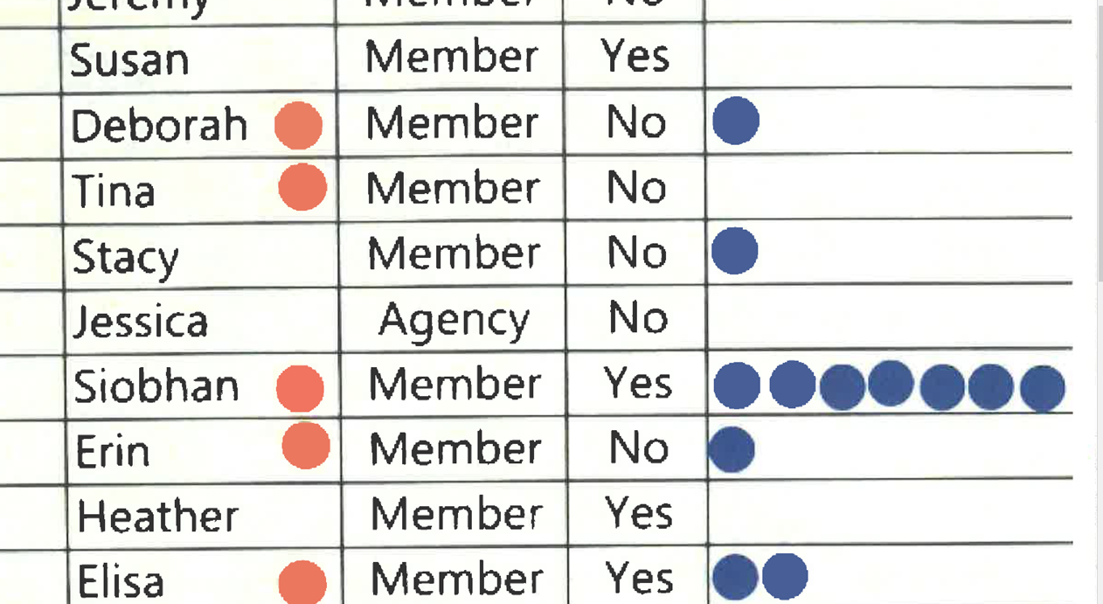
Looking at the data - what do you notice?

Slide 21
Key Points
Just because they have been identified by a number of colleagues does not immediately mean they are the “best” leaders for what the local needs – the needs to be more work to build a relationship with them about what their agenda is and what the agenda of the union is – moving them to work with the union’s agenda.

Slide 22
Club to Union

Slide 23
Opportunities for Leadership
Fighting Union
Members Lead with Courage and Risk
Union
Member and Staff Partners – Mid Risk Activities
Staff Coach and Build Leader Capacity
Club
Staff Lead – Already Active Members –Low Risk Activities
Staff Focus on Engagement and Leader ID
Unorganized
Staff Lead – No Risk by Members
Staff Advise and Coach
Focus on Recruitment and Engagement

Slide 24
Club or Union? p.71
Unorganized
Club
Union
Fighting Union
Think of a local you work with – at what point of the continuum are they on?
What is your role in moving locals from left to right in this framework?
What do you think is most required to move from left to right?

Slide 25
Club or Union Debrief
Unorganized
Club
Union
Fighting Union
What did you learn?
How useful was this in thinking about your work with ESP units?
What would you add to it?

Slide 26
Key Ideas
Unions with leaders who are unwilling to take any level of risk will not be able to grow into unions that can demand and win what members want and need.
The way to build leaders is to not do for them what they can do for themselves, design “tasks” that cause people to have more leadership and ownership

Slide 27
Hedy and Adam

Slide 28
Building Engaged Leaders

Slide 29

Building Engaged Leaders
“Social scientists have found that tasks designed to yield “intrinsic” (inherently satisfying) rewards by overcoming some level of risk produces great motivation, commitment, and adaptive learning more than tasks that only yield financial, recognition or status rewards.”
-Hackman and Olham, 1980

Slide 30
Building Engaged Leaders
The best way to grow leaders is to give them meaningful, challenging (risky) tasks (tests), and see if they can achieve them. Then give them another task to do . . .

Slide 31
Conditions of Motivational Task Design
Meaningfulness
Responsibility
Results
From their perspective...

Slide 32
How you make the ask matters
Communicate:
Why the task is significant
Why their input and contribution are key
That multiple skills are involved...and you'll
help coach them if needed

Slide 33
Nothing is meaningful if you aren't expected to be accountable

Slide 34
Conditions of Motivational Task Design
Experience meaningfulness: the task is important in the overall scheme of things and is big enough that it will be a challenge to achieve.
1
Experience responsibility: how well the task gets done is up to me.
2
Experience results: as I attempt to do the work, I can see whether or not I am doing well.
3

Slide 35
Conditions of Motivational Task Design are achieved when the leader:
Task Significance (Why) – understand and recognize the impact of the work on the world and the risks involved
Task Identity – one’s own contribution, from start to finish, is clear in the final result
Skill Variety – engaging a variety of skills, including heart, hands, and head.
Autonomy – having the space to make competent choices about how to do the work.
Feedback – results are visible to the person performing the task as they perform it.

Slide 36
“enabling others to achieve shared purpose in the face of uncertainty” (Ganz) p.87
Tasks
Organizing
Low Leadership High
Low Ownership High
Servicing
Socializing

Slide 37
Key Points
Tasks must be meaningful and members need to own them.
Our job is to look for opportunities to increase ownership and leadership whenever possible.
Leaders grow by taking risk, accepting ownership, and sharing accountability

Slide 38
Naomi

Slide 39
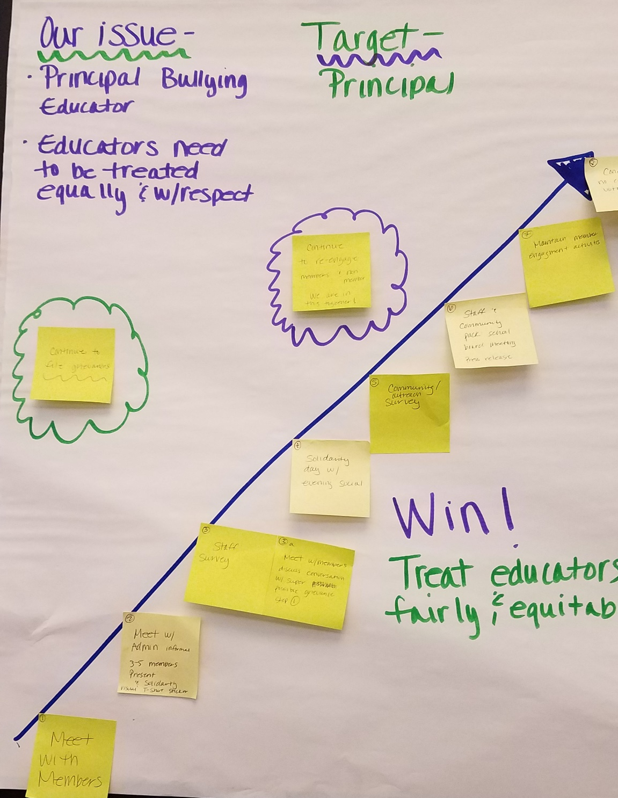

Team Work Time
Notes:
Ellen

Slide 40
Helena and Juli

Slide 41
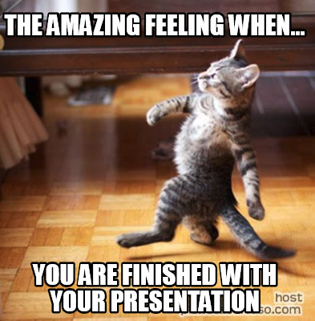
Team Presentation and Coaching Time

Slide 42
Feedback Questions
What specific elements of the plan stood out to you?
How did the plan engage others around the values they share?
How did the plan address finding and developing leaders to help implement the plan?
In what ways does the plan use opportunities to build structure and power?

Slide 43
Ellen

Slide 44

Ending it Right
Choice Networking
Housekeeping

Slide 45
Extra slides

Slide 46
Targets, Tactics & Escalation

Slide 47
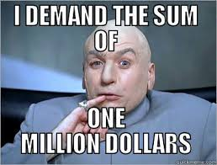
When making a demand …
  A demand is the outcome that addresses the issue that you are making of a target
  Measurable
  Achievable
Notes:
Hedy

Slide 48

Targets:
A single person:
  - a name, face, & address
Has the power to give you what you are demanding
Notes:
Hedy

Slide 49

Scenario Work! (Charts)
Identifying Issues, Demands, and Targets
In your groups, return to your scenario and decide the:
    Issue
    Keep in mind what makes a good issue!
    Demand
    What do you want to win to solve your issue?
    Target
    Who has the power to give you your demand?

Slide 50
Key Points
A well thought out campaign has a strong issue, with an identifiable target and a strategic demand.
A target is a specific person!
We don’t choose the issues! We identify the issues from talking to members!
Notes:
Hedy

Slide 51

BREAK

Slide 52
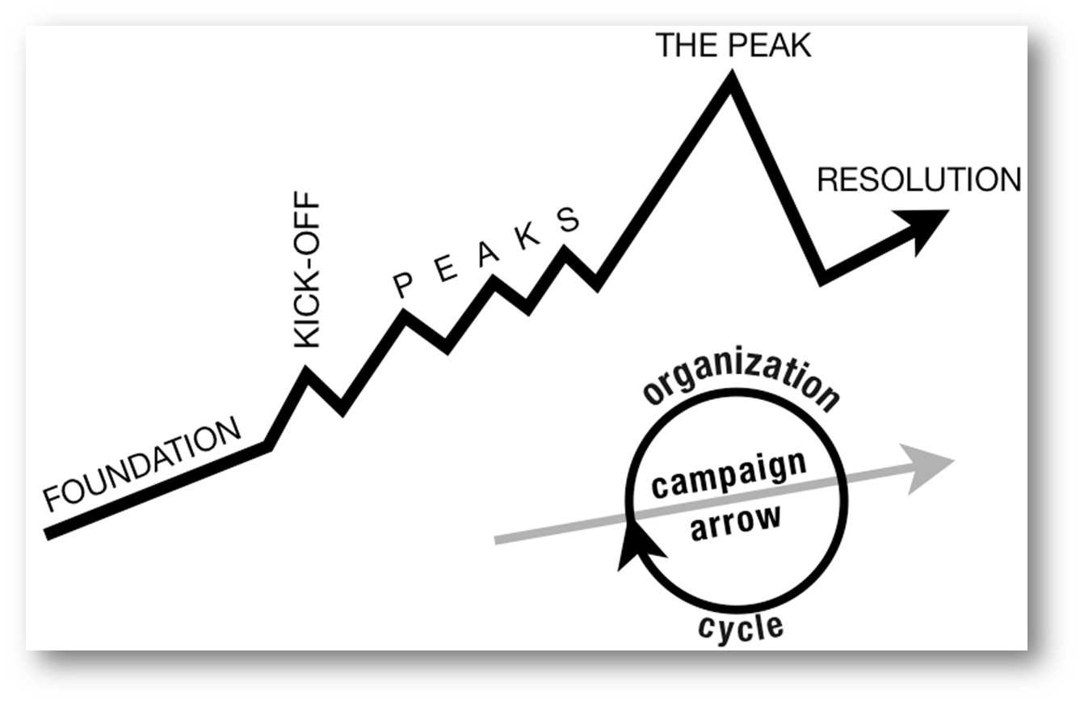
Structure of a Campaign
WIN
Notes:
Hedy
Tactic scramble!

Slide 53

Tactics
Tactic – Actions you to take as a part of an escalation plan that increases pressure on your target to try to win your demand.
Notes:
Sara

Slide 54


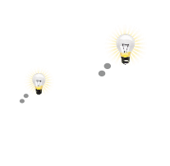

A TACTIC SHOULD:
Goal
Puts pressure on your Target
(puts them out of their comfort zone)
1.
Builds your Power
(develops leaders, brings more people in, etc.)
2.
Is Strategic
Notes:
Sara

Slide 55
Scenario Work!
Tactics Brainstorm
+++YOU HAVE 5 MINUTES!+++
Brainstorm AS MANY tactics as you can on 1 chart.
Be creative!
You are NOT evaluating right now! Everything goes on the board!

Slide 56
Evaluating Tactics
Does the action relate to your issue?
Will it increase the pressure on the decision-maker?
Is it visible?
Is it timed for effect?
Is it new and different—or tried and true?
Are enough people ready to do it?​
Will it unify people?​
How will management react?​
Does it violate the law? (If so, are we prepared for the consequences?)​
Will it be fun?

Slide 57
Compression Points
Points on the calendar where you celebrate short term wins or escalate your tactics based on how you have assessed your readiness to escalate.
  Naturally occurring deadlines
  Artificial deadlines
  Help us build urgency and crisis

Slide 58

Why do you think tactics escalate gradually?
Building an Escalation Plan
GOAL
Tactic
Tactic
Notes:
Sara

Slide 59
Each escalation is more public, more visible, and has more risk. WE transform members to activists, activists to leaders by asking them to take bigger risks.
GOAL
Tactic
Tactic
Notes:
Sara

Slide 60
ORGANIZE TACTICS INTO… A CAMPAIGN Timeline
WIN
Notes:
Sara
Tactic scramble!

Slide 61
Scenario Work!
Building your Escalation Campaign
STEP 1: Decide on your tactics
(Use the evaluation questions on Pg. 111)
STEP 2: Add in any compression points that are important to your campaign
STEP 3: Build your tactics into an escalation campaign
(Use the campaign mountain on Pg. 103)

Slide 62
Key Points
Strategy without tactics is simply a collection of good ideas and big dreams.
Tactics without strategy are a random collection of activities and wasted resources.
The bigger the win you want, the more resource you need.
Good tactics actually result in more resources – relationships, skills, hope and trust.
Notes:
Sara

Slide 63
Transformational
Conversations
Notes:
1 minute

Slide 64
Why do we want to build relationships?
Notes:
1 minute-Seleste
How do we get our assets, our people, to use their most valuable assets?
So now we are going to get into the elements of a good relationship.
How many of you have best friends? When you met you didn’t have immediate commitment to one another. It grew over time as you built your relationship.
In the same way, we are building public relationship based on values to build commitment. We are taking the time to learn about the others values and interests of others. We are taking time to learn what motivates us and others to act.
How do we do this?
We do this by being vulnerable enough to connect and grow together while also being intentional about how and what we communicate. You are strengthening this muscle today.

Slide 65
Organizing is leadership that enables people to turn the resources they have into the power they need to make the change they want.
Power comes from our commitment to work together to achieve common purpose, and commitment is developed through our
Relationships
Notes:
1 minute-Seleste

Slide 66
“Organizing is a
fancy word for
relationship building.”
– Mary Beth Rogers
Notes:
1 minute-Seleste

Slide 67
Relationships are
Relationships are
Built Around Shared Values
Long Term
Mutual Commitment
Involve Consistent Attention and Work
Notes:
1 minute-Seleste
Like in other parts of our lives, relationships in organizing are based on shared values and shared purpose.
Audience: What are some of the shared values you discovered during our work together on Story of Self? What common purpose did you begin to discover there?
So finding common values and purpose is important. However, if we just build relationships with people just like us, or with people who will just agree with us all the time, what type of campaign or organization will we end up in?
Relationships are based as much on difference as on similarities. When we’re building our leadership teams, organization and campaign, we need to recruit and build relationships with people who are different from each other, who have diverse resources, experiences & skills, which will strengthen our common effort.
But remember, having shared values, a shared purpose and some skills & resources doesn’t mean that you have a relationship. If there is no commitment, there isn’t any glue in your campaign. A relationship with no commitment is not a relationship. If several people come to an association event but I don’t ask them to explicitly to make a commitment to joining me in this work, then they may have a relationship to with me, but not with the campaign or the association.

Slide 68
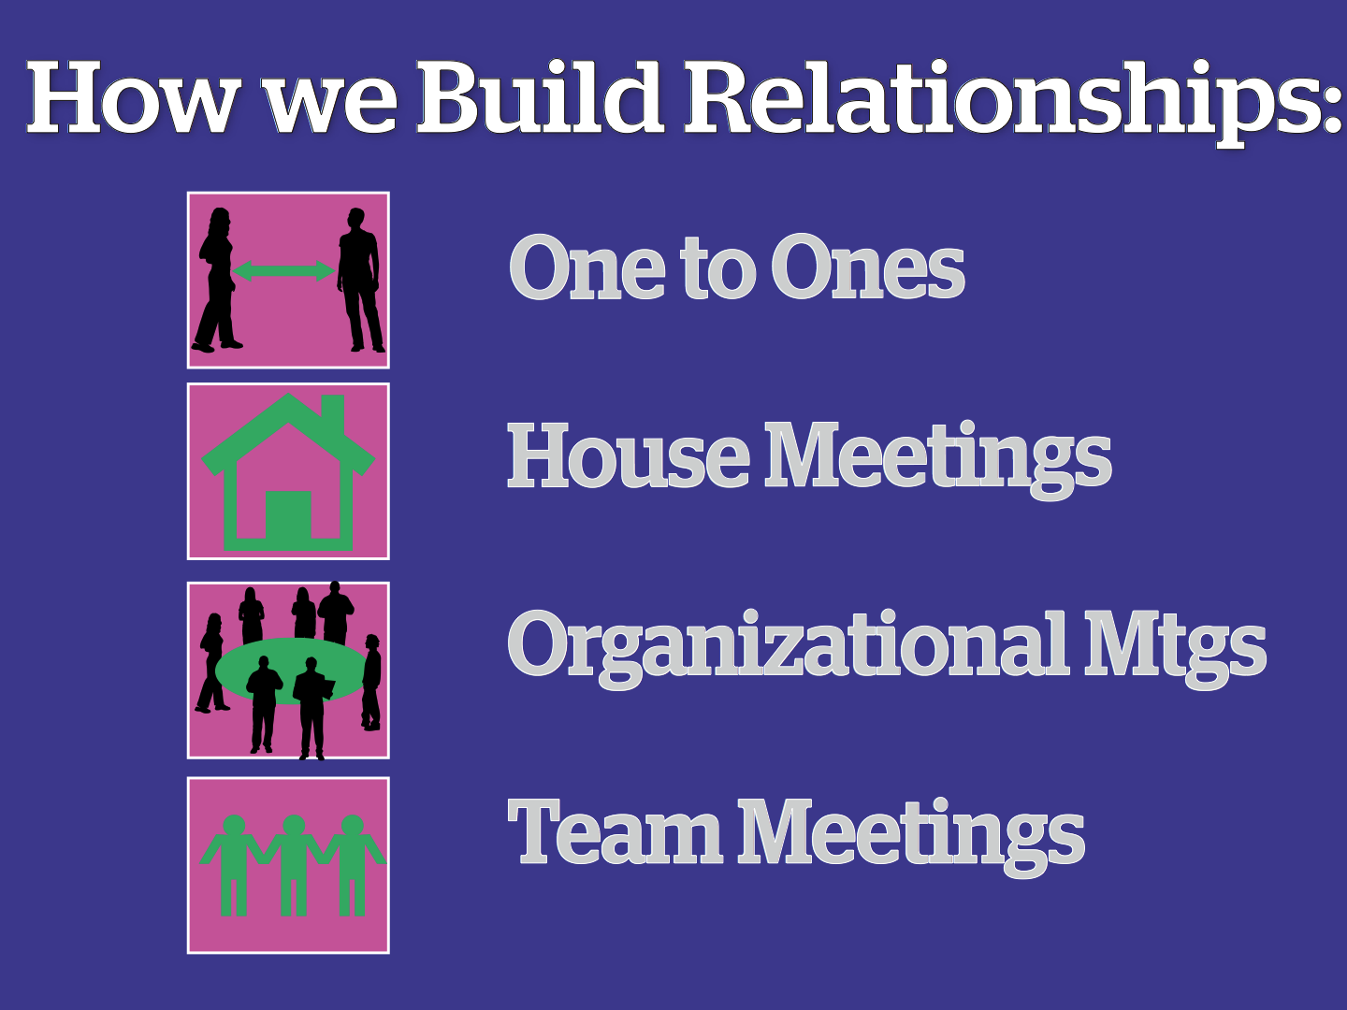
Notes:
1 minute-Seleste
So how do we build and maintain that commitment to each other in order to build our capacity and create change?
Basically the same way we build relationships in other parts of our lives, but in an intentional and transparent way.
These are several ways you can build relationships but the one we will focus on now is the One-to-One.
This is a great tool to identify leaders and recruit them into leadership teams. They are critical for building strong relationships in which both people grow and learn together over time. We use them to build community and commitment within a new leadership team. We use them to build deeper relationship with some people we may already know from other work.

Slide 69
Basics of One on Ones
Notes:
3 minutes-Seleste
Ask participants best practices they have found about having one-on-one conversations. Participants can popcorn responses.

Slide 70
We listen to relate to our people
Listen 80%; talk 20%
Use open ended questions
Not about winning an argument or interrogating
Learning where our stories connect
Notes:
1 minute-Seleste
This slide highlights best practices

Slide 71
We listen to identify Issues
Use probing questions
What’s not right?
What would they change?
How could our schools be even better for us and our students?
Notes:
1 minute-Seleste

Slide 72
We ask for commitment
Use direct and specific language
Stress the shared values you have exchanged
Frame it so that the person IS the solution to the ask
Notes:
1 minute-Seleste

Slide 73
We ask to identify leaders
Who is trusted and respected
To objectively identify leaders, we must ask our people
Notes:
1 minute-Seleste

Slide 74
3 Types of One on Ones
Recruitment
Escalation
Maintenance
Notes:
1 minute-Katrina
There are different types of conversations. Each has value or a purpose.

Slide 75
Power of Positive Messaging
Transformational vs. Transactional
Strength in numbers
Magical wand conversation
Notes:
3 minutes- Katrina

Slide 76

Responding to Recruitment Objections-pg. 58-67
A-Affirm
A-Answer
R-Redirect
Notes:
10 minutes- Katrina
Ask participants for member recruitment objections
After listing the objections, how do we shift the conversations from becoming transactional/create more of a positive message?
Possible objections
Unions are only for teachers
Dues cost too much
Why should I pay when I can get it for free
The answer is AAR
Activity
Participants will write the objections at the top of chart paper (one topic/piece of paper). After brainstorming the list of objections, participants can write possible responses to the objections.

Slide 77
Conversation Wheel
Purpose
Exploration
Exchange
Commitment
Leadership Id
Pg. 47-52
Begin Here
Purpose
  Let them know why you are meeting even before you get there.
Exploration and Exchange
  Most of the 1 on 1 is devoted to asking probing questions
  So that we can exchange resources, stories, information, support, insight
Commitment
  We end with a commitment to start working together or continue working together.
Leadership ID
  Who here is trusted and respected
Notes:
1 minute-Seleste
Regardless of the type of conversation, the structure of a 1:1 conversation is similar

Slide 78

Practicing
One on One’s
Triads
1. Organizer – Asks questions
2. Worker – Answers
3. Observer – Coaches
pg. 126-127
Notes:
21 minutes-Seleste
3 rounds of 5 minute conversations and 2 minutes of coach feedback
Coaching Questions: pg. 126
Organizer Questions: pg. 46, 127
Goal of the exercise is to practicing using the Conversation Wheel
Worker- allow the organizer to ask questions-see pg. 46 and 127
Observer/coach-how did the organizer flow through the conversation wheel. As a UD, you spend a lot of time coaching. Use pg. 126 as a resource
Questions
What struggles do you have around moving ESP work?
How can you get your colleagues or organization to do ESP work?
Escalating conversation
Focusing on getting colleagues to act

Slide 79
Debrief
What did you learn?
What did you notice?
Resource: p. 47-67
Notes:
10 minutes-Katrina

Slide 80
Key Points
Organizers listen and ask questions!
We want our workers to realize:
  • They care about a problem
  • There is a decision-maker who has the power to fix this problem
  • The decision-maker won’t fix it until someone pushes them to
  • To really solve the problem they need to join their colleagues, share their resources and take action together
Notes:
1 minute-Katrina

Slide 81

Team Presentation and Coaching:
Group 1: Present first! Walk people through your plan and answer any questions.
Group 2: Visit every campaign plan and provide feedback to the presenter.
We will switch and then come back for a group debrief at the end.

Slide 82
Sample Feedback Questions:
  How did the plan address finding and developing leaders to help implement the plan?
  Are the tactics directly related to representing the issue and goal of the campaign?
  In what ways does the plan use opportunities to build structure and power?

Slide 83
Group Debrief:
Are there specific tactics or ideas that you are going to take back to your locals and share with leaders? What about with co-workers? Why did that stand out for you?
What are the skills from today you are hoping to train your leaders/members/activists on in the next 6 months?
What is something you learned from a colleague in the last three days that changed the way you thought about your work?

Slide 84

Lunch

