Slide 1

Membership Conversations:
From Finding Your Why to Closing the Deal

Slide 2
Association & Individual Homework
Make the “ask.”
I am hoping that after our conversation today that you consider joining the Association.
I would like to send you membership information.
Would you be interested in membership? Can I send you an application?
Begin with “ask” in mind.
I’m contacting you today to talk about the Association. I’d like to share some things exciting things with you about the Association.
START HERE
JOIN NOW
HAVING THE CONVERSATION
Do you have any questions for me about the Association? (This is where you might hear objections.)
Share your “why.”
I became involved when . .
I value the Association because . . .
It is important to me that our Union is strong because . . .
Share what you know.
In the past year the Association has . . .
“Jim” from you building is a member . . .
We are a strong group that advocates for . . .
The building you work in has a strong record of involvement and high membership numbers . . .

Slide 3
Association & Individual Homework
Make the “ask.”
I am hoping that after our conversation today that you consider joining the Association.
I would like to send you membership information.
Would you be interested in membership? Can I send you an application?
Begin with “ask” in mind.
I’m contacting you today to talk about the Association. I’d like to share some things exciting things with you about the Association.
START HERE
JOIN NOW
HAVING THE CONVERSATION
Do you have any questions for me about the Association? (This is where you might hear objections.)
Share your “why.”
I became involved when . .
I value the Association because . . .
It is important to me that our Union is strong because . . .
Share what you know.
In the past year the Association has . . .
“Jim” from you building is a member . . .
We are a strong group that advocates for . . .
The building you work in has a strong record of involvement and high membership numbers . . .

Slide 4
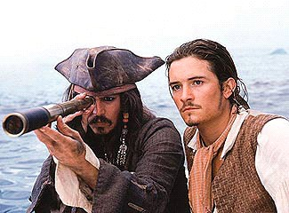
Do your Homework
Finding the
Potential Members
Notes:
Prework before conversation, initial email, etc.

Slide 5
What do you mean, homework?
THE BUILDING
RELATIONSHIPS: Who is a trusted & respected member in their building? In their same job category? A friend in the Association?
Membership status of the
building/work site, job classification, etc.
NEW ED CARD INFO
(Demographics, Interests, Job Site, Job Classification)
LISTEN: What do you already know about or what have you learned about the potential member’s likes, interests, or values?

Slide 6
Association & Individual Homework
Make the “ask.”
I am hoping that after our conversation today that you consider joining the Association.
I would like to send you membership information.
Would you be interested in membership? Can I send you an application?
Begin with “ask” in mind.
I’m contacting you today to talk about the Association. I’d like to share some things exciting things with you about the Association.
START HERE
JOIN NOW
HAVING THE CONVERSATION
Do you have any questions for me about the Association? (This is where you might hear objections.)
Share your “why.”
I became involved when . .
I value the Association because . . .
It is important to me that our Union is strong because . . .
Share what you know.
In the past year the Association has . . .
“Jim” from you building is a member . . .
We are a strong group that advocates for . . .
The building you work in has a strong record of involvement and high membership numbers . . .

Slide 7
Begin with the “ask” in mind
Do your HOMEWORK...
Be INTENTIONAL
Be PROUD
of your membership
Don’t be AFRAID TO ASK
Don’t be TIMID

Slide 8
Begin with the “ask” in mind
FOOT IN THE DOOR: It a much easier conversation to begin if a bit of legwork has already been done: an introductory postcard, email, etc.
TRANSPARENCY: You don’t have to sneak around your reason for contacting the potential member. “I’d like to talk to you about membership in our Association. Did you receive…?”
AUTHENTICITY: You’re not selling vacuums. You’re a member because you think it’s a worthwhile investment, and you’re going to share those genuine reasons.

Slide 9
Association & Individual Homework
Make the “ask.”
I am hoping that after our conversation today that you consider joining the Association.
I would like to send you membership information.
Would you be interested in membership? Can I send you an application?
Begin with “ask” in mind.
I’m contacting you today to talk about the Association. I’d like to share some things exciting things with you about the Association.
START HERE
JOIN NOW
HAVING THE CONVERSATION
Do you have any questions for me about the Association? (This is where you might hear objections.)
Share your “why.”
I became involved when . .
I value the Association because . . .
It is important to me that our Union is strong because . . .
Share what you know.
In the past year the Association has . . .
“Jim” from you building is a member . . .
We are a strong group that advocates for . . .
The building you work in has a strong record of involvement and high membership numbers . . .

Slide 10

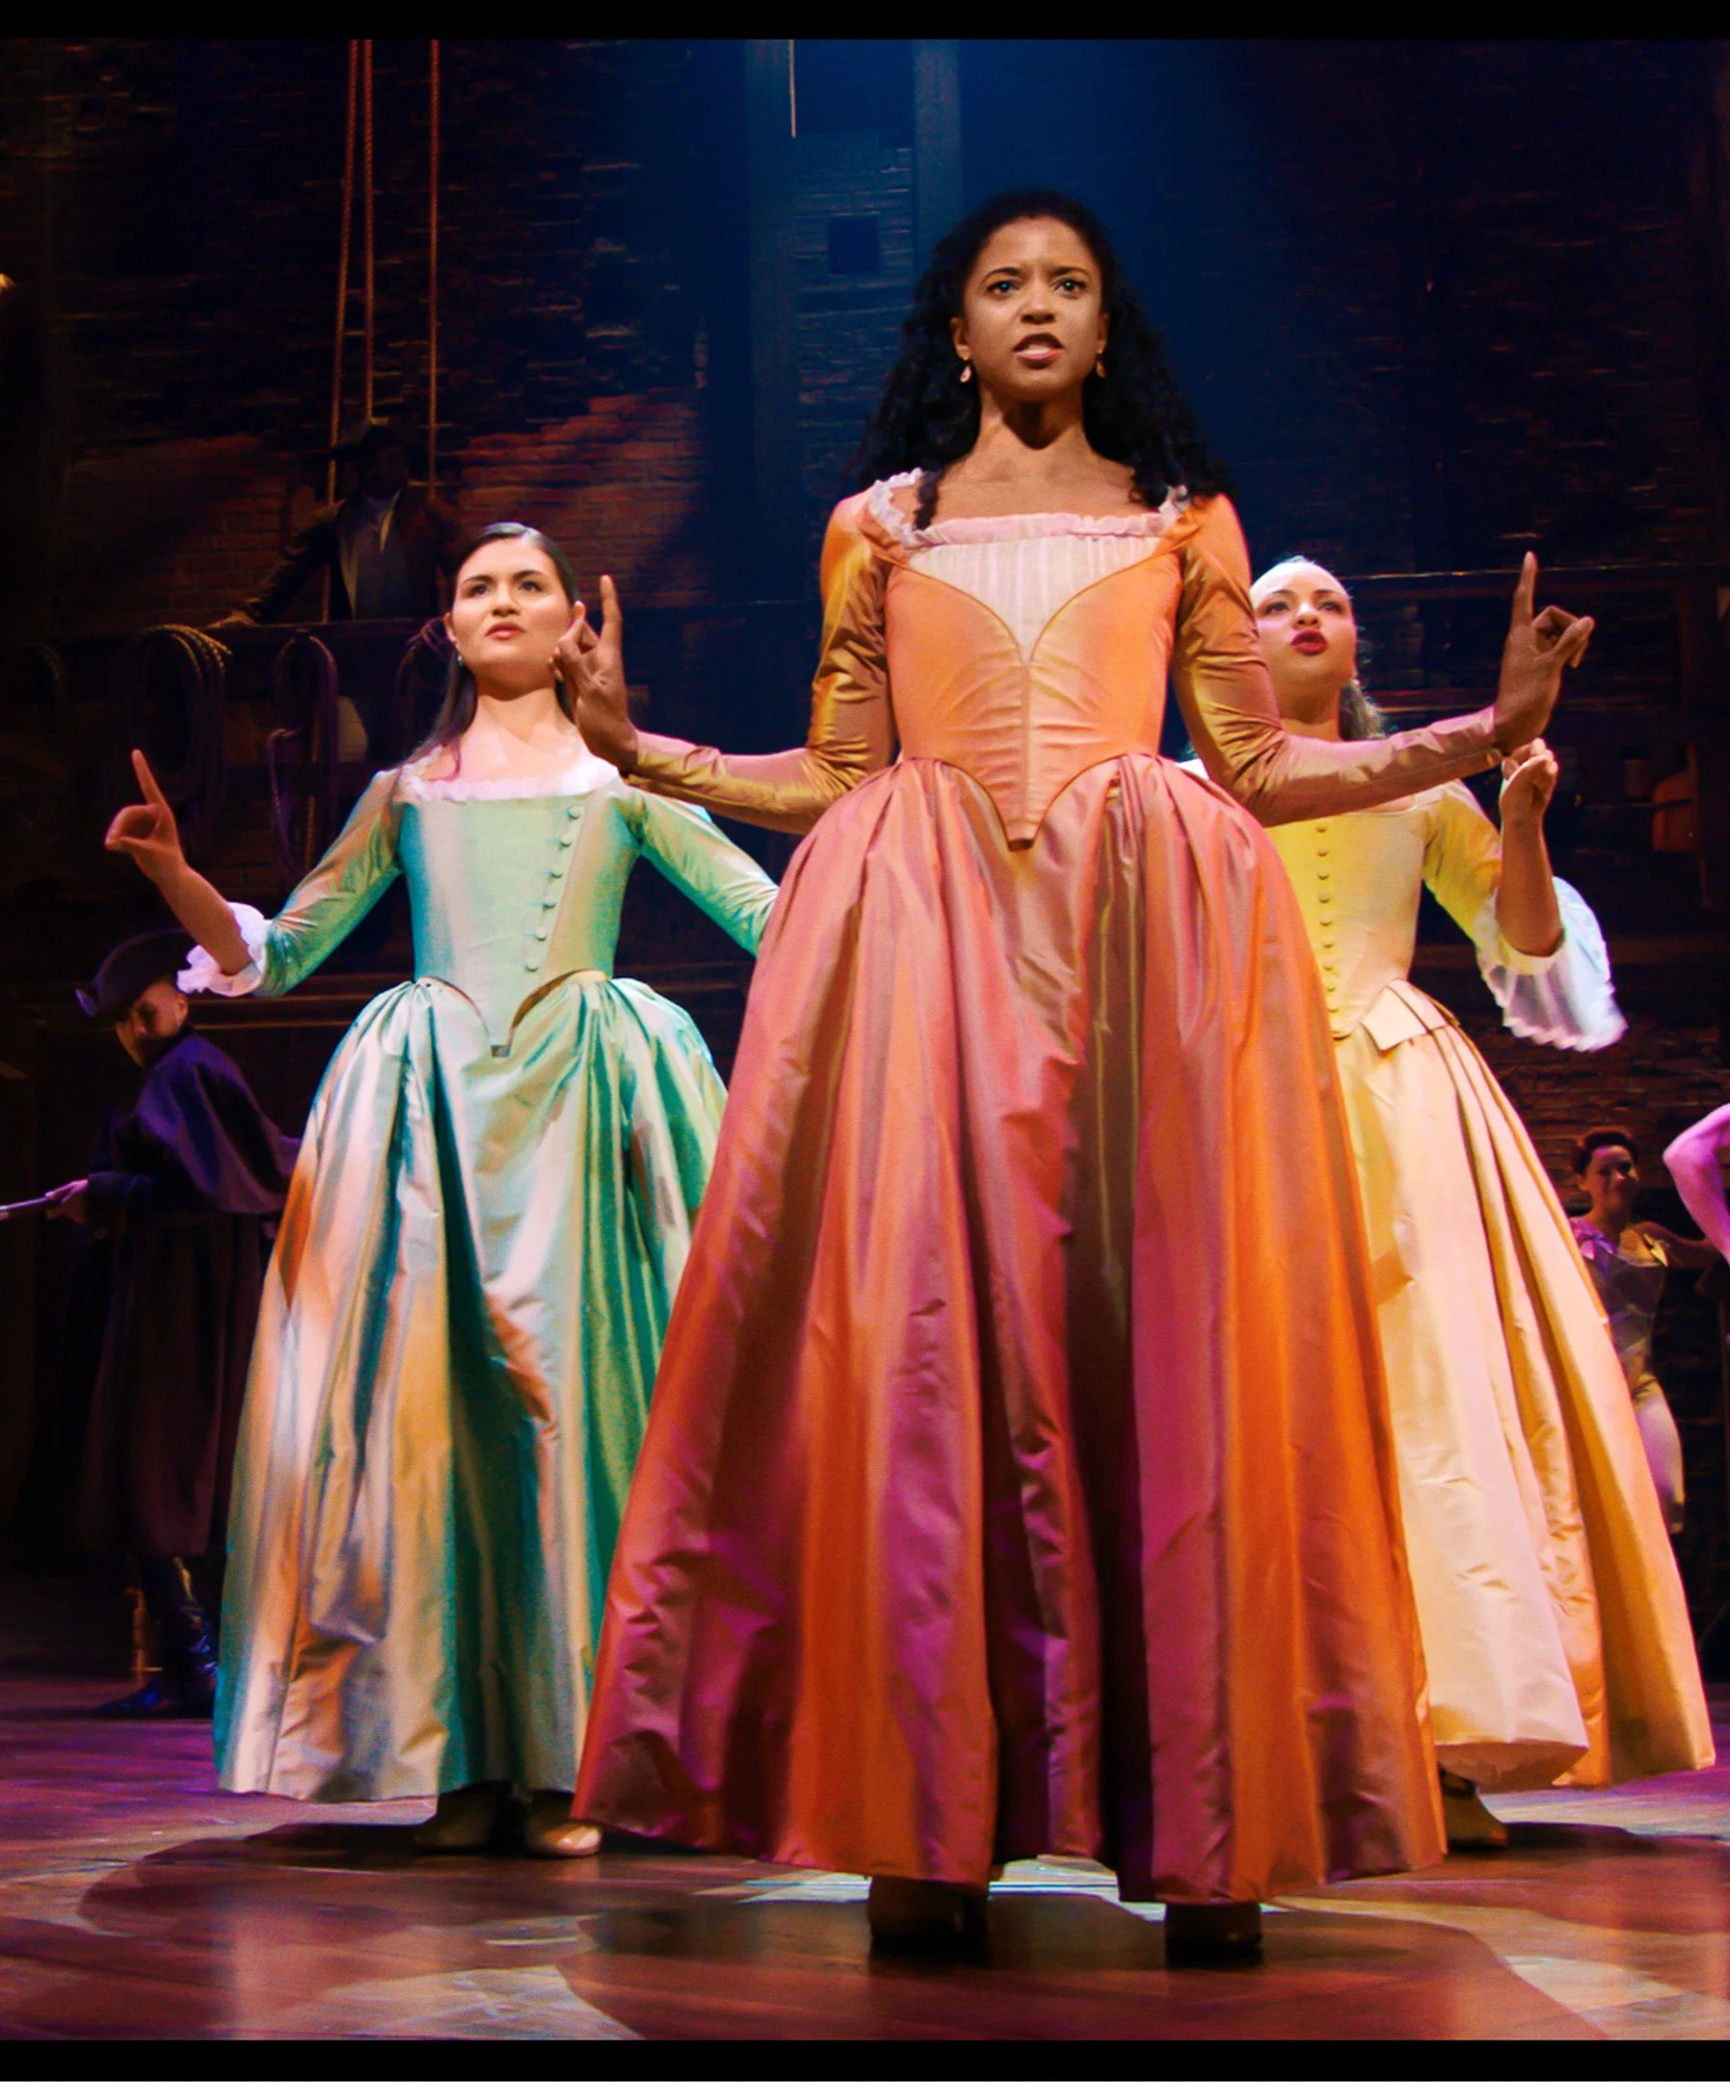

Tell Your Story

Slide 11

Tell Your Story: Four Corners
Who was the person who talked to you about Association membership? What do you remember about that person? What about them made you trust their reasons that you should join the Association?
OR
When you think about being proud of your Association membership, who comes to mind? What about those individuals makes them a great representation of your Association?
WHO
What is the story of your association membership?

Slide 12
Tell Your Story: Four Corners
What are the things that you get the most value out of, being a part of the Association? How has being in solidarity helped you? (Rights, Professional Development, Job Jeopardy, Salary & Benefits, etc.)
WHO
WHAT
What is the story of your association membership?

Slide 13
Tell Your Story: Four Corners
WHO
WHAT
How do you show your support of your Association? In what ways do you participate in making your Association strong? How have you seen others caring enough to contribute to the Association and make your district a better place to work?
HOW
What is the story of your association membership?

Slide 14
Tell Your Story: Four Corners
WHO
WHAT
Time to put it all together: Why did you join your Association, and more importantly, WHY HAVE YOU STAYED? What does membership in your Association mean to your professional life?
(Elevator Pitch)
HOW
WHY
What is the story of your association membership?

Slide 15
Tell Your Story:
The more often you talk about your why, the more comfortable it will feel.
Storytelling is a way we connect to others, and telling the story of your own Association membership (your Why) could be the factor that helps others really understand the impact of standing in solidarity.
Find a partner, take turns sharing elements of your Why.
Your goal is to get more comfortable talking about the reasons you believe in Association membership.
What is the story of your association membership?
Each person should have about three minutes to share.
Notes:
If this is a small training and time allows it, you could just do this in the main room without a Break Out. In that case, please MAKE A COPY of this slideshow and adjust the slide.

Slide 16
Association & Individual Homework
Make the “ask.”
I am hoping that after our conversation today that you consider joining the Association.
I would like to send you membership information.
Would you be interested in membership? Can I send you an application?
Begin with “ask” in mind.
I’m contacting you today to talk about the Association. I’d like to share some things exciting things with you about the Association.
START HERE
JOIN NOW
HAVING THE CONVERSATION
Do you have any questions for me about the Association? (This is where you might hear objections.)
Share your “why.”
I became involved when . .
I value the Association because . . .
It is important to me that our Union is strong because . . .
Share what you know.
In the past year the Association has . . .
“Jim” from you building is a member . . .
We are a strong group that advocates for . . .
The building you work in has a strong record of involvement and high membership numbers . . .

Slide 17
Share what you Know!
THE BUILDING
RELATIONSHIPS: Who is a trusted & respected member in their building? In their same job category? A friend in the Association?
Membership status of the
building/work site, job classification, etc.
LISTEN: What do you already know about or what have you learned about the potential member’s likes, interests, or values?
THE HOOK

Slide 18

What’s The Hook?
What piece of information about the Association can share that will connect with the potential member?
What do you know about the potential member that connects or aligns with the Association’s actions, interests, or values?
Notes:
Share what you know

Slide 19
Association & Individual Homework
Make the “ask.”
I am hoping that after our conversation today that you consider joining the Association.
I would like to send you membership information.
Would you be interested in membership? Can I send you an application?
Begin with “ask” in mind.
I’m contacting you today to talk about the Association. I’d like to share some things exciting things with you about the Association.
START HERE
JOIN NOW
HAVING THE CONVERSATION
Do you have any questions for me about the Association? (This is where you might hear objections.)
Share your “why.”
I became involved when . .
I value the Association because . . .
It is important to me that our Union is strong because . . .
Share what you know.
In the past year the Association has . . .
“Jim” from you building is a member . . .
We are a strong group that advocates for . . .
The building you work in has a strong record of involvement and high membership numbers . . .

Slide 20
How to Respond to Common Objections
Dues are too expensive
What do I get that non-members don’t?
Philosophical opposition to unions
Don’t support political positions taken by union
Dislike leadership
Union only get troublemakers out of trouble

Slide 21
Association & Individual Homework
Make the “ask.”
I am hoping that after our conversation today that you consider joining the Association.
I would like to send you membership information.
Would you be interested in membership? Can I send you an application?
Begin with “ask” in mind.
I’m contacting you today to talk about the Association. I’d like to share some things exciting things with you about the Association.
START HERE
JOIN NOW
HAVING THE CONVERSATION
Do you have any questions for me about the Association? (This is where you might hear objections.)
Share your “why.”
I became involved when . .
I value the Association because . . .
It is important to me that our Union is strong because . . .
Share what you know.
In the past year the Association has . . .
“Jim” from you building is a member . . .
We are a strong group that advocates for . . .
The building you work in has a strong record of involvement and high membership numbers . . .

Slide 22

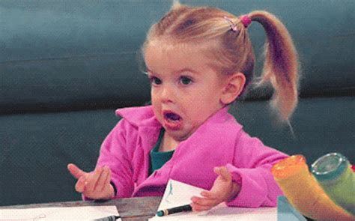
Q. What’s the worst thing you could do?

Slide 23
A. Never actually make
a direct ask.
You miss 100% of the shots you don’t take. --Wayne Gretzky

Slide 24
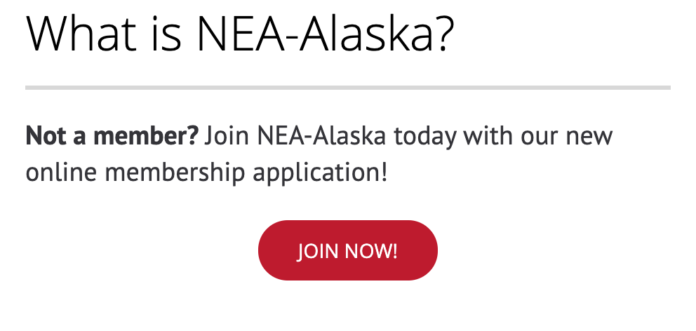
USING THE ONLINE
“JOIN NOW”
FEATURE
Click on the graphic to the left to travel to the NEA-Alaska homepage, with its new Join Now button!

Slide 25

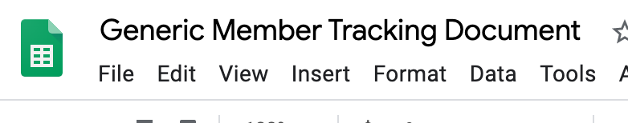
Membership Tracking
Click on the screenshot above in order to view the Generic Member Tracking Document in Google Sheets

Slide 26
Association & Individual Homework
Make the “ask.”
I am hoping that after our conversation today that you consider joining the Association.
I would like to send you membership information.
Would you be interested in membership? Can I send you an application?
Begin with “ask” in mind.
I’m contacting you today to talk about the Association. I’d like to share some things exciting things with you about the Association.
START HERE
JOIN NOW
HAVING THE CONVERSATION
Do you have any questions for me about the Association? (This is where you might hear objections.)
Share your “why.”
I became involved when . .
I value the Association because . . .
It is important to me that our Union is strong because . . .
Share what you know.
In the past year the Association has . . .
“Jim” from you building is a member . . .
We are a strong group that advocates for . . .
The building you work in has a strong record of involvement and high membership numbers . . .

Slide 27

Trying on the Ask
Role Play in Breakout Rooms
Count off by 9
In your breakout: Count off as a 1, 2, or 3
Ones: You are the potential member. You will make it just a little bit “tough” on the current member, so they need to tell you their “why.” You can use one of the objections from Slide 18.
Twos: You are the current member. You will have the Membership Conversation with the potential member, using your Why that you’ve built. Respond to any objections they might have.
Threes: You are the coach. You will observe the conversation and lead the one-minute debrief. Let the current member know two things they did well and then ask them what they think they need to work on.
Rotation #2: 3s are PM, 1s are CM, 2s are coach.
Rotation #3: 2s are PM, 3s are CM, 1s are coach.
Assume the potential member has received an email from the Local President about the Association.
Each conversation & debrief should take about five minutes, and then rotate.

Slide 28
Thank you for being here this evening, and for doing this work for your Association.
What questions do you still have about the process? Is there anything else you need to feel comfortable having membership conversations?
(Type it in the chat.)

