Slide 1
Right Wing Groups and Elections Activity:
Read Articles related to the positions that far-right groups use to take over school boards and win elections.
Participants in groups will chart the position statements and share how these positions will impact their students, colleagues, and community.
Participants will share out

Slide 2
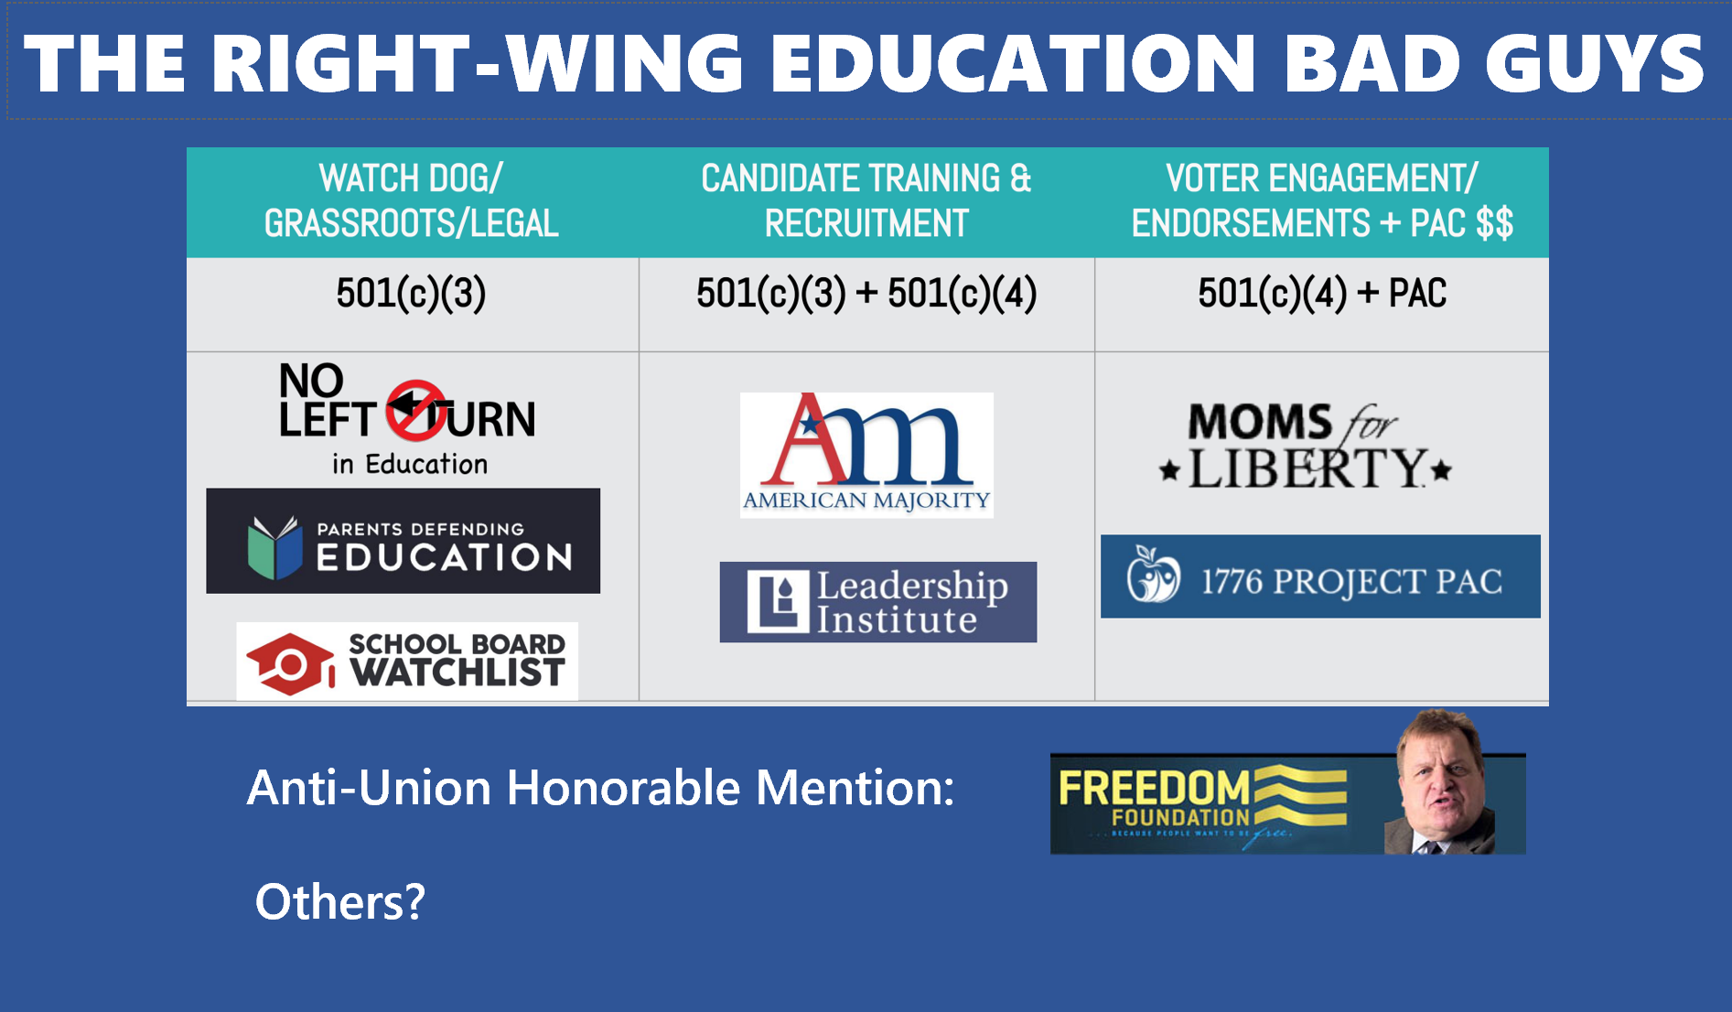

Slide 3
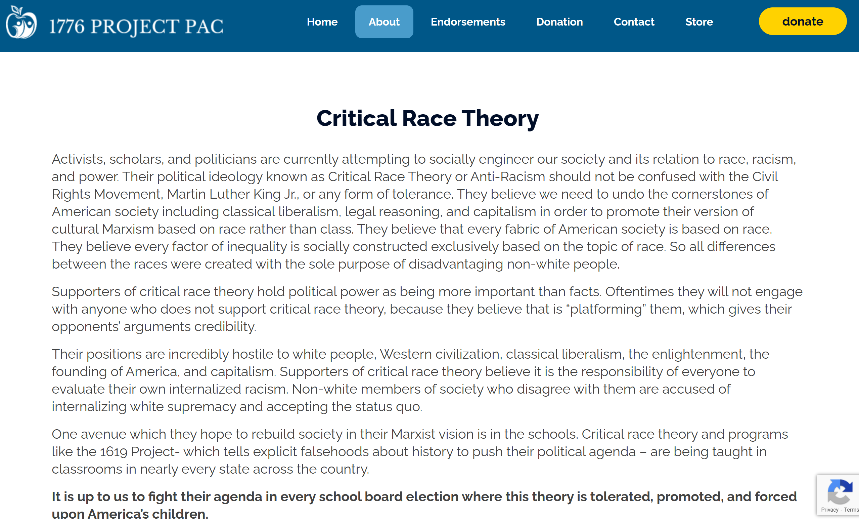

Slide 4
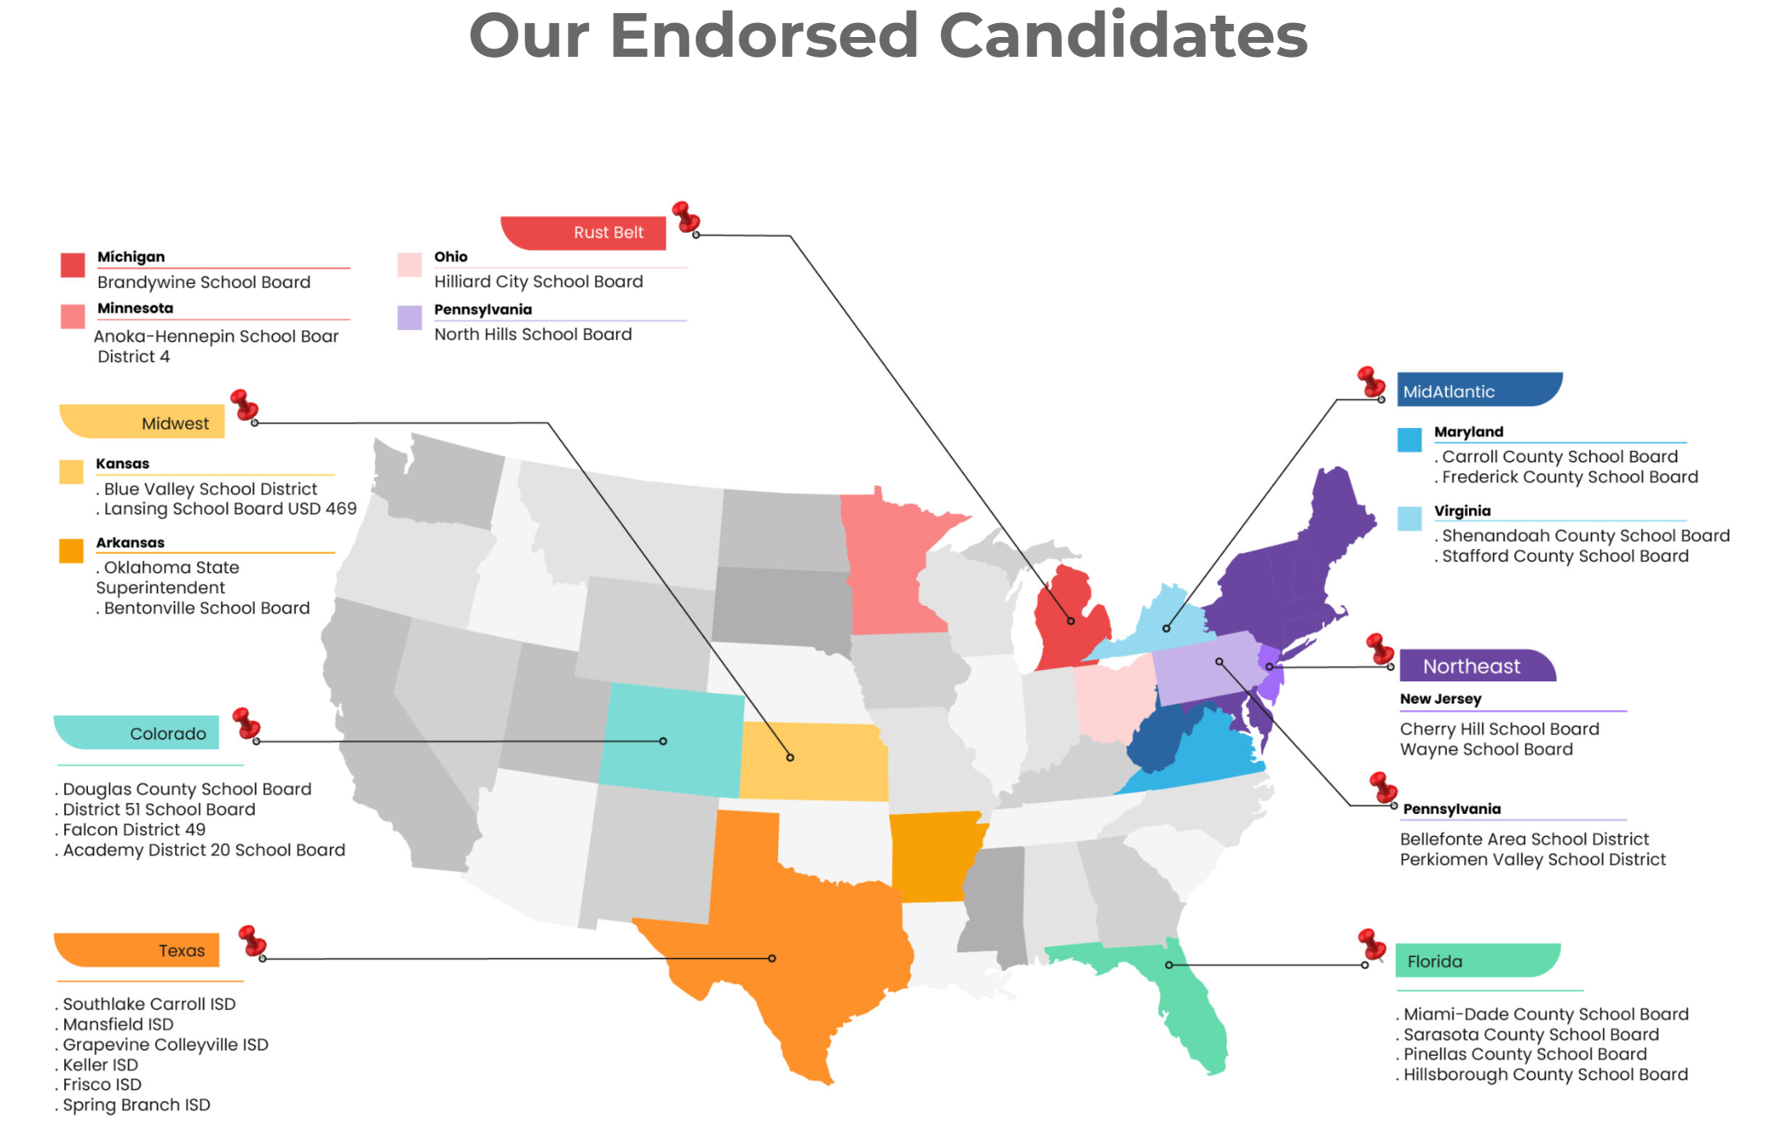
1776 Project School Board Endorsements

Slide 5
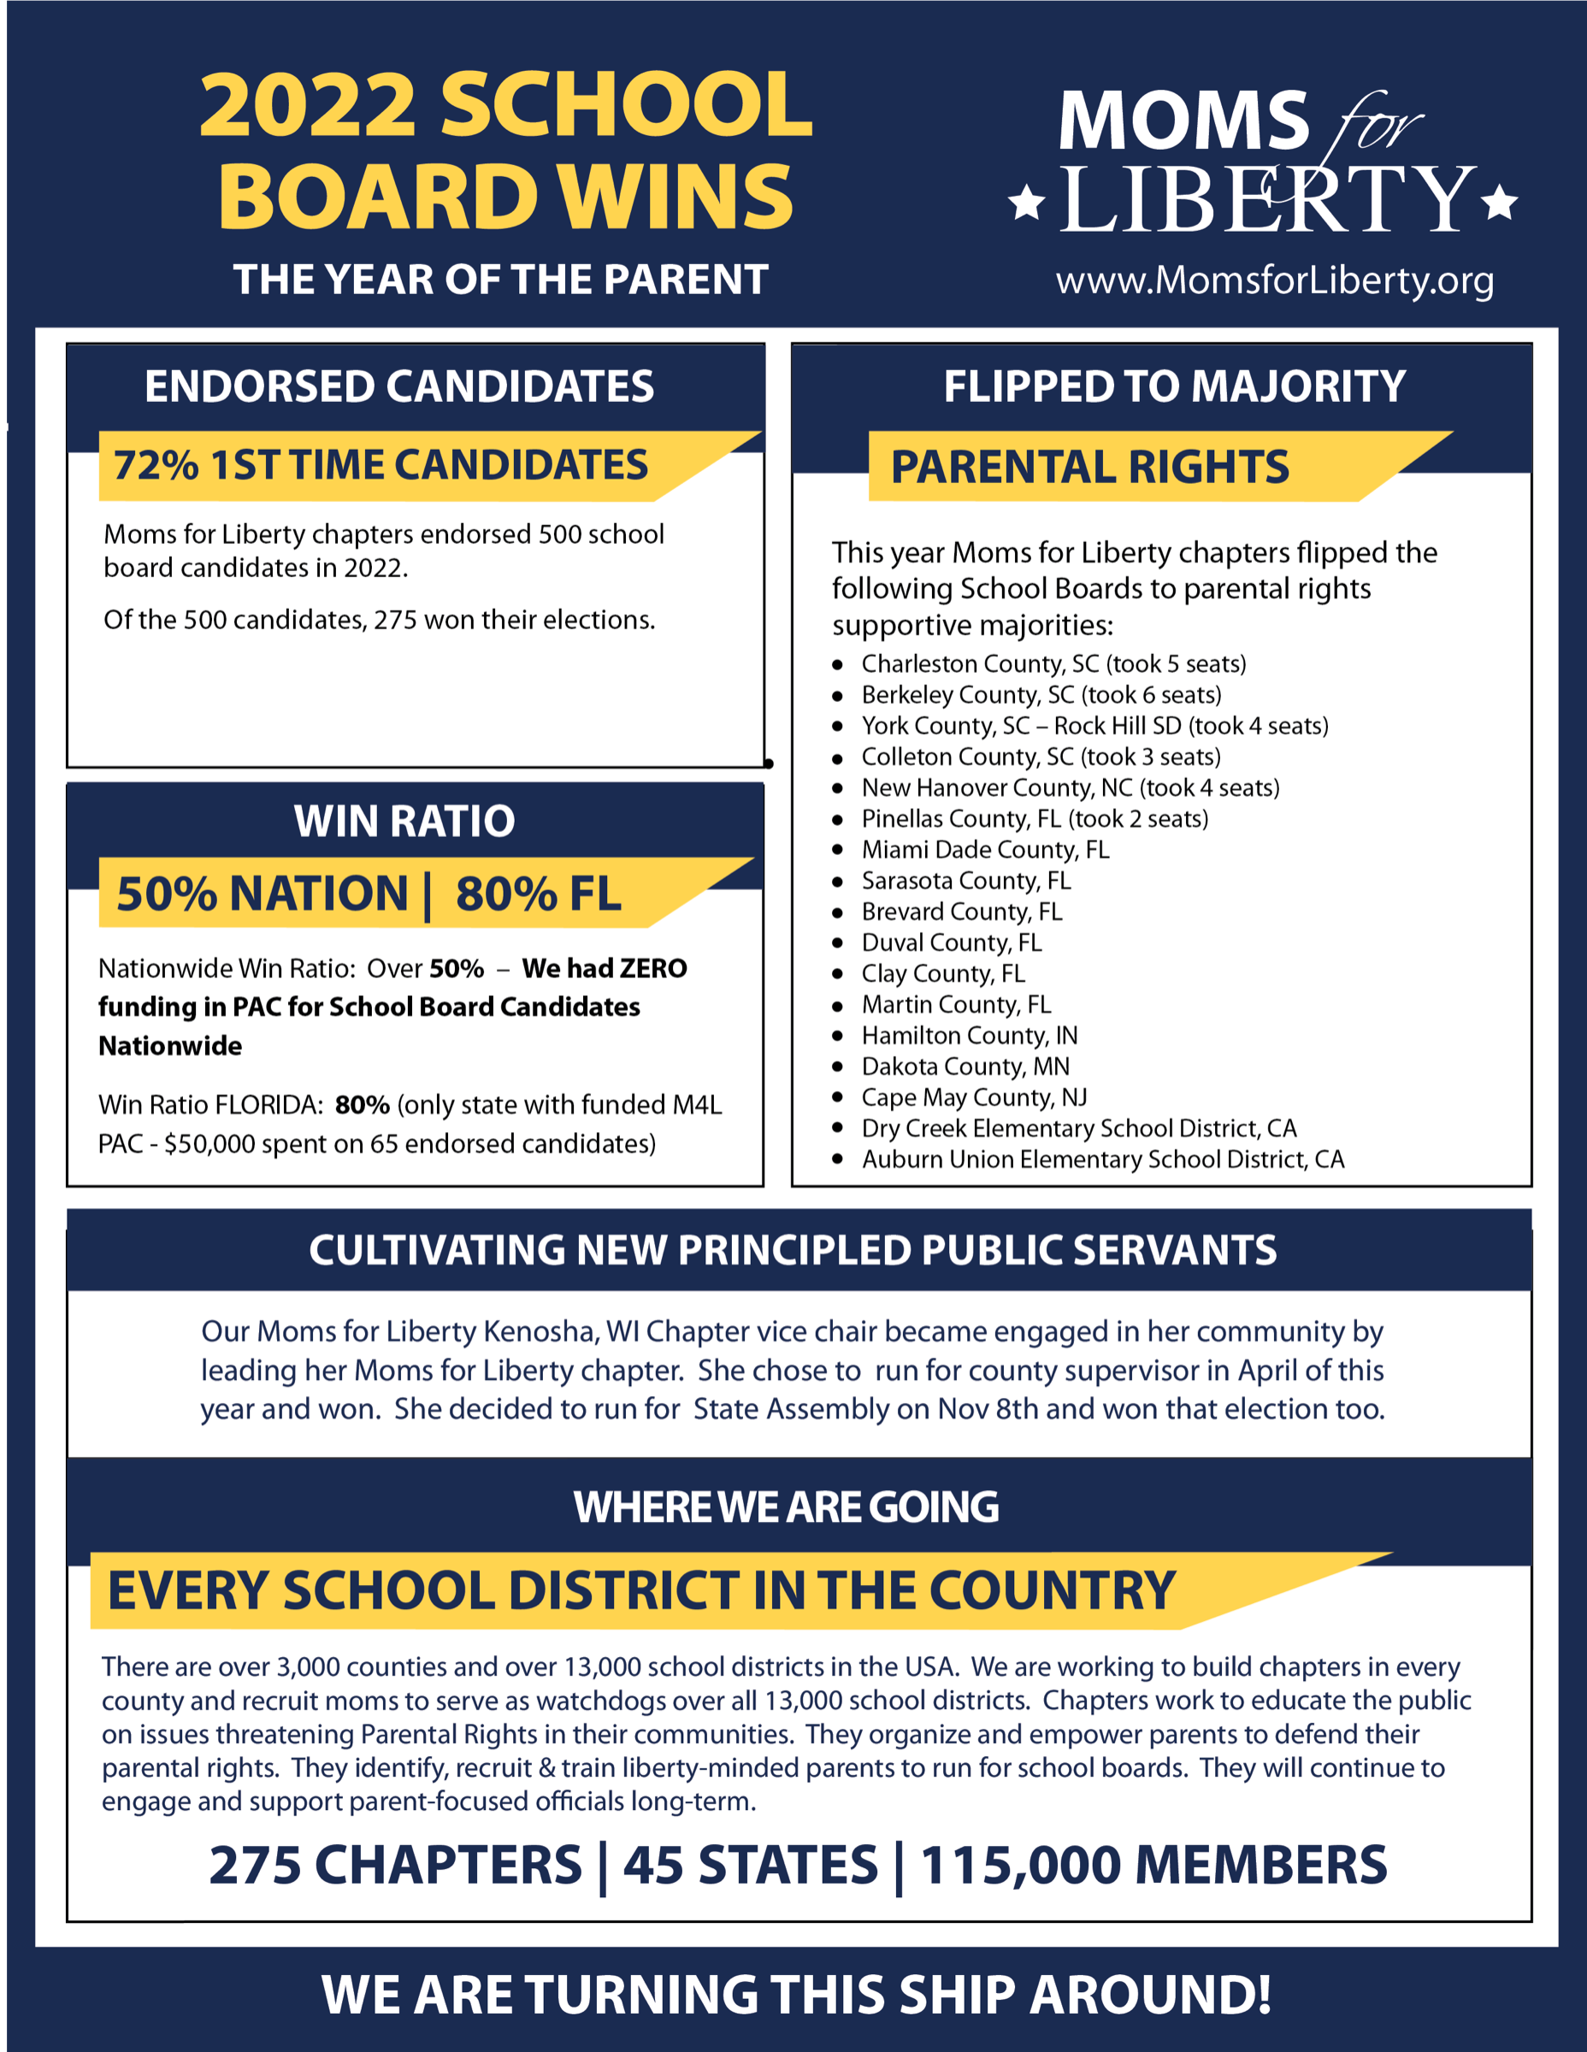

Slide 6
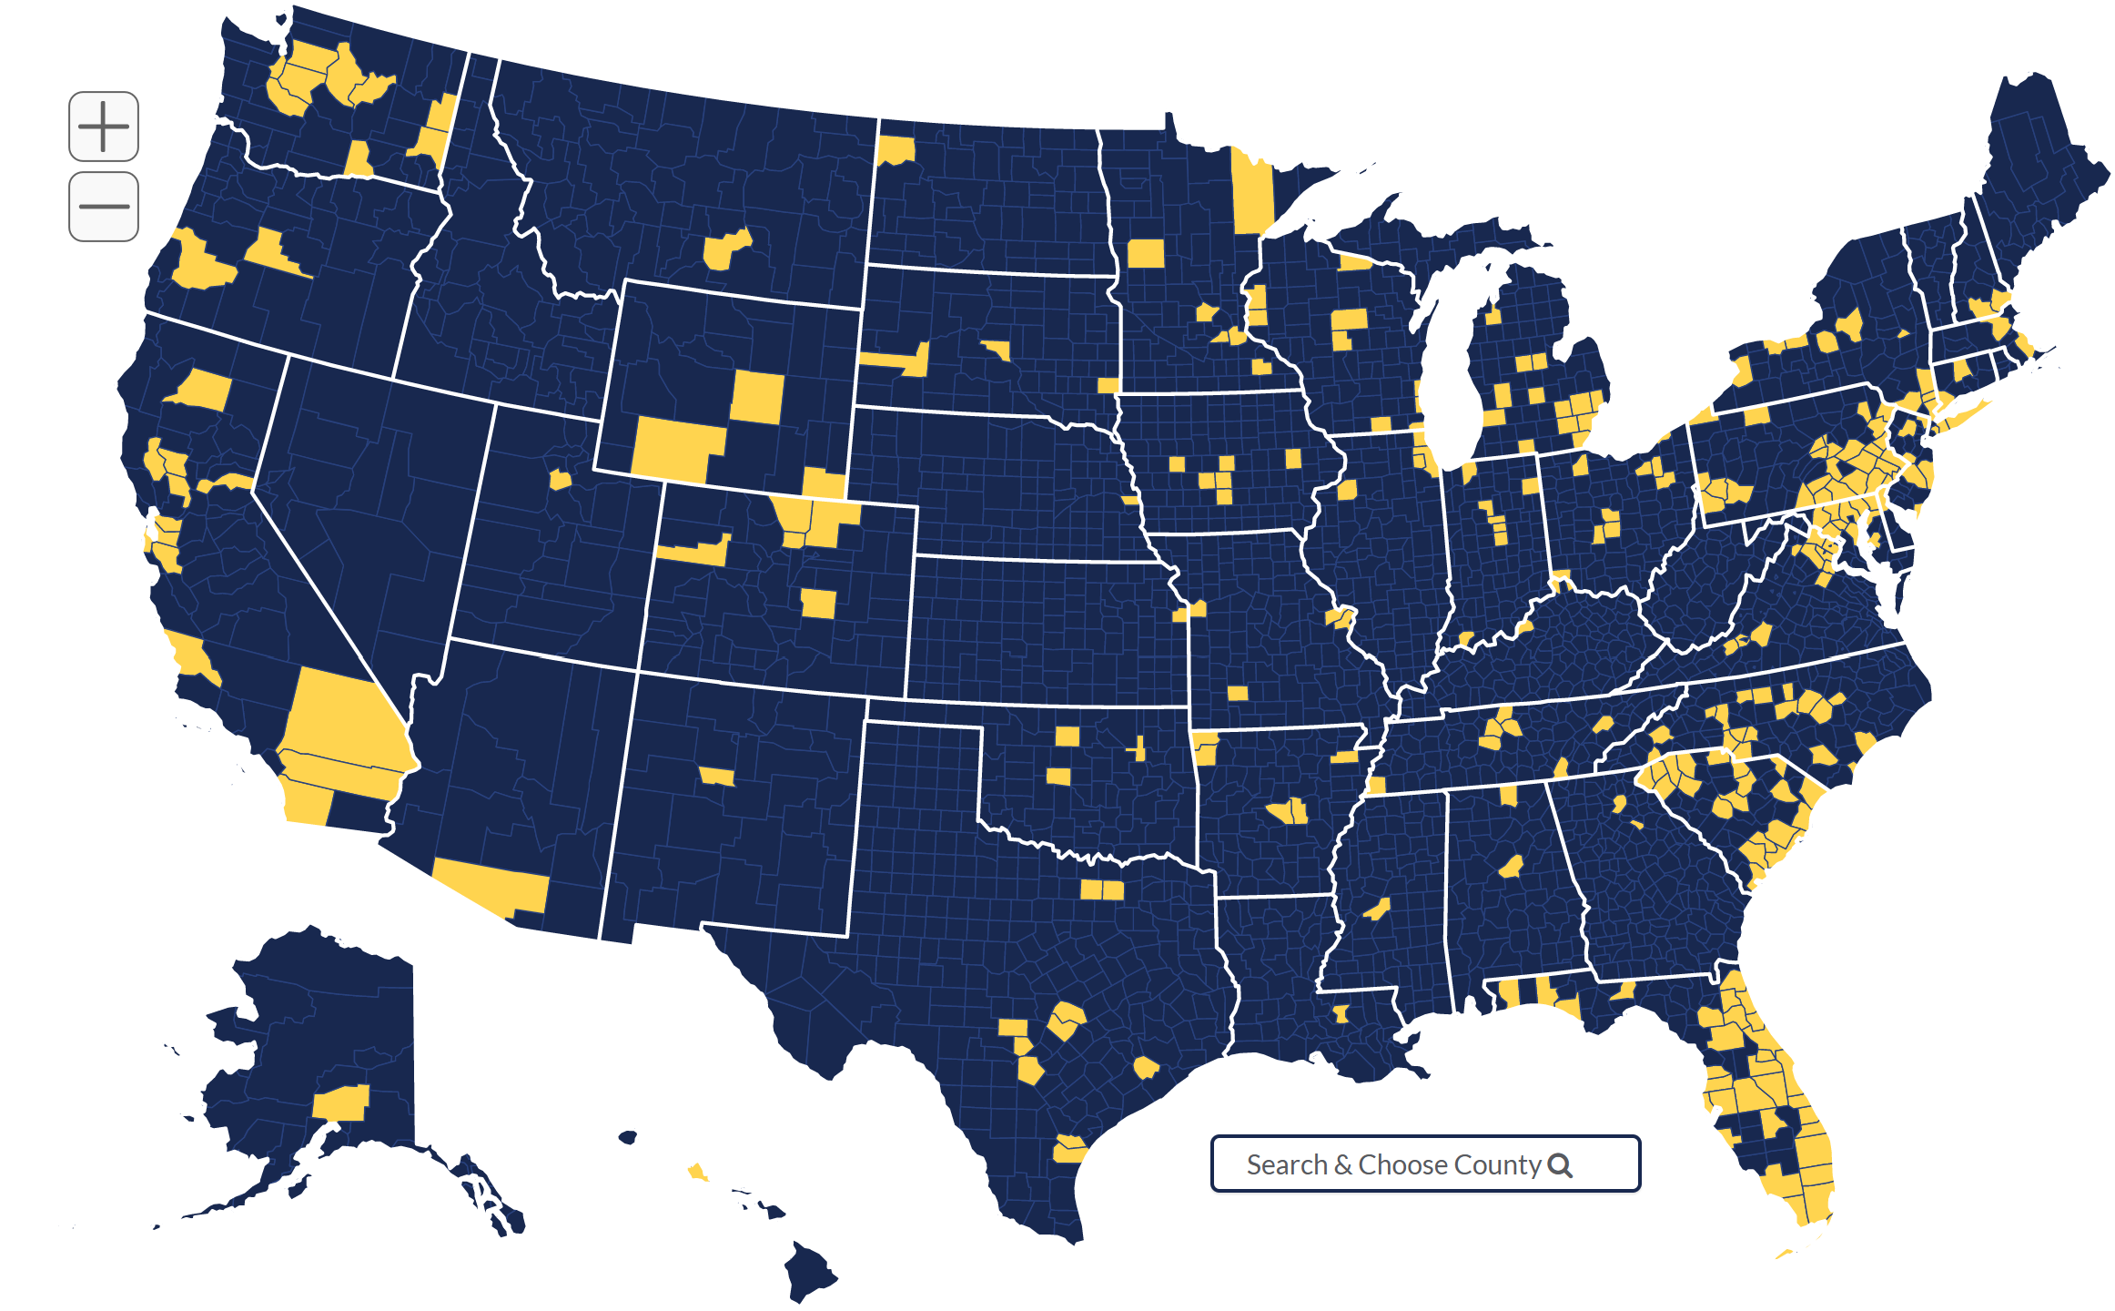
Moms for Liberty Chapter Map

Slide 7
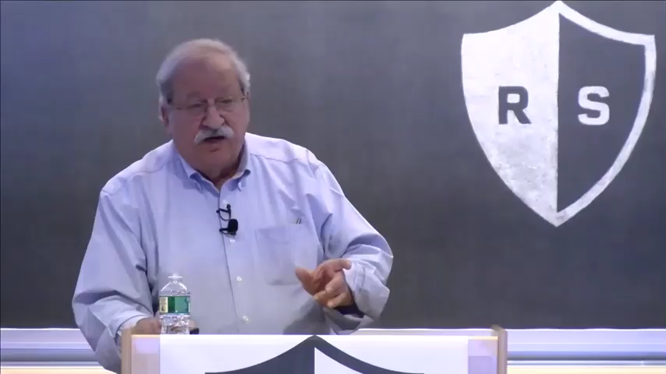
Team & Leader Structures - Ganz

Slide 8
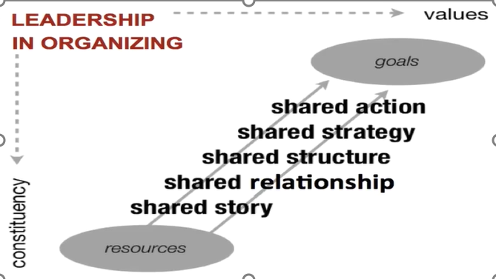
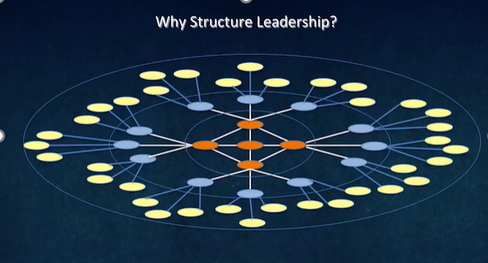
How can we expand our power and impact?

