Slide 1

Connecticut:
2025 See educators Run
Gus Melita
Political Engagement Coordinator
Connecticut Education Association

Slide 2

What we’re seeing in CT
Positive trends
  Growing educator interest in public service
  More community recognition of educator voices
  Rising understanding of municipal processes
Why that understanding is growing
  Growing local budget battles
  Pressure to fund schools without major property tax hikes
Notes:
Ask members what they've done? Any examples?

Slide 3
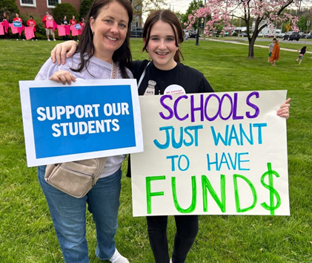
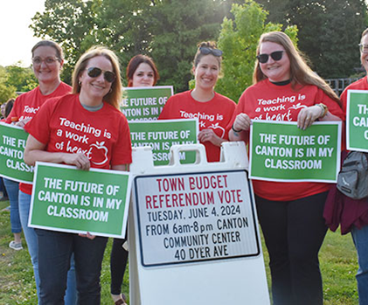
WHY EDUCATORS ARE STEPPING UP IN CT
Educators are running because they:
  Understand how public institutions impact students/families
  Have deep community ties
  Bring lived experience + problem‑solving
This year:
  Many stepped up due to instability and urgent system needs
  18 of 43 districts with educator candidates had recent major budget challenges

Slide 4
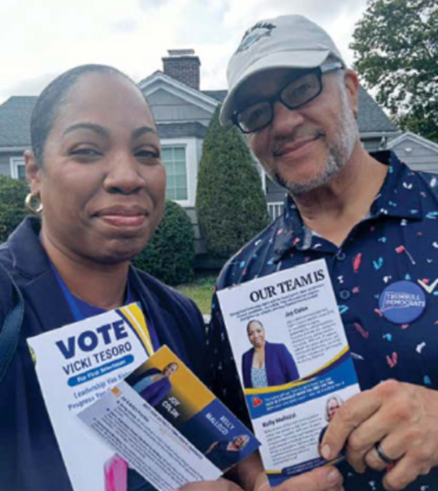
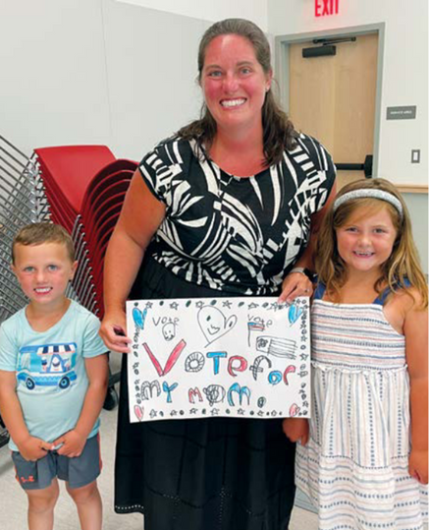
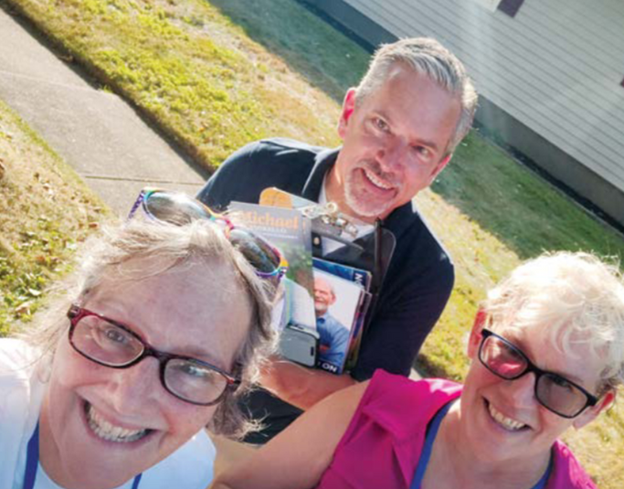
2025 Participation & Engagement
Educators Running!
  60+ educators stepped forward (first timers & longtime leaders)
  250% increase in identified candidates from 2023
  Participation across political affiliations, career stages, and backgrounds
Notes:
Relationships: how to reach out, what resonates, why teachers are trusted voices.
Storytelling: framing issues through student/educator impact, not just numbers.
Collective action: petitions, rallies, visibility campaigns—examples of what’s worked.
Electoral engagement: supporting pro-public education candidates, from school board to state legislature.
What do want decision makers to understand better? How do we frame it politically?

Slide 5
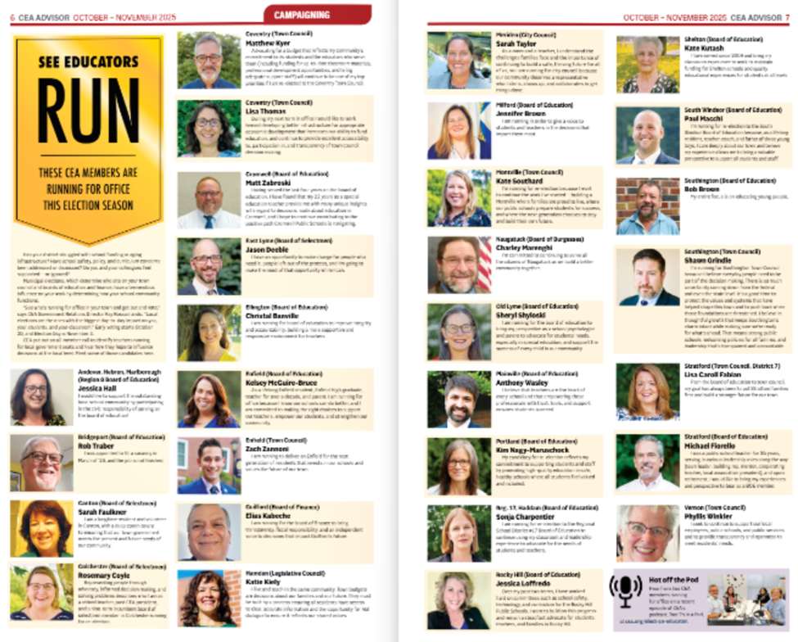
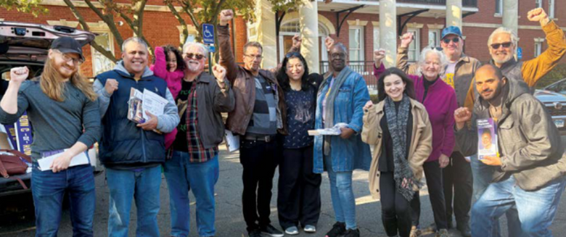
2025 Participation & Engagement
CT See Educators Run Support Included:
  1:1 guidance
  Local association connections
  Candidate questionnaire
  Features in Advisor + CEA platforms
  Member communication + access to information
  No state-level endorsements
Notes:
Relationships: how to reach out, what resonates, why teachers are trusted voices.
Storytelling: framing issues through student/educator impact, not just numbers.
Collective action: petitions, rallies, visibility campaigns—examples of what’s worked.
Electoral engagement: supporting pro-public education candidates, from school board to state legislature.
What do want decision makers to understand better? How do we frame it politically?

Slide 6
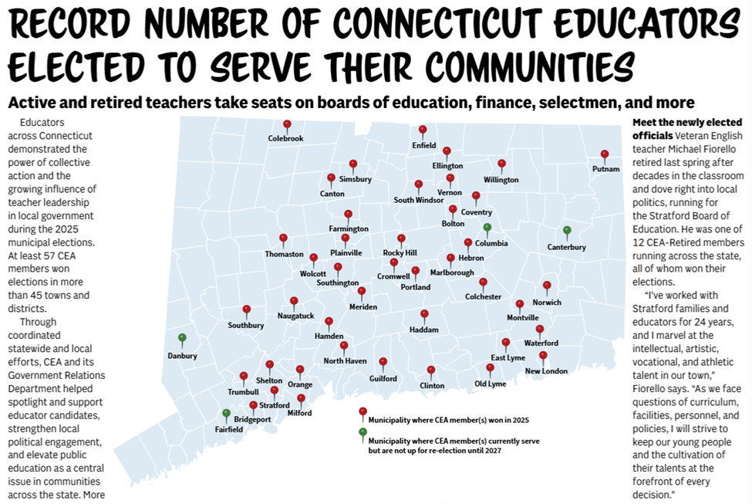
2025 Outcomes
Results
  57 CEA members elected in 40+ towns
  Candidates reflected the diversity of our professional community — different political affiliations, career stages, and personal experiences.

Slide 7
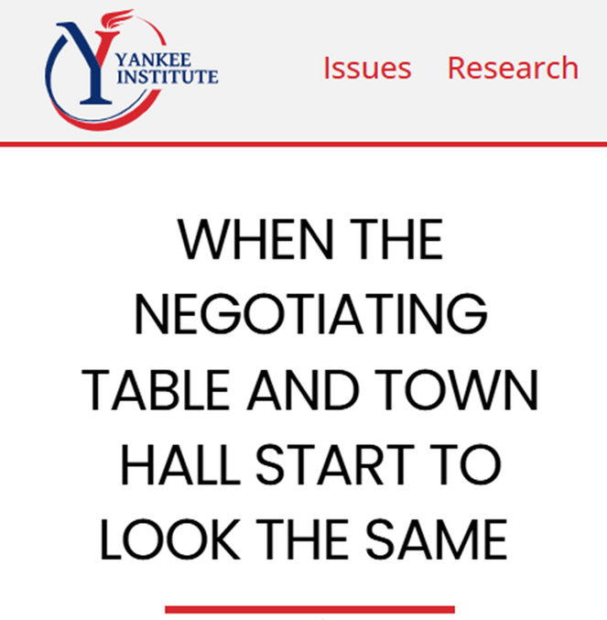
2025 Outcomes
External attention
  Highlighting CEA’s “deliberate strategy” to build local influence
“What is most striking about the CEA’s own messaging is its candor. The union is not downplaying its role or presenting these outcomes
as incidental. The map, the language, the celebratory tone reflects
a deliberate strategy to expand influence at the local level. This is
not power reluctantly accepted. It is power actively sought and
openly claimed.”

Slide 8


What We Learned: Building a Leadership Pipeline
Key lessons
  Preparation lowers barriers
  Local associations can serve as powerful connectors
  Authentic lived experience builds trust
  Understanding systems leads to engagement
  Leadership development must be ongoing (training, networks, mentorship, long‑term support)
  Emerging Trend: Stepping up together with 13 of 43 towns seeing multiple members running

Slide 9
EMERSON HOFFZALES
LAWRENCE EDUCATION ASSOCIATION PRESIDENT

Slide 10
KEVIN PAPE
COLORADO EDUCATION ASSOCIATION
POLITICAL DIRECTOR

Slide 11
KEVIN PAPE
COLORADO EDUCATION ASSOCIATION
POLITICAL DIRECTOR

Slide 12

Evolution of School Board Races
2020
*Unlimited Term Limits
*Small Budget Campaigns
2022
*COVID backlash led to Moms for Liberty candidates funded by Governor
*12-year term limits imposed by Legislature
2024
*8-year term limits imposed by Legislature
*Partisan School Board Constitutional Amendment defeated
2026
*Gov. DeSantis leaving office, MFL fizzling out
*Partisan Elections post-2026?

Slide 13
2022 Election Results
Primary Results
28 FEA endorsed candidates won their Primary Election
4 FEA endorsed candidates beat DeSantis endorsed candidates
23 FEA endorsed candidates lost their races
19 DeSantis endorsed candidates won their Primary Election, of which 10 beat FEA endorsed candidates
6 DeSantis endorsed candidates went to November runoff
5 DeSantis endorsed candidates lost outright
General Results
FEA endorsed 31 candidates in the General Election
11 FEA candidates won
20 FEA endorsed candidates lost their races
2 DeSantis endorsed candidates won

Slide 14
2024 Elections and Beyond
2024
* Endorsed 55 school board and 5 Superintendent candidates
* Won 36 school board and 4 Superintendent seats
2026
*Over 150 seats up in August and November

Slide 15
Florida Pipeline Project
Launched in 2021
Coalition of labor, constituent groups, coalition partners, and statewide leaders, Florida Democratic Party
FEA takes lead on races to ensure we aren’t spending money against our own interests

Slide 16
QUESTIONS?

Slide 17
KEY TAKEAWAYS & ADVICE

Slide 18
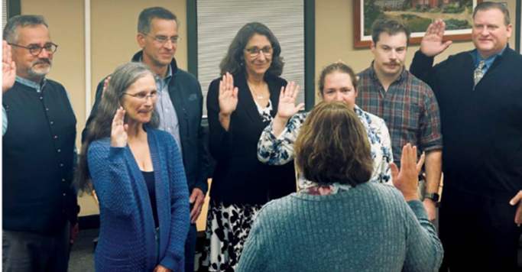
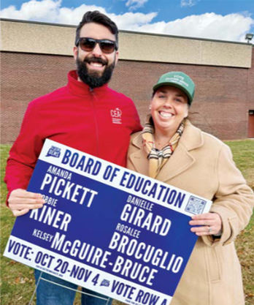
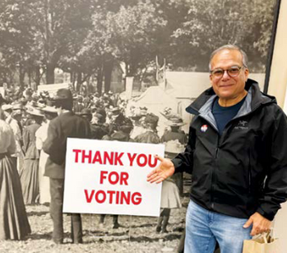
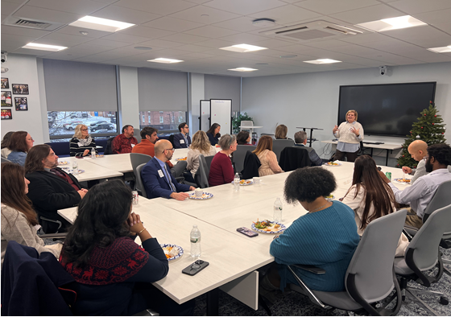
Key Takeaways & Advice
Build pathways, not one‑time opportunities
    Exposure leads to leadership
Start with strengths & authentic stories
    Educators already lead every day
Create a support system that lasts
    Clarity, networks, mentorship, encouragement
Leadership is contagious
    Visibility → confidence → more leaders

