Slide 1
Constituency Organizing: Club to Fighting Union
Day 3

Slide 2

Community Agreements pg 2-3
Using Self-Awareness and Self-Knowledge
Listening for Understanding
Being Gracious
Staying Engaged
Being Open and Suspend Judgment
Saying “I”- tell your truth
Seeking Discomfort
Reaching Empathy
Expecting Non-Resolution and Non-Closure
*Adapted from “Embracing equity and inclusion”, Annie E. Casey Foundation
Notes:
Community Agreements for Our Time
Awareness and Self-Knowledge
This requires self-knowledge and self-awareness. Self-knowledge allows you to see what causes you pain and conflict and enables you to embrace your contradictions and inconsistencies. It allows the space to work on things about yourself that you are not happy with. In turn, self-knowledge helps to prevent you from projecting your negative aspects onto other people. Bringing your best self also requires that you have a positive attitude, are willing to deeply explore your perspectives and remain open to the perspectives and experiences of others.
Listening for Understanding
Be an active listener. Active listening involves paying full and careful attention to the other person, looking him or her in the eye, avoiding interruptions, reflecting your understanding, clarifying information, summarizing the other person’s perspectives and sharing your own. Remember that most people need time to open up and might not be willing to immediately share their personal stories, hopes, fears and/or concerns.
Being Gracious
Being kind is a vital way of bringing meaning to our own lives, as well as the lives of others. Kindness is about caring genuinely for others around you, wanting the best for them and recognizing in them the same wants, needs, aspirations and even fears that you may have. Being kind and generous allows us to communicate better with others, to be more self-compassionate and to be a positive force in other people’s lives. This includes following the COVID protocols that are in place to protect the health of this learning community.
Stay Engaged
Staying engaged requires you to be morally, emotionally, intellectually and socially involved in the conversation. Staying engaged means that you are listening with curiosity and willing to deepen your understanding. Staying engaged might also require you to sustain the conversation even when it gets uncomfortable or diverted. This also means a commitment to keeping your electronic communications to a minimum with folks not present in this learning community.
Be Open and Suspend Judgment
Listening with an open mind includes being receptive to the influence of others. You can suspend judgment by becoming aware of preconceived notions and listening to everything someone has to say before jumping to conclusions. Most importantly, suspending judgment also means listening to what the speaker has to say for understanding, not just to determine whether the speaker is right or wrong.
Say “I”- tell your truth
Speaking your truth in authentic and courageous conversations about race requires a willingness to take risks. It means that you will be absolutely honest and candid about your own thoughts, feelings, experiences and opinions and not just saying what you perceive others want to hear. Speaking your truth will require you to speak from the “first person” and use “I” statements.
Seek Discomfort
Leaning in to discomfort will require you to let go of racial understandings and stereotypes that you may be holding onto in order to move forward. Leaning in means that you will avoid judgment, assume positive intent and be open to the kernel of wisdom in each individual’s experiences. Leaning in to discomfort will require you to sit through moments of embarrassment, confusion, anxiety and/or fear.
Reaching Empathy
Empathy and compassion allow you to understand the other person’s point of view. When you are empathetic, you are more understanding, patient and kind. Expanding your capacity to feel empathy will also allow others to enter your circle of human concern.
Resolution and Closure
Expect and accept that there may not be closure. It is not likely that you will resolve your personal understanding about race or another person’s racial experience in a single conversation. The more you talk about race with another person, the more you learn and the more they will learn. Authentic and productive conversations about race are continuous and always evolving.
*Adapted from “Embracing equity and inclusion”, Annie E. Casey Foundation

Slide 3
Feedback on Feedback

Slide 4
Your Words on our work –

Slide 5

Today’s Outcomes

Slide 6


Slide 7
Mapping Your Allies

Slide 8
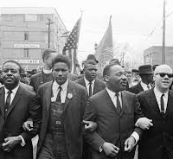
“In the end we will remember not the words of our enemies, but the silence of our friends.”
Martin Luther King, Jr.

Slide 9
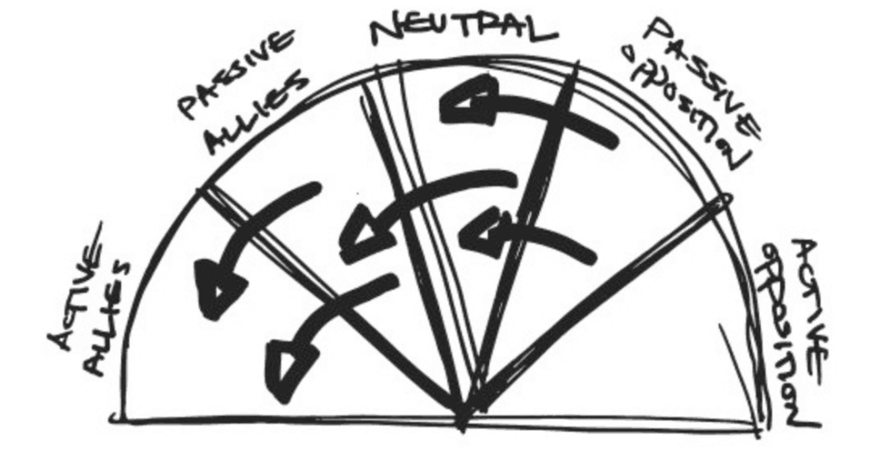
Adding to Your Base from the Outside P. 131-132

Slide 10
Three Kinds of Fights of That Fail P. 130
Only work with Active Allies – Preaching to the Choir
Only focus on Opposition–
Whole World is Against Us
Only focus on Active Opponents – Speak Truth to Power (Moral Appeal and Righteous Argument)

Slide 11
How to Win
Use strategic tactics that shift each segment to the left .
Focus on the “Aims” or outcomes you want from each of the segments.

Slide 12
Definitions to Know
active allies, or people who agree with
you and are fighting alongside you;
passive allies, or people who agree with you but aren’t (yet) doing anything about it;
neutrals, or the unengaged and uninformed;
passive opposition, or people who disagree with you but aren’t actively trying to stop you; and
active opposition, or people who not only disagree with you, but are actively organizing against you.

Slide 13
Let’s Do this Shift - 2 Steps
Use pages 131 and 132 to create a map of allies that would make sense for your assigned constituency group.
Identify visible tactics that create the outcome you want from each group.
Be ready to share what you learned

Slide 14
Whole Room Talk
What did you learn doing this process?
What is important to know if you are going to use this with leadership teams?

Slide 15

Key Ideas
Campaigns are won not by overpowering one’s active opposition, but by shifting each group one notch around the spectrum increasing people power in favor of change and weakening your target.
Tactics and actions need to match your target outcomes

Slide 17
The Target

Slide 18

Who has the power and resources to prevent or grant the change you want?

Slide 19
Who is the Boss – P. 60-66
Who is the boss or the fight with?
How did they win?

Slide 20

What did you learn?

Slide 21
Key Ideas
Having a clear target to mobilize our leaders around the issues we cannot address alone is critical.
Without a clear target, we do not have an effective strategy or plan.

Slide 23
The Tactics

Slide 24
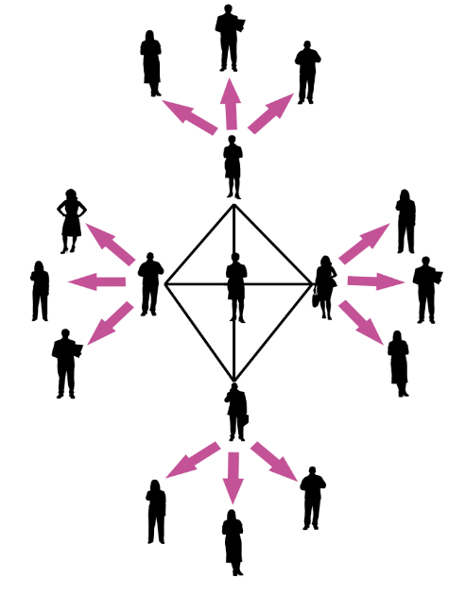
How do we build a club into a fighting union?
Structure Tests
Escalate
Leader Development
Assess Commitments

Slide 25
Power is a function of Courage and Unity P.147
Our Ultimate Power
Amount of Effort or Courage to Persist and Act
Unity - Number of People Sharing the Values, Pain, and Actions

Slide 26
Low level of courage and high number of actors…
Amount of Effort or Courage to Persist and Act
Sign an online Petition
Unity - Number of People Sharing the Values, Pain, and Actions

Slide 27
High level of courage and low number of actors…
Storm the Superintendent’s Office
Amount of Effort or Courage to Persist and Act
Unity - Number of People Sharing the Values, Pain, and Actions

Slide 28
High Participation Is a Prerequisite to Power - Super Majority of Workers Engaged

Slide 29
But Also Need…
Unity (against division) TIGHT STRUCTURE Demonstrable & Sustainable Super-Majorities

Slide 30
Case Study – Seattle P. 87-95
Our Ultimate Power
Focus on P. 93
Was this tactic effective in achieving their demand? Do they have the power to achieve their demand? Why?
Use Tool on 162 to consider the eefectiveness of this tactic.

Slide 31
What were the strengths and weaknesses of this tactic?
Where was this local in the levels of organizing?
What would you do instead?

Slide 32
Key Ideas
If we stay in the 1-1s and never ask to act or choose to act, we stay in the basics to beginning of organizing.
Building power with each other and giving leaders the role of doing the tasks and organizing of the action helps to build the over all unity and allows us to leverage more resources for change.

Slide 34


Slide 36
Group Work

Slide 40
Key Ideas

Slide 42
Group Presentations

Slide 43
Gallery Walk:
Use post-its to leave feedback
Focused questions OR affirmations (not suggestions)

Slide 44
Feedback Responses
What feedback is particularly useful or thought-provoking?

Slide 45
Key Ideas

Slide 47

Ending it Right
Lunch
Travel
Feedback via email

Slide 48
Feedback on Feedback

