Slide 1
Adult Learning

Slide 2
Today’s Outcomes
You will learn key characteristics of adult learners
You will learn to differentiate your practice within learning events
You will learn specific structures in our work that support strong adult learning
You will learn characteristics of strong leaders of adult learning
You will learn specific strategies that support strong adult learning

Slide 3
Adult Learning Big Ideas
Ellen

Slide 4

The Good and the Bad

Slide 5
What Makes Adult Learning Good?
When have you felt like you have been in a really great learning situation?
A really awful one?
Best Worst
Participants
Environment
Facilitator/Trainer
Materials
Content

Slide 6
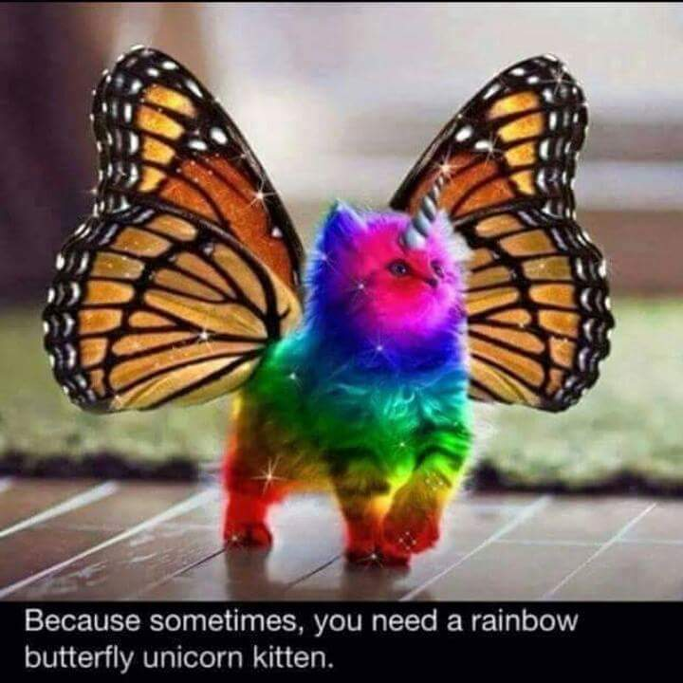
What is tough about leading adult learners?

Slide 7
So, what do we need to do?
Involve Them with Choices
Include Their Experiences
Task/Role Focused
Solution Focused Activities
Balance New Content with Open Ended Application

Slide 8
Adults Want to Know
Agenda (Will it be loose or tight?)
Time Constraints (When is the start and end – are breaks co-developed?)
Expectations (How will we proceed as a group?)
Your Name & Credentials (Why are you worthy?)
Personal Connection (How will their prior expertise be honored?)

Slide 9
5 Stages of Adult Learning We See
Polite
Challenge - Why are we here?
Bid for power - Anxiety!
Productive Stage - Involvement and learning
Esprit de Corps
Notes:
Polite: Participants unrevealing of self. Laid back; waiting to see what happens. Reserved, formal, stiff, uncertain
Agenda Challenge : Why are we here? I don’t want to stand under the sign.
Aren’t we going to do this/that? THESE INSECURITIES WILL BUILD CHALLENGE, LEADING TO
Bid for Power:
If this occurs, work through it realizing
1. They can use personal authority and try to take it away from you.
2. Anxiety comes from a new learning experience.
3. Modeling is extremely important. (Don’t remain aloof and withdraw from participation with
trainees.)
4. The group – especially if they know each other -
is stronger than you!
Work hard at climate and individual needs and you will get to the
Productive stage: Stick to the program with accommodations and you will get to this
Esprit de Corps: This comes after the anxieties are reduced and no one feels threatened.
REMEMBER : Anxiety comes with any new experience.
AND, anxiety can get in the way of learning.
Two major sources of anxiety:
Authority 2)Inter-Personal Relations
(Intimacy)
Sharing/Giving Away Sharing of Self

Slide 10

10 Big Ideas About How We Work
Don’t Talk at them – Involve them
Building Community occurs throughout – Move and Re-form groups regularly
Don’t give them all the information – Allow them to discover first, apply their
thinking –THEN provide yours
Ask them to reflect and future-think often – What did this mean? How will you…?
Change the delivery every 20 minutes
End with something THEY built
Ensure they can share their thinking throughout
Use many formats for learning
Lead what YOU are passionate about

Slide 11
As You do Your Work with Us Remember
Anxiety comes with any new experience AND
Anxiety can get in the way of learning.
  Two major sources of anxiety:
    Authority - Sharing/Giving Away
    Inter-Personal Relations (Intimacy) - Sharing of Self
Notes:
REMEMBER : Anxiety comes with any new experience.
AND, anxiety can get in the way of learning.
Two major sources of anxiety:
Authority Sharing/Giving Away
Inter-Personal Relations (Intimacy) Sharing of Self

Slide 12
Adult Learning Practices
Heidi

Slide 13
Training, Presenting, Facilitating?
What is a working definition for each?
What are participants doing in each?
What are you doing in each?

Slide 14
Training, Presenting, Facilitating
Presenting is one way. The content dump.
Training can be two way and should include modeling, questioning, and application of skills or knowledge. Think preset outcomes.
Facilitating is getting the participants to do the work. Identifying problems, naming solutions, mediating conflicts, coming to resolution. There are more questions than answers and the focus is on what the participants bring to the work not what the facilitator brings.

Slide 15
How do we design learning that sticks?
Arrange the following in the order that you believe is the most effective way to support learning in adults:
Participating in Discussion
Watching a Movie
Reading
Hearing a Lecture
Doing Something
Watching a Demonstration
Least Effective
Most Effective
Notes:
Timing: 5 mins minutes on this slide and next Handout #16: Average Retention Rates 6:00 appointment
TELL PARTICIPANTS:
1. On your table you will find a handout called “Average Retention Rates.”
2. Take a handout and then go find your 6:00 appointment partner.
3. Working together, quickly decide how to arrange these learning strategies on the pyramid—at the top should be the least effective strategy and the most effective strategy should be at the bottom.
4. You are focusing on the strategies that have the greatest impact on the retention of learning for the average student.
5. You have 2 minutes—GO!
Source: Dr. Angie Koppang, University of North Dakota.

Slide 16
How do we design learning that sticks?
10% of what is read
20% of what we hear
30% of what we see and hear
70% of what we say
90% of what we do
Lecture
Reading
Watching a Movie
Watching a Demonstration
Discussion
Doing Something
Notes:
Timing: 5 mins minutes on this slide and next Handout #16: Average Retention Rates 6:00 appointment
TELL PARTICIPANTS:
1. On your table you will find a handout called “Average Retention Rates.”
2. Take a handout and then go find your 6:00 appointment partner.
3. Working together, quickly decide how to arrange these learning strategies on the pyramid—at the top should be the least effective strategy and the most effective strategy should be at the bottom.
4. You are focusing on the strategies that have the greatest impact on the retention of learning for the average student.
5. You have 2 minutes—GO!
Source: Dr. Angie Koppang, University of North Dakota.

Slide 17
What I hear, I forget;
What I see, I remember;
What I do, I understand.
-Confucius 451 B.C.E.

Slide 18

What do adults and goldfish have in common?

Slide 19
Goldfish and adults…
Researchers in Canada surveyed 2,000 participants and studied the brain activity of 112 others using electroencephalograms (EEGs).
Since the year 2000 the average adult attention span dropped from 12 seconds to eight seconds.
On the positive side, the report says our ability to multitask has drastically improved.
http://time.com/3858309/attention-spans-goldfish/
Key Idea – We change our method or mode about every 15 to 20 minutes.
Notes:
http://time.com/3858309/attention-spans-goldfish/
The average attention span for the notoriously ill-focused goldfish is nine seconds, but according to a new study from Microsoft Corp., people now generally lose concentration after eight seconds, highlighting the affects of an increasingly digitalized lifestyle on the brain.
Researchers in Canada surveyed 2,000 participants and studied the brain activity of 112 others using electroencephalograms (EEGs). Microsoft found that since the year 2000 (or about when the mobile revolution began) the average attention span dropped from 12 seconds to eight seconds.
“Heavy multi-screeners find it difficult to filter out irrelevant stimuli — they’re more easily distracted by multiple streams of media,” the report read.
On the positive side, the report says our ability to multitask has drastically improved in the mobile age.
Microsoft theorized that the changes were a result of the brain’s ability to adapt and change itself over time and a weaker attention span may be a side effect of evolving to a mobile Internet.
The survey also confirmed generational differences for mobile use; for example, 77% of people aged 18 to 24 responded “yes” when asked, “When nothing is occupying my attention, the first thing I do is reach for my phone,” compared with only 10% of those over the age of 65.
And now congratulate yourself for concentrating long enough to make it through this article.

Slide 20
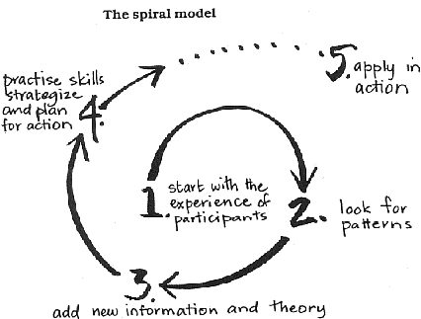
What is popular education?
Start with what they know.
Fill in gaps and elevate foundations
Practice and Apply

Slide 21

Rules to Remember – Who is Rick Perry?

Slide 22
Know your learners' outcomes
Build multiple paths to those outcomes
Use their knowledge first
Apply their learning on the spot
Be prepared

Slide 23
Directions and Questions
Ellen

Slide 24
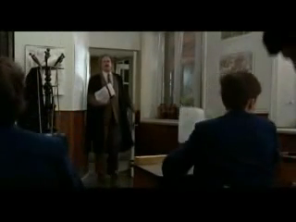
Follow these directions

Slide 25
The Basics of Giving Directions
Directions must be Practiced, Clear, and Succinct
Everyone is Quiet – Yes, Everyone- So WAIT for it.
Give logistical directions first, where, who, and materials.
ONLY GIVE academic directions AFTER groups are settled and ready to listen – AKA - Quiet.
Give a time expectation – either for when you will check OR when to be finished.
When possible, make directions visible and check for understanding of the directions so that it’s clear that all have heard them.

Slide 26
Our questions are MORE important than OUR answers or OUR stories.

Slide 27
Why do questions matter in adult learning?
Questions coach don’t tell - Allows the adult a sense of efficacy, control, and choice
Questions democratize the learning – Allows adults’ experiences to be part of their new understandings
Questions build community – Allows adult engagement and shared understanding across participants

Slide 28
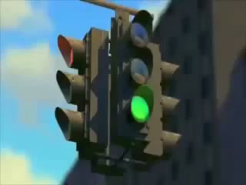
What did they need for directions?
What would you ask them to support their learning?

Slide 29
Adults can’t learn if they are frustrated with the directions.
Adults need coaching more than they need telling.

Slide 30
Difficult Adult Learners
Heidi

Slide 31
Difficult Situations Scenarios
You don’t know any of the people who will be attending your training session. You have no idea what they know about the topic at hand and have planned for a fairly basic overview of the content. At the training you learn early on that most of them already know what you plan to present. What can you do to create some interest in the training and motivation to work hard and learn?
You notice that a number of folks are not “with you” – they are having side conversations, working on their cell phones or computers, and are not participating with their table mates. What would you do to address this?
During your session, you get a very pointed question/opinion from one of the participants that is a direct challenge to what you are saying. The tone of the question makes you feel defensive. Further you see a shift in the group towards this question/opinion. What would be some ways to address this and make it a productive experience for you and the individual?

Slide 32
What does not work…
Great for Fun – Not so Great for Leading Learning
  Sarcasm
  Exaggerated Facial Responses
  Over-sharing and LONNNNNNGGGG Stories
  Presuming a Personal Relationship
  Jokes About Real People Either Present or Not Present

Slide 33
What Works
Know your content and your process for teaching it
Remain calm and have a plan
Respect personal space
Be aware of your body language
Pay attention to your own paraverbals (How we say the words. Example: "What were you thinking?")
Recognize that your effective response and behavior can influence a positive outcome

Slide 34
Wrap Up
Ellen

Slide 35
Summary of What you Know
Create a Freyer Chart
What motivates adult learners?
What do leaders of adult learning need to keep in mind?
Who are Adult Learners?
What are some characteristics of preferred adult learning events?
What are your three most important ideas?

Slide 36

Same rules apply…
Don’t do for others what they can do and discover for themselves.

Slide 37
Wrap it up!
4 Sentence Dissertation:
Using only 4 sentences, present to all of us:
  What is your most important new idea…
  What you will now be able to do…
  What you know you will apply…
  …as a result of this training.
  Bonus - What do you wish we would have gotten to that we did not?

