Slide 1
Honoring This Space
We begin by acknowledging that through a history of colonization and brutality, we are currently on the traditional lands stewarded by generations of the indigenous peoples.
We honor these people, all elders, past, present, and emerging. We are called to learn and share these learnings about this tribal history, culture, and contributions that have been suppressed in the telling of the story of what we now call the United States of America.

Slide 2
Facilitator Planning Meeting
2024

Slide 3

3 Day Agenda
Days 1 and 2
7:30-8:30 Breakfast
8:30 Convene
9:45-10:00 Break
10:00-12:00 Break-outs
12:00-12:45 LUNCH
12:45-3:00 Breakouts
4:30- Networking
DAY 2
5:30- 7:00 Team Building
Day 3
7:30-8:30 Breakfast
8:30 Convene
Break on your own
12:00 Adjourn

Slide 4

Our
Outcomes
Day 1
Day 2
Day 3 Finish, or Make Plans to Finish

Slide 5

Community Agreements
Using Self-Awareness and Self-Knowledge
Listening for Understanding
Being Gracious
Staying Engaged
Being Open and Suspend Judgment
Saying “I”- tell your truth
Seeking Discomfort
Reaching Empathy
Expecting Non-Resolution and Non-Closure
*Adapted from “Embracing equity and inclusion”, Annie E. Casey Foundation
Notes:
Community Agreements for Our Time
Awareness and Self-Knowledge
This requires self-knowledge and self-awareness. Self-knowledge allows you to see what causes you pain and conflict and enables you to embrace your contradictions and inconsistencies. It allows the space to work on things about yourself that you are not happy with. In turn, self-knowledge helps to prevent you from projecting your negative aspects onto other people. Bringing your best self also requires that you have a positive attitude, are willing to deeply explore your perspectives and remain open to the perspectives and experiences of others.
Listening for Understanding
Be an active listener. Active listening involves paying full and careful attention to the other person, looking him or her in the eye, avoiding interruptions, reflecting your understanding, clarifying information, summarizing the other person’s perspectives and sharing your own. Remember that most people need time to open up and might not be willing to immediately share their personal stories, hopes, fears and/or concerns.
Being Gracious
Being kind is a vital way of bringing meaning to our own lives, as well as the lives of others. Kindness is about caring genuinely for others around you, wanting the best for them and recognizing in them the same wants, needs, aspirations and even fears that you may have. Being kind and generous allows us to communicate better with others, to be more self-compassionate and to be a positive force in other people’s lives. This includes following the COVID protocols that are in place to protect the health of this learning community.
Stay Engaged
Staying engaged requires you to be morally, emotionally, intellectually and socially involved in the conversation. Staying engaged means that you are listening with curiosity and willing to deepen your understanding. Staying engaged might also require you to sustain the conversation even when it gets uncomfortable or diverted. This also means a commitment to keeping your electronic communications to a minimum with folks not present in this learning community.
Be Open and Suspend Judgment
Listening with an open mind includes being receptive to the influence of others. You can suspend judgment by becoming aware of preconceived notions and listening to everything someone has to say before jumping to conclusions. Most importantly, suspending judgment also means listening to what the speaker has to say for understanding, not just to determine whether the speaker is right or wrong.
Say “I”- tell your truth
Speaking your truth in authentic and courageous conversations about race requires a willingness to take risks. It means that you will be absolutely honest and candid about your own thoughts, feelings, experiences and opinions and not just saying what you perceive others want to hear. Speaking your truth will require you to speak from the “first person” and use “I” statements.
Seek Discomfort
Leaning in to discomfort will require you to let go of racial understandings and stereotypes that you may be holding onto in order to move forward. Leaning in means that you will avoid judgment, assume positive intent and be open to the kernel of wisdom in each individual’s experiences. Leaning in to discomfort will require you to sit through moments of embarrassment, confusion, anxiety and/or fear.
Reaching Empathy
Empathy and compassion allow you to understand the other person’s point of view. When you are empathetic, you are more understanding, patient and kind. Expanding your capacity to feel empathy will also allow others to enter your circle of human concern.
Resolution and Closure
Expect and accept that there may not be closure. It is not likely that you will resolve your personal understanding about race or another person’s racial experience in a single conversation. The more you talk about race with another person, the more you learn and the more they will learn. Authentic and productive conversations about race are continuous and always evolving.
*Adapted from “Embracing equity and inclusion”, Annie E. Casey Foundation

Slide 6

Logistics to Remember
Questions to Ask
Bathroom
Materials
Food
Room Temperature
Karla as a Resource
Travel
Vouchers

Slide 7
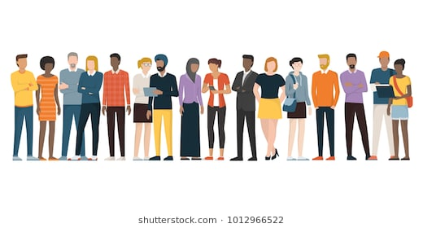
Getting to Know Us
Move Up and Represent
New, Pre Ellen, Ellen Era, Former Member or Leader, Organizer, UniServ, Both, Team Lead, Worksite Lead, Pre UniServ Alumni
Line Up by Experience with this Team, two Circles.
Questions and Wisdom

Slide 8

Shared Drive
Our Information
This Meeting
Content Teams
Materials for Karla to Make and Print
Let’s talk about printing

Slide 9

Why are we Here?
Me
You
This Team

Slide 10

Peer to Peer Expectations
Hedy & Yvie

Slide 11

What occupies your time?
Think about it . . .
How much do each of these people/groups direct your time?
  Manager(s)
  Members
  Colleagues
  You

Slide 12
Time Matters
Manager(s)
Members
Colleagues
You
You have 10 post it notes to divide between the four charts
Place your post-its on the card/poster in a way that reflects how your time is occupied and by whom.

Slide 13

What do you see?
Turn and talk to your neighbor.
  What do you notice?
  What surprises you?
  What does it tell you?
  How is this space different?

Slide 14

Key Ideas
None of us are managers- key to authenticity, and requires respectful communication
None of us are lone rangers- do not shoulder everything, but do your part
Let’s protect and care for the space for us as UDs/Organizers doing this work
Keep this in mind when we work on Leadership styles

Slide 15

Barb and Linda
Roles and Responsibilities

Slide 16
Key Ideas
People can grow if given direct, actionable feedback.
Communicating outcomes first provides a big picture
Continuous reinforcement and correction keeps a team on track
Debriefing helps misses become learning wins.

Slide 17


Or
"Oh I forgot to do my homework"
Albert Jones & Melissa Dan

Slide 18
Instructional Styles
Structuralist: “The mind is like a computer; the teacher is the programmer.”
Functionalist: “People learn best by doing, and they will do best what they want to do. People will learn what is practical.”
Humanist: “Learning is self-directed discovery. People are natural and unfold (like a flower) if others do not inhibit the process.”
Behaviorist : “New behavior can be caused and ‘shaped’ with well-designed structures around the learner.”

Slide 19
Instructional Styles- At your table...
How well does your style describe how you think about learning?
How does it shape how you engage with adult learners?
How does it impact how you express yourself interpersonally in your leadership style?
What's my leadership style?

Slide 20
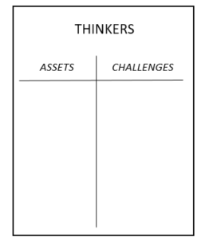
Leadership Styles
SYSTEMATIC
Step 1: Go to the chart where your dominant style is posted.
Step 2: Create a T-Chart with one side listing what makes this style an asset in the work of a facilitator, and on the other side the challenges this style creates for a facilitator.
Direct
Systematic
Spirited
Considerate

Slide 21
Leadership Styles Report Out
Direct
Systematic
Spirited
Considerate
Tell two superpowers.
In a facilitator crisis, how do these superpowers help?

Slide 22
Leadership Styles Report Out
Direct
Systematic
Spirited
Considerate
Look back to your challenges on your chart.
Which style can you lean on to fill each gap?
How do they help with those gaps?

Slide 23
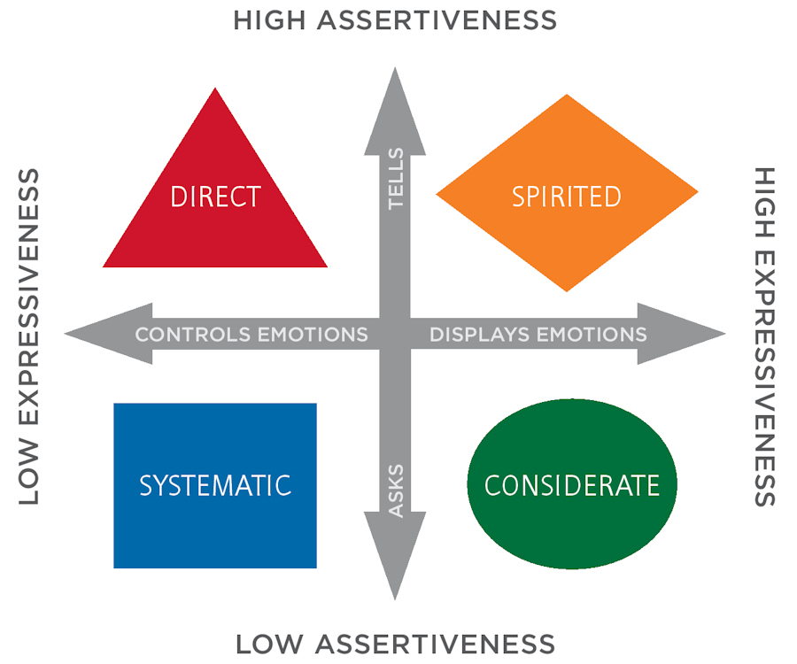
Leadership Styles Report Out
Pg 48- How do the aspects of your leadership style affect how you show up in the room?

Slide 24
Key Ideas
Being able to be a leader within a team requires skills from all the quadrants.
Teams need to have a balance to be most effective
How we communicate, how people perceive us and how we listen are all factors in being effective team members.

Slide 25


Slide 26
Choose Your Own Adventure Round 1
Adult learning (Ellen – Heidi) - Will Repeat
Debriefing, Coaching, Difficult Situations (Jessica and Linda) - Will Repeat
Your Biases as a facilitator and handling when bias shows up in the learners - etc. (Shelly and Lucy ) - Will Repeat
Team Leads and Potentials ( Barb, and Adam )
Using Data and NEA 360 for Organizing (Randy Johnston and Beth Barton)

Slide 27


Slide 28
Choose Your Own Adventure Round 2
Newish Folk Clinic (Hedy – Yvie)
Best Practices for Online Learning (Brandy and Kricket – Chad)
Your Biases as a facilitator and handling when bias shows up in the learners - etc. (Shelly and Lucy )
Adult learning (Ellen – Heidi)
Debriefing, Coaching, Difficult Situations (Jessica and Linda)

Slide 29
Just like cowbells – more Ellen and some Lucy.

Slide 30
Core Beliefs of this Program
Those closest to the work need to lead others in the work.
Democracy is a messy process that is continually practiced and modeled.
If you figure it out, help the next person get it.

Slide 31
Why do we do this? | What is our shared purpose? | How do we achieve this purpose?
Workers can solve their problems and their colleagues' problems by working together, and this group provides an example of what that might look like in real work. We facilitate learning to sharpen our own practices and build our colleagues' work across the country. | Our primary purpose is to support colleagues in sharing knowledge and developing skills. Our team creates and provides tools and resources to support adult learners, inspire people, and provide a nationwide network of practitioners. We foster community and growth by being vulnerable and honest with each other. | Our team achieves its purpose by distributing leadership, sharing expertise, and provides engaging opportunities through various platforms. We train and refine our skills to achieve success with colleagues safely and systemically. Our vision of union work and adult learning is intentionally inclusive and acknowledges members must lead their union and take risks to win. Our key to profound learning is delivering high-quality, communally developed information vetted by personal experiences shared across the room.

Slide 32

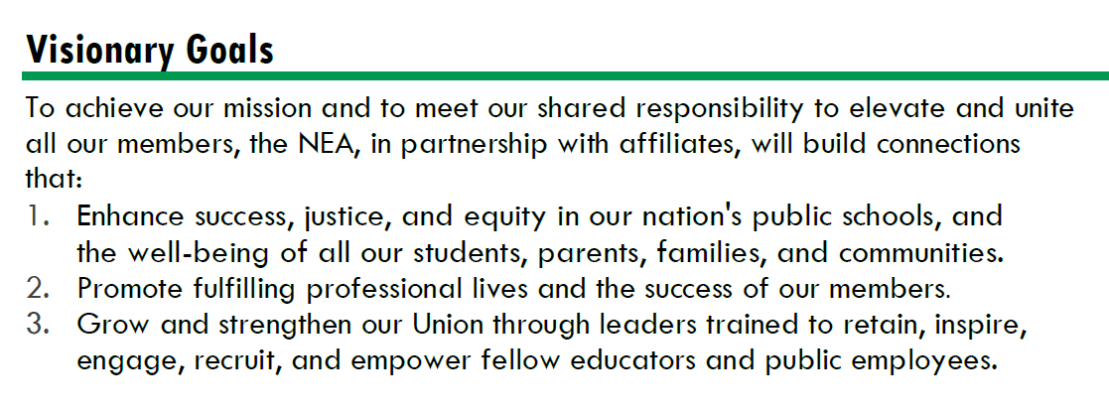




Strengthen Public Education as the Cornerstone of Democracy
Advance Racial Justice and Social Justice
Promote Healthy, Safe, Inclusive, Collaborative, and Future-Focused Public Schools
Improve Professional Respect and High Quality Working Conditions
Support Professional Excellence and Student Learning
Fuel the Transformation of Affiliate Organizational Capacity

Slide 33
By the Numbers
8 Face to Face Programs
  4 Foundations
  1 New Program
  4 Partnership Programs-
    CSRJ, CBMA, School Safety, ESPQ, Campaigns and Elections
1 Significantly Revised Foundations
TOTAL 416 Face to Face Participants
15 Online Programs
TOTAL 635 Online Registrants
1.1 Million Dollar Investment Over 1051 People and Us

Slide 34
Why This Work and This Team
325 out of 1778
817 to 714

Slide 35
Lucy and the Charts

Slide 36

Ending it Right
PLAN FOR BREAKFAST
Networking Shenanigans on Your Own

Slide 37
Facilitator Planning Meeting
Day 2

Slide 38
Please Have the Sharepoint Site
Open on Your Laptop

Slide 39
Community Agreements
Using Self-Awareness and Self-Knowledge
Listening for Understanding
Being Gracious
Staying Engaged
Being Open and Suspend Judgment
Saying “I”- tell your truth
Seeking Discomfort
Reaching Empathy
Expecting Non-Resolution and Non-Closure
*Adapted from “Embracing equity and inclusion”, Annie E. Casey Foundation
Notes:
Community Agreements for Our Time
Awareness and Self-Knowledge
This requires self-knowledge and self-awareness. Self-knowledge allows you to see what causes you pain and conflict and enables you to embrace your contradictions and inconsistencies. It allows the space to work on things about yourself that you are not happy with. In turn, self-knowledge helps to prevent you from projecting your negative aspects onto other people. Bringing your best self also requires that you have a positive attitude, are willing to deeply explore your perspectives and remain open to the perspectives and experiences of others.
Listening for Understanding
Be an active listener. Active listening involves paying full and careful attention to the other person, looking him or her in the eye, avoiding interruptions, reflecting your understanding, clarifying information, summarizing the other person’s perspectives and sharing your own. Remember that most people need time to open up and might not be willing to immediately share their personal stories, hopes, fears and/or concerns.
Being Gracious
Being kind is a vital way of bringing meaning to our own lives, as well as the lives of others. Kindness is about caring genuinely for others around you, wanting the best for them and recognizing in them the same wants, needs, aspirations and even fears that you may have. Being kind and generous allows us to communicate better with others, to be more self-compassionate and to be a positive force in other people’s lives. This includes following the COVID protocols that are in place to protect the health of this learning community.
Stay Engaged
Staying engaged requires you to be morally, emotionally, intellectually and socially involved in the conversation. Staying engaged means that you are listening with curiosity and willing to deepen your understanding. Staying engaged might also require you to sustain the conversation even when it gets uncomfortable or diverted. This also means a commitment to keeping your electronic communications to a minimum with folks not present in this learning community.
Be Open and Suspend Judgment
Listening with an open mind includes being receptive to the influence of others. You can suspend judgment by becoming aware of preconceived notions and listening to everything someone has to say before jumping to conclusions. Most importantly, suspending judgment also means listening to what the speaker has to say for understanding, not just to determine whether the speaker is right or wrong.
Say “I”- tell your truth
Speaking your truth in authentic and courageous conversations about race requires a willingness to take risks. It means that you will be absolutely honest and candid about your own thoughts, feelings, experiences and opinions and not just saying what you perceive others want to hear. Speaking your truth will require you to speak from the “first person” and use “I” statements.
Seek Discomfort
Leaning in to discomfort will require you to let go of racial understandings and stereotypes that you may be holding onto in order to move forward. Leaning in means that you will avoid judgment, assume positive intent and be open to the kernel of wisdom in each individual’s experiences. Leaning in to discomfort will require you to sit through moments of embarrassment, confusion, anxiety and/or fear.
Reaching Empathy
Empathy and compassion allow you to understand the other person’s point of view. When you are empathetic, you are more understanding, patient and kind. Expanding your capacity to feel empathy will also allow others to enter your circle of human concern.
Resolution and Closure
Expect and accept that there may not be closure. It is not likely that you will resolve your personal understanding about race or another person’s racial experience in a single conversation. The more you talk about race with another person, the more you learn and the more they will learn. Authentic and productive conversations about race are continuous and always evolving.
*Adapted from “Embracing equity and inclusion”, Annie E. Casey Foundation

Slide 40
3 Day Agenda
Days 1 and 2
7:30-8:30 Breakfast
8:30 Convene
10:15-10:30 Break
12:00- 1:00 LUNCH
2:15-2:30 Break
4:30- Networking
DAY 2
5:30- 7:00 Team Building
Day 3
7:30-8:30 Breakfast
8:30 Convene
Break on your own
12:00 Adjourn

Slide 41
Our
Outcomes
Day 1 Skill Building
Day 2 Presentation Teams, Content Teams, Team Building
Day 3 Finish, or Make Plans to Finish

Slide 42
Thinking about Presenting Teams
This is volunteer work
If you can’t say no, your yes has little meaning
When you drop out – a colleague has to drop in
10 Days
You work with your manager
Diverse in all ways
Team Lead
Alternates

Slide 43
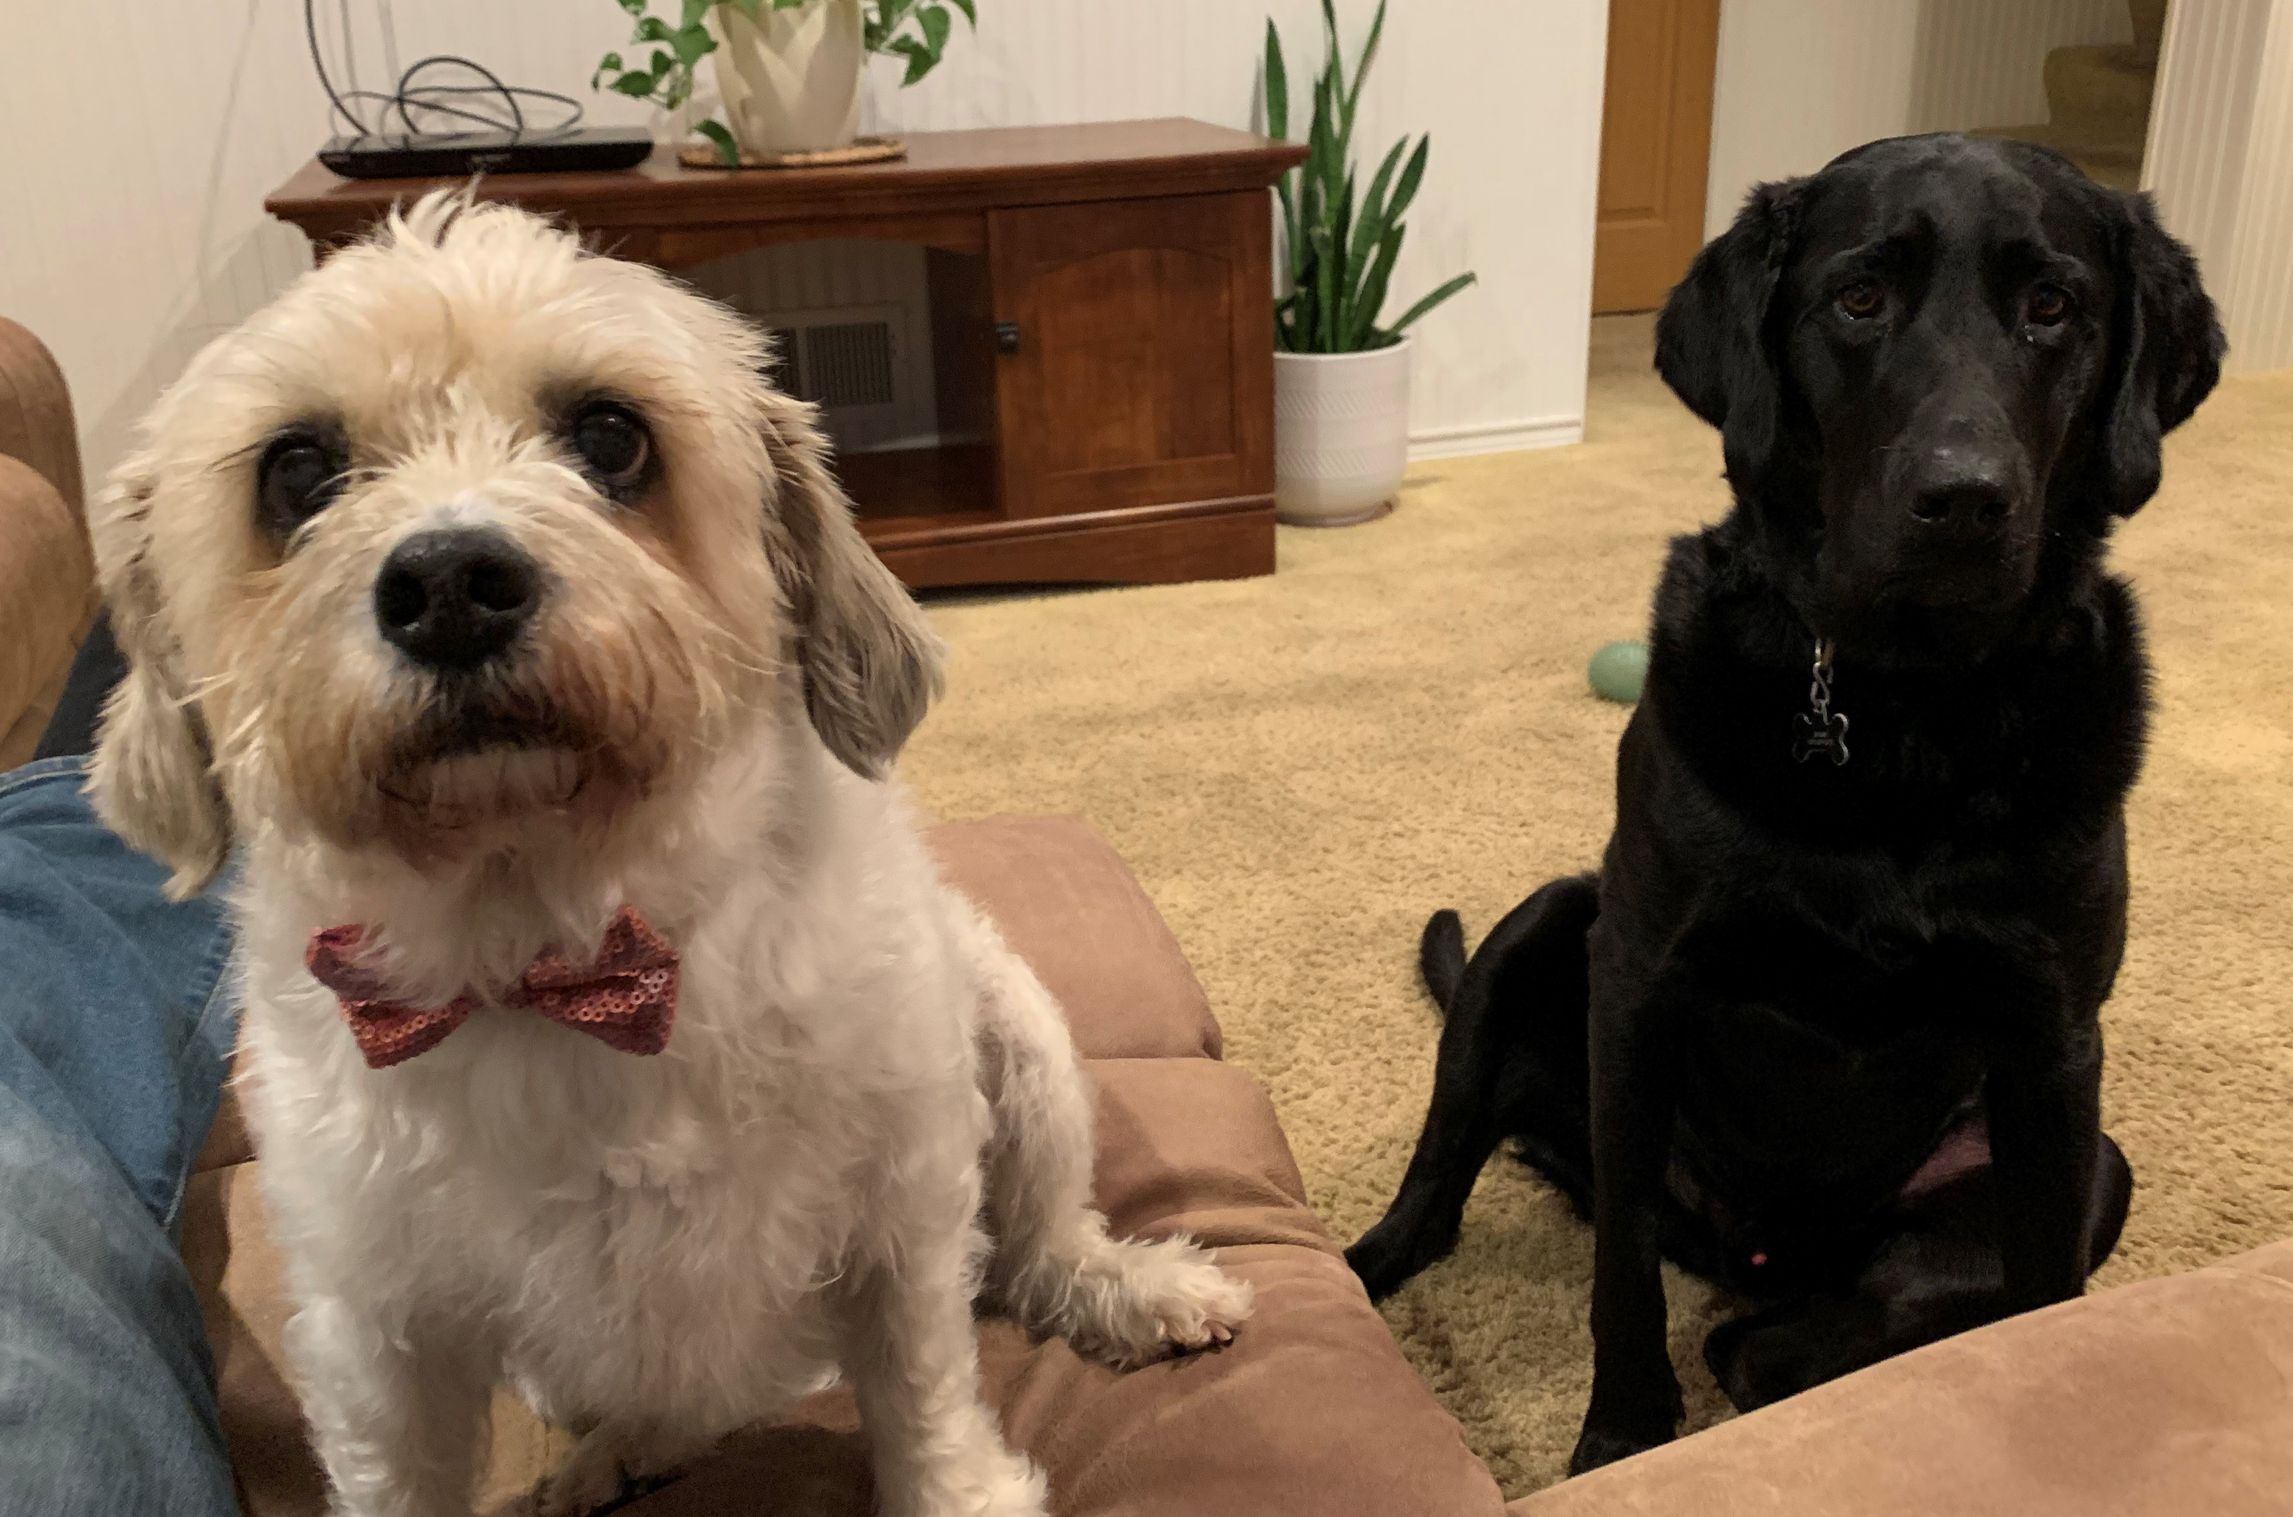
Adam & Vanessa
Team Formation!

Slide 44
The Goal
8 facilitators per event (9 for Foundations)
Each facilitator assigned to 2 trainings & serve as an alternate on at least 1
Each training has priority alternates
Each facilitator is able to facilitate at their first, second, and/or third choices (no guarantee)
Each team is diverse, in aspects of identity, state dynamics, etc.

Slide 45

The Process- Round 1
All in-person programs are posted around the room
Everyone will go to a program for which they wish to be a facilitator.

Slide 46
The Process- Round 1- Continued
If there are 9 or more interested in facilitating that program:
  First, anyone can move to a program that has less than 8, or if that doesn't happen...
  Next we will look at the makeup of the group and consider if anyone could move to maintain broad representation, and...
  Last we’ll have the group figure out who moves.
Anyone who leaves to find another program may first write their name as a “priority alternate”. ​
We will repeat this for each program with 9 or more facilitators. ​
Once each group has 8 or fewer facilitators, all will write their names as facilitators.

Slide 47

Process- Round 2
Wash, Rinse, Repeat...
Go to the program for which you wish to facilitate
  If there are already 4 facilitators listed, then the same rule applies for determining the remaining 4 facilitators.
  Should someone move to a new choice, they can place their name as a priority alternate.

Slide 48

Process- Round 3
All facilitators can place their name as alternates on all of the programs there are able and willing to facilitate

Slide 49
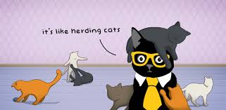
Process- Round 4
Team Leads!
  Each team needs to designate a team lead
  For Foundations, there needs to be a team lead and a worksite organizing lead
  We will do this one team at a time, since we all serve on 2 teams

Slide 50
Content Team Work Time

Slide 51
Process and Resources
Spreadsheet with your content teams
Outcomes (besides those sent to your group in advance)
  Handouts
  Review the facilitator notes for suggestions, and change size of slides
  Review of the Evaluations
  Review of any content that might support it
Face to Face First
Online Next – everyone is going to be putting their Pre-Attendance on line

Slide 52
Progress Report

