Slide 1


Addressing Bias
Co-facilitated by Shelly Clements and Lucy Griswold

Slide 2
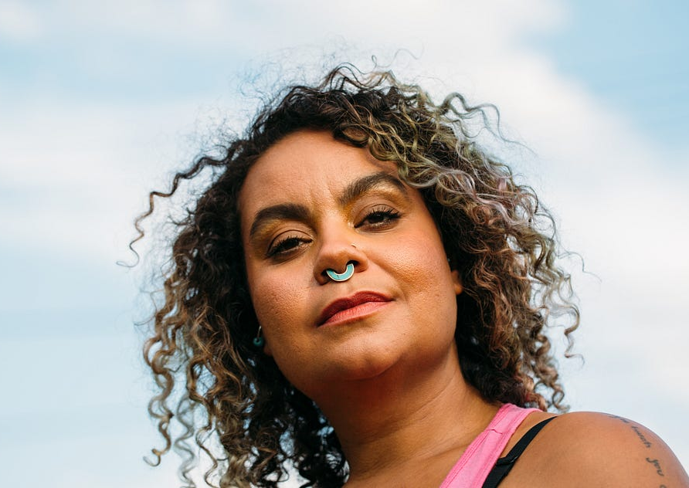
adrienne maree brown
“[Facilitators] are called to hold containers in which life transforms and the future unfolds.

Slide 3
Journaling Questions:
Who are you and what do you bring to any room you enter as a facilitator?
Who is your facilitation lineage?
Where are you still growing and learning in your facilitation?
How do your values come to life in your facilitation practice?

Slide 4
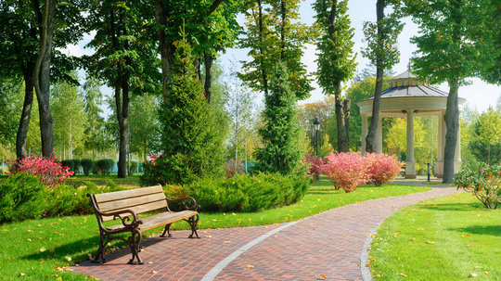

Notes:
A Walk in The Park Activity
Guided fantasy: A walk in the park (adapted from Dundalk Outcomers Facilitator’s Pack)
Procedure for Guided Fantasy: Ask the group to sit in a circle, and slowly talk through the following guided fantasy; play birds chirping audio once eyes are closed; keep the pace of the exercise slow and calm:
Close your eyes. Take a minute to imagine yourself in a public park. Just for now it is empty of people. It’s a warm summer’s day, the trees are heavy with leaves and the sun breaks through to make you feel warm. There is a slight breeze; you can feel it on your face. As you look forward you can see a path winding its way far into the distance. Around the path there are followers, grassy patches of cut grass and large leafy trees. The only sound is of birds singing. You hear the birds and smell the freshly cut grass; you feel the heat of the sun and are refreshed by the slight breeze. You look in front of you and decide to follow the path. You begin to walk and you move along the path and hear human voices in the distance. You look first to your right and then to your left, you notice a young child kicking a football. The child throws the ball into the air and catches it as it falls. You notice the ball fall hard into the child’s hands. Two people are playing with the child – you smile and wave towards them noticing the smiles on their faces. You continue to walk around some large trees and pass two people sitting on a bench. They are laughing loudly – you try to hear what they are saying. You move again along the path and see a couple walking towards you holding hands. They walk past you as you look at them. As you walk on a number of men are sitting on a bench by the path, talking and laughing – you look at them one by one. As you walk on you are nearing the gate of the park, you walk through the gateway and in front of you, you see this building (make relevant to environment). You walk into the building and then into this room. You sit on the chair and feel it under you. You begin to slowly open your eyes and come back into the group when you are ready.
Key Questions for Discussion:
– When you saw the child with the ball, was the child female
– The two people you saw with the child, did you imagine them to be the child’s parents?
– The two people sitting on the bench: what did they look like? Were they white and able-bodied?
– The couple holding hands that were walking towards you; were they an old or retired couple, were they able-bodied, were they non-white, were they two women or two men?
– The group of men on the bench, were they young or old, were they able-bodied, and were they white?
– Did anyone in your park wear clothing or jewelry which made you think they were from a different culture?
- Was everyone in your park: – White? – Able Bodied? – Young or middle-aged? – Were there couples of the same sex
– Were there any retired or old people in your park?
– Were there different ethnic groups in your park?
Final debriefing questions:
– Why do you think that you saw the park in that way?
– How do you think that the way we see the world influences our work

Slide 5
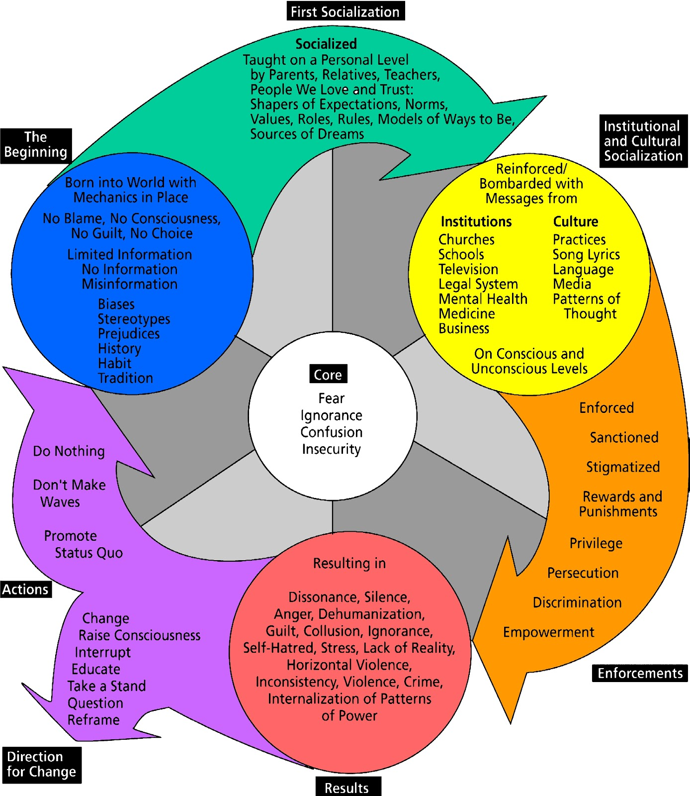
Cycle Of Socialization
Source: Cycle of Socialization developed by Bobbie Harro
Readings for Diversity and Social Justice, © Routledge, 2000
Notes:
Review fundamental concepts:
Unconscious
Normal attribute
Manifest in behaviors; influences behaviors
Understanding how implicit bias can affect perceptions and behavior is the first step to overriding implicit bias
Socialized several levels – earliest experiences at home and then the institutions we move through on a daily basis / the

Slide 6

Cognitive Biases – race/gender/ability
Affinity bias = natural tendency to warm up to people who we think are like us
Out-group homogeneity Bias = we perceive out-group members as homogenous and our own in-group as more diverse
Blind spot bias = we don't think we have bias, and we see it in others more than ourselves
Examine and challenge your "gut feelings"
Notes:
Script: Unconscious biases are learned stereotypes that are automatic, unintentional, deeply ingrained, universal and able to influence behavior. Unconscious bias is far more prevalent than conscious prejudice and often incompatible with one’s conscious values. Certain scenarios can activate unconscious attitudes and beliefs. For example, biases may be more prevalent when multitasking or working under time pressure, like when you are facilitating a workshop.
Means of simplifying information, by finding shortcuts and making generalizations that help us navigate interactions.

Slide 7

Key Points
Recognize your own human biases
Understand how it affects your perception and behavior
Develop the skills and tactics to reduce the influence

Slide 8
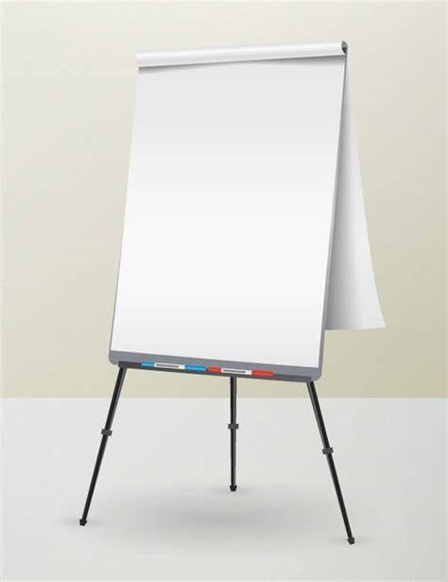
Charting Activity:
Expressions of Facilitator Bias
Draw a T-chart on your poster. Label the left side, "Examples of facilitator bias" and the right side "Response/Prevention".
Left side: List examples of how facilitator bias shows up.
Right side: For each example, identify how you might respond to or prevent that expression of bias.

Slide 9
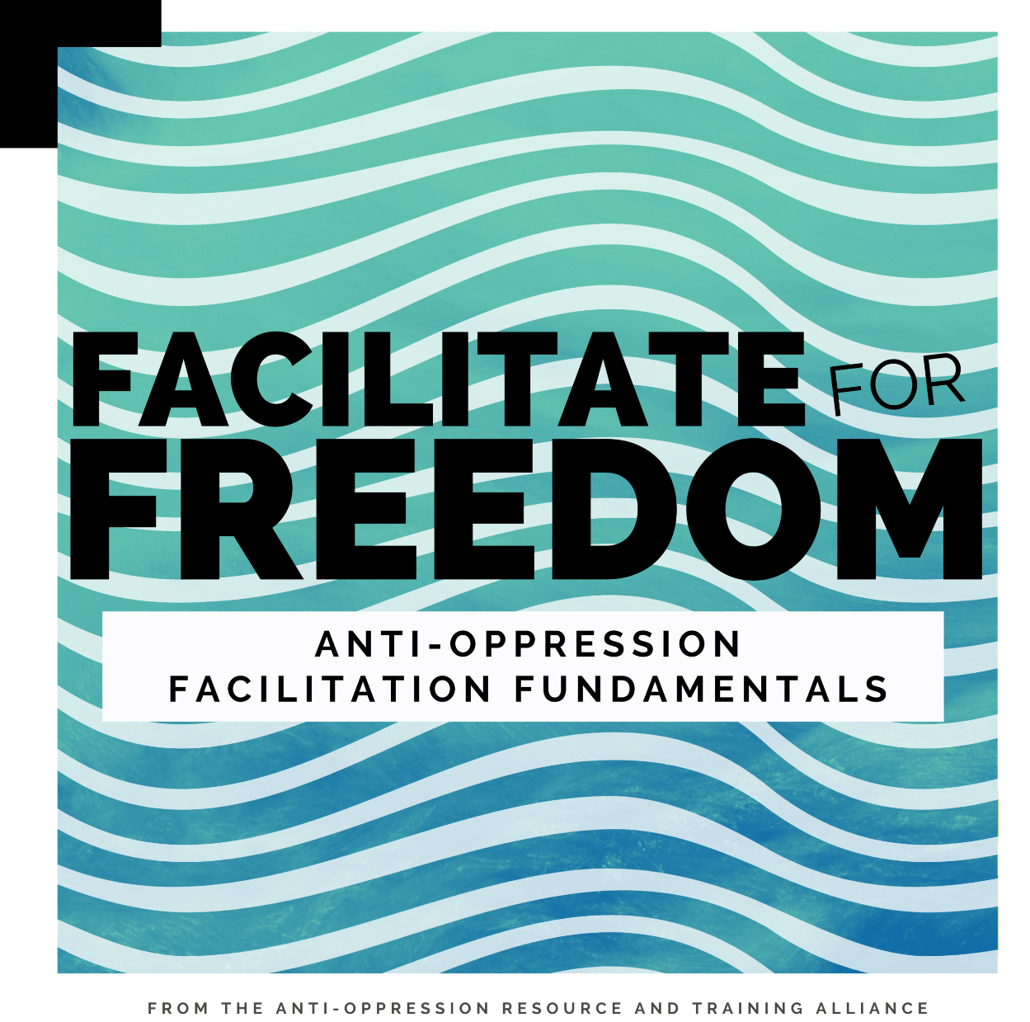

Responding to Facilitator Bias
Expect mistakes, practice repair
Practice a culture of learning / calling in on your facilitator team
Ask for feedback
Continue Learning:
  BOOK: bell hooks: Teaching to Transgress
  COURSE: AORTA Coop: Anti-Oppressive Facilitation Fundamentals

Slide 10
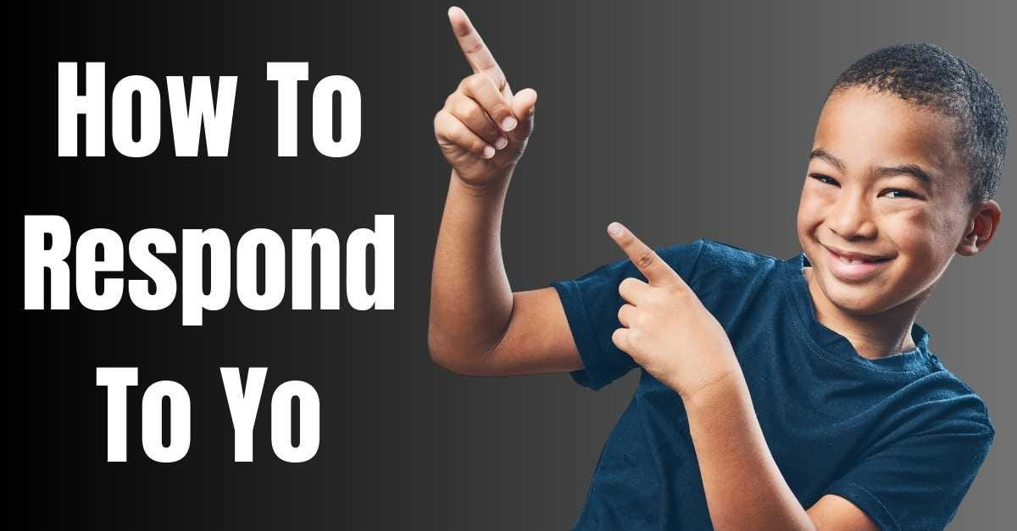
Participant Bias
Notes:
There is no one right way to respond

Slide 11
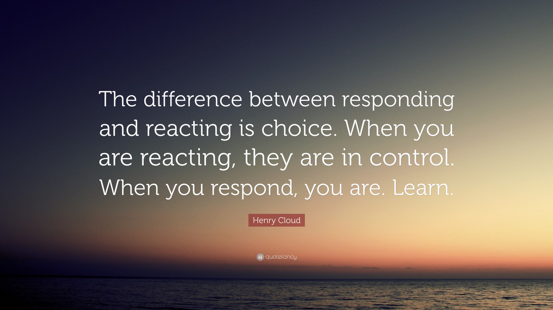
Notes:
The difference between Reacting and Responding:
Reacting = impulsive, out of emotions & fear, short-sighted and often irrational
Responding = intentional, out of love & respect, sees the bigger picture long-term, and most importantly is exercising self-control

Slide 12
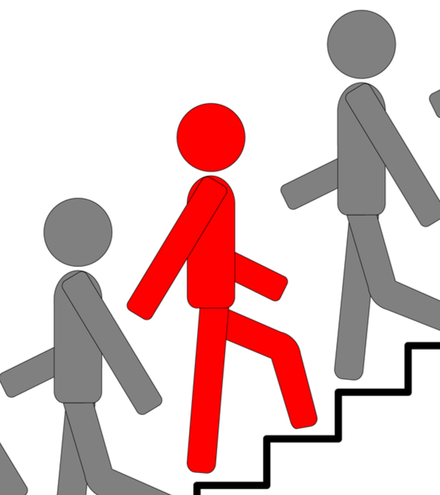
Responding to and Redirecting Resistance
Why it is necessary
When we avoid conflict and play it safe:
Maintaining white solidarity by staying silent
Not challenging thinking
Leaving people of color to deal with the racism

Slide 13
Responding to and Redirecting Resistance
Challenges and Creative Approaches
There are ten (10) situations on the walls around the room.
Each represents challenges that facilitators may encounter when training.
With your team, visit each challenge and brainstorm how to respond. Write your ideas in the space provided.
Notes:
Problems/Challenges:
Trying to keep things too safe/comfortable for those who need to get uncomfortable
The tone of the resistance became very aggressive, but then became passive-aggressive
“This doesn’t matter” “Why do we have to talk about ...?” (dismissive)
When the leadership is silent…(allows other staff to disengage)
When folks feel that because they are working in a majority White space---that means they don't need to do this work
When folks feel that because they are working in a majority BIPOC space--that alone means they don’t need to do this work
Having someone get up and storm out
When white male voices are most dominant in the session.
When you observe people who appear to be uncomfortable speaking up.
When Black female voice is most dominant in a session

Slide 14

Creative Approaches
Time Remaining

Slide 15
Tips and Tactics
Cannot stress enough the importance of interrupting, even when the tendency is to be laid back…we need to be assertive and jump in
As a starting place, one can say: “What do you mean by that?” Often folks are not able to back up their statement, so it tends to shut down the resistance effectively
‘Preview’ conversations (pre-exposure to potential “difficult comments” that might occur) with the leadership/team, so that you have the tools to address what may come up during trainings
Reminders to participants of impact vs. intent and that what is “heard” is important
Have clear norms at the outset
Pause when something comes up
Icebreaker activities to improve relationships early
Gather with like-minded people and strategize before and during meetings where we think things might come up

Slide 16
Calling People In vs Calling People Out
Cityline video
https://youtu.be/tAW2-ganAZ4?si=fZD-otlr0hSMMir0

Slide 17
Key Points
Responding is intentional, out of love & respect, sees the bigger picture long-term, and most importantly is an exercise of self-control
Advance team preparation is key – be proactive
Allies essential actors when it comes to calling in

Slide 18
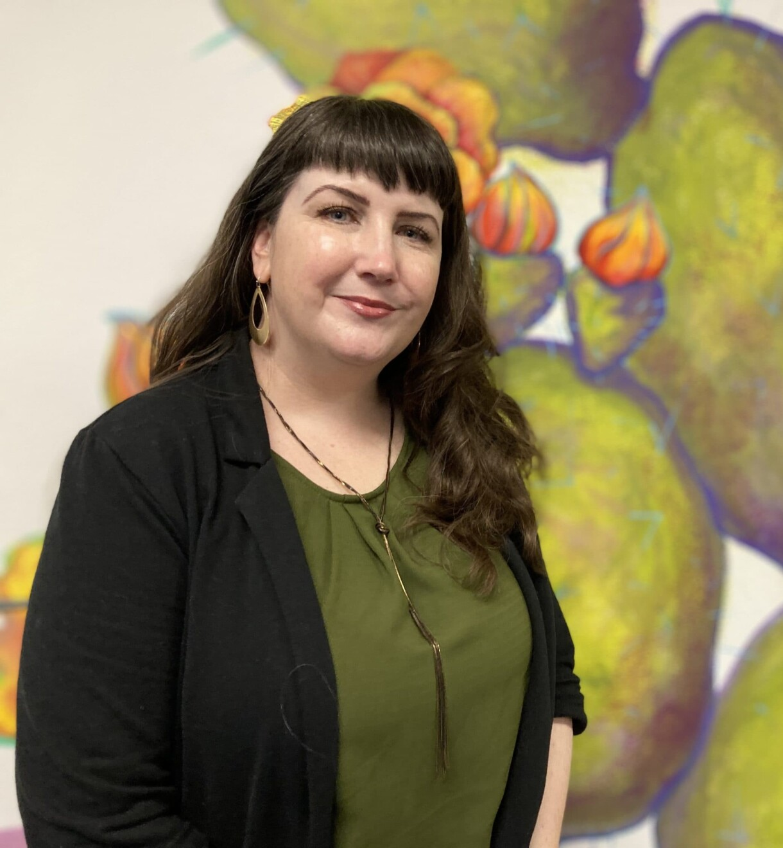
There is no such thing as a “safe space” —
We exist in the real world.
We all carry scars and have caused wounds.
This space
seeks to turn down the volume of the world outside,
and amplify voices that have to fight to be heard elsewhere,
This space will not be perfect.
It will not always be what we wish it to be
But
It will be our space together,
and we will work on it side by side
Untitled Poem by Beth Strano

Slide 19

Questions, Connections, Reflections

