Slide 1

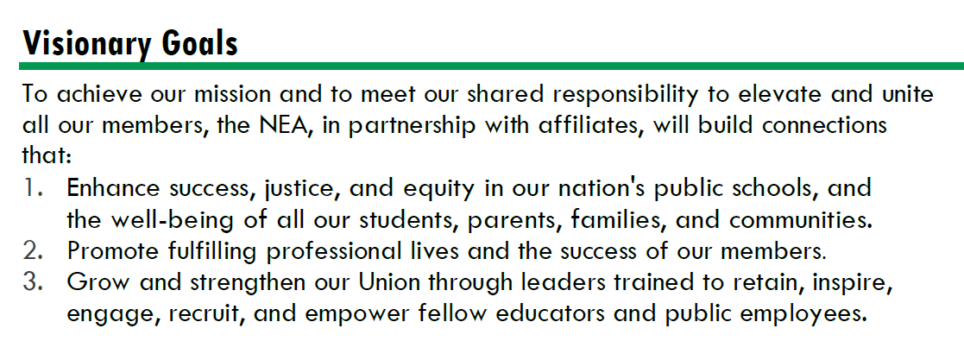
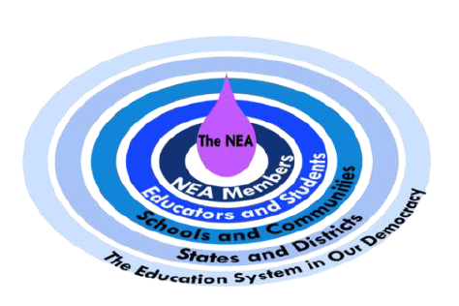



Strengthen Public Education as the Cornerstone of Democracy
Advance Racial Justice and Social Justice
Promote Healthy, Safe, Inclusive, Collaborative, and Future-Focused Public Schools
Improve Professional Respect and High Quality Working Conditions
Support Professional Excellence and Student Learning
Fuel the Transformation of Affiliate Organizational Capacity

