Slide 1
Best Practices for Online Learning

Slide 2
What We Are Not Talking About...
Fancy graphic design applications
Specific presentation/PD platforms
Branding guidelines
Our good friends in Comms

Slide 3
What We Are Talking About...
Learning design principles
Why digital learning is important
Digital vs in-person learning
Our good friends in IT

Slide 4

Digital Learning Design Philosophy
Information
Curate – Information is a commodity, so the info you select must have added personal value.
Experience
Engage – You control the entire experience, build a play with intermissions and speak to the senses.
Time
Focus – 90 minutes is the new 6 hours. 90 minutes is the limit of sustained concentration. 2-3 big points max.
Utility in Context
One Cool Thing – Create the starting point that allows them to do one cool thing tomorrow. They got it from there.

Slide 5
Why Should I Care About Digital Learning Design?
Let’s examine the benefits of delivery modes as staff
Group
Activity
In-Person
Digital

Slide 6
Building The Experience
Every good story/lesson utilizes a structure that forms and guides the experience. Social Emotional frameworks help us evaluate the components of the structure for optimal experience.
[Pedagogical]
4-E Framework
5-E Instructional Framework
Backward Curriculum Design
Conversational Framework
[Narrative]
Classic Story Structure
Hero’s vs Heroine's Journey
Three Act Structure
Seven Point Story Structure
[Social Emotional]
SCARF
UDL
Partnership Principles
Notes:
Resources:
https://blog.reedsy.com/guide/story-structure/
https://thedecisionlab.com/reference-guide/management/4e-framework
https://knowledgequest.aasl.org/the-5-es-of-inquiry-based-learning/
https://images.squarespace-cdn.com/content/v1/6348398d9d21fd6277c64f96/cb44e48e-c86b-4588-bcc4-d219a56d4b7f/scarf+model+david+rock+diagram.png
https://udlguidelines.cast.org/
https://www.ascd.org/el/articles/seven-principles-for-true-partnership
https://www.dropbox.com/scl/fi/cn8d5uh8euaplzmtrjh2p/Part-1-5-E-for-Trainers-CLL.pdf?rlkey=5qk2083ecuhs3ory2j3gqn3sw&st=ycke3hx1&dl=0

Slide 7
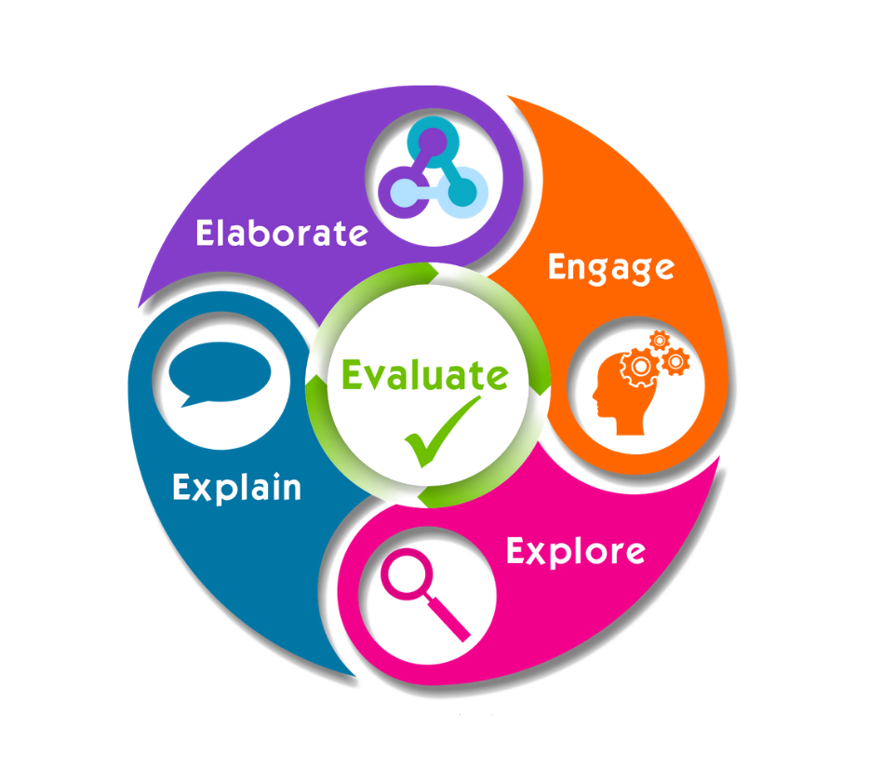
5E Instructional Model
Pedagogy
Engage
  Novel, Emotional, Descriptive
Explore
  Prior knowledge
Explain
  The big idea(s)
Elaborate
  Activity
Evaluate
  Reflection and context

Slide 8
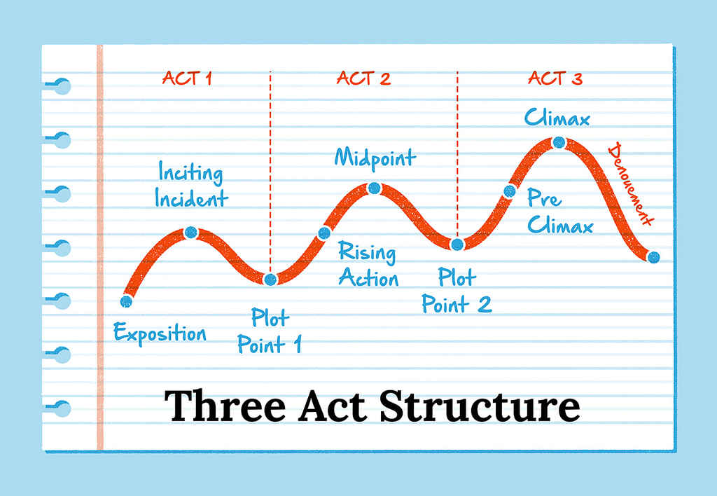
5E Instructional Model
Narrative
Notes:
Hero vs Heroine journey

Slide 9
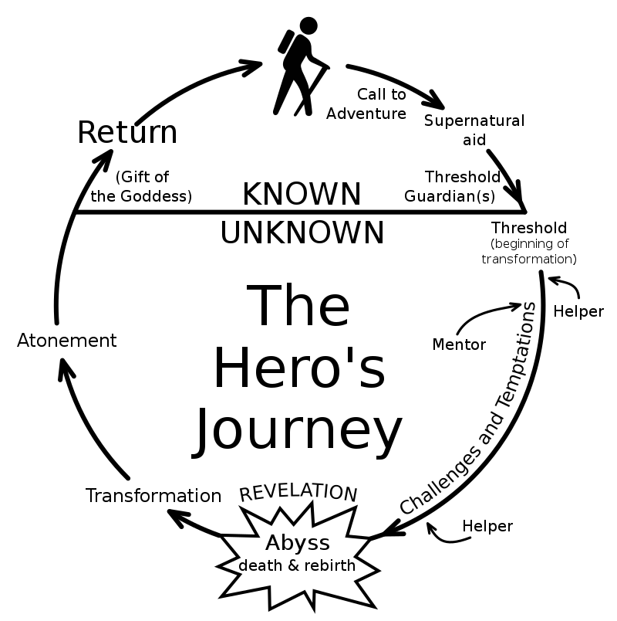
Increasingly isolated protagonist stomps around prodding evil with pointy bits, eventually fatally prods baddie, gains glory and honor
~ The Heroine's Journey by Gail Carringer
Act 1
Ordinary world
Call to adventure
Refusal of the call
Act 2
Beginning of transformation
Challenges and temptations
Revelation
Reward
Act 3
The road back
Returns often alone after much personal sacrifice and loss but victorious

Slide 10
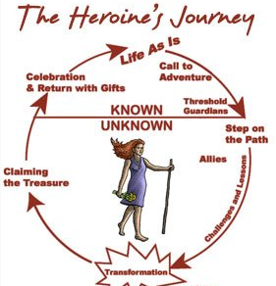
Increasingly networked protagonist strides around with good friends, prodding them and others to victory, together.
~ The Heroine's Journey by Gail Carringer
Act 1
Pleas ignored
Call to action
Act 2
Search
Allies
Delegation, networking and information gathering
Act 3
Negotiation for reunification
Involuntary withdrawal
Broken familial network
Companions
Revenge and glory irrelevant
Rebuilding with allies

Slide 11
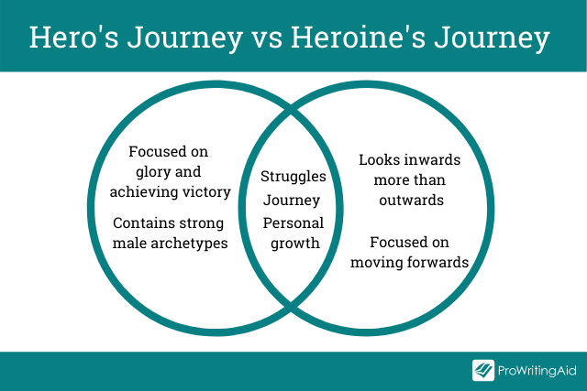

Slide 12
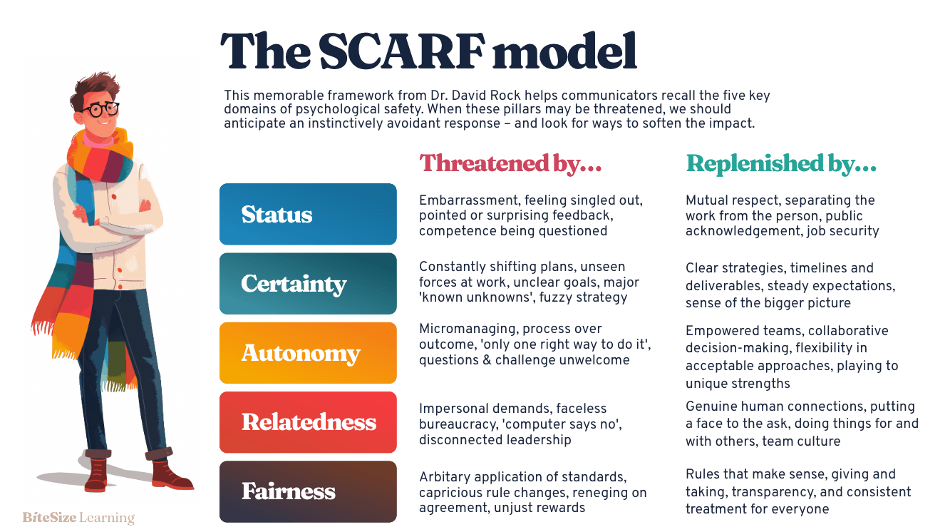
Social Emotional
Notes:
Examples of Digital Learning-Brandy

Slide 13
SCARF Activity (15 minutes)
Adapted from: David Rock’s, SCARF activity
Individual Reflection (2 min)
  Read the “Classroom Management 101” Example
  Think about each domain, what is happening in the example that threatens well-being, and how you would adjust to support well-being
Partner Conversation (10 min)
  Discuss each domain and talk about what is happening in the example and how you would adjust for a more positive professional development experience.
Share: (5 min)
  Each team will share 1 thing they would change and why
Notes:
https://neahq.sharepoint.com/:w:/r/sites/NationalUniServandOrganizerProgramMaterials/_layouts/15/Doc.aspx?sourcedoc=%7B12FF7FAD-8FDE-411F-BF22-8507FE08BFC7%7D&file=SCARF%20Activity%20Template.docx&action=default&mobileredirect=true

Slide 14
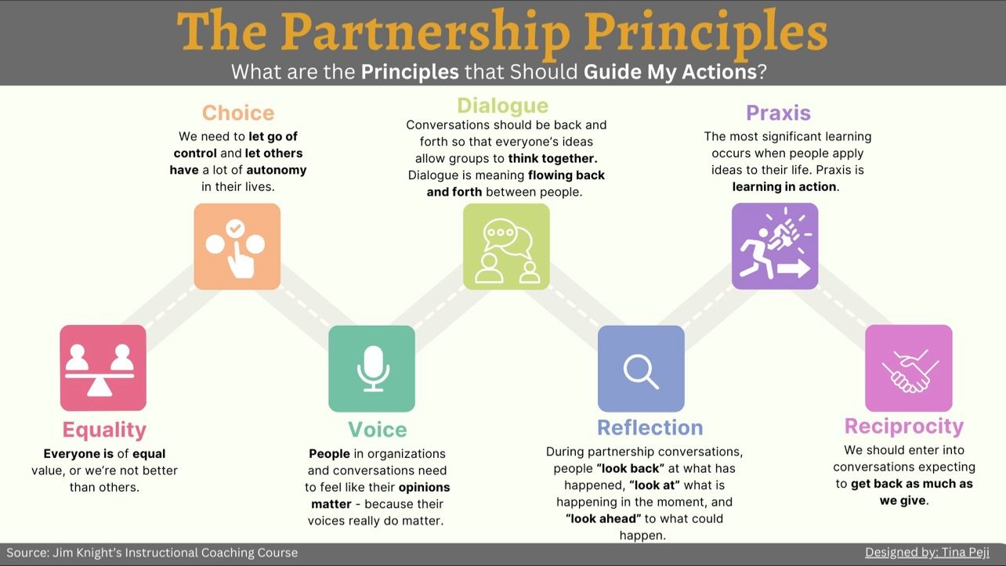

SCARF
Social Emotional

Slide 15
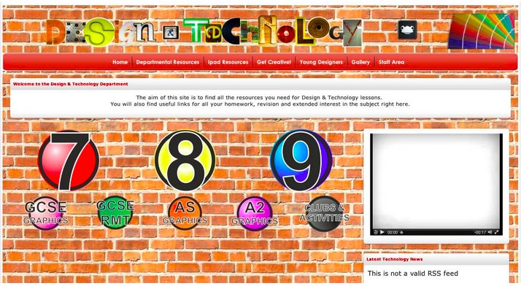
Digital Design Errors To Avoid
Using only words (no graphics) on slides/modules
Using images/graphics that don’t relate or add to the content
Presenting questions and feedback on separate slides/modules
Presenting directions and activities on separate slides/modules
Mismatching graphic complexity with concept simplicity
Visual elements don’t lead the eye

Slide 16
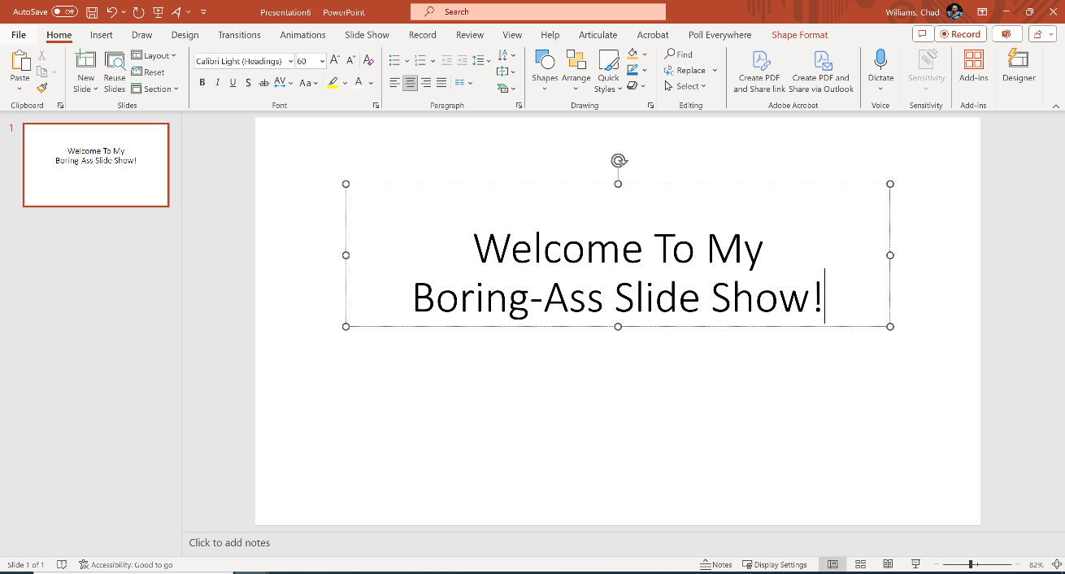
Digital Design Errors To Avoid
Using only words (no graphics) on slides/modules
Using images/graphics that don’t relate or add to the content
Presenting questions and feedback on separate slides/modules
Presenting directions and activities on separate slides/modules
Mismatching graphic complexity with concept simplicity
Visual elements don’t lead the eye

Slide 17
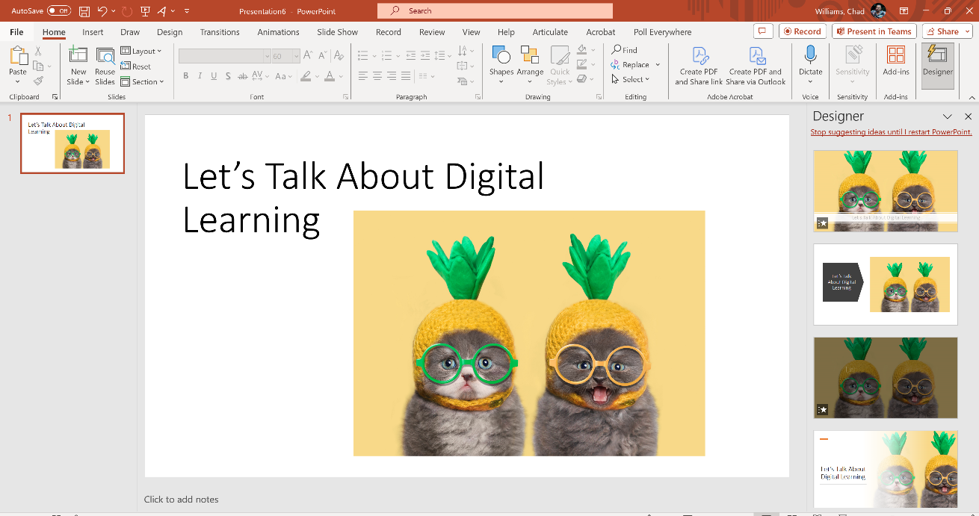
Digital Design Errors To Avoid
Using only words (no graphics) on slides/modules
Using images/graphics that don’t relate or add to the content
Presenting questions and feedback on separate slides/modules
Presenting directions and activities on separate slides/modules
Mismatching graphic complexity with concept simplicity
Visual elements don’t lead the eye

Slide 18
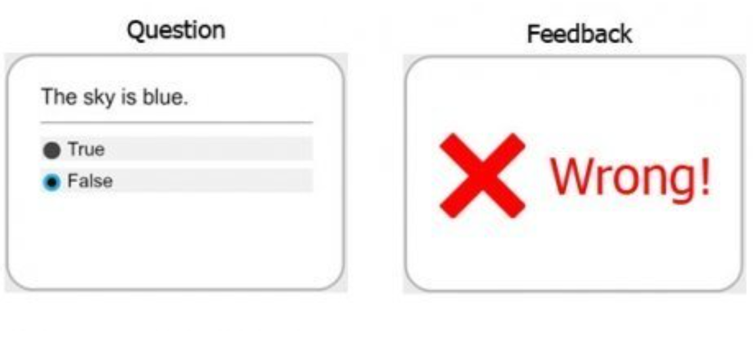
Digital Design Errors To Avoid
Using only words (no graphics) on slides/modules
Using images/graphics that don’t relate or add to the content
Presenting questions and feedback on separate slides/modules
Presenting directions and activities on separate slides/modules
Mismatching graphic complexity with concept simplicity
Visual elements don’t lead the eye

Slide 19
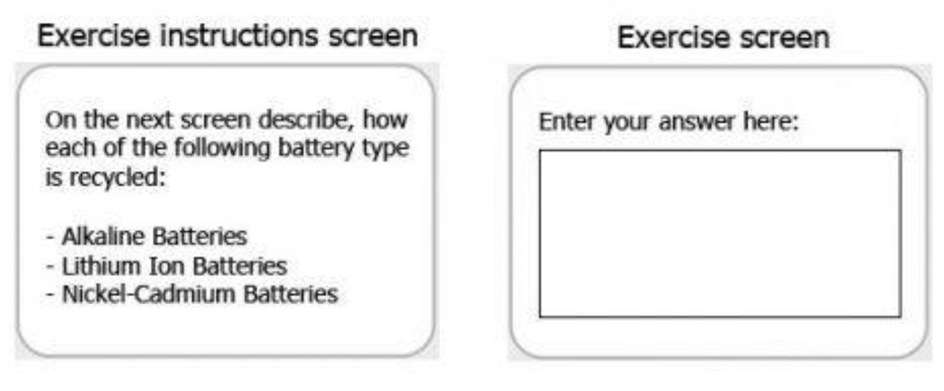
Digital Design Errors To Avoid
Using only words (no graphics) on slides/modules
Using images/graphics that don’t relate or add to the content
Presenting questions and feedback on separate slides/modules
Presenting directions and activities on separate slides/modules
Mismatching graphic complexity with concept simplicity
Visual elements don’t lead the eye

Slide 20
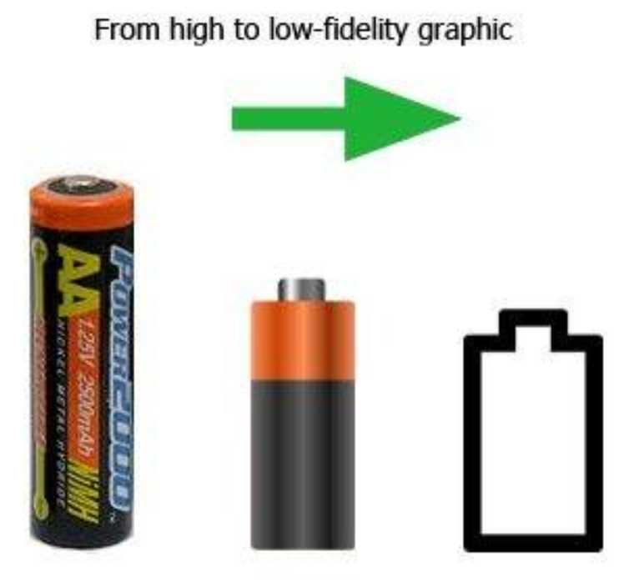
Digital Design Errors To Avoid
Using only words (no graphics) on slides/modules
Using images/graphics that don’t relate or add to the content
Presenting questions and feedback on separate slides/modules
Presenting directions and activities on separate slides/modules
Mismatching graphic complexity with concept simplicity
Visual elements don’t lead the eye

Slide 21
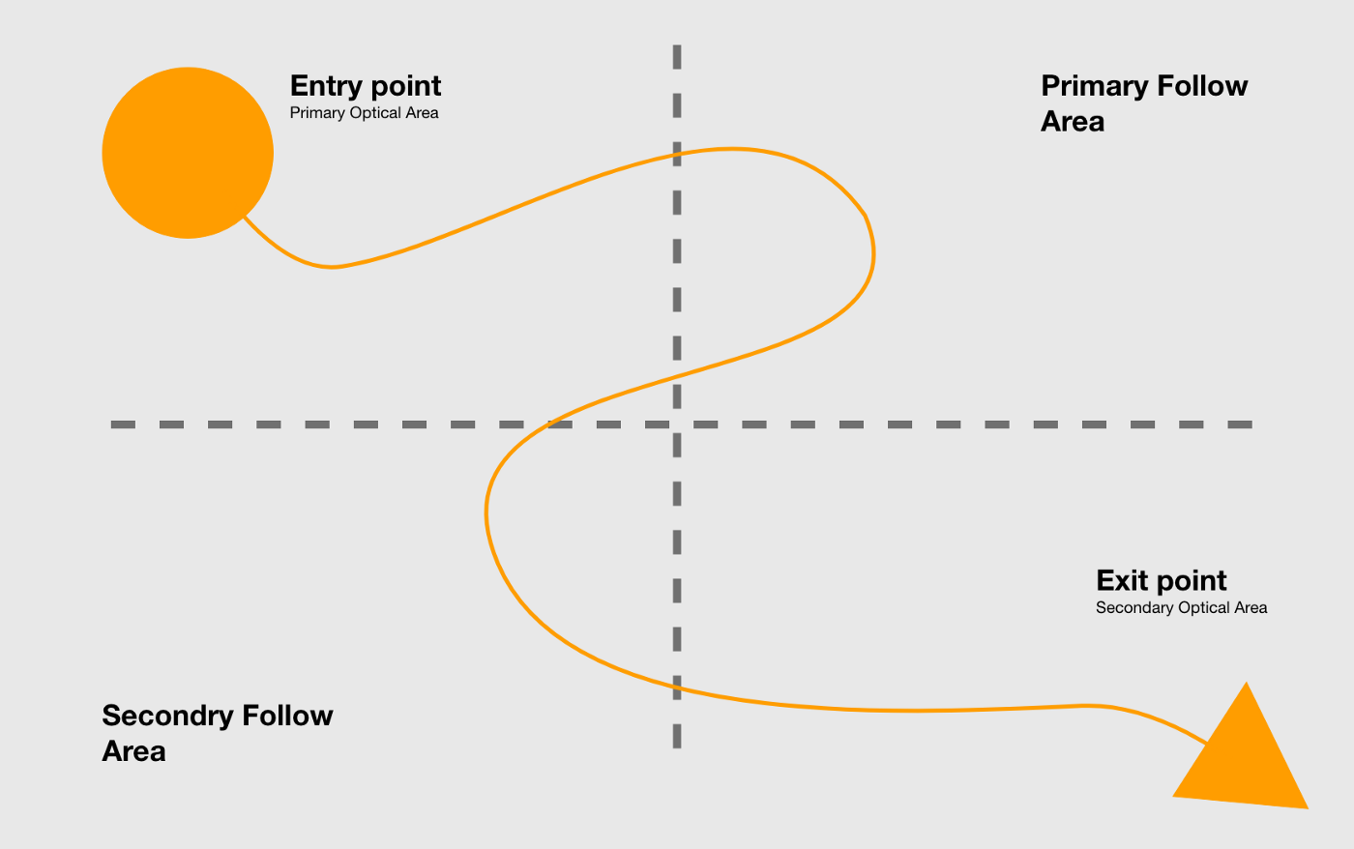
Digital Design Errors To Avoid
Using only words (no graphics) on slides/modules
Using images/graphics that don’t relate or add to the content
Presenting questions and feedback on separate slides/modules
Presenting directions and activities on separate slides/modules
Mismatching graphic complexity with concept simplicity
Visual elements don’t lead the eye

Slide 22

Learning Ecosystem
Where are we learning...
  In-Person Events
  Professional Learning Communities
  Digital Forums
  Hybrid/Blended Learning
Online- Informal
  Job Aids
  Knowledgebase
  System Libraries/ Repositories
  Video Aids
  Manuals
  Online Help
Social
On Demand
  Online Repositories
  Virtual Sessions
  Synchronous/
  Asynchronous Courses
Mobile
Personal
  Mentoring
  Coaching
  (ILT) Instructor Led Training
Online- Formal
  NEAe3 Learning Management System
  Micro-learning
Notes:
These are the main modes of learning and there’s some overlap in these. There’s some bleed over between Social Learning and Personal Learning. Between On Demand/Online and Formal.
We design learning differently depending on how our learners are going to experience it.
Some, like the social platforms, leverage the learners’ intrinsic motivation and autonomous learning rather than a top-down “push” approach.

Slide 23

Online Learning Ecosystem
What’s needed for successful e-learning...
Content Creation
Digital Learning Delivery
Learning Gateways
  NEAe3 – NEA’s Enterprise LMS
  NEA Micro-Credentials
  *Knowledgebase
  SCORM files
  Reference Materials
    Job Aids
    User Guides
    How-to videos
    Toolkits
    Videos
  Surveys
  Certificates
  Storage - secure, shared drive
Course
Creation & Mgmt
Promotional Pathways
  NEA and Affiliate websites
  Social Media
  In person - conferences, events, site visits, flyers
Learning Analytics
Learning Metrics Sources
  NEAe3 LMS Data
  NEA Micro-Credentials
  Cvent Data
  Join Now
  Web Conferencing Tools
  *Knowledgebase
  Authoring Tools (SCORM)
    Articulate Rise & Storyline
  Power Point/Presenter
  Video
  Graphics
  Animation
  Audio
eLearning Design
Data360 – Analysis & Reporting
  *Data360 – Analysis and Reporting
  NEA360
Learning Strategy
   Define Goals  Align with business strategy  Determine measures
* Future roadmap
Notes:
When approaching online learning creation, in addition to the pedagogy and content, there’s the mechanics and technology we use.
Here we employ a variety of technological tools to create, deliver, promote, analyze and report on the learning course or program. Online learning excels at gathering qualitative vs quantitative data that can inform our decision-making and our strategy on how best to support our learning audiences.

