Slide 1


NEAe3 Show Me Session
Teacher Quality
Brandy Bixler
Luis-Gustavo Martinez

Slide 2
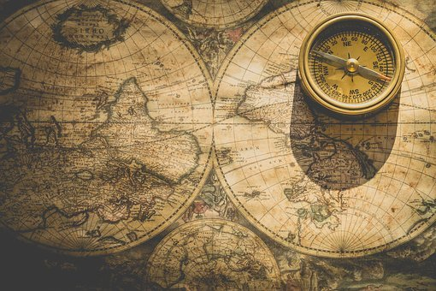
Please chat a greeting, your department and where you are zooming in from.

Slide 3
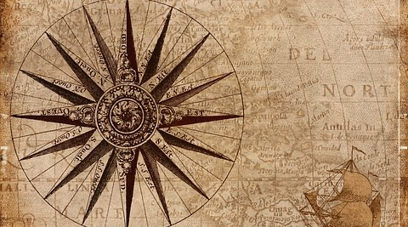
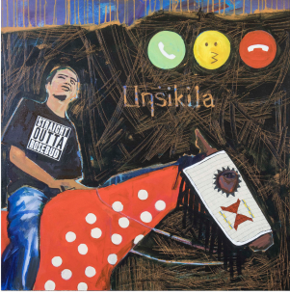
DID YOU KNOW? “There are 567 federally recognized Indian Nations (variously called
tribes, nations, bands, pueblos, communities and native villages) in the United States...
Additionally, there are state recognized tribes located throughout the United States
recognized by their respective state governments.”
Learn more from the National Congress of American Indians.
Takunsa Unsiklia
By BraveHeart
(Oceti Sakowin: Oglala Lakota)
Notes:
“I would like to acknowledge that I am joining this meeting from the traditional lands of the Cheyenne, Arapaho and Ute People, and pay my respect to elders both past and present.”

Slide 4

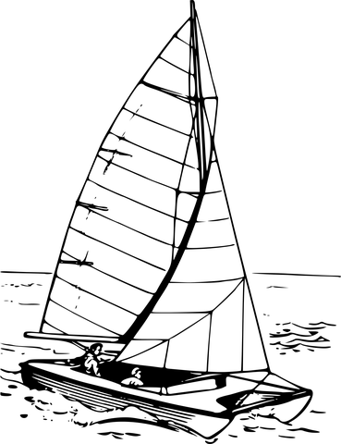
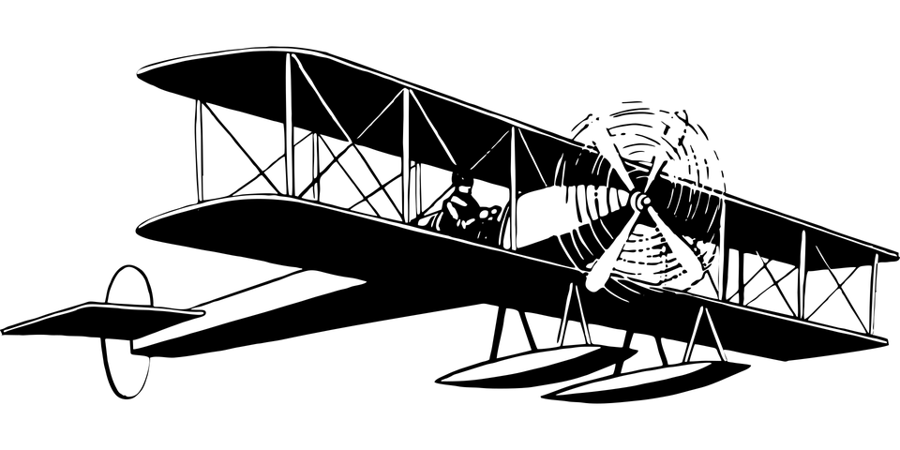
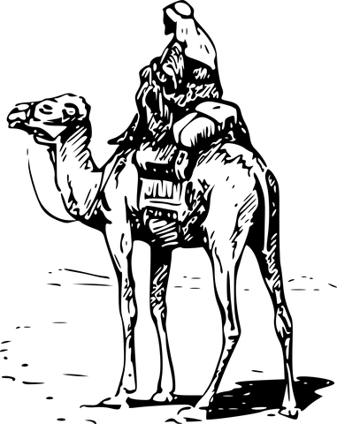
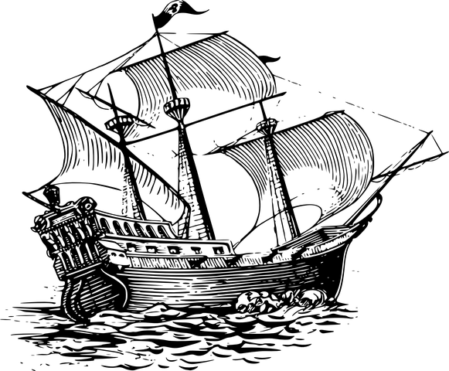

Journey Through the Land of Learning:
2020-2022
Chapter 1:
Desert of Desolation
Chapter 2:
Ocean of Opportunity
Chapter 3:
Continent of Chaos and Creation
Chapter 4:
The islands of improvement
Chapter 5:
The Sea of Standardization
2019-2020
2017-2019
2016-2017
2016

Slide 5
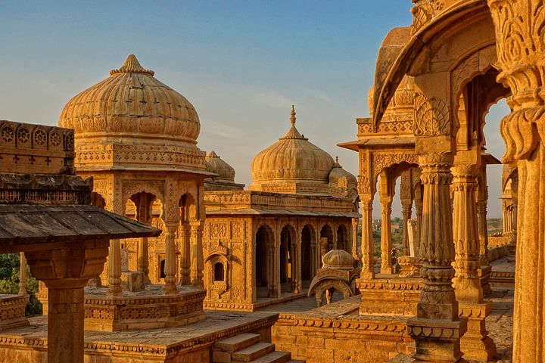

Dome of Content Development
Conception
Planning
Writing
Copy editing
Development
Publish
Affiliate Needs
NEA Priorities
Policy
Member Needs

Slide 6

Dome of Content Development
Conception
Planning
Writing
Copy editing
Development
Publish
Small group of content experts
1-2 meetings
Decide on big ideas
Plan logistics

Slide 7

Dome of Content Development
Conception
Planning
Writing
Copy editing
Development
Publish
Members
A state/local team
A national team
20 hours each course

Slide 8

Dome of Content Development
Conception
Planning
Writing
Copy editing
Development
Publish
Important
Consultant
Staff
Stylistic consistancy

Slide 9

Dome of Content Development
Conception
Planning
Writing
Copy editing
Development
Publish
Rise
Storyline
InnoVersity
Staff

Slide 10

Dome of Content Development
Conception
Planning
Writing
Copy editing
Development
Publish
NEAe3 (LMS)
Add to portal library
Create Course
Publish to Catalog or Store

Slide 11
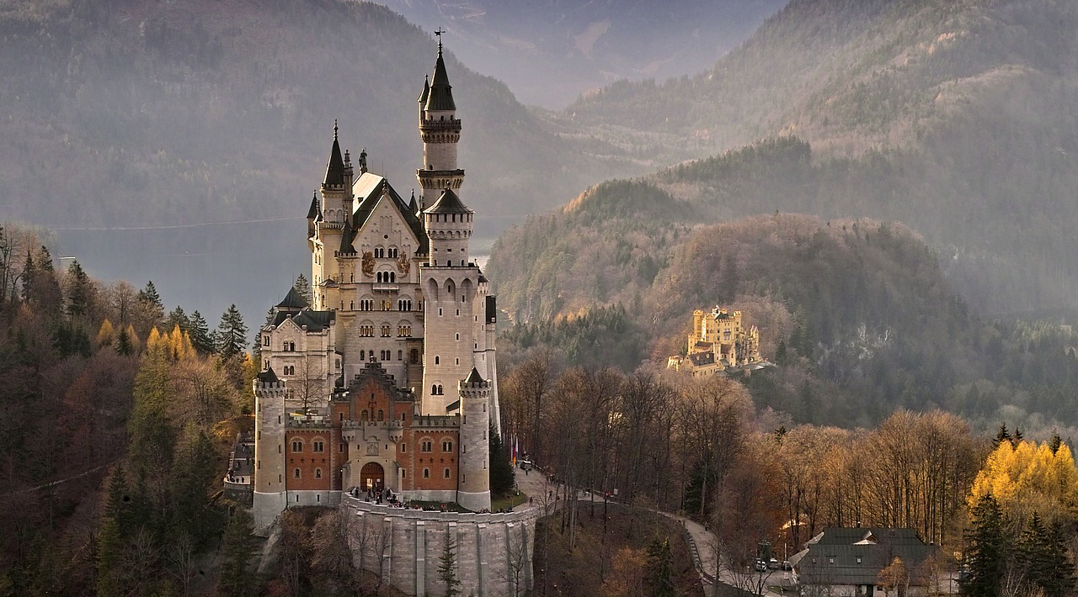
Palace of Performance
Facilitated National BL Courses
Facilitated Local Affiliate BL Courses
Independent Study BL Courses
Implementation options
Training Protocol
Pre-Course Deliverables
Facilitation of BL Course
Post-Course Deliverables

Slide 12
Palace of Performance
NEAe3 (LMS) training
Pedagogical Skills
Professional Skills
NEA Member-Led
Implementation options
Training Protocol
Pre-Course Deliverables
Facilitation of BL Course
Post-Course Deliverables

Slide 13
Palace of Performance
Implementation options
Training Protocol
Pre-Course Deliverables
Facilitation of BL Course
Post-Course Deliverables
Course Welcome Email
Course Syllabus
Pre-Course Tracking Tool
Professional Bio

Slide 14
Palace of Performance
BL Cycle (6-8 weeks)
Course Launch
Weeks1-2 Learn
Weeks 3-4 Design
Weeks 5-6 Do
Week 7 Reflect
Implementation options
Training Protocol
Pre-Course Deliverables
Facilitation of BL Course
Post-Course Deliverables

Slide 15
Palace of Performance
Post-Course Tracking Tool
Course Completion Certificates -15 PD HRS
BL Coordinator/Facilitator Communication log
New BL Course Selection Survey
Implementation options
Training Protocol
Pre-Course Deliverables
Facilitation of BL Course
Post-Course Deliverables

Slide 16
