Slide 1
Engaging and Inspiring 21st Century Adult Learners by Design
Brandy Bixler, Teacher Quality, NEA
Kricket Ichwantoro​, Learning Solutions, NEA

Slide 2
Quiz

Slide 3

Land acknowledgment
“Welcome to our sacred land, Nubagantu. It is a place that has power.
The land has feelings to greet you, eyes to see you, and ears to hear you.
It talks from every place in your sight.
All the plants, animals, rocks, water, snow, and ice in this landscape are living and need to be in balance to remain healthy.
To sustain this balance, we treat all being with the utmost respect, as we have since the beginning of time.
We are inseparable from these mountains, which are powerful, yet delicate, our language and songs resonate through the springs, trees, rocks, and animals.
We harvest resources here and renew our cultural and familial ties.
The Nuwivi continue to care for this land as they have for thousands of years….”
~ Welcome statement from the Spring Mountains Recreational Area

Slide 4
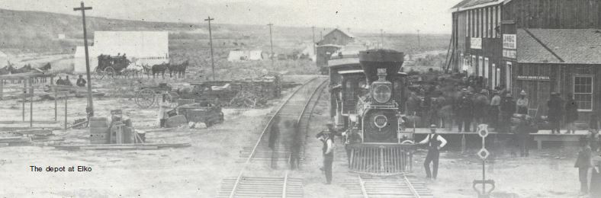
Colonization
Pre 1800s The Tudinu (or Desert People) thrived on this land
1800s colonization, which began with the construction of the Transcontinental Railroad and the arrival of trappers and traders, ultimately ended the Southern Paiute free movement and way of life.
1848 the United States government officially colonized this land.
1911 Helen Steward deeded 10 acres of her land in downtown Las Vegas to the Paiutes people.
1934 the Paiute tribe was officially recognized as a sovereign nation
1983, an additional 4,000 acres came into Paiute possession at the Snow Mountain Reservation. The Snow Mountain Reservation would become the site for the future economic development of the Las Vegas Paiute Tribe.

Slide 5

Today
Paiute's Cigarette Business
Paiute's Golf Resort Business Venture
​New Interchange, Gateway to
The Las Vegas Paiute Resort
​Pete Dye Designed Golf Course
​Nu-Wav Kaive Course
Annual Pow-wow
27th annual Pow-Wow at Snow Mountain

Slide 6
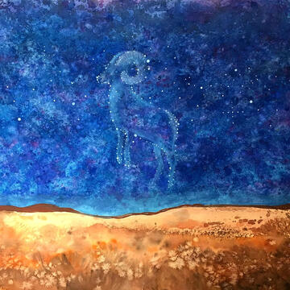
Decolonization
The Endangered Languages Project and the First Peoples’ Cultural Council warn that about 40% of the world’s 7,000 languages are in danger of disappearing.
These include the Northern Paiute, the Southern Paiute, Shoshone, and Washoe.
The more we can do to encourage the teaching of these languages to current and future generations, the better our chances of preserving these important parts of the cultural heritage of these people, and of Nevada.
Fawn Douglas, Where the Creator Goes to Dream (View of the Desert National Wildlife Refuge and the story of the Bighorn Sheep), mixed media, 24” x 18”, 2019

Slide 7
Group Activity
C.R.A.P. Design Principles
+ Accessibility Considerations ​
Image Choice
+ Accessibility Considerations
Color ​Harmony
Design Challenge
​Summary​ & Questions
Agenda

Slide 8
Activity
Notes:
Time: 4-7 minutes
Overview: Participants take part in brainstorming that allows for a high level of inclusion and encourages the acceptance of offbeat or novel ideas.
When and Why: This activity promotes creative and fluid thinking. It sparks conversation, establishes readiness for further exploration of a topic, and can be explicitly connected to a literacy objective.
Steps:
1. Project a poorly designed slide for the learners to view.
2. Explain that the task is identify three things they like about the slide and three things they don’t like in one to two minutes.
Debrief: • Participants either in small groups or individually, share their observations. Ask the learners what we can do to improve the slide?
Ask the group, how the slide makes them feel in general. How does it make them feel as a learner?

Slide 9
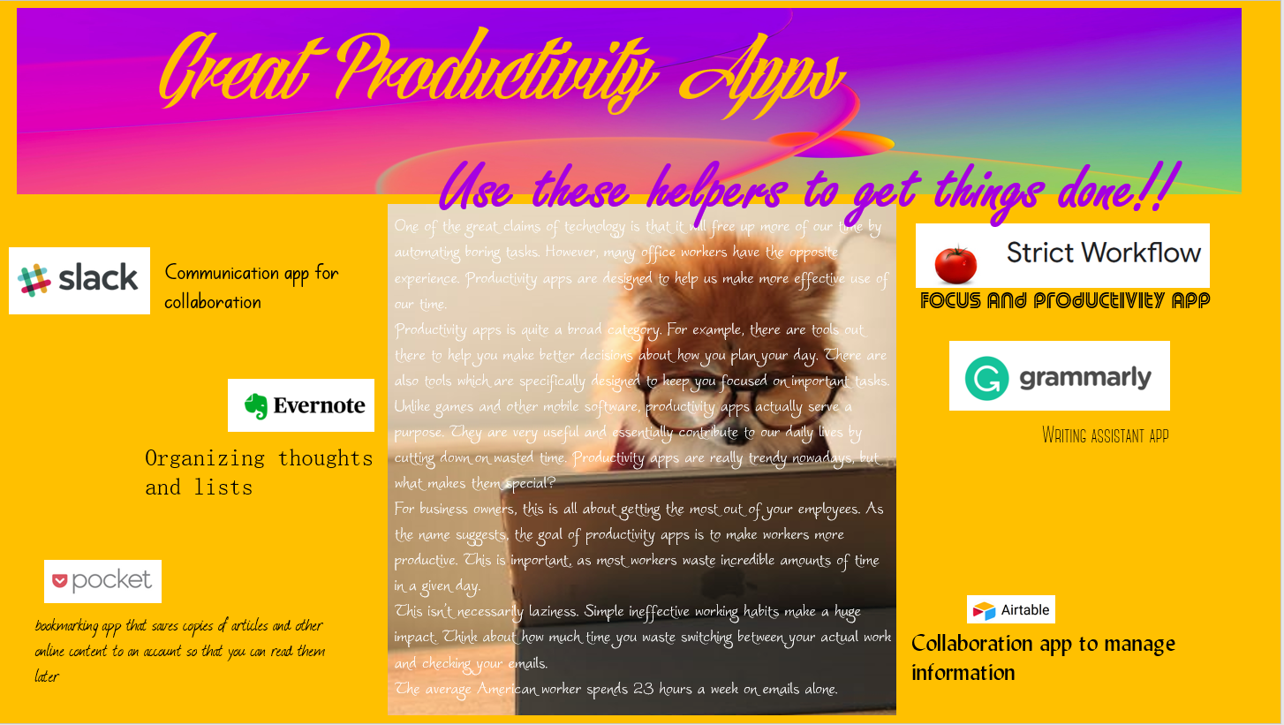
Great Productivity Apps
Notes:
Time: 4-7 minutes
Overview: Participants take part in brainstorming that allows for a high level of inclusion and encourages the acceptance of offbeat or novel ideas.
When and Why: This activity promotes creative and fluid thinking. It sparks conversation, establishes readiness for further exploration of a topic, and can be explicitly connected to a literacy objective.
Steps:
1. Project a poorly designed slide for the learners to view.
2. Explain that the task is identify three things they like about the slide and three things they don’t like in one to two minutes.
Debrief: • Participants either in small groups or individually, share their observations. Ask the learners what we can do to improve the slide?
Ask the group, how the slide makes them feel in general. How does it make them feel as a learner?

Slide 10
"Since working memory has a limited capacity, instructional methods should avoid overloading it with additional activities that don’t directly contribute to learning."
Richard Branson

Slide 11
Learn to spot the visual design problems
The first step to becoming better at visual design is recognizing the problems
Contrast
Repetition - Consistency
Alignment
Proximity - Empty Space & Timing
Image Considerations
Color Harmony
Notes:
CRAP, a design principle developed by Robin Patricia Williams. We’ve expanded it here – CRAPIC.

Slide 12
Contrast

Slide 13
Contrast
Identifying the main point quickly

Slide 14
Contrast
size
shape
shade
color
proximity
Duarte, N. (2008) Slide:ology
Notes:
Contrast helps to emphasize the main point and can be expressed in a number of ways: size, shape, shade, color, and proximity. Which one is most noticeable to you? Which do you use most often?

Slide 15
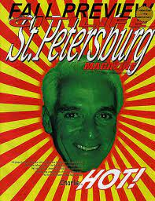

Contrast
Notes:
Both of these images use contrast. One to a greater success.

Slide 16
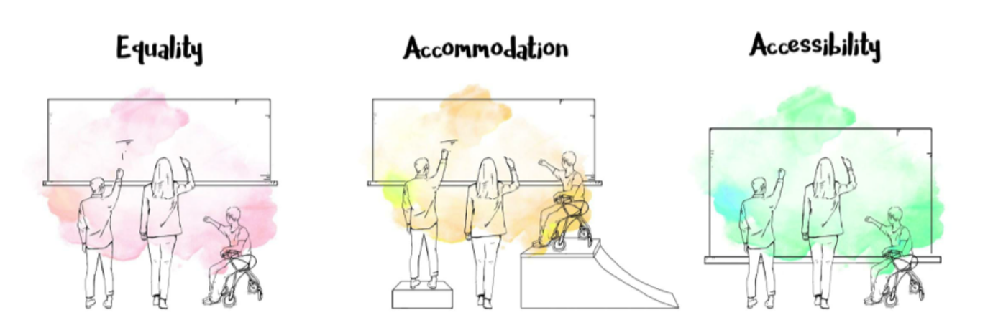
Inclusive Design
https://otis.libguides.com/accessibility
Notes:
“Inclusive Design, also known as Universal Design, is a proactive approach to electronic accessibility. With Inclusive Design, we focus on eliminating the barriers in the environment so that fewer accommodations are needed.” https://www.chhs.colostate.edu/accessibility/what-is-inclusive-design/
Accessibility provides the tools you need in the circumstances you are in right now. Focuses on the situation that disables us and less on the medical or biological disability.

Slide 17
WCAG 2.1 Guidelines
The 3 conformance levels
A – Minimum Accessibility Criteria met
AA – More Accessible Criteria met
AAA – Highest-level Accessibility Criteria met
The levels are accumulative – so if you meet AA requirements, then you also meet A level requirements
Notes:
The Web Content Accessibility Guidelines (WCAG) are technical standards on web accessibility developed by the World Wide Web Consortium (W3C). These guidelines were developed to make the web more accessible by determining standards for websites. Although, if we are creating content that will be consumed electronically, we should also keep these guidelines in mind. Consider that some ‘disabilities’ are temporary (loud environments, glare on a screen, fatigue and eye strain, etc.) So, by being compliant, we can ensure our work is accessible to the broadest audience.
There are three levels of conformance, though most strive for level AA.

Slide 18
WCAG 2.1 Guidelines
Contrast Ratio - defines the difference in contrast of two colors. In most cases a foreground (e.g. text) and a background color.
Passes
AAA (all text)
Passes
AA (all text)
Passes
AA (large text)
7.1
4.5.1
3.1
Notes:
One of the WCAG guidelines addresses contrast and color in our designs for those who are visually impaired and others.

Slide 19
WCAG 2.1 Guidelines
Contrast Ratio - defines the difference in contrast of two colors. In most cases a foreground (e.g. text) and a background color.
What are some steps we can take to ensure the best contrast/visibility for the widest audience?
Passes
AAA (all text)
Passes
AA (all text)
Passes
AA (large text)
7.1
4.5.1
3.1
Notes:
What are some steps we can take to ensure the best contrast/visibility for the widest audience?

Slide 20

Inclusive Design Tip #1
Checking Contrast
In PowerPoint - try viewing the deck in grayscale
Notes:
One thing we can do fairly quickly in PowerPoint is to check the contrast in grayscale. Go to File – Print – and change Color to Grayscale. When we do this, what do we notice in these two pictures?

Slide 21
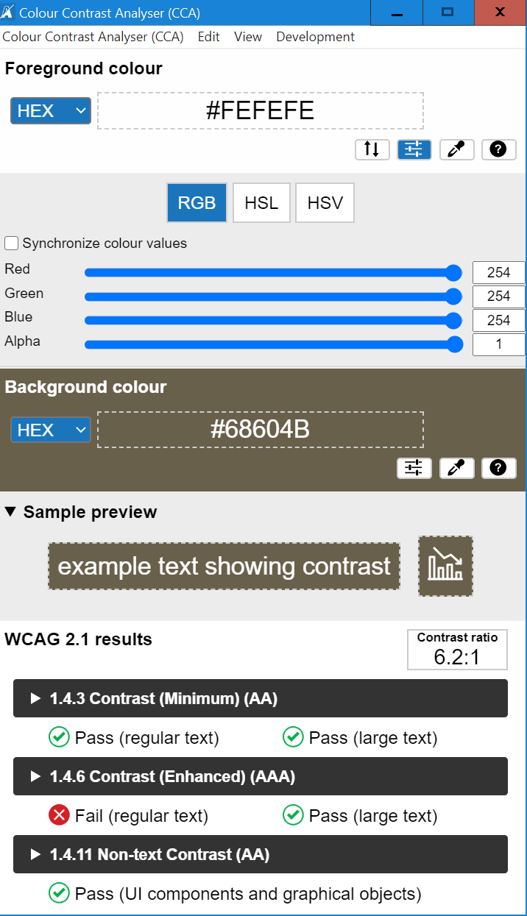
Inclusive Design Tip #2
Checking Color Contrast
Contrast checkers help us evaluate the contrast of two colors.
Notes:
Another, most specific way to check color contrast is with color contrast checkers. There are browser-based options and there is a computer downloaded application, all for free. With these, we can enter a foreground color (often text but can be anything) and a background color. The results of the contrast are displayed as either passing or failing the AA or AAA specifications.
The Resources list at the end of the presentation provides the links to these. I also like the browser-based color blindness empathy test. This allows you to quickly see your page with various types of color blindness and allows you to view the page in grayscale and with moderate and severe vision loss.

Slide 22
Inclusive Design Tip #2
Checking Color Contrast
Notes:
Color should not be used as the only visual means of conveying information, indicating an action, prompting a response, or distinguishing a visual element. Text or further guidance should be included.

Slide 23
Inclusive Design Tip #2
Checking Color Contrast

Slide 24
Inclusive Design Tip #2
Checking Color Contrast

Slide 25
Inclusive Design Tip #2
Checking Color Contrast
Notes:
We’ve looked at contrast, and specifically, color in our designs. Let’s move on to the next design element: ‘R’.

Slide 26
Font Friends
OSWALD
Pacifico
GARAMOND
Roboto
Quicksand
Oxygen
Raleway
LORA
Monserrat
Roboto Condensed
Source Sans Pro
Courier New
Notes:
Fonts, too, can provide a subtle contrast. It is suggested to limit fonts to two. Choose fonts that are compatible and provide just enough contrast, like these.

Slide 27
Repetition

Slide 28
Repetition
Consistency
Notes:
You can apply repetition with color, fonts, shapes, texture, size and lines. With repetition, we want to think about what are the visual “rules” that users can rely on to understand our design? Do headlines follow a consistent font structure? Is information, such as ‘Help’ or ‘Learn More’ links, typically located in the same place?

Slide 29


Repetition
Notes:
Repetition and moderation go hand-in-hand. Choose a very select number of fonts, patterns, colors, or image styles. Repeating those throughout the project can make for a very strong design.

Slide 30

Repetition
Gregg Fouch
Notes:
Here, we can see repetition with the colors in the text, arrow, stain, and background to reflect the colors in the logo and nachos. Notice how this ad looks more cohesive and professional.

Slide 31
Repetition
Templates and themes help reinforce repetition by standardizing:
Course Introductions
Color themes
Fonts
Interactions
Quiz instructions
Notes:
Employing templates or themes, either self-created or provided in the tool you are using, helps reinforce repetition by standardizing things such as:
Course Introductions
Color themes
Fonts
Interactions
Quiz instructions

Slide 32
Alignment
Notes:
A – for Alignment

Slide 33
Alignment
A sense of order
Notes:
Alignment helps create a sense of order.

Slide 34
Alignment
Notes:
Alignment indicates organization, polish, and strength. Text on a page is easier to read and understand if it is properly aligned to the margin and with other text.

Slide 35
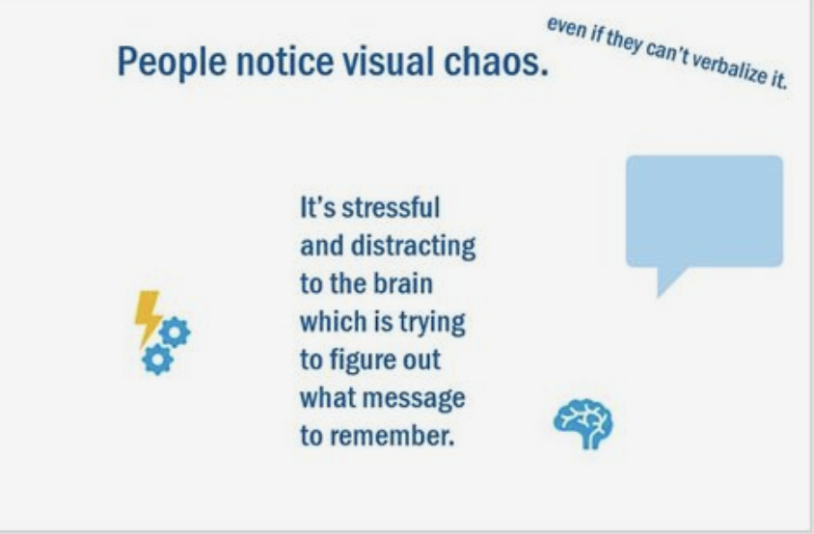
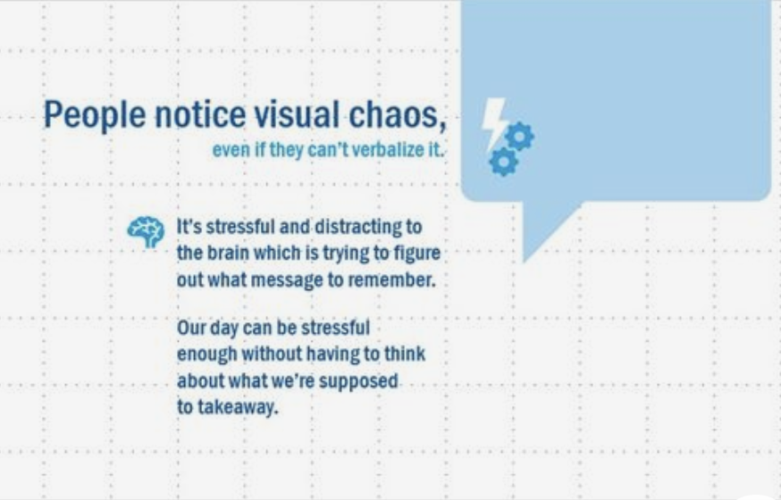
Alignment
Notes:
Does your design make effective use of the grid structure? Do any of your visual elements appear to be floating out of place?

Slide 36
Proximity
Notes:
P for Proximity

Slide 37
Proximity
Perceiving meaning from location
Notes:
Think of proximity as how information is grouped together.

Slide 38
Proximity
unite fragment
order chaos
equal unequal
Duarte, N. (2008) Slide:ology
Notes:
Proximity is a synonym for “breathing room.” Put elements (Images, videos, and text) that relate to one another and are associated with each other together.

Slide 39

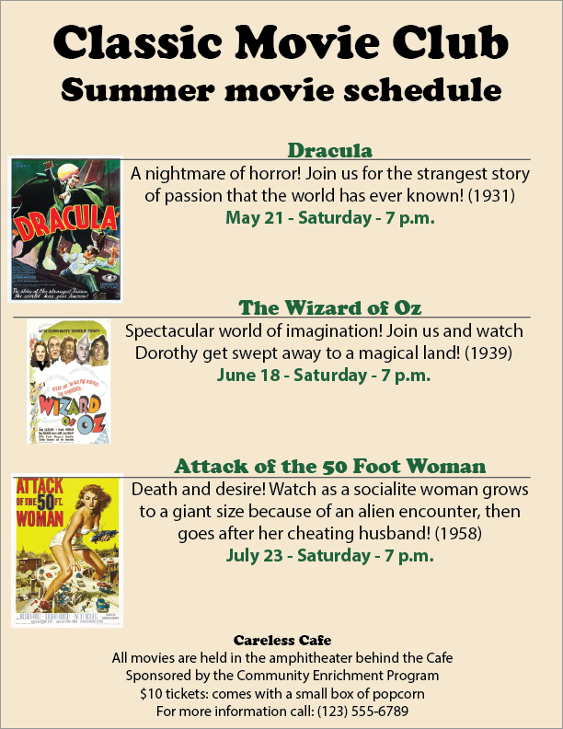
Proximity
Notes:
What does the placement of each element say about the items around it? Proximity provides a critical cue about whether items are or are not related.
Good proximity will form visual units and give structure to the layout. It also ensures that the audience will never have to work to figure out a design. Proximity also helps create a clear visual hierarchy.

Slide 40
Images
Notes:
Now we leave the CRAP design and focus on using images in our online learning materials.

Slide 41
Images
Reinforce and clarify meaning
Notes:
In addition to reinforcing and clarifying the meaning of the text or audio, images make learning memorable and assist learners with dyslexia by breaking up the text.

Slide 42
picture superiority effect
“
to improve the recognition and recall of key information, Use pictures and words together, and ensure that they reinforce the same information for optimal effect.
”
— Universal Principles of Design (page 152)
Notes:
The picture superiority effect is a fancy way of referring to the phenomenon in which pictures and images are more likely to be remembered than are words alone.
Here are some ways to incorporate images a meaningful helpers in our learning designs:

Slide 43
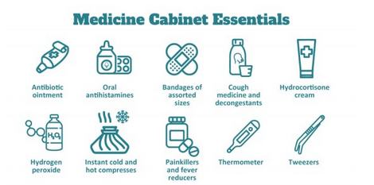
picture superiority effect
Show the actual object or subject
Live Well Work Well Newsletter October 2022
Notes:
By including a labeled image of the subject, we clarify what we are talking about and help second-language learners while reinforcing the meaning of the message. Note the use of white space allowing the pictures room to ‘breathe.’

Slide 44
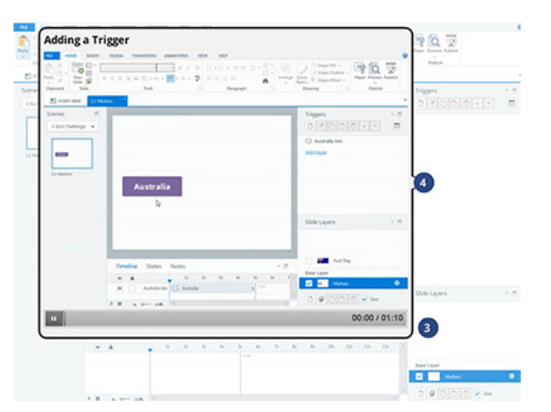
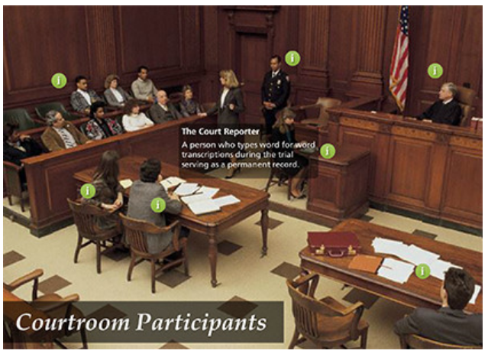
picture superiority effect
Identify Parts and Components
Notes:
Use labeled illustrations when a learner needs to know the specific parts of an object or picture. This is particularly useful when there are many components, such as in anatomical or mechanical illustrations and diagrams. As shown here, it can also aid in software training (on the left) and identifying locations or participants in a particular scenario (like the courtroom on the right).

Slide 45
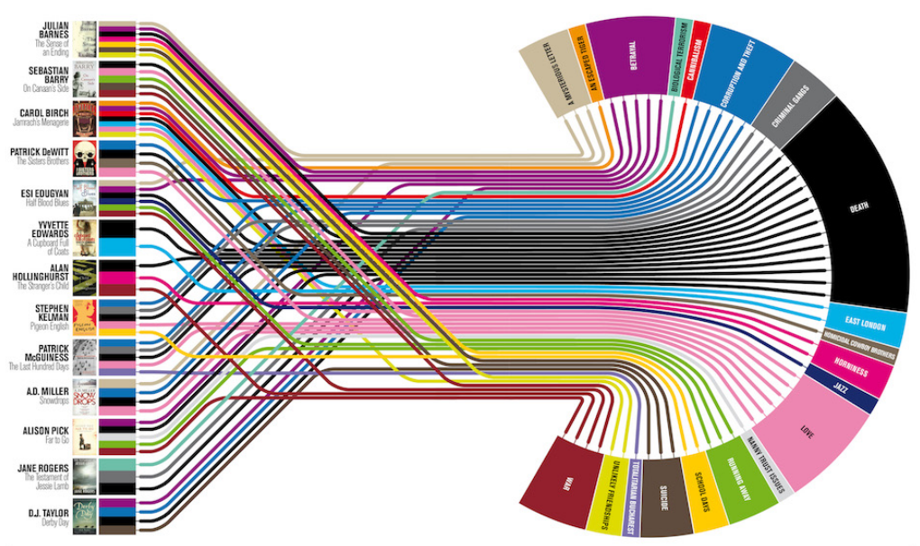
picture superiority effect
Data Visualization
Visualization by Johanna Kamradt on Delayed Gratification.
Notes:
When it comes to graphics, like data visualization, don’t try and put in too much information.
This example is an attempt to determine what makes a prize-winning novel by charting the themes of one year’s Longlisters for the Booker Prize. The connections between the authors and the themes that make a prize winning novel are somewhat difficult to follow. But the overall esthetic is very cool.

Slide 46
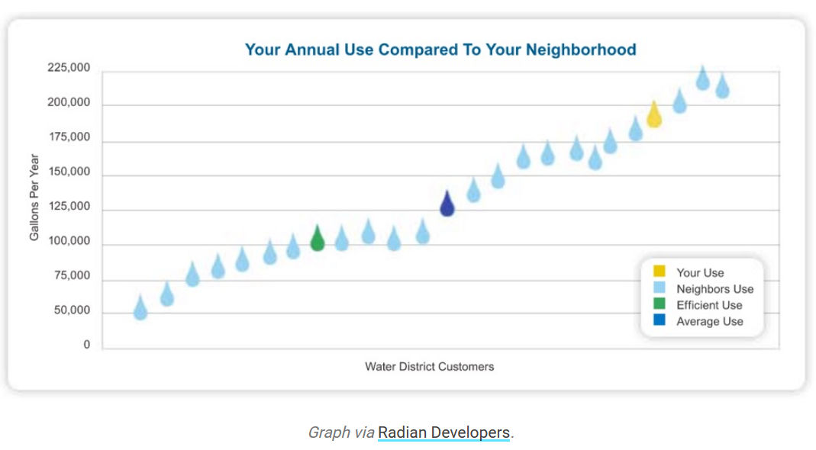
picture superiority effect
Data Visualization as a Cognitive Aid
Notes:
Better to keep it simple so learners don’t have to work hard to understand the meaning.

Slide 47


picture superiority effect
Reinforce Emotions in Scenarios
Jed Villejo
Josue Escoto
Notes:
People love stories and we remember them. By using images to reinforce the emotional points in the scenario, we can help ensure the meaning is conveyed to the learners. Showing the characters as they experience an event adds emotional depth. A voice-over can also help convey meaning to the scenario and the image.

Slide 48
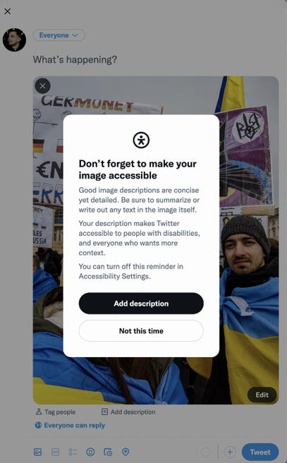
image descriptions, or “alt-text”
In the digital world, image descriptions help blind people and people with low vision consume visual content. They use screen readers — programs that transform text content into speech.
Besides, image descriptions are helpful for people with poor internet connection or outdated devices: they can imagine, based on the text, what’s depicted in a picture until it fully loads or if it doesn’t load at all.
Shestopalov, Slava
Notes:
Screen readers read the alt text first before reading the image caption (if it has one). If the caption and the alt text are identical, then the user will hear the same information twice! Even though this is technically compliant, it still isn’t great user experience.

Slide 49
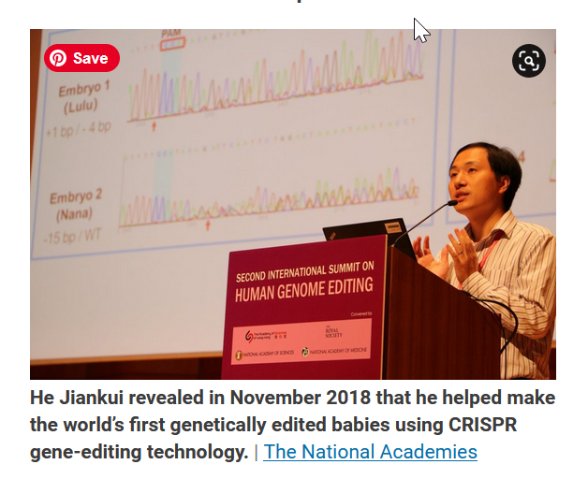
image descriptions, or “alt-text”
Don’t write “Photo of…” or “Image of…” at the beginning of your alt-text. Users already know that an image is being described, so this text adds needless verbiage.
Do distinguish if the image is a drawing or an illustration, if it is not a photo.
For infographics, charts, and maps: Focus on what is of highest informational value. Rely on surrounding text and captions to provide further information.
For images that contain words: Type the words verbatim (within space constraints).
Alt-text: A man stands at a podium labeled Second International Summit on Human Genome Editing. Scientific data appear on a screen behind him.

Slide 50

Color Harmony
Color harmony theory is based on the color wheel.
Color Theory provides you with a variety of formulas you can use to create a design that is aesthetically pleasing.

Slide 51
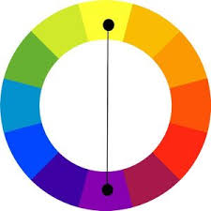

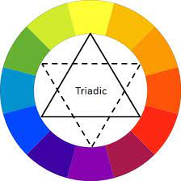

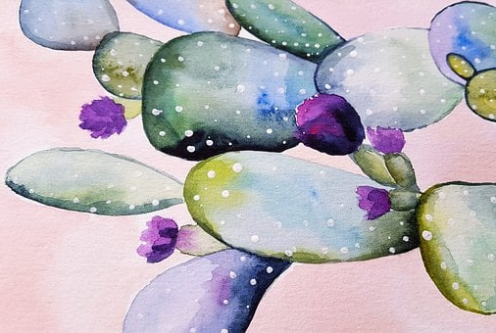

The Basics
Complementary
Analogous
Triadic

Slide 52

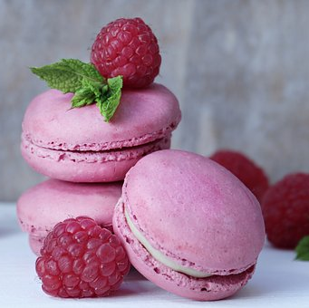


Psychology Of Color
Red
Pink
Orange
Yellow
Innocence, optimism, nurturing and Peace
Adventure, rejuvenation, full of life
Happiness, Joy, Hope and Confidence
Love, Energy War, Passion, and Power

Slide 53




Psychology Of Color
Blue
Green
Purple
Black and White
Renewal, Growth, Aliveness, and Inner Calm
Calming, Trust, and Dependable
Black evokes sophistication; white suggests innocence
Love, Energy War, Passion, and Power

Slide 54
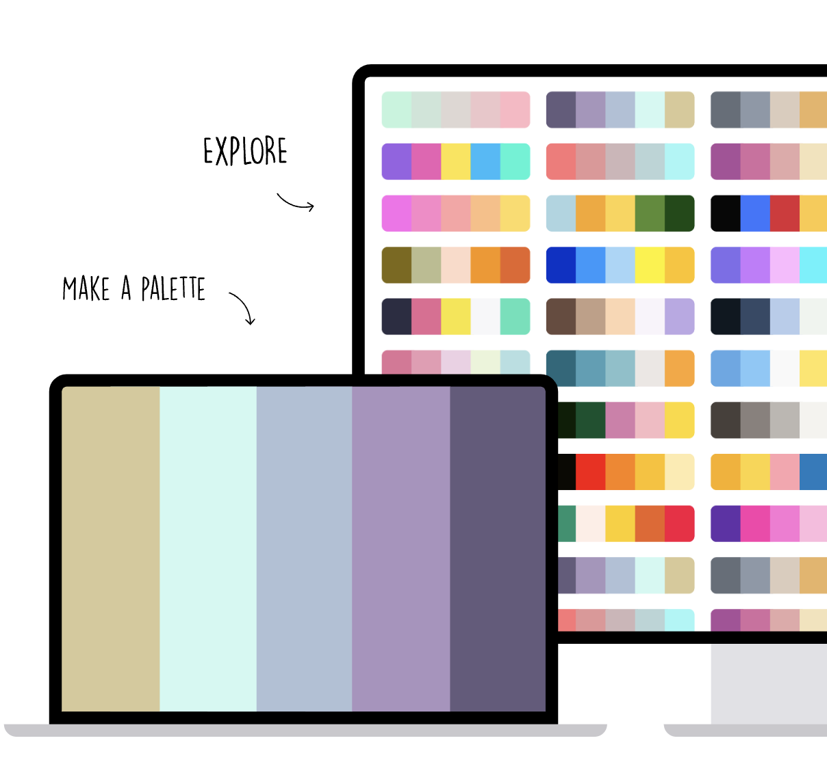
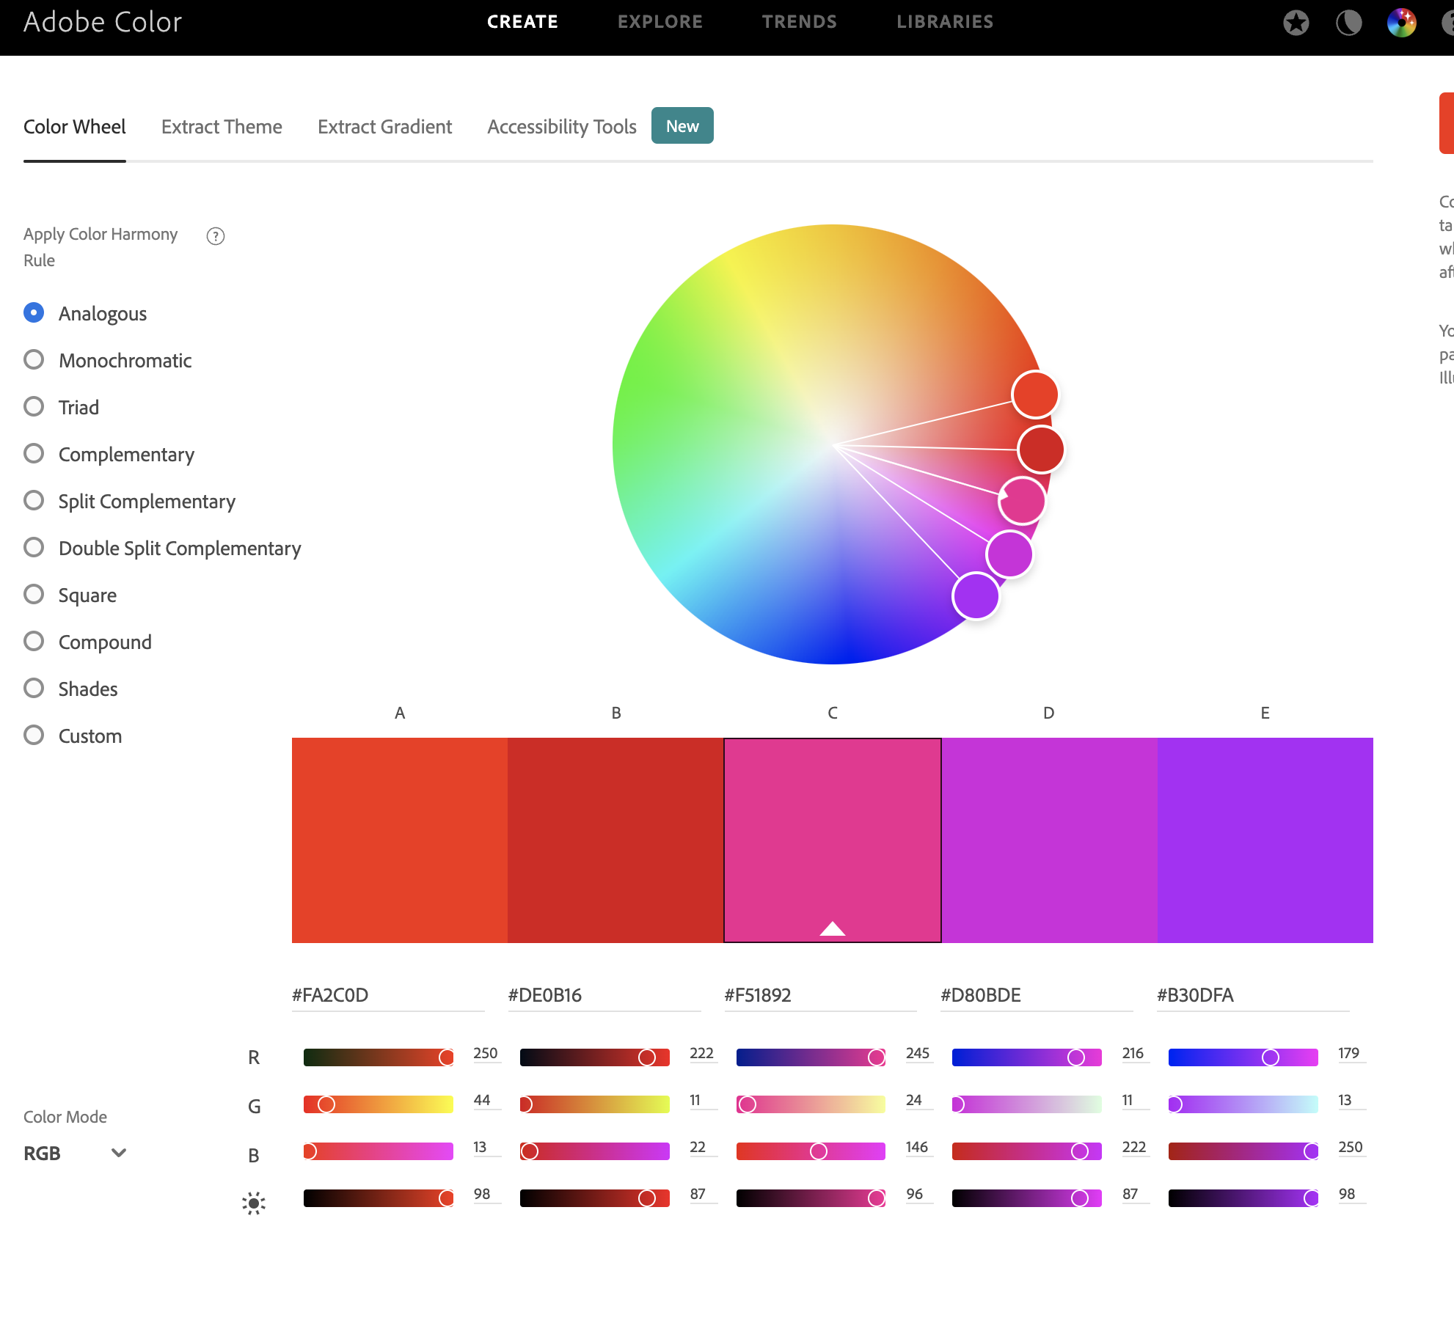
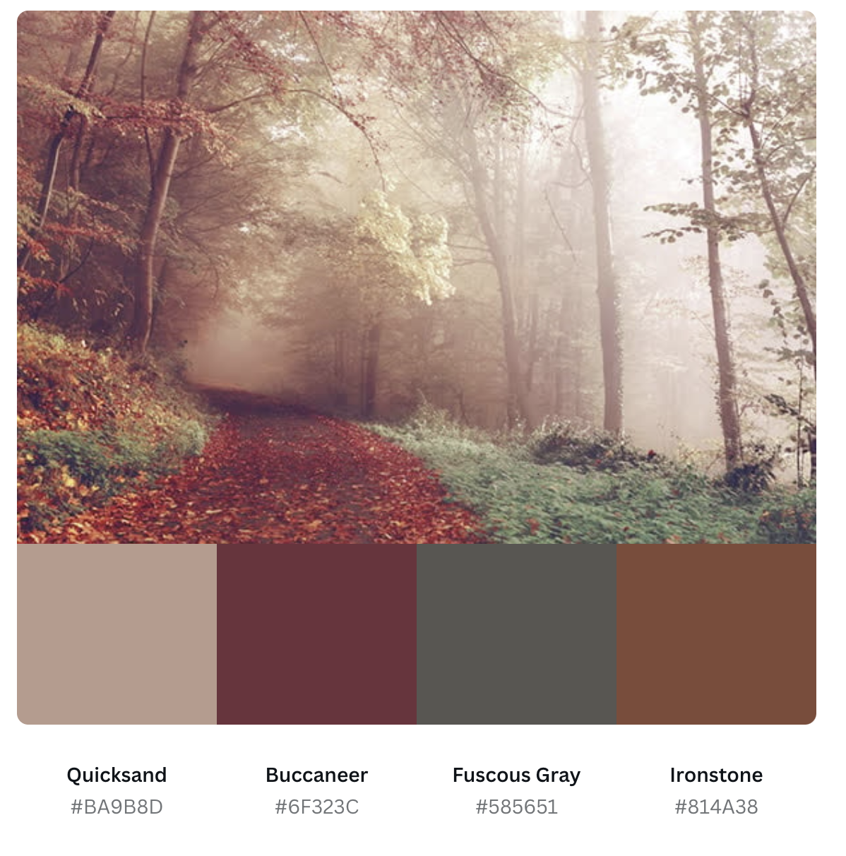
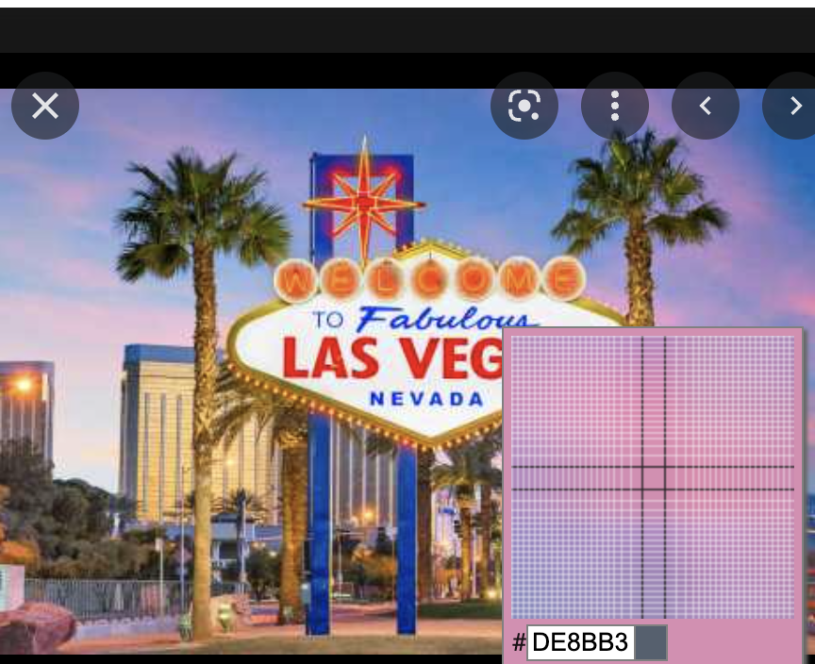
Tools for working with digital Color
Coolors
Adobe Color
CAnva Color Pallet Generator
Color Dropper
https://coolors.co/
https://color.adobe.com/create/color-wheel
https://colordropper.xyz/
https://www.canva.com/colors/color-palette-generator/

Slide 55

Thumbs up ∙ Thumbs Down

Slide 56

Explore Colorado

Slide 57
Explore Colorado

Slide 58

Recycling Day

Slide 59
Recycling Day

Slide 60

John Smith

Slide 61
John Smith

Slide 62


Slide 64
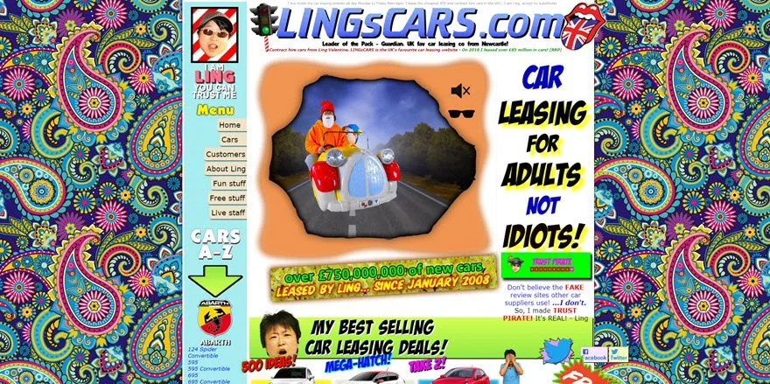

Slide 66


Slide 68
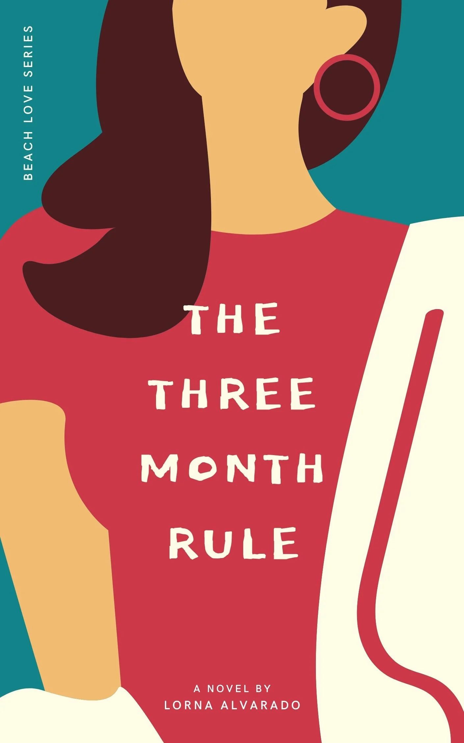

Slide 70
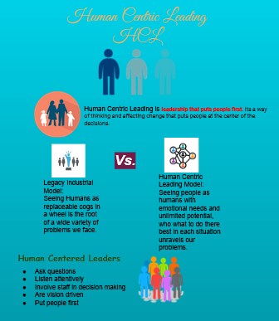
Design Challenge
Use the provided Google slide
edit to create a better design
https://bit.ly/3TFNEvJ
Notes:
Brandy handout rubric

Slide 71
SUMMARY & Additional Questions
Thoughtful and human-centered design allows us to create more effective learning resources by assisting learners visually and by supporting those with visual challenges.
The goal is for learners to experience great learning. Learning that is accessible and that learners love.

Slide 72
Reference List
Slide:ology, the art and science of creating great presentations, Nancy Duarte
Using C.R.A.P Design in Your eLearning Training – Lisa Parmley
How to Use Graphics To Improve Learning – Connie Malamed
Twitter reminds us about Alt Text, but how good are we at it?, Inclusive Design – Slava Shestopalov

Slide 73
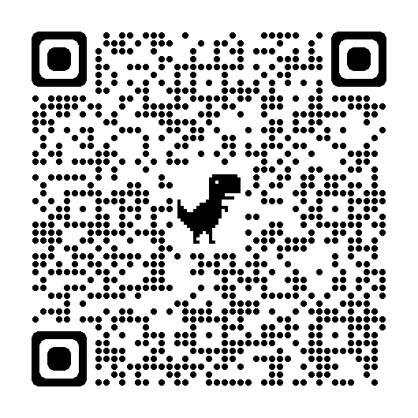
THANK YOU!
Brandy Bixler​
bbixler@nea.org
Kricket Ichwantoro
kichwantoro@nea.org

