Slide 1


Or
Oh I forgot to do my homework”
p 40-51
Albert Jones & Melissa Dan

Slide 2
Instructional Styles
Structuralist: “The mind is like a computer; the teacher is the programmer.”
Functionalist: “People learn best by doing, and they will do best what they want to do. People will learn what is practical.”
Humanist: “Learning is self-directed discovery. People are natural and unfold (like a flower) if others do not inhibit the process.”
Behaviorist : “New behavior can be caused and ‘shaped’ with well-designed structures around the learner.”

Slide 3
Instructional Styles- At your table...
How well does your style describe how you think about learning?
How does it shape how you engage with adult learners?
How does it impact how you express yourself interpersonally in your leadership style?
What's my leadership style?

Slide 4
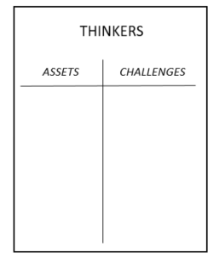
Leadership Styles
SYSTEMATIC
Step 1: Go to the chart where your dominant style is posted.
Step 2: Create a T-Chart with one side listing what makes this style an asset in the work of a facilitator, and on the other side the challenges this style creates for a facilitator.
Direct
Systematic
Spirited
Considerate

Slide 5
Leadership Styles Report Out
Direct
Systematic
Spirited
Considerate
Tell two superpowers.
In a facilitator crisis, how do these superpowers help?

Slide 6
Leadership Styles Report Out
Direct
Systematic
Spirited
Considerate
Look back to your challenges on your chart.
Which style can you lean on to fill each gap?
How do they help with those gaps?

Slide 7
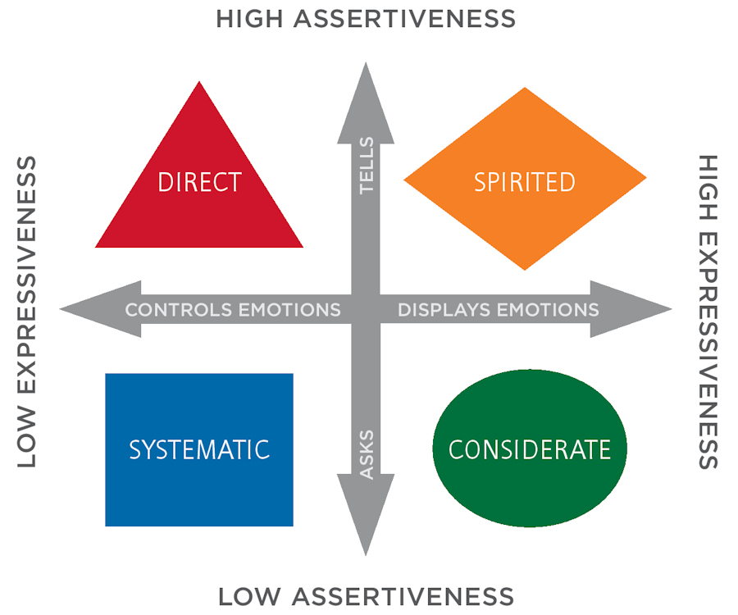
Leadership Styles Report Out
How do the aspects of your leadership style affect how you show up in the room?

Slide 8

Key Ideas
Being able to be a leader within a team requires skills from all the quadrants.
Teams need to have a balance to be most effective
How we communicate, how people perceive us and how we listen are all factors in being effective team members.

