Slide 1
Team Lead and Potentials
Barb Whitman
Adam Janiak

Slide 2

Notes:
Barb
If you could have one superpower today, what would it be, and what would you use it for?

Slide 3
Look at your card and explain…
Ace- If you could have one superpower today, what would it be, and what would you use it for?
2 - What is your favorite season?
3 - What is your favorite book?
4 - What is something you cannot live without?
5 - What is your favorite food?
6 - What is your favorite sport?
7 - What is your favorite movie?
8 - What is your favorite city?
9 - What is your favorite thing about yourself?
10 - What is your favorite hobby?
Jack - What is your biggest challenge currently?
Queen - What is your considered your happy place?
King - What is your great accomplishment?
Notes:
Barb

Slide 4
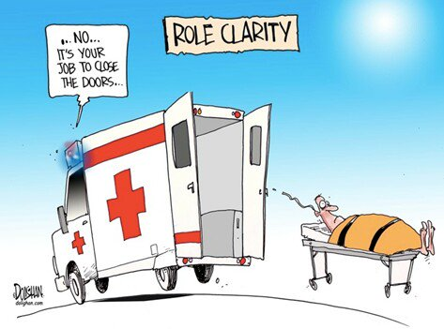
Ellen’s role vs the Team Lead’s role
Notes:
AJ

Slide 5
Things throughout that are for Ellen
Difficult participants (openly hateful or hurtful)
Emergencies (health, hotel, weather, COVID)
Dysfunction within the training team (reconnect, repair and move on)
Request of Karla (things that time suck)
Notes:
AJ

Slide 6
Ellen will share Initial Expectations for Team Members
Every communication includes the lead, Ellen and Karla
Confirm you are on the team
Communicate with the TEAM LEAD
Calendar invite needs to update to the correct status
Attend the scheduled planning meetings
Respond to requests for scheduling, etc. within time frame.
If no longer able to participate, email team lead ASAP and copy Ellen and Karla.
Notes:
AJ

Slide 7
Foundations vs Focused Academies
Focus Academies are designed for experienced UniServ Directors and are on timely topics for our organization. Some of these academies provide opportunities specifically for affiliates that already possess strong leadership, effective structures, and a demonstrated track record of using power to make meaningful change.
Facilitators Travel on Sunday, plan on Monday, participants begin on Tuesday and all leave on Thursday.
Notes:
Barb

Slide 8
Foundations vs Focused Academies
Designed for UniServ Directors in their first and second years of UniServ staff work. Foundations Academies are five full days. All Foundations Academies include a field experience and focus on supporting new staff in their work of building high-functioning locals that can recruit and engage members, organize around issues that our members care about, and develop emerging leaders.
Foundations - Facilitators travel on Saturday, plan on Sunday, participants begin on Monday and all leave on Friday.
Notes:
Barb

Slide 9

It’s time to lead…what have you experienced?
Notes:
Barb
Ask who has been a lead- Turn and talk then share out

Slide 10

Preparation
Resources folder
Team lead info
Team folder
Contact info
Check with Ellen and Karla:
Logistics (changes or questions)
Number of participants
Check in with prior team lead and/or summer revision team, if needed, to understand pitfalls, content issues, etc.
Notes:
AJ

Slide 11
Initial team contact
60 days in advance
Confirm participation
Check availability for two virtual meetings
  First is planning and section assignments (2 hours)...30+ days prior to event
  Second is the final check-in (1 hour)...about a week or so before
  Additional meetings may be needed if your team lacks experience or if the content is being created/heavily revised.
Once date is picked:
Share calendar invite
Share folders with content
Share that everyone should to take a look at materials to the meeting
Notes:
AJ

Slide 12
Planning session #1
Share how the team will:
Identify which content will be initially assigned (always subject to change!)
Talk through considerations for scheduling facilitators
  Everyone leads on day one
  Partners - balance with styles and how they represent
  Balance workload
Team lead shouldn’t be over scheduled due to other responsibilities
Foundations only - Worksite organizing lead must be scheduled to accommodate their extra duties
Notes:
AJ

Slide 13
Planning session #1 (continued)
Status of facilitator guides and ppts
Talk through how the guides/ppts will and should be updated.
Talk through all sections
Agree on who is leading each section
Update sections as you go in the facilitator guide (top and throughout)
Make sure times are correct
Agree on work needed between meetings (partner planning, ppt updates, etc)
Notes:
AJ

Slide 14

Immediately after Meeting #1
Between meetings
Create a text chain
Schedule and share calendar invite for Mtg 2
Follow up on any loose ends from Mtg 1
Plan own sections
Notes:
AJ

Slide 15
Meeting #2
Walk through sections and see if there are questions or changes to discuss
Update PPT and facilitator agenda
Share Planning day meeting information
Full day
Start/End time
Meeting room location (if known)
Full walk through of each section
Prepare before planning day, should be ready upon arrival but…..be ready for changes
Notes:
AJ

Slide 16
Foundations Worksite Organizing Lead expectations
About 12 Weeks Out:
Ellen will set up introduction and initial meeting with state affiliate .
See Timeline for WOP planning
8 Weeks Out:
Initial Meeting - Introduction of team lead to state and local staff contacts.
See Initial Meeting Agenda
Notes:
AJ

Slide 17
Foundations Worksite Organizing Lead expectations
3 Weeks Out:
Team Lead sets up meeting with State Contacts – Invite Ellen too!
3rd Planning Meeting Monday of Foundations Academy:
Team Lead sets up meeting with State Contacts – Invite Ellen too!
Working on up to Thursday:
Continue contact with state/local on scheduling/transportation/etc.
Following through on info sharing and prep materials week of
Work with Karla and Ellen on social event
Leading Prep sections
Facilitating morning of Worksite Organizing
Leading debrief and related sections
Notes:
AJ

Slide 18
Planning Day- (Sunday or Monday)
Create agenda for meeting
Share the meeting rooms and office location
Open PPT on projector for walk through, someone different ready to edit facilitator guide
Discuss team norms/practices/teamwork/engagement/arrival timeLead walk through of sections and discussion
Plan other roles - Timers/Microphones/other
Discuss how day looks during training (prep, engaged, debrief)
Prep room (tables, posters, etc)
Notes:
Barb

Slide 19
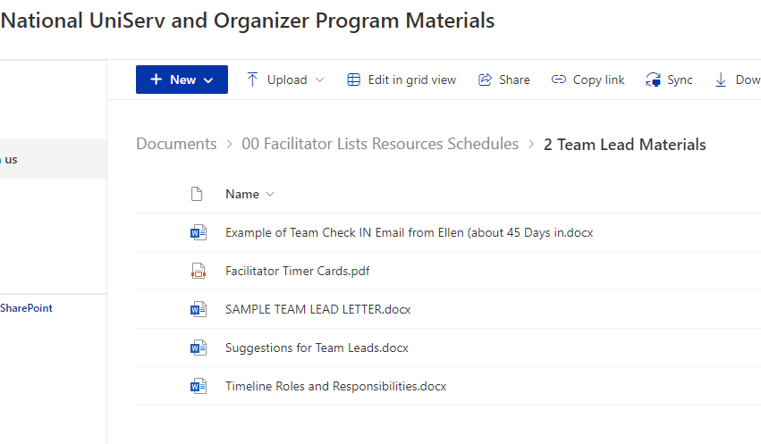
Digital Resources - Team
Team folder
Notes:
Barb

Slide 20
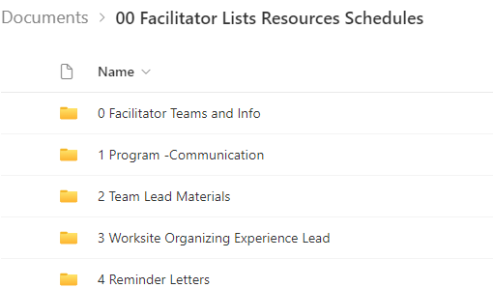
Digital Resources -Lead
Lead folder (and content)
Team Lead Materials
Worksite Organizing Experience Lead
Notes:
Barb

Slide 21

During the training
Ensure room setup is complete (microphones, charts, etc)
Check in with team during (support, reflection)
Ensure changes are noted in docs
Debrief end of day
Example: A rose and a thorn
Changes for future
Planning for the next day
Notes:
Barb
Ellen may have under control - room set up

Slide 22

Enough logistics!
Notes:
AJ

Slide 23

Working together
Let’s make a T-Chart - What works and what often doesn’t
What are ways to approach, proactively and reactively?
Notes:
AJ - Chart paper and markers

Slide 24
Reinforcing the norms and realities of this work and your “Day Job”
(Should also be shared by Ellen repeatedly)
Yes this is volunteer, but…this is a “we”
Be honest about your capacity (or lack thereof)
Communication with Team Lead (and entire team) is key
Things may not be your way or the way it is done at “home”
Yes, our local work comes first, but this is also an important commitment
Remember...Your colleagues are depending on you (team and participants)
Preparation is key
Notes:
AJ

Slide 25
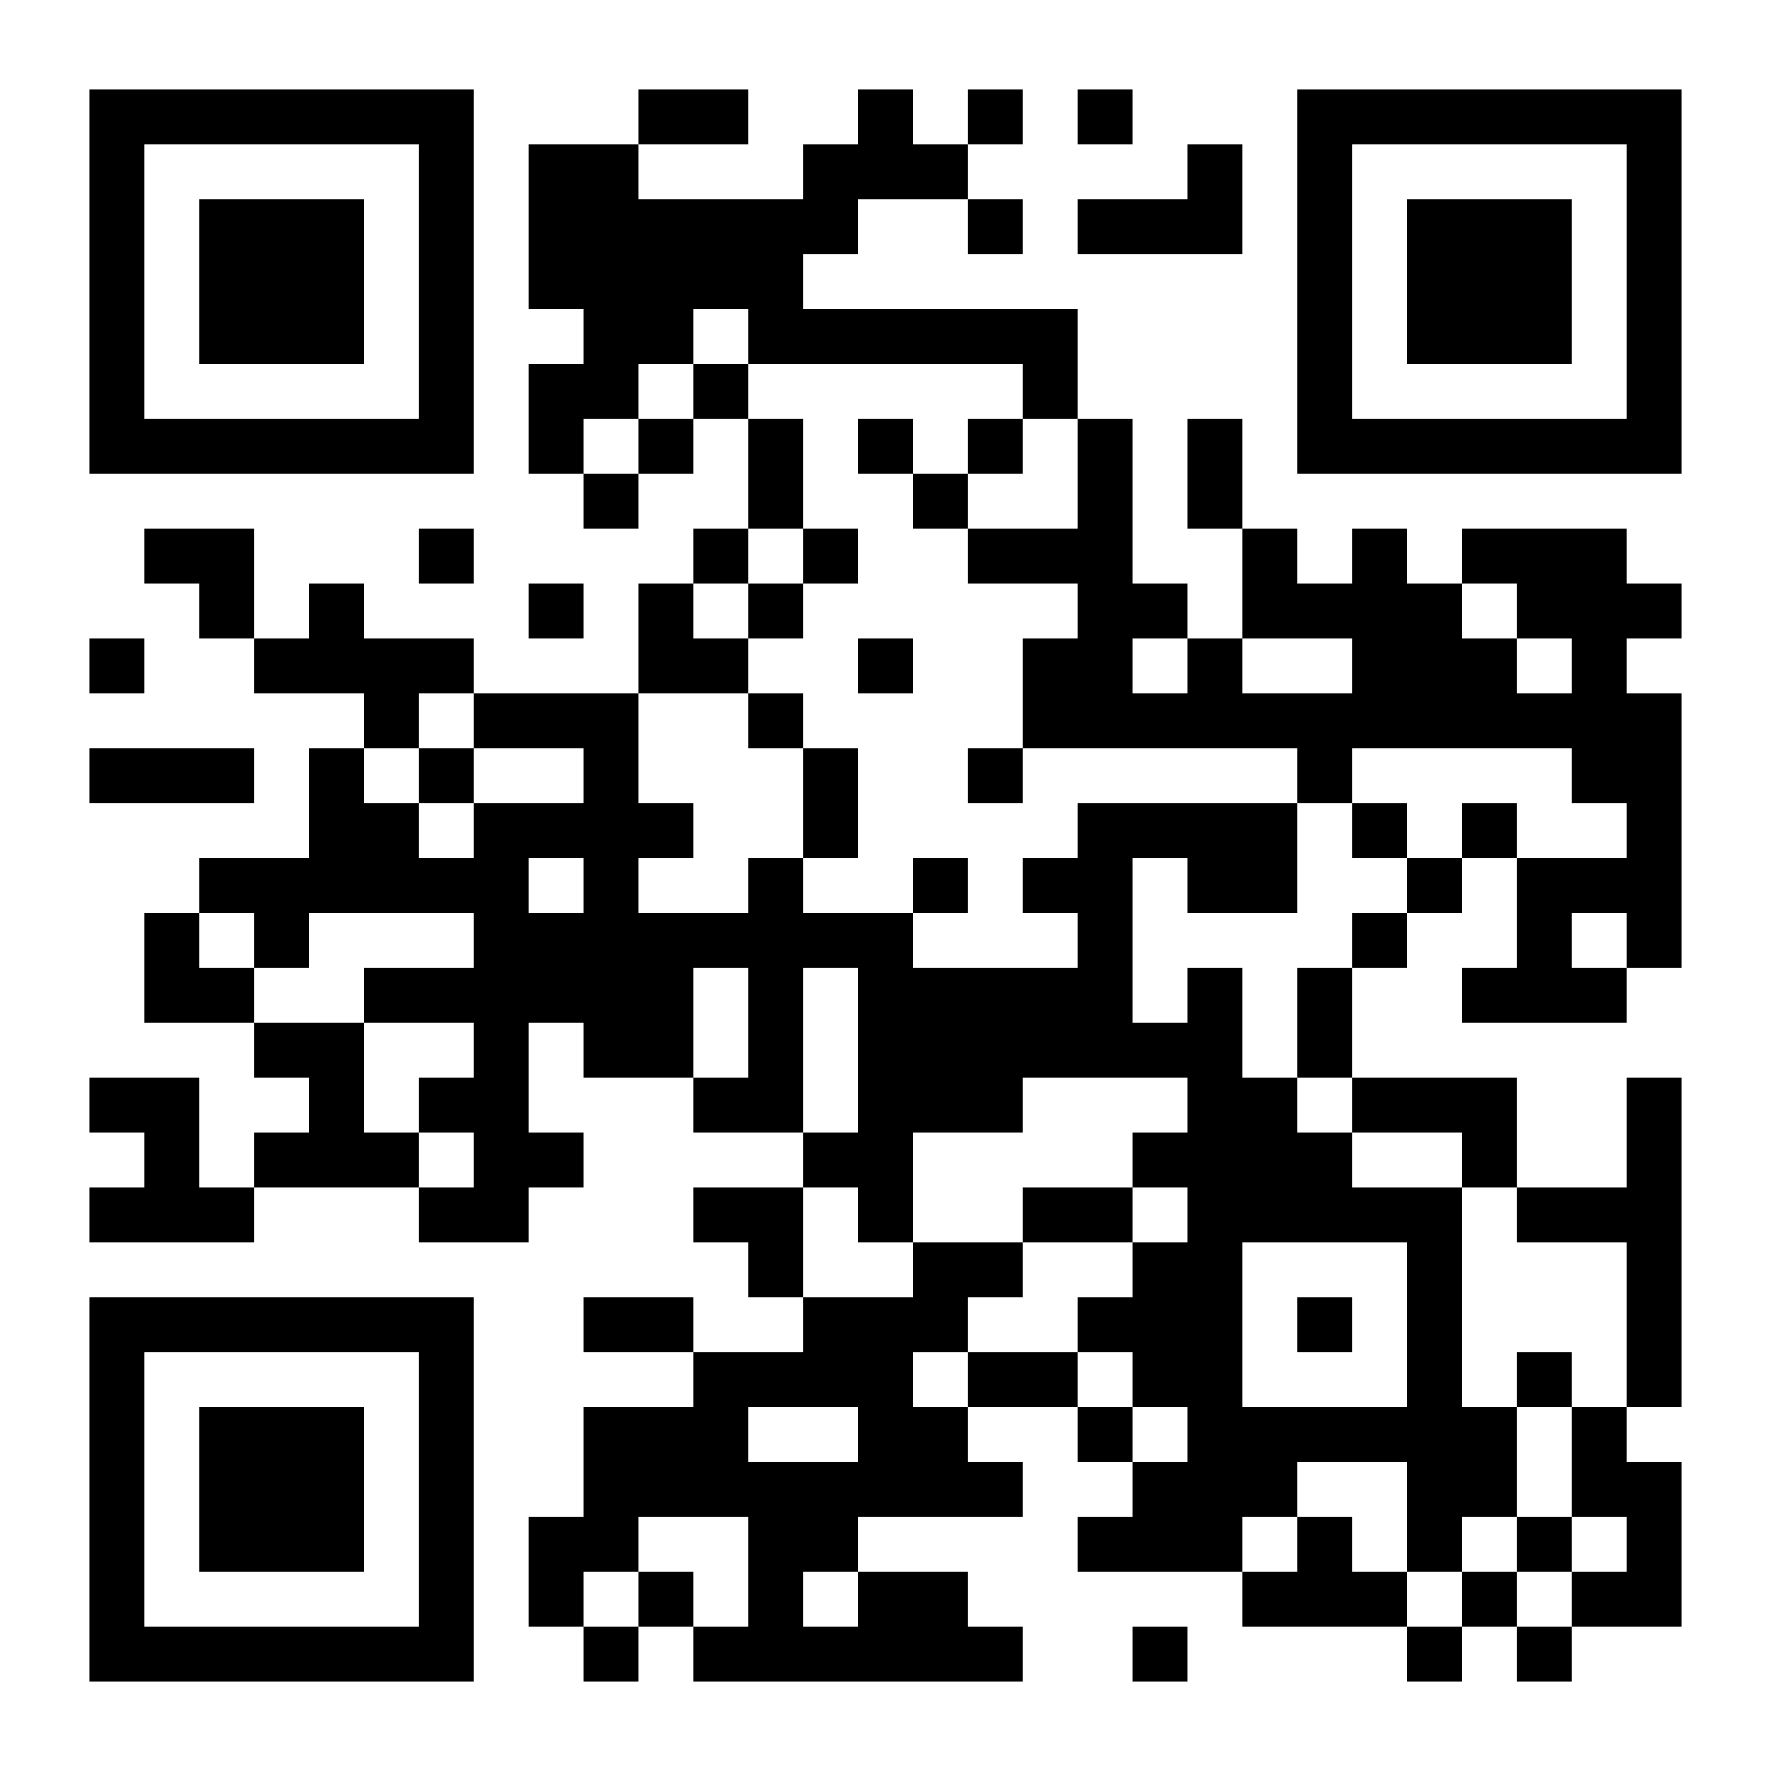
Working together
Take on the role of teacher
Learn how to work with everyone
Hold your team accountable
Read
Considering our work and teammates:
What is key advice?
What comes up/probable challenges? What’s missing?
How to bounce back from missing something or making a mistake?
https://docs.google.com/document/d/1hGlWCcs5QTDROyeBcmqs-QCxqCakoT2NYITTVLjM-PM/edit?usp=sharing
Notes:
Barb

Slide 26

What happens if Ellen isn’t able to be there?
All good - all your fabulous planning will pay off!
Lean on your team.
Karla will support team logistics.
Notes:
Barb

Slide 27
See what you recall
Go to
Gimkit.com/join enter code
Or
Scan QR code on screen
Notes:
Barb

Slide 28

Questions?
Notes:
AJ

