Slide 1
Q1: What are the elements of impactful learning design?
Q2: How do we know people are learning?

Slide 2

Drivers of Impactful Learning
- Andragogy (Learning Methods) is interactive, high-participation, and experiential
-Content is highly-relevant, action-focused, and applied

Slide 3
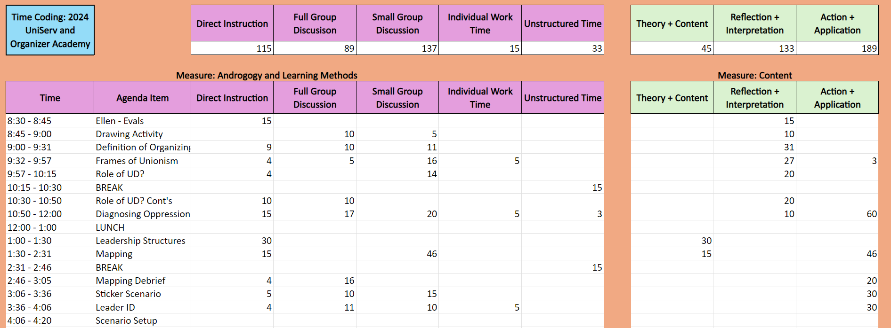

Slide 6
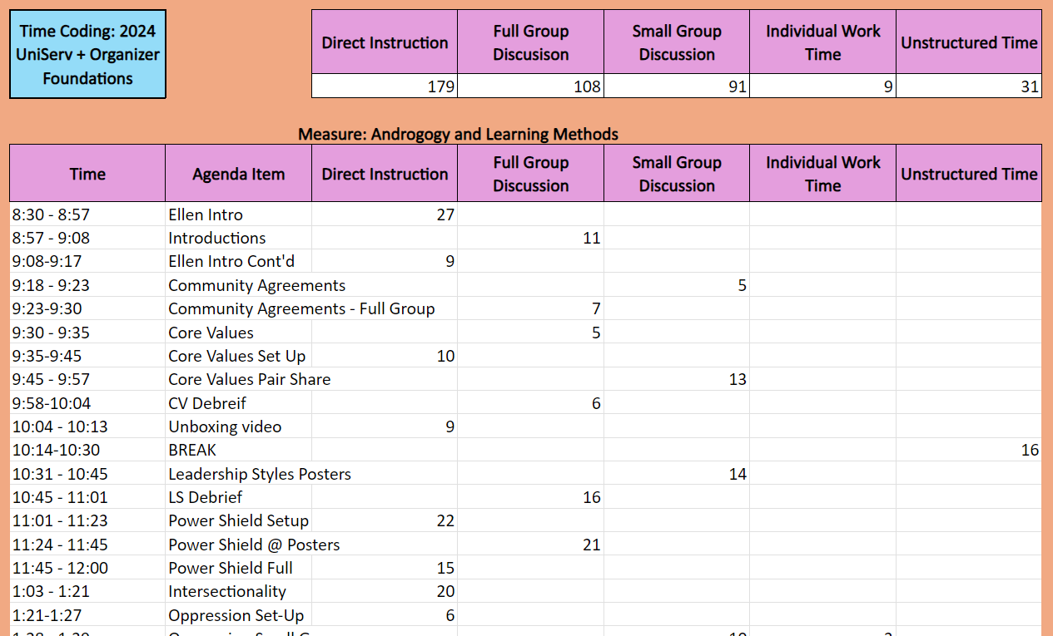

Slide 9
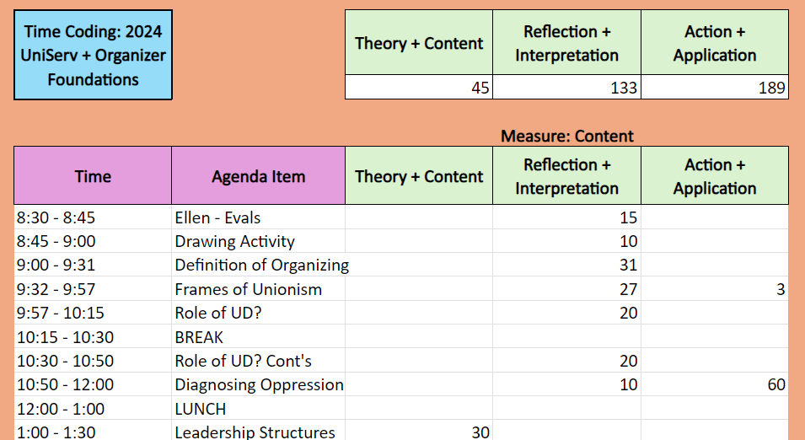

Slide 10
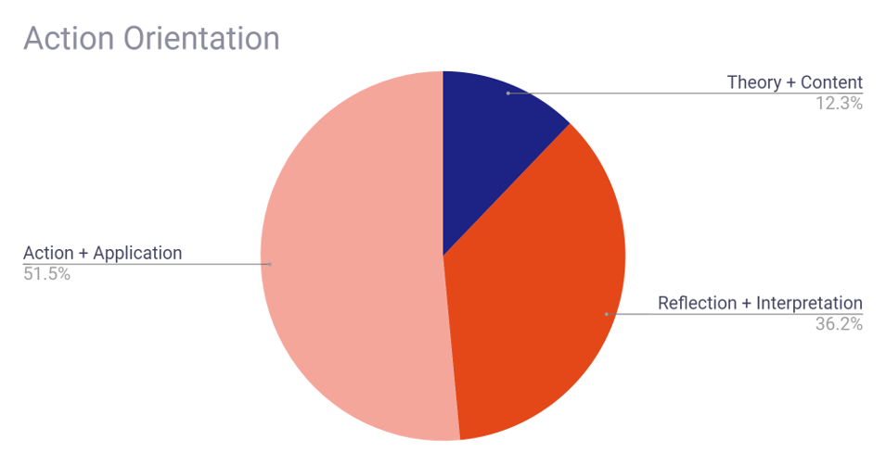

Slide 11
Key Points:
70/30 Rule applies to learning design
In learning spaces, ask – how can we make this more action-focused?

