Slide 1
Facilitator Planning Meeting
2025-26

Slide 2

First Timer

Slide 3

3 Day Agenda
Day 1
7:30-8:30 Breakfast
8:30 Convene
10:00-10:15 Break
10:15-11:45 Team Formation
11:45-12:00 Content Prep
12:00-12:45 LUNCH
12:45-4:20 Content Work
4:20-4:30 – Wrap up
Day 2
7:30-8:30 Breakfast
8:30 -10:00 Ellen, Tom and Kyle
10:00-10:15 Break
10:15-11:45 Break Outs
11:45-12:30 Lunch
12:30-2:00 Break Outs
2:00-2:15 Break
2:15-3:45 Break Outs
3:50- 4:30 Closing
Day 3
7:30-8:30 Breakfast
8:30- 12:00 Content teams
Break on your own
12:00-1:00 Team Presentations
1:00-1:30 Closing
1:30 Adjourn

Slide 4

Logistics to Remember
Questions to Ask
Bathroom
Materials
Food
Room Temperature
Karla as a Resource
Travel
Vouchers

Slide 5

Our
Outcomes
Day 1 – Form teams, begin content work
Day 2 – Improve our practice, Know our Purpose
Day 3 -Finish, or Make Plans to Finish

Slide 6
Honoring This Space - Alex
We begin by acknowledging that through a history of colonization and brutality, we are currently on the traditional lands stewarded by generations of the indigenous peoples.
We honor these people, all elders, past, present, and emerging. We are called to learn and share these learnings about this tribal history, culture, and contributions that have been suppressed in the telling of the story of what we now call the United States of America.

Slide 7

Community Agreements - Yvie
Using Self-Awareness and Self-Knowledge
Listening for Understanding
Being Gracious
Staying Engaged
Being Open and Suspend Judgment
Saying “I”- tell your truth
Seeking Discomfort
Reaching Empathy
Expecting Non-Resolution and Non-Closure
*Adapted from “Embracing equity and inclusion”, Annie E. Casey Foundation
Notes:
Community Agreements for Our Time
Awareness and Self-Knowledge
This requires self-knowledge and self-awareness. Self-knowledge allows you to see what causes you pain and conflict and enables you to embrace your contradictions and inconsistencies. It allows the space to work on things about yourself that you are not happy with. In turn, self-knowledge helps to prevent you from projecting your negative aspects onto other people. Bringing your best self also requires that you have a positive attitude, are willing to deeply explore your perspectives and remain open to the perspectives and experiences of others.
Listening for Understanding
Be an active listener. Active listening involves paying full and careful attention to the other person, looking him or her in the eye, avoiding interruptions, reflecting your understanding, clarifying information, summarizing the other person’s perspectives and sharing your own. Remember that most people need time to open up and might not be willing to immediately share their personal stories, hopes, fears and/or concerns.
Being Gracious
Being kind is a vital way of bringing meaning to our own lives, as well as the lives of others. Kindness is about caring genuinely for others around you, wanting the best for them and recognizing in them the same wants, needs, aspirations and even fears that you may have. Being kind and generous allows us to communicate better with others, to be more self-compassionate and to be a positive force in other people’s lives. This includes following the COVID protocols that are in place to protect the health of this learning community.
Stay Engaged
Staying engaged requires you to be morally, emotionally, intellectually and socially involved in the conversation. Staying engaged means that you are listening with curiosity and willing to deepen your understanding. Staying engaged might also require you to sustain the conversation even when it gets uncomfortable or diverted. This also means a commitment to keeping your electronic communications to a minimum with folks not present in this learning community.
Be Open and Suspend Judgment
Listening with an open mind includes being receptive to the influence of others. You can suspend judgment by becoming aware of preconceived notions and listening to everything someone has to say before jumping to conclusions. Most importantly, suspending judgment also means listening to what the speaker has to say for understanding, not just to determine whether the speaker is right or wrong.
Say “I”- tell your truth
Speaking your truth in authentic and courageous conversations about race requires a willingness to take risks. It means that you will be absolutely honest and candid about your own thoughts, feelings, experiences and opinions and not just saying what you perceive others want to hear. Speaking your truth will require you to speak from the “first person” and use “I” statements.
Seek Discomfort
Leaning in to discomfort will require you to let go of racial understandings and stereotypes that you may be holding onto in order to move forward. Leaning in means that you will avoid judgment, assume positive intent and be open to the kernel of wisdom in each individual’s experiences. Leaning in to discomfort will require you to sit through moments of embarrassment, confusion, anxiety and/or fear.
Reaching Empathy
Empathy and compassion allow you to understand the other person’s point of view. When you are empathetic, you are more understanding, patient and kind. Expanding your capacity to feel empathy will also allow others to enter your circle of human concern.
Resolution and Closure
Expect and accept that there may not be closure. It is not likely that you will resolve your personal understanding about race or another person’s racial experience in a single conversation. The more you talk about race with another person, the more you learn and the more they will learn. Authentic and productive conversations about race are continuous and always evolving.
*Adapted from “Embracing equity and inclusion”, Annie E. Casey Foundation

Slide 8
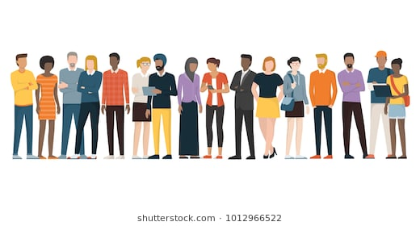
Introductions - Greylor

Slide 9
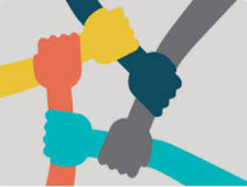
Peer to Peer Expectations
Albert and Linda

Slide 11

Key Ideas

Slide 12

Ellen
Why are we Here?
Me
You
This Team

Slide 13
Why are YOU here?
Total 1770
Men-Women 817-712 W - 40%
LGBTQ+ ?
AI/NA 10
NH 6
Muliple 20
Asian 21
Black 169
Hispanic 99 Total 18%
White Men 1031 Total 58%
Total 58 28 States and NEA
Men-Women 17-40 W- 74%
2 Gender Nonconforming/ Non Binary .04 %
LGBTQ+ 15 26%
Other than White 28 49%
White Men 12%

Slide 14
Core Beliefs of this Program
Those closest to the work need to lead others in the work.
Democracy is a messy process that is continually practiced and modeled.
If you figure it out, help the next person get it.

Slide 15
Why We Choose This Work
We belong to this work because we believe in the power of collective action, equity, and justice.
This work brings together passionate colleagues who challenge and support one another to grow, learn, and create real change.
We are allowed to lead with love, trust in our judgement, and meaningful accountability.
We value community, professional development, and the opportunity to empower others.
At its core, this work gives us hope—it reminds us that together, we can build something better for members, students, and workers everywhere.

Slide 16
What is Our Shared Purpose
Our shared purpose is to equip, connect, and mobilize members
and union staff to build individual skills and collective power for lasting, equity‑driven change through issue campaigns.
Specifically, we:
  Empower members & staff with high‑quality, intentional training, resources, and mentorship focused on organizing.
  Foster community & collaboration via safe spaces and peer networks that break down silos between national, state, and local.
  Advance equity & collective action around racial justice, workers’ rights, and social‑justice issues.
  Uphold democratic, values‑driven unionism that centers every worker’s voice, dignity, and agency in campaign-driven change.

Slide 17
How We Achieve this Purpose
We achieve our purpose within this team through collective leadership, authentic relationships, shared accountability, and a deep commitment to learning together. By showing up with humility, curiosity, and vulnerability, we create space for real growth and collaboration.
Our approach is responsive and adaptable. We listen to the needs of our members and communities, offering timely, relevant training rooted in justice and adult learning theory. We embrace risk, reflection, and continuous improvement to stay aligned with our shared purpose.
Equity and inclusion guide our work. We intentionally create welcoming spaces that elevate diverse voices, challenge assumptions, and empower participants to lead in their own contexts.
We build power through solidarity, skill development, and organizing rooted in popular education. By supporting one another, sharing knowledge, and acting collectively, we move our work forward with purpose and impact.
In the end, our strength lies in the “we”—a community grounded in trust, committed to justice, and always learning from each other.

Slide 18

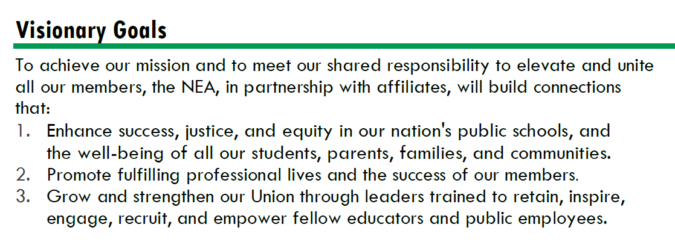




Strengthen Public Education as the Cornerstone of Democracy
Advance Racial Justice and Social Justice
Promote Healthy, Safe, Inclusive, Collaborative, and Future-Focused Public Schools
Improve Professional Respect and High Quality Working Conditions
Support Professional Excellence and Student Learning
Fuel the Transformation of Affiliate Organizational Capacity

Slide 19
By the Numbers
Face to Face Programs
  2 Foundations and 6 Focused Academies (4 Staff and Members)
  2 New Programs (Campaign Lab and HBCU)
  3 State Special Projects (Alaska, Illinois, Delaware)
  5 New Conference Tracks
    (YRO, Retired, Higher Ed, LGBTQ Caucus, NCUEA)
  4 Partnership Programs
    CSRJ, CBMA, School Safety, ESPQ, Campaigns and Elections
Online Programs Using LMS
  12 Online Events (Synchonous)
  All In Person Programs have an LMS Course- Paperless
TOTAL 408 Face to Face Participants
TOTAL 828 Online Registrants
1.1 Million Dollar Investment Over 1236 People and Us

Slide 20

Leadership Styles
Halimah
Salina
Lindsay

Slide 21


Halimah Mekki, Salina Serricchio-Joiner, Lindsay Bova
Or
"Oh I forgot to do my homework"

Slide 22
Instructional Styles
Structuralist: “The mind is like a computer; the teacher is the programmer.”
Functionalist: “People learn best by doing, and they will do best what they want to do. People will learn what is practical.”
Humanist: “Learning is self-directed discovery. People are natural and unfold (like a flower) if others do not inhibit the process.”
Behaviorist : “New behavior can be caused and ‘shaped’ with well-designed structures around the learner.”

Slide 23
Instructional Styles- At your table...
How well does your style describe how you think about learning?
How does it shape how you engage with adult learners?
How does it impact how you express yourself interpersonally in your leadership style?
What's my leadership style?

Slide 24
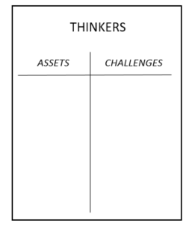
Leadership Styles
SYSTEMATIC
Step 1: Go to the chart where your dominant style is posted.
Step 2: Create a T-Chart with one side listing what makes this style an asset in the work of a facilitator, and on the other side the challenges this style creates for a facilitator.
Direct
Systematic
Spirited
Considerate

Slide 25
Leadership Styles Report Out
Tell two superpowers.
In a facilitator crisis, how do these superpowers help?
Direct
Systematic
Spirited
Considerate

Slide 26
Leadership Styles Report Out
Direct
Systematic
Spirited
Considerate
Look back to your challenges on your chart.
Which style can you lean on to fill each gap?
How do they help with those gaps?

Slide 27
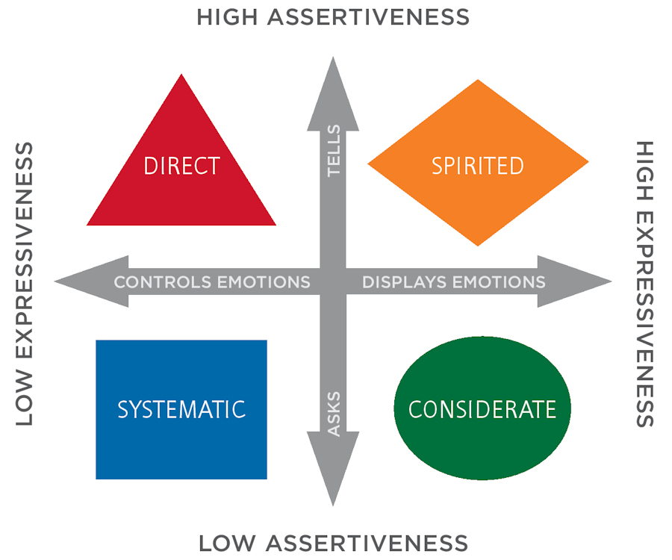
Leadership Styles Report Out
How do the aspects of your leadership style affect how you show up in the room?
What's your group's theme song?

Slide 28
Key Ideas
Being able to be a leader within a team requires skills from all the quadrants.
Teams need to have a balance to be most effective
How we communicate, how people perceive us and how we listen are all factors in being effective team members.

Slide 29


Slide 30
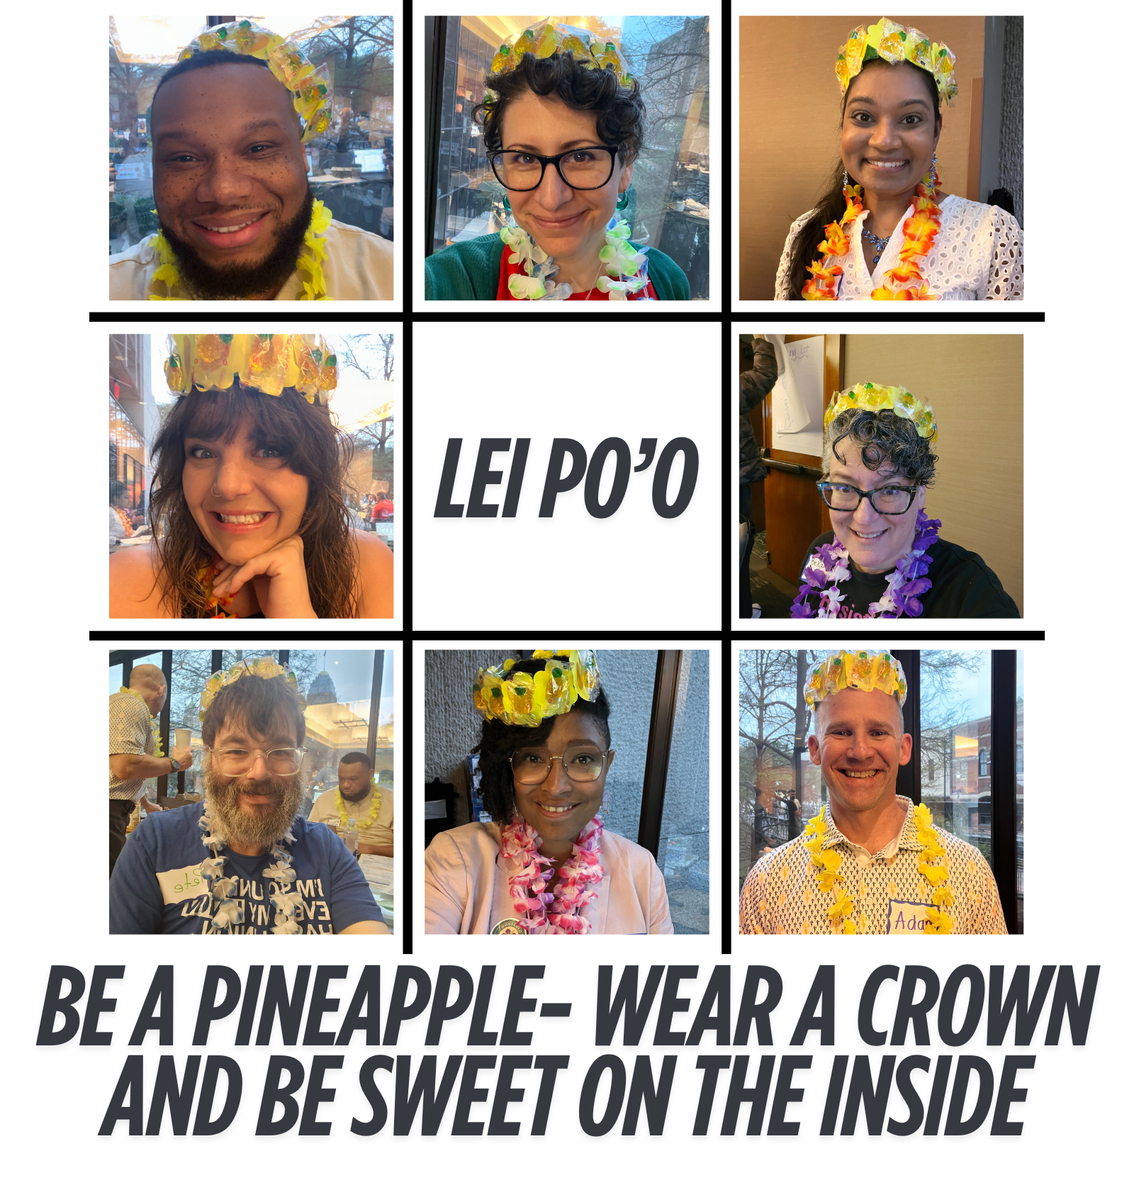
Monet, Katie, and Michael
Team Formation!

Slide 31
The Goal
8 facilitators per event (9 for Foundations and School Board)
Each facilitator volunteers for two (2) trainings & serve as an alternate on at least one (1)
Each training has three (3) alternates, one (1) of which is a priority alternates
Each facilitator is able to facilitate at their first, second, and/or third choices (if available- no guarantee)
Each team is diverse, in aspects of identity, state dynamics, etc.

Slide 32
Team Diversity And Balance
It's not as much about how we identify as it is about the initial "do I see diversity."
White presenting or all femme/masculine presenting people has an impact on our training space(s).
As we work to build our teams, we need to be aware of the dynamics of power and representation.
Notes:
We also want to discourage folks from forming pre-determined teams that have consistently trained together.

Slide 33

The Process- Round 1
All in-person programs are posted around the room
Everyone will go to a program for which they wish to be a facilitator.

Slide 34
The Process- Round 1- Continued
If there are 5 or more interested in facilitating that program:
  First, anyone can move to a program that has less than 4, or if that doesn't happen...
  Next, we will look at the makeup of the group and consider if anyone could move to maintain broad representation, and...
  Last, we’ll have the group figure out who moves.
Anyone who leaves to find another program may first write their name as a “priority alternate” of their initial Round 1 pick. ​
We will repeat this for each program with 8 or more facilitators. ​
Once each group has 4 or fewer facilitators, all will write their names as facilitators.

Slide 35

Round 2
Wash, Rinse, Repeat...
Go to the second program for which you wish to facilitate
  If the program is full, including alternates, find an open program.
  If there are already 4 facilitators listed, then the same rule applies for determining the remaining 4 facilitators.
  Should someone move to a new choice, they can place their name as a priority alternate of their initial Round 2 pick.

Slide 36

Round 3
All facilitators can place their name as an alternates on all of the programs there are able and willing to facilitate, and as a Facilitator on all programs that do not have a complete team.

Slide 37
Is your team balanced?

Slide 39
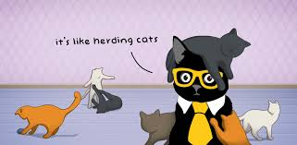
Team Leads!
  Each team needs to designate a team lead
  For Foundations and School Board, there needs to be a team lead and a worksite organizing lead
  We will do this one team at a time, since we all serve on 2 teams
  Do not choose unless all members that are present in person, are present at your chart to choose.

Slide 40
Content Team Work
Ellen

Slide 41
Team Leads
ARJ: Albert Jones and Shelly Clements
Foundations: Barb Whitman and Michael Ruiz
HBCU: Illissa Morrow and LaQuita Maxey
LGBTQ: Natasha Eckart and Anthony Brisson
ESP: Grat Dalton
School Boards: Monet Reilly and Meighan Davis
Campaigns and Coaching: Zac Johnson and Halimah Mekki
Conferences: Michelle Couture and Kristin Lytie
LMS-Articulate: Jenny Gardner
LMS-Events: Chad Williams

Slide 42
Process and Outcomes
First 45 Minutes – Review of any highlighted notes in the facilitator agenda, any thoughts from the person who was last on this team, and a light review of the evaluations.
Team leads have the charges from Ellen outlined also in the agenda.
  Review all handouts, slides, pre-attendance handouts
Coaching and Campaigns – We are building from Scratch
LMS – Two Teams – synchronous and asynchronous
Set meetings for continued revision, prep, and planning

Slide 43
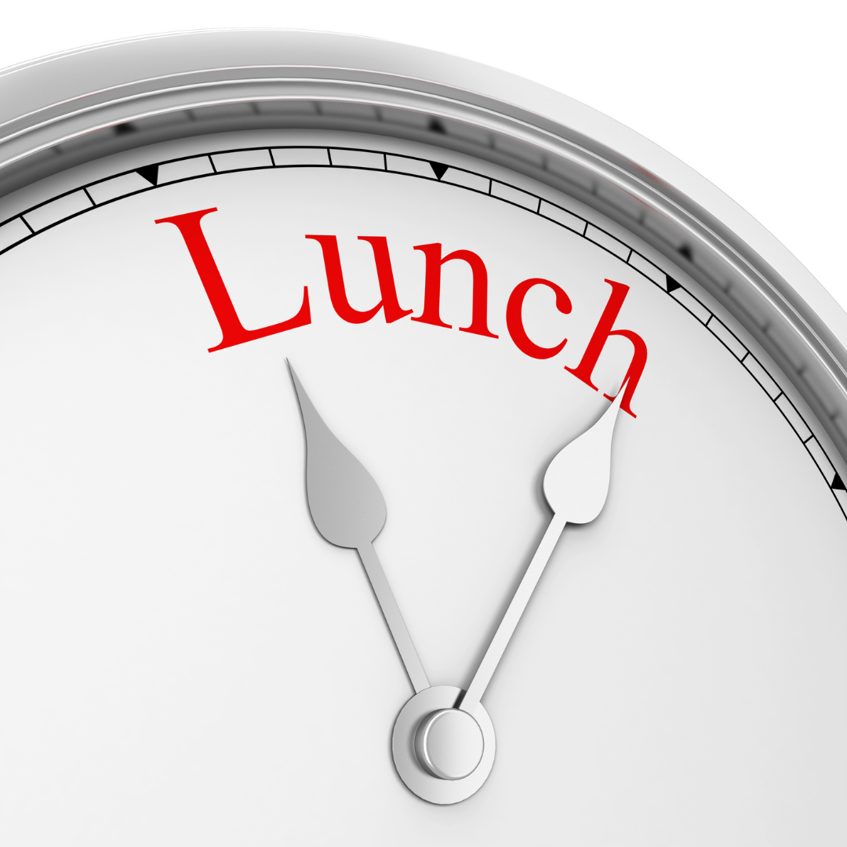

Slide 44
Team Work Sessions
Break on Your Own
See You at 4:20

Slide 45

Ending it Right
PLAN FOR BREAKFAST
Networking Shenanigans on Your Own

Slide 46
Facilitator Planning Meeting
Day 2

Slide 47
Community Agreements - Yvie
Using Self-Awareness and Self-Knowledge
Listening for Understanding
Being Gracious
Staying Engaged
Being Open and Suspend Judgment
Saying “I”- tell your truth
Seeking Discomfort
Reaching Empathy
Expecting Non-Resolution and Non-Closure
*Adapted from “Embracing equity and inclusion”, Annie E. Casey Foundation
Notes:
Community Agreements for Our Time
Awareness and Self-Knowledge
This requires self-knowledge and self-awareness. Self-knowledge allows you to see what causes you pain and conflict and enables you to embrace your contradictions and inconsistencies. It allows the space to work on things about yourself that you are not happy with. In turn, self-knowledge helps to prevent you from projecting your negative aspects onto other people. Bringing your best self also requires that you have a positive attitude, are willing to deeply explore your perspectives and remain open to the perspectives and experiences of others.
Listening for Understanding
Be an active listener. Active listening involves paying full and careful attention to the other person, looking him or her in the eye, avoiding interruptions, reflecting your understanding, clarifying information, summarizing the other person’s perspectives and sharing your own. Remember that most people need time to open up and might not be willing to immediately share their personal stories, hopes, fears and/or concerns.
Being Gracious
Being kind is a vital way of bringing meaning to our own lives, as well as the lives of others. Kindness is about caring genuinely for others around you, wanting the best for them and recognizing in them the same wants, needs, aspirations and even fears that you may have. Being kind and generous allows us to communicate better with others, to be more self-compassionate and to be a positive force in other people’s lives. This includes following the COVID protocols that are in place to protect the health of this learning community.
Stay Engaged
Staying engaged requires you to be morally, emotionally, intellectually and socially involved in the conversation. Staying engaged means that you are listening with curiosity and willing to deepen your understanding. Staying engaged might also require you to sustain the conversation even when it gets uncomfortable or diverted. This also means a commitment to keeping your electronic communications to a minimum with folks not present in this learning community.
Be Open and Suspend Judgment
Listening with an open mind includes being receptive to the influence of others. You can suspend judgment by becoming aware of preconceived notions and listening to everything someone has to say before jumping to conclusions. Most importantly, suspending judgment also means listening to what the speaker has to say for understanding, not just to determine whether the speaker is right or wrong.
Say “I”- tell your truth
Speaking your truth in authentic and courageous conversations about race requires a willingness to take risks. It means that you will be absolutely honest and candid about your own thoughts, feelings, experiences and opinions and not just saying what you perceive others want to hear. Speaking your truth will require you to speak from the “first person” and use “I” statements.
Seek Discomfort
Leaning in to discomfort will require you to let go of racial understandings and stereotypes that you may be holding onto in order to move forward. Leaning in means that you will avoid judgment, assume positive intent and be open to the kernel of wisdom in each individual’s experiences. Leaning in to discomfort will require you to sit through moments of embarrassment, confusion, anxiety and/or fear.
Reaching Empathy
Empathy and compassion allow you to understand the other person’s point of view. When you are empathetic, you are more understanding, patient and kind. Expanding your capacity to feel empathy will also allow others to enter your circle of human concern.
Resolution and Closure
Expect and accept that there may not be closure. It is not likely that you will resolve your personal understanding about race or another person’s racial experience in a single conversation. The more you talk about race with another person, the more you learn and the more they will learn. Authentic and productive conversations about race are continuous and always evolving.
*Adapted from “Embracing equity and inclusion”, Annie E. Casey Foundation

Slide 48
Tom
Kyle
Ellen
Amanda
Carrie

Slide 50
Breakouts!

Slide 51
Choose Your Own Adventure 3 Rounds
Adult Learning Methods We Use (Halimah, Anthony, Albert) - Will Repeat
Your Biases as a facilitator and What to do When Bias shows up in Learners (Shelly, Matt, Sara ) - Will Repeat
The Roles all Teams Need and Pro Tips (Barb, Michelle, Chad) - Will Repeat
New Folks Clinic (Michael, Pete, Illissa) - Will NOT Repeat
Round 1: 10:15-11:45 Round 2: 12:30-2:00 Round 3: 2:15-3:45

Slide 52
Linda
Ellen

Slide 54
Ending it Right
PLAN FOR BREAKFAST
Networking Shenanigans on Your Own

Slide 55
Facilitator Planning Meeting
Day 3

Slide 56
Content Team Work Time

Slide 57
Team Progress Reports, Dances, and Chants
Scott
Jackie
Sara
LaQuita

Slide 58
Ending it Right

