Slide 1
Best Practices
Barb Whitman
Chad Williams – In spirit
Michelle Couture

Slide 2
Today's Agenda:
Understanding Team roles
Strategies for Building community
Setting the norms for teams,
Pro Tips for Team Debriefing,
Pro Tips for Convening Teams,
Pro Tips: Wisdom Nuggets
Best practices for Jumping in and jumping out,
Who is responsible with communication breakdowns happen?
What do we do when...?
Notes:
Michelle

Slide 3

What would the ideal team look and feel like?
Table talk
Notes:
Barb

Slide 4

The Roles all Teams Need
Time Keepers
Keeps us on schedule
How facilitator wants to be timed
Notifies facilitator of time in session
Coordinates with lead and/others if more time is needed due to group activity
Coordinating with local so is unable to facilitate a lot of content
Presents work-site materials and introduces state collaborators
Online Support
Technology is operating , production crew is determined- monitoring chat, admitting into room, etc.
Sound is working
Team Members
Charting, running mics and generally supporting lead facilitator
Being present during the whole training for support and to “jump in”
Taking notes on facilitator guide on suggested changes and tweaks needed based on experiences
Worksite Leads
Notes:
Michelle

Slide 5

What is community?
a feeling of fellowship with others, as a result of sharing common attitudes, interests, and goals.
Notes:
Barb

Slide 6
Building of the Team Community
Understand who your people are and their communication and learning style.
Appreciate the variety of style and types of folks on your team especially those who are different than you.
Let folks self select content and activities and offer support as needed.
Encourage growth and offer positive feedback.
Make decisions as a team.
Find your “truth” speaker.
Have fun
Ice Breakers:
  Michelle’s Favorite: Wrestling entrance song
  Barb’s Favorite: Poker cards
Notes:
Barb
Creative Icebreakers:
Trading Cards: Give team members index cards and markers and have them write down interesting facts about themselves to share with others.
Jenga Questions: Write questions on Jenga blocks and have team members answer them as they play.
Movie Pitch: Divide into small groups and have them create a movie pitch in a short amount of time.
The 4 C's: Ask each team member to write down a car, color, cartoon character, and cuisine that best describes who they are and explain why.
Unique and Shared: Have team members identify something unique about themselves and something they share with others.
Quotes: Have team members share a favorite quote and explain why it resonates with them.
Show and Tell: Have team members bring in an object that represents something important to them and share its story.
Find Your Pair: Have team members find someone who shares a specific trait or interest.
Never Have I Ever: Go around the room and have people share something they've never done.
Guess Who: Have team members guess who a person is based on clues or questions.
The One Word Icebreaker Game: Have team members pick one word to describe their thoughts on a work topic.
Diversity Bingo: Create bingo cards with prompts about different backgrounds and experiences.
Year of the Coin: Have each person share a significant event or memory from a specific year.
The Candy Game: Have team members share a favorite candy and explain why they like it.
Paper Airplane Game: Have team members design and launch paper airplanes.

Slide 7
Setting the norms for teams
ACTIVITY DIRECTIONS:
Each team member gets a talking card.
Think about the question/topic.
Any teammate can begin discussion by placing card in center of table (leave it when done talking).
Any participant with a card can continue discussion by using their card. Participants with no card must wait until teammates have used their cards.
When all cards are used, teammates collect cards and continue discussion using their cards.
QUESTION:
What ideas do you have to set the norms for your team?
Notes:
Michelle
Explain activity for non-dominating

Slide 8
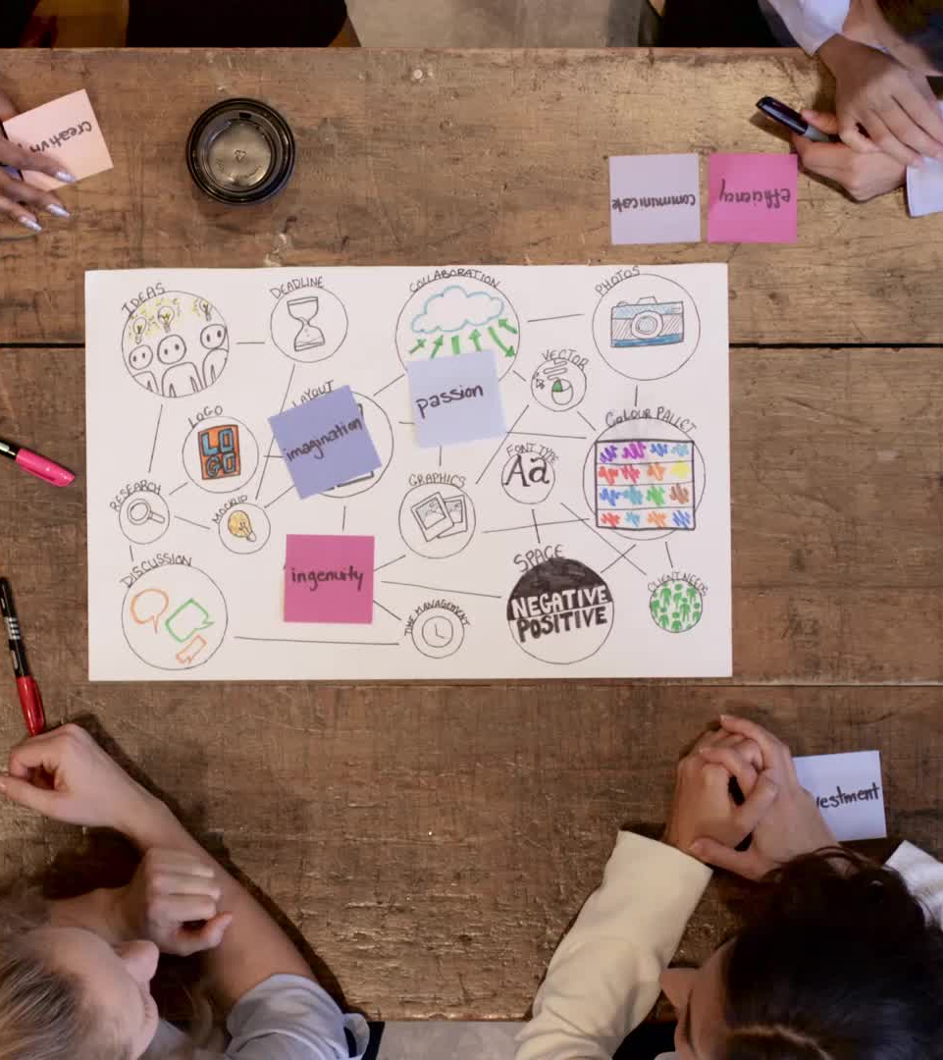
Convening Teams
Invite Ellen to everything
Reach out to new folks prior to actual meeting for introduction and relationship building
Create a doodle poll or some other polling mechanism and consider time zones when scheduling meetings
Invite all, even alternates
Remind folks that everything is electronic and to print out their own stuff.
Remind folks that their printouts won't match after we make changes on our planning session day
Ask for volunteers or designate specific roles: update PowerPoint, update facilitator guide, review participant handouts, make a list of charts, ETC.
Notes:
Barb

Slide 9
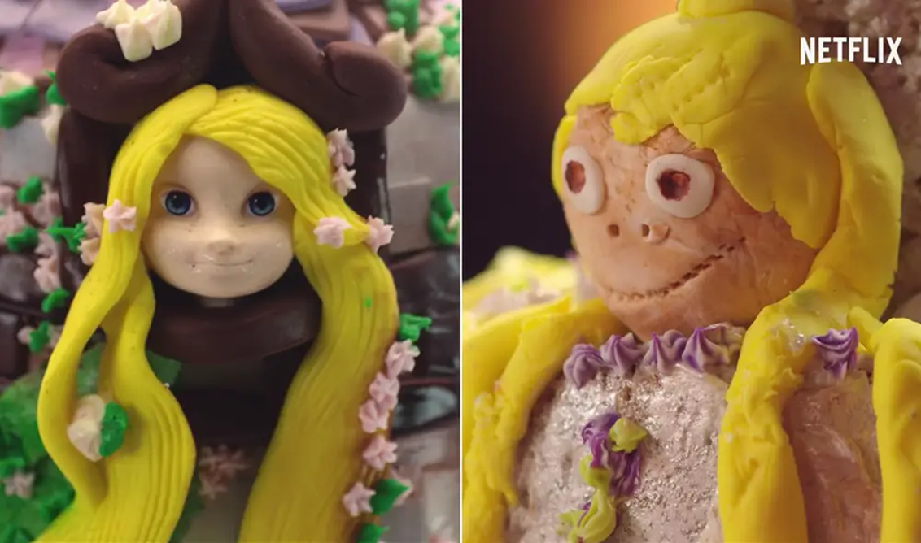
Debriefing Teams
What are you looking to learn?
What did we do right?
What was supposed to happen?
What actually happened?
What did we wish we had done differently?
Notes:
Michelle

Slide 10

Jumping in and jumping out
Notes:
Barb
Paying attention to the script
No off script – fidelity of the content

Slide 11

Pro Tips for Team Leads During Training:
Wizard behind the curtain
Facilitators:
  Check-in before and after each session
  Concierge
  Anticipate needs
  Create a text group
Watching the room:
  Fully Present
Participants:
  timeliness of participants
  accountability of participants
  understanding of activity or directions,
Team problem solving:
  when to pivot
Notes:
Michelle

Slide 12

Pro Tips for Team Leads- Wisdom Nuggets
Build relationship before first meeting- esp. newer members to team
Be clear with your own mental or physical presentation and needs
Let your team know what your triggers are
Focus on the team and the content
The struggle is real: allow folks to struggle If they will ultimately be successful in what they are doing.
If their struggle is significant, coaching on the side and listening to them. Ultimately the decision will be if the energy to help this person will help or if this is a struggle that this person has had for their entire lifetime.
Notes:
Barb

Slide 13

What do you do?
What happens when Ellen doesn’t show up?
Who is responsible with communication breakdowns happen?
What do we do when a co-facilitator cannot present?
What happens when you have venue issues? (tech, rooms, clean, food, etc.)
Notes:
Michelle
Count off???

Slide 14
Not my JOB- Whose responsibility is it?
I will read the situation
determine whose responsibility it is
go to the corner with that person's name on it.
Ellen | Team lead
Karla | Team member
Notes:
Barb
Whose responsibility is it?
Emailing evaluations
Creating charts for presentation
Addressing travel changes/issues
Handling food complaints
Keeping time for presentations
Checking in on absent attendees
Updating powerpoint with evaluation feedback from participants
Photocopying materials
Getting access to Sharepoint
Speaking to participants about inappropriate behavior
Problems with hotel billing
Speaking to participants about their own contribution to the room
Coordinating meeting times for facilitators
Rental car issues
"field trips" during training

Slide 15
9 tips for difficult conversations
Don’t avoid it
Have a purpose
Be confident and direct
Be open to the other person’s perspective
Be empathetic
Use “I” statements
Stick to the facts
Come up with a solution
Follow up to prevent fallout
Notes:
Michelle

Slide 16
How to handle when a personality clashes with the team.
Not everyone is going to get along and when this happens, it tends to create an uncomfortable environment.
If folks can’t seem to work it out themselves, pull both aside privately.
Make sure to listen to both sides, determine the real issue and find a solution.
Here’s a way to start that conversation:
  “I understand there is an issue between you and [NAME]. I wanted to pull you aside to make sure this wasn’t affecting your work and those around you...”
https://havenlife.com/blog/difficult-conversations-at-work
Notes:
Barb

Slide 17
When a team member doesn’t meet expectations but has a positive attitude.
It’s hard to tell someone you genuinely like that they aren’t performing well.
However, positive attitude or not, someone’s performance affects the whole, so it’s important to discuss it in a professional manner.
For this conversation, address the problem, offering ways to help and providing reassurance.
  “As the lead, it’s my job to make sure everything is going well and everyone is confident and well prepared. I want you to be successful. How are you feeling about [X ] material? I would like you to practice and focus on [AREA THEY NEED WORK IN]. Let’s set up some one on one time and go over the materials.”
https://havenlife.com/blog/difficult-conversations-at-work
Notes:
Michelle

Slide 18
Stand Up, Hand Up, Pair Up
Stand up and keep one hand in the air until you find the closest partner who is not a teammate/tablemate.
When I say “go” find your partner and then stand quietly and look at me.
Assignment: Think about one thing you just learned and why it’s important to you.
You will each have 30 seconds to share
One of you will be Partner A, the other Partner B
Notes:
Barb
Stand Up, Hand Up, Pair Up (Square Up)
Participants stand up and keep one hand in the air until they find the closest partner who is not a teammate.
Assignment: Think about one thing you just learned and why it’s important to you. Give think time.
You will each have 30 seconds to share one thing you’ve learned and why it’s important.
Partner A, you are the one with the longest hair. Partner B, you will go first. Share one thing you’ve learned.
After 30 seconds – stop. Partner A – Look at your partner and say, “I’m astonished by your intelligence.”
Partner B, your turn. Share one thing you’ve learned and why it’s important. Go.
After 30 seconds – stop. Partner A – Look at your partner and say, “Thanks for sharing your brilliance.”

Slide 19
Thank you!

