Slide 1
Communication Styles

Slide 2
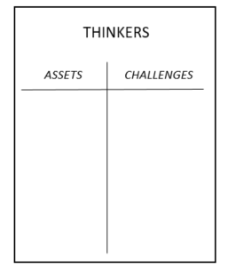
Communication Styles Pages 6- 11
Step 1: Go to the chart where your dominant style is posted
Step 2: Colleagues create a T-Chart with one side listing what makes this style an asset in the work of Affiliate Staff, and on the other side the challenges this style creates for Affiliate Staff.
SPIRITED
Direct
Spirited
Systematic
Considerate

Slide 3
Communication Styles
What makes this work style a great asset as staff?
What sorts of challenges does this style create as staff?
Direct
Spirited
Systematic
Considerate

Slide 4
Communication Styles Report Out
Report out from the Styles
Which style is most challenging for your group to work with?
Direct
Spirited
Systematic
Considerate

Slide 5

Key Points
Effective communication is vital for a healthy work culture and improved morale.
How we communicate, how people perceive us and how we listen are all factors in our effectiveness.
Recognizing our patterns is what is most important as it allows you to respond more effectively.

Slide 6
Communication Styles Under Stress

Slide 7
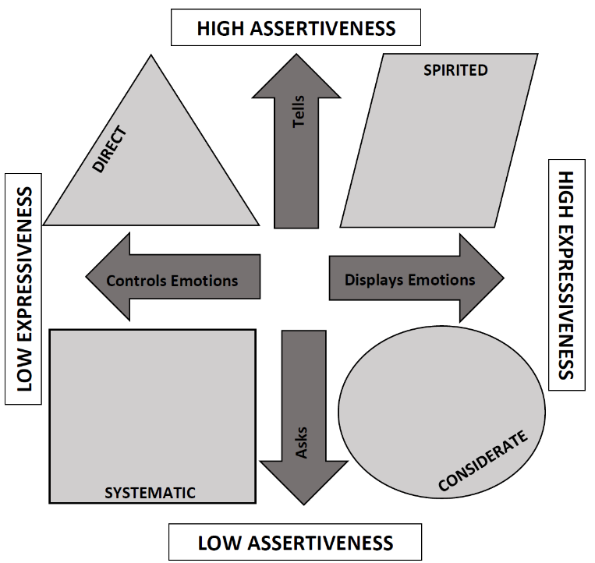
How Styles Handle Resistance 12-18
Expect resistance and try to prepare for it
Avoid resistance and skirt around it

Slide 8
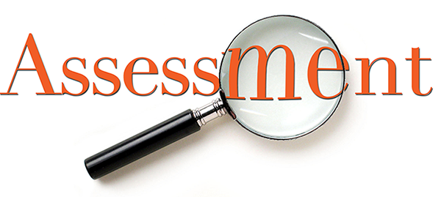
Style Under Stress
Violence
Controlling
Labeling
Attacking
Silence
Masking
Avoiding
Withdrawing

Slide 9
Direct and Systematic | Spirited and Considerate
Violence Patterns Violence patterns consist of any verbal strategy that attempts to convince, control, or compel others to your point of view. It violates safety by trying to force meaning into the pool. Methods range from name-calling and monologuing to making threats. The three most common forms are controlling, labeling, and attacking. | Silence Patterns Silence patterns consist of any act to purposefully withhold information from the pool of meaning. It’s almost always done as a means of avoiding potential problems, and it always restricts the flow of meaning. Methods range from playing verbal games to avoiding a person entirely. The three most common forms of silence are masking, avoiding, and withdrawing.

Slide 10
Use our Handouts
Style / Pattern | Checks
Masking | Rather than tell people exactly what you think, do you sometimes rely on jokes, sarcasm, or snide remarks to let them know you’re frustrated? When you have something tough to bring up, do you sometimes offer weak or insincere compliments to soften the blow?
Avoiding | Sometimes when people bring up a touchy or awkward issue, do you try to change the subject? When it comes to dealing with awkward or stressful subjects, do you sometimes hold back rather than give your full and candid opinion?
Withdrawing | At times, do you avoid situations that might bring you into contact with people you are having problems with? Have you put off returning phone calls or emails because you simply don’t want to deal with the person who sent them?
Controlling | In order to get your point across, do you sometimes exaggerate your side of the argument? If you seem to be losing control of a conversation, do you cut people off or change the subject in order to bring it back to where you think it should be?
Labeling | When others make points that seem stupid to you, do you sometimes let them know it without holding back at all? When you’re stunned by a comment, do you sometimes say things that others might take as forceful or attacking – comments such as “Give me a break!” or “That’s ridiculous!” ?
Attacking | Sometimes when things get heated, do you move from arguing against other’s points to saying things that might hurt them personally? If you get into a heated discussion, are you known to be tough on the other person. In fact, does the person feel a bit insulted or hurt?

Slide 11

How do you react when conversations become tense or awkward?
Masking
Avoiding
Withdrawing
Controlling
Labeling
Attacking

Slide 12
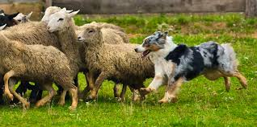



Why do we act this way?

Slide 13
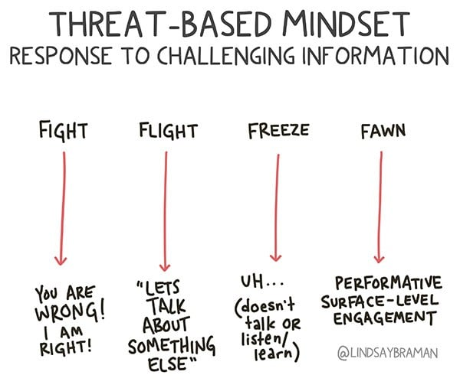
Masking
Avoiding
Withdrawing
Controlling
Labeling
Attacking

Slide 14

What is Needed…
Dialogue
  A two-way communication between persons who hold significantly differing views on a subject, with purpose of learning more truth about the subject from one another. Both are committed to speaking and listening.
  Building a pool of shared meaning.

Slide 15
Pool of Shared Meaning
All the shared knowledge in a conversation.
A measure of a group’s shared maturity.
More information in the pool makes for better decisions.
Remember
  The totality of information in the pool is what matters most
  One dominant person shouldn’t control it
  Other people’s contributions are just as valuable
  People are also more likely to follow through if they have contributed.
  Morale and trust grown when people feel they’re working towards a common goal.

Slide 16
How Our Style Can Affect the Pool of Meaning
Direct and Systematic | Spirited and Considerate
Violence Patterns Violence patterns consist of any verbal strategy that attempts to convince, control, or compel others to your point of view. It violates safety by trying to force meaning into the pool. | Silence Patterns Silence patterns consist of any act to purposefully withhold information from the pool of meaning. It’s almost always done as a means of avoiding potential problems, and it always restricts the flow of meaning.

