Slide 1

New Facilitator Clinic
Ilissa, Pete & Michael

Slide 2
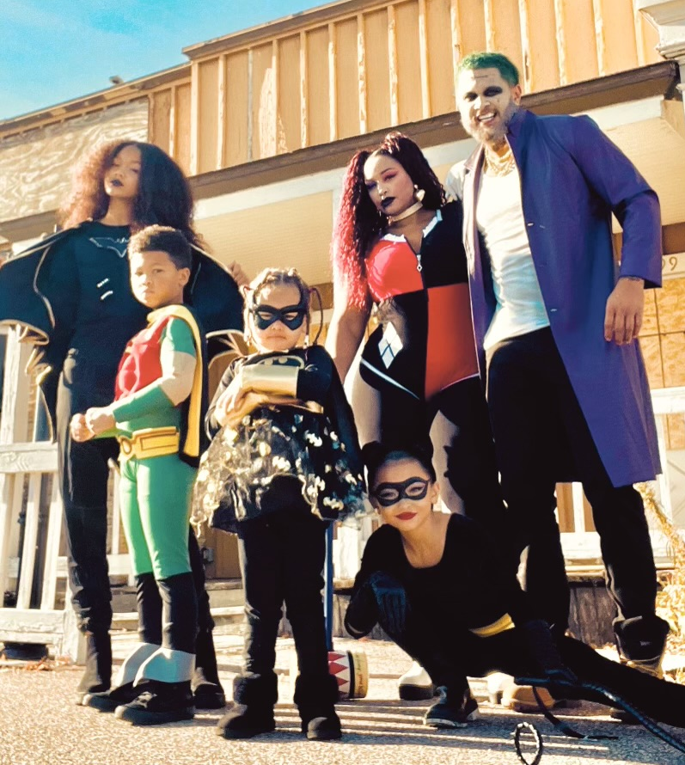
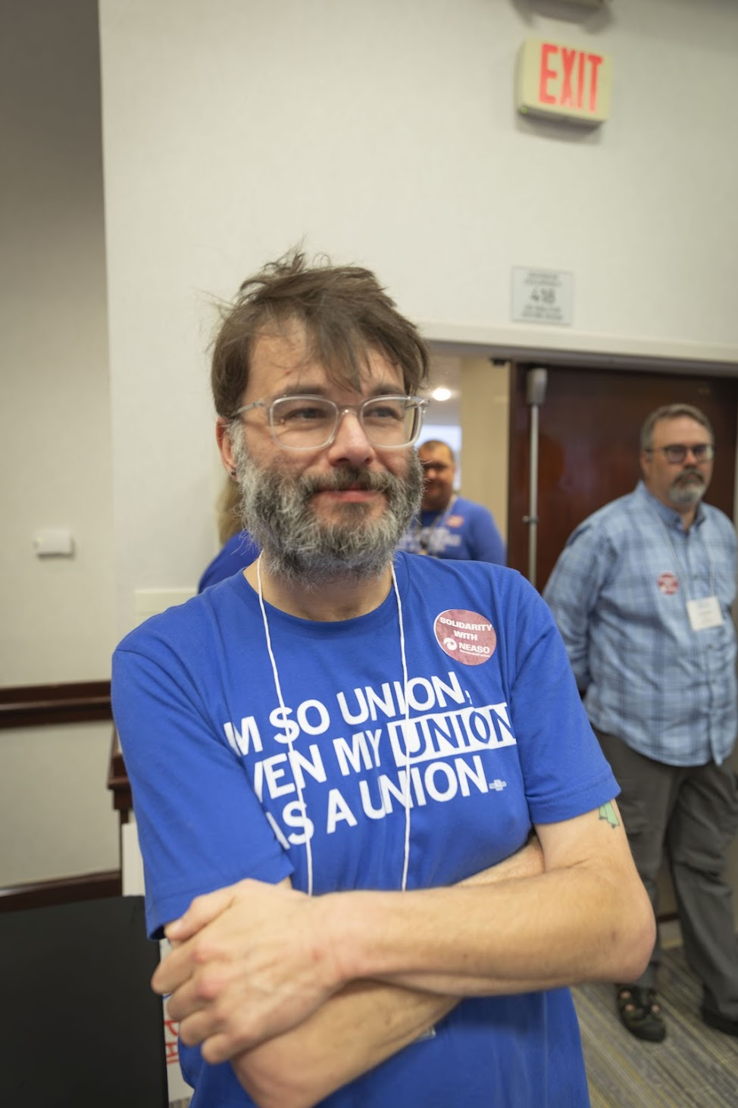
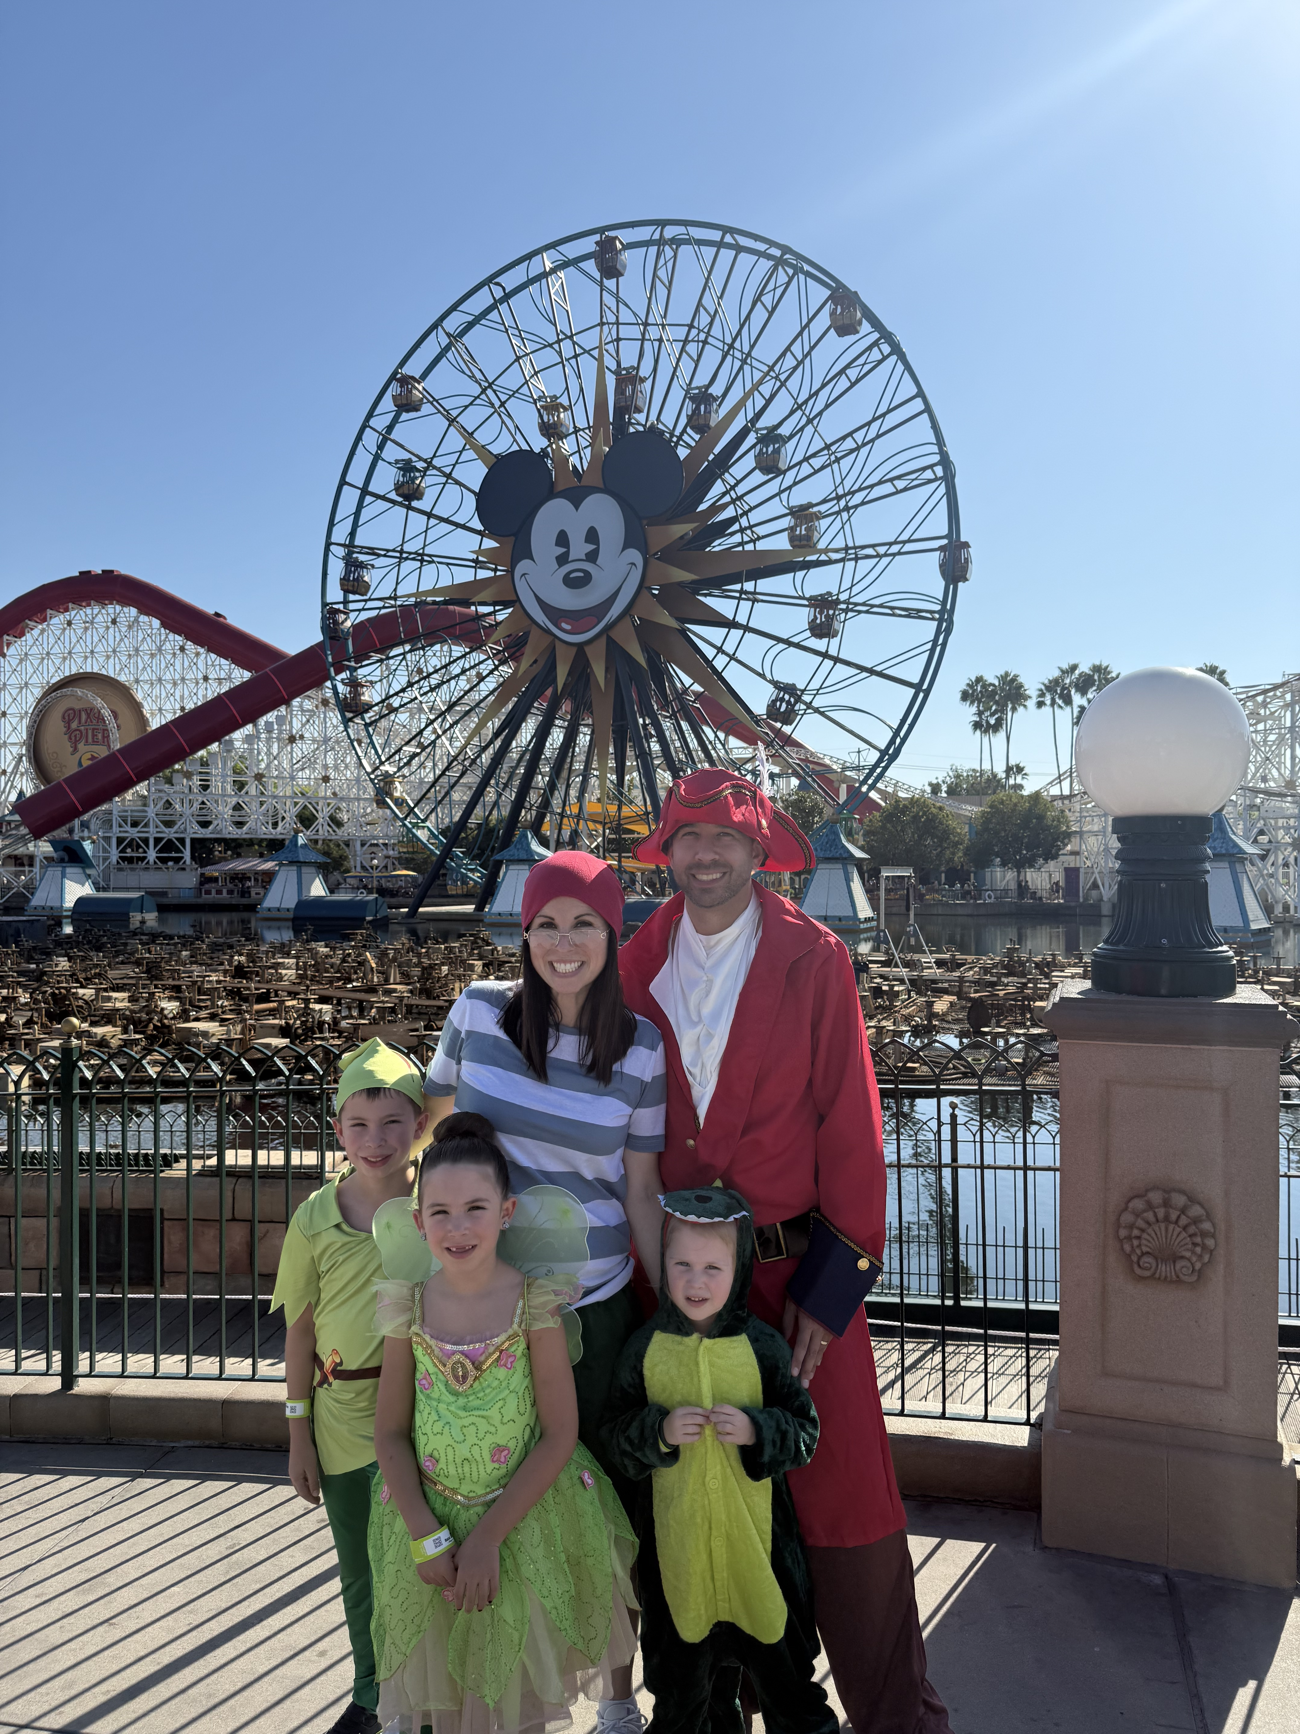
Who are we?
Ilissa Morrow SHE/HER/ HERS Education Minnesota 3-year facilitator | Michael Ruiz He/Him Washington Education 2-year facilitator | Pete Clancy He/Him Iowa Education 2-year facilitator

Slide 3

How did I get here?
Peer identification
Invite from Ellen to you and manager
Intentionality in team building (diversity, communication styles, strengths and experiences)

Slide 4
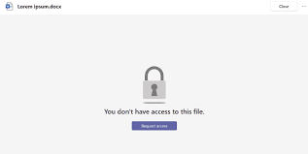
How do I use the tools?
Drive
  Don’t Panic: Contacts if it isn’t working Jay Hunter jhunter@nea.org and cc Ellen
Folders
Agenda
Tips and Tricks for Access
What to do if you have to withdraw – responsibilities
Bookmark the site!

Slide 5
Expectations
Timelines
  3-4 meetings prior to training
  Meet one day prior to training to prep and plan
  Arrive early in AM, plan to stay after training to debrief and prep for next day
  Foundations – 6-7 days (Travel Saturday and home on Friday)
  Focus trainings – 4-5 days (Travel Sunday and home on Thursday)

Slide 6
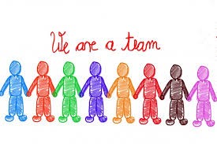
Meeting with the Team
  Prioritize the time together planning on zoom and during the training
  Do your individual prep so you come to group prepared
  Don’t go rogue- We make adjustments as a team (this is why its important to be present and engaged, even when you aren’t in front)

Slide 7

Meeting with the Team - Committments
  When adjustments are necessary, frame communication to participants as “we” “the team” “the room”, avoid blaming or scapegoating colleagues
  Plan to leave time for end of day debrief before engaging in other “back home” work or needs.
    This time is pivotal for addressing wrinkles, repairs, adjustments, feedback on feedback, etc. Your absence puts you and the team at a disadvantage.

Slide 8
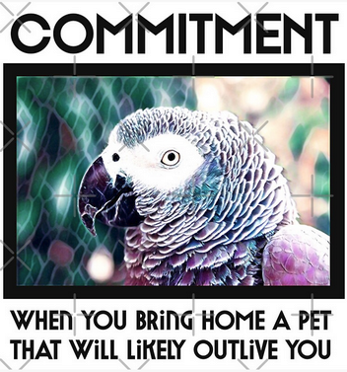
Commitments
  Planning time before arrival
  Sit as a team
  No outside work in the room
  Stay engaged even from the back
  Be prepared/Study your content
  Be authentic- you are empowered with creative freedom (but communicate with your team)

Slide 9
Talk about it:
What are three things you can do to free up/focus your time?
  Brain storm as a table – share out
Write about it:
What are three things you can do to free up your time?
  Make a personal commitment

Slide 10

Communication
  Don't get ahead of the person leading the room (Let them lead)
  Trust the participants and the debrief process (learning they work for is more valuable than learning you hand them)
  Contributions: Does it move the team/learning forward (check in and share publicly) or affirm what is already in the room (share privately)

Slide 11

Oops and Ouches, Yours and Others

Slide 12

Three-day rule . . . .
  Fish, Family, and Friends all start to stink after three days

Slide 13
What is your style?
Gather in groups of four based on your Leadership Style.
In a team setting, what kinds of ouches isolate you?
What sticks?
What rolls off?
Direct
Systematic
Spirited
Considerate

Slide 14
Gather in groups of four – be sure you have at least one of each Leadership Style in your group.
When am I at my best?
When am I at my worst?
Use Pg 49 the handouts to guide your discussion
Direct
Systematic
Spirited
Considerate

Slide 15
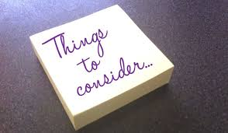
When you feel harm
Things to consider:
    Communication styles
    Cultural differences
    Assuming best intentions while self-advocating
    Timing
    Call out v. Call in

Slide 16

When you feel harm
  Steps to address it:
    (Maybe) get coaching/advocacy
    Speak with colleague/advocate speaks with colleague
    Seek mutual understanding
    State what you need for repair
    Consider together whether there is harm to the group and determine if the group needs for repair
  Seek Team Lead support if you are unable to resolve the issue

Slide 17
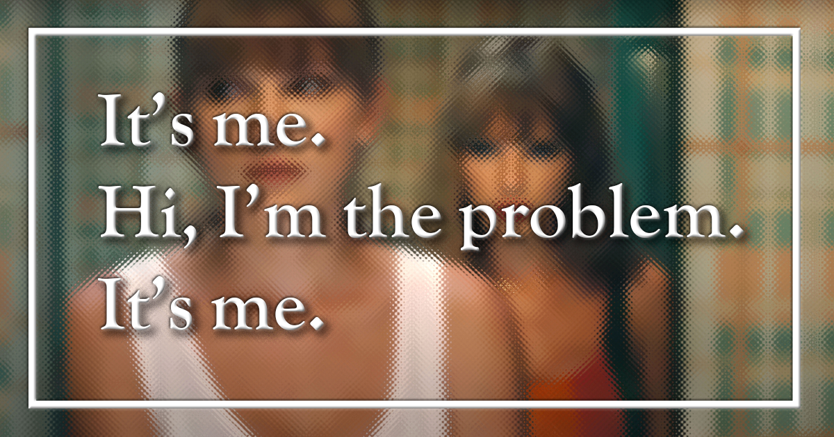
When you do harm
Something to consider:
  Impact matters more than intention
  Steps to address it
    Listen/Hear to understand harm
    Reflect on where/how/why of disconnect
    Suggest and solicit means for repair
    Consider together whether there is harm to the group and determine group needs for repair
  Seek Team Lead support if you are unable to resolve the issue

Slide 18
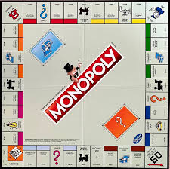
Exceptions that go straight to Ellen
  Slurs
  Discriminatory speech
  Sexual harassment
  Etc.

Slide 19


Key Ideas
Our leadership styles work is for more than internal self-reflection, it’s for interpersonal understanding. It isn’t just how the wheels turn in our own heads, but how the wheels fit with everyone else’s to move the team. (slide animations: one gear, and interlocking gears)

Slide 20
Key Ideas
We are all human and fallible. What makes or breaks the group isn’t whether harm is caused, it’s how we respond to it and what we do next.
This knowledge and understanding is not a free pass for bad behavior. It's a guide for how to prevent and repair harm so we bring our best to the participants and cultivate a safe space for all.

