Slide 1

Understanding Race, Class, and Gender as a System of Power

Slide 2
Facilitator

Slide 3
Disclaimer
Reminder about sensitive topics
The content we are going to explore may bring up strong feelings. Throughout our time together, we will explore examples of racism, ableism, heterosexism, and sexism.
These oppressive ideas and assumptions are offensive, problematic and false. Yet, over time, they have become as pervasive and invisible as the air we breathe. We need to examine them so that we can understand and ultimately challenge them. Modified ADL

Slide 4

POWER
This module was modified from Jobs with Justice’s Organizing Training.

Slide 5
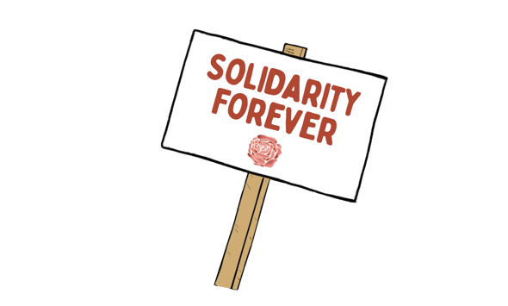
BRAINSTORM
Who are people in our society that we see as powerful?
Notes:
Count off by 8
Three Minute Report Outs ​
Summary​
What Level​
Why​
Then for all groups…​
What did you struggle with? ​
What was Clear to You?

Slide 6

What makes these people powerful?

Slide 7
FINISH THE SENTENCES
_______ power corrupts absolutely.
_______ is the root of all evil​.

Slide 8
Absolute power corrupts absolutely.
(THE LOVE OF) Money is the root of all evil.

Slide 9

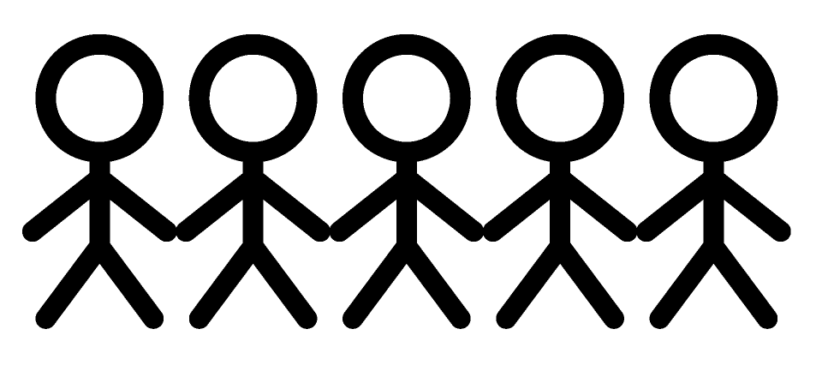
POWER
The ability to create, control, and prevent change.
ORGANIZED PEOPLE + ORGANIZED MONEY

Slide 10
FILL IN THE BLANK
_______ is power.

Slide 11
Review POWER
The ability to create, control, and prevent change.
ORGANIZED PEOPLE + ORGANIZED MONEY

Slide 12

Key Points
1. It is our job to help workers assess the power they need to achieve the change they want
2. Providing information and advocacy for individuals does not result in systemic changes ​- it does not shift power relations
​
3. Shifting power relationships is disruptive and will be met with resistance

Slide 13
Facilitator

Slide 14
Defining Race
Race is a relatively modern, European colonizer construct for the rule and management of human difference and a social system that positions people in relation to power and exploitation.
Race is at its core an idea with no scientific evidence of its existence, that is used to organize and manage groups of people at the level of populations with a view to exploiting them in various ways. So race does not stand alone from systems of power – the state, the colonial system and capitalism.
This construct of race works in conjunction with other constructs, such as rule of law, policy, policing, surveillance, borders, and state and non-state institutions of various kinds, to enact practices that separate between people in order to dominate and exploit them.
Race, class, and gender are always open to transformation because they are not concrete objects. The social constructs of intrinsic differences between people based on race, class, or gender has no basis in science. Rather to understand it, we must see it as a range of – adaptable – understandings for effecting domination and exploitation.

Slide 15
Table Discussion and Report Out
What challenges and surprises you about this definition?
What are the most important ideas for you to keep present in your work?

Slide 16
Defining Racism
Racism is the entirety of practices that produce and reproduce race. Racism is systemic and about imbalanced power dynamics that can be correlated with socially constructed race, class, and gender categories.
Race as a construct is a tool of power – and the use of it to divide and exploit people on the grounds of made-up divisions that are said to make them different from each other in an essential way is racism.
Racism exists when ideas and assumptions about racial categories are used to justify and reproduce a racial hierarchy and racially structured society that unjustly limits access to resources, rights, and privileges on the basis of race.
Racism’s existence is permitted when an imbalance in power and social status is generated by how everyone in a given society understand and act upon race.

Slide 17
Table Discussion and Report Out
What challenges and surprises you about this definition?
What are the most important ideas for you to keep present in your work?

Slide 18
Power and Privilege
Privilege and power are inequitably pooled among middle/owning class white straight men. A key to eradicating all types of inequity—racism, sexism, homophobia, etc.—is for anyone with privilege to resist denying inequity, especially by focusing on individual examples and by ignoring the central role of power in all types of inequity such as racism.
Racism is not just a matter of bad attitudes towards people who are different to ourselves. Neither is it just the extremist actions of lone wolves. It is about creating the conditions in which whole groups of people are made more likely to die.
Race, class, and gender are intentional constructs that define people as more or less-than-human. More or less capable of high paying jobs, deserving of access to care, and likely to be forced to exist in conditions which leads to impoverished lives which, in turn, can cause premature death.
This is by design to preserve the status quo of those in power.
Power gives nothing that it is not forced to give.

Slide 19
Definition of Privilege
A special right, advantage, or immunity granted by our unique relationship to a system of power.

Slide 20
Table Discussion and Report Out
What challenges and surprises you about this definition?
What are the most important ideas for you to keep present in your work?

Slide 21
Key Points
1. The outcomes of injustice in our society are the result of the use of race, class, and gender constructs within an imbalanced system of power.
2. Providing training and advocacy for individuals does not result in systemic changes ​- it does not shift power relations that will result in better outcomes for those most exploited by the imbalance of power in the system
3. This imbalanced system of power is a problem for all of us.
​
4. Shifting systemic power relationships disruptive and will be met with resistance

Slide 22
Facilitator

Slide 23
Reminder: Definition of Privilege
A special right, advantage, or immunity granted by our unique relationship to a system of power.

Slide 24
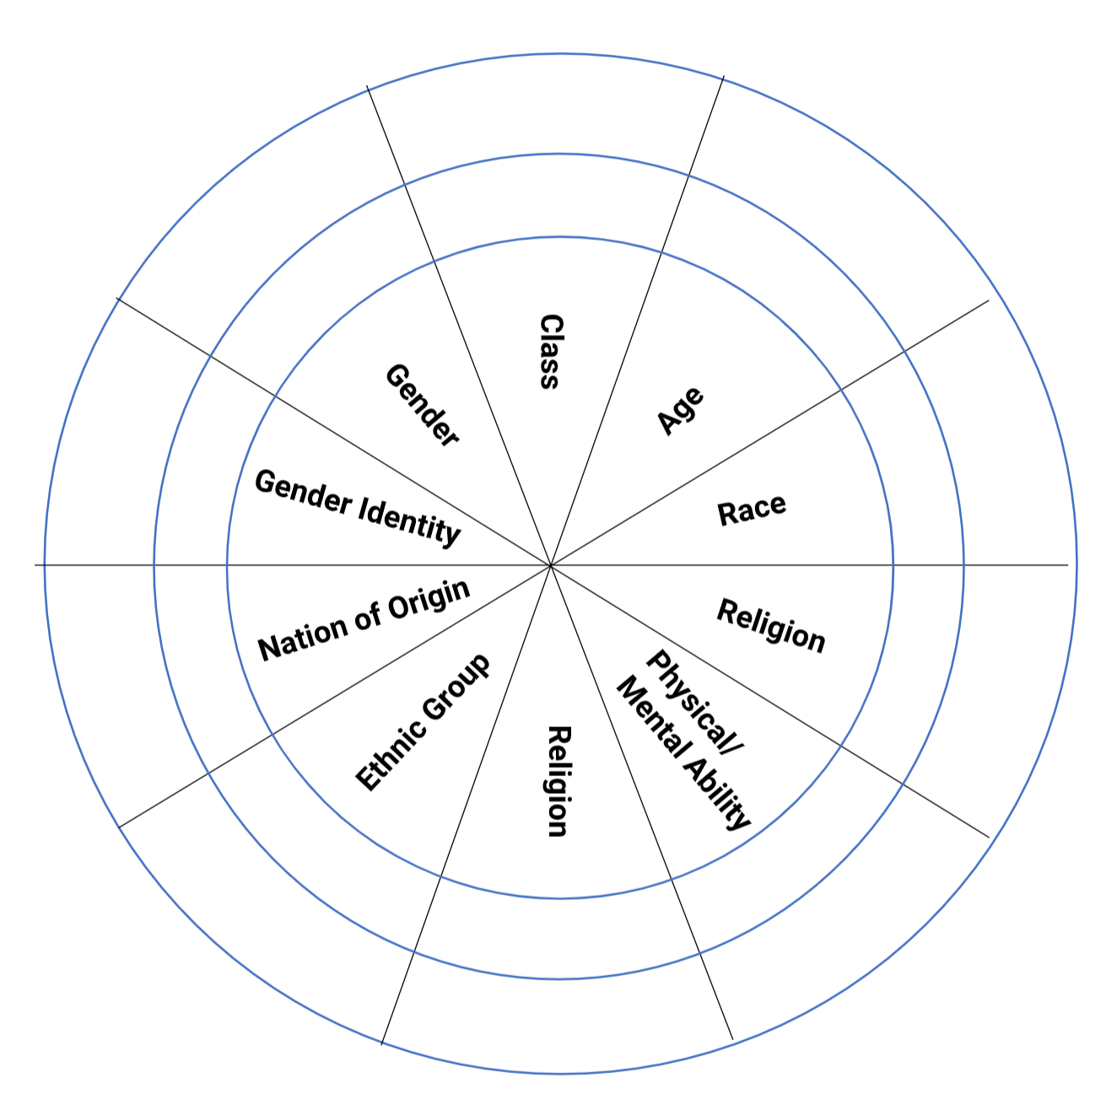
Power Shield
Power
Shield
P. 18
With one
Correction on the handouts
Sex
Sexual Orientation
Notes:
We are going to take a minute to look intentionally at our identities, and how they relate to power.
Stations around room for activity: Gender/Presentation, Race, Sexual Orientation, Ethnicity, Religion, Class, Nation/Language of Origin, Physical/Mental Ability, Age, Work Category
Challenge by choice; not meant to out someone.
Which identity do you think about the most?
…the least?
Which identity are people most surprised to learn about it?
Which identify brings you the most discomfort or confusion?

Slide 25
Power Shield Activity p.18
Analysis of Power and Privilege as Individuals
Inner Ring – Dominant Identities
Outer Ring – Oppressed Identities
First on your own, then discuss as a group
Sex
Sexual Orientation

Slide 26
Power Shield Activity
On your own --
Mark the inner or outer ring of each trait to describe your identity.
Consider as a table group:
How many of your segments are not dominant, meaning you do not share those areas of power conferred by society?
What insight does this provide on how you have been treated as a person of privilege or a marginalized person?
Which Identity brings you the most discomfort or confusion?
Sex
Sexual Orientation

Slide 27
Power Shield Activity
Let’s Move –
Notice the stations around the room correlated to the shield.
Which identity of yours do you think about the most?
Move to that station, discuss your reasons why, and report out.
Sex
Sexual Orientation

Slide 28
Power Shield Activity
Which identity of yours do you think about least?
Move to that station and discuss:
Why don’t you have to think about it as much?
What could that mean in terms of your identity?
How can you leverage that power/privilege for marginalized people in your scope of influence?
Sex
Sexual Orientation

Slide 29
Power Analysis Debrief
How did you feel as you completed your own?
What are ways you might use this in your work?
  With members
  With your colleagues
Sex
Sexual Orientation

Slide 30
Key Points
Race, Class, and Gender are intentionally constructed ideas built for the rule and management of human difference in a social system that positions people in relation to power and exploitation.
Each of us has a unique relationship to this system of power and exploitation.
We have the ability to use our collective agency to act to change these systems of power.

Slide 31
Power Shield Activity- when you go to lunch
Everyone--
Place your dots on the large poster as you marked your handout.
The composite picture will tell us what you think about your privileges as a group.
Sex
Sexual Orientation
Notes:
See facilitator guide for more/alternate reflection questions

Slide 32


Slide 33
Power Shield Activity – Welcome back
Dots...
What do you notice?
Sex
Sexual Orientation
Notes:
See facilitator guide for more/alternate reflection questions

Slide 34
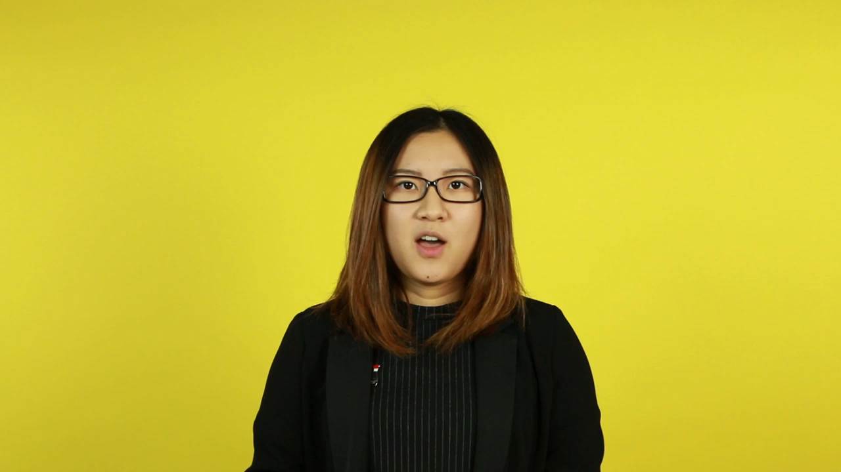
Intersectionality

Slide 35
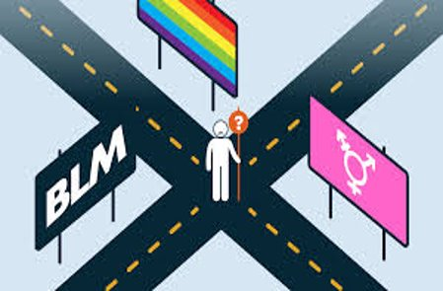
Intersectionality
Intersectionality is a framework for understanding a person, group of people, or social problem as affected by a number of discriminations and disadvantages. It takes into account people's overlapping identities and experiences in order to understand the complexity of prejudices they face.​

Slide 36
Levels of Expressions of Oppressions pg 19
I n d i v i d u a l | Internalized Oppression lies within individuals. These are our private beliefs and biases about others, influenced by our culture, that reside inside our minds. | S y s t e m i c | Institutional Oppression occurs within institutions and systems of power. It is the norms, policies and practices that are structured into political, societal and economic institutions that have the net effect of imposing oppressive conditions, denying rights, opportunity, and equality to identifiable groups.
 | Interpersonal Oppression occurs between individuals. Once we bring our private beliefs into our interactions with others, we are now in the interpersonal realm. |  | Structural Oppression is bias across institutions and society. It’s the cumulative and compounded effects of an array of factors that systematically privilege some and disadvantage others.
Notes:
10:45-11:30 Ben

Slide 37
Key Points
1. There are no hard and fast lines between the levels – and changing one can affect another. ​
​
While we believe that the individual is ​
responsible for exploring personal bias …​
​2. The way to effect change is by addressing institutionalized and structural oppression – this is where injustice lives.

Slide 38
Lucy

Slide 39
Understanding Levels of Expressions of Oppression p. 20-24
Drawing on your knowledge base and experiences: ​
Independently analyze the scenarios and determine the expression of oppression. ​
Discuss at your tables and reach consensus about the expression of oppression in each scenario.​
TOTAL Report Out – 3 Minutes be prepared to report a 2 Sentence Summary of your scenario and the Consensus Decision about what level of oppression is being expressing and why.
Notes:
Count off by 8
Three Minute Report Outs ​
Summary​
What Level​
Why​
Then for all groups…​
What did you struggle with? ​
What was Clear to You?

Slide 40
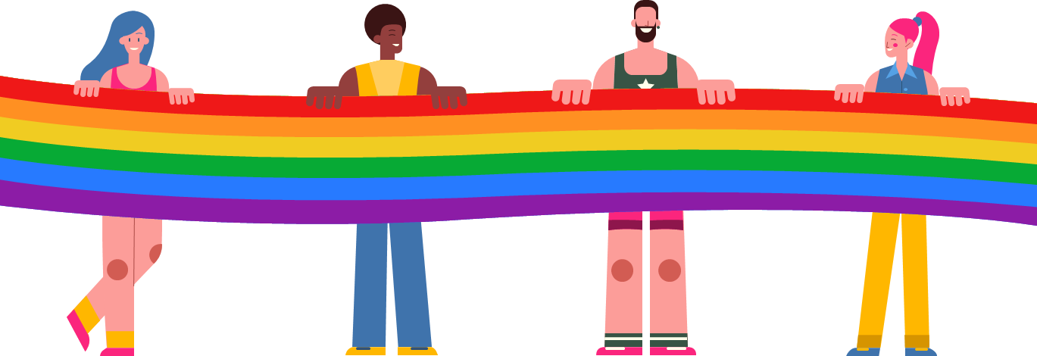
What did you struggle with?
What was clear to you?
Debriefing the Levels of Expressions of Oppression

Slide 41
Key Points
1. There are no hard and fast lines between the levels – and changing one can affect another. ​
​
​2. The way to effect change is by addressing institutionalized and structural oppression – this is where injustice lives.
3. This framework helps us think about the size of the solution we need to fight injustice at a particular level.
4. Using and intersectional lens alongside the understanding of the levels of expressions of oppression help us decide the scope of the solution we need and the power it will take to implement that solution.

