Slide 1
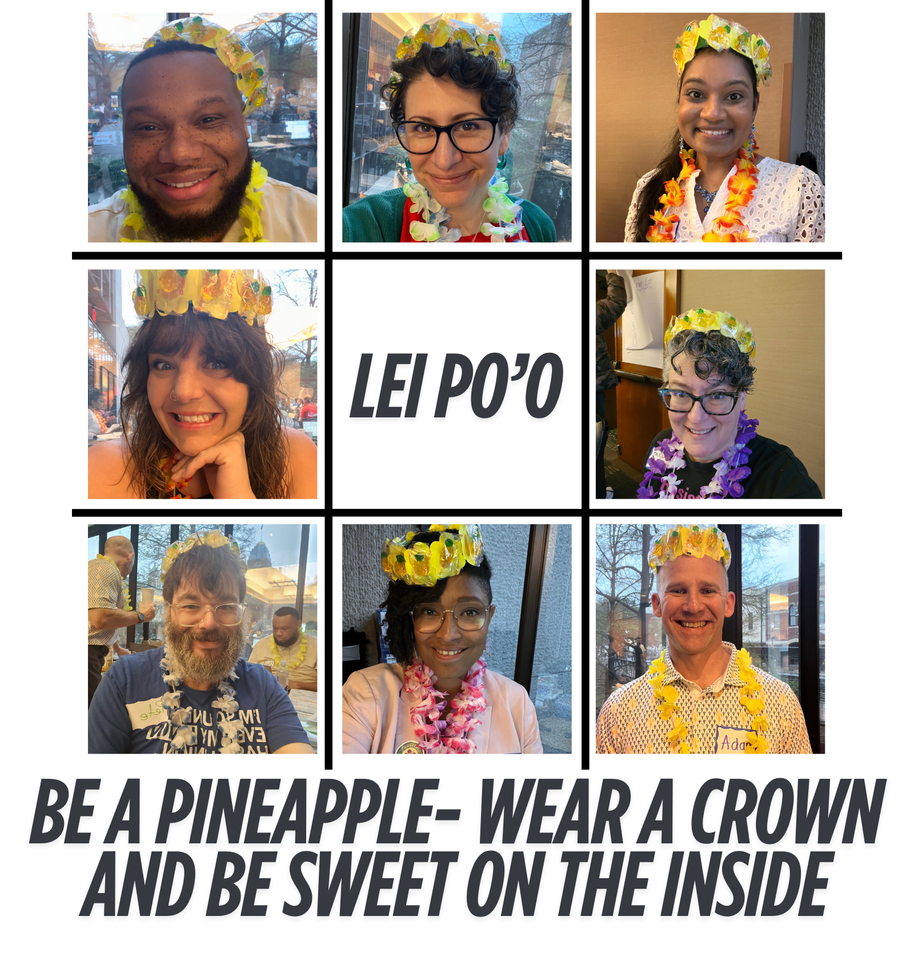
Monet, Katie, and Michael
Team Formation!

Slide 2
The Goal
8 facilitators per event (9 for Foundations)
Each facilitator volunteers for two (2) trainings & serve as an alternate on at least one (1)
Each training has three (3) alternates, one (1) of which is a priority alternates
Each facilitator is able to facilitate at their first, second, and/or third choices (if available- no guarantee)
Each team is diverse, in aspects of identity, state dynamics, etc.

Slide 3
Team Diversity And Balance
It's not as much about how we identify as it is about the initial "do I see diversity."
White presenting or all femme/masculine presenting people has an impact on our training space(s).
As we work to build our teams, we need to be aware of the dynamics of power and representation.
Notes:
We also want to discourage folks from forming pre-determined teams that have consistently trained together.

Slide 4

The Process- Round 1
All in-person programs are posted around the room
Everyone will go to a program for which they wish to be a facilitator.
No more than 4 people per team in Round 1

Slide 5
The Process- Round 1- Continued
If there are 5 or more interested in facilitating that program:
  First, anyone can move to a program that has less than 4, or if that doesn't happen...
  Next, you will look at the makeup of the group including those that aren't with us today and consider if anyone could move to maintain broad representation before adding your name to the sheet, and...
  Last, we’ll have the group figure out who moves.
Anyone who leaves to find another program may first write their name as a “priority alternate” of their initial Round 1 pick. ​
We will repeat this for each program with 4 or more facilitators. ​
Once each group has 4 or fewer facilitators, all will write their names as facilitators.

Slide 6

Round 2
Wash, Rinse, Repeat...
Go to the second program for which you wish to facilitate
  If the program is full, including alternates, find an open program.
  If there are already 4 facilitators listed, then the same rule applies for determining the remaining 4 facilitators.
  Should someone move to a new choice, they can place their name as a priority alternate of their initial Round 2 pick.

Slide 7

Round 3- Alternates!
All facilitators can place their name as an alternates on all of the programs there are able and willing to facilitate, and as a Facilitator on all programs that do not have a complete team.

Slide 8
Is your team balanced?

Slide 9
Let's Check Our Teams! Jeopardy Rules
As we call out your team and dates- please come up to the front of the room as a group.
As an audience, please look at the make-up of the team
1. Be Kind
2. Ask questions, not statements. (E.g. Would gender increase the balance of this team? How did you consider race in created a balanced team?)
If your team is not balanced, please look at your alternates or ask the audience for help.

Slide 10
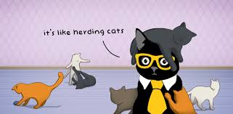
Team Leads!
  Each team needs to designate a team lead
  For Foundations there needs to be a team lead and a worksite organizing lead
  We will do this one team at a time, since we all serve on 2 teams
  Do not choose unless all members that are present in person, are present at your chart to choose.
  Picking leads by paper color, wait until your color is called.

