Slide 1
What it means to be on the team
Basics
Balancing
Team dynamics

Slide 2
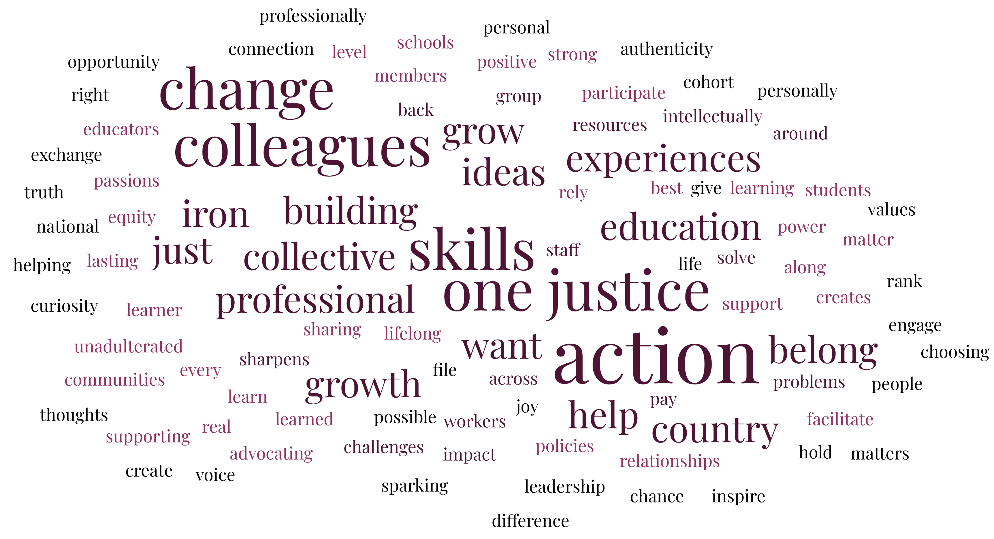
Why do we collectively do this work?

Slide 3
The basics—existing in the session’s universe
Know with whom to communicate (TEAM LEAD makes decisions; include Ellen and Karla)
Confirm your availability ASAP
Update Calendar Invites for Status:
  Attending—YES
  Not Attending—NO
  Alternate—MAYBE

Slide 4
The basics—The planning sessions
Scheduled planning meetings aren’t optional
  As an alternate—attend first meeting and then others as requested by Team Lead or Ellen
Respond to requests for scheduling, etc. within time frame requested by Team Lead
Do the work requested in the time frame requested by Team Lead
Team Lead=your deity.

Slide 5
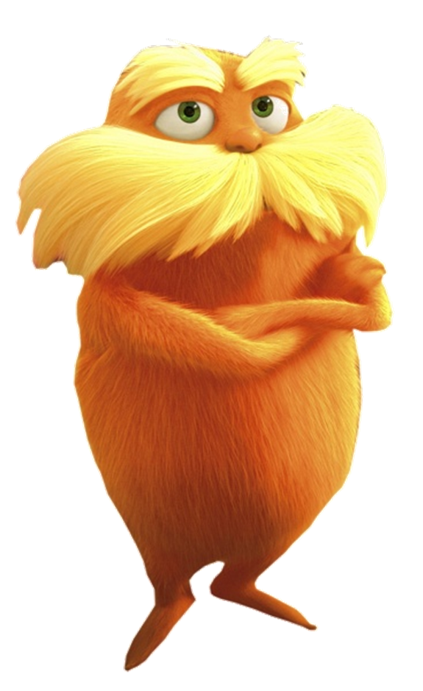
The basics—The session itself
If no longer able to participate, email Team Lead ASAP and copy Ellen and Karla (notice the pattern?)
You are responsible for bringing your own paper copies (if you want them) and MUST bring your technology

Slide 6
The balancing Act
Volunteer Job ≠ Flaking out
Honesty about capacity is way cooler than doing everything
Communication with Team Lead is life
Our way ≠ your way
We know work back home takes priority, but you can’t routinely back burner this work
Preparation takes longer than your flight to the site
Self-Awareness: How do you fit into the skills and team?

Slide 7
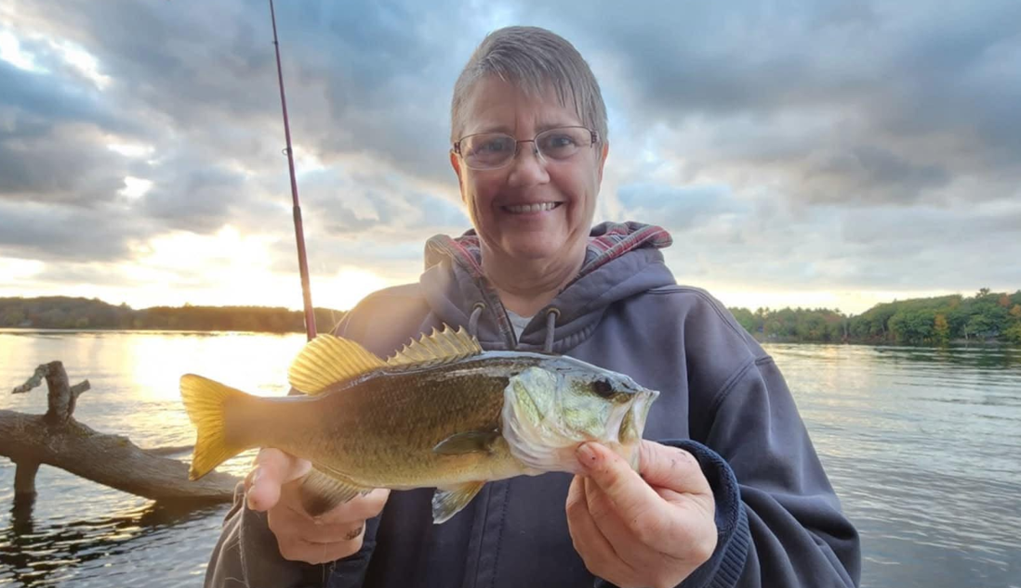

Team dynamics

Slide 8

Team dynamics
We teach: non-closure.
We teach: accepting each other’s diversity of thought and person
We teach: not letting interpersonal interaction disrupt the room moving forward.
We need to live these values as well.

Slide 9

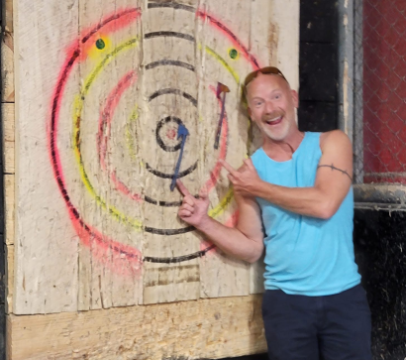
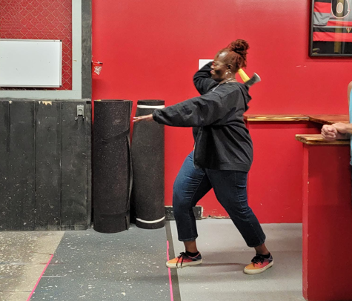
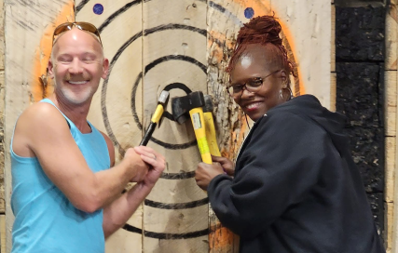
Team dynamics
Independent People + Independent Beliefs =
Needing to forward curriculum that may/may not perfectly align with you
Calling you up for not doing this isn’t a personal attack

Slide 10

Team dynamics
And finally:
We work together as a team.
This requires honesty.
When we are not feeling well. When we aren’t performing well. When we experience an interaction that isn’t our best. We communicate and we move forward with grace.
Keep the goal in mind: Providing the best damn learning opportunity for our colleagues across the nation. And we do.

Slide 11
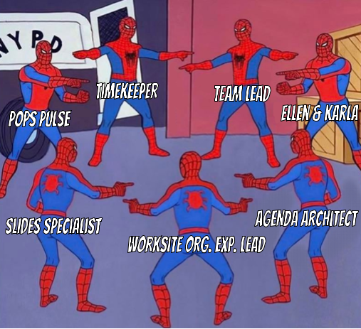
What May this look like in person?

