Slide 1
Facilitator Planning Meeting
2026-2027

Slide 2
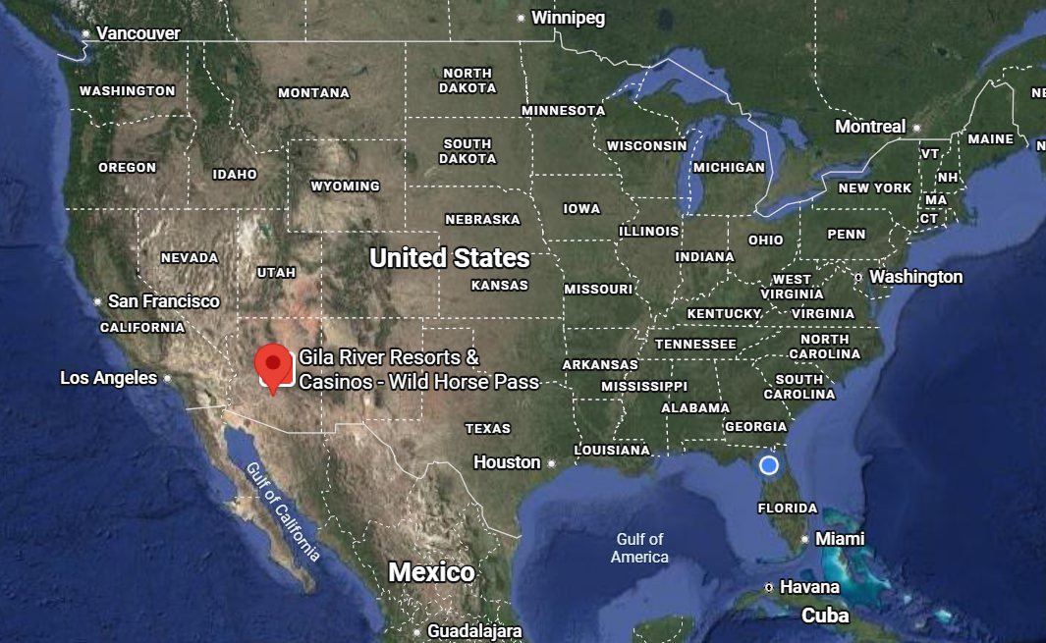
Welcome!
Gulf of Mexico

Slide 3
By attending this training, you confirm that you are either an NEA affiliate staff person or NEA member in good standing. The information you receive here is only for your use in your capacity as an NEA affiliate staff person or NEA member.
This presentation and its contents are confidential and may not be further distributed or passed on to any other person or published or reproduced, in whole or in part, by any medium or in any form, for any purpose unless written consent has been provided by Ellen Holmes. Audio/video recording, copying of slides, and the use of AI note-taking tools are prohibited without the written consent from Kyle Serrette. Violation of these terms may result in legal action.

Slide 4
NEA Standards of Conduct
NEA has adopted a Standard of Conduct Policy to ensure that all of our gatherings are welcoming to and free from discriminatory, harassing, or otherwise unacceptable behavior. Discrimination or harassment based on race, color, ethnicity, religion, sex, age, national origin, sexual orientation, disability, gender identity, or expression, or any other characteristic protected by law will not be tolerated. If you experience any discriminatory or harassing behavior, please report the incident by emailing Ron "Duff" Martin (rmartin@nea.org) and Gladys Marquez (gmarquez@nea.org). Thank you for your commitment to ensuring a positive event for all.

Slide 5

3-Day Agenda
Day 1
7:30-8:30 Breakfast
8:30 Convene
10:00-10:15 Break
10:15-11:00 Community Agreements Process
11:00-12:00 Team Reflection
12:00-12:45 Lunch
12:45-2:15 Team Formation
2:15-2:30 Break
2:30-4:20 Content Prep and Teams
4:20-4:30 – Wrap up
Day 2
7:30-8:30 Breakfast
8:30-10:00 Whole Group
10:00-10:15 Break
10:15-11:45 Break Outs
11:45-12:30 Lunch
12:30-2:00 Break Outs
2:00-2:15 Break
2:15-3:45 Content Teams
3:45- 4:30 Closing
5:30 Team Building
Day 3
7:30-8:30 Breakfast
8:30- 11:30 Content Teams
11:30-12:30 Team Presentations
12:30-1:30 Closing
1:30 Adjourn

Slide 6

Logistics to Remember
Questions to Ask
Bathroom
Materials
Food
Room Temperature
Karla as a Resource
Travel

Slide 7

Our
Outcomes
Day 1 – Form teams, begin content work
Day 2 – Improve our practice
Day 3 - Finish, or Make Plans to Finish

Slide 8

Ellen
Why are we Here?
Me
You
This Team

Slide 9
Why are YOU here?
Total: 1,770
Men-Women: 817-712 W - 40%
LGBTQIA+ ?
AI/NA:10
NH: 6
Multiple: 20
Asian: 21
Black: 169
Hispanic: 99
Total 18%
White Men 1,031 - Total 58%
Total: 58 (28 States and NEA)
Men-Women: 19-39 W- 67%
Gender Non-Conforming/Non-Binary - 2 (.04%)
LGBTQIA+ : 15 - 26%
Other than White: 28 - 49%
White Men – 12%

Slide 10
Core Beliefs of this Program
Those closest to the work need to lead others in the work.
Democracy is a messy process that is continually practiced and modeled.
If you figure it out, help the next person get it.

Slide 11
Why We Choose This Work
We choose this work because our values and our purpose are not separable. We show up because we believe in collective action, equity, justice, liberation, and solidarity, and because this community gives us hope when the world makes hope hard to hold. This space demands honest reflection, genuine growth, and the courage to be challenged and to challenge back, and we are better humans for it. We believe that those closest to the work are best positioned to lead it, and we choose to be people who open doors rather than guard them. Many on this team came first as participants before returning as facilitators. That history carries both a responsibility and a joy: if you figure it out, you help the next person get there too.

Slide 12
What is Our Shared Purpose
Our shared purpose is to equip, connect, and mobilize members and staff to build individual skills and collective power for lasting, equity-driven change through issue campaigns and winning elections. We create brave spaces grounded in popular education and adult learning, because people grow when they are active participants in the process, not passive recipients of content. We advance racial justice, workers' rights, and social justice rooted in the conviction that those closest to the work lead others in it. We do not hand people answers. We help them discover that the power to create change already lives within them, and that shared knowledge, never gatekept, is the foundation of everything we build together.

Slide 13
How We Achieve This Purpose
We achieve our purpose through collective leadership, authentic relationships, and a commitment to learning together that is not focused on reaching a finish line. Our approach is responsive: we listen deeply, adjust continuously, and treat participant feedback and honest reflection as conditions of the work itself, not optional add-ons. We model democracy rather than merely teaching it, staying in the messy, uncertain, imperfect process because that is what it looks like to live our values. We show up, even when tired, even through difficulty, building not just for this cycle but for every cycle to come.

Slide 14

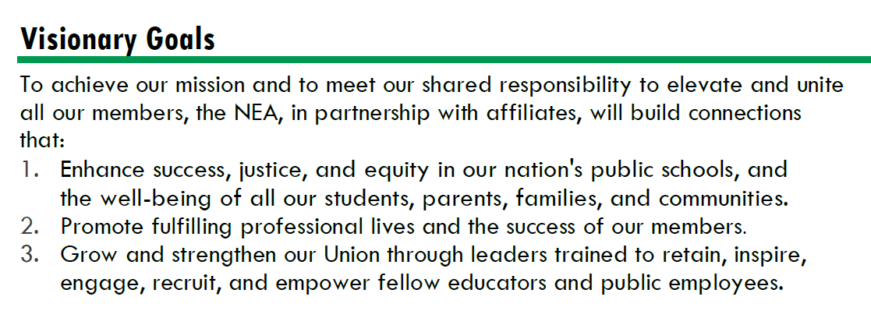




Strengthen Public Education as the Cornerstone of Democracy
Advance Racial Justice and Social Justice
Promote Healthy, Safe, Inclusive, Collaborative, and Future-Focused Public Schools
Improve Professional Respect and High-Quality Working Conditions
Support Professional Excellence and Student Learning
Fuel the Transformation of Affiliate Organizational Capacity

Slide 15
By the Numbers
Face to Face Programs
  3 Foundations and 4 Focused Academies (For Staff and Members)
  3 Campaign Lab Academies
  2 State Special Projects (Arizona, Maryland)
  3 Conference Tracks
    (Retired, Higher Ed, ESP)
  4 Partnership Programs
    CSRJ, CBMA, School Safety, ESPQ, Campaigns and Elections
Online Programs Using LMS
  10 Online Events (Synchronous)
  All In Person Programs have an LMS Course- Paperless
TOTAL 408 Face to Face Participants
TOTAL 828 Online Registrants
1.1 Million Dollar Investment Over 1236 People and Us

Slide 16
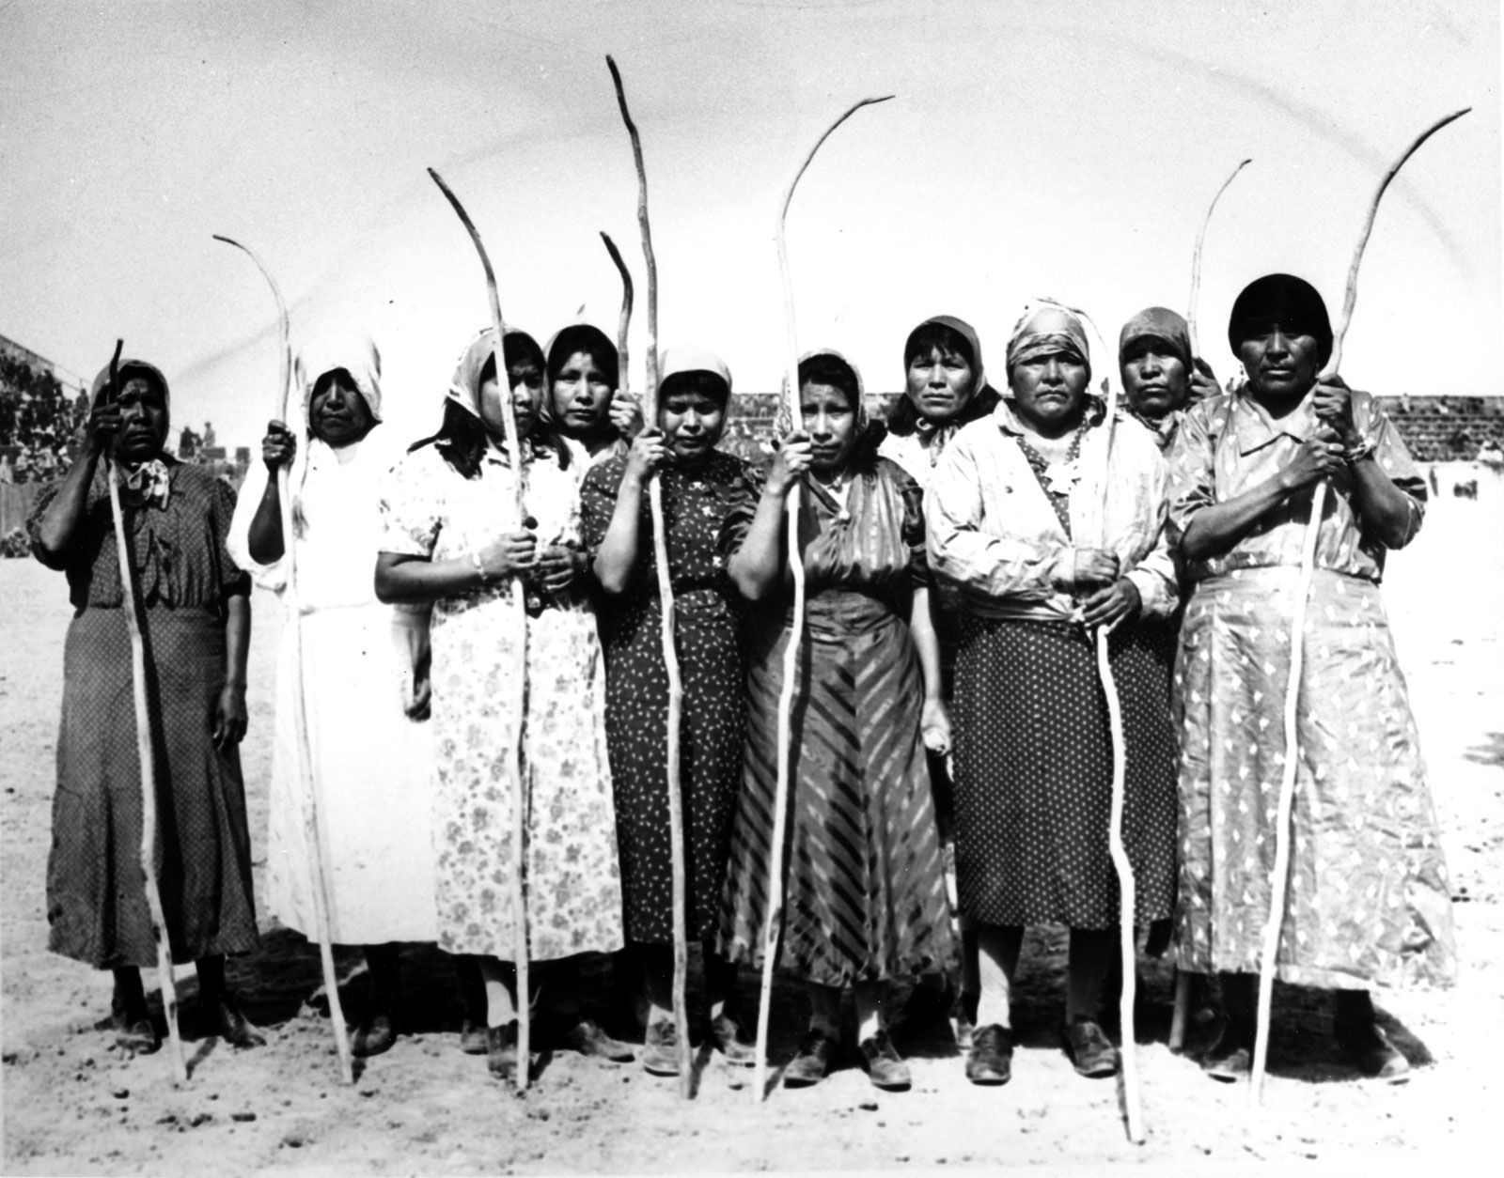
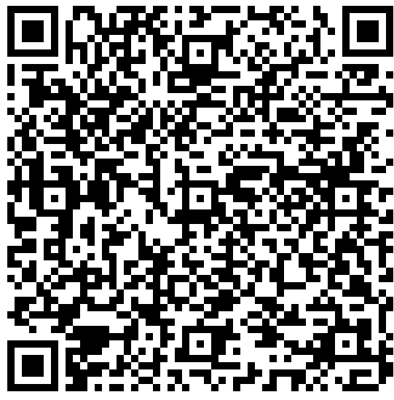
Honoring This Space - Kayla
We begin by acknowledging that through a history of colonization and brutality, we are currently on the traditional lands (O’odham Jeweḍ, Akimel O’odham, & Hohokam) stewarded by generations of indigenous people.
We honor these indigenous people, all elders, past, present, and emerging. We are called to learn and share these learnings about this tribal history, culture, and contributions that have been suppressed in the telling of the story of what we now call the United States of America.
Scan here to learn more:

Slide 17

Community Agreements - Alan
Using Self-Awareness and Self-Knowledge
Listening for Understanding
Being Gracious
Staying Engaged
Being Open and Suspend Judgment
Saying “I”- tell your truth
Lean Into Discomfort
Reaching Empathy
Expecting Non-Resolution and Non-Closure
*Adapted from “Embracing equity and inclusion”, Annie E. Casey Foundation
Notes:
Community Agreements for Our Time
Awareness and Self-Knowledge
This requires self-knowledge and self-awareness. Self-knowledge allows you to see what causes you pain and conflict and enables you to embrace your contradictions and inconsistencies. It allows the space to work on things about yourself that you are not happy with. In turn, self-knowledge helps to prevent you from projecting your negative aspects onto other people. Bringing your best self also requires that you have a positive attitude, are willing to deeply explore your perspectives and remain open to the perspectives and experiences of others.
Listening for Understanding
Be an active listener. Active listening involves paying full and careful attention to the other person, looking him or her in the eye, avoiding interruptions, reflecting your understanding, clarifying information, summarizing the other person’s perspectives and sharing your own. Remember that most people need time to open up and might not be willing to immediately share their personal stories, hopes, fears and/or concerns.
Being Gracious
Being kind is a vital way of bringing meaning to our own lives, as well as the lives of others. Kindness is about caring genuinely for others around you, wanting the best for them and recognizing in them the same wants, needs, aspirations and even fears that you may have. Being kind and generous allows us to communicate better with others, to be more self-compassionate and to be a positive force in other people’s lives. This includes following the COVID protocols that are in place to protect the health of this learning community.
Stay Engaged
Staying engaged requires you to be morally, emotionally, intellectually and socially involved in the conversation. Staying engaged means that you are listening with curiosity and willing to deepen your understanding. Staying engaged might also require you to sustain the conversation even when it gets uncomfortable or diverted. This also means a commitment to keeping your electronic communications to a minimum with folks not present in this learning community.
Be Open and Suspend Judgment
Listening with an open mind includes being receptive to the influence of others. You can suspend judgment by becoming aware of preconceived notions and listening to everything someone has to say before jumping to conclusions. Most importantly, suspending judgment also means listening to what the speaker has to say for understanding, not just to determine whether the speaker is right or wrong.
Say “I”- tell your truth
Speaking your truth in authentic and courageous conversations about race requires a willingness to take risks. It means that you will be absolutely honest and candid about your own thoughts, feelings, experiences and opinions and not just saying what you perceive others want to hear. Speaking your truth will require you to speak from the “first person” and use “I” statements.
Seek Discomfort
Leaning in to discomfort will require you to let go of racial understandings and stereotypes that you may be holding onto in order to move forward. Leaning in means that you will avoid judgment, assume positive intent and be open to the kernel of wisdom in each individual’s experiences. Leaning in to discomfort will require you to sit through moments of embarrassment, confusion, anxiety and/or fear.
Reaching Empathy
Empathy and compassion allow you to understand the other person’s point of view. When you are empathetic, you are more understanding, patient and kind. Expanding your capacity to feel empathy will also allow others to enter your circle of human concern.
Resolution and Closure
Expect and accept that there may not be closure. It is not likely that you will resolve your personal understanding about race or another person’s racial experience in a single conversation. The more you talk about race with another person, the more you learn and the more they will learn. Authentic and productive conversations about race are continuous and always evolving.
*Adapted from “Embracing equity and inclusion”, Annie E. Casey Foundation

Slide 18
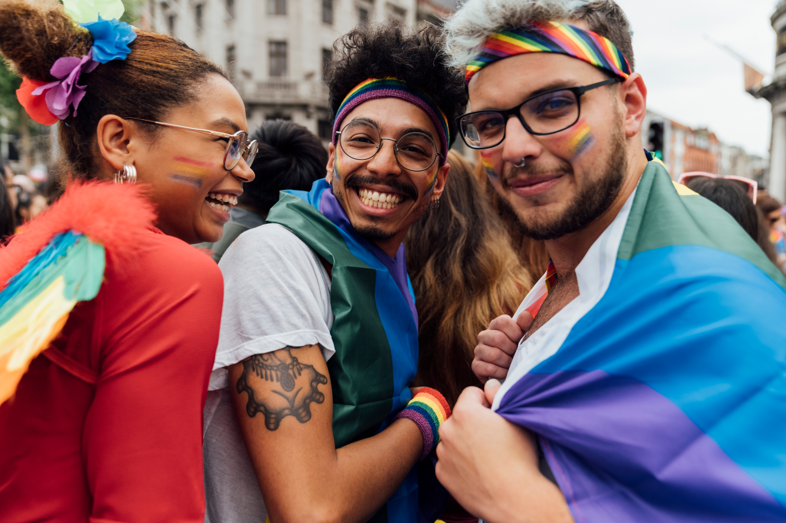

Introductions – Jeny, Rita, and Scout

Slide 19
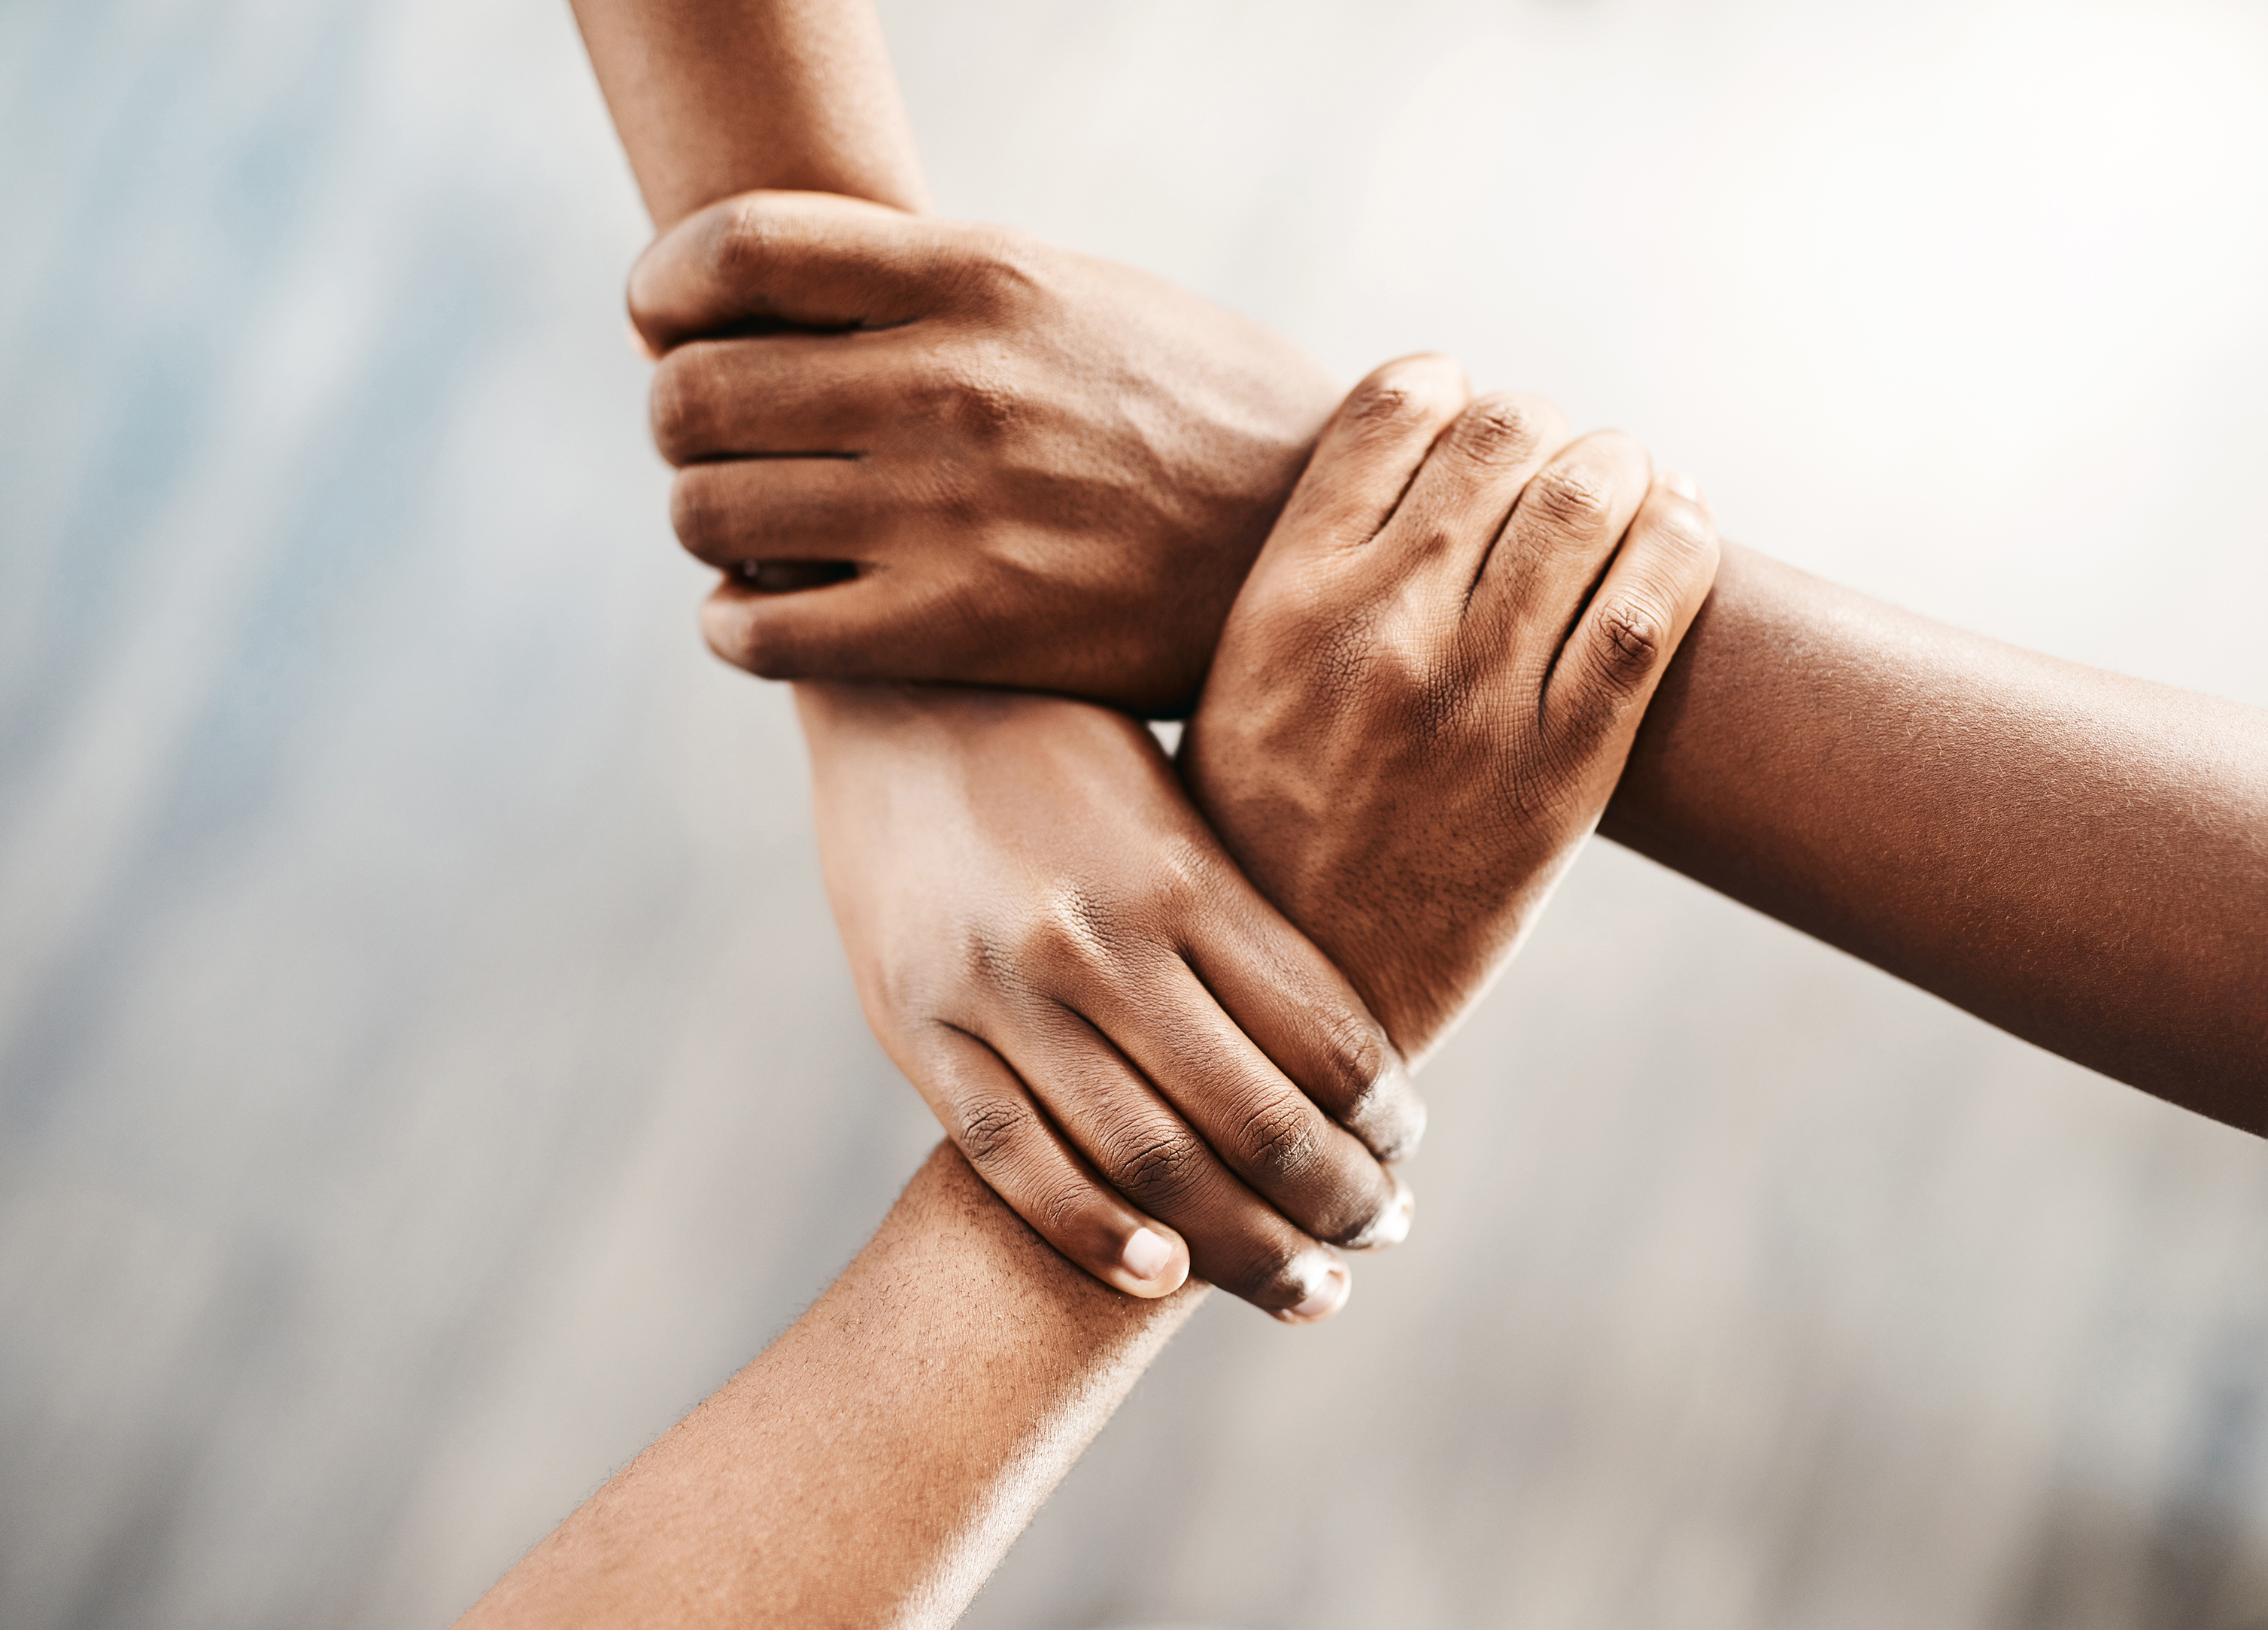
Future of this Program: 🐘 The Elephant in the Room
Ellen

Slide 20

Styles
Katie
Andrew

Slide 21


Or
"Oh I forgot to do my homework"
Katie and Andrew

Slide 22
Facilitator Styles
Structuralist: “The mind is like a computer; the teacher is the programmer.”
Functionalist: “People learn best by doing, and they will do best what they want to do. People will learn what is practical.”
Humanist: “Learning is self-directed discovery. People are natural and unfold (like a flower) if others do not inhibit the process.”
Behaviorist : “New behavior can be caused and ‘shaped’ with well-designed structures around the learner.”
Notes:
Behaviorist - "The Doctor" or "The Manipulator"
Structuralist - "The Expert" or "The Elitist"
Functionalist - "The Coach" or "Sink or Swim"
Humanist - "The Counselor" or "The Fuzzy Thinker"
(^positive vs. Negative expression of the style)

Slide 23
Facilitator Styles- At your table...
How well does your style describe how you think about learning?
How does it shape how you engage with adult learners?
How does it impact how you express yourself interpersonally in your leadership style?
What's my leadership style?
Notes:
-5 minutes for table discussion
-4 minutes group discussion
1.) Raise your hand by style
2.) Popcorn share out - one person per first 3 questions
Finish Facilitator Styles by 9:45am

Slide 24
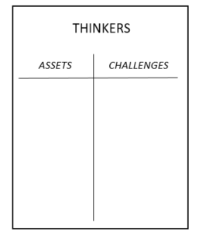
Leadership Styles
Step 1: Go to the chart where your dominant style is posted.
Step 2: Create a T-Chart with one side listing what makes this style an asset in the work of a facilitator, and on the other side the challenges this style creates for a facilitator.
Step 3: What's your group's theme song? (Do not sing it right now...)
SYSTEMATIC
Direct
Systematic
Spirited
Considerate

Slide 25
Leadership Styles Report Out
Tell two superpowers.
In a facilitator crisis, how do these superpowers help?
Direct
Systematic
Spirited
Considerate

Slide 26
Leadership Styles Report Out
Direct
Systematic
Spirited
Considerate
Look back to your challenges on your chart.
Which style can you lean on to fill each gap?
How do they help with those gaps?

Slide 27
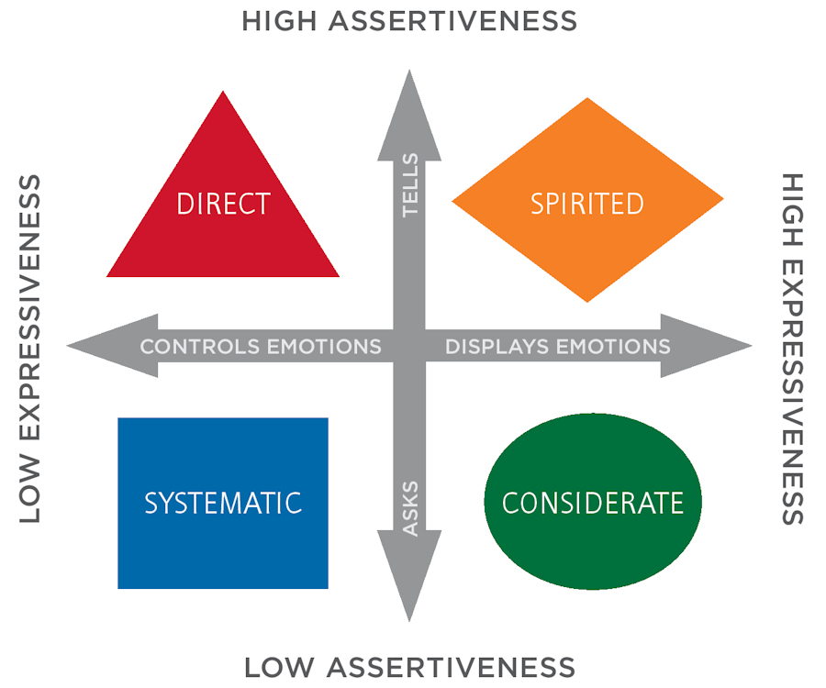
Leadership Styles Report Out
How do the aspects of your leadership style affect how you show up in the room?
What's your group's theme song?

Slide 28

Key Ideas
Being able to be a leader within a team requires skills from all the quadrants.
Teams need to have a balance to be most effective
How we communicate, how people perceive us and how we listen are all factors in being effective team members.

Slide 29


Slide 30
Community Agreement Process
Ellen
Melissa
Albert

Slide 31
Small Group Discussion
As facilitators of adult learning, how will we intentionally model and uphold these community agreements with participants?
What will accountability look like in practice amongst one another, and how will we support one another in honoring these agreements throughout our work together?

Slide 32
Team Reflection
Ilissa
Josh
Albert

Slide 33
Line Up and Bend the Line - Josh
Line up around the room from the most seasoned facilitator to the brand new to the team
Bend the line
Most seasoned
Brand new
Notes:
10 minutes
Ideally 6 people in each group
Total groups 7-8

Slide 34
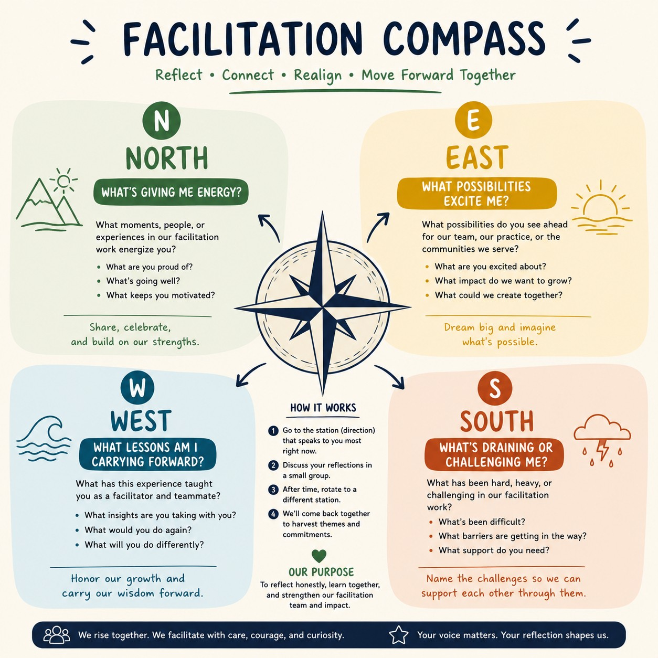
Facilitation Compass - Ilissa
In groups no more than 6, have a conversation around these questions:
North: What’s giving me energy?
South: What’s challenging me?
East: What possibilities do I see ahead?
West: What lessons am I carrying forward?
Notes:
35 minutes
6 minutes at each section. = 20 minutes total
10 minutes gallery walk

Slide 35

Debrief - Albert
Notes:
15 minutes

Slide 36
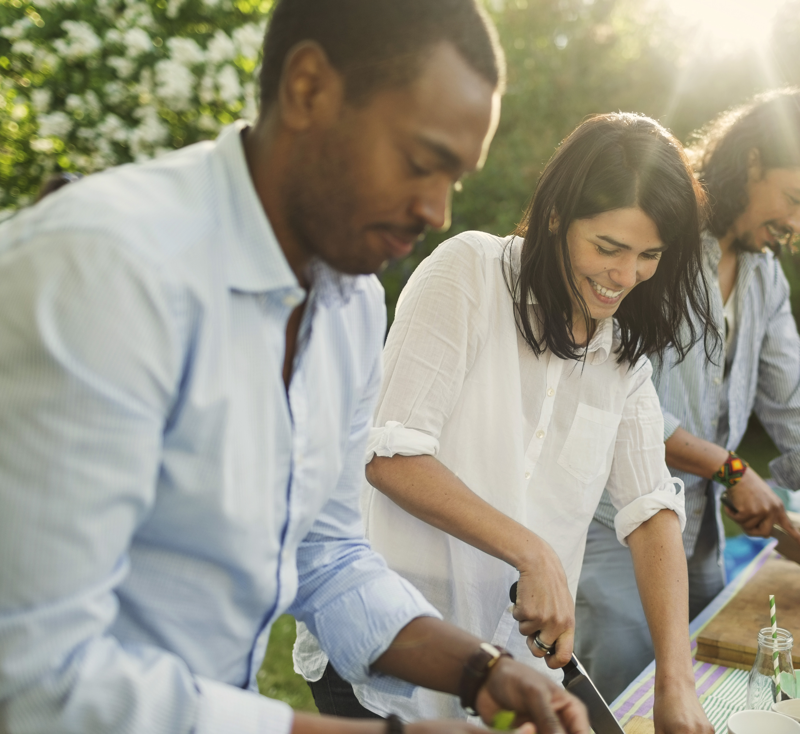
LUNCH TIME

Slide 37
Team Formation!
Barb, Ben, Beth B., and Michael

Slide 38
May 2026 Feedback
4.76 out of 5
Moving team formation to Day 1
"I liked that we reviewed the team formation. It forces us to "walk our talk""
Good system to represent absent members
People not honoring the process of conversations before writing names down
People felt relieved

Slide 39
The Goal
8 facilitators per event (9 for Foundations and School Board)
Each facilitator volunteers for two (2) trainings & serve as an alternate on at least one (1)
Each training has three (3) alternates, one (1) of which is a priority alternates
Each facilitator is able to facilitate at their first, second, and/or third choices (if available- no guarantee)
Each team is diverse, in aspects of identity, state dynamics, etc.

Slide 40

Team Diversity And Balance
It's not as much about how we identify as it is about the initial "do I see diversity."
White presenting or all femme/masculine presenting people has an impact on our training space(s).
As we work to build our teams, we need to be aware of the dynamics of power and representation.
Taking into account leadership styles and work styles.
Notes:
We also want to discourage folks from forming pre-determined teams that have consistently trained together.

Slide 41

The Process- Round 1
All in-person programs are posted around the room in order
Everyone will go to their first choice for which they wish to be a facilitator.

Slide 42
The Process- Round 1- Continued
If there are more interested in facilitating than spots available:
  First, anyone can move to a program that has less.
  Look at the makeup of the group and consider representation, availability, experience, etc.
  Last, the group will discuss who could move.
Anyone who leaves to find another program may write their name as a “priority alternate” of their initial Round 1 pick before departing.
Once each group has come to a consensus, they will write down the facilitator names.
We will repeat this for Round 2

Slide 43

Round 2
Go to the second program for which you wish to facilitate
  If there are more facilitators than spots remaining, then the same rule applies for determining the remaining spots.
  Should someone move to a new choice, they can place their name as a priority alternate of their initial Round 2 pick.
  If the program is full, including alternates, move to your third choice.

Slide 44

Round 3
All facilitators can place their name as an alternates on all of the programs they are able and willing to facilitate, and as a Facilitator on all programs that do not have a complete team.

Slide 45

Is your team balanced?

Slide 46
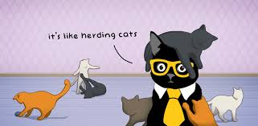
Team Leads!
  Each team needs to designate a team lead
  For Foundations and School Board, there needs to be a team lead and a worksite organizing lead
  We will do this one team at a time, since we all serve on 2 teams
  Do not choose unless all members that are present in person, are present at your chart to choose.

Slide 48
Content Team Outcomes
Ellen

Slide 49
Content Leads
Foundations Academies: Barb Whitman and Earl Spriggs
Advancing Racial Justice: Albert Jones, Linda Torres, and Matt Fargen
Organizing on HBCU Campuses: LaQuita Maxey, Ilissa Morrow, and Kayla Moore
Advancing LGBTQUIA+ Justice: Anthony Brisson and Scout Anvar
Organizing with ESPs: Beth Barton and Eric Simmons
Winning School Board Elections: Meighan Davis and Michael Ruiz
Campaign Lab Academy Group: Jeny Gardner, Katie Bishop, Seleste Harris, Melissa Dan, and Amanda Kail

Slide 50
Gold 🏅 | Silver 🥈 | Bronze 🥉
- All core materials (pre-attendance materials, facilitator guides, PowerPoints, participant handouts, and additional resources) are finalized, reviewed, and uploaded into the appropriate 2026 or 2027 SharePoint folder - All materials are fully facilitation-ready (finalized content, formatted, and organized for immediate use) - Two virtual planning meetings with the Presentation Team are scheduled prior to the training - Calendar invites for both meetings are sent and include all the Presentation Team, including Ellen and alternates | - All core materials are uploaded into the appropriate SharePoint folder - Most facilitator guides and PowerPoints are facilitation-ready, with only minor edits or formatting needed (Note: This needs to be completed at least 4 weeks prior to this event) - Additional resources and/or pre-attendance materials are partially complete or still being finalized with a plan and timeline to complete (Note: This needs to be completed at least 4 weeks prior to this event) - There is a scheduling tool (Doodle, When2meet, Email, etc.) already sent to confirm the two meetings to the Presentation Team, including Ellen and alternates | - Some core materials are uploaded to the appropriate SharePoint folder with a plan and timeline of when this will be complete (Note: This needs to be completed at least 4 weeks prior to this event) - Core materials are in draft form and not yet fully facilitation-ready but there is a plan and timeline for this to be complete (Note: This needs to be completed at least 4 weeks prior to this event) - There is a plan and timeline of when the two meeting dates will be decided and calendar invites will be sent to the Presentation Team, including Ellen and alternates

Slide 51

Process and Outcomes
First 45 Minutes – Review of any highlighted notes in the facilitator agenda, any thoughts from the person who was last on this team, and a light review of the evaluations.
Teams have the outcomes table as a guide.
Review all handouts, slides, pre-attendance handouts
Set meetings for continued revision, prep, and planning

Slide 52
Team Work Sessions
Break on Your Own
See You at 4:20

Slide 53

Ending it Right
Networking Shenanigans on Your Own

Slide 54
Facilitator Planning Meeting
Day 2

Slide 55
Community Agreements - Ellen
Using Self-Awareness and Self-Knowledge
Listening for Understanding
Being Gracious
Staying Engaged
Being Open and Suspend Judgment
Saying “I”- tell your truth
Lean Into Discomfort
Reaching Empathy
Expecting Non-Resolution and Non-Closure
*Adapted from “Embracing equity and inclusion”, Annie E. Casey Foundation
Notes:
Community Agreements for Our Time
Awareness and Self-Knowledge
This requires self-knowledge and self-awareness. Self-knowledge allows you to see what causes you pain and conflict and enables you to embrace your contradictions and inconsistencies. It allows the space to work on things about yourself that you are not happy with. In turn, self-knowledge helps to prevent you from projecting your negative aspects onto other people. Bringing your best self also requires that you have a positive attitude, are willing to deeply explore your perspectives and remain open to the perspectives and experiences of others.
Listening for Understanding
Be an active listener. Active listening involves paying full and careful attention to the other person, looking him or her in the eye, avoiding interruptions, reflecting your understanding, clarifying information, summarizing the other person’s perspectives and sharing your own. Remember that most people need time to open up and might not be willing to immediately share their personal stories, hopes, fears and/or concerns.
Being Gracious
Being kind is a vital way of bringing meaning to our own lives, as well as the lives of others. Kindness is about caring genuinely for others around you, wanting the best for them and recognizing in them the same wants, needs, aspirations and even fears that you may have. Being kind and generous allows us to communicate better with others, to be more self-compassionate and to be a positive force in other people’s lives. This includes following the COVID protocols that are in place to protect the health of this learning community.
Stay Engaged
Staying engaged requires you to be morally, emotionally, intellectually and socially involved in the conversation. Staying engaged means that you are listening with curiosity and willing to deepen your understanding. Staying engaged might also require you to sustain the conversation even when it gets uncomfortable or diverted. This also means a commitment to keeping your electronic communications to a minimum with folks not present in this learning community.
Be Open and Suspend Judgment
Listening with an open mind includes being receptive to the influence of others. You can suspend judgment by becoming aware of preconceived notions and listening to everything someone has to say before jumping to conclusions. Most importantly, suspending judgment also means listening to what the speaker has to say for understanding, not just to determine whether the speaker is right or wrong.
Say “I”- tell your truth
Speaking your truth in authentic and courageous conversations about race requires a willingness to take risks. It means that you will be absolutely honest and candid about your own thoughts, feelings, experiences and opinions and not just saying what you perceive others want to hear. Speaking your truth will require you to speak from the “first person” and use “I” statements.
Seek Discomfort
Leaning in to discomfort will require you to let go of racial understandings and stereotypes that you may be holding onto in order to move forward. Leaning in means that you will avoid judgment, assume positive intent and be open to the kernel of wisdom in each individual’s experiences. Leaning in to discomfort will require you to sit through moments of embarrassment, confusion, anxiety and/or fear.
Reaching Empathy
Empathy and compassion allow you to understand the other person’s point of view. When you are empathetic, you are more understanding, patient and kind. Expanding your capacity to feel empathy will also allow others to enter your circle of human concern.
Resolution and Closure
Expect and accept that there may not be closure. It is not likely that you will resolve your personal understanding about race or another person’s racial experience in a single conversation. The more you talk about race with another person, the more you learn and the more they will learn. Authentic and productive conversations about race are continuous and always evolving.
*Adapted from “Embracing equity and inclusion”, Annie E. Casey Foundation

Slide 56
Feedback on Feedback
72% Response Rate, high of 4.8 for beginning and community building and low of 4.3 for the breakout sessions that didn’t actually happen (oops!)
Themes -
  Appreciation to the facilitator team
  Compass activity was great
  Newbies drinking water from a fire hose
  Great to discuss with one another​
  Continue refining the Community Agreements and Team Formation

Slide 57
Your words
I loved the new compass activity. It was awesome.
Well done getting the teams made. That is not easy.
"The fold the line pairing and conversations were great. It gave us a chance to reflect in a variety of ways and reinforce each other. Loved this.
Building teams right off the bat felt like a good step to give us newer people a chance to then connect and meet some of the people we don't know well yet.
This is a crucial time for all of us to ‘commune’. The structure today provided that time in meaningful ways. Nice job! Assignment of the team leads prior to the content breakout was ideal.
I appreciated the multiple ways our community agreements wove into conversations, work, and content planning

Slide 58
Facilitating with Awareness
Dr. Taraja Shephard Allen

Slide 59
Why This Section Exists
Facilitation is not neutral. Facilitators enter spaces carrying bodies, identities, histories, leadership styles, and adaptations shaped by power.
Long before we speak, participants are already interpreting:
  our credibility
  our authority
  our right to lead
Even well‑intentioned facilitation can cause harm when identity and power go unnamed. The goal is to create aware, prepared, and accountable facilitators, not perfect facilitation.

Slide 60
What This Training Is (and Is Not)
This training is:
  A space to examine patterns that show up in facilitation
  A professional learning space for facilitators
  Focused on impact, not personal intent
  Designed for both virtual and in‑person facilitation
This training is not:
  A performance evaluation
  A test of political correctness
  A demand for personal disclosure
  A debate about whether harm is "real”
We name patterns here so individuals don’t have to carry them alone.

Slide 61
Things to Note: A point of Self-Reflection
What is Bias?
  Unexamined beliefs that shape interpretation, trust, interruption, and credibility.
Typically, facilitators hold (a somewhat biased) Power:
  perceived authority
  control of time and structure
  influence over whose voices are amplified or silenced
Facilitators are responsible for using their Power to either:
  reduce inequity
  or quietly reinforce it
Facilitators are not immune from bias. They are given more room to enact bias—not less. Awareness is a professional responsibility—not a personality trait.

Slide 62
Leadership Style Is Not Neutral
Leadership and facilitation styles reflect preferences under pressure, not value or effectiveness.
  Common styles (direct, spirited, considerate, systematic) are interpreted through identity and bias, not objectivity.
The same style may be:
  praised as leadership in one body and labeled unprofessional, abrasive, or weak in another
  Style does not explain reaction. Power does.
Under stress, facilitators often:
  lean harder into dominant styles, tighten control
  rush transitions and prioritize efficiency over access

Slide 63
Definition: Identity
Identity encompasses the memories, experiences, relationships, and values that create one’s sense of self. This amalgamation creates a steady sense of who one is over time, even as new facets are developed and incorporated into one's identity.

Slide 64
Identity Shapes Facilitation Conditions
Facilitators are read through identity whether we name it or not.
  race and ethnicity
  gender and gender expression
  LGBTQ identity
  age
  body size and disability (visible and invisible)
  accent, language, and communication style
  role, credentials, and institutional power
The same style of facilitation (words, body language, actions…) is not received the same way based upon pieces of perceived identity.

Slide 65
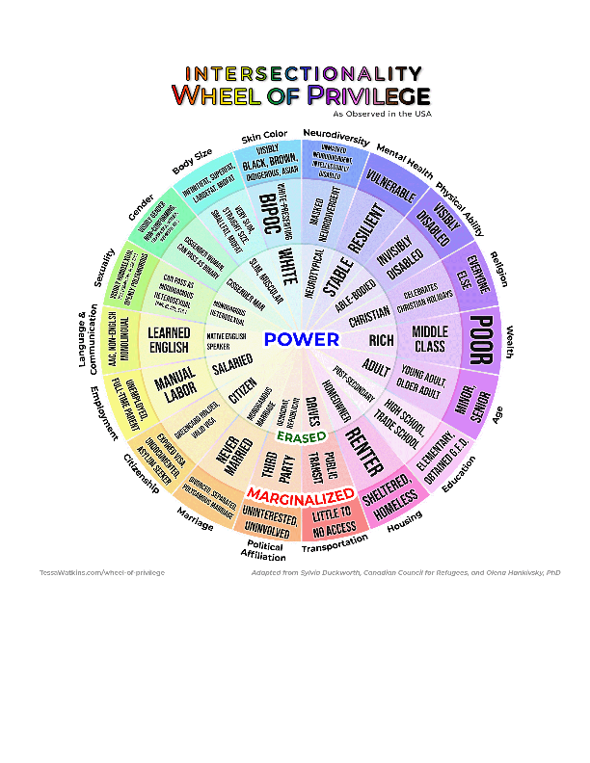
The Wheel of Identity (Facilitator Lens)
Facilitators often move between identities that are:
  Central and powerful
  Erased or flattened
  Marginalized and scrutinized
These positions shape:
  how much grace we are offered
  how mistakes are interpreted
  whether authority is assumed or challenged
Understanding where we land on this wheel helps us anticipate impact before harm occurs.

Slide 66
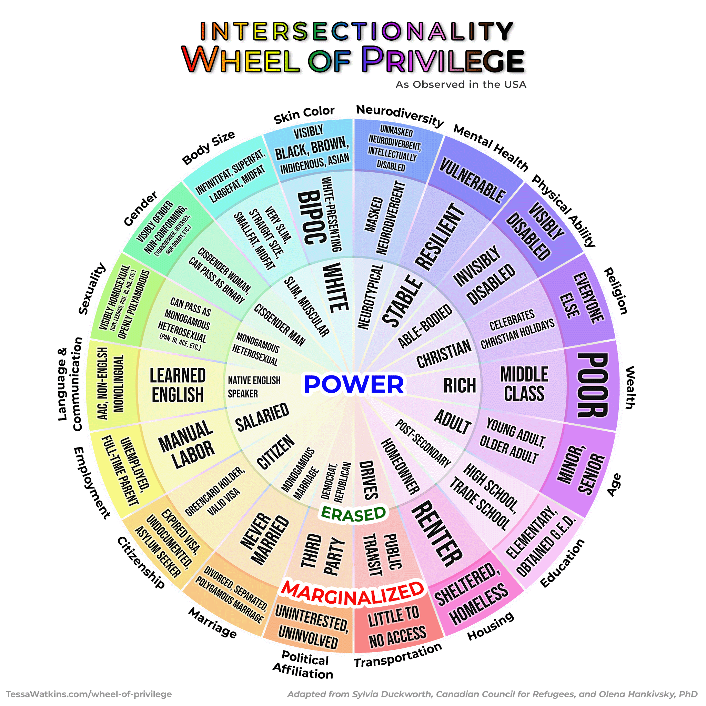
Intersectionality
Power
People who exist in this ring are the most powerful and usually hold the most privileged in any room ( their voice, ideas, and opinions matter).
Notes:
Taraja - Pass out paper- It is important to see all the different pieces of intersectionality when thinking about equity. If we are only looking at one or two pieces on the wheel then you still leaving inequities unaddressed. Focus on class to help address inequities in school but that still leaves other inequities that disproportionately affect other groups i.e. students of color, LGBTQIA students, students with a disability . This is where allyship is important. If you’re a privileged and/or powerful person and you’re in the room with someone that isn’t, your job as an ally is to make space for them, amplify their voice, and listen. If they aren’t in the conversation, that is the only time when it is appropriate for you to speak on their behalf. Also, ask yourself why they’re not part of the discussion and look for ways to invite them to it.
https://just1voice.com/advocacy/wheel-of-privilege/

Slide 67
Intersectionality
Erased:
People who exist in this ring are often the forgotten ring or have their identities erased or are marginalized in unique ways. Some of these people can “pass” and “choose” to be marginalized or privileged when it benefits them.

Slide 68
Intersectionality
Marginalized:
People who exist in this ring experience more overt discrimination and are most impacted by systemic discrimination. Underrepresented in media unless they serve a negative purpose:
the subject of jokes in comedy
villains in media
children are taught to avoid them or not talk about them
behavior or appearance is criminalized
children dress up as them for costumes
used as school mascots
and so much more…

Slide 69
What challenges have come up in facilitation?
(everything from team formation to delivery to content adjustment)

Slide 70
Consider if the feedback about these challenges is delivered evenly… or are some people given a pass while others are held to scrutiny?

Slide 71
Behaviors Commonly Misread in Facilitation
These facilitation behaviors are often critiqued:
These behaviors are frequently rooted in:
  over‑preparing
  over‑ or under‑explaining
  speaking louder or softer
  managing transitions tightly
  avoiding visible conflict
  = surveillance
  = erasure
  = tone policing
  = power imbalance
  = long‑standing safety strategies
  What may look like an area of weakness in facilitation style has often been developed and reinforced over time as a mechanism for facilitation survival.

Slide 72
When Interpretation Is Not Equal
People of color, LGBTQ facilitators, women, younger facilitators, larger body facilitators, and disabled facilitators are more likely to have their tone or presence policed rather than their content engaged.
These labels are not evenly applied. Interpretation is not neutral. It is shaped by bias. The same behavior can be labeled very differently:
  “Engaged” vs. “Defensive”
  “Assertive” vs. “Aggressive”
  “Passionate” vs. “Unprofessional”
  “Direct” vs. “Difficult”
Some interpretation of expression of erased identities can still be interpreted negatively or be judged based upon Power identity standards. Facilitation norms can still cause harm without anyone naming why.

Slide 73
Table Talk:
During a session on Centering Equity, the facilitator cuts a conversation in the room and pivots to the next thing. There is a visible and audible response from the room.
How do you decide whether to intervene or not? If you choose to intervene, when and how do you do it?

Slide 74
Grace understands why behaviors exist but does not excuse harm.
Accountability decides what happens next.

Slide 75
Using Grace and Accountability to Name Harm
Intersectionality explains why harm is uneven, credibility is inconsistent, and scrutiny lands harder on some facilitators than others. Not experiencing harm does not make it unreal.
Common Types of Facilitator Harm (not an exhaustive list):
  Microaggressions- Everyday comments or behaviors that dismiss, stereotype, or minimize:
      tone policing
      surprise at competence
      ignoring pronouns
      “I don’t see identity here”
  Micro assaults- Intentional actions meant to demean or exclude:
      misgendering after correction
      mocking identities
      dismissive or derogatory language

Slide 76
Trust is built through clarity—not chemistry.

Slide 77
Team Preparation Is Equity Work
Especially when:
  facilitators are paired quickly
  time is limited
  relationships are thin
  power is uneven
Preparation should include:
  role clarity
  who names tension
  who interrupts harm
  what is non‑negotiable
  how power may land differently
  signals for when help is needed
  understanding various cultural dynamics of attendees, region, and topics

Slide 78
Key Points
Leadership and facilitation styles are contextual.
Facilitation behaviors are often adaptive, not deficient.
Intersectionality matters. The same behavior is interpreted differently depending on who embodies it.
Grace and accountability are not opposites.
Preparation is equity work.

Slide 79
Breakouts!

Slide 80
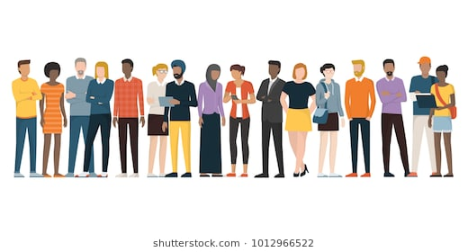
Two Rounds
Facilitating after Tough News (Jessica, Salina, Albert) - Will Repeat
Navigating Conflict and Challenges Within Facilitation Teams and Participant Groups (Rachel, Grat, Rita) - Will Repeat
New-ish Folks Clinic with an Adult Learning Component (Katie, Josh, Scott) - Will NOT Repeat
Break: 10:00-10:15
Round 1: 10:15-11:45
Lunch: 11:45-12:30
Round 2: 12:30-2:00
Break: 2:00-2:15
Content Team Work Session: 2:15-3:45
Back in this room: 3:45

Slide 82
Content Team Work Session

Slide 83
Ending it Right
Team Building Info
  Starts at 5:30
You will begin in your content teams tomorrow

Slide 84
Facilitator Planning Meeting
Day 3

Slide 85
Content Team Work Session

Slide 86
Content Team Presentations
Seleste
Lindsay

Slide 87
Ending it Right

