Slide 1
Navigating Conflict and Challenges Within Facilitation Teams and Participant Groups
Rachel, Grat, and Rita
Notes:
Slides 1-3: 2 min
Rachel

Slide 2
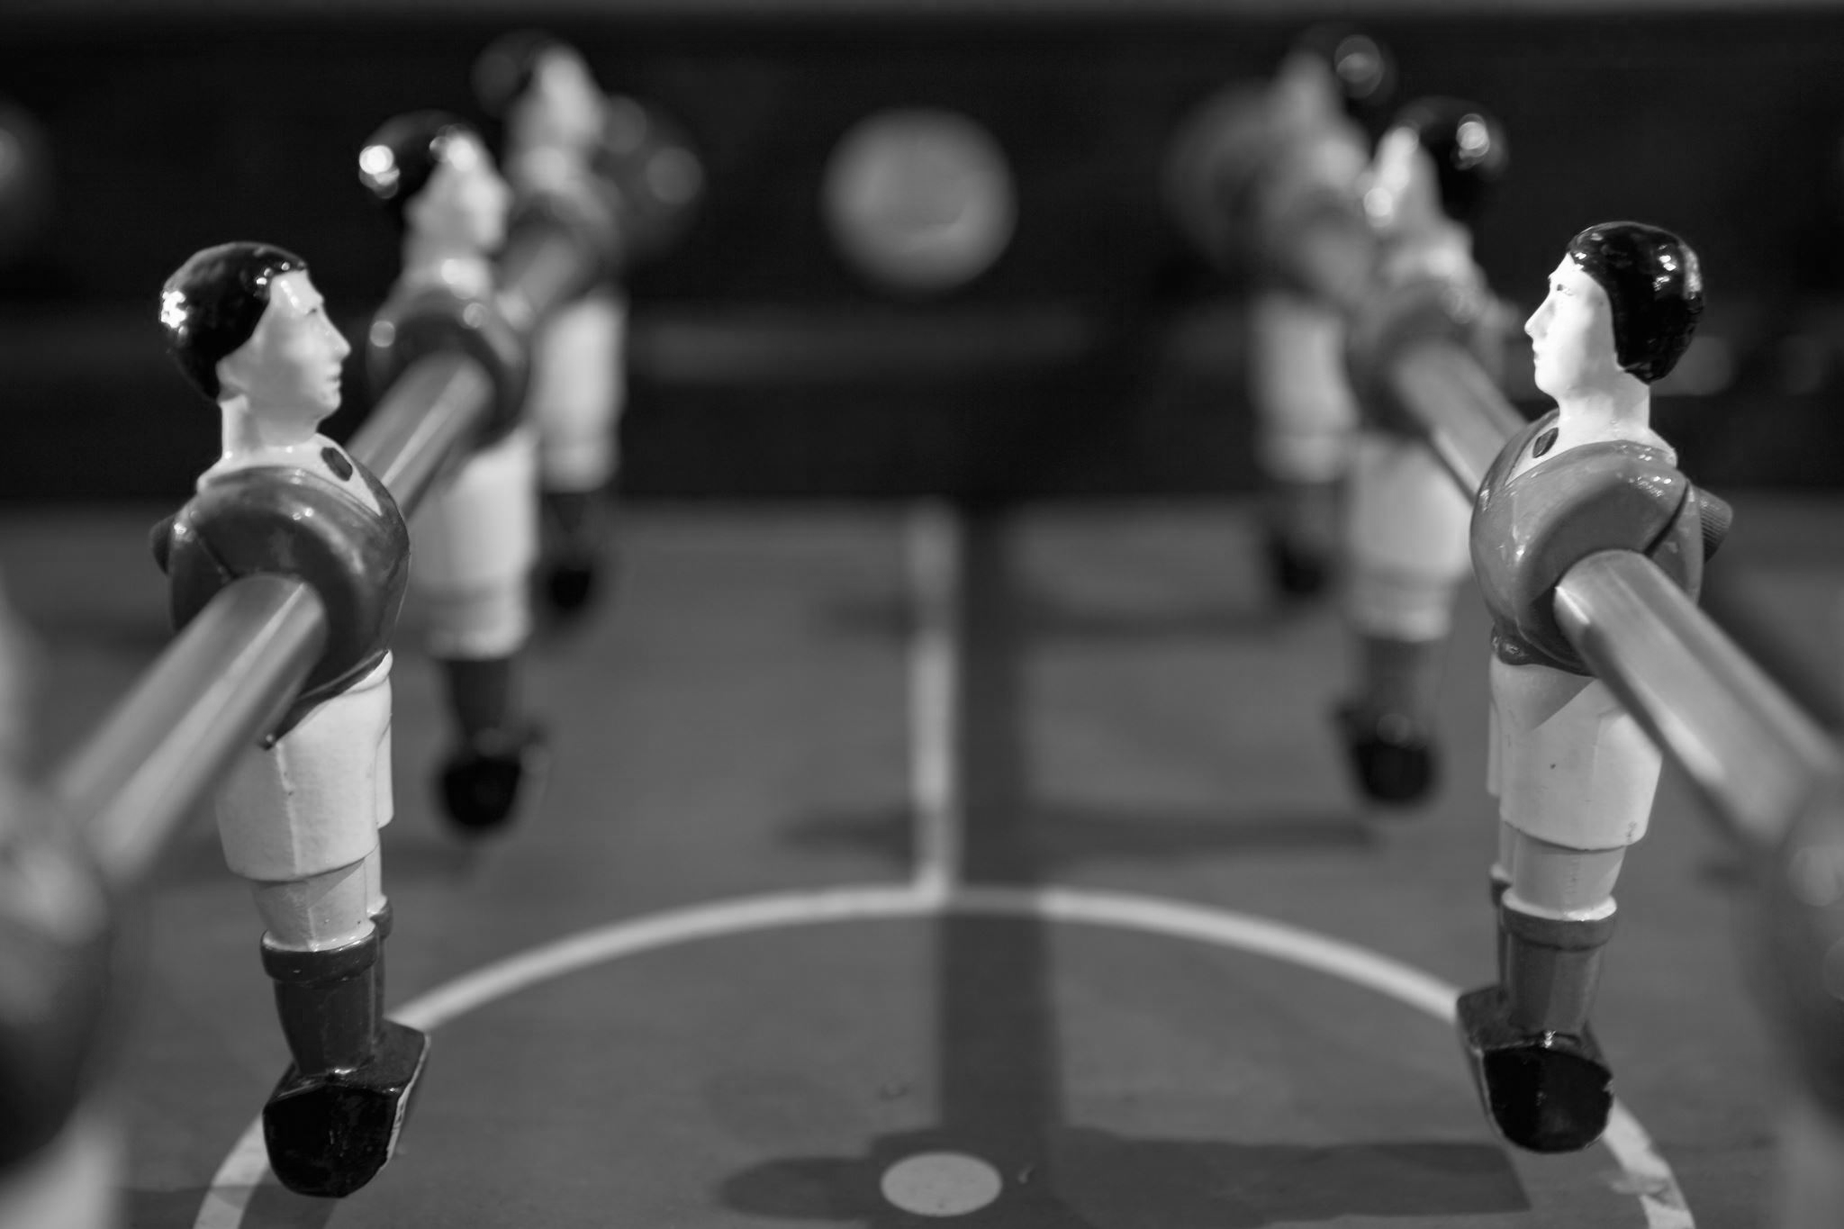
Navigating Conflict Agenda
Necessary Situations
What should we do?
Scenarios
Participants and Facilitators
Practice and Team Talk
Notes:
The goal is never to feel like you are locked in constant conflict management or conflict itself – Adress, redirect, resolve ( when possible), mitigate as needed – Rachel

Slide 3
Overview
Conflict comes in many possible forms.
External and internal pressures
Individual and group
We work to intercede, redirect, resolve, and mitigate.
We take these steps to encourage engagement, learning, vulnerability, and growth – for ourselves and the participants.
Notes:
Rachel

Slide 4
Things Happen. . .
Notes:
Slides 4-7: 3-4 min Grat

Slide 5
So, there is a Situation:
Ice Storms, Hotel Implosions, & Missing Participants
The best-laid plans of mice and facilitators...
Facilitator-Ellen-Karla-AmTrav Roulette
Everybody here is a grown-up. Everybody can help.
We cannot pour from an empty cup. Or one that is full of coffee and Skittles.
Take a breath. Take a breath. Take a breath.
It will be worse than you expect. It will also be better than you expect.
Notes:
Difficult Situations: Ice Storms, Hotel Implosions, & Missing Participants - Grat
(Yes, these all happened. In the same week!)
Things happen, that you won't be able to plan for. Every training has its own difficult situation.
It's important to know who is the right entity to address the DS. We are a team, and knowing everyone's skill set is essential.
This is not taking a group of students on a field trip. All participants are adults, and adults make choices. It's not our job to save someone from consequences. Generally, our participants are incredibly generous, and know when something is going on. Be honest, but don't infodump. If we need to make changes or adjust, they are more often than not very willing to flex.
Take care of yourself and take care of each other. If you're not sure, ask.
Take a breath. Take a breath. Take a breath.
Sometimes you just need to laugh at what's happening; hopefully, whatever it is will be a story that facilitators and participants tell with a smile.
Avoid talking TOO MUCH about how much TIME it is taking away from what was planned

Slide 6
Necessary Conversations
Cultural appropriation
Identity "adjacency"
Tokenism
  Participants
  Coaching
Academic knowledge vs. Lived experience
Intent vs. Impact/Effect on others
Debrief with those affected (facilitators, participants)
Bias
Notes:
Difficult Situations that have to do with bias – Grat
Cultural appropriation
Identity "adjacency"
Tokenism
Participants
Coaching
Academic knowledge vs. Lived experience
Intent vs. Impact/Effect on others
Debrief with those affected (facilitators, participants)

Slide 7
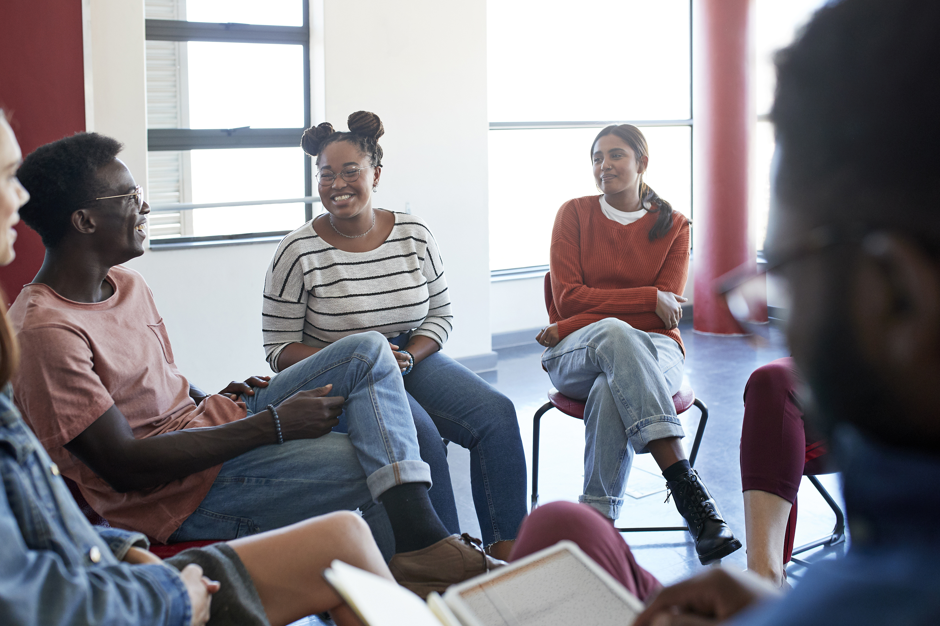
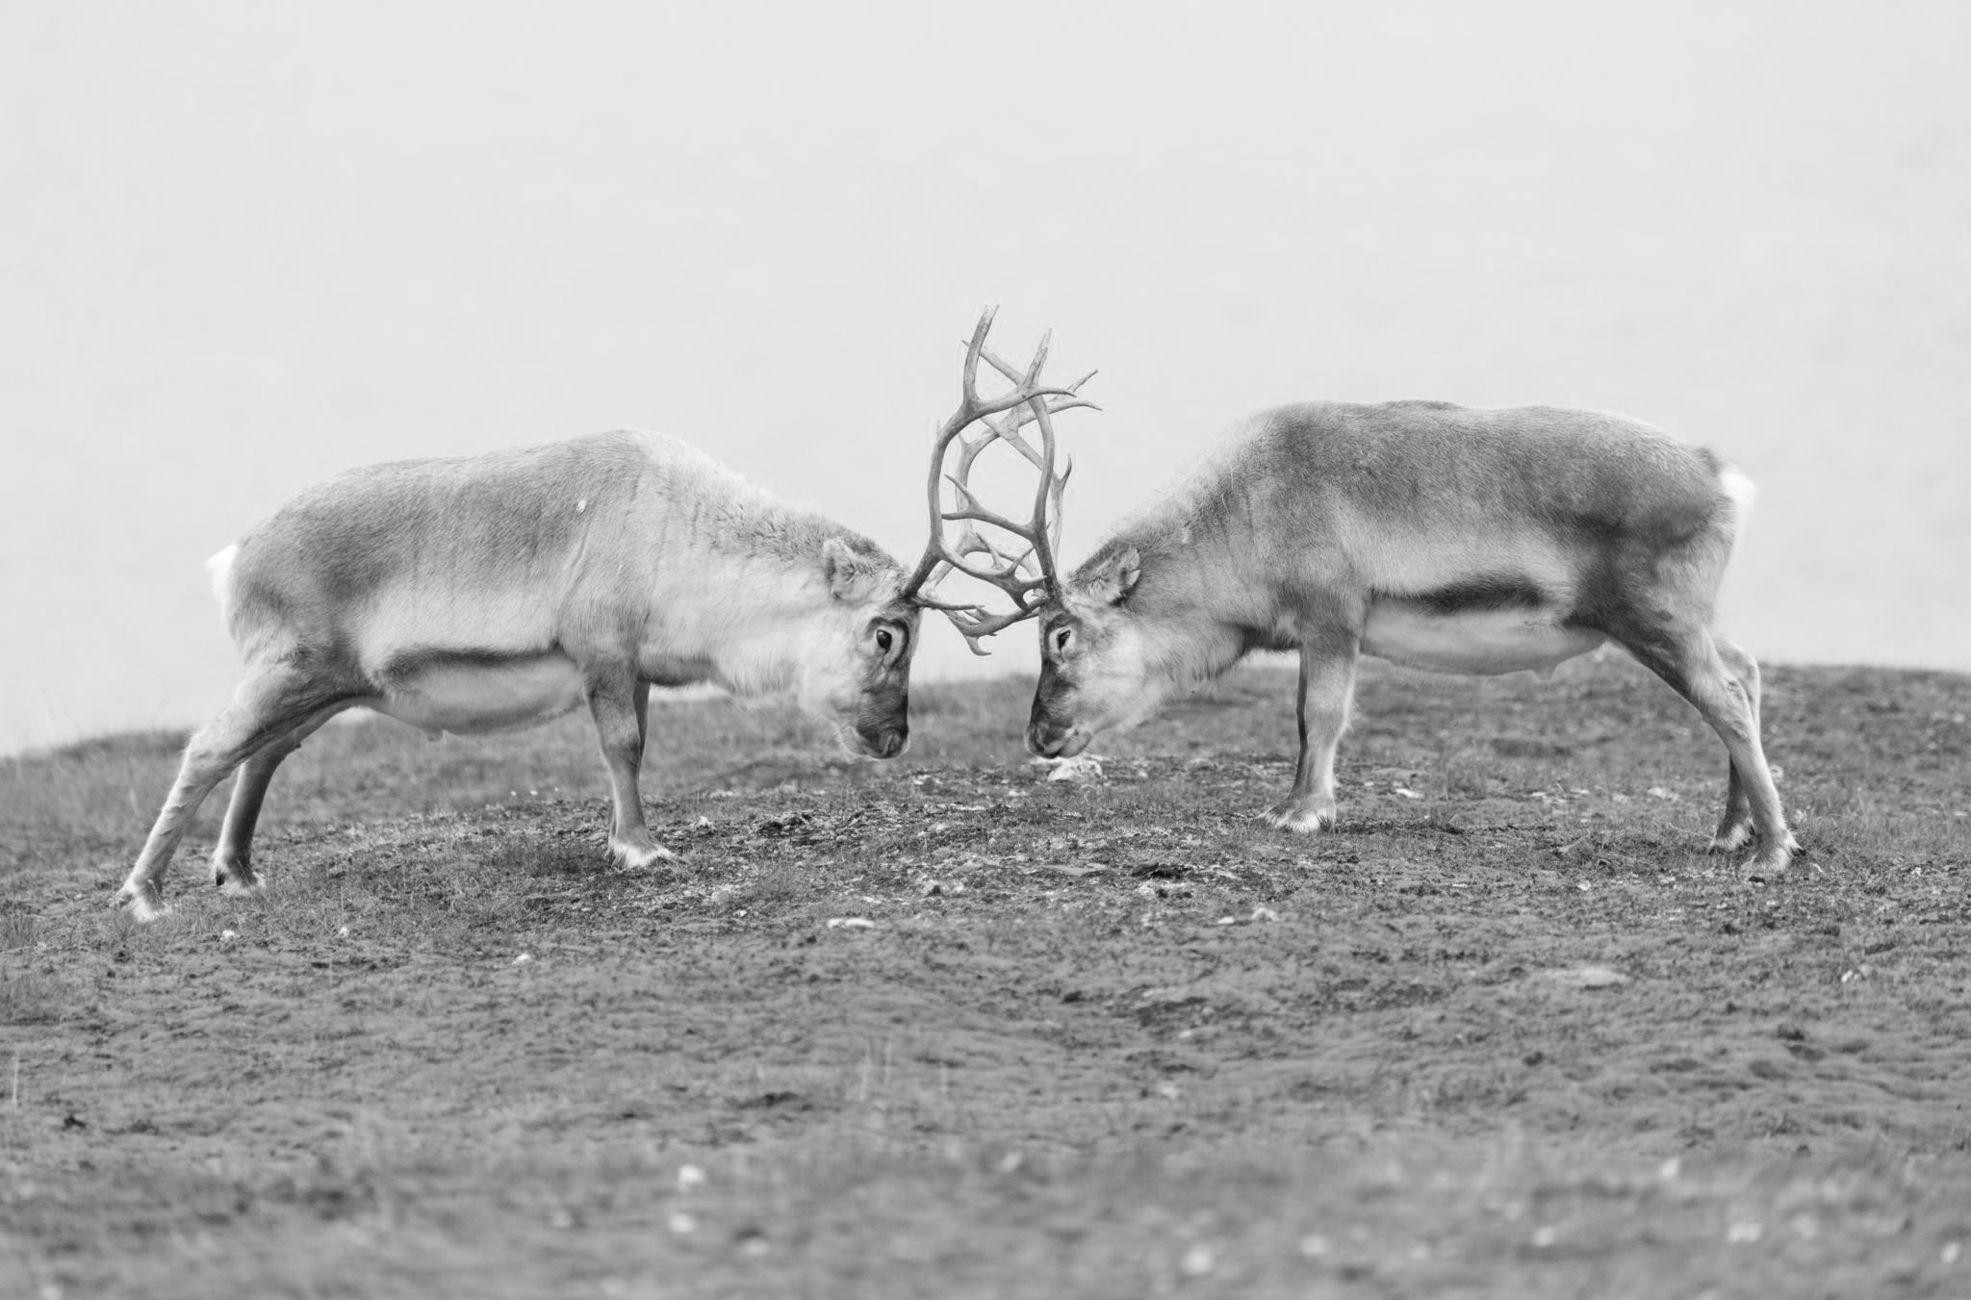
What Can We Do?
When Conflict Happens. . .
  Between Participants
  Participant-Facilitator Interactions
  Within the Facilitator Team
Frameworks:
Call In/Out/On
FOCUS
STOP
ACT
Notes:
Before you get locked in – use a framework to help you respond - Slides 7-12 5 minutes Rachel (Intro and In), Grat (Out), Rita (On)

Slide 8
Call In/Out/On: What’s the goal?
To stop the perpetuation and negative effects of harmful words or behavior
To create a compassionate space for listening, understanding, offering new information, and correcting assumptions
To lean into having tough conversations with people in your sphere of influence - the individuals or groups you know personally, and that will be open to conversation with you
Notes:
Rachel

Slide 9
The Art of Calling Out
Calling out is bringing public attention to an individual, group, or organization's harmful words or behavior
Remember, it is a powerful thing for the target of oppression to hear these words from the mouth of an ally, accomplice, or co-conspirator!
Notes:
Grat

Slide 10
Calling Out with Courage. Confidence. Clarity.
Name It!
  Be clear about your own intentions. Be specific!!!
  That’s not okay when…
  That’s problematic when…
Claim It!
  Use “I” statements:
  I don’t like when…
  I am not comfortable with…
Stop It!
  Clarify expectations!
  Please don’t use sexist language.
  Please don’t make racist comments.
Source: Adapted from NEA Diversity Training. Our Diverse Community: Living, Working and Learning Together.

Slide 11
The Art of Calling In
“Tell me more”
“Can you elaborate on your point?”
“What is it about this that concerns you the most?”
“What would happen if….”
“Could there be another way to look at this…”
“What could you do differently….”
“What would happen if you considered the impact on…”
When navigating challenging conversations, ask questions that can encourage reflection and mindfulness
Notes:
Rita

Slide 12
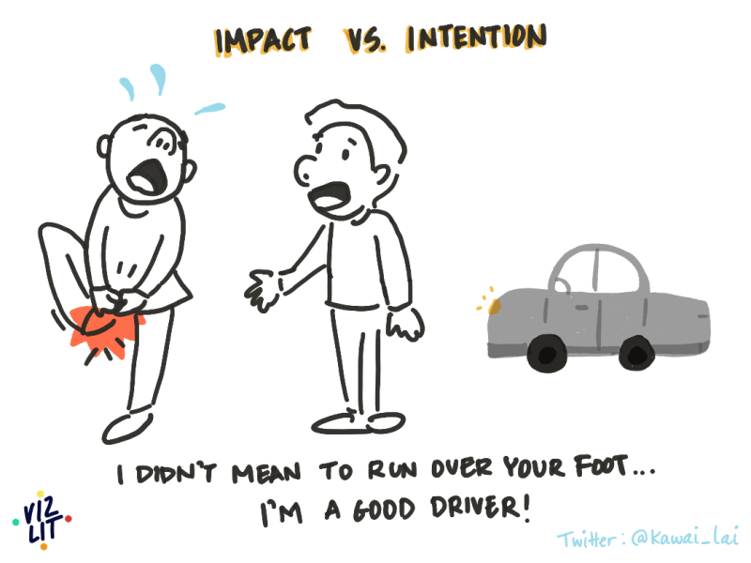
The ART of Calling On
Create a compassionate space for listening, understanding, and accountability that “calls on” another for deeper and more impactful self-dialogue and self-reflection that promote constructive change.
Notes:
Rita
Ask: Do you think some of these work better than others – can you talk to your folks at your table about a time you have used one of these methods in a team or with a participant?

Slide 13
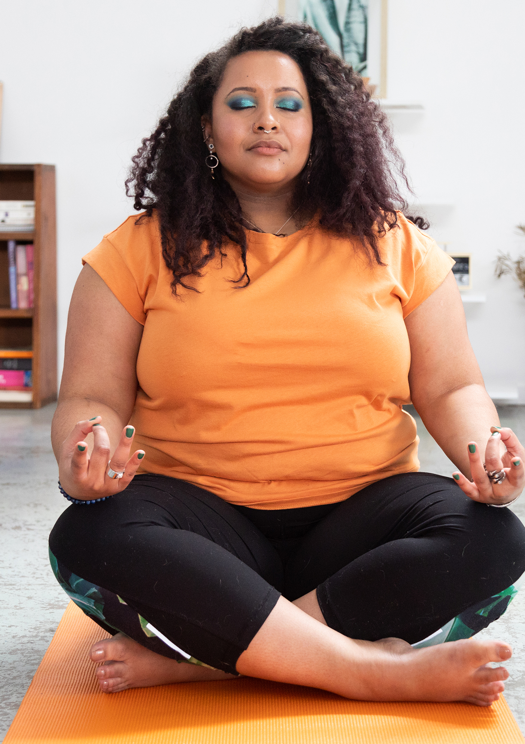
FOCUS
FOCUS (to stay on track)
F – Frame the issue
O – Own your role
C – Contribute solutions
U – Understand others
S – Set next steps
Use when meetings spiral into complaints.
Notes:
Slides 13-17 – 5 min
RITA

Slide 14

STOP
STOP (for accountability in real time)
S – Stop harmful behavior
T – Tell the truth
O – Own your impact
P – Pivot forward
Use when things start to go sideways.
Notes:
Rita

Slide 15
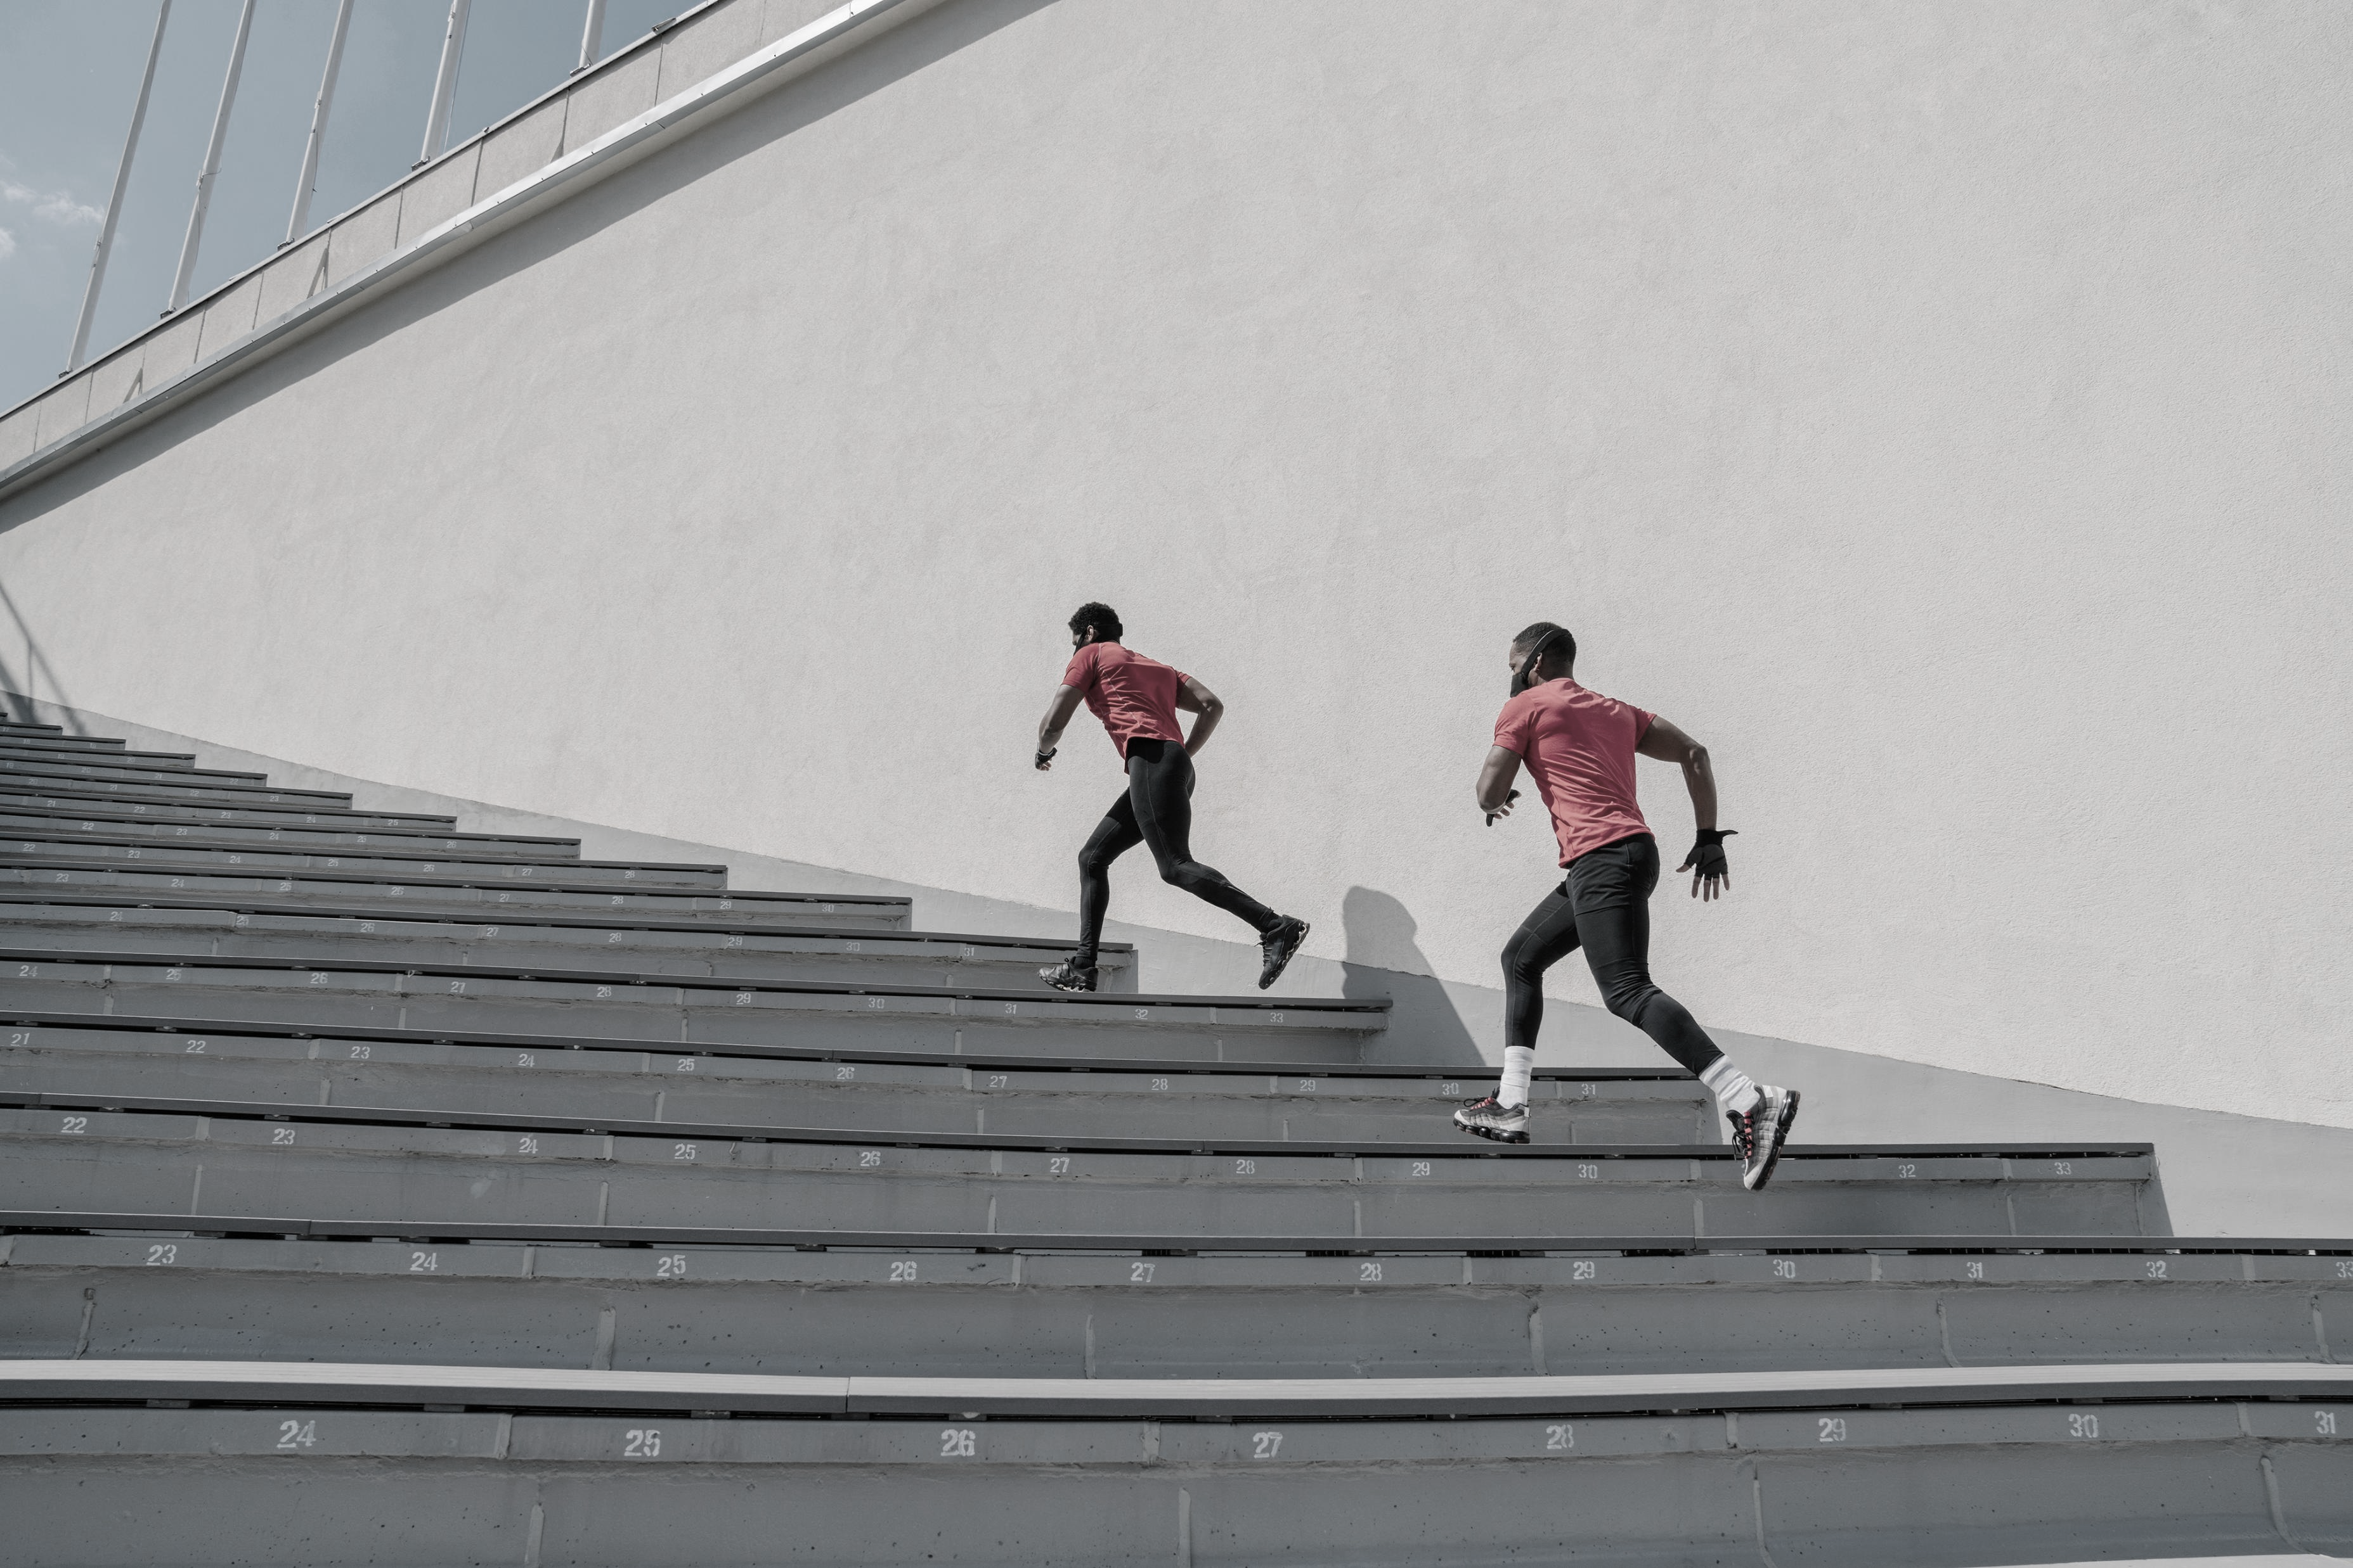
ACT
ACT (simple and direct)
A – Acknowledge the issue
C – Communicate clearly
T – Take action
Use to address and intercede/mitigate
Notes:
Rita

Slide 16

When you feel harm
Things to consider:
Communication styles
Cultural differences
Assuming best intentions while self-advocating
Timing
Call out v. Call in
Notes:
Rita

Slide 17
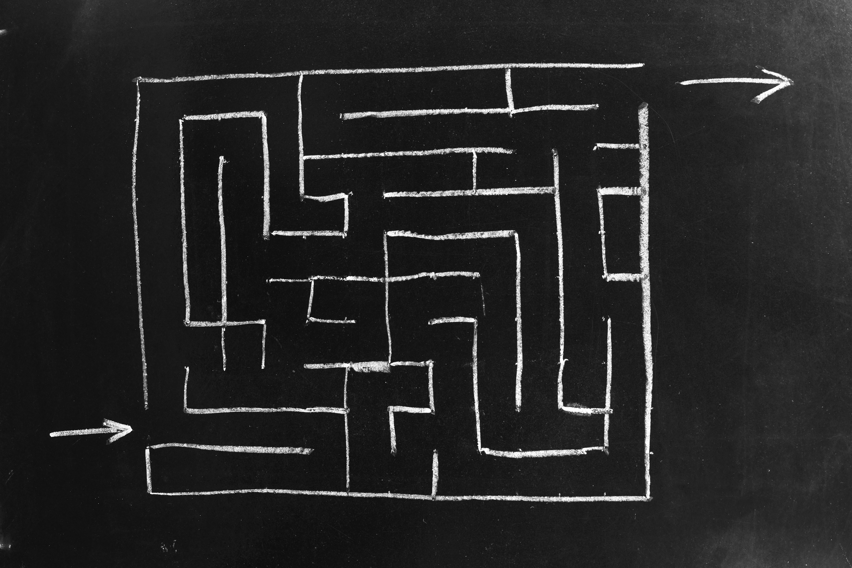
  When you feel harm
  Steps to address it:
  (Maybe) get coaching/advocacy
  Speak with colleague/advocate speaks with colleague
  Seek mutual understanding
  State what you need for repair
  Consider together whether there is harm to the group and determine if the group needs for repair
  Seek Team Lead support if you are unable to resolve the issue
Notes:
Rita

Slide 18
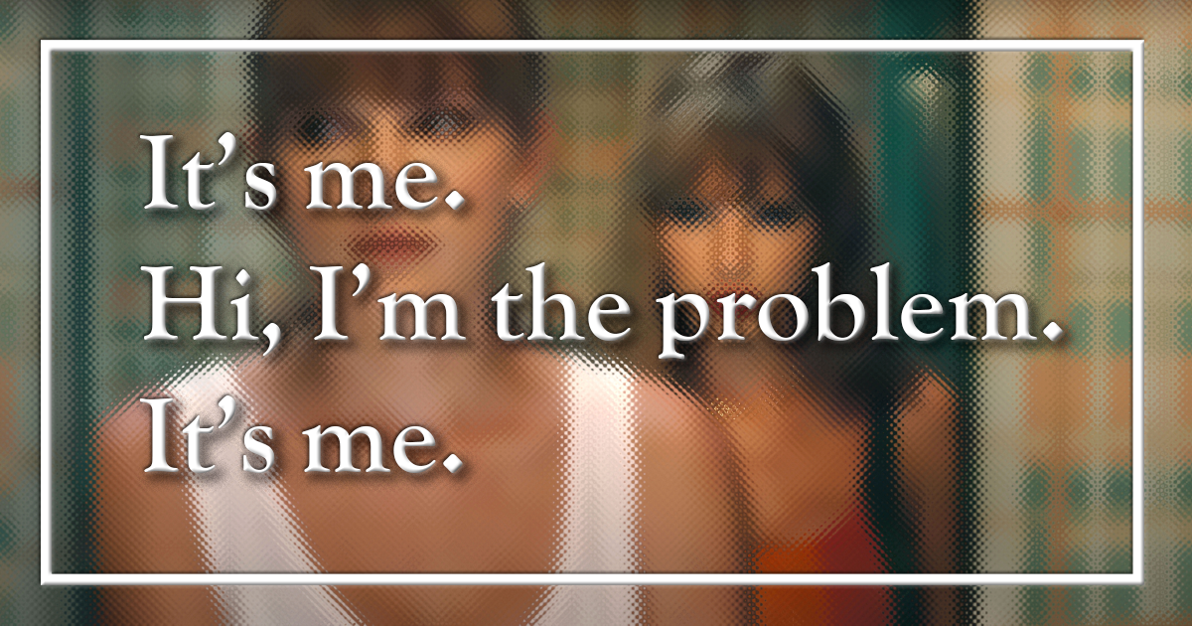
When you do harm
Somethings to consider:
  Impact matters more than intention
  Steps to address it
    Listen/Hear to understand harm
    Reflect on where/how/why of disconnect
    Suggest and solicit means for repair
    Consider together whether there is harm to the group and determine group needs for repair
    Seek Team Lead support if you are unable to resolve the issue
Notes:
Rachel

Slide 19
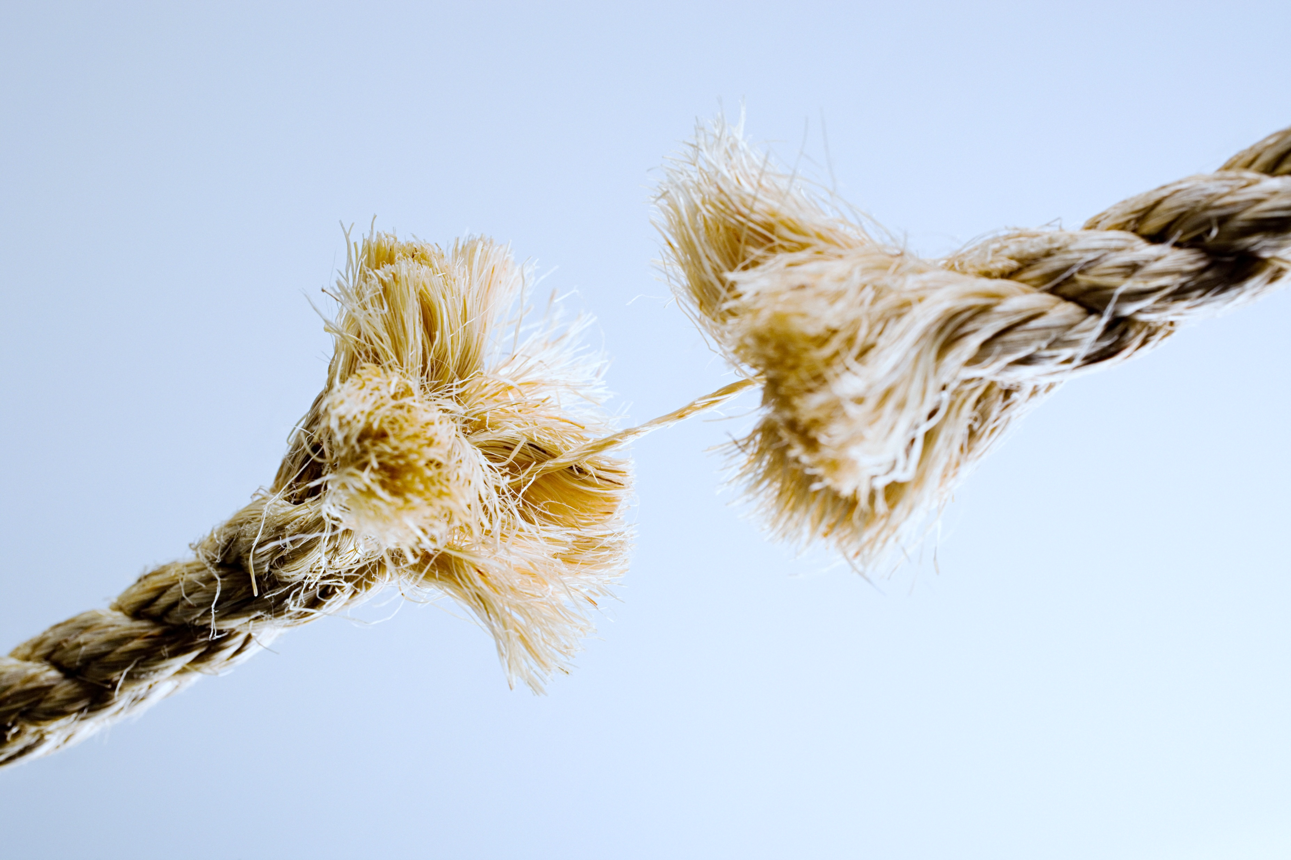
Exceptions that go straight to Ellen or _____??
  Slurs
  Discriminatory speech
  Sexual harassment
  Etc.
Notes:
Rachel

Slide 20
Growth Conversations
We are part of a team of facilitators, colleagues, and other supports. Don't be an island.
We never know what someone has going on behind the scenes. We can be generous to the person and still hold behavior accountable.
Key Points
Notes:
Rachel

Slide 21
Count Off in 3’s
Notes:
2 min Grat

Slide 22
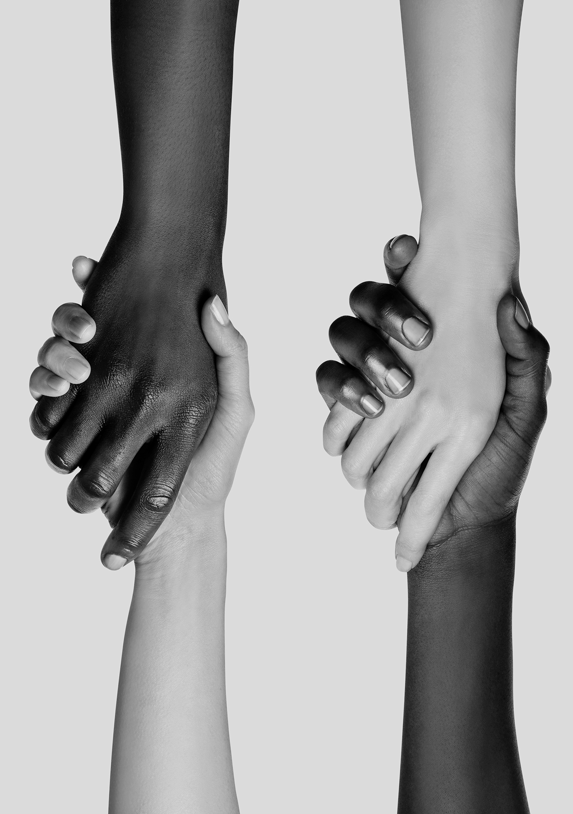
Scenario 1
At a training including both ESP members and staff - a white male UniServ staff person said, "The issue is that ESP just don't want to join us. They just don't see the value. I have worked for years providing bargaining and protection and frankly they just don't wan to show up and do anything for their union."
A white woman ESP participant said, " I take offense to that. That assumes that ESP don't care. WE do care, but it often sounds like the people who run our union don't listen to us or know what we need. Our dues are often more than our whole paycheck. "
The UniServ volleyed back, "You are making assumptions that I don't get to know my ESP leaders..." At that point the facilitator jumped in and said — Let's pause and let's focus on using some "I" statements. This is a much larger conversation that we can not complete here. Let's keep in mind that there are a number of viewpoints on this.
Notes:
3 min As you may be aware, this training includes both staff and ESP members. The incident happened at the end of the day. A staff person, who is a white male, made a general statement about ESPs that was not appropriate, full of assumptions, and very dismissive. @Holmes, Ellen [NEA], since you were leading the conversation, can you please provide more context?
Another participant a member took the comments very personally, took the microphone and responded to the comment- she was upset. The staff, who had made the comment, first apologized but attempted to respond by explaining himself, which made things worse. Ellen attempted to redirect him, but the harm was already done. I am also aware that other participants approached Ellen after the session.
I also know that this staff is a frequent flyer- he has behaved similarly in other settings.
I think that, as a presenter, it is hard to redirect in the moment because every situation is different. We also have to quickly think on our feet and find the best way to respond, which may not be what is needed in the moment or in support of the individuals who have been harmed.

Slide 23
Scenario 2
15 minutes left in a two-day training for staff and managers about crucial conversations about race. The whole outcome of the meeting was to rebuild a collaborative culture. A white participant intentionally and publicly says," Why aren't all the members of that team back in this room?" It was explained that two of them had day care pick ups to make to which the person says," I have kids I could pick up too." What do you do?
Notes:
2 min

Slide 24
Growth Conversations Group Work
Half of the Groups Take Scenario 1 ( ESP/UniServ Participants) and the other half Scenario 2 (Staff Training End of Day Comments)
Round 1: How would you respond? Use methods we discussed, write down tips/suggestions on chart paper (5 min)
Round 2: Share out from tables (5 min)
  FOCUS/STOP/ACT?
  Call In/Out/On
  Questions: ?
  Additions: +
Notes:
10 min total – Rachel Grat Rita ( circulate between the tables etc..)

Slide 25
Round 2: Choose your own adventure
Please write ONE down on EACH sticky note (5 min)
(use as many as you need!)
  Examples of conflicts/ situations you have experienced
  Examples of conflicts/situations you imagine are possible/worry about
Do NOT use specific names, etc.
Each group should have at least one sticky note involving participants and one involving the facilitator team
Use Chart paper (T Chart) to list how you would navigate these scenarios (15 min)
Notes:
20 min

Slide 26
DEBRIEF
Share out ( 5 min)
Participants and Facilitators: Different Methods?
Group Comments ( 5 min)
  Pluses +
  Deltas
  Remaining Concerns
Notes:
10 min – Rachel, Grat, Rita

