Slide 1
Facilitating after Tough News
Salina
Jessica
Albert

Slide 2
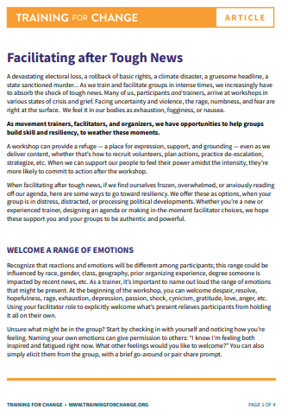
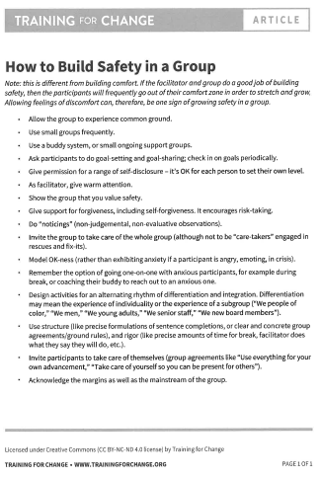

Slide 3
Jessica

Slide 4
Session Intentions
Accept that agendas may need to be flexible
  Unpack and acknowledge what happened
Explore macro and micro responses
Understand individual and collective dynamics
Practice facilitator responses

Slide 5
Session Flow
Part 1: Defining Tough News
Part 2: Practice Scenario
Part 3: Reflection, Debrief, and Commitments

Slide 6
Considerations
This topic may connect to personal experiences and triggers
Take care of yourself as needed
We will focus on facilitation practice, not reliving events

Slide 7
The Training Room Bubble
Many trainings feel insulated from events outside the room
Content, campaigns, and governance often appear more orderly than reality
Participants and facilitators bring real-world experiences into the space

Slide 8
When the World Intrudes
Sometimes events outside the room cannot be ignored
Participants may be grieving, angry, fearful, distracted, or exhausted
Facilitators must make intentional choices about how to respond

Slide 9
Working Definition: Tough News
News or events that significantly impact participants, facilitators, or communities
If unacknowledged, the event may harm both people and the learning environment

Slide 10

If you’ve been a facilitator or a participant at one of our trainings where there has had to be a major content pivot because of “tough news”, please raise your hand.

Slide 11
Small Group Discussion
What might participants need?
What might facilitators need?
What special considerations might affinity groups require?
Chart your thinking.

Slide 12
Proposals
Before supporting participants, check in with your team
  Who may be most impacted?
  What support is needed internally?
Balancing in the moment
  Large-group processing vs. affinity spaces
  Processing vs. closure
  Original agenda vs. adapting to reality

Slide 13
Salina

Slide 14
Practice Scenario
You are facilitating one of the academies (mix with members and staff). You are midway through the training and after a short break horrible news breaks that a transgender child has been killed in the city where several participants live.
This is not an isolated incident. Violence against transgender people has been escalating for years, and this is the second death in the community within the past year. Despite repeated calls from transgender folks and their allies, local government and law enforcement have failed to prioritize the safety of the trans community or take meaningful action to prevent further harm.
Protests have begun throughout the city. The weight of grief, fear, anger, and exhaustion is present in the room.
  A few participants are visibly shaken and quiet.
  One person is angry and pacing, loudly scrolling on their phone.
  Another participant pulls a facilitator aside to say, “There is no way I can talk about organizing now.”
  You overhear someone say: “This training feels pointless right now.”

Slide 15
Small Group Discussion (Chart your thinking)
As a facilitator and before engaging the full group:
  What do you need to check on internally?
  Who on your team might be most impacted by this news?
  What information do you need before deciding what to do next?
Then discuss:
  What do you name out loud, and what do you not?
  How do you acknowledge the tough news without causing additional harm?
  What modifications or adjustments need to be considered in the training in the moment or overall?

Slide 16
Share Out
As folks share, let's listen for:
  Where did people prioritize human needs over content?
  What tensions came up between:
    Large group processing vs. affinity spaces
    Care vs. urgency
    Flexibility vs. responsibility to the training goals and overall outcomes

Slide 17
Albert

Slide 18
What's Still in the Room
Something I’m still sitting with from today...
Something I wanted to name but didn’t get to...

Slide 19
Harvesting the Lessons
When tough news happens as a facilitator I/we can,...
Framing:
  What are at least 2 or 3 concrete things you’re taking away?
  Things you will actually do or try the next time tough news arrives?
  Think about what you’ll do in the moment and what you can plan ahead.

Slide 20
Reflection

