Slide 1

New Facilitator Clinic
Scott, Josh, & Katie

Slide 2
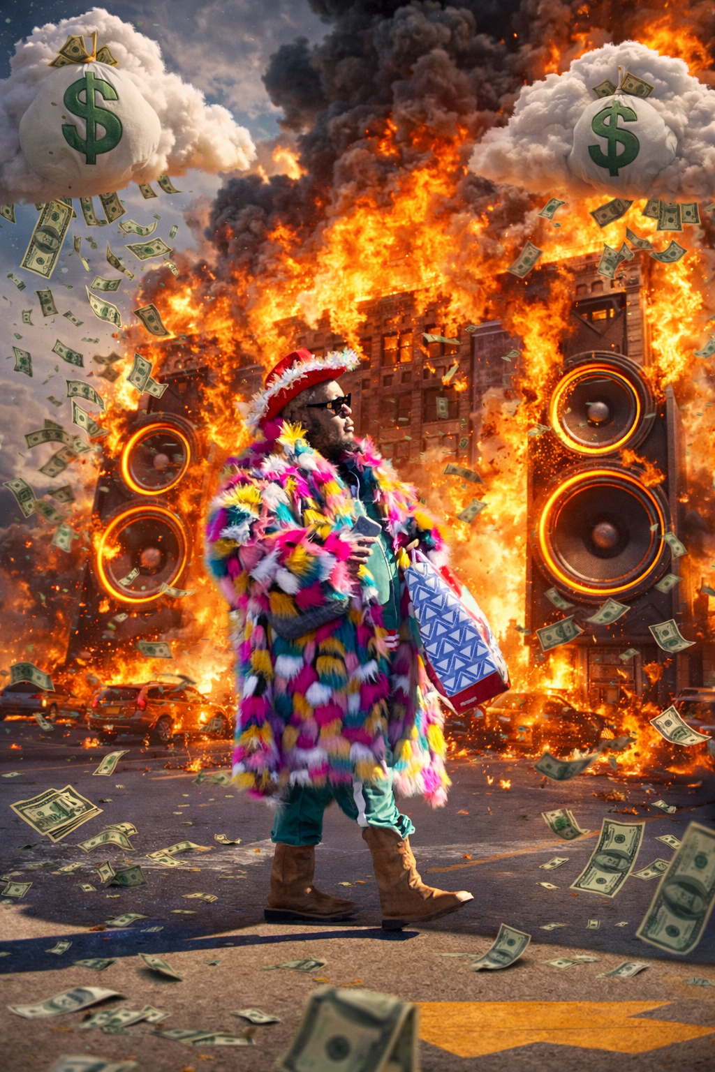
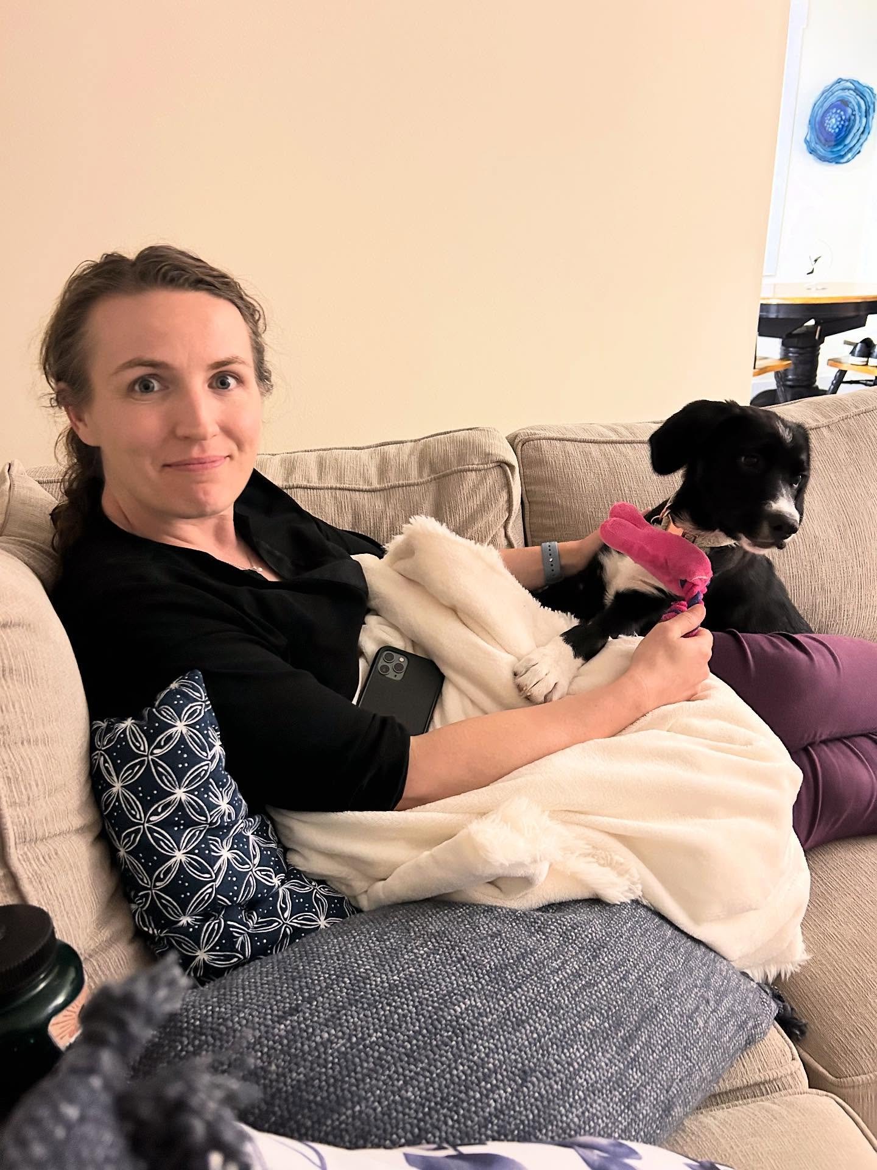
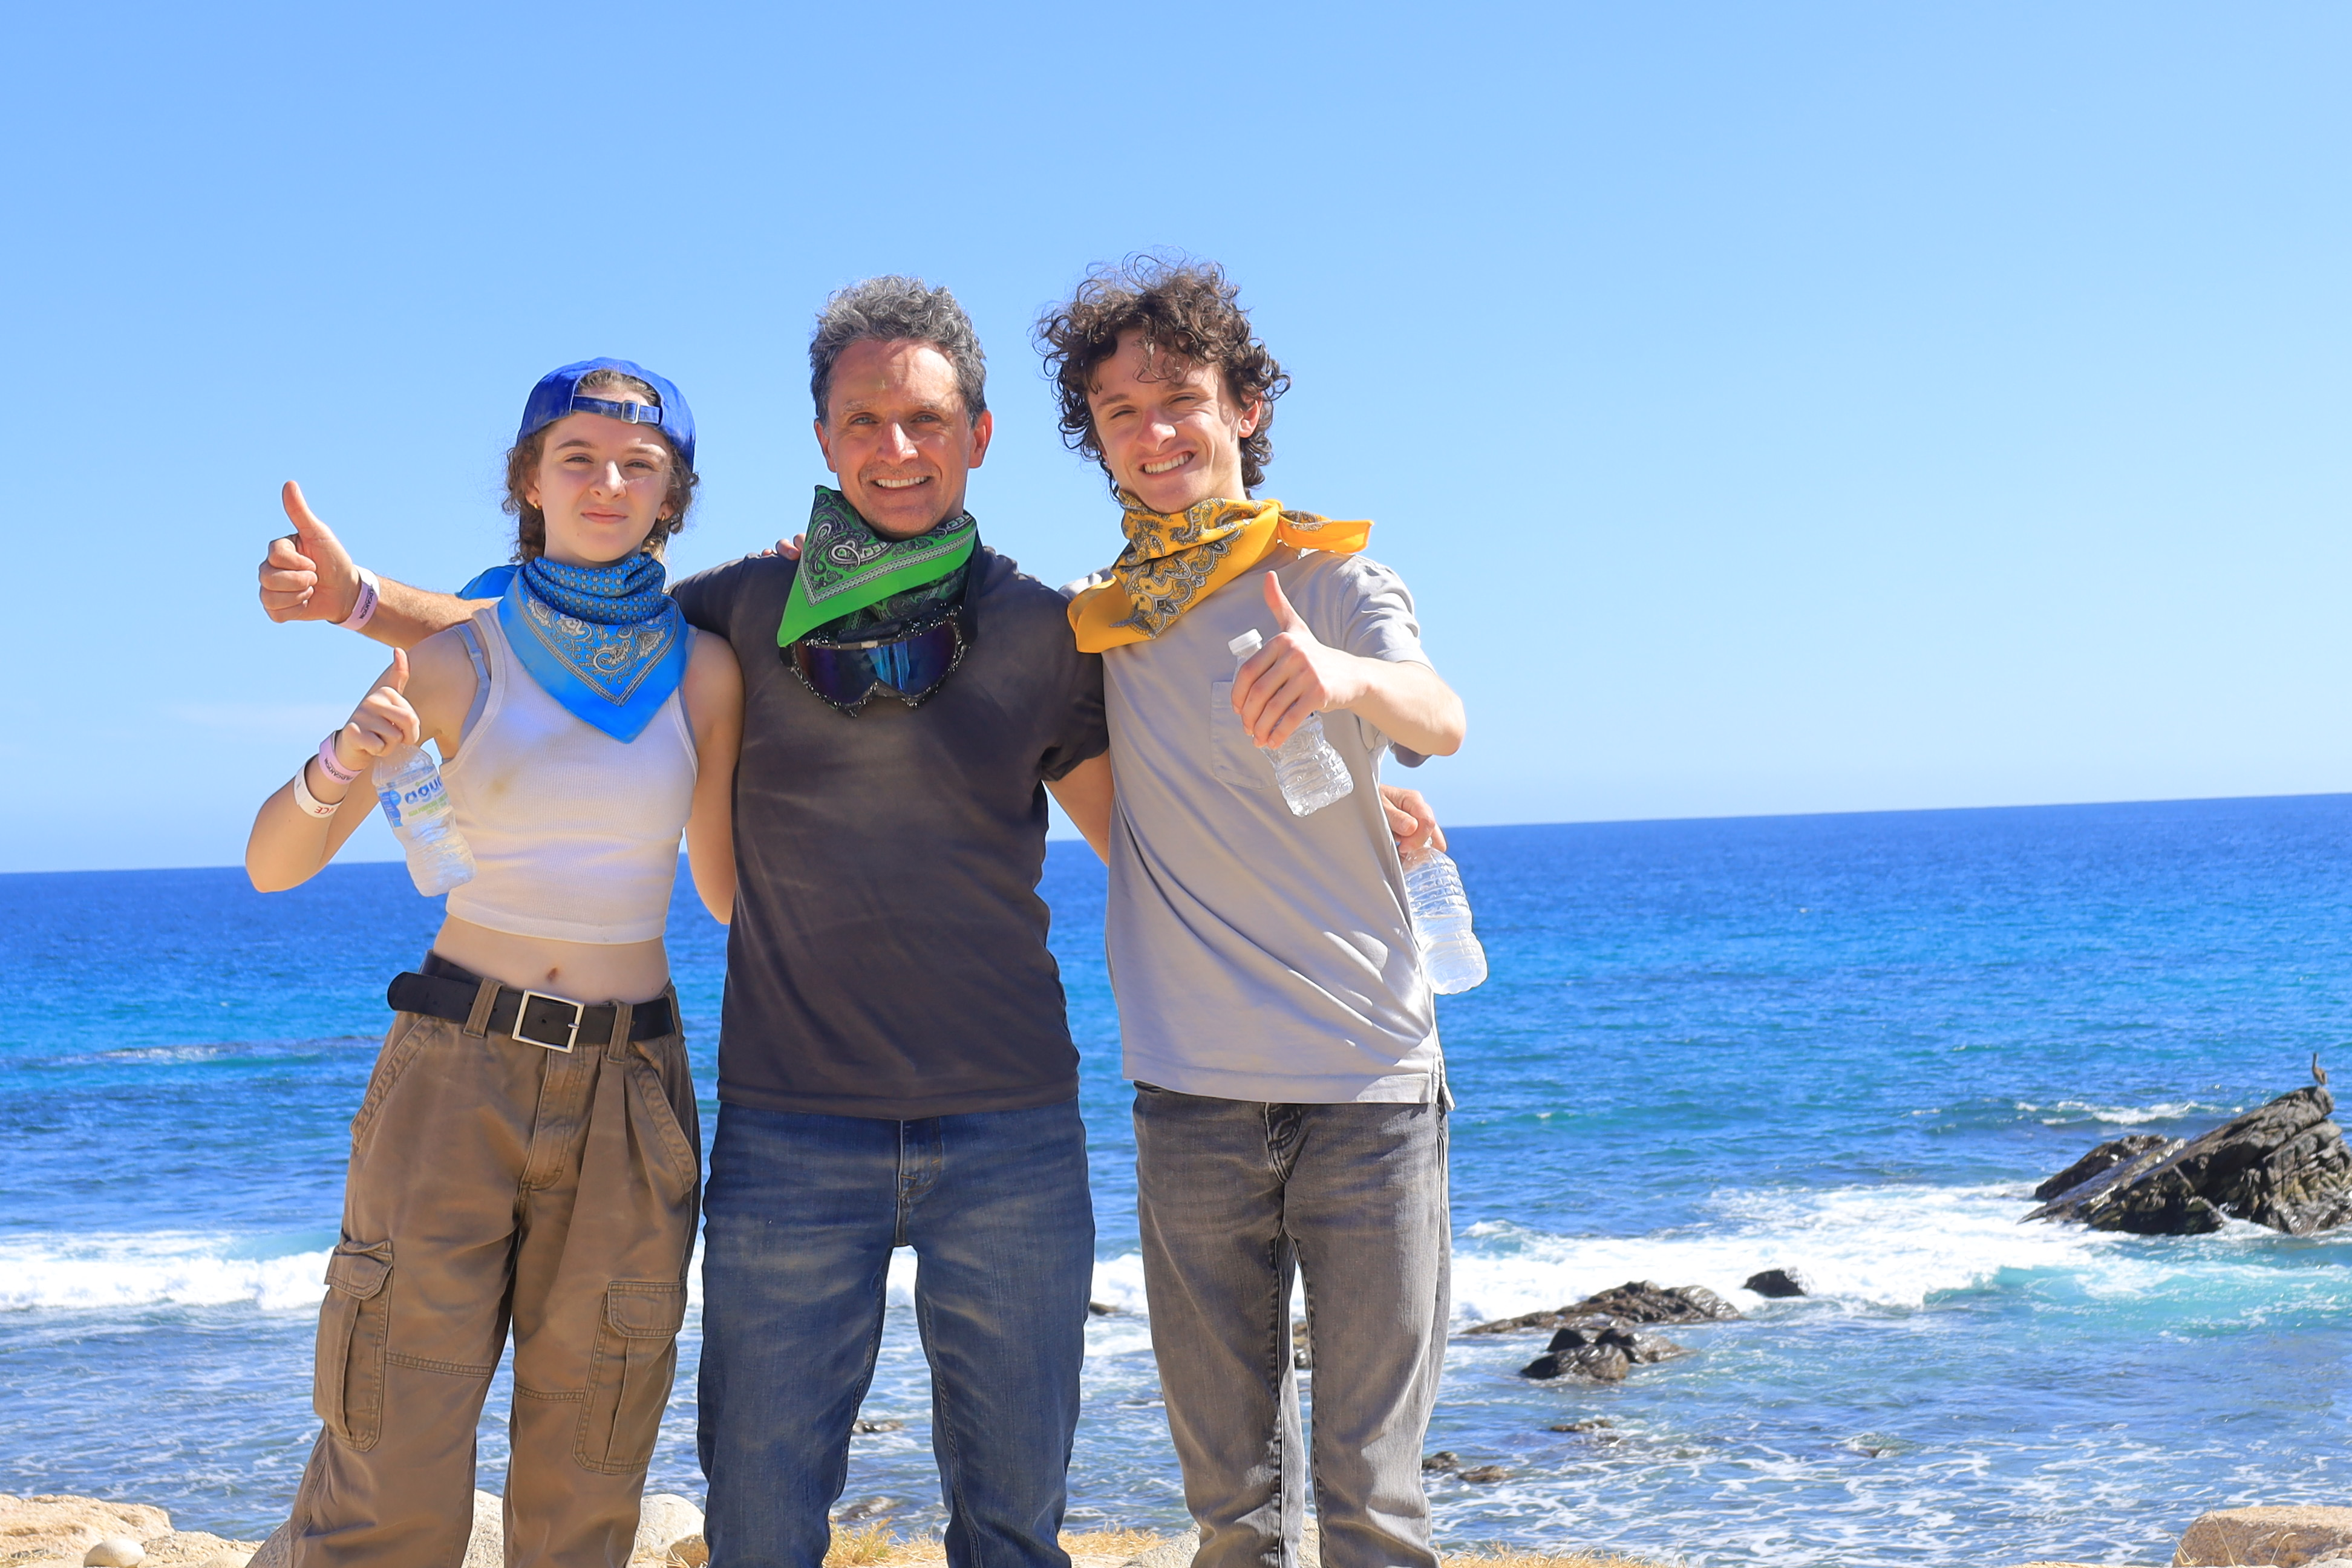
Who are we?
Scott Warrow He/Him 3 years | Josh Frazier He/him 2 years | Katie Bishop She/her 9 years

Slide 3
Scott

Slide 4

How did I get here?
Peer identification
Invite from Ellen to you and manager
Intentionality in team building (diversity, communication styles, strengths and experiences)

Slide 5
Katie

Slide 6
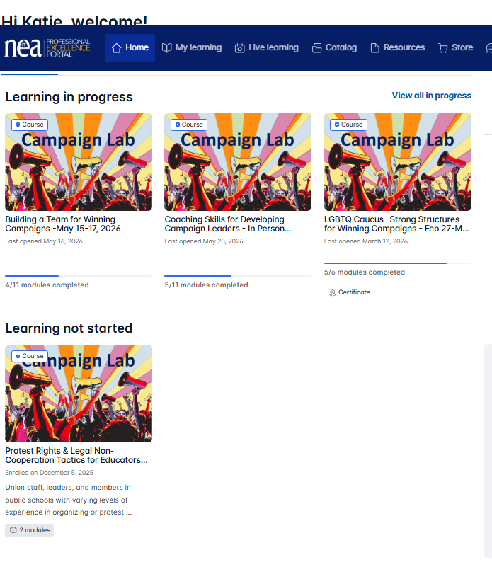
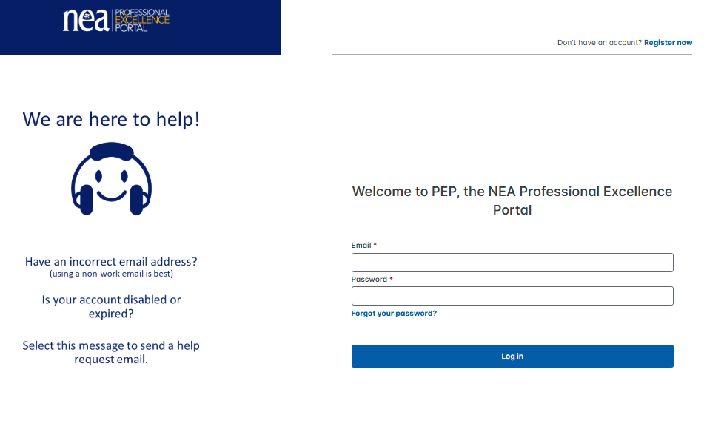
PEPs!
Professional
Excellence
Portal

Slide 7
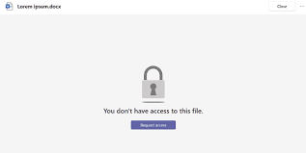
How do I use the tools?
Drive
  Don’t Panic: Contacts if it isn’t working Jay Hunter jhunter@nea.org and cc Ellen
Folders
Agenda
Tips and Tricks for Access
What to do if you have to withdraw – responsibilities.
Bookmark the site!

Slide 8
Scott

Slide 9
The Basics: Adults Need to Know
Agenda (Loose or Tight?)
Time Constraints (Start/end/breaks?)
Expectations (Group/Individual?)
Personal Connection (Relate to me?)

Slide 10
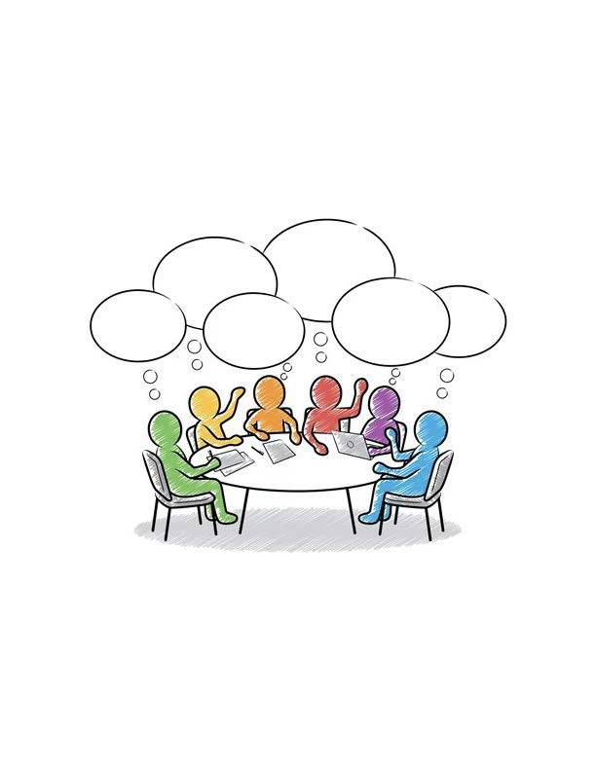
TABLE SHARE
What Makes Adult Learning Challenging​
  3 minutes
  Share with whole group

Slide 11
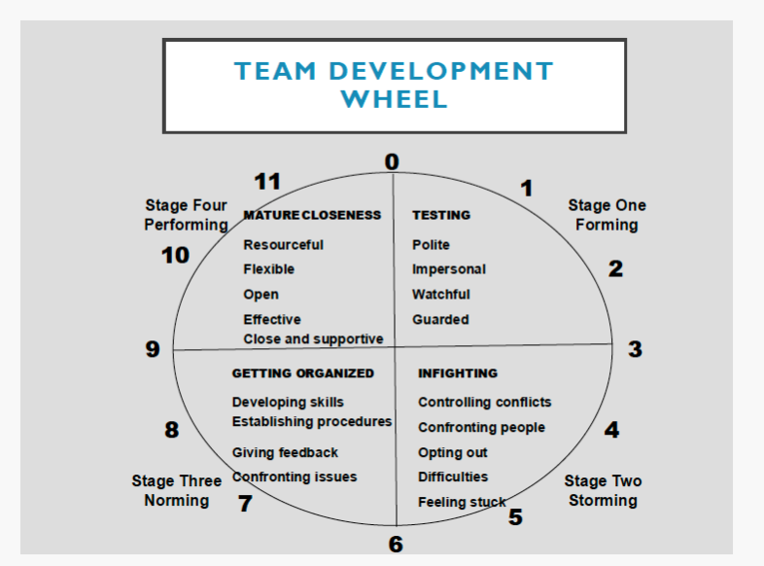

Slide 12
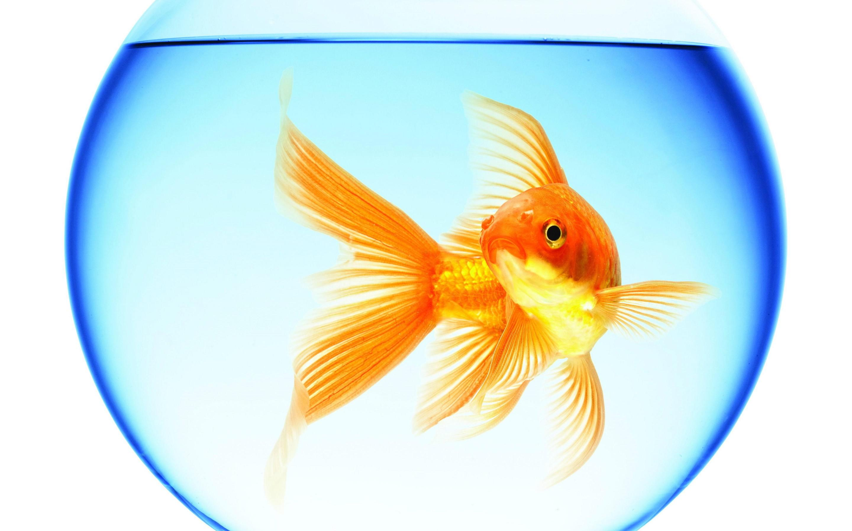
What do adults and goldfish have in common?

Slide 13
Goldfish and adults…
Since the year 2000 the average adult attention span dropped from 12 seconds to 8 seconds
On the positive side, the report says our ability to multitask has drastically improved.
  http://time.com/3858309/attention-spans-goldfish/
We change our method or mode about every 15 to 20 minutes.
*Researchers in Canada surveyed 2,000 participants and studied the brain activity of 112 others using electroencephalograms (EEGs).
Notes:
http://time.com/3858309/attention-spans-goldfish/
The average attention span for the notoriously ill-focused goldfish is nine seconds, but according to a new study from Microsoft Corp., people now generally lose concentration after eight seconds, highlighting the affects of an increasingly digitalized lifestyle on the brain.
Researchers in Canada surveyed 2,000 participants and studied the brain activity of 112 others using electroencephalograms (EEGs). Microsoft found that since the year 2000 (or about when the mobile revolution began) the average attention span dropped from 12 seconds to eight seconds.
“Heavy multi-screeners find it difficult to filter out irrelevant stimuli — they’re more easily distracted by multiple streams of media,” the report read.
On the positive side, the report says our ability to multitask has drastically improved in the mobile age.
Microsoft theorized that the changes were a result of the brain’s ability to adapt and change itself over time and a weaker attention span may be a side effect of evolving to a mobile Internet.
The survey also confirmed generational differences for mobile use; for example, 77% of people aged 18 to 24 responded “yes” when asked, “When nothing is occupying my attention, the first thing I do is reach for my phone,” compared with only 10% of those over the age of 65.
And now congratulate yourself for concentrating long enough to make it through this article.

Slide 14
How do we design learning that sticks?
At your Table:
  Arrange the following in the order that you believe is the most effective way to support learning in adults:
Participating in Discussion
Watching a Movie
Reading
Hearing a Lecture
Doing Something
Watching a Demonstration
Least Effective
Most Effective
Notes:
Timing: 5 mins minutes on this slide and next Handout #16: Average Retention Rates 6:00 appointment
TELL PARTICIPANTS:
1. On your table you will find a handout called “Average Retention Rates.”
2. Take a handout and then go find your 6:00 appointment partner.
3. Working together, quickly decide how to arrange these learning strategies on the pyramid—at the top should be the least effective strategy and the most effective strategy should be at the bottom.
4. You are focusing on the strategies that have the greatest impact on the retention of learning for the average student.
5. You have 2 minutes—GO!
Source: Dr. Angie Koppang, University of North Dakota.

Slide 15
How do we design learning that sticks?
10% of what is read
20% of what we hear
30% of what we see and hear
70% of what we say
90% of what we do
Lecture
Reading
Watching a Movie
Watching a Demonstration
Discussion
Doing Something
Notes:
Timing: 5 mins minutes on this slide and next Handout #16: Average Retention Rates 6:00 appointment
TELL PARTICIPANTS:
1. On your table you will find a handout called “Average Retention Rates.”
2. Take a handout and then go find your 6:00 appointment partner.
3. Working together, quickly decide how to arrange these learning strategies on the pyramid—at the top should be the least effective strategy and the most effective strategy should be at the bottom.
4. You are focusing on the strategies that have the greatest impact on the retention of learning for the average student.
5. You have 2 minutes—GO!
Source: Dr. Angie Koppang, University of North Dakota.

Slide 16

What I hear, I forget;
What I see, I remember;
What I do, I understand.
-Confucius 451 B.C.E.

Slide 17
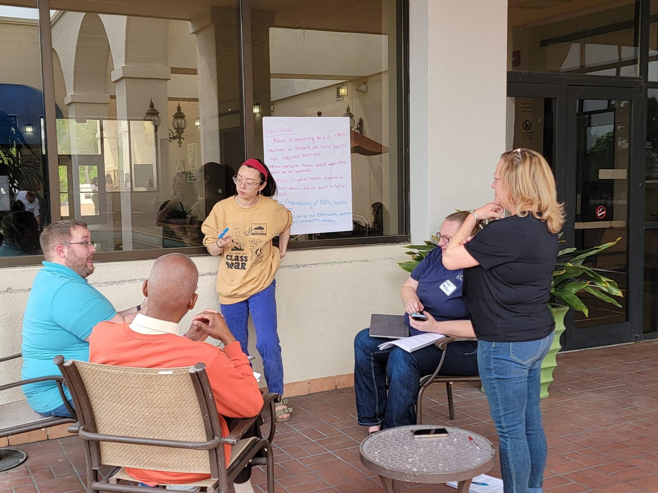
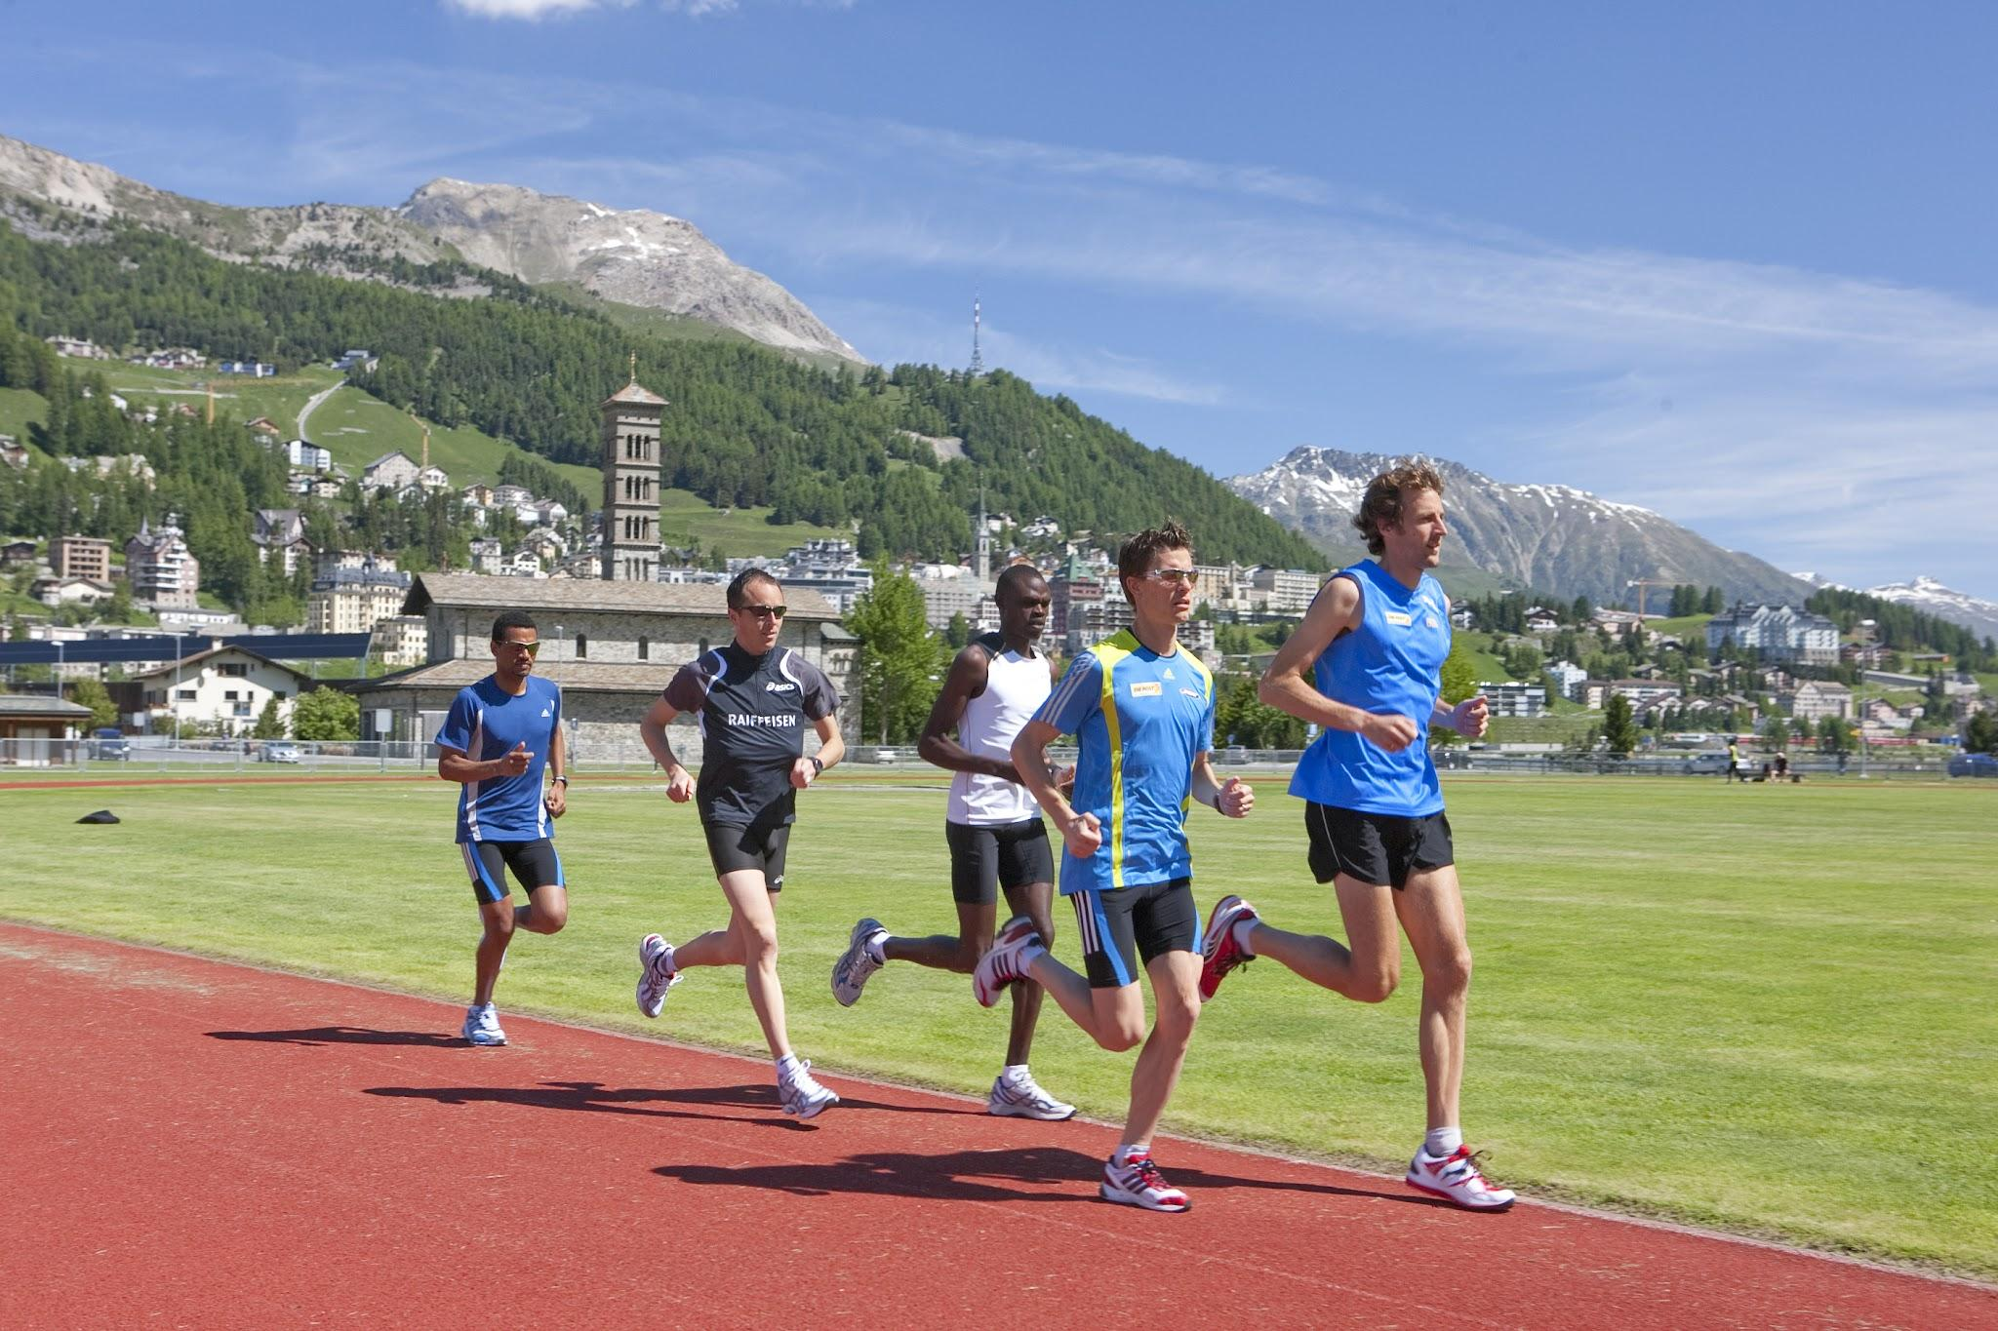
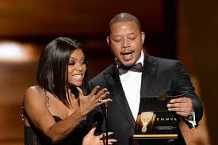
Training, Presenting, Facilitating?
Training
Acquire knowledge and skill for a specific use
Presenting
Information is delivered to the audience to inform, persuade, inspire, or even entertain
Facilitating
Guided through a process which might include generating ideas, analyzing the ideas, solving a problem, or making a decision

Slide 18
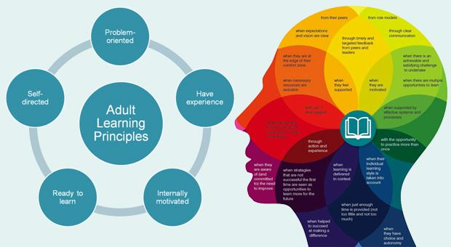
Adult Learning: Key Reminders
BEHAVIORS
  Kindness is Clarity
  Talk time
  Grace in Accountability
PURPOSE
  Lead What you are Passionate about
  Need to Know the Why
  Differentiation
DESIGN
  Many Formats
  Ownership and Self Direction
  Interconnectivity
  Solution Based Activities
REFLECTION
  Life Experiences
  Culminating Ending

Slide 19
Josh

Slide 20
Expectations
Timelines
  3-4 meetings prior to training
  Meet one day prior to training to prep and plan
  Arrive early in AM, plan to stay after training to debrief and prep for next day
  Foundations – 6-7 days (Travel Saturday and home on Friday)
  Focus trainings – 4-5 days (Travel Wednesday and home on Sunday)

Slide 21
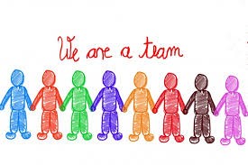
Meeting with the Team
  Prioritize the time together planning on zoom and during the training
  Do your individual prep so you come to group prepared
  Don’t go rogue- We make adjustments as a team (this is why its important to be present and engaged, even when you aren’t in front)

Slide 22

Meeting with the Team - Committments
  When adjustments are necessary, frame communication to participants as “we” “the team” “the room”, avoid blaming or scapegoating colleagues
  Plan to leave time for end of day debrief before engaging in other “back home” work or needs.
    This time is pivotal for addressing wrinkles, repairs, adjustments, feedback on feedback, etc. Your absence puts you and the team at a disadvantage.

Slide 23

Commitments
  Planning time before arrival
  Sit as a team
  No outside work in the room
  Stay engaged even from the back
  Be prepared/Study your content
  Be authentic- you are empowered with creative freedom (but communicate with your team)

Slide 24
Talk about it:
What are three things you can do to free up/focus your time?
  Brain storm as a table – share out
Write about it:
What are three things you can do to free up your time?
  Make a personal commitment

Slide 25

Oops and Ouches, Yours and Others
Katie

Slide 26

Three-day rule . . . .
  Fish, Family, and Friends all start to stink after three days

Slide 27
What is your style?
Gather in groups of four based on your Leadership Style.
In a team setting, what kinds of ouches isolate you?
What sticks?
What rolls off?
Direct
Systematic
Spirited
Considerate

Slide 28
New Group! Gather in groups of four – be sure you have at least one of each Leadership Style in your group.
When am I at my best?
When am I at my worst?
Talk as a group for 4 minutes.
Direct
Systematic
Spirited
Considerate

Slide 29
Josh

Slide 30

Turn and Talk
How you dealt with an issue or incident when you felt harmed
4 minutes

Slide 31
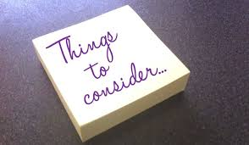
When you feel harm
Things to consider:
    Communication styles
    Cultural differences
    Assuming best intentions while self-advocating
    Timing
    Call out v. Call in

Slide 32

When you feel harm
  Steps to address it:
    (Maybe) get coaching/advocacy
    Speak with colleague/advocate speaks with colleague
    Seek mutual understanding
    State what you need for repair
    Consider together whether there is harm to the group and determine if the group needs for repair
  Seek Team Lead support if you are unable to resolve the issue

Slide 33
Scott

Slide 34
Turn and Talk
How you dealt with an issue or incident when you harmed someone. What taking accountability looked like?
4 minutes

Slide 35
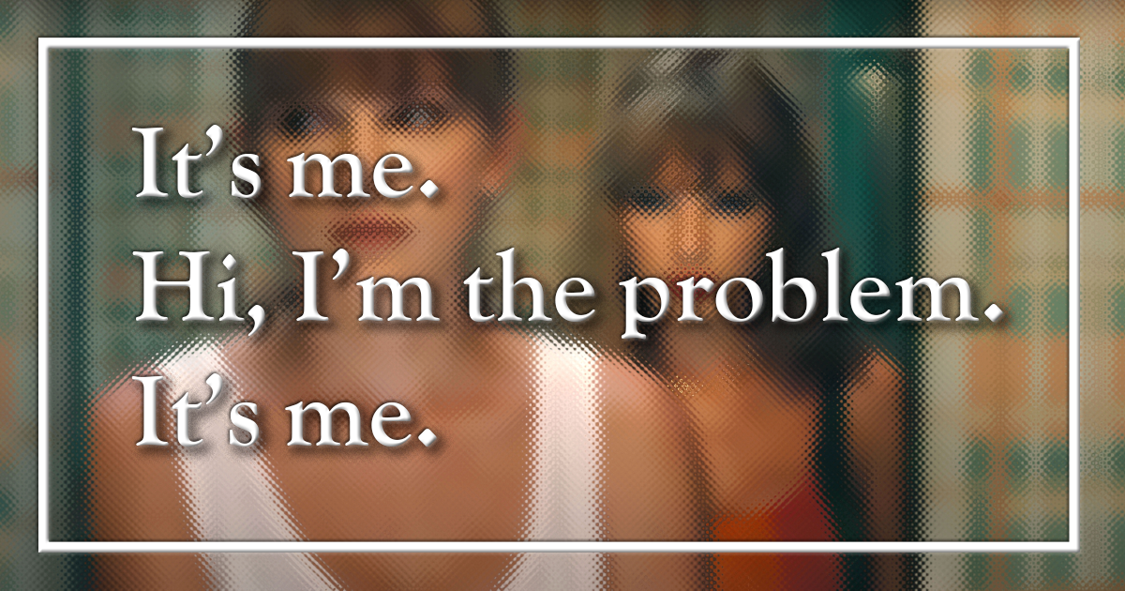
When you do harm
Something to consider:
  Impact matters more than intention
  Steps to address it
    Listen/Hear to understand harm
    Reflect on where/how/why the disconnect
    Suggest and solicit means for repair
    Consider together whether there is harm to the group and determine group needs for repair
  Seek Team Lead support if you are unable to resolve the issue

Slide 36
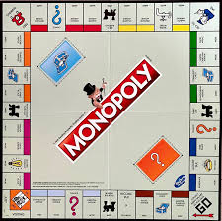
Exceptions that go straight to Ellen
  Slurs
  Discriminatory speech
  Sexual harassment
  Etc.
Notes:
At 11:15 be at this slide.

Slide 37
Scenario Time!
3 Different Scenario
Read Scenario
Same questions at the end of the different scenarios.
Discuss with your group and answer questions.
Be ready to share your scenario and the answer to your question

Slide 38
Debrief Questions
What harm, if any, occurred?
What assumptions may have been operating?
How might the harmed person have experienced the interaction?
What responsibilities do facilitators have in the moment?
How can repair occur after harm has happened?

Slide 39
Katie

Slide 40


Key Ideas
Our leadership styles work is for more than internal self-reflection, it’s for interpersonal understanding. It isn’t just how the wheels turn in our own heads, but how the wheels fit with everyone else’s to move the team. (slide animations: one gear, and interlocking gears)

Slide 41
Key Ideas
We are all human and fallible. What makes or breaks the group isn’t whether harm is caused, it’s how we respond to it and what we do next.
This knowledge and understanding is not a free pass for bad behavior. It's a guide for how to prevent and repair harm so we bring our best to the participants and cultivate a safe space for all.

Slide 42
Wonderings....
Questions....
Final Thoughts to share as you leave

