Slide 1
Building an Issue Campaign
Notes:
Why a campaign? What is the first thing that comes to mind when you hear campaign?
Political campaign? What make a campaign a campaign? What do campaigns need to win?
*Get folks to talk about People, A demand/change.
campaigning: people think of phone calls and door knocking. The main purpose of that is talking to and moiblizing folks.

Slide 2

Why a campaign?
Notes:
Why a campaign? What is the first thing that comes to mind when you hear campaign?
Political campaign? What make a campaign a campaign? What do campaigns need to win?
*Get folks to talk about People, A demand/change.
campaigning: people think of phone calls and door knocking. The main purpose of that is talking to and moiblizing folks.

Slide 3

An Organizing Approach
Well-organized worksites, locals, and coalitions have a positive, visible presences and members feel that they have the collective power to solve their problems – not a third party (UD, Lawyer, Lobbyist).
When the entire building, local, or coalition comes to act in ways to address the issue, those actors see themselves in both the action and win.
This builds power by continually increasing the amount of member leadership and ownership for the actions.
Notes:
What is an issue campaign? how is it different from a grievance? An issue campaign takes on an organizing approach.
When I started organizing the two most common things my mentors told me were “don’t third party the union” and “people join for the fight not for the win”. An organizing campaign is both of those ideas in practice. It is a critical time to make sure members understand that the power of the union comes from them. An issue campaign should EMPOWER members to continue being involved and continue to fight for the common good. People want an active and powerful union. Having a powerful union means being active in your union. Being active in your union means that you are constantly being asked to be a part of the fight. An issue campaign is the cornerstone of having a powerful and active union that addresses the needs of the members and the community. It is practicing and flexing power when it is needed not just during negotiations!

Slide 4
What is an Issue Campaign
An action plan that:
  Builds and leverages power
  Is created to solve an Issue
  Involves a series of tactics
  Escalates
  Increasing pressure on a target
  Wins our Demand
Notes:
It is an ACTION PLAN:

Slide 5
Key Parts of an Organizing Campaign
Power
Issue
Demand
Target
Tactics
Escalation

Slide 6
STEP 1:
Power
Notes:
Katie Romich and power. We should not shy away from talking about power with our members. People inherently understand that there is a power difference at work between them and their Super/Principal/School Board. I was always shy to talk about how individual people lacked power because I was afraid it would lead people to feel powerless. The reality is that many folks already feel powerless. Apathy comes from feeling powerless. Naming that and speaking frankly about it is important and makes sure we are centering our organizing in giving workers the power to tackle not just THE issue, but any issue that can arise. We fight for power not for crumbs.
What is power? How do you talk about power in the workplace?

Slide 7


POWER

Slide 8
Mobilization = Power
Campaigning maximises the motivation of the audience, not their knowledge. Try using education to campaign, and you will end up circling and exploring your issue but not changing it.
All campaigns have some 'educational' effect but it is education by doing, through experience, not through being given information. Moreover, information is not power until it leads to mobilization.
Notes:
taken from Chicago Training Strategic campaigns
By placing workers in the center of the “fight” we give them the tools, practice and organization to give them the power to tackle the issue today and the issues of tomorrow.
We can beat back apathy through a course of collective action that demonstrates their power. Mobilization is the practice of power.

Slide 9
STEP 2:
Issue

Slide 10
Issue
An issue is a slice of the larger problem that is manageable and solvable.

Slide 11
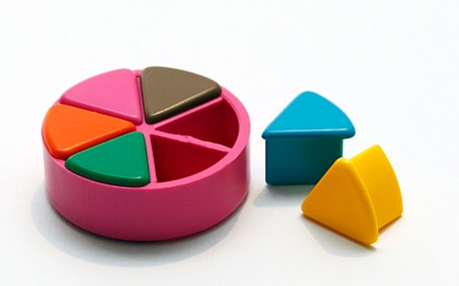
PROBLEM vs. ISSUE
A problem is the whole pie. Problems are vast, complex, and entrenched.
When we try to tackle a problem, we reinforce the hopelessness of the situation. We are trying to take on the full pie all at once.
Issues are the pieces of the pie. It’s a small chunk of the larger problem that we can make progress on, and in turn we are slowly taking on the full problem over time.
Notes:
What are some “red flags” to look out for when identifying the issue?

Slide 12

PROBLEM vs. ISSUE

Slide 13
EXAMPLES- Problem and Issue
PROBLEM -Our school is hostile to LGBTQ+ staff and students
  ◦ Issue Cut – There are no gender inclusive bathrooms and/or transgender students are forced to use the wrong restroom
PROBLEM - Our school reinforces racism and the school to prison pipeline
  ◦ Issue Cut– We need to stop armed security guards from arresting students for minor infractions in our schools.

Slide 14
SCENARIO WORK!
TIME: 10 Minutes
In your group, spend 10 minutes identifying the potential “Issues” in your scenario.

Slide 15
Assessing Our Issues
Widely felt and/or deeply felt.
  The pain can be felt by just one, but the injustice of that pain is shared by many.
  The pain AND the injustice of that pain is felt by many.
Winnable.
Builds the union and builds leaders.
Has a connection to students and the public.
Secrets of a Successful Organizer “A Good Organizing Issue” handout

Slide 16

Issue Criteria Checklist
PG. XX

Slide 17
SCENARIO WORK!
TIME: 10 Minutes
In your group, spend 10 minutes evaluating your issue using the “Issue Criteria Checklist”

Slide 18
STEP 3:
Demand

Slide 19
Demand:

Slide 20
STEP 4:
Target

Slide 21
Targets:

Slide 22
SCENARIO WORK!
TIME: 15 Minutes
In your group, spend 15 minutes deciding the following:
• Issue
Revisit to make sure its the one you want!
• Demand
What do you want to win (and why) to solve your issue?
• Target
Who has the power to give you your demand?
(feel free to make up names and titles if your scenario doesn’t have one!)

Slide 23
REPORT OUT
“Hey TARGET, we demand DEMAND!”

Slide 24
Target Power Analysis
Now that we have our target, we need to do a "power analysis" to figure out how to influence our target.

Slide 25
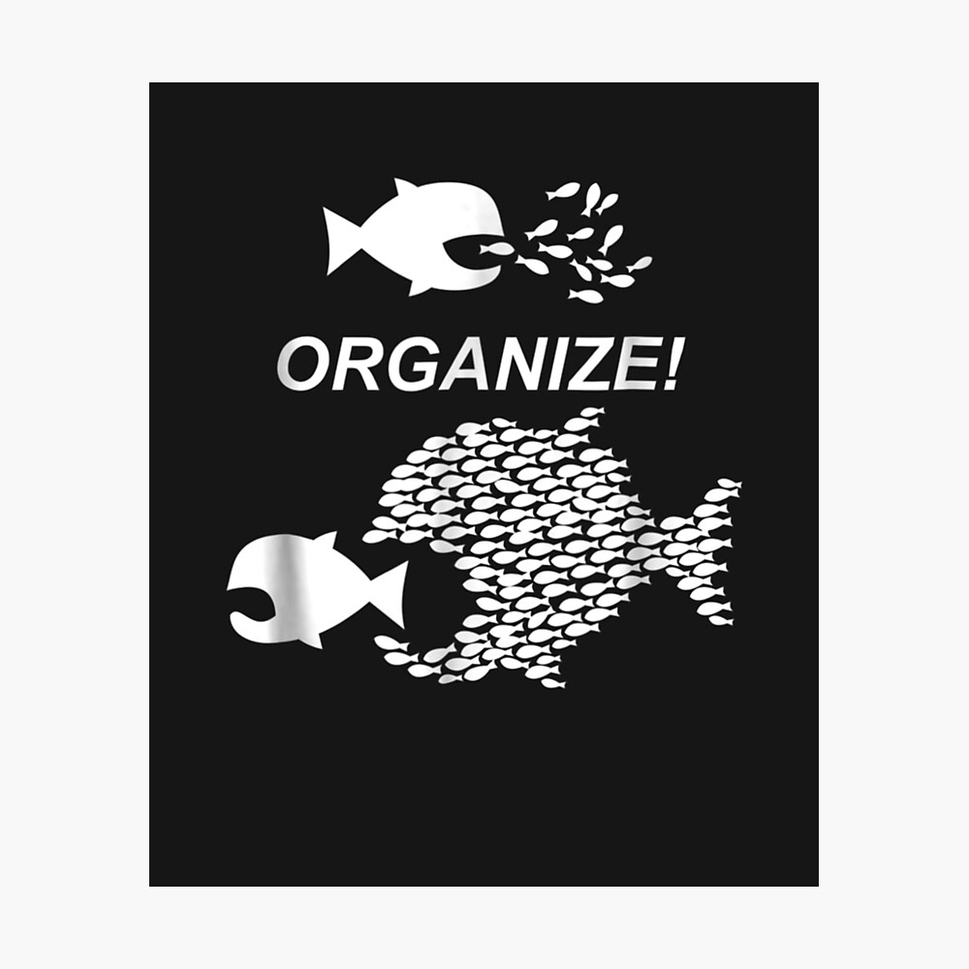
Target Power Analysis- Key Questions
What does the target care about?
Who influences the target?

Slide 26
SCENARIO WORK!
TIME: 3 Minutes
On your own, review the Enchanted County scenario. Find information about your target that helps answer the questions:
What does the target care about?
Who influences the target?

Slide 27
REVIEW

Slide 28

Structure of a Campaign

Slide 29
STEP 5:
Tactics

Slide 30
Tactics
Tactic: Actions we take as a part of an escalation plan that increases pressure on your target to try to win your demand.

Slide 31
Tactics Must:
Put pressure on your Target
(puts them out of their comfort zone)
Build your Power
(develops leaders, brings more people in, etc.)
Be Strategic

Slide 32
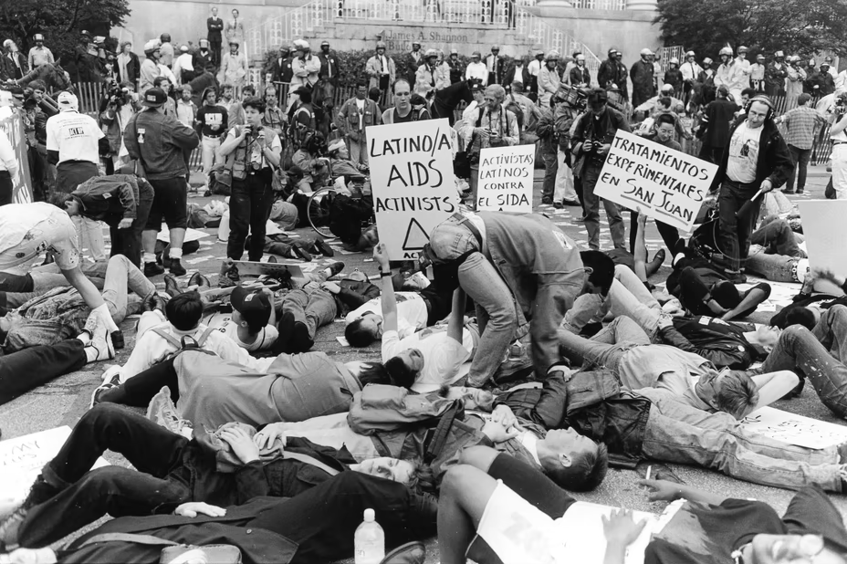

Historic Tactics
ACT UP!

Slide 33
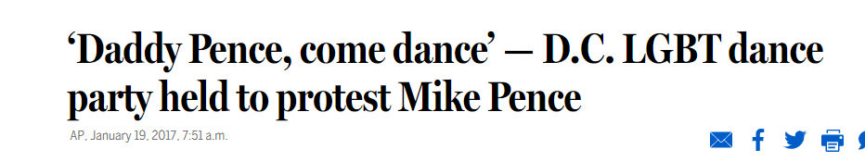
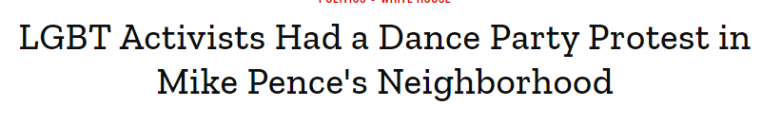
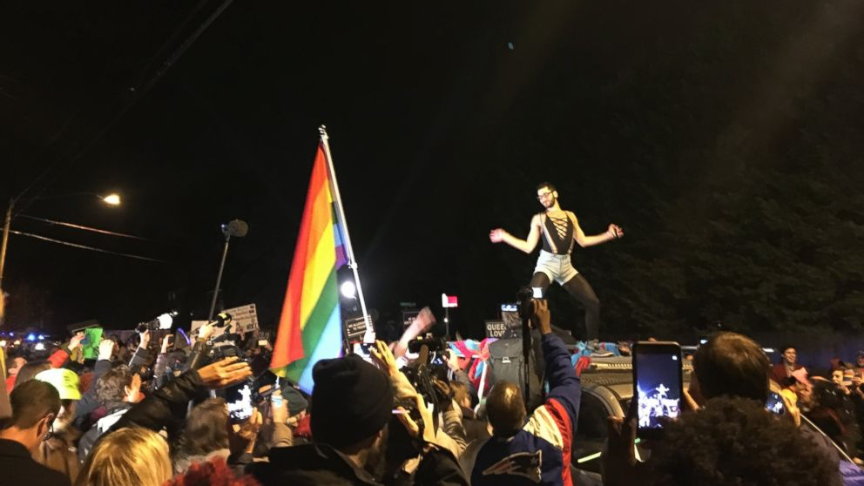
Historic Tactics

Slide 34
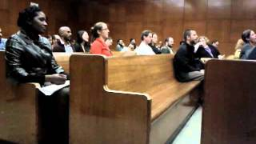
Historic Tactics
Brooklyn, NYC- Occupy action to fight foreclosure. Demanding a moratorium on foreclosure and evictions
https://youtu.be/u3X89iViAlw

Slide 35
Why creative tactics?
Table Discussion:
The tactics we showed were creative and unique.
Why do we think creative/fun tactics are important?

Slide 36
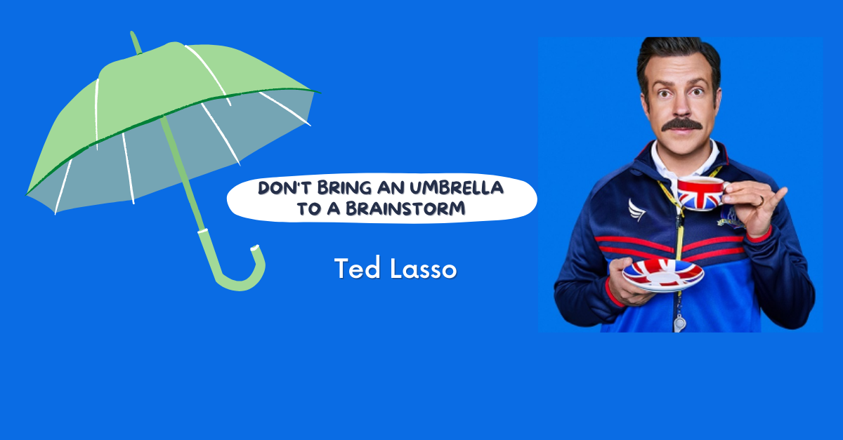
SCENARIO WORK!
TIME: 5 Minutes
TACTICS BRAINSTORM!
+YOU HAVE 5 MINUTES!+
Brainstorm AS MANY tactics as you can on 1 chart.
•Be creative!
•You are NOT evaluating right now! Everything goes on the board!

Slide 37
Evaluating Tactics
Does the action relate to your issue?
Will it increase the pressure on the decision-maker?
Is it visible?
Is it timed for effect?
Is it new and different—or tried and true?
Are enough people ready to do it?​
Will it unify people?​
How will management react?​
Does it violate the law?
(If so, are we prepared for the consequences?)​
Will it be fun?

Slide 38
SCENARIO WORK!
TIME: 10 Minutes
Evaluate your tactics
Decide which tactics that you came up with are strategic based on the evaluation criteria
(Pg. XX)
CIRCLE the tactics you decide are strategic
CROSS OUT the tactics you decide are not strategic

Slide 39
STEP 5:
Compression Points &
Escalation

Slide 40
Compression Points
Points on the calendar where you celebrate short term wins or escalate your tactics.
◦Naturally occurring deadlines- Breaks, Board Meetings
◦Artificial deadlines-target has till day X to act
◦Help us build urgency and crisis

Slide 41

Why do you think tactics escalate gradually?

Slide 42
Less escalated actions prepare our people for more escalated actions
Give the target the opportunity to do the right thing before things escalate
The threat of escalation can be as powerful as actual escalation

Slide 43
Group Work
TIME: 30 minutes
Build your campaign!
You have 30 minutes to build your campaign and be ready to present out! Make sure that you include at least…
Issue
Demand
Target
Tactics + Compression points in a campaign mountain!
Extra points if you include some messaging, graphics, hashtags, etc.

Slide 44

Key Points
A well thought out campaign has an issue, target and a strategic demand.
We use strategic tactics to put pressure on our target and win our demand
Every campaign should make us stronger!
Notes:
Hedy

